Slide 1
Property Investment Optimiser
TEAM IMPAKD

Slide 2
Project Overview
To create a tool to evaluate investments in the property rental space.
The application will calculate the Return of Investment (ROI) between different configurations of property rentals
and can be used to optimise the best investment strategy depending on the users’ portfolio.

Slide 3
What we have done since The previous demo
Integrated client and server side using REST web services
Implemented session management using local storage in JavaScript
Property is persisted to database and is retrieved back to html
Client can view property details
We are in the process of calculating the return of investment(ROI) of a property
We came up with a formula to calculate the net present value which is needed to
calculate the return of investment

Slide 4
Our wow factor
We are planning on using a Particle Swarm Optimization algorithm to optimize the Return On Investment calculation
This Artificial Intelligence algorithm will be combined with a Hill Climbing algorithm to maximize its accuracy
The values retrieved from the user will be placed in the algorithm and optimized using a local optima technique to ensure that the best values are chosen
These values will then be used to calculate the Net Present Value which will produce an optimized Return On Investment result

Slide 5
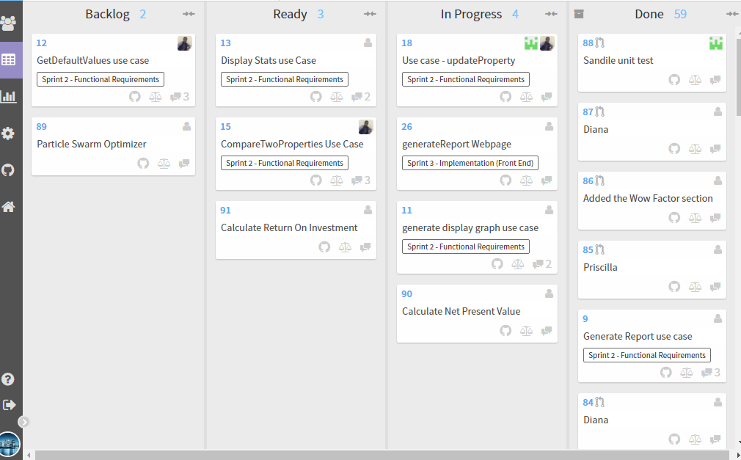

Slide 6
