Slide 1
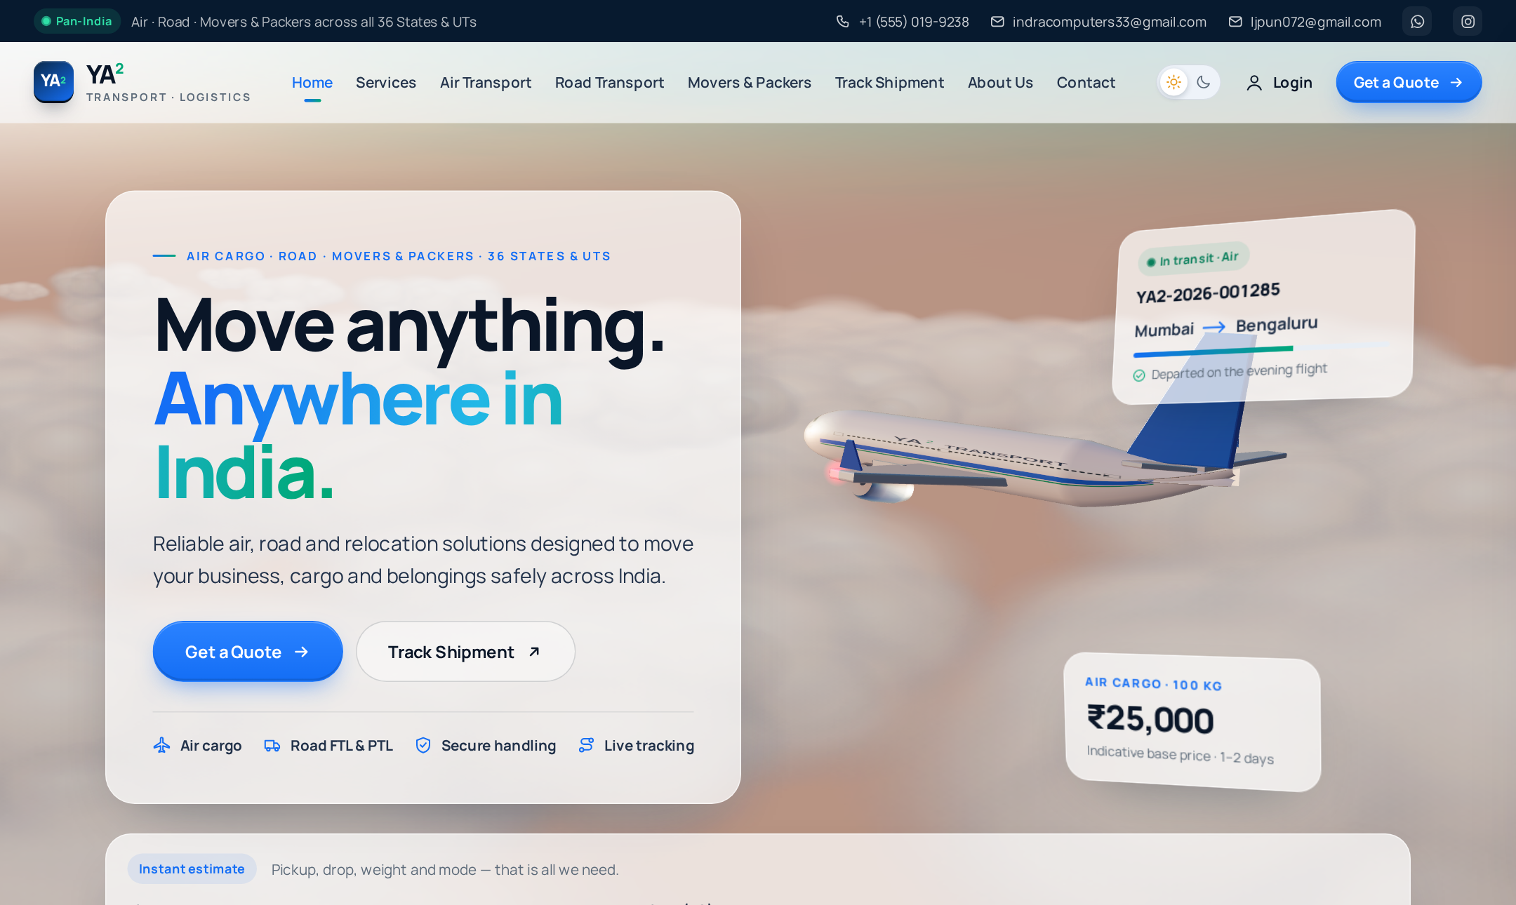
YA²
TRANSPORT · LOGISTICS
YA² Transport
Moving India Forward.
A complete logistics website for Air Cargo, Road Transport and Movers & Packers across all 36 States & UTs of India.
Air Cargo
Road Transport
Movers & Packers
Home page — 3D aeroplane that flies as you scroll
Notes:
Good morning. Our project is YA² Transport, a complete logistics website for India. It covers three services: air cargo, road transport, and movers & packers, across all 36 states and union territories. On the home page you see a 3D aeroplane that flies through the clouds as you scroll. In the next slides I will show what the website does, how a customer uses it, the technology behind it, and how we keep data safe.

Slide 2









What the website offers
Three services, and everything a customer needs to move goods — online.
Air Cargo
Road Transport
Movers & Packers
Fastest option for urgent parcels and documents, 1–3 days.
Full and part truck loads, up to 25,000 kg, door to door.
Household and office shifting with packing and handling.
Instant price calculator
Online booking
Online payment
Price by distance, weight, cargo type and speed
Pickup & drop for any city in India
UPI, cards, net banking (safe demo mode)
Live tracking
My YA² dashboard
Works everywhere
Tracking ID, timeline and route on an India map
Shipments, quotes, addresses and account History
Phone, tablet and laptop · light & dark mode
Notes:
The website offers three services. Air cargo is the fastest, road transport handles full and part truck loads, and movers & packers handles house and office shifting. Below are the main features: an instant price calculator, online booking with pickup and drop, online payment, live tracking with an India map, a personal dashboard, and it works on every device in light and dark mode.

Slide 3
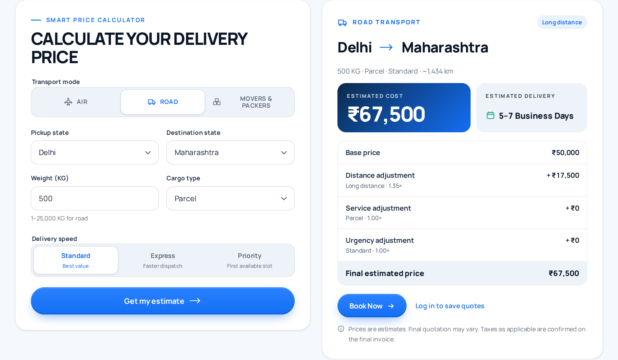
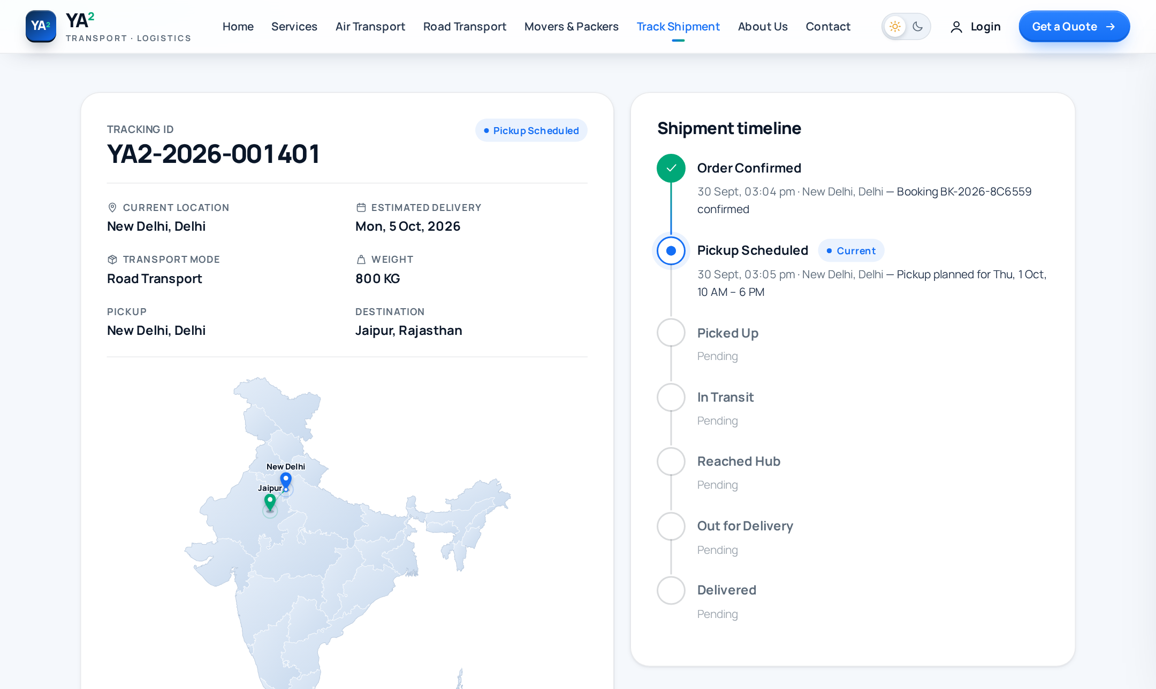
How a customer uses it
From price to delivery in five simple steps.
1
Calculate price
›
2
Book pickup
›
3
Pay online
›
4
Track shipment
›
5
See history
Price calculator — full price breakdown before booking
Tracking — status, timeline and route on the India map
Notes:
This is how a customer uses the website. First, they calculate the price: they choose the states, weight, cargo type and speed, and get a full price breakdown. Second, they book a pickup with sender and receiver details. Third, they pay online. After payment the system creates a tracking ID. Fourth, anyone can track the shipment and see its timeline and route on the India map. Fifth, the customer sees everything in their own account history.

Slide 4



Technology behind the website
A real three-part system: website, server and Oracle database.
Website (front end)
Server (back end)
Database
React + TypeScript
3D aeroplane with three.js
Responsive design, light/dark
Node.js + Express API
Price engine on the server
Login, booking, payment, tracking
Oracle Database
Tables created automatically
SQLite for quick testing
35
10
36
20+
API endpoints
database tables
States & UTs covered
website pages
Deployable on Vercel or Render · Oracle Cloud Free Tier supported
Notes:
The website has three parts. The front end is built with React and TypeScript, with a 3D aeroplane made in three.js. The back end is a Node.js and Express server with 35 API endpoints. It calculates prices on the server, so customers cannot change them. All data is stored in an Oracle database with 10 tables, and the server creates those tables automatically on first start. For quick testing it can also use SQLite. The site covers all 36 states and union territories, and it can be deployed on Vercel or Render.

Slide 5
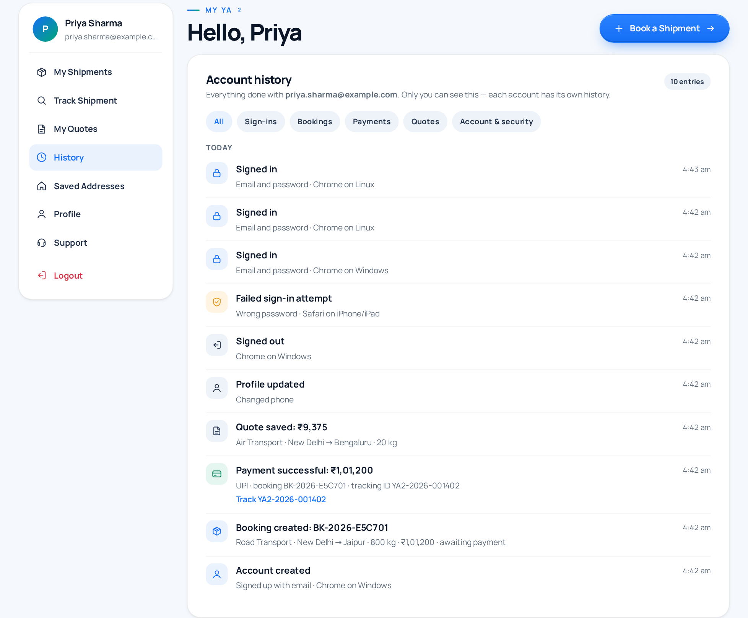





Accounts, security & history
Every customer has a private, secure account.
Passwords are never stored as text
Scrambled with scrypt and a random salt
Safe login sessions
Secure cookies; only a hashed token is saved
Personal account history
Sign-ins, devices, bookings, payments, changes
Continue with Google
Google’s own sign-in window, no email shown
Hidden admin console
Read-only view of the database for staff
Each login sees only its own history
Notes:
Security was important for us. Passwords are never saved as plain text; they are scrambled with scrypt. Login sessions use secure cookies, and the database stores only a hashed token. Every account has its own history. It records sign-ins with the device, bookings, payments and changes, and even failed password attempts, and each customer can only see their own. Customers can also continue with Google. Staff have a hidden, read-only admin console to view the database.

Slide 6


YA²
Thank You
Questions are welcome.
+1 (555) 019-9238
indracomputers33@gmail.com
ljpun072@gmail.com
YA² Transport · Moving India Forward
Notes:
Thank you for your time. We are happy to answer any questions, and we can show the website live.

