Slide 1

QR Notifier System, QR-Alimy Website, and Real-Time Chat Application
PROJECT (ED511)
Submitted in partial fulfillment of the requirements for the award of the Degree of
Integrated Master of Science
in
Quantitative Economics & Data Science
by
Ujjawal Saurav
IED/10016/21
Guide: Dr. Mrinal Jana
Department for Quantitative Economics & Data Science
Birla Institute of Technology, Mesra
Ranchi-835215, Jharkhand

Slide 2
INTRODUCTION
Overview of the Internship : This internship was conducted at JEJECOMMS Co., Ltd., South Korea, from January 2026 to June 2026, where I worked as a Frontend Web Developer. The internship focused on developing privacy-oriented web applications and real-time communication systems using modern frontend technologies and cloud-based architectures
During the six-month internship, I worked on three major projects:
QR Notifier System — A React and TypeScript-based Single Page Application (SPA) designed to provide secure and anonymous communication between vehicle owners and the public through QR code scanning.
QR-Alimy Promotional Website — A responsive and interactive website developed using HTML5, CSS3, JavaScript, jQuery, and PHP, focused on explaining the QR-Alimy service and onboarding workflow.
Real-Time Chat Application — A Firebase-powered real-time messaging platform supporting anonymous authentication, image sharing, typing indicators, online presence tracking, and real-time synchronization.

Slide 3
Problem Statement
Existing Problems
Vehicle owners display personal phone numbers publicly
Risk of spam calls, phishing, and privacy leakage
No secure anonymous communication system
Traditional systems lack real-time interaction
Technical Challenges
Responsive multi-device UI design
Real-time message synchronization
Secure cloud-based communication
Efficient user onboarding workflow
Proposed Solution
QR-based anonymous notification system
Responsive promotional website
Firebase-powered real-time chat application

Slide 4
Technology Stack
Core Web & Scripting: HTML5, CSS3, JavaScript, and jQuery.
Modern Frontend Frameworks: React 18, TypeScript, and Vite.
Styling & UI Components: Tailwind CSS and shadcn-style UI.
Cloud Infrastructure (Serverless): Authentication, Cloud Firestore (NoSQL), and Firebase Storage.
Routing & State Management: React Router DOM, TanStack React Query, and PHP (for root redirection).
Testing & Local Storage: Firebase Emulator, Jest, localStorage, and sessionStorage.

Slide 5
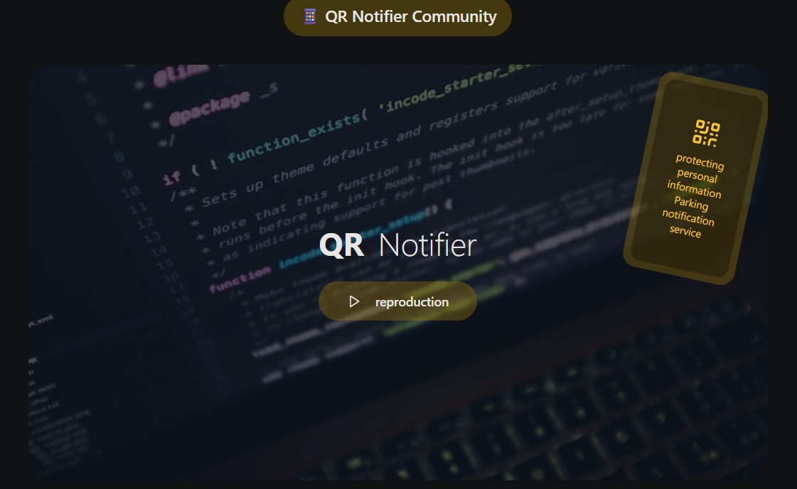
Internship Work
Task 1: QR Notifier System Development
Develop a privacy-first parking communication system
Prevent public exposure of personal phone numbers
Build a modern React-based Single Page Application (SPA)
QR Notifier UI

Slide 6
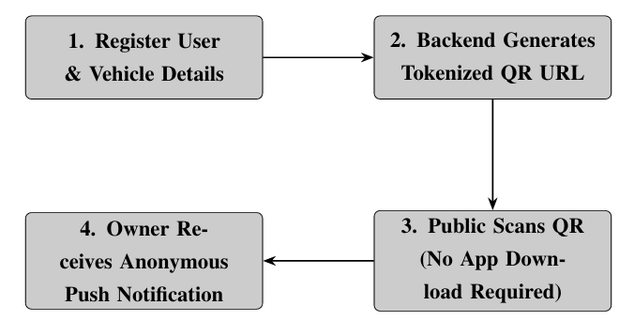
The QR Communication Workflow Design
Stage 1: Vehicle Registration
The vehicle owner accesses the application, authenticates, and registers their vehicle data (license plate model)
Stage 2: QR Tokenization
The critical architectural requirement is that the generated QR code must not contain the owner’s phone number.
Stage 3: Secure Scanning Protocol
When an individual encounters a blocked vehicle, they scan the QR sticker using a standard smartphone camera.
Stage 4: Notification Dispatch
Upon selecting a template, the frontend makes a POST request to the backend API. The backend resolves the x8f9q2m4 token against the database, retrieves the actual owner’s 19 device ID, and dispatches the notification. The scanner and owner interact entirely through the proxy server.

Slide 7
Internship Work
Task 2: QR-Alimy Promotional Website
Develop a responsive promotional website for the QR-Alimy service with interactive onboarding and user-guide features.
Responsive multi-device design
Interactive QR registration workflow
Dynamic image mapping
Lightweight static architecture
Pixel-perfect Figma implementation

Slide 8
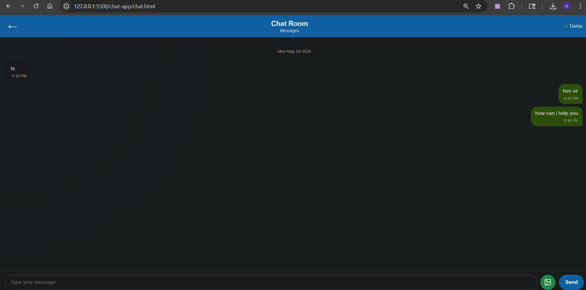
Internship Work
Task 3: Real-Time Chat Application with Firebase
Develop a real-time cloud-based chat application with secure authentication, live messaging, and media sharing capabilities.
Real-time message synchronization
Anonymous user authentication
Image upload and sharing
Typing indicators Online/offline presence tracking
Cursor-based message pagination
Technologies Used
HTML5, CSS3, JavaScript, Firebase
Firebase Services Used
Firebase Authentication
Cloud Firestore
Firebase Storage

Slide 9
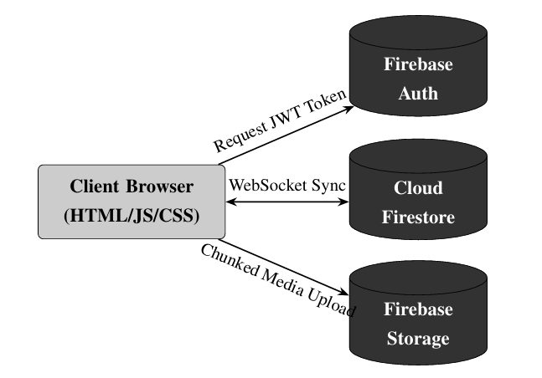
Internship Work
Task 3: Real-Time Chat Application with Firebase
System Architecture and Serverless Model
Traditional Architecture
Requires dedicated backend servers
Uses WebSocket servers (Socket.io)
Manages SQL databases and load balancers
Higher infrastructure complexity
Proposed Serverless Architecture
Direct client-to-cloud communication
Firebase SDK integration
No dedicated backend server required
Real-time synchronization using Firestore

Slide 10
Challenges Faced and Solutions
Challenges
Real-time synchronization handling
Responsive UI across devices
Firebase security rule configuration
Large image optimization
State management complexity
Solutions
Firestore real-time listeners
Tailwind responsive utilities
Secure Firebase Rules
Image compression & lazy loading
React Hooks and modular architecture

Slide 11
Conclusion
Successfully completed three industry-oriented development projects
Developed privacy-first communication and notification systems
Gained practical experience in React, TypeScript, Firebase, and responsive web technologies
Implemented real-time synchronization and serverless cloud architecture
Improved frontend engineering, UI/UX implementation, and debugging skills
Learned Agile development workflow, GitHub collaboration, and real-world software engineering practices
Bridged theoretical academic knowledge with practical industrial application development

Slide 12
Future Scope
Integration of AI-based smart parking analytics
Expansion of push notification and alert systems
Multi-language and internationalization support
Enhanced Firebase security and access control mechanisms
Scalable deployment for large concurrent user bases
Mobile application integration for Android and iOS
Advanced real-time collaboration and communication features
Performance optimization using advanced caching and CDN strategies

Slide 13
REFERENCES
[1] Facebook Open Source. (2024). Jest: Delightful JavaScript Testing Framework. https://jestjs.io/
2] GoogleDevelopers. (2024). Firebase Documentation: Authentication, Cloud Fire store NoSQL Models, and Cloud Storage. https://firebase.google.com/ docs
[3] Microsoft Corporation. (2024). The TypeScript Handbook: Interfaces, Types, and Compilation. https://www.typescriptlang.org/docs
[4] Mozilla Developer Network (MDN). (2024). Web Technology Reference: HTML5 Semantics, CSS3 Grid/Flexbox, and JavaScript ES6+. https://developer. mozilla.org/en-US/
[5] OpenJS Foundation. (2024). jQuery API Documentation: DOM Traversal and Manipulation. https://api.jquery.com
[6] PHP Group. (2024). PHP Manual: Using the built-in web server for local routing. https://www.php.net/manual/en/features.commandline. webserver.php
[7] React Core Team. (2024). React Official Documentation and Hooks API Refer ence. Meta Open Source. https://react.dev
[8] Shadcn. (2024). Shadcn UI: Accessible, Reusable Components built with Radix UI. https://ui.shadcn.com/
[9] Tailwind Labs. (2024). Tailwind CSS v3 Core Concepts and Utility API. https: //tailwindcss.com/docs
[10] You, E.(2024). Vite: Next Generation Frontend Tooling and ESMServing. https: //vitejs.dev

Slide 14
THANK YOU

