Slide 1

ReactJS Part 1
IMY 220  Lecture 17

Slide 2
What is React?
It was created and is maintained by Facebook
“React is a declarative, efficient, and flexible JavaScript library for building user interfaces. It lets you compose complex UIs from small and isolated pieces of code called ‘components’.”
https://reactjs.org/tutorial/tutorial.html
React is a front-end framework

Slide 3
Why React?
React has a number of strengths which make it useful as a front-end JS framework
We will focus on two of these:
The Virtual DOM
JSX

Slide 4
The Virtual DOM
When we use something like AJAX to manage information and elements on a page, we are interacting with the DOM API
For example, when we use document.createElement or document.appendChild
Some of these DOM instructions are very slow, which means that if we’re constantly creating and destroying elements, we are paying a huge performance cost

Slide 5
The Virtual DOM
When using React, we don’t interact with the DOM directly
Instead, we interact with the Virtual DOM which consists out of JS objects called React elements
(Interacting with JS objects is much faster performance-wise that interacting with the DOM)
React then uses the virtual DOM to efficiently manage changes to the (real) DOM
https://reactjs.org/docs/faq-internals.html#what-is-the-virtual-dom

Slide 6
The Virtual DOM
“A React element is a description of what the actual DOM element should look like. In other words, React elements are the instructions for how the browser DOM should be created.”
Learning React
So, generally speaking, we use React to create React elements, which can consist of other React elements, DOM elements and text nodes, and then render them to the DOM
React elements can be created in many ways…

Slide 7
React Elements
The example above creates a React element (greeting) that consists of a div with a header (with a text node) nested inside
The React.createElement function is used to create an element which can be rendered to the DOM. React.createElement is the basis of much of React’s functionality
const greeting = React.createElement("div", {"className": "container"},
React.createElement("h1", null, "Hello there!")
);

Slide 8
React Elements
In other words, this…
…creates a virtual DOM version of this…
const greeting = React.createElement("div", {"className": "container"},
React.createElement("h1", null, "Hello there!")
);
<div class="container">
<h1> Hello there! </h1>
</div>

Slide 9
React Elements
This example does the same thing, but first defines GreetingBox as a component (we’ll deal with components in a while)
const GreetingBox = React.createClass({
displayName: "Greeting",
render(){
return React.createElement("div", {"className": "container"},
React.createElement("h1", null, "Hello there!")
)
}
});
const greeting = React.createElement(GreetingBox, null, null);
Notes:
React.createClass might be deprecated in the future

Slide 10
React Elements
This example creates a stateless functional component
It also has a “name” property. (Just like DOM elements, React elements can have properties. These can be used to alter their behaviour.)
const GreetingBox = ({name}) =>
React.createElement("div", {"className": "container"},
React.createElement("h1", null, "Hello " + name)
);
const greeting = React.createElement(GreetingBox, {"name": "Diffie"}, null);

Slide 11
React Elements
However, in this module we’ll focus on using a React-specific syntax extension called JSX (JavaScript XML) to create React elements
JSX allows you to create React elements using a combination of JS and an XML-syntax, for example
const greeting = (
<div>
<h1>
Hello React!
</h1>
</div>
);

Slide 12
Including React (+ some issues)
But first… let’s look at including and using React
As usual, you can download and include the JS files or link to CDN versions. React is split up into two packages called React and ReactDOM
This allows core React functionality to be used efficiently for non-browser contexts, such as mobile applications
Since we are going to use React exclusively in the browser, we need to include both packages

Slide 13
Including React (+ some issues)
However, if we want to use JSX (which is obviously not valid JS syntax) we have to include and use Babel
<script crossorigin src="https://unpkg.com/react@16/umd/react.production.min.js"></script>
<script crossorigin src="https://unpkg.com/react-dom@16/umd/react-dom.production.min.js"></script>
<script src="https://cdnjs.cloudflare.com/ajax/libs/babel-standalone/6.26.0/babel.js"></script>
<script type="text/babel">
// All your JS goes here
</script>

Slide 14
Including React (+ some issues)
NB!!! You should never include and use Babel as shown for production websites
For production websites, you need to use a tool like Webpack that has a loader which converts JSX code into something that the browser can understand
However, for these two lectures, we’re going to use the in-browser Babel transformer as shown in the previous slide

Slide 15
React Elements
In order to view React elements in the browser, we have to render them using a method called ReactDOM.render
This method is part of the ReactDOM package and takes two parameters:
A React element to be rendered
An HTML element to render the React element to
// Using any one of our previously created "greeting" React elements
// ...as well as an (HTML) element with an id of "react-container"
ReactDOM.render(
greeting,
document.getElementById("react-container")
);

Slide 16
React Elements
In order to view React elements in the browser, we have to render them using a method called createRoot
Rendering HTML to the browser page involves two steps:
Selecting the root HTML element to render React elements to using createRoot
Rendering the React elements using render
// Using any one of our previously created "greeting" React elements
// ...as well as an (HTML) element with an id of "root"
const root = ReactDOM.createRoot(document.getElementById("root"));
root.render(<greeting />);

Slide 17
<div id="root"></div>
<script crossorigin src="https://unpkg.com/react@18/umd/react.development.js"></script>
<script crossorigin src="https://unpkg.com/react-dom@18/umd/react-dom.development.js"></script>
<script src="https://unpkg.com/@babel/standalone/babel.min.js"></script>
<script type="text/babel">
const greeting = (
<div>
<h1> Hello React! </h1>
</div>
);
const root = ReactDOM.createRoot(document.getElementById("root"));
root.render(<greeting />);
</script>

Slide 18
React Components
However, we will focus on using React Components in this module
“Conceptually, components are like JavaScript functions. They accept arbitrary inputs (called “props”) and return React elements describing what should appear on the screen.”
https://reactjs.org/docs/components-and-props.html
Components can also be defined in a variety of ways. We will focus on using ES6 classes to define components.

Slide 19
class Greeting extends React.Component{
render(){
return (
<div>
<h1>
Hello React!
</h1>
</div>
);
}
}
const root = ReactDOM.createRoot(document.getElementById("root"));
root.render(<Greeting />);

Slide 20
React Components - example
Let’s go through this example bit by bit and discuss how it works
In order to create our own component, we need to create our own subclass which inherits from the React.Component class
Class names (and thus component names) should always be capitalised, as per convention
class Greeting extends React.Component{

Slide 21
React Components - example
Remember that components return react elements. So, to render the result of our component, we must define a render() function which returns a react element.
The render() function is required when defining a component
(All other functions are optional)
render(){
return (
<div>
<h1>
Hello React!
</h1>
</div>
);
}

Slide 22
React Components - example
Now that we’ve defined our component, we can render it using the ReactDOM.render() method. This calls the render() method we defined earlier in our component
Note that we have to close elements when using React. Using a JSX element without a closing tag, for example <Greeting>, will cause an error
ReactDOM.render(
<Greeting />,
document.getElementById("react-container")
);

Slide 23
React Components - example
Now that we’ve defined our component, we can render it using the render() method. This calls the render() method we defined earlier in our component
Note that we have to close elements when using React. Using a JSX element without a closing tag, for example <Greeting>, will cause an error
const root = ReactDOM.createRoot(document.getElementById("root"));
root.render(<Greeting />);

Slide 24
React Components
We can also inject JS into JSX by enclosing it in curly brackets, for example:
The JS between curly braces is evaluated and the values are returned
let name = "Diffie";
class Greeting extends React.Component {
render(){
return (
<h1> {"Hello " + name} </h1>
);
}
}

Slide 25
React Components
We can also inject JS into JSX by enclosing it in curly brackets, for example:
The JS between curly braces is evaluated and the values are returned
let name = "Diffie";
class Greeting extends React.Component {
render(){
return (
<h1> {"Hello " + name} </h1>
);
}
}
Note: this is purely for illustrative purposes.
You should never have to use a global variable inside a component like this

Slide 26
React Components
Components can also contain other components
This is a big part of the strength of React: creating reusable pieces of code that represent small pieces of content and/or functionality
This helps keep our code clear and scalable

Slide 27
class ListItem extends React.Component {
render(){
return (
<li> My custom list item </li>
);
}
}
class List extends React.Component {
render(){
return (
<ul>
<ListItem />
<ListItem />
<ListItem />
</ul>
);
}
}

Slide 28
React Components
You can then render List as usual
Using components inside one another allows us to abstract the creation of elements and reuse this abstraction to create more complex content and/or functionality in an intuitive, readable way
const root = ReactDOM.createRoot(document.getElementById("root"));
root.render(<List />);

Slide 29
React Components
Note that you cannot return multiple
elements without wrapping them
inside a parent element, for
example, instead of doing this…
…you have had to do this:
(the first will give you an error)
render(){
return (
<h1> Hello React! </h1>
<p> This is not going to work </p>
);
}
render(){
return (
<div>
<h1> Hello React! </h1>
<p> This will work </p>
</div>
);
}

Slide 30
React Components
However, wrapping elements to be rendered in a parent element, such as a div, doesn’t always make sense, for example
class Table extends React.Component {
render(){
return (
<table>
<tr>
<Columns />
</tr>
</table>
);
}
}
class Columns extends React.Component {
render(){
return (
<div>
<td>Hello</td>
<td>World</td>
</div>
);
}
}

Slide 31
React Components
However, wrapping elements to be rendered in a parent element, such as a div, doesn’t always make sense, for example
class Table extends React.Component {
render(){
return (
<table>
<tr>
<Columns />
</tr>
</table>
);
}
}
class Columns extends React.Component {
render(){
return (
<div>
<td>Hello</td>
<td>World</td>
</div>
);
}
}
This is obviously not ideal

Slide 32
React Components
The recommended way to solve this problem is by using what is called the Fragments API, which works by wrapping elements in a parent element called <React.Fragment>
render(){
return (
<React.Fragment>
<td>Hello</td>
<td>World</td>
</React.Fragment>
);
}

Slide 33
React Components
The recommended way to solve this problem is by using what is called the Fragments API, which works by wrapping elements in a parent element called <Fragment>
render(){
return (
<>
<td>Hello</td>
<td>World</td>
</>
);
}

Slide 34
React Components
You can also add other code inside the render() function
class List extends React.Component {
render(){
let listItems = [], listLength = 5;
for(let i = 0; i < listLength; i++){
listItems.push( (<ListItem />) );
}
return (
<ul>{listItems}</ul>
);
}
}
Note the extra brackets around the JSX

Slide 35
Component properties
Like HTML elements, React components can also contain “attributes”
However, in React components, these are called props (short for properties) and are accessed via this.props.(attributeName)
<Greeting personName="Diffie" />
render(){
return (
<div>
<h1>
Hello {this.props.personName}!
</h1>
</div>
);
}

Slide 36
class Greeting extends React.Component{
render(){
return(
<div>
<h1>
Hello {this.props.personName}!
</h1>
</div>
);
}
}
ReactDOM.render(
<Greeting personName="Diffie" />,
document.getElementById("react-container")
);
// Output: Hello Diffie!

Slide 37
class Greeting extends React.Component{
render(){
return(
<div>
<h1>
Hello {this.props.personName}!
</h1>
</div>
);
}
}
const root = ReactDOM.createRoot(document.getElementById("root"));
root.render(<Greeting personName="Diffie" />);
// Output: Hello Diffie!

Slide 38
Component properties
JS variables can also be passed to a component’s props
For example, if we want to render a list using an array of JS objects, we can pass it as the props of a component:
let peopleList1 = [
{name: "Troy", surname: "Barnes"},
{name: "Abed", surname: "Nadir"}
];
ReactDOM.render(
<PersonList people={peopleList1} />,
document.getElementById('root')
);
Since we are injecting JS variables into JSX, we need to enclose it in curly brackets. Similar to previous examples, any JS between the curly brackets is evaluated and the values are returned
Also note the lack of inverted commas

Slide 39
Component properties
JS variables can also be passed to a component’s props
For example, if we want to render a list using an array of JS objects, we can pass it as the props of a component:
let peopleList1 = [
{name: "Troy", surname: "Barnes"},
{name: "Abed", surname: "Nadir"}
];
const root = ReactDOM.createRoot(document.getElementById("root"));
root.render(<PersonList people={peopleList1} />);
Since we are injecting JS variables into JSX, we need to enclose it in curly brackets. Similar to previous examples, any JS between the curly brackets is evaluated and the values are returned.
Also note the lack of inverted commas.

Slide 40
Component properties
Then we can access it via this.props.(attributeName)
class PersonList extends React.Component {
render(){
return (
<ul>
{this.props.people.map((person, i) => {
return <li> {person.name} {person.surname} </li>;
})}
</ul>
);
}
}

Slide 41

class PersonList extends React.Component {
render(){
return (
<ul>
{this.props.people.map((person, i) => {
return <li> {person.name} {person.surname} </li>;
})}
</ul>
);
}
}
let peopleList1 = [
{name: "Troy", surname: "Barnes"},
{name: "Abed", surname: "Nadir"}
];
const root = ReactDOM.createRoot(document.getElementById("root"));
root.render(<PersonList people={peopleList1} />);

Slide 42
Component properties
Finally, we can also pass variables between components using props
For example, we can create a component which encapsulates a single person in a list and prints out the first letter of their name, followed by a full stop and then their surname (for example, T. Barnes)
An instance of this component will receive a person via its props:
class Person extends React.Component {
render(){
return (
<li>{`${this.props.person.name[0]}. ${this.props.person.surname}`}</li>
);
}
}

Slide 43
Component properties
We can then create a
PersonList component
which prints out a
heading stating the
number of people in
the list, followed by
the list itself
class PersonList extends React.Component {
render(){
return (
<div className="container">
<h1>
{this.props.people.length} people in the list:
</h1>
<ul>
{this.props.people.map((person, i) => {
return <Person key={i} person={person} />;
})}
</ul>
</div>
);
}
}

Slide 44
Side note
There are two new things to note in the previous slide:
The parent div is given a className attribute of “container”. Since class is a JS keyword as of ES6, we can’t set an element’s class attribute using the class keyword, so when doing React, we have to use className
When creating list items, we should always give list elements a unique key attribute. “Keys help React identify which items have changed, are added, or are removed. Keys should be given to the elements inside the array to give the elements a stable identity”
https://reactjs.org/docs/lists-and-keys.html

Slide 45
Component properties
As per the previous example, we simply pass the array of people as the props for the PersonList component, and it will use the array to create an appropriate heading and list
let peopleList1 = [
{name: "Troy", surname: "Barnes"},
{name: "Abed", surname: "Nadir"}
];
ReactDOM.render(
<PersonList people={peopleList1} />,
document.getElementById('root')
);

Slide 46
Component properties
As per the previous example, we simply pass the array of people as the props for the PersonList component, and it will use the array to create an appropriate heading and list
let peopleList1 = [
{name: "Troy", surname: "Barnes"},
{name: "Abed", surname: "Nadir"}
];
const root = ReactDOM.createRoot(document.getElementById("root"));
root.render(<PersonList people={peopleList1} />);

Slide 47
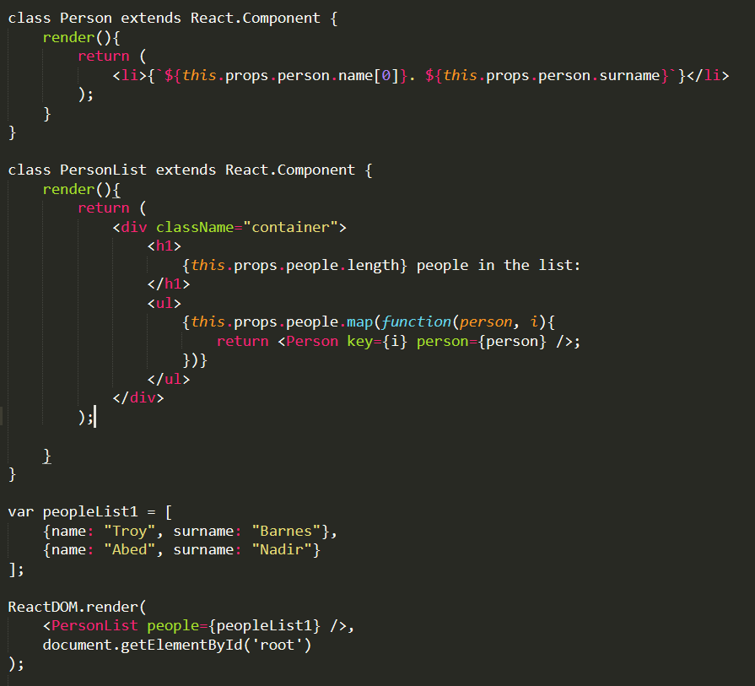
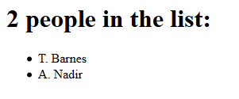

Slide 48
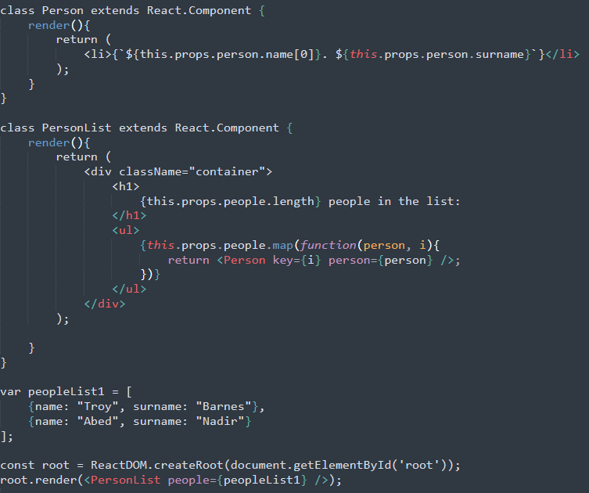

Slide 49
Next time
In this class we introduced React by creating static content
In the next class we’ll look at adding interactivity to our components

Slide 50
References
Banks, A. & Porcello, E. 2017. Learning React: Functional Web Development with React and Redux. O’Reilly Media, Inc.
https://react.dev/reference/react

