Slide 1






MACROHARD
Home
Content
Introduction to
COMPAREIT

Slide 2
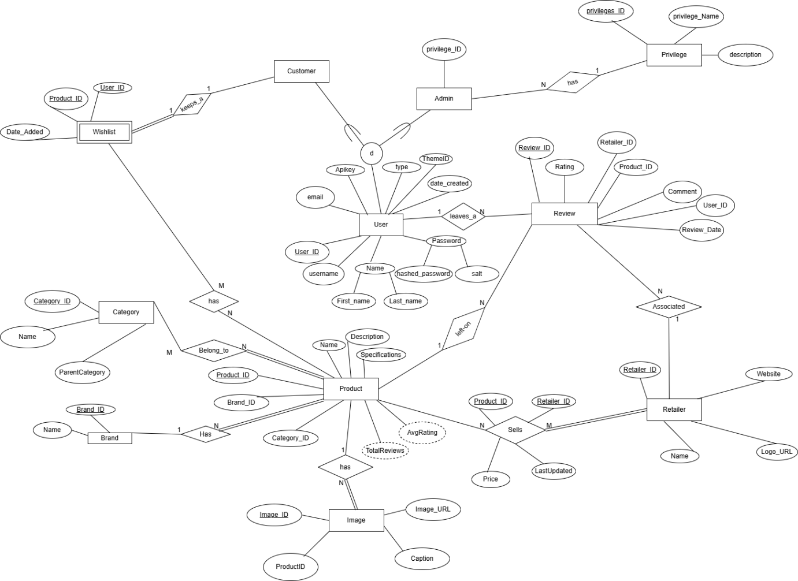


MACROHARD
Home
Content
EER-Diagram
(E)ER DIAGRAM

Slide 4

MACROHARD
Home
Content
Mapping
MAPPING

Slide 5
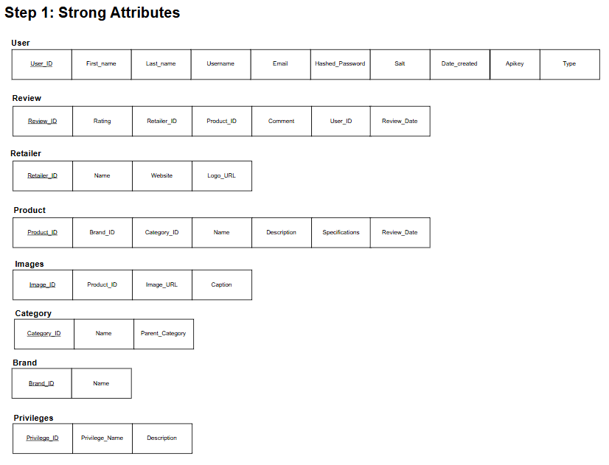

Slide 6
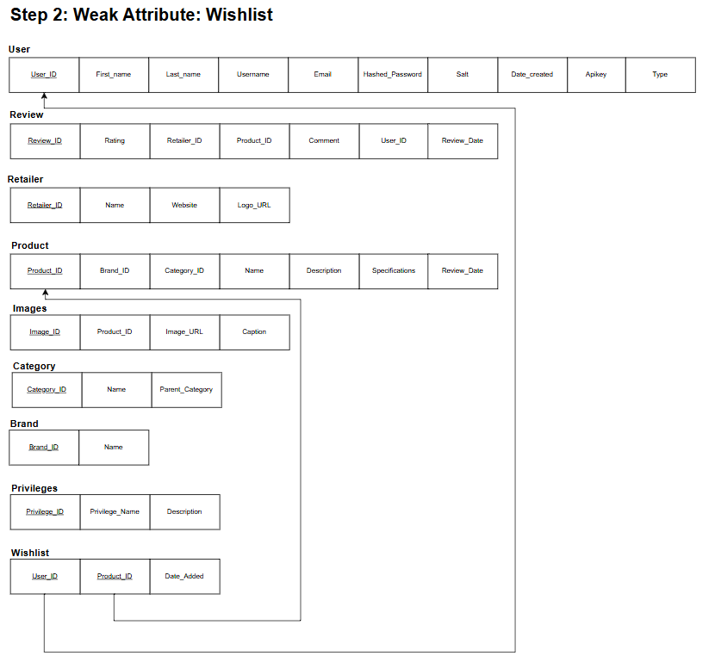

Slide 7
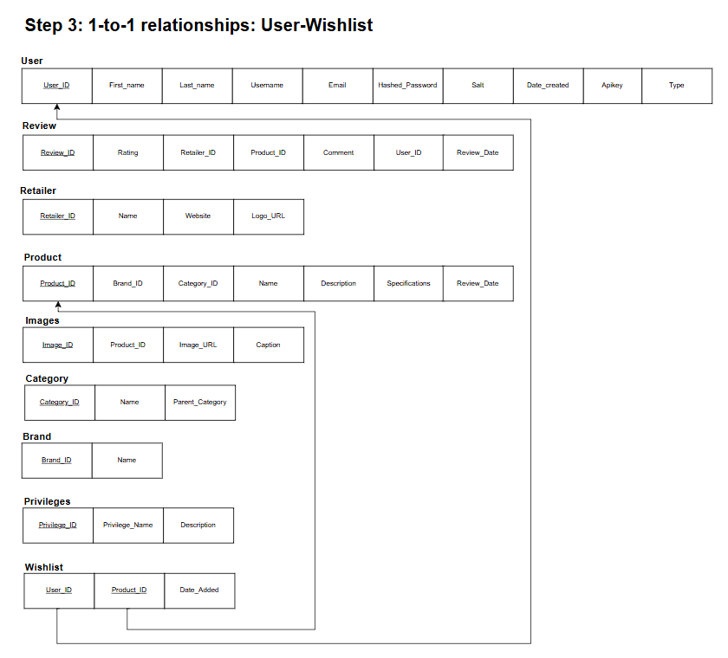

Slide 8
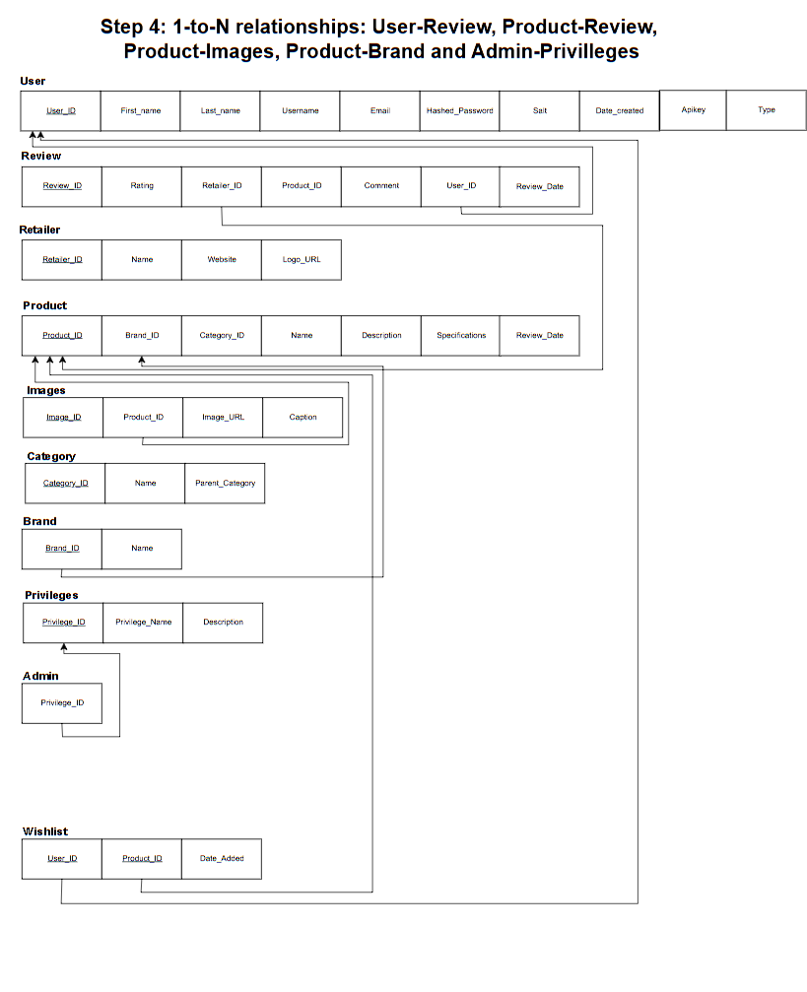

Slide 9
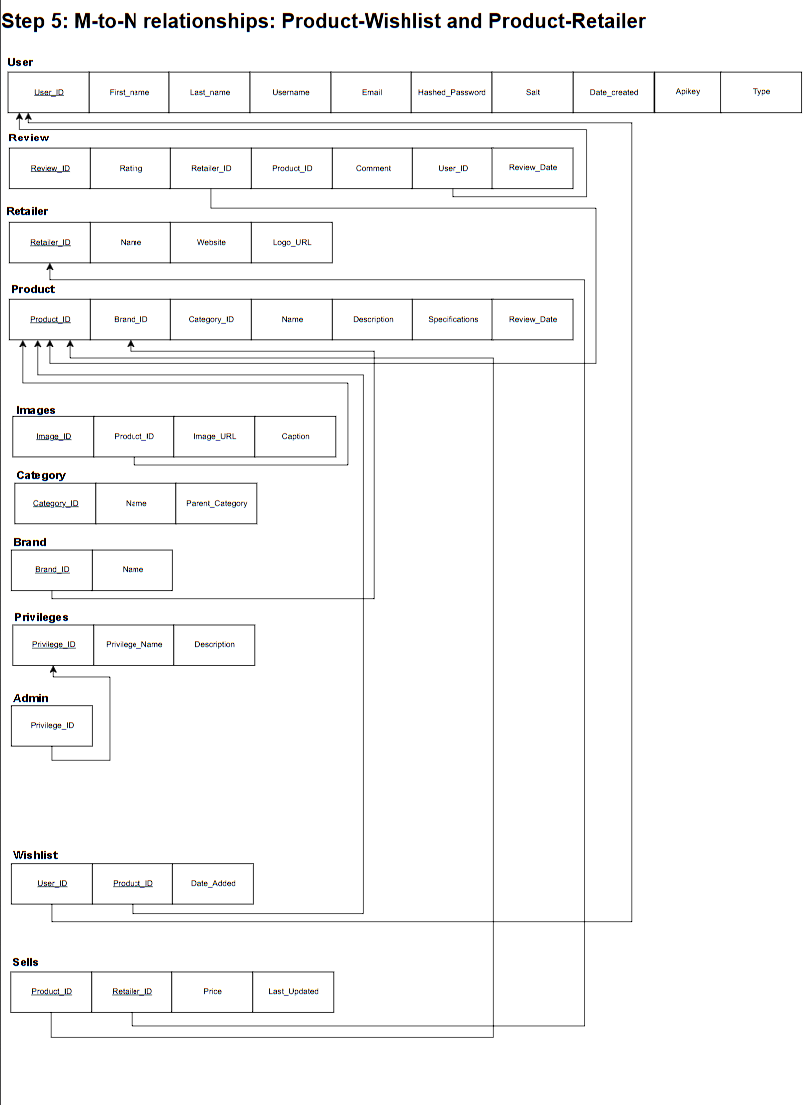

Slide 10
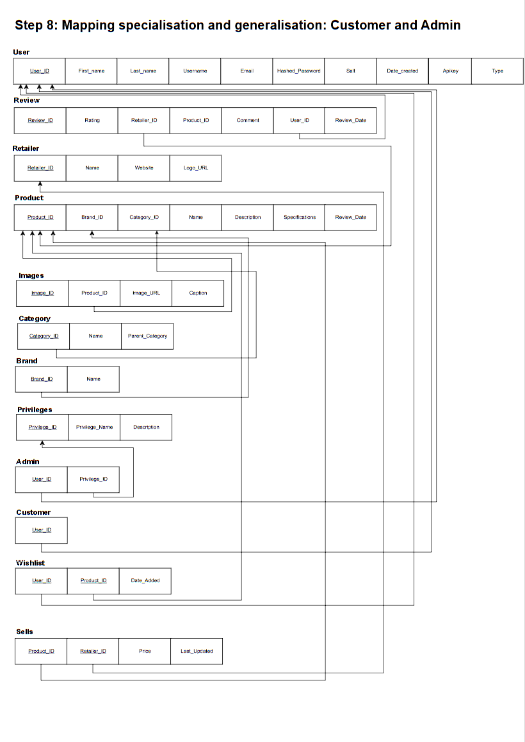

Slide 11



MACROHARD
Home
Content
Relational Schema
RELATIONAL
SCHEMA

Slide 12
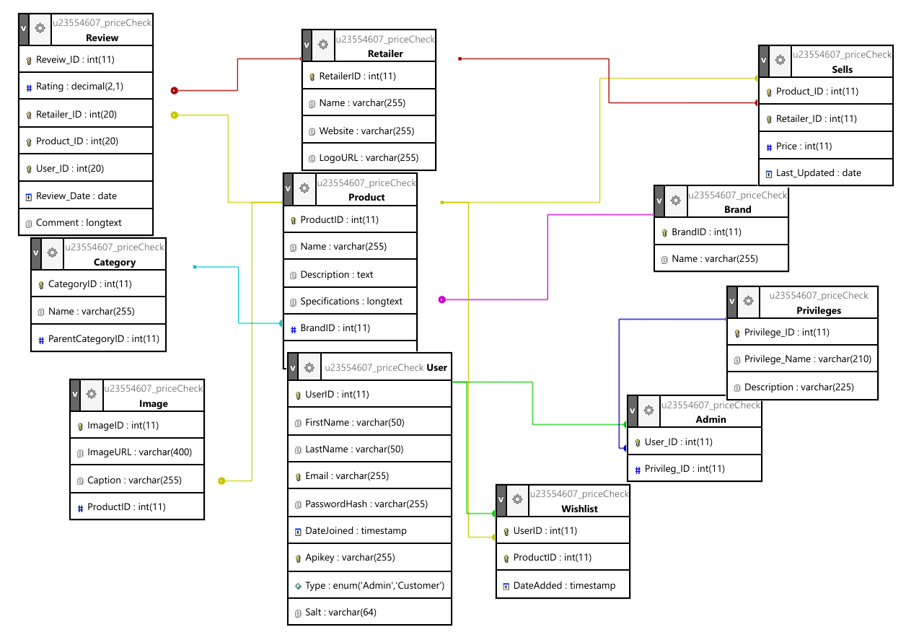

Slide 13


MACROHARD
Home
Content
Optimisation
OPTIMIZATION

Slide 14

MACROHARD
Home
Content
optimisation
SELECT P.`ProductID`,P.`Name`,P.`Description`,
P.`Specifications`,B.Name AS Brand,C.Name AS Category
FROM Category AS C JOIN( Product AS P JOIN Brand AS B ON
P.BrandID=B.BrandID) ON C.CategoryID=P.CategoryID
WHERE `P`.`ProductID`=?
UNOPTIMISED QUERY

Slide 15
MACROHARD
Home
Content
optimisation
SELECT ROUND(AVG(`Rating`), 1) AS Star FROM Review WHERE `Retailer_ID` = ? AND `Product_ID` = ?
OPTIMISED QUERY

Slide 16



MACROHARD
Home
Content
contributions
CONTRIBUTIONS

Slide 17

MACROHARD
Home
Content
MICHAEL NETO
U24641342
Frontend Designer, database population, GitHub branch manager and worked on the Admin side of the Webpage.

Slide 18
MACROHARD
Home
Content
KEEGAN LEWIS
U24594522
EER diagram, database finalisation, API, optimisation and slight database population.

Slide 19
MACROHARD
Home
Content
VELE NDAMULELO
U23554607
original database designer, Wishlist implementation and the presentation slides creator.

Slide 20
MACROHARD
Home
Content
MULONDI MAKHADO
U24739163
Relational Mapping, Products development, Implementation of Login, Registration and Homepage pages and setup the GitHub repository.

Slide 21
MACROHARD
Home
Content
TSHEPISO MAKELANA
U23588579
Frontend Designer, View page developer, README file and EER diagram input.

Slide 22
MACROHARD
Home
Content
ARRAN LAMOND
U23655675
Research document, Admin side of the Webpage, input on customer side of the webpage and completed the final PDF.

