Slide 1
Introduction to Algorithms
Lab2 Routing
2021/11/23 Professor: Hung-Ming Chen Ling-Chun, Yen
Yu-Cheng, Yang

Slide 2
Outline
Introduction
Input
Output
Grading
Submission
Notice

Slide 3
Introduction
Routing is a big issue in back-end EDA. We hope to connect all gates in the design correctly and minimize the cost.
We only consider the distance as cost.
You need to connect all given pins with smallest cost.
There are some fixed routing segments, and you cannot remove it. That is, you don’t need to count them into cost.
In brief, we will give you several pins and existing routing segments within a net, and you should finish routing to connect all pins, and your cost should minimize.

Slide 4
Cost - Manhattan distance
cooridinate of pin1: (x1, y1)
cooridinate of pin2: (x2, y2)

Slide 5
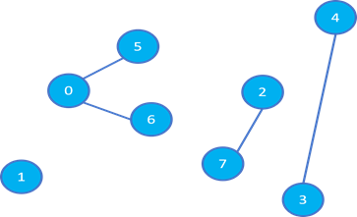
Input
Input example
8 // number of pins
10 60 // coordinate(x, y) of pin 0
0 5 // 1
74 55 // 2
100 0 // 3
113 113 // 4
35 94 // 5
41 47 // 6
63 13 // 7
0 5 // existing routing segment(segment connects pin 0 and pin 5)
0 6
3 4
2 7

Slide 6
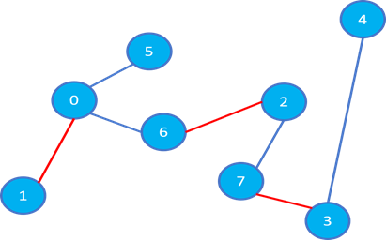
Output
Manhattan distance
pin 0 --- pin 1
d = (10 - 0) + (60 - 5) = 65
pin 2 --- pin 6
d = (74 - 41) + (55 - 47) = 41
pin 3 --- pin 7
d = (100 - 63) + (13 - 0) = 50
Minimal cost
65 + 41 + 50 = 156
Output example
156 // minimal cost
0 1 // added routing segment between pin 0 and pin 1
2 6
3 7
Order does not affect the correctness

Slide 7
Grading
Small case (x4) 60%
Big case 20%
Correct answer 10%
Timing performance (if the answer is correct) 10%
Report 20%
No more than 2 page
Time complexity analysis
The flow chart of your program

Slide 8
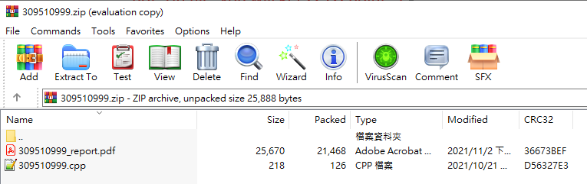
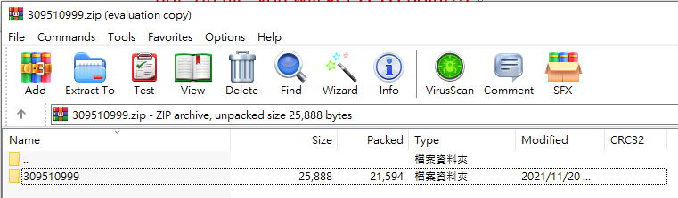
Submission
<student_id>.zip (example: 309510999.zip)
Including source code and report
Source code: <student_id>.cpp (example: 309510999.cpp)
Report: <student_id>_report.pdf (example: 309510999_report.pdf)
Naming error: -5% per file
zip format



Slide 9
Notice
Please make sure your code is available on our linux server.
Please use argc and argv to read input and output files.
Do not print anything on the terminal!
Please check the output format!
Compile procedure: g++ -std=C++11 <student_ID>.cpp -o Lab2
Execution procedure: ./Lab2 [input] [output]
Example: ./Lab2 case1.txt output.txt
You MUST WRITE YOUR OWN CODE. Plagiarism is not allowed!!!

Slide 10
Thank you for listening.

