Slide 1
Verify

Slide 2
Outline
How to use verify
Result
Wrong case
Correct result

Slide 3

How to use verify
STEP1: Load the executable file into server
STEP2: Authority modified command:
chmod 755
STEP3: Start to verify
./verify [input file] [golden output file] [your output file]
You cannot execute the given file
Now you can access the file

Slide 4
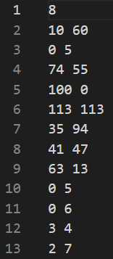
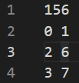
Result
Example
input.txt
output.txt

Slide 5
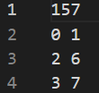

Wrong case
Case1: Min. cost value is wrong in the first line
out_std.txt

Slide 6
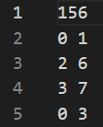
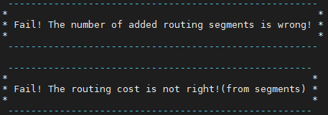
Wrong case
Case2: Number of added segments is wrong
Case3: Your added segments cost is not equal min. cost
out_std.txt
It’s possible that you get multiple wrong case messages

Slide 7
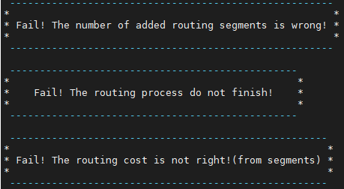

Wrong case
Case4: Targeted net doesn’t be connected completely
out_std.txt
It’s possible that you get multiple wrong case messages

Slide 8
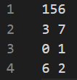

Correct result
Right answer
out_std.txt

