Slide 1
Introduction to Algorithms
Lab3 Exchanging Tangyuans on Winter Solstice
2021/12/14 Professor: Hung-Ming Chen Ling-Chun, Yen
Yu-Cheng, Yang

Slide 2
Outline
Introduction
Input
Output
Grading
Submission
Notice

Slide 3
Introduction
Objection
shortest path
max-flow min-cut

Slide 4
Introduction
Introduction
Winter Solstice is coming, and the neighbor invites Karen to a tangyuan party. She is going to buy the Tangyuans with different flavors. There are many supermarkets in the town, and Karen will buy tangyuan on her way to the party. Because Karen is almost late, she needs to go to the party as soon as possible.
When Karen arrives at the party, she finds that some people have tangyuan that she doesn’t have. So she wants to get the tangyuan with different flavors as many as possible.
In brief, you need to solve 2 problems in this lab.
First, you need to find out the shortest path from Karen’s home to everywhere in town.
Second, you need to find out how many flavors of tangyuan Karen have at most after exchanging tangyuan in the party.

Slide 5
Introduction
Problem assumption
Each supermarket can only sell tangyuans with certain flavor and Karen can only buy one when passing through the supermarket.
There exists only one shortest path from Karen’s home to party.
Karen’s initial number of tangyuans is from the path from her home to the party.
Everyone in the party only exchanges tangyuan with Karen.
There exists exchanging rules shown on the next page.

Slide 6


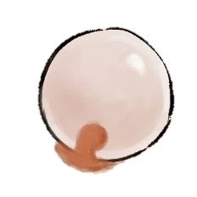

Exchanging rules
Another person in the party will accept the exchange if the conditions below are satisfied:
She/He has duplicate tangyuans.
Karen has the tangyuans She/He doesn’t have.
Karen
another
1
1
2
2

Slide 7
Exchanging rules
Another person in the party will accept the exchange if the conditions below are satisfied:
She/He has duplicate tangyuans.
Karen has the tangyuans She/He doesn’t have.
Karen
another
1
1
2
3
3
3
2

Slide 8
Exchanging rules
Another person in the party will accept the exchange if the conditions below are satisfied:
She/He has duplicate tangyuans.
Karen has the tangyuans She/He doesn’t have.
Karen
another
1
1
3
4

Slide 9
Exchanging rules
Another person in the party will accept the exchange if the conditions below are satisfied:
She/He has duplicate tangyuans.
Karen has the tangyuans She/He doesn’t have.
Karen
another
1
1
2
2
1
2
3
3

Slide 10
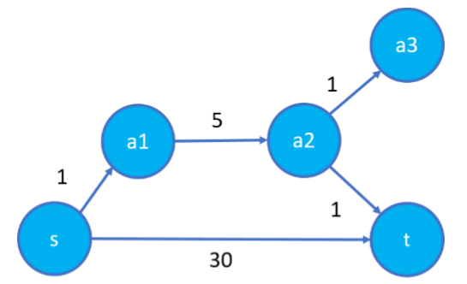
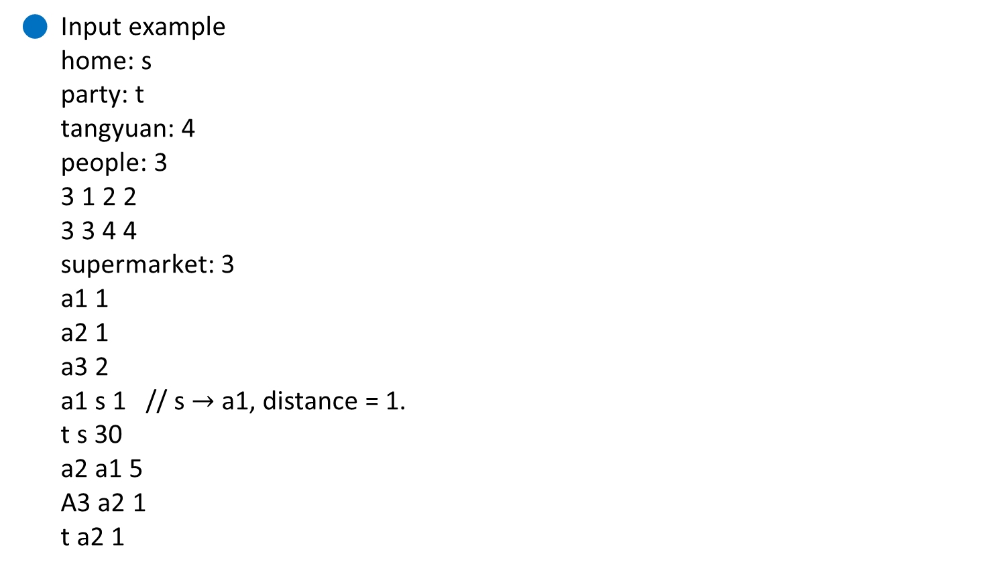
Input
Input example
home: s
party: t
tangyuan: 4
people: 3
3 1 2 2
3 3 4 4
supermarket: 3
a1 1
a2 1
a3 2
a1 s 1 // s $→$ a1, distance = 1.
t s 30
a2 a1 5
A3 a2 1
t a2 1
2
1
1

Slide 11
Output 1
2
7
Output example
s: 0
t: 7
a1: 1
a2: 6
a3: 7
1
1
6
1
0
7

Slide 12
Input
Input example
home: s
party: t
tangyuan: 4
people: 3
3 1 2 2
3 3 4 4
supermarket: 3
a1 1
a2 1
a3 2
a1 s 1 // s $→$ a1, distance = 1.
t s 30
a2 a1 5
A3 a2 1
t a2 1
1
1
1
2
2
3
4
4

Slide 13
Output 2
Output example
2
1
1
1
2
2
3
4
4

Slide 14
Grading
Case (x5) 90%
In each case 18%
Shortest path 9%
Max-flow min cut 9%
Report 10%
No more than 2 page
Time complexity analysis
The flow chart of your program

Slide 15
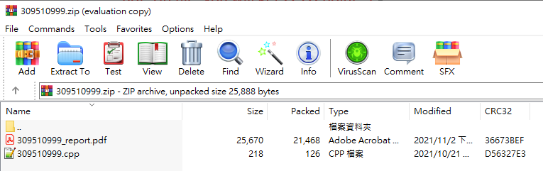
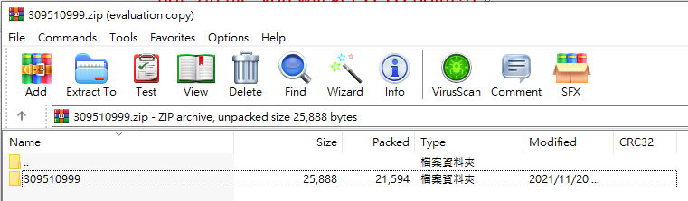
Submission
<student_id>.zip (example: 309510999.zip)
Including source code and report
Source code: <student_id>.cpp (example: 309510999.cpp)
Report: <student_id>_report.pdf (example: 309510999_report.pdf)
Naming error: -5% per file
zip format



Slide 16
Notice
Please make sure your code is available on our linux server.
Please use argc and argv to read input and output files.
Do not print anything on the terminal!
Please check the output format!
Compile procedure: g++ -std=C++11 <student_ID>.cpp -o Lab3
Execution procedure: ./Lab3 [input] [output] [output]
Example: ./Lab3 case1.txt short.txt max.txt
You MUST WRITE YOUR OWN CODE. Plagiarism is not allowed!!!

Slide 17
Thank you for listening.

