Slide 1
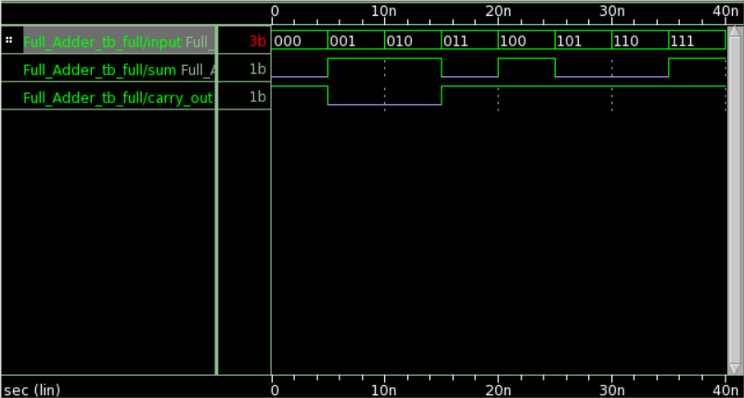
Full_Adder

Slide 2
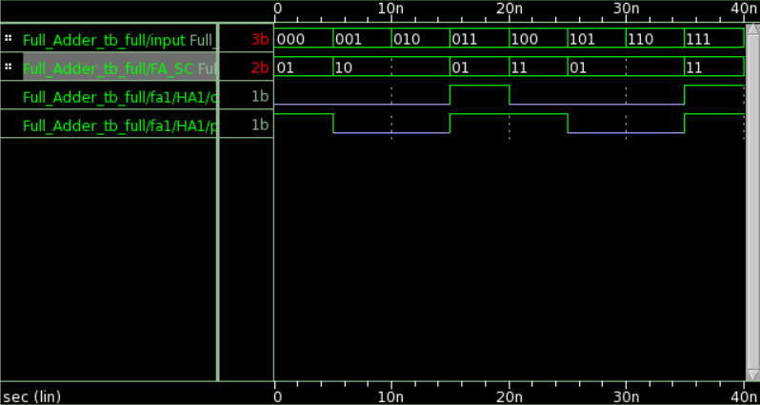
Full_Adder
Golden Circuit Signal

Slide 3
Full_Adder

