Slide 1
Automatic Journal Reader

Slide 2
Contents
Automatic journal reader process
Guideline of installation
Initial usage
Guideline of usage
Main program usage

Slide 3
Automatic journal reader process
This program opens various journal websites automatically and starts to extract data about original researches, then the data is presented in a word and a pdf file to save time and increase effectiveness of study times

Slide 4
Guideline of installation and usage

Slide 5
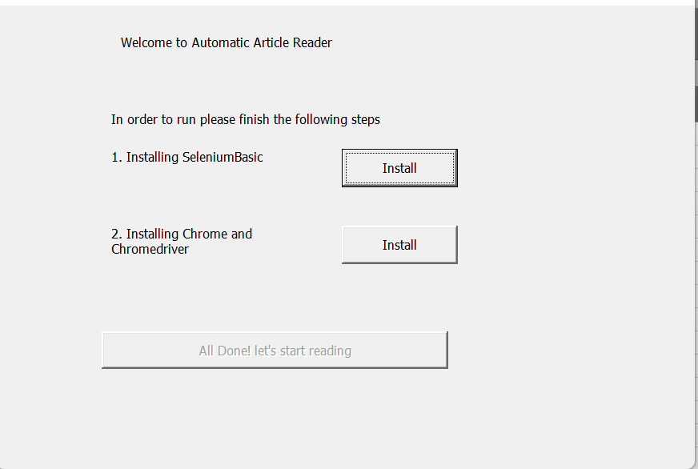
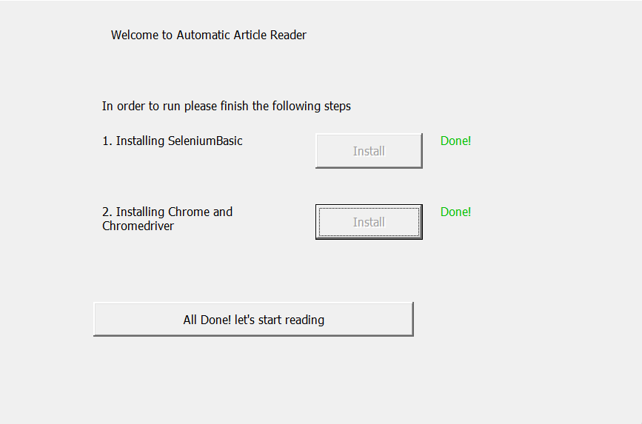
Initial usage
Extract the zip file in a folder in Desktop then open the excel file
If you are running the program for the first time, the program will check for requirements and present you with the following menu
After you click the install for each step, the program will do the required tasks and show a green done button if successful

Slide 6
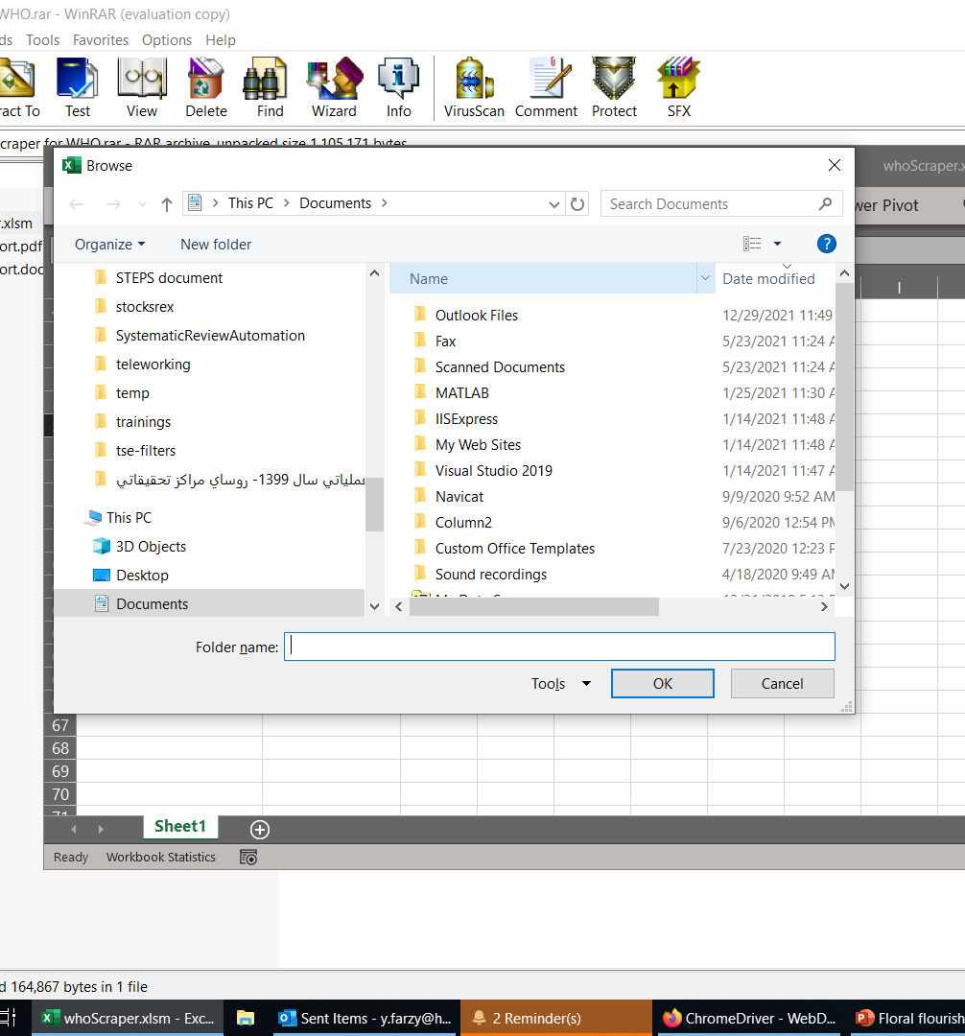
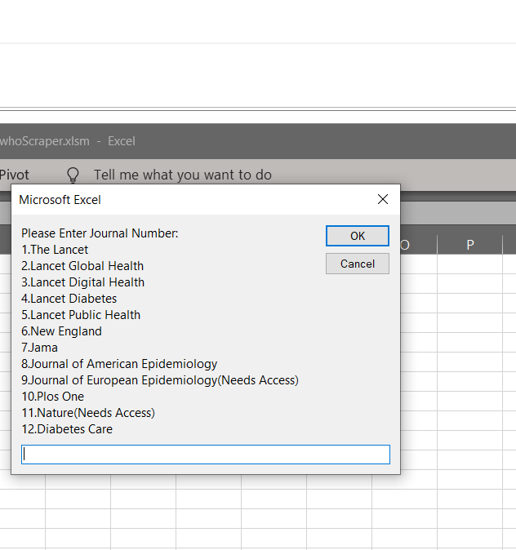
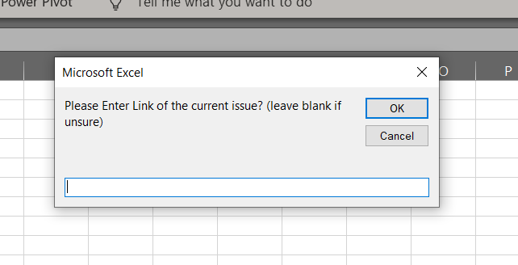
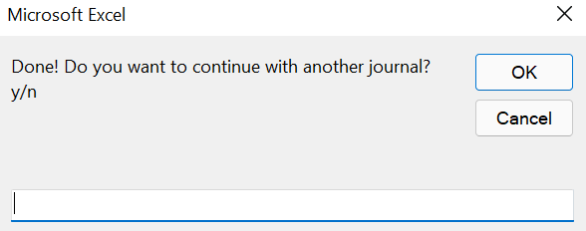
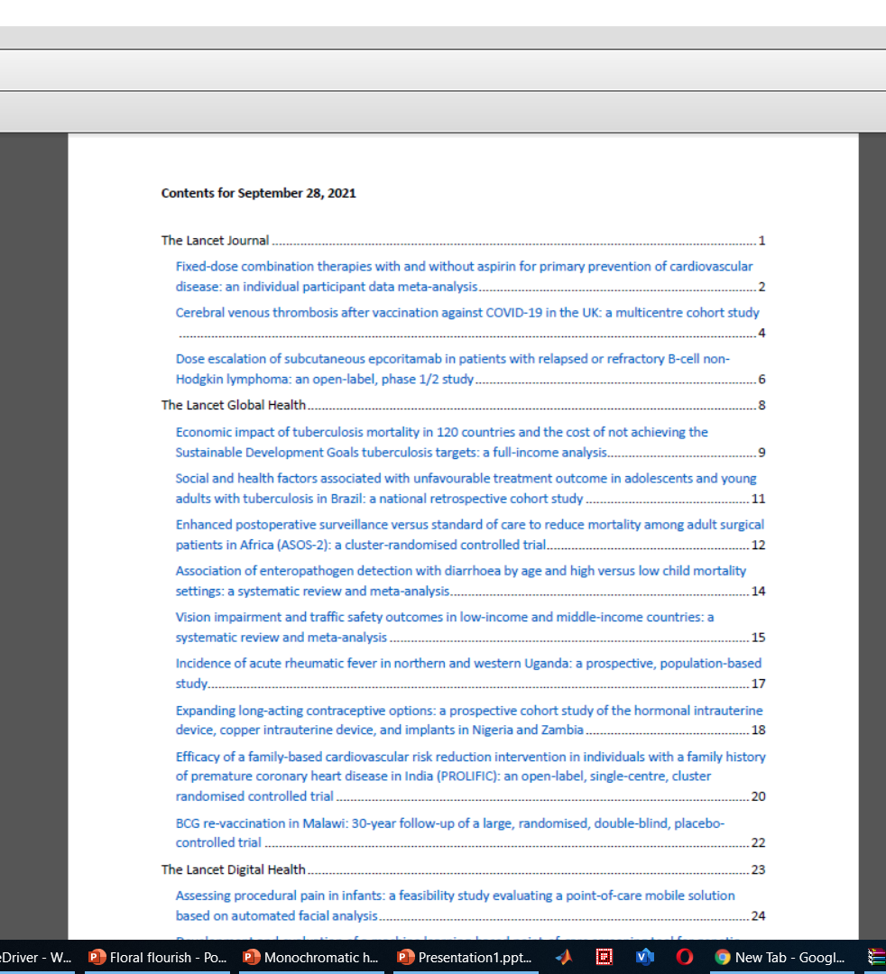
Main program usage
Open the excel file
The program will ask for a folder to save outputs Select the folder to save outputs
Select which journal you would like to read
Enter the website address (leave blank if not sure)
Now, your web browser will open and start to read the journal website
After finishing you will be asked to whether continue with another journal or not (enter y for yes and n for no)
If not a word document will be opened and the files will be created in the specified folder in step 4
Step 2
Step 3
Step 6
Step 4
Step 7

