Slide 1
Splay Tree
Insertion

Slide 2
Splay tree is a self-balancing data structure where the last accessed key is always at root. The insert operation is similar to Binary Search Tree insert with additional steps to make sure that the newly inserted key becomes the new root. Following are different cases to insert a key k in splay tree. 1) Root is NULL: We simply allocate a new node and return it as root. 2) Splay the given key k. If k is already present, then it becomes the new root. If not present, then last accessed leaf node becomes the new root. Splay tree is a self-balancing data structure where the last accessed key is always at root. The insert operation is similar to Binary Search Tree insert with additional steps to make sure that the newly inserted key becomes the new root.

Slide 3
3) If new root’s key is same as k, don’t do anything as k is already present.
4) Else allocate memory for new node and compare root’s key with k.
…….4.a) If k is smaller than root’s key, make root as right child of new node, copy left child of root as left child of new node and make left child of root as NULL.
…….4.b) If k is greater than root’s key, make root as left child of new node, copy right child of root as right child of new node and make right child of root as NULL.
5) Return new node as new root of tree.

Slide 4
Rotations
There are six types of rotations used for splaying:
Zig rotation (Right rotation)
Zag rotation (Left rotation)
Zig zag (Zig followed by zag)
Zag zig (Zag followed by zig)
Zig zig (two right rotations)
Zag zag (two left rotations)

Slide 5
Splay Tree
Deletion

Slide 6
Steps
First search the element you want to delete
Then check for element if it is less than root element or greater than root element
If it is less than root element go to left and search for element
If it is greater than root element go to right and search for element
If element is not found then splay for last accessed element and make it the root node, this is called splaying.
If element is found then splay for this element and make it the root node, that is called what -> splaying.
If the root element is the element that is to be deleted then no splaying is occurred and we’ll delete the element
Now you’ll get two subtrees left and right

Slide 7
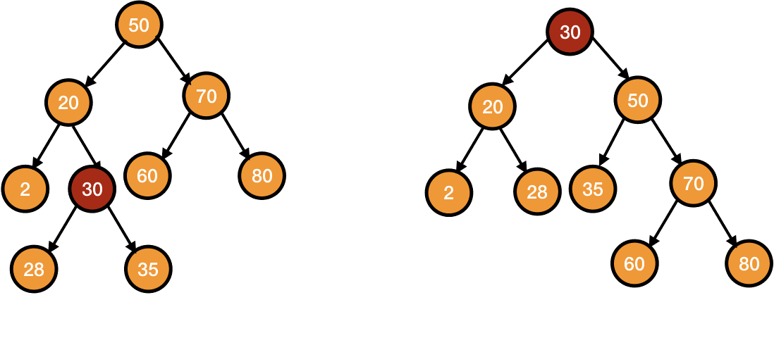
Delete 30
Let I want to delete 30
Search for 30
Splay for 30 and make it the root node

Slide 8
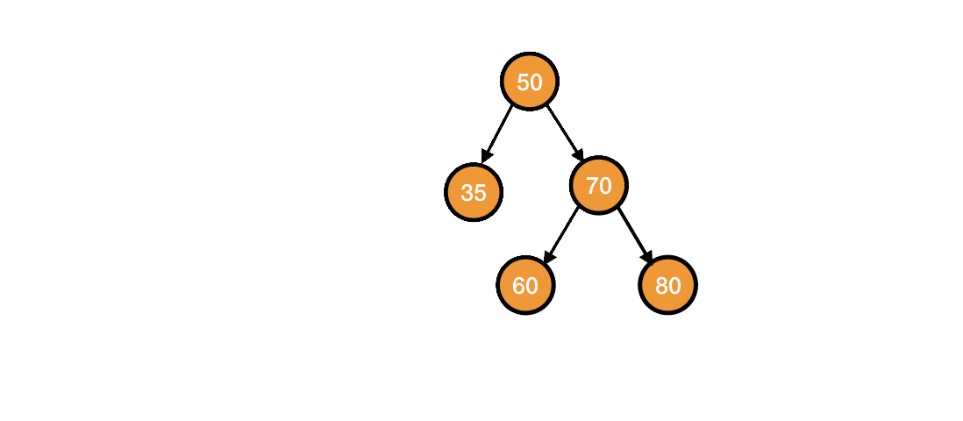
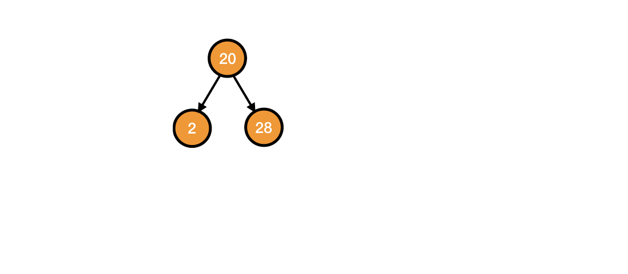
Deleted 30
After this We will just delete the root node
And then It will give us two subtrees
First one is left subtree and second is right subtree

Slide 9

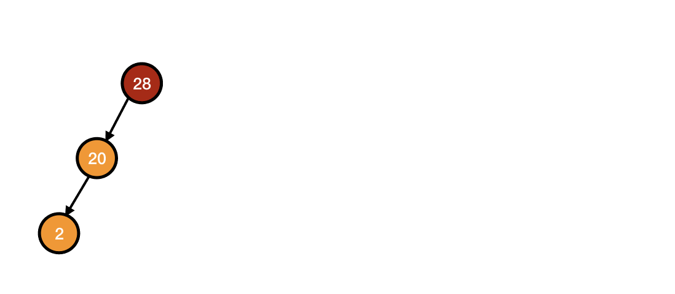
splay 28
Now we will find the largest element on left subtree
And splay it and make it the root node

Slide 10
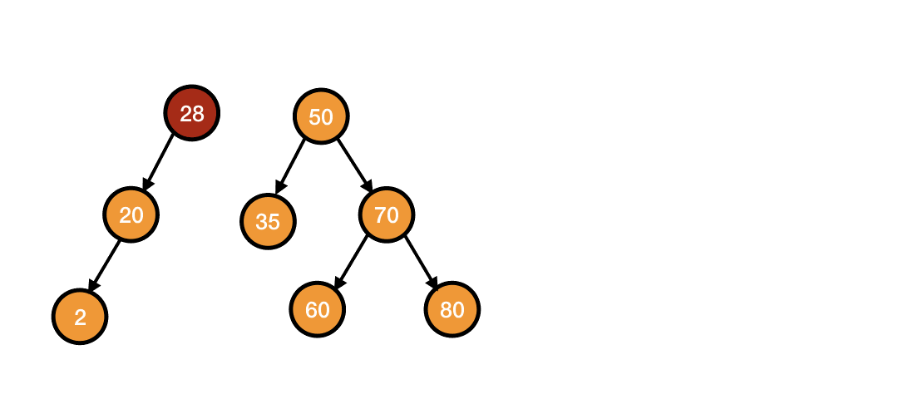
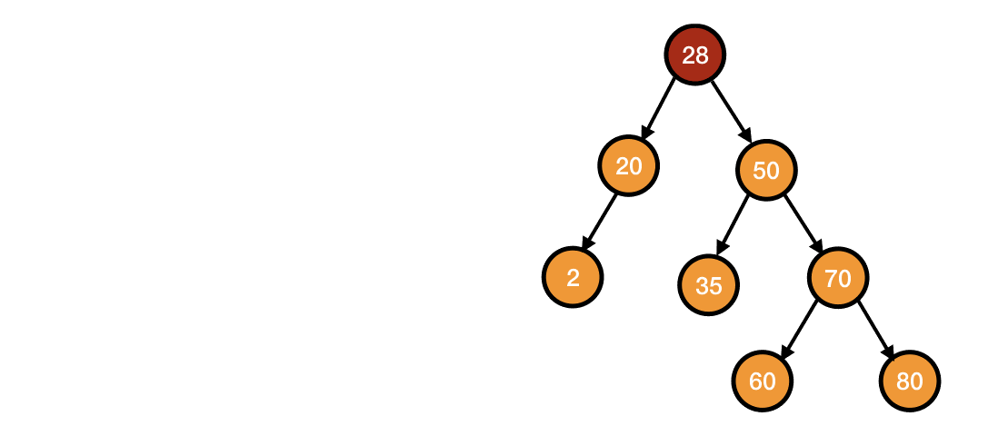
After Deletion
Lastly, we attach the right subtree as the right child of the left subtree.

Slide 11
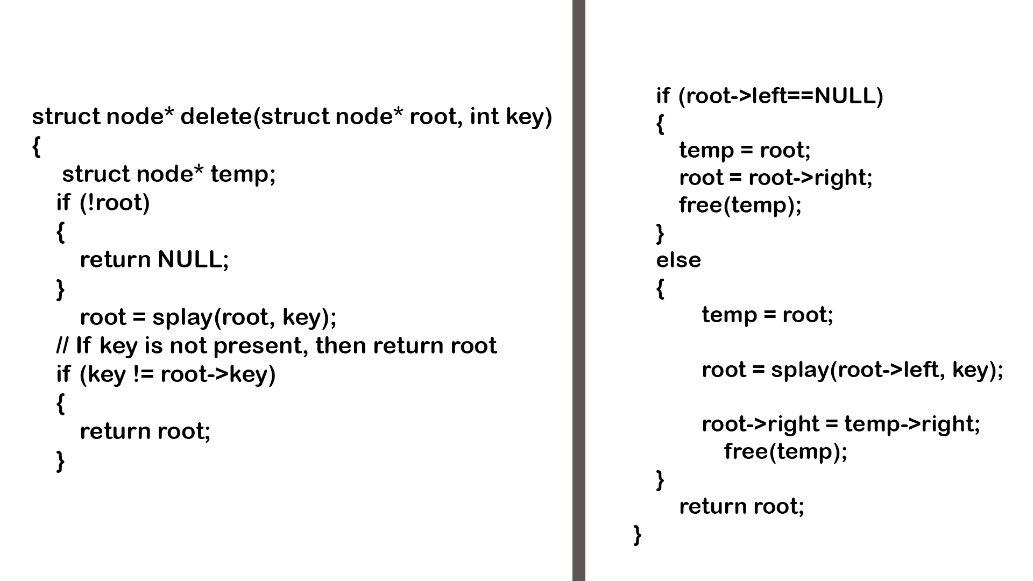
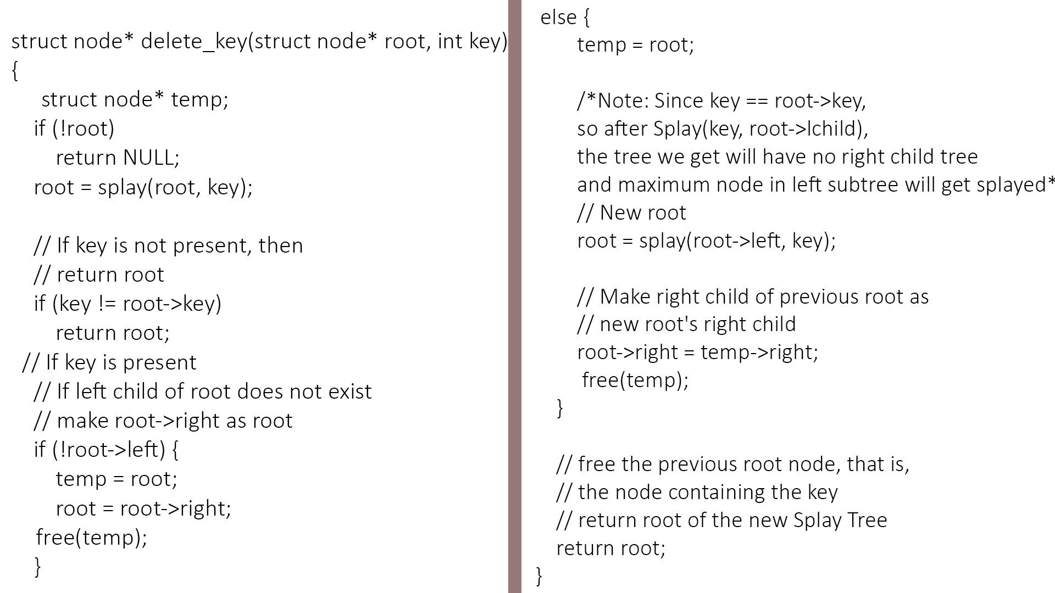

Slide 12
Space and Time Complexity
Operations | Best | Average | Worst
Insert | O(logn) | O(logn) | O(n)
Search | O(logn) | O(logn) | O(n)
Delete | O(logn) | O(logn) | O(ln)

