Slide 1
Weekly Report

Slide 2
Specific question
have you tried changing the desktop background wallpaper?
General question
What do you mean by 'Unity disappeared'?

Slide 3
Frequent patterns (rules de xijie) (每个pattern一个例子)（多少改了，多少怎么改）
1. ask for clarification (yitu): do you want to, are you trying to, what do you mean by…
2. ask for details: can you add some details about… (which editor is used, etc.)
3. ask for versions:what/which version of ubuntu are you using, what Ubuntu release are you using … (sometimes hardware/software version)
4. ask for output of sth. : what is the output of, your question to include the output…
5. possible duplicate question, provide links to other questions
6. ask for other edits like + sources/links

Slide 4
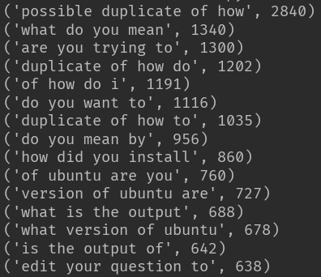
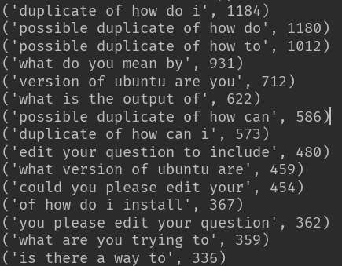
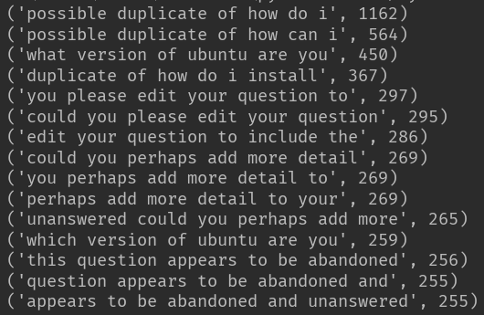
frequency
4-gram
5-gram
6-gram

Slide 5
132,264 questions (token length >= 6)
Ask for clarification: 6793
Ask for version: 5105
Ask for detail: 1203 (not precise)
Ask for output:4700
Duplicate questions: 4795

Slide 6
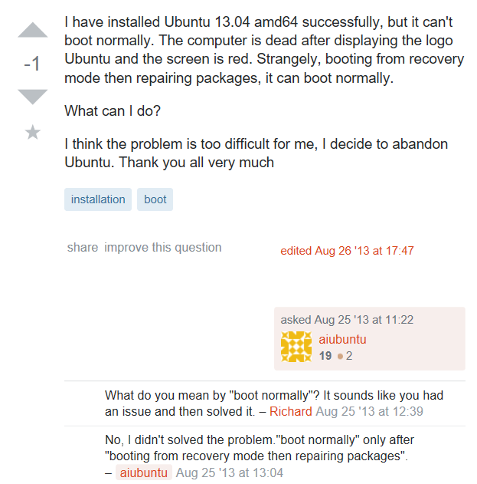
Examples

Slide 7
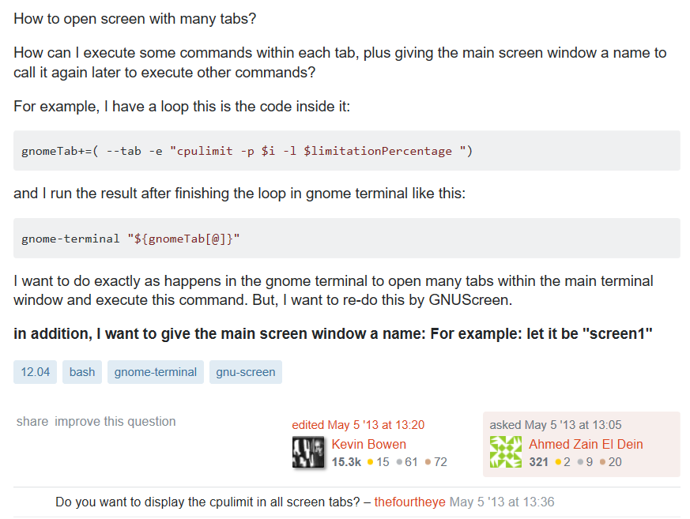
Examples

Slide 8
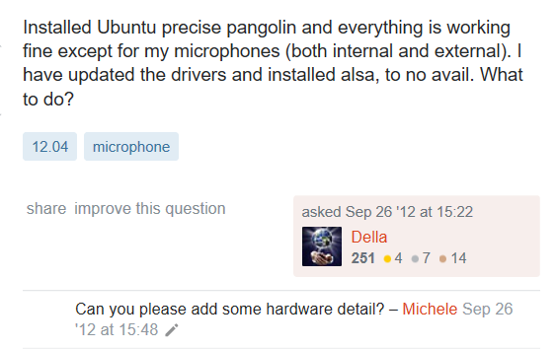
Examples

Slide 9
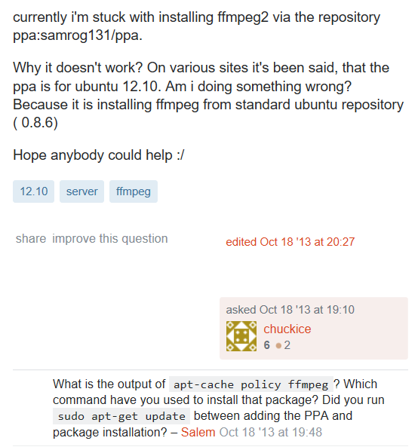
Examples

Slide 10
LDA modeling

