Slide 1
Weekly report
06/07/2019

Slide 2
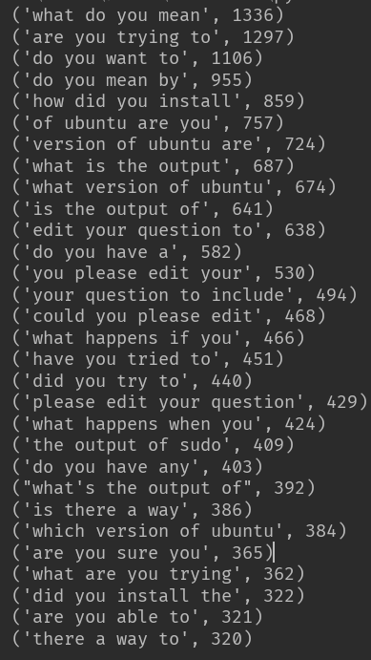
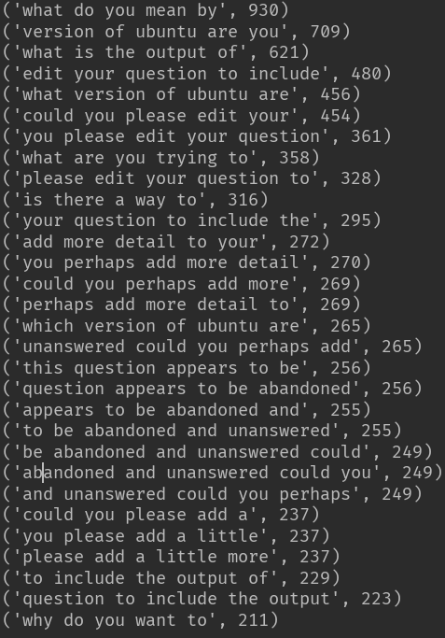
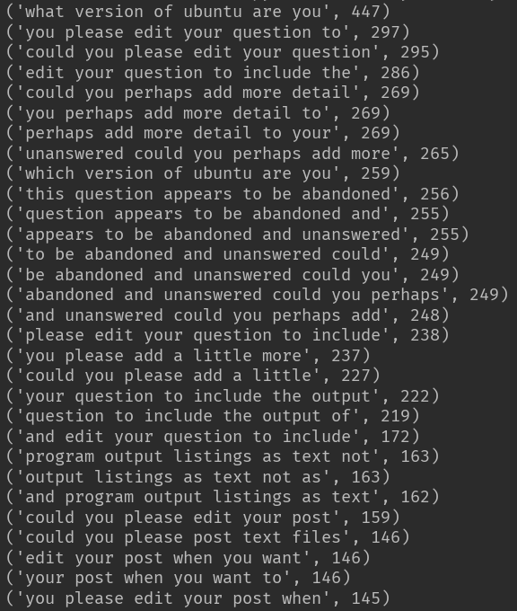
N-grams frequency

Slide 3
Frequent patterns
1. ask for intention: do you want to, what are you trying to…
2. ask for reason of questioning: why do you want to…
3. ask for meaning: what do you mean by…
4. ask for versions: what/which version of ubuntu are you using, what Ubuntu release are you using … (sometimes hardware/software version)
5. ask for output of sth. : what is the output of, your question to include the output…
6. possible duplicate question, provide links to other questions
7. ask for other edits like + sources/links
8. a general question for further explanation: can you add some details about…

Slide 4
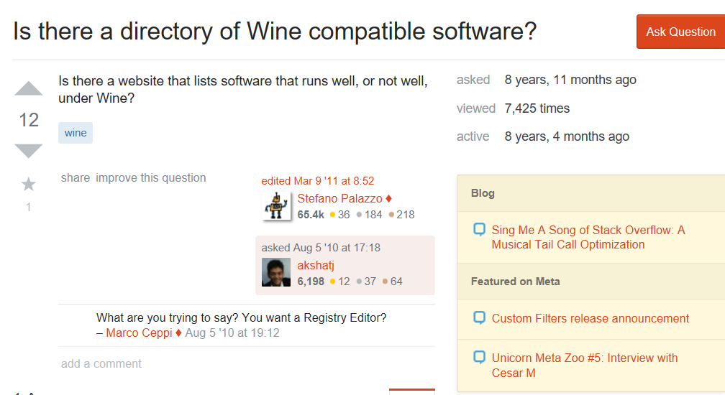
ask for intention: （类似的问题， 改了以后的分数，参考以前的paper，统计数据， is it good enough for）找关键词，找更多的meaning pattern, 找引号外面的pattern 5 responds, 3 post edits

Slide 5
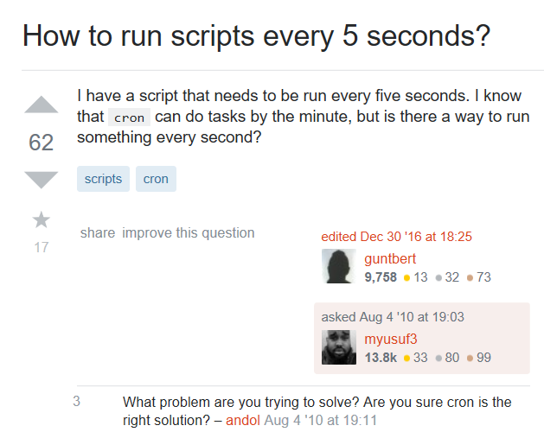
Ask for intention

Slide 6
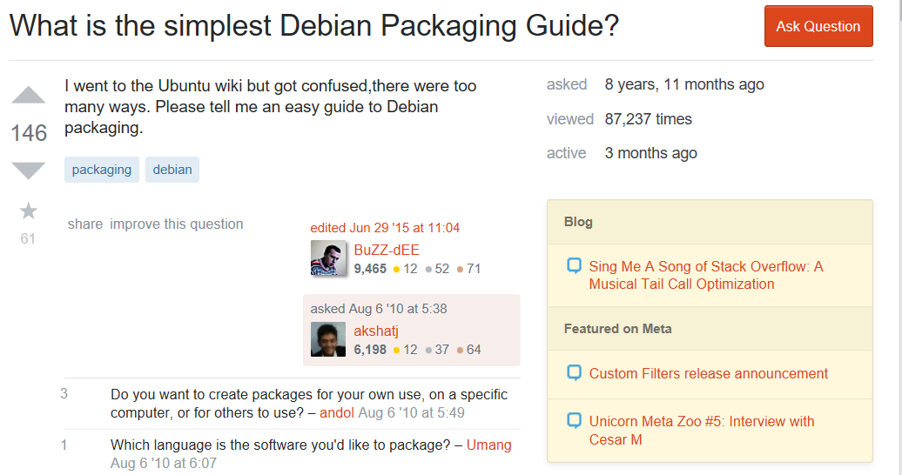
Ask for intention

Slide 7
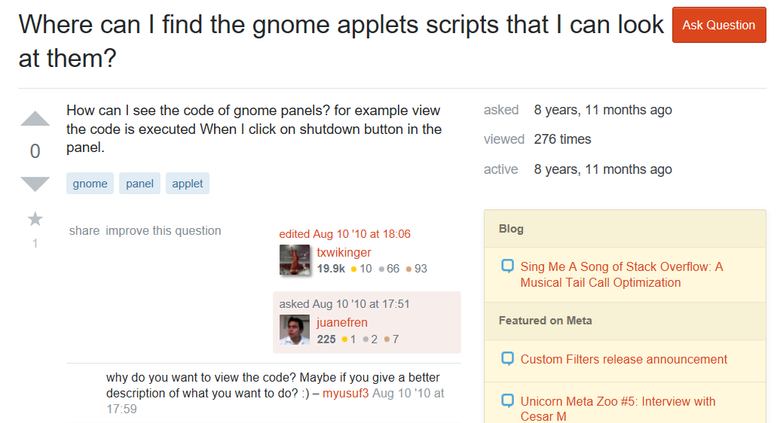
Ask for reason 3 responds, 0 post edits

Slide 8
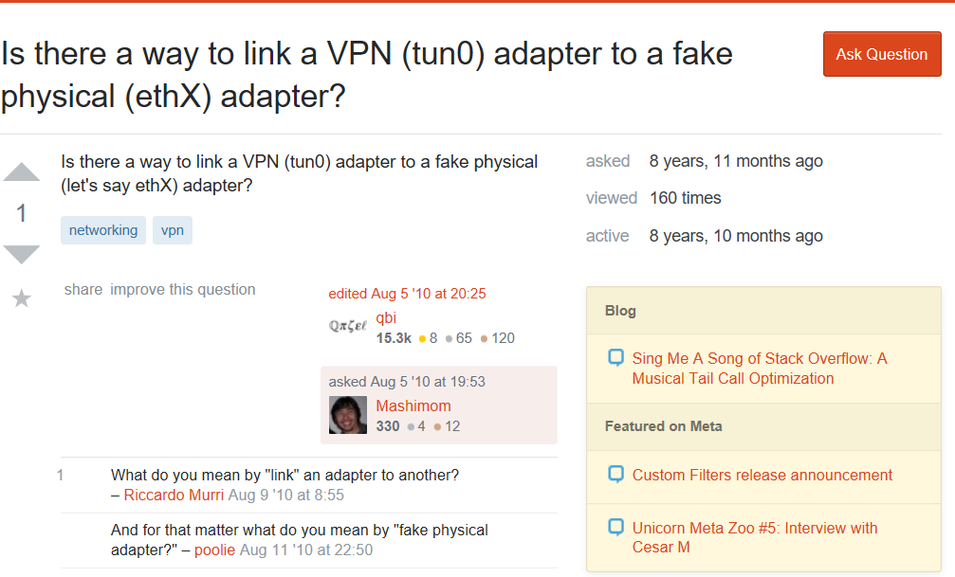
Ask for meaning 6 responds, 2 post edits

Slide 9
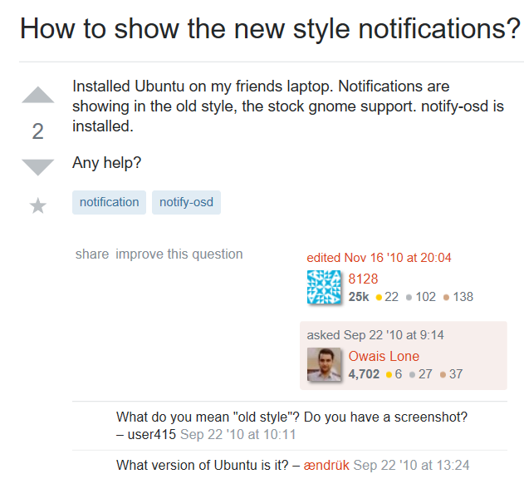
Ask for meaning

Slide 10
30 examples
Respond + edit: 4
Respond: 12
No respond or edit: 14
Avg question score: with responds: 6.64; with no respond: 3.31
Avg #answers: with responds: 3.14, with no respond: 2.15
Avg answer score: with responds: 2.51; with no respond: 2.29

Slide 11
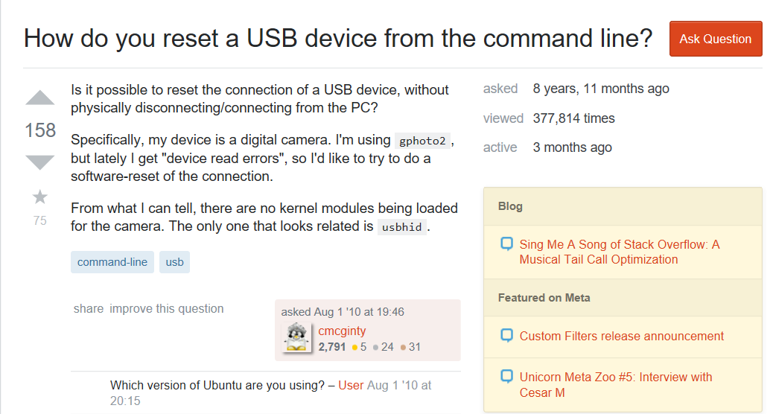
Ask for version 2 responds, 3 post edits

Slide 12
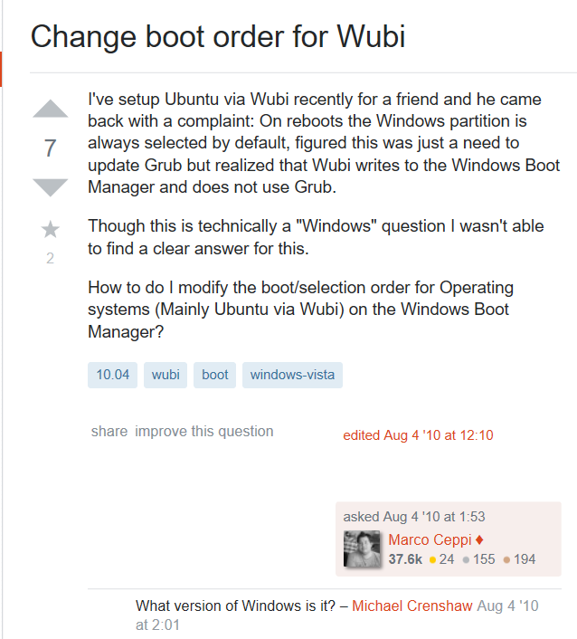
Ask for version

Slide 13
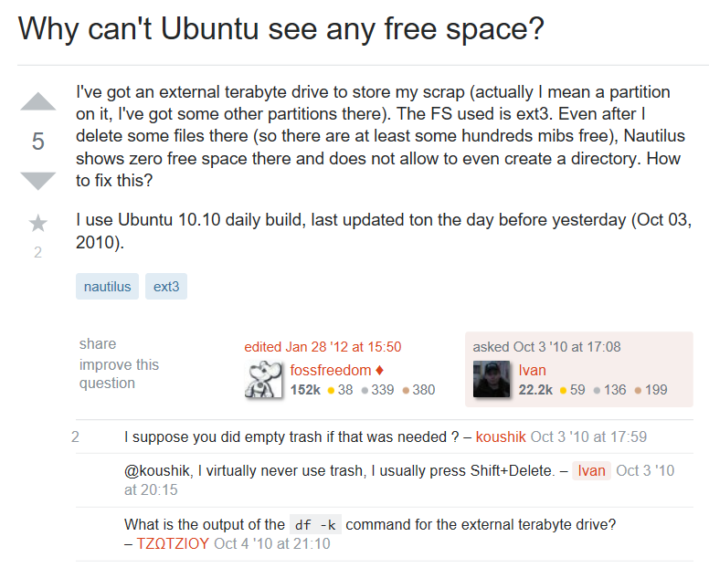
Ask for output 6 responds, 4 post edits

Slide 14
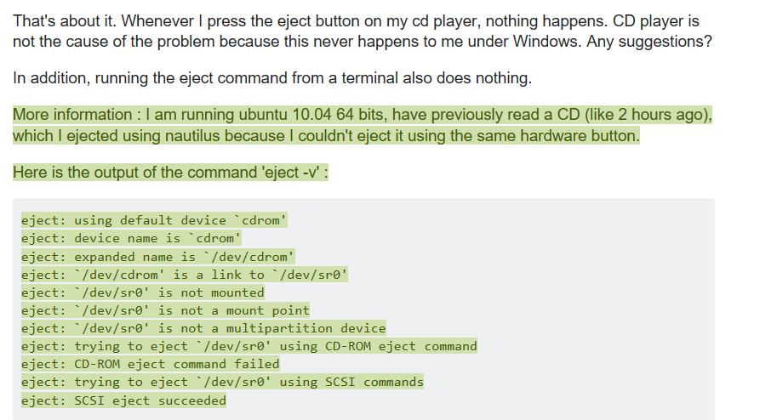
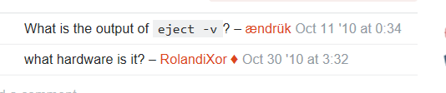
Ask for output

Slide 15
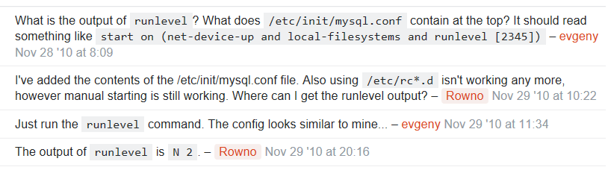
Ask for output

Slide 16
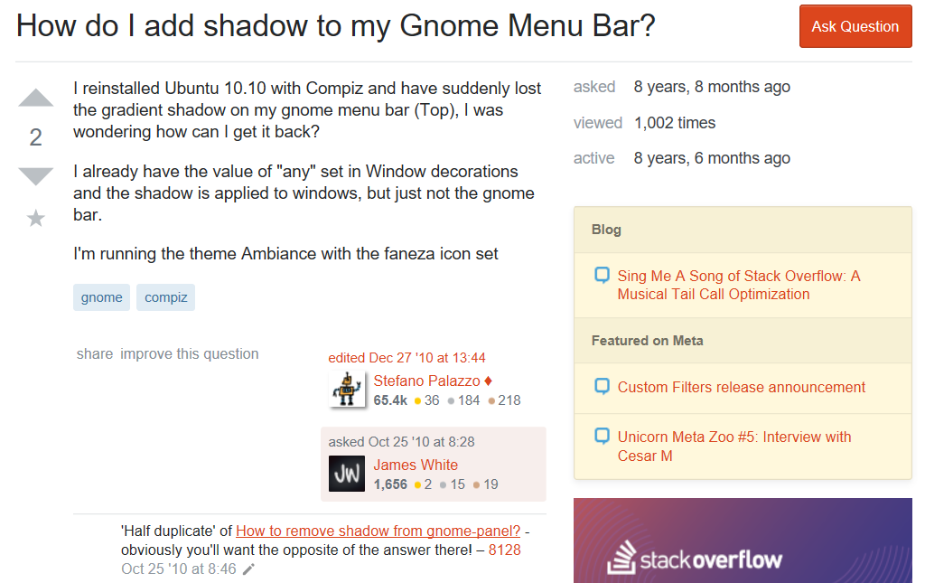
Possible duplicate questions

Slide 17
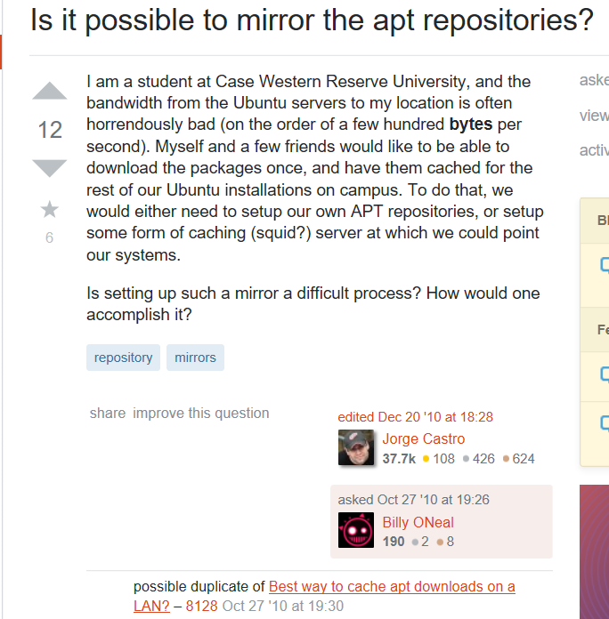
Possible duplicate questions

Slide 18
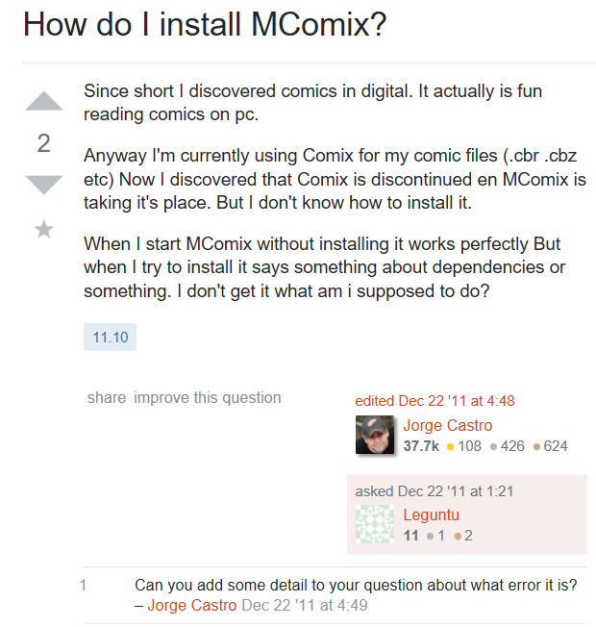
Others

Slide 19
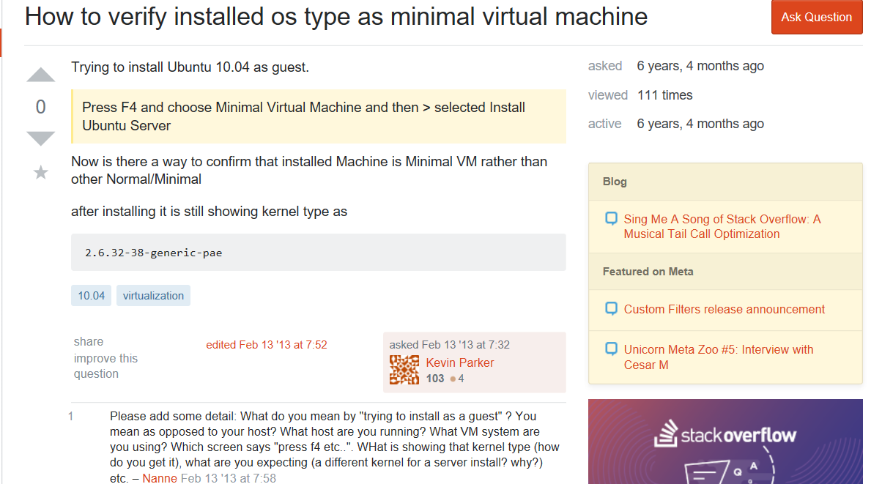
Others

Slide 20
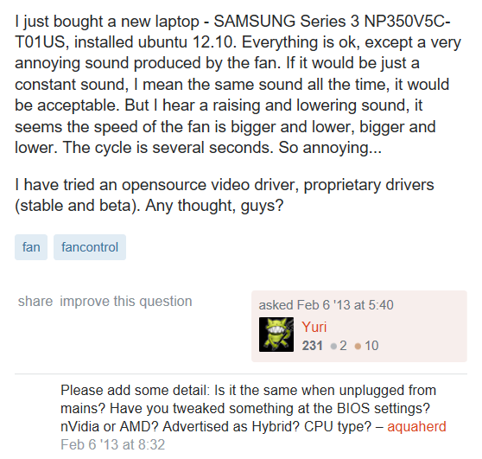
Others

