Slide 1
Weekly report

Slide 2
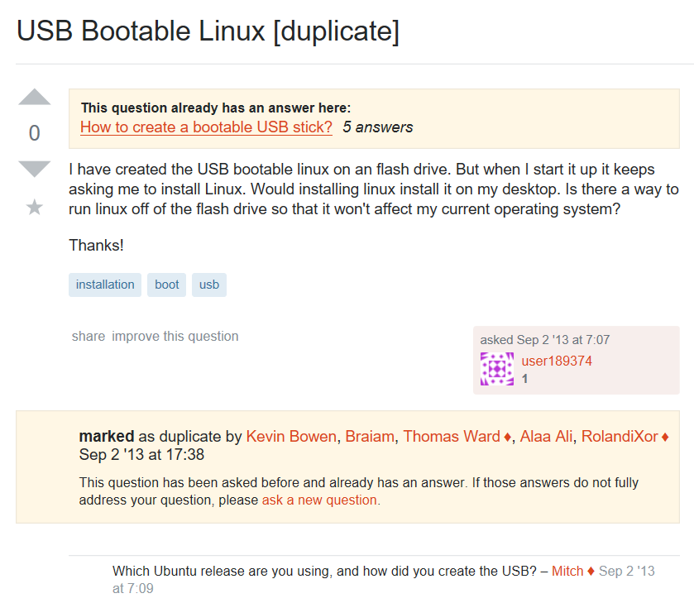
How did you install, how did you create…

Slide 3
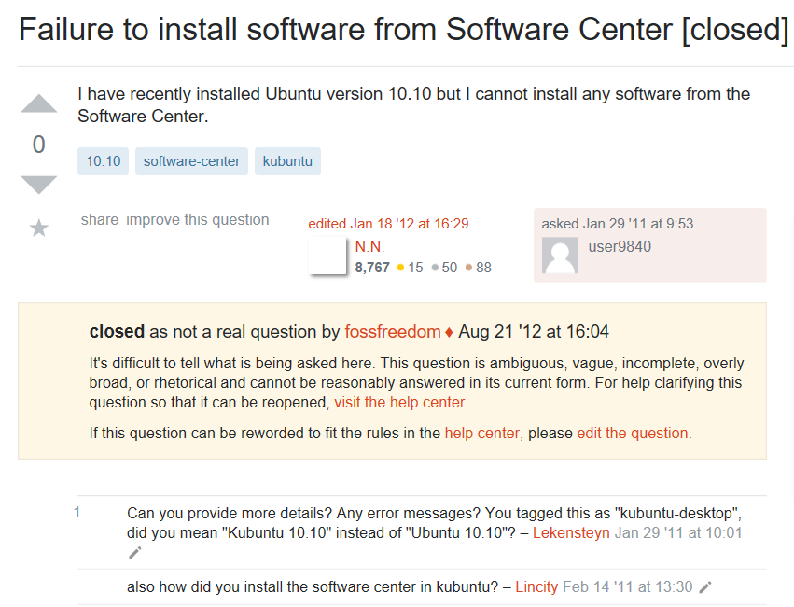
How did you install, how did you create…

Slide 4
Comment response 回答的人回答问题，引号总结pattern，berp model 聚类dbscan，更大数据集，model
Version 0.60 0.90
Meaning 0.56 0.89
How install 0.59 0.90
How create 0.58 0.92

