Slide 1
Weekly report
2019/07/18

Slide 2
BERT + DBSCAN
Reference： https://github.com/hanxiao/bert-as-service
Result：
1. what is the output of `***`, what does `***` show, can you please add the output from the `***` command, ' can you run `***` on a terminal and post its output ‘ (what does `***` output)
2. do you mean `***` , what is `***` (what does `***` say)
3. do you have the package `***` installed, have you installed `***`, will show details of installed package `***`
4. why do you need `***`, why are you using `***`, why did you choose `***`
5.did you try `***`, have you tried `***`, have you tried with `***` (does `***` help, does `***` work)
6. can you run `***`, can you try `***` instead, can you try something like `***`
7. what about `***`, how about `***`
8. what happens when you type `***`, what happens when you running `***`, what happens if you select `***` instead, what happens if you enter `***`
9. how did you install `***`, how did you download `***`, how did you get `***`, how did you try `***`
10. what version of `***` do you have, which `***` version are you using
11. what is wrong with `***`
12. what are the permission on `***` do you have permission on `***`

Slide 3
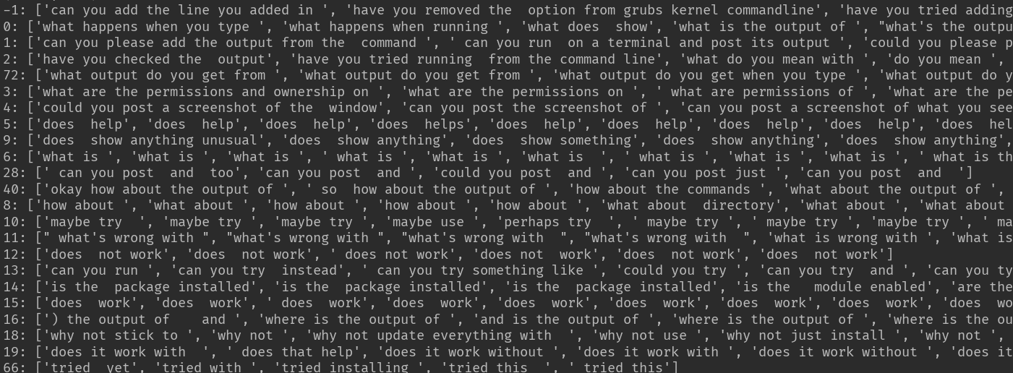
Raw

Slide 4
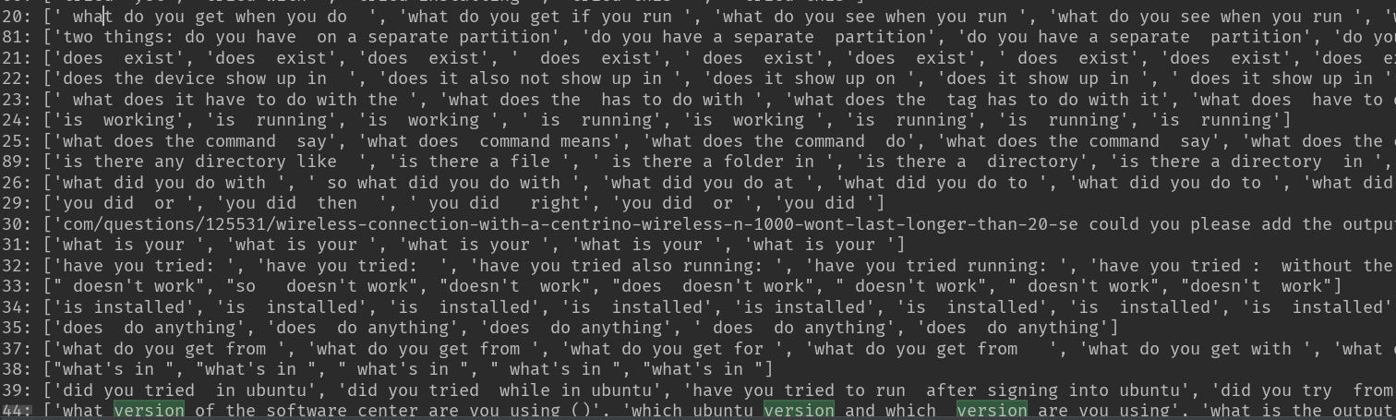
Raw

Slide 5
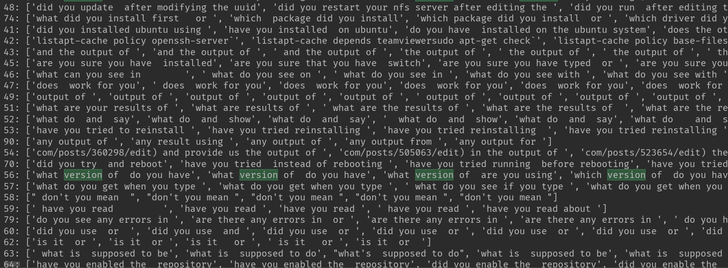
raw

Slide 6
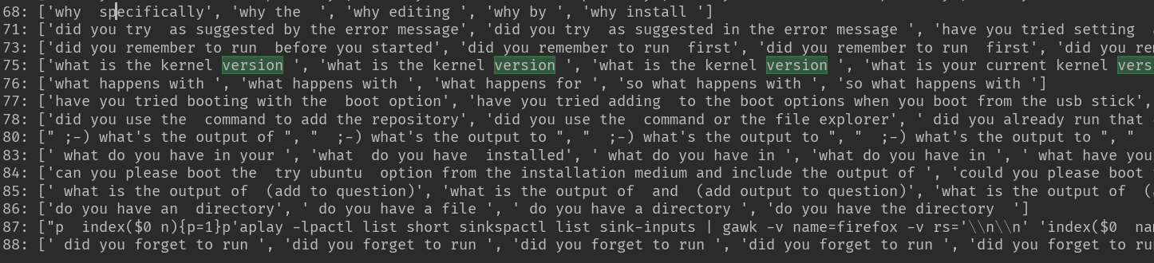
raw

Slide 7
response
if post owner generates comment after the comment question is raised and the earliest comment is the corresponding response.
51660 answered question
42906 unanswered question
Response Proportion: 54.63%

Slide 8
Edit after questioned
Version: 21.13% ([0-9].[0-9] in diff or ‘version’ in diff or [0-9]-[0-9] in diff)
Meaning: 13.24% (add or remove key words or ‘mean’ in diff or i.e. in diff)
Problem: hard to collect statistics from the overall data as it is difficult to judge whether an edit is related to the question’s answer.

Slide 9
After A answered B’s comment question, B answered A post question
Among 35775 comment questions that had been answered, 9254 users who raise the comment questions answered the post questions.
Proportion: 25.87%

Slide 10
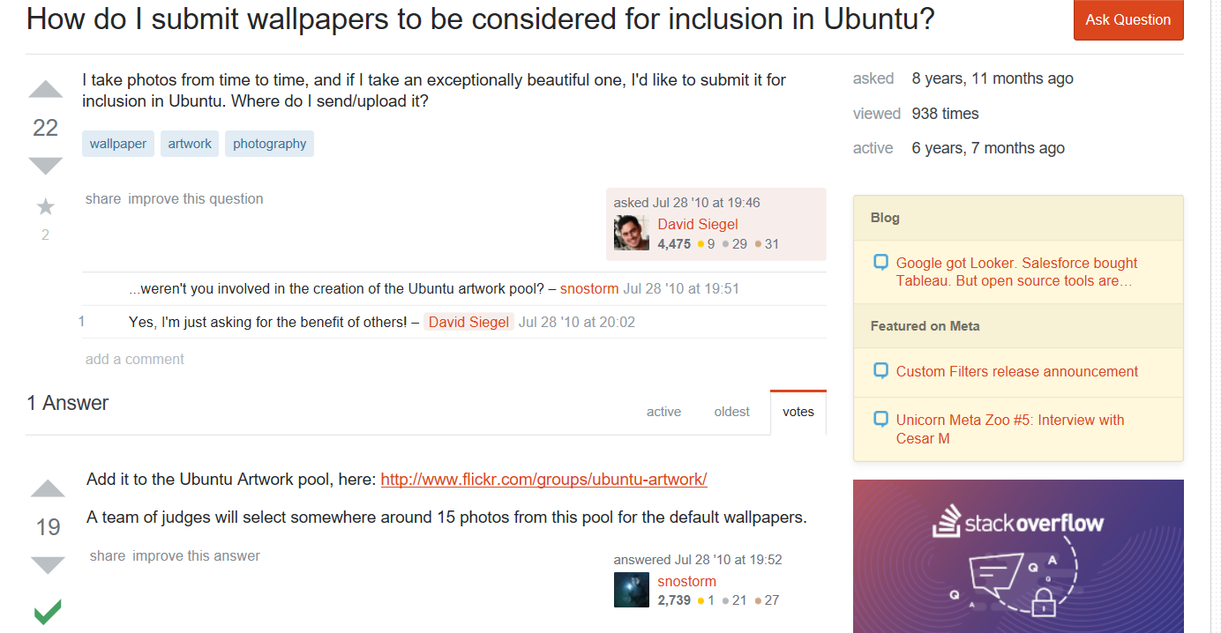
Example

Slide 11
Possible rules
what is ***? , meaning of ***, do you mean by/with ***
Version of ***, configuration of ***
Is it good enough to 。。Wiki 统计score，
跑model. transformer model, seq-to-seq, overall one model，general 一点的问题。
翻之前的project有没有什么没做的，

