Slide 1
Report
2019/07/31

Slide 2
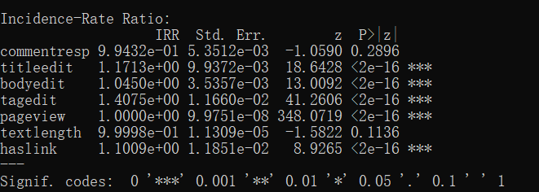
Score

Slide 3
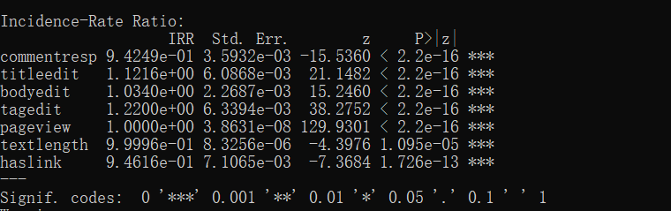
Answer Count

Slide 4
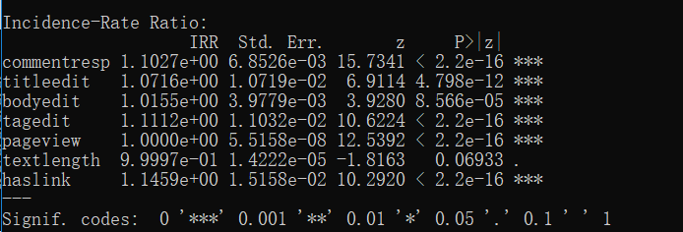
Has accepted answer (google pretrained model, berp.) Duplicate Stackflow (Russian, English) pair

