Slide 1
report
29/08/2019

Slide 2
Data Update
Data from Stack Overflow have been updated
Have extracted url from:
1. all the solution posts
2. all the post comments from both question posts and solution posts
And then found the content of corresponding question posts
Number of questions: 6002

Slide 3
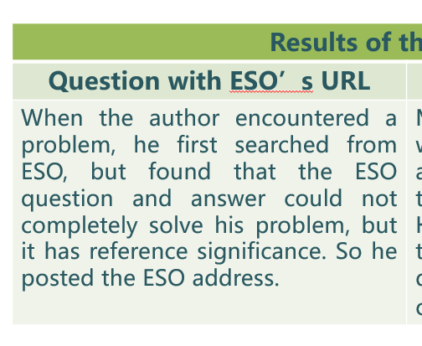
Note
As from the empirical study, it is concluded that links in question posts are usually not useful. So we do not consider that case.

Slide 4
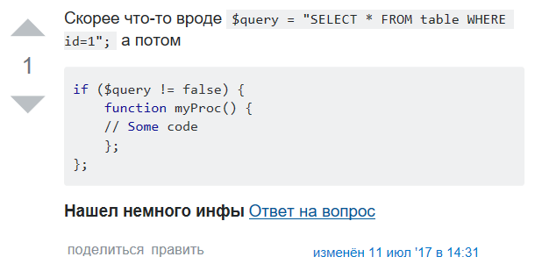
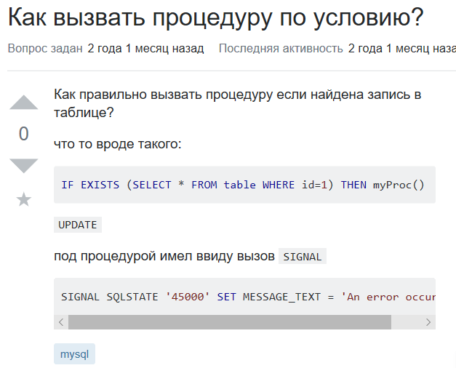
1. Extracting URL from solution posts
Question: Answer:

Slide 5

1. Extracting URL from solution posts
Linked Answer:

Slide 6

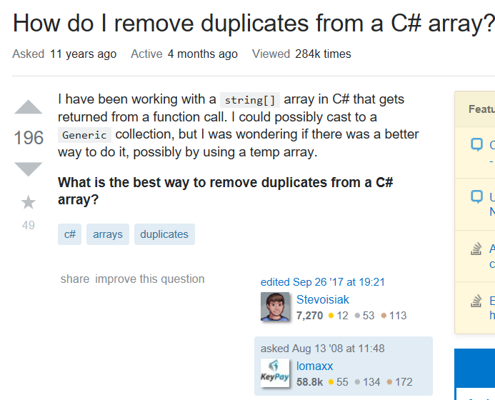
2.1 Extracting URL from post comments of question posts
Rus Question: Linked Question:

Slide 7
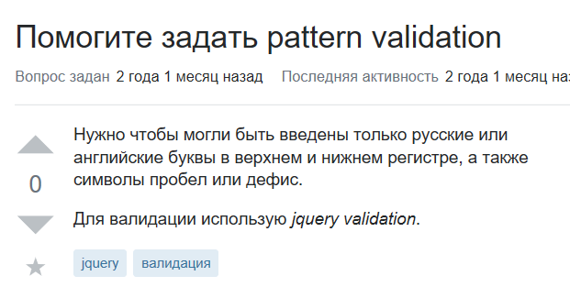
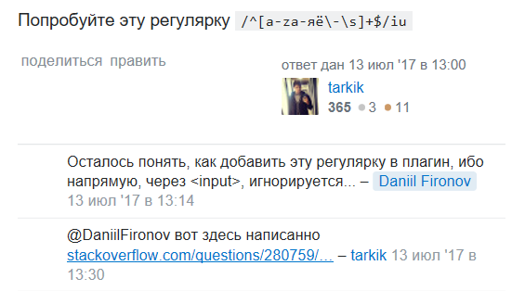
2.2 Extracting URL from post comments of solution posts
Question: Solution:

Slide 8

2.2 Extracting URL from post comments of solution posts
Linked posts

Slide 9




2.2 pairs are not always of the same topics

Slide 10
Negative Data Extracting
If len(tags of linked post ∩ tags of current post)) > 0 & len(tags of linked post ∪ tags of current post) < len(tags of linked post) => relevant but not of the same topic.
E.g.
Eng: PDF Editing in PHP?
Rus: Вставка ссылки в pdf
Eng-neg: Best way to allow plugins for a PHP application
Disadv: some question posts do not have tags
There might be some better heuristics…

Slide 11

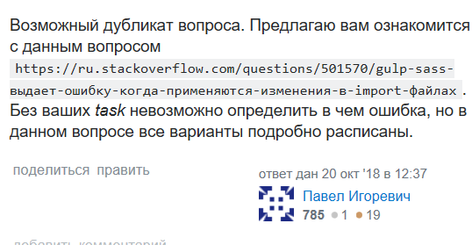
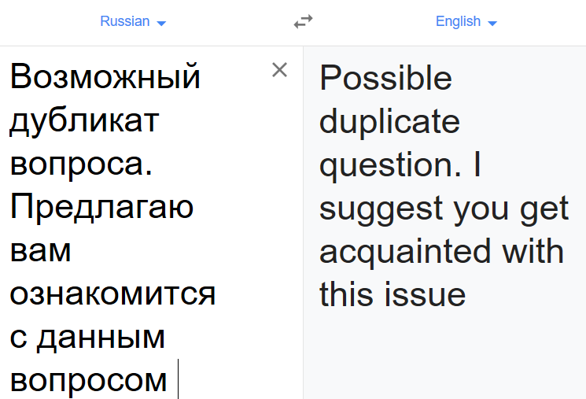
Possible duplicate posts
There seems no such function in Russian Stack Overflow

Slide 12
Possible duplicate posts
Better to make a diff using post edit history and find links that have been removed?
Data found: 30 (632 but most of the links are in question posts)

Slide 13
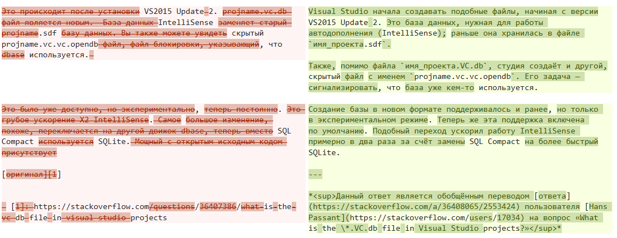
e.g.
Actually, the reason for deleting the link is not because it is useless

Slide 14
Data filtering
Some links are still invalid after data are updated
Some question posts do not have tags thus we cannot find the corresponding negative pairs
Positive data: 5544
Negative data: 5544
(seems ignore /a/?)

Slide 15
Result
Multilingual encoding + fully conntected layer (20 epochs):
Loss: 0.2680 - acc: 0.9285 - val_loss: 0.2739 - val_acc: 0.9319
Multilingual encoding + siamese model (20 epochs):
loss: 0.0574 - acc: 0.9873 - val_loss: 0.1330 - val_acc: 0.9639
Only Multilingual encoding:
Training_acc : 0.6368 Test_acc: 0.6330 (using inner product to compute similarities & tuning threshold using training dataset to achieve the best performance, at the end threshold = 0.29)
Precision_10,5… siamese baseline, multilingual encoding daima fine tuning=>chouqu gaozhiliang embedding, rank (10000)

Slide 16
Result
Doc2vec + fully conntected layer (20 epochs):
loss: 0.0880 - acc: 0.9839 - val_loss: 0.0972 - val_acc: 0.9850
Doc2vec + siamese model (20 epochs):
loss: 0.0932 - acc: 0.9970 - val_loss: 0.0739 - val_acc: 0.9990
Only Doc2vec :
Training_acc : 0.6350 Test_acc: 0.6492 (using inner product to compute similarities & tuning threshold using training dataset to achieve the best performance, at the end threshold = 0.005)

Slide 17
Next step
+ /a/, - solution comment
Better neg data extraction?
Parameter tuning
Observing testing examples to find the reason behind the results.

