Slide 1
Report
20190904

Slide 2
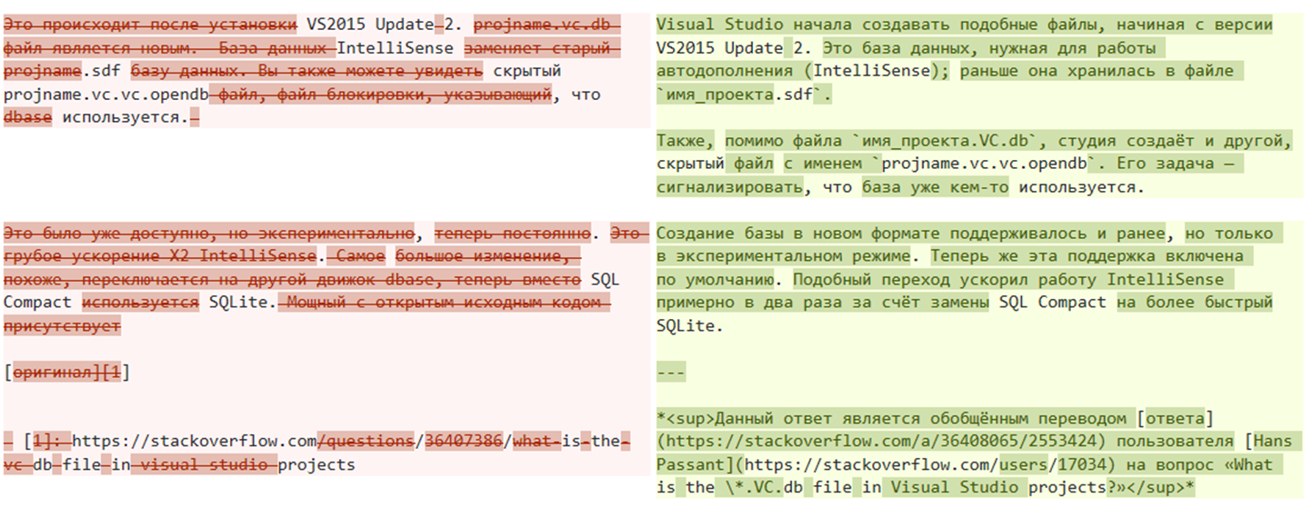
Example in last week
They are the same post!

Slide 3
Data
Positive data (6470):
question where the solution post or question comment include:
https://stackoverflow\.com/questions/\d+/
https://stackoverflow\.com/q/\d+/
https://stackoverflow\.com/a/\d+/
\d => post_id (not question_id)

Slide 4
Data
Negative data (1328):
not includes ‘delete after add’
includes post question that contains English post links

Slide 5
Rank results
Method: for each Russian post in test data, rank the relevance level of all English posts in test data.
Problem:
1. May need expand the negative data.
2. All negative data is equal to zero in ground truth, which may not be reasonable
3. the performance depends on how many candidate English posts are involved.

Slide 6
Multilingual Encoding
Did not find source code of the pretrained model…
重新弄Negative， 跑。

