Slide 1

CAPESTONE PROJECT
Employee Attrition Problem
By-
Utkarsh Vardhan
Roll No.E17023
Praxis 2017 January Batch

Slide 2
Company background
Company business objective
Problem Statement
Company Background
ABC Company is an IT firm. They have presence across all urban areas. Company hires employees to meet the client deliverables.
Company Business Objectives
Because of increasing attrition level, the company is loosing in meeting client deliverables and reputation.
Problem Statement
Company is seeing higher attrition rate as c wants to Uncover the factors that lead to employee attrition.
We need to design a model to identify the employees, those who are likely to attrite in near future so that company can understand the reason for attrition and can take necessary steps.
To design a model –We need to leverage the historic data collected by company which has all details of employees along with their attrition status..
To validate the model-We are given a test data to test how accurate our model is in predicting the attrition status.

Slide 3
Variables in the dataset
Age | MonthlyIncome
BusinessTravel | MonthlyRate
DailyRate | NumCompaniesWorked
Department | Over18
DistanceFromHome | OverTime
Education | PercentSalaryHike
EducationField | PerformanceRating
EmployeeCount | RelationshipSatisfaction
EmployeeNumber | StandardHours
EnvironmentSatisfaction | StockOptionLevel
Gender | TotalWorkingYears
HourlyRate | TrainingTimesLastYear
JobInvolvement | WorkLifeBalance
JobLevel | YearsAtCompany
JobRole | YearsInCurrentRole
JobSatisfaction | YearsSinceLastPromotion
MaritalStatus | YearsWithCurrManager
Predictor
Attrition
Response

Slide 4
Descriptive Analysis Results
Employees who travel rarely in every age group are the ones leaving the firm.
Out of total attrition 60% of the employees were at Job level 1.
Employees who stays far from office are leaving the jobs.
Employees who joined after 1st switch are the ones leaving the job most.
Overtime is resulting in employee attrition.
Employees with low Stock Option Level are leaving the jobs.
High experience employees doing Overtime are leaving the jobs.
Majority of the Employees at Job Involvement level 3 are leaving the job.

Slide 5
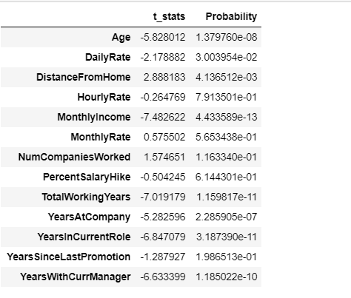
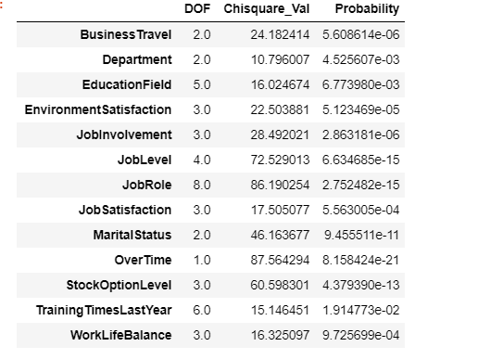
Statistical Test Results
T Test for Continuous Variables
Chi Square Test for Categorical Variables

Slide 6
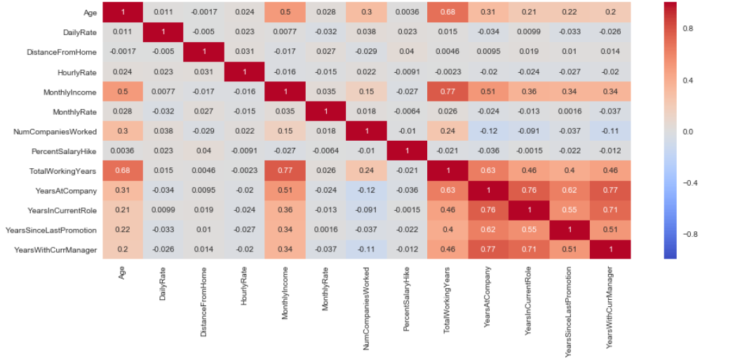
Statistical Test Results
Correlation Matrix

Slide 7
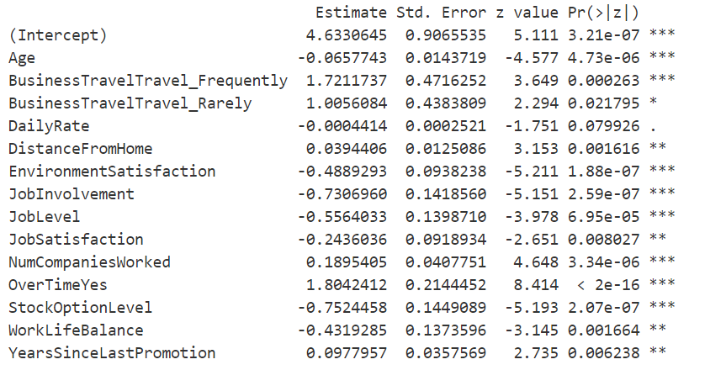
MODEL RESULTS
Logistic Regression Output

Slide 8
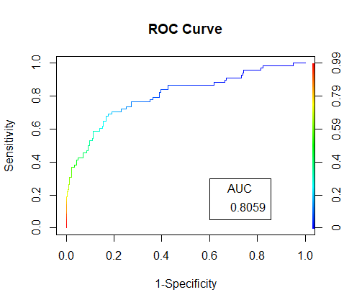
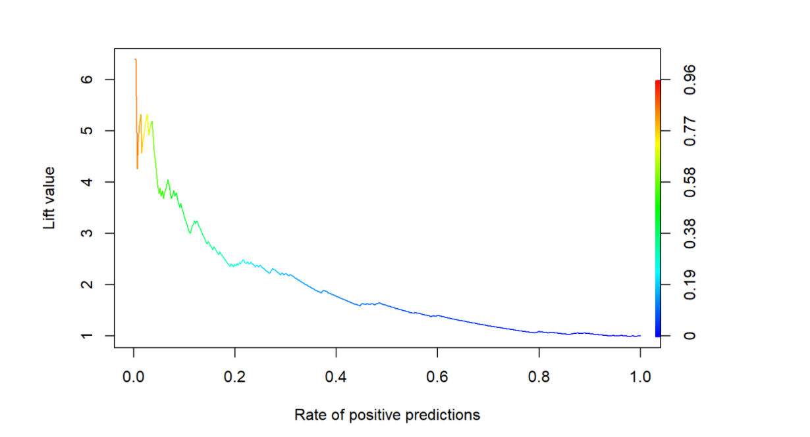
MODEL RESULTS
LIFT Chart

Slide 9
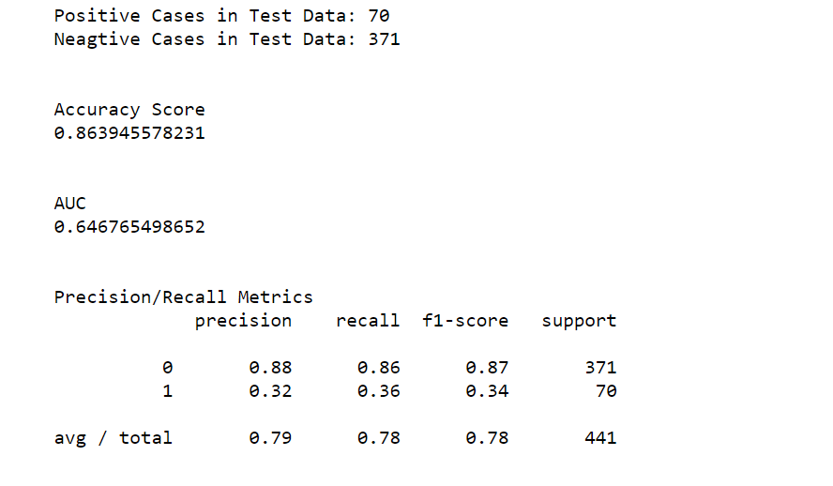
MODEL RESULTS
Decision Tree

Slide 10
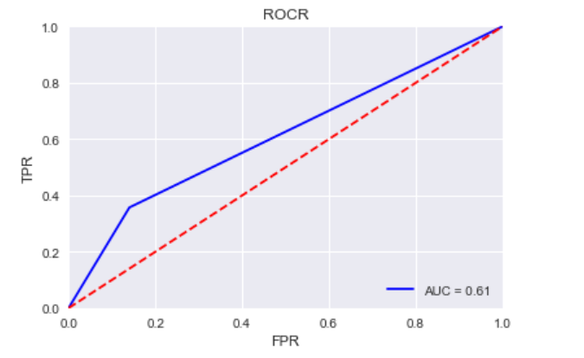
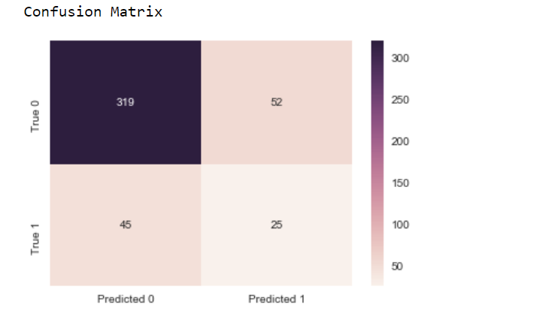
MODEL RESULTS
Decision Tree

Slide 11
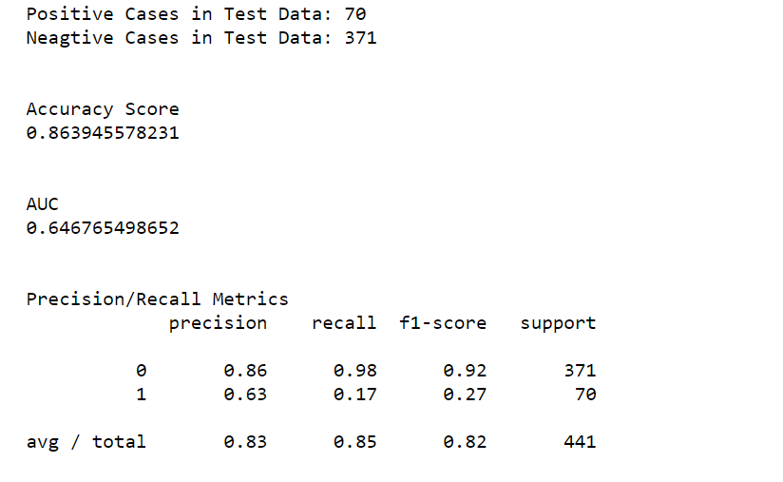
MODEL RESULTS
Random Forest

Slide 12
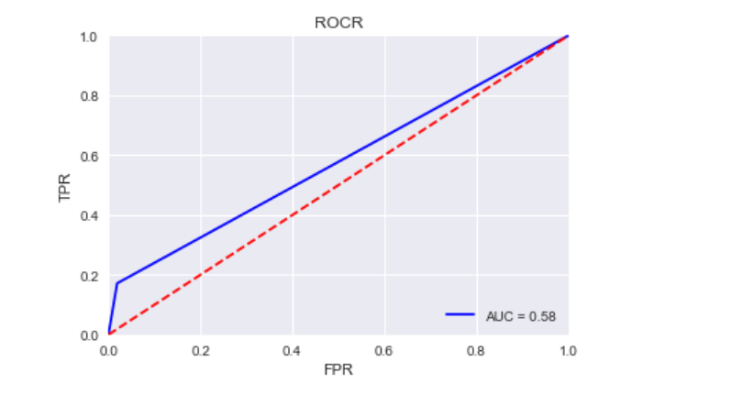
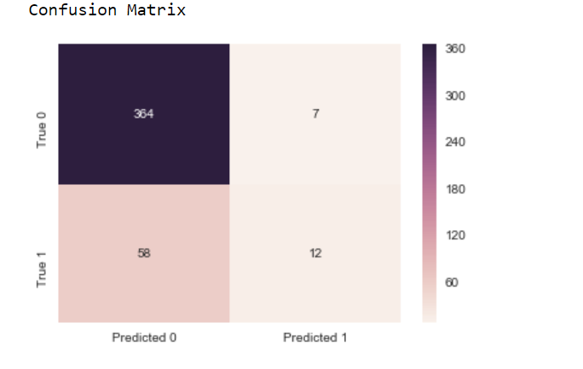
MODEL RESULTS
Random Forest

Slide 13
Conclusion
1.Logistic Regression and Random Forest are giving good results as compared to Decision Tree.
2.All the Models are predicting as 0 a lot of cases that should be predicted as 1.
This can be a fatal issue resulting in missing on the employee who is likely to attrite.
3.Applying different techniques to handle imbalanced dataset is not solving the above issue.
4. There must be some other feature, that hasn’t been taken into account which could help to
predict more of these cases correctly.

