Slide 1

StockRoom
A small inventory app, shipped the DevSecOps way
DevOps Capstone · github.com/u7k4rs6/Capstone
Notes:
Hi, this is StockRoom. It's an inventory tracker, but the real project is everything around it: tests, containers, a security gate, Terraform, Kubernetes, GitOps and monitoring.

Slide 2
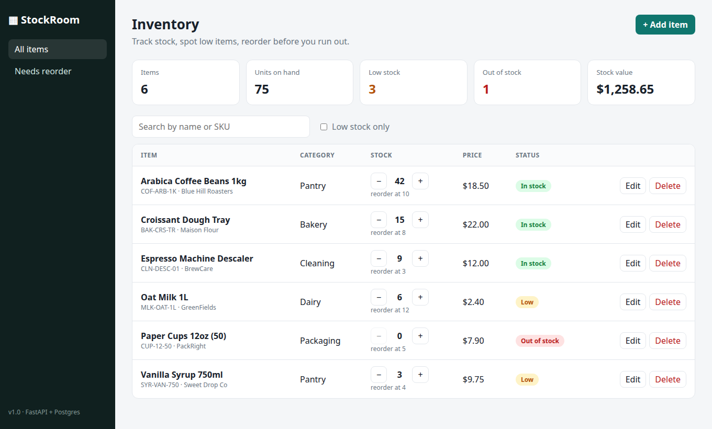


What I built
Track stock
Add items, bump quantities up or down, edit or delete
Spot low items
Anything at or under its reorder level gets flagged
Ship it properly
Every push is tested, scanned and rolled out by ArgoCD
React + FastAPI + Postgres. 10 API routes, 12 tests.
Notes:
The app: a dashboard of items with KPIs up top. You can search, filter to low stock, and nudge quantities with plus and minus. Behind it is a FastAPI service with full CRUD plus a stock adjust endpoint and a stats endpoint.

Slide 3








Tech stack
App
Testing
Containers
CI/CD
React 19, FastAPI, Postgres 17, Alembic
pytest on SQLite, ruff
Docker, Compose, non-root
GitHub Actions, GHCR
Security
Infra
Deploy
Observability
Trivy, fail on HIGH/CRITICAL
Terraform, AWS VPC + EKS
Helm, ArgoCD, HPA, ingress
Prometheus, Grafana
Notes:
Quick tour of the stack. Each box maps to a module in the rubric.

Slide 4
Architecture
Developer
AWS EKS · namespace stockroom
ingress-nginx
frontend x2
GitHub
ArgoCD
backend x2-6
Postgres
GitHub Actions
Prometheus
Grafana
GHCR
Terraform
/ goes to frontend, /api goes to backend. Prometheus scrapes /metrics.
Notes:
Left side is delivery: push to GitHub, Actions builds and scans, images land in GHCR. CI then bumps the image tag in git and ArgoCD syncs it into EKS. Terraform builds the cluster itself. Inside the cluster, ingress routes slash to the frontend and slash api to the backend, backend talks to Postgres, Prometheus scrapes the backend and Grafana reads Prometheus.

Slide 5
CI/CD pipeline
1
2
3
4
5
6
Test
Build
Scan
Push
Bump
Sync
ruff, pytest -v, npm build
both images, tagged with commit SHA
Trivy, fails on HIGH or CRITICAL
ghcr.io/u7k4rs6/stockroom-*
CI commits new tag to values.yaml
ArgoCD rolls the cluster forward
Runs on every push to main. PRs get test + build + scan, but nothing is pushed or deployed.
Why SHA tags: any pod in the cluster traces back to the exact commit. No guessing what "latest" means.
Notes:
Six stages. If tests fail nothing gets built. If Trivy finds a fixable high or critical CVE nothing gets pushed. On main, the last job rewrites the image tag in the Helm values and commits with skip ci, which is what ArgoCD watches.

Slide 6
Security gate with Trivy
What it scans
4 → 0
OS packages (Debian, Alpine) and Python wheels inside both final images.
What it found
setuptools CVE-2025-47273, 2 urllib3 CVEs, 1 msgpack. All inside pip's vendored copies.
HIGH CVEs in the backend image, first scan vs now
The fix
Frontend: clean from day one
pip is build-time only, so the Dockerfile uninstalls it. Scan went clean.
Notes:
Trivy scans both images. The pipeline uses ignore-unfixed and exit code 1, so only HIGH or CRITICAL CVEs with an available fix block the build. First scan had four highs, all in pip's own vendored libraries. The app never imports those, and pip isn't needed at runtime, so I uninstall it and the scan comes back clean. I also pinned the Trivy action to a commit SHA, since tags can be moved.

Slide 7
Infrastructure with Terraform
VPC 10.20.0.0/16 · ap-south-1
2 public + 2 private subnets over 2 AZs
EKS 1.35, managed node group 2 to 4
Add-ons: VPC CNI, CoreDNS, kube-proxy, EBS CSI
Subnets tagged so load balancers land in public ones
No keys in git. tfvars.example only
AZ a
AZ b
public subnet + NAT
public subnet
private subnet
private subnet
EKS node (t3.large)
EKS node (t3.large)
init → plan → apply → destroy
Notes:
Terraform builds the network and the cluster with the community VPC and EKS modules. Nodes sit in private subnets, load balancers in public ones. One NAT to keep the bill down. EBS CSI is there so Postgres can get a gp3 volume. And terraform destroy at the end so nothing keeps billing.

Slide 8

Kubernetes, Helm and ArgoCD
Deployments
Postgres
GitOps loop
frontend x2, backend x2 with HPA up to 6 at 60% CPU
StatefulSet + PVC, backend waits on it with an init container
Push to main
CI writes new SHA into values.yaml
ArgoCD sees the commit
Auto sync, prune, self-heal
Networking
Hardening
ClusterIP services, ingress splits / and /api
non-root, no privilege escalation, all caps dropped
Notes:
The Helm chart has everything: two deployments, Postgres as a StatefulSet, services, ingress, HPA, a ServiceMonitor and the Grafana dashboard as a ConfigMap. ArgoCD owns the deploy. Git is the source of truth, so if someone edits the cluster by hand ArgoCD puts it back.

Slide 9
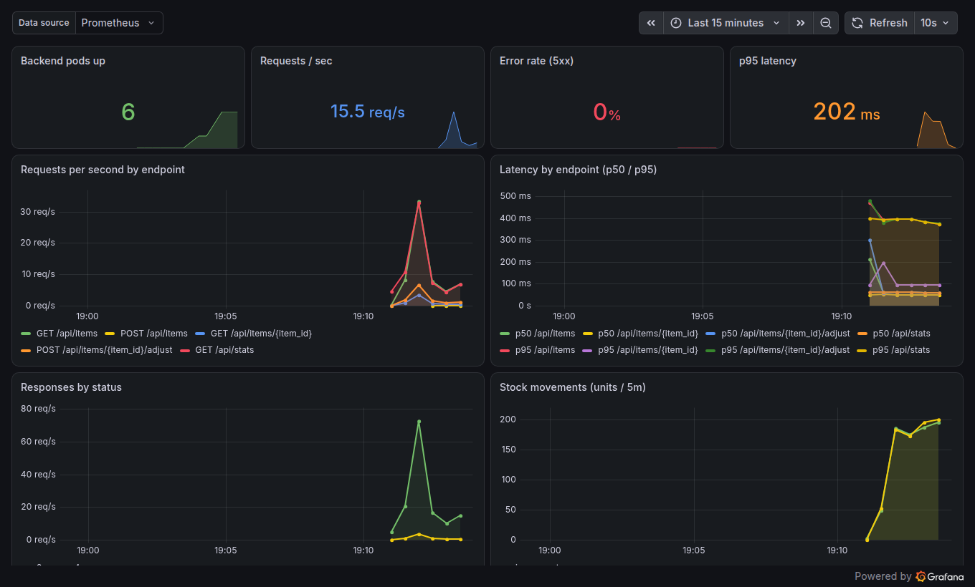
Observability
/metrics
request count and latency per endpoint, plus a custom stock movement counter
Prometheus
ServiceMonitor picks up every backend pod, all UP
Grafana
dashboard ships with the chart: traffic, p95, 5xx rate, stock moves
Notes:
The backend exposes Prometheus metrics. A ServiceMonitor in the chart tells Prometheus to scrape it, and the dashboard is a ConfigMap the Grafana sidecar loads automatically, so a fresh cluster gets the dashboard with zero clicking.

Slide 10




Key learnings
Replicas race on first boot
CVEs hide in your tooling
Two pods ran migrations at once and crashed. Fixed with an init container and a Postgres advisory lock.
Every Trivy hit was in pip, not the app. Shipping less fixes more than patching.
Red targets aren't always bugs
Pin what you run
Managed control planes hide their metrics. Turned those scrapes off so real failures stand out.
Actions pinned by SHA, images tagged by SHA. Tags move, hashes don't.
Notes:
A few things that bit me. First boot: two backend replicas both tried to run migrations and one crashed, fixed with an init container plus an advisory lock. Trivy findings were all in pip. Some Prometheus targets are always down on a managed control plane. And pin everything by hash.

Slide 11
Live demo
Code · CI run · Terraform · ArgoCD · kubectl · Prometheus · Grafana
github.com/u7k4rs6/Capstone
Notes:
That's the overview. Now the live walkthrough, in that order.

