Slide 1
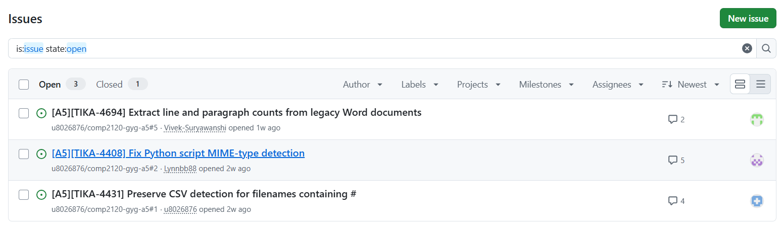
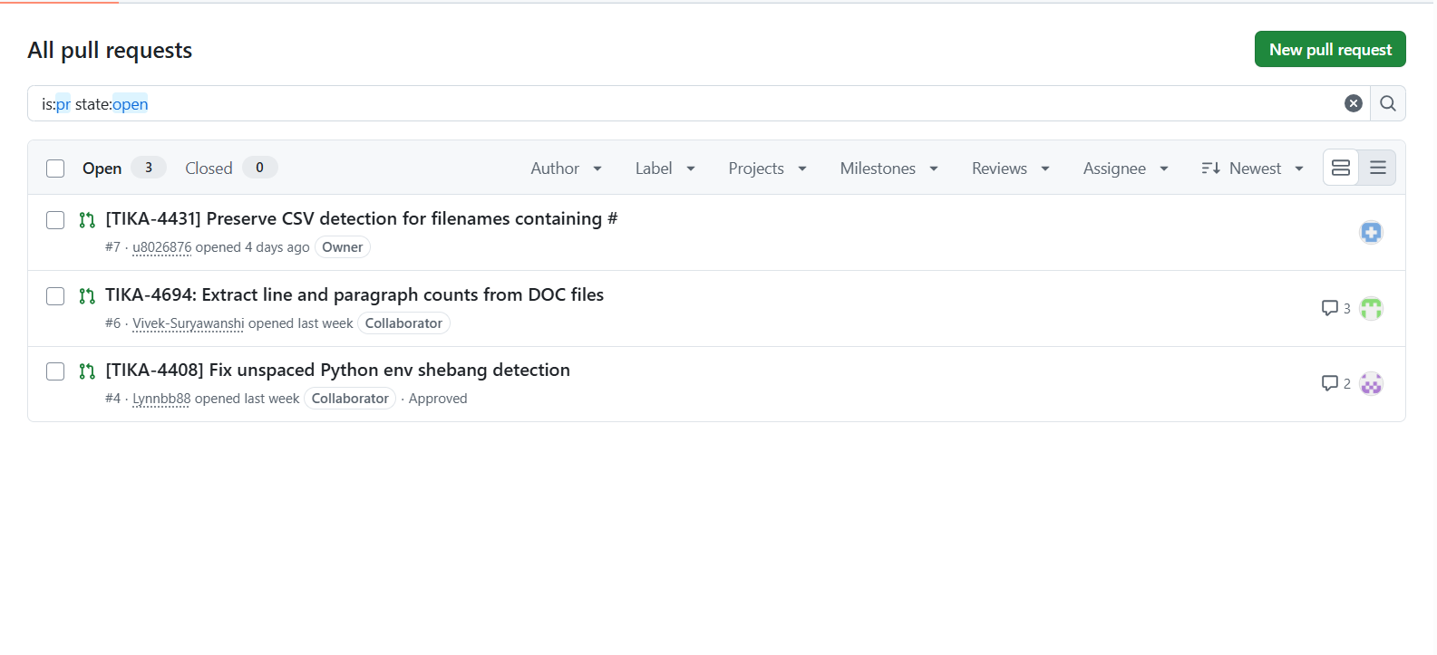
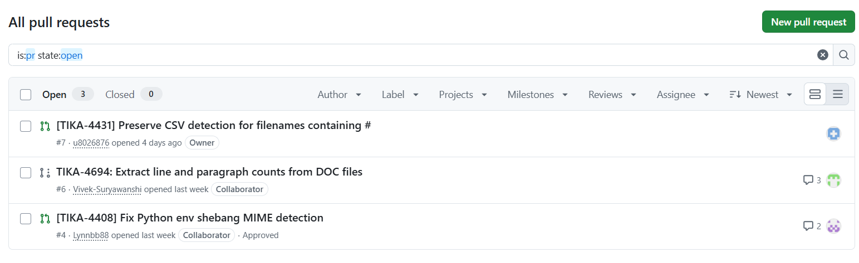
APACHE TIKA / GROUP DEMONSTRATION
Our work is tracked in GitHub
4 TRACKED ISSUES
3 INTERNAL PULL REQUESTS
TIKA-4431 · TIKA-4408 · TIKA-4694
#7 CSV · #6 Word metadata · #4 Python (approved)
Also tracked: TIKA-4083 (ClamAV CDiff) — group issue closed
Source: group repository Issues and Pull Requests screenshots
Notes:
The group used GitHub to track four Apache Tika issues and opened three internal pull requests. The screenshots show the open issue list and the PR list. TIKA-4083 appears separately as a closed group issue. Group issue status and internal PR status should not be confused with acceptance upstream.

Slide 2

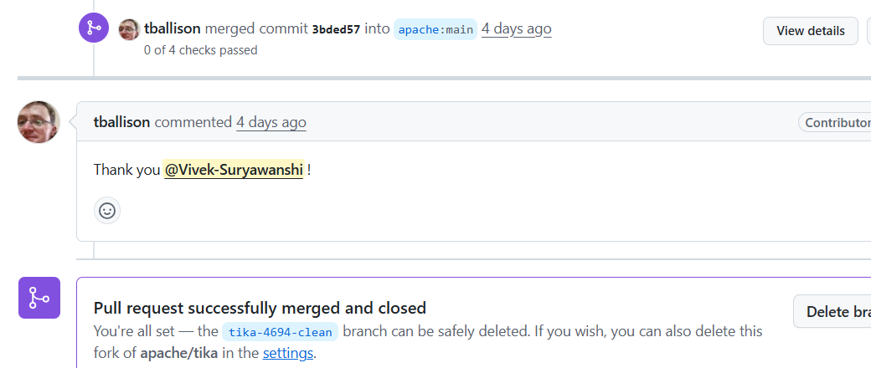
APACHE TIKA / EVIDENCE OF UPSTREAM IMPACT
A contribution accepted by Apache Tika
OFFICIAL UPSTREAM PULL REQUEST
MAINTAINER CONFIRMATION
TIKA-4694
Merged into apache/tika:main
Evidence: upstream PR #3376 • merged by an Apache Tika maintainer
Notes:
Our group submitted changes for review, and one independently confirmed upstream outcome is TIKA-4694, which corrects missing line and paragraph counts in legacy Word documents. The upstream pull request #3376 is marked Merged into apache/tika main, and the maintainer replied with thanks. The other group issues and pull requests should not be presented as upstream merged without verifying their status.

