Slide 1
From a Jira ticket to an upstream PR
APACHE TIKA / OFFICIAL CONTRIBUTION REQUIREMENTS
01
01
Jira issue + reproducible failure
Every upstream PR needs a TIKA Jira ID. Reproduce the bug, then write a test that fails without the fix.
02
Focused patch + quality checks
Use a fork/branch; run ./mvnw clean install. Check tests, CHANGES.txt, license headers and AI disclosure.
03
Submit, respond, and possibly merge
Target apache/tika:main with [TIKA-XXXX] in the title, squashed commits and no conflicts. Maintainers decide.
Terry / @zit060523terry
Notes:
Speaker notes (around 55 seconds):
Apache Tika has more specific contribution rules than simply opening a GitHub PR. First, a contributor needs a related TIKA Jira issue; the project says it cannot accept a PR without one. We should reproduce the original problem and include a test that fails without our change. Second, we work on a focused branch, run the Maven build, and check things like the changelog, license header and source quality. We also disclose AI-assisted work according to Apache rules. Third, the official PR targets apache/tika main. The title needs the Jira ID, the commits should be squashed, and there should be no merge conflicts. Maintainers can request more changes. Only they decide whether to merge. Our assessment does not require a successful upstream merge.
Source: https://github.com/apache/tika/blob/main/CONTRIBUTING.md
Full guide: https://tika.apache.org/contribute.html
Scope: official upstream process, not proof of any group code already merged.

Slide 2
A real bug: Python detected as Shell
REAL EXAMPLE / TIKA-4408
02
#!/usr/bin/env python3
BEFORE / EXISTING RULE
AFTER / PROPOSED FIX
match: /bin/env python
offset: 1 (second byte)
match: #!/usr/bin/env python
offset: 0 (file start)
→ application/x-sh
→ text/x-python
Regression evidence: 7/18 checks failed before; all 18 passed after (group-reported local tests).
Terry / @zit060523terry
Notes:
Speaker notes (around 55 seconds):
This concrete example shows why the issue and test process matters. The TIKA-4408 issue was about Python scripts beginning with #!/usr/bin/env python3 being classified as Shell scripts. The original MIME rule searched for /bin/env python at offset 1, instead of matching the complete shebang from the beginning of the file. The proposed fix replaces this with patterns starting with #! and offset zero. A test suite was added for Python variants, direct Python paths, Shell controls and filename hints. The group reported seven failures in eighteen checks before the fix, and eighteen passing after. These numbers are local evidence supplied on PR #4, not test results I independently reran. I also left a review comment asking about a previous false positive and the env -S variant.
Jira: https://issues.apache.org/jira/browse/TIKA-4408
Group patch: https://github.com/u8026876/comp2120-gyg-a5/pull/4
Review notes: https://github.com/u8026876/comp2120-gyg-a5/issues/2
Scope: illustrative group PR, not an upstream merge.

Slide 3
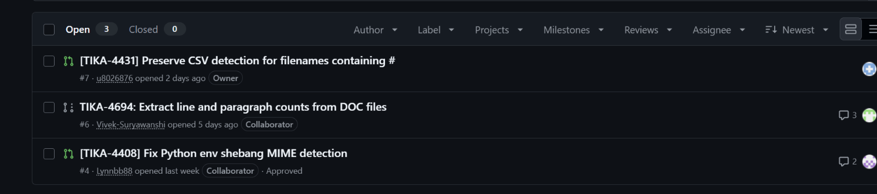
Four tracked issues, three review PRs
OUR GROUP / HOW WE FOLLOWED THE PROCESS
03
Issue tracking in our fork
Four Jira-linked tasks:
4083 CDiff · 4408 Python
4431 CSV # · 4694 DOC
Internal review before upstream
PRs #4, #6 and #7 are in our fork. I reviewed #4 and raised edge cases; a human approval is separate.
Three open group PRs — captured 23 Oct 2026
Actual review: I checked the offset-1 → 0 fix and raised a false-positive test case (x/bin/env python).
Internal PRs are not upstream merges
Terry / @zit060523terry
Notes:
Speaker notes (around 55 seconds):
Our own work follows a similar pattern, but we distinguish the shared group fork from the official Apache repository. We tracked four Jira-linked tasks: CDiff identification, Python shebang detection, CSV filenames containing a hash, and Word document line and paragraph counts. The screenshot shows three pull requests in our shared group fork at the time of capture: #4 for Python detection, #6 for Word counts, and #7 for CSV filenames. These are NOT three PRs merged upstream. Our own group review policy requires one approving review from another human member; agent-only checks cannot count as that approval. For example, I examined the TIKA-4408 change and left a GitHub review comment about a false-positive regression check and a shebang variant. The reviews and local tests help prepare the patches for eventual upstream submission; acceptance remains Apache's decision.
GitHub issues: https://github.com/u8026876/comp2120-gyg-a5/issues
Group PRs: https://github.com/u8026876/comp2120-gyg-a5/pulls
Review issue: https://github.com/u8026876/comp2120-gyg-a5/issues/2
Group review policy: https://github.com/u8026876/comp2120-gyg-a5/blob/main/A5_REVIEW_POLICY.md
Screenshot provided by team, 23 October 2026.
Limitations: PR counts reflect that screenshot; my code review was AI-assisted, not an independently rerun Tika suite.

