Slide 1
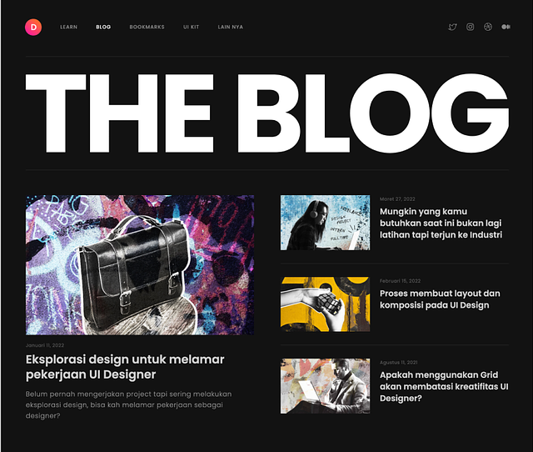
MENU-BAR
MENU-TEXT
SMALL CARD
BIG-CARD

