Slide 1



User-friendly Desktop Internet GIS (uDig)
  Jessie Eichar
  Jody Garnett
  Jeff Lounsbury

Slide 2
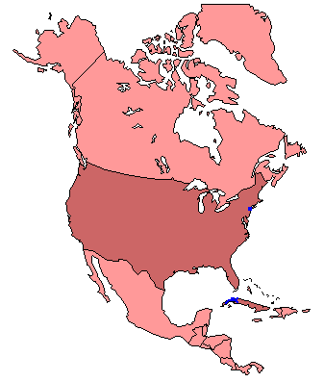
Refractions Research
Started uDig in 2004
Spatial Systems Consulting Company
  Victoria BC based
  25 employees
  In business for 10 years
Clients
  Canada/US/International
  Federal/Provincial/Private Sector

Slide 3
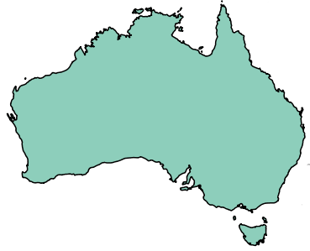
LISAsoft
Spatial Systems Integration
  Open Standards
  Open Source
  Australia in Sydney,
  Melbourne, Adelaide
  … and Brisbane
Clients
  Federal / State / Private Sector
  OGC

Slide 4
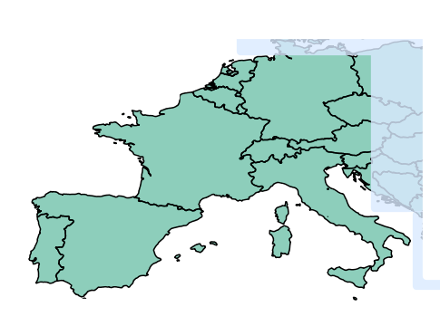
Other Organizations
CampToCamp
  Switzerland
  and France
HydroloGIS
  Based in Italy
  Hydrology and
  Geomorphological analyses
Axios
  Based in Spain
  Advanced Edit Tools
Notes:
CampToCamp: Talend based Spatial Data Integrator
HydroloGIS: JGrass (Java Geographic Resources Analysis Support System), BeeGIS (Tablet based system for field surveys)
Axios: Advanced editing tools.
“Scientific study of landforms predicting future changes etc... geology/geography/etc... why landscapes look the way they do”

Slide 5
So why open source?
We need to get the job done
  We use open source
  We use proprietary
Open source our own tools allows us to share maintenance costs
Being active allowed me to meet you
(good advertising)
Access to experts
Sharing development risk

Slide 6
Geospatial Architecture
Spatial Database
  Concurrency
  Transactions
  Seamlessness
Internet Publishing
  Feature Access
  Map Access
Data Manipulation
  Direct Access
  Editing
  Cartography

Slide 7
ESRI Architecture
ArcGIS Image Server
Web Pages
ArcGIS Server
ArcGIS
ArcSDE

Slide 8




Open Source Geospatial Architecture
Web Pages
uDig
PostGIS
Notes:
Recommend Open Layers

Slide 9
Open Standards
WMS Context
Web Map Server
Web Feature Server
OWS Context
SFSQL

Slide 10
Missing Link for OpenGIS
Directly view WMS
Directly edit WFS
Search Catalogs
Integrate standard GIS data
Hide complexity of network access

Slide 11
Missing Link for Open Source Spatial
Standards GIS Functionality
Directly Edit GIS data
Connect to PostGIS, MapServer and GeoServer
Create paper cartography
Integrate with proprietary infrastructures

Slide 12
User-friendly
Direct hands on experience
  Drag and Drop
  Responsive user interface
Sensible defaults
  optimize for the 90% use case
  Make use of all the information
Consistency

Slide 13
Desktop
A normal Desktop Application
Desktop integration; drag and drop
Native OS widgets

Slide 14
Internet
Web Map Server
Web Feature Server
Catalog Service Web
Open Web Map Context

Slide 15
GIS
Working with local data
Integrate with existing infrastructure
Paper Cartography

Slide 16
uDig Software Developers Kit
the best of the open source stack
  Plug-in System – Eclipse RCP
  Topology – JTS
  Standards Support – GeoTools
Not limited to just Java
  ImageIO-Ext project bridging GDAL to JAI
  OSSIM integration
LGPL means no per seat license

Slide 17
Successful Projects
DIVA GIS
  Front end to data-warehouse using R for stats
JGRASS
  Hydrology Project now in the help menu
Axios
  Advanced Editing Tools
LISAsoft
  SLIP Tile Download Plugin
Refractions
  Populations at Risk, Line Matcher, etc...

Slide 18
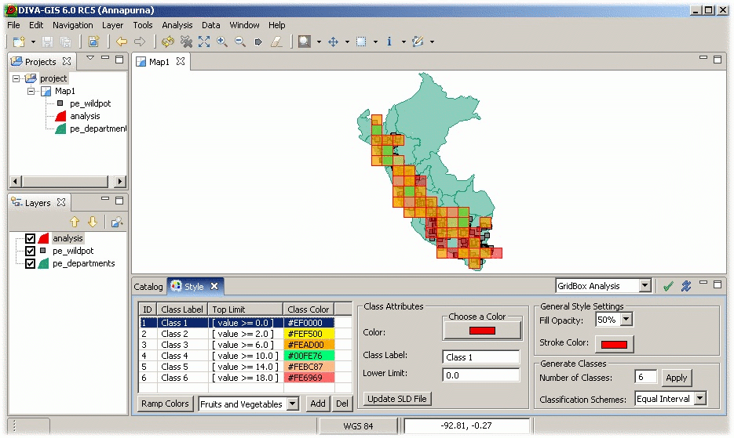
DIVA GIS
Notes:
Built by the International Potato Centre
Reads from the CIP (International Potato Centre) genetics database
Allows researchers to explore potential locations for growing known strains, and potential locations for discovering new strains suited to various micro-climates.
Seeks to improve food security by providing rapid response to such threats as blights, droughts, floods of climate change.

Slide 19

JGrass

Slide 20
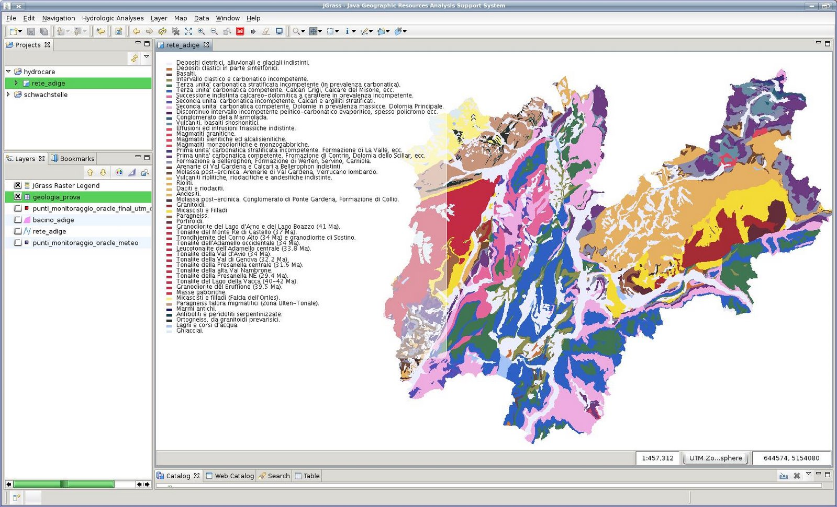
JGrass
Notes:
Provides analytical tools and algorithms to complement the uDig framework and spatial capabilities of GeoTools.

Slide 21
JGrass
Notes:
Provides analytical tools and algorithms to complement the uDig framework and spatial capabilities of GeoTools.

Slide 22
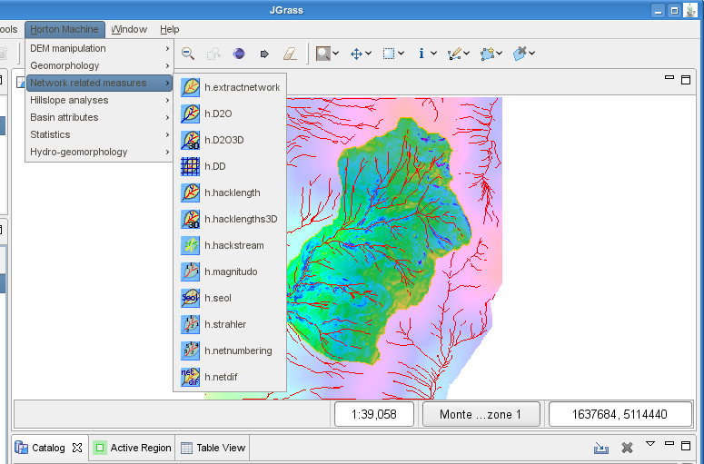
JGrass Hydrology

Slide 23
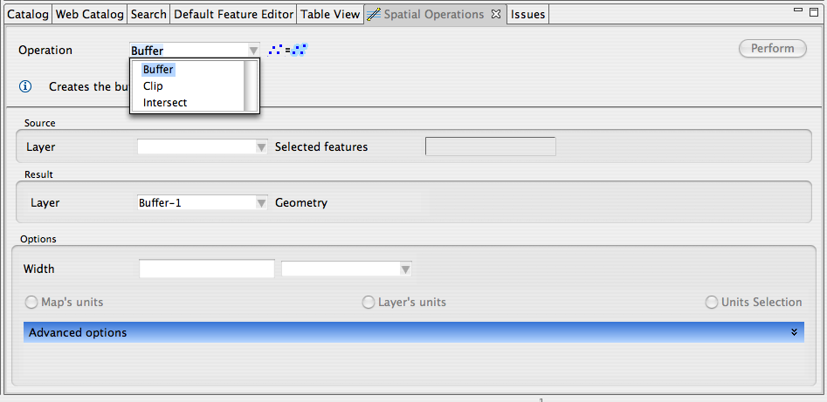
Axios Spatial Operations
Notes:
Includes a variety of spatial operations such as buffer, merge, clip, split, dissolve, fill, cut, trim, etc.

Slide 24
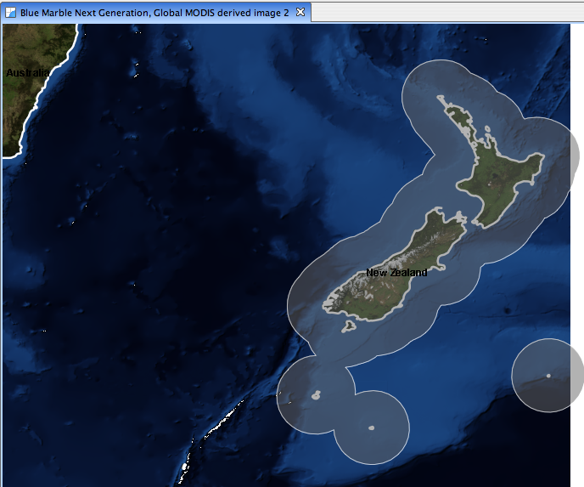
Axios Spatial Operations - Buffer

Slide 25
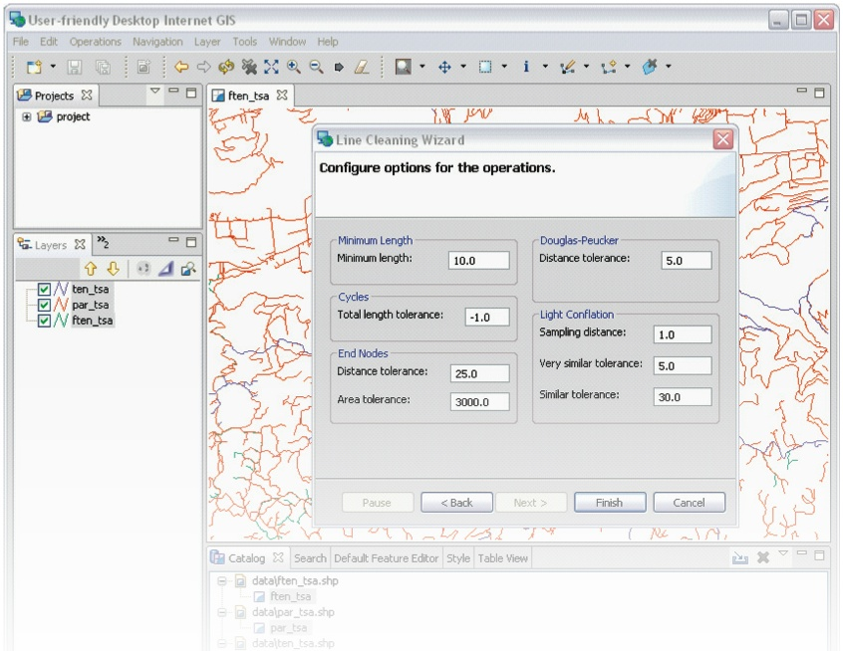
Line Cleaner
Notes:
Allows the conflation of linear data sets using customisable matching and merging criteria by first simplifying features such as topologically insignificant nodes, cyclical, very short or zero-length geometries and extraneous vertices.

Slide 26
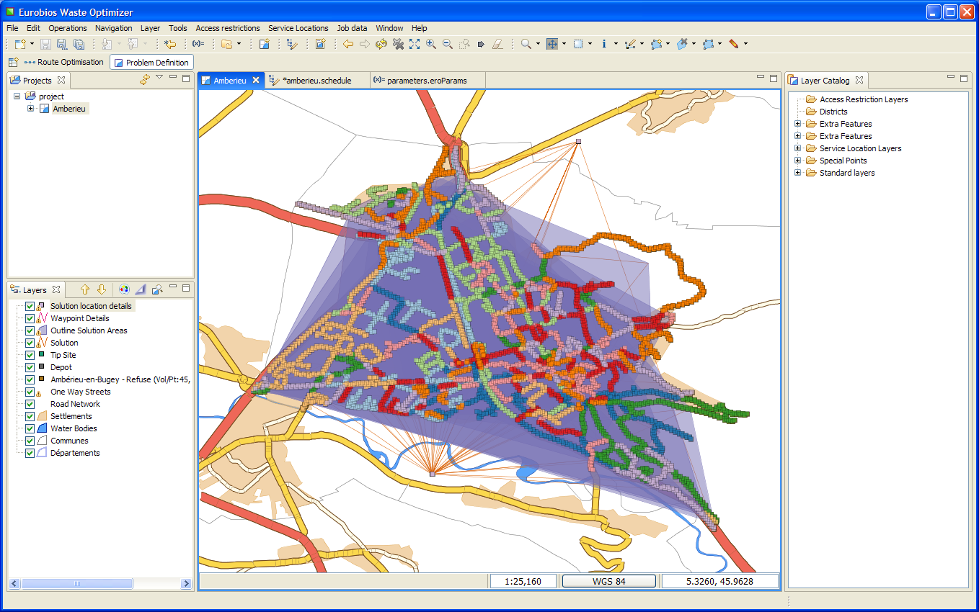
Eurobios Route Optimization Engine
Notes:
Waste Collection Route Optimization Engine
First version deployed in 7 Areas in UK and France
Each area services 50,000 – 100,000 households
Allows the definition of pickup and drop-off locations, asset storage sights and asset types and other details needed for route generation

Slide 27
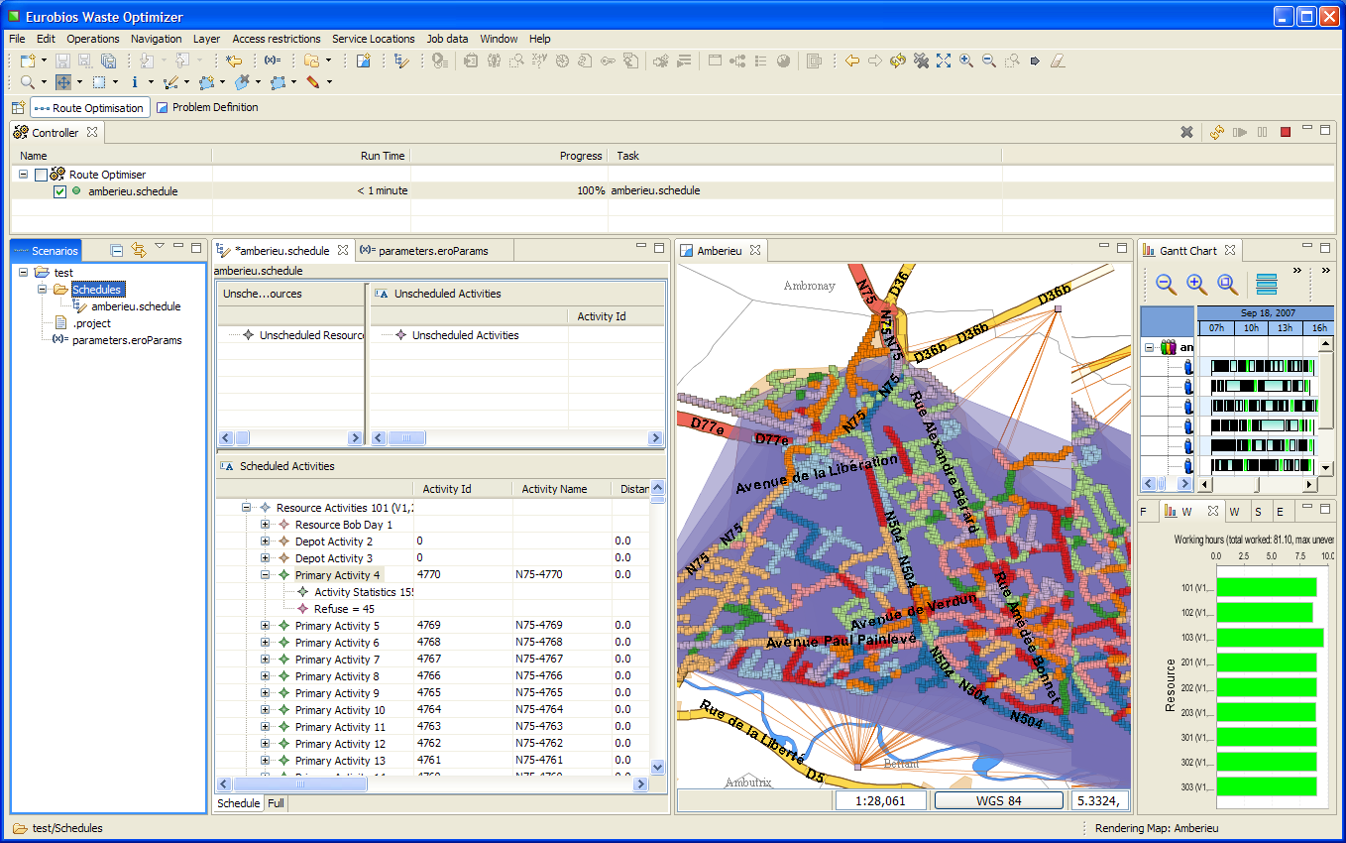
Eurobios Route Optimization Engine

Slide 28
52º North
From the city of Münster Germany
OGC Web Processing Client
Chaining of data services within the process
request
Manage multiple WPS instances
Log interaction with Ganymede plugin

Slide 29
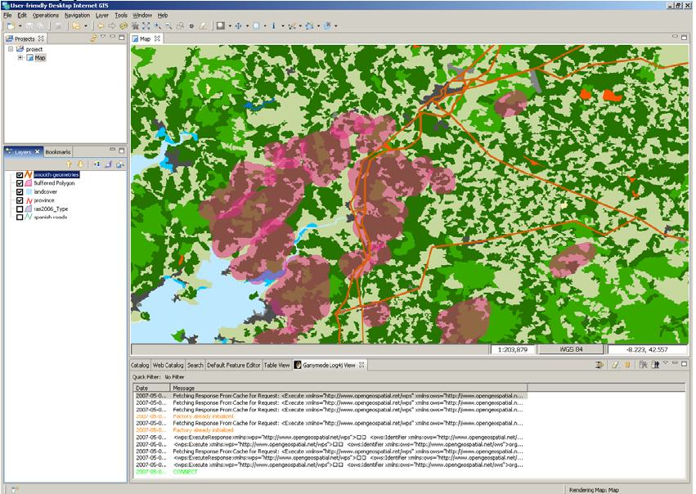
52º North

Slide 30
Arbonaut
Arbonaut – private company out of Helsinki,
ArboGIS - automation for forest inventory update
  Extract forest stand information from aerial maps
  Attach information from old inventory to new stands
TAAKA
Notes:
Provides fast-edit tools for the management of stand borders
Automates stand delineation based of aerial imagery and 'forced borders' such as property boundaries and power transmission lines.

Slide 31
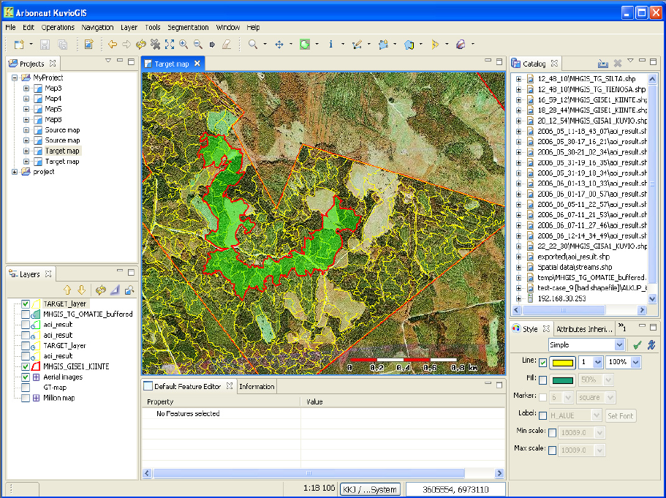
Arbonaunt - ArboGIS

Slide 32
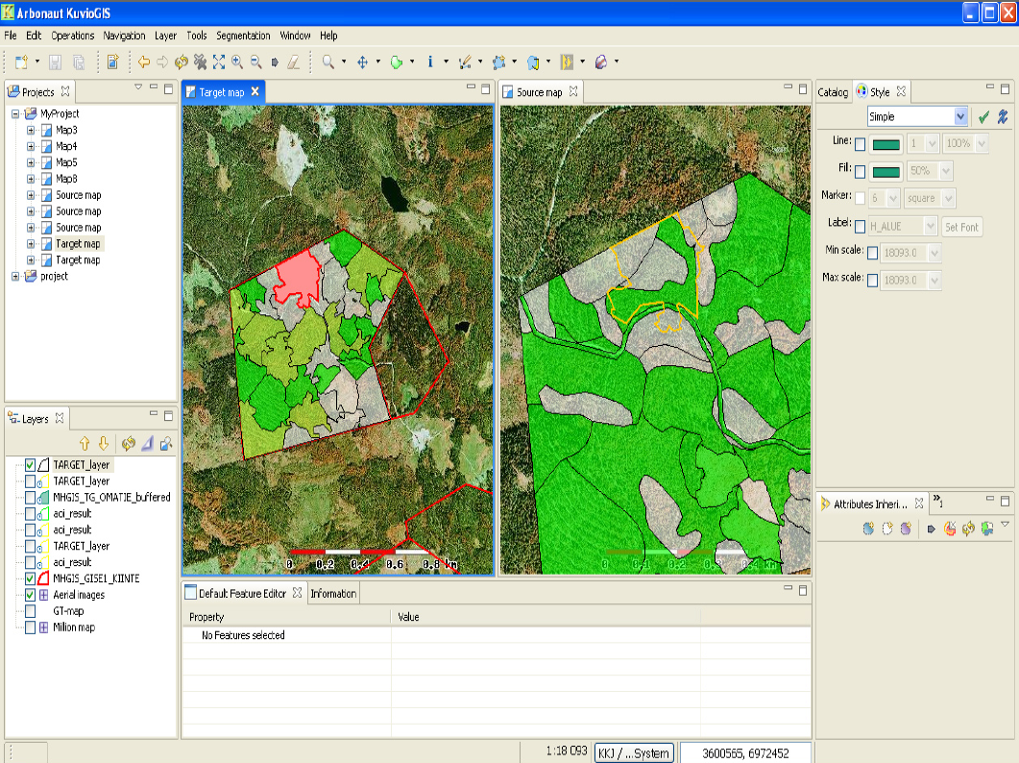
Arbonaut - ArboGIS

Slide 33
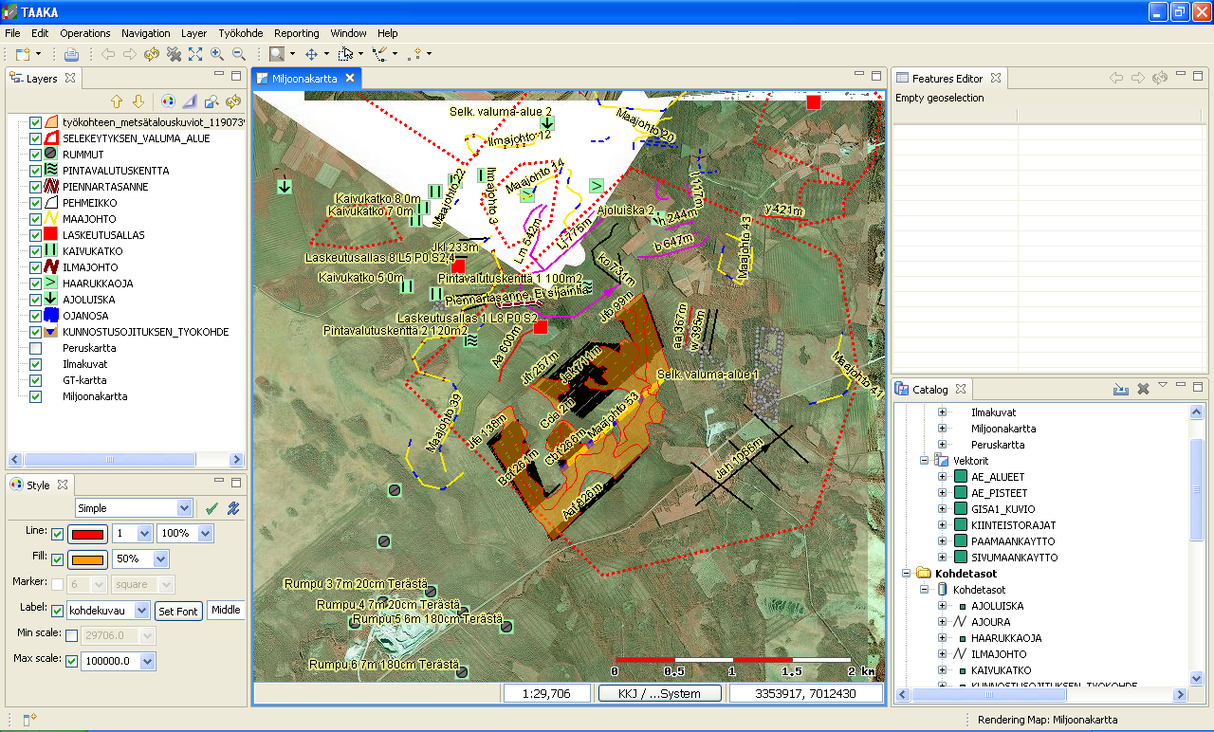
Arbonaut - TAAKA

Slide 34
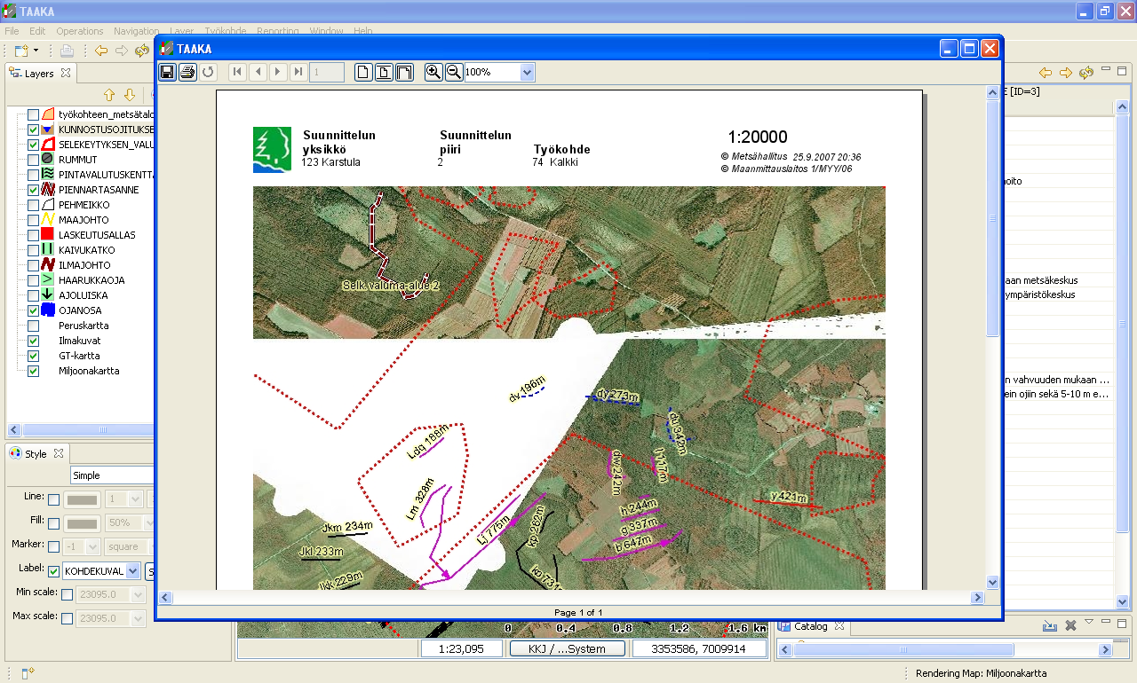
Arbonaut - TAAKA

Slide 35
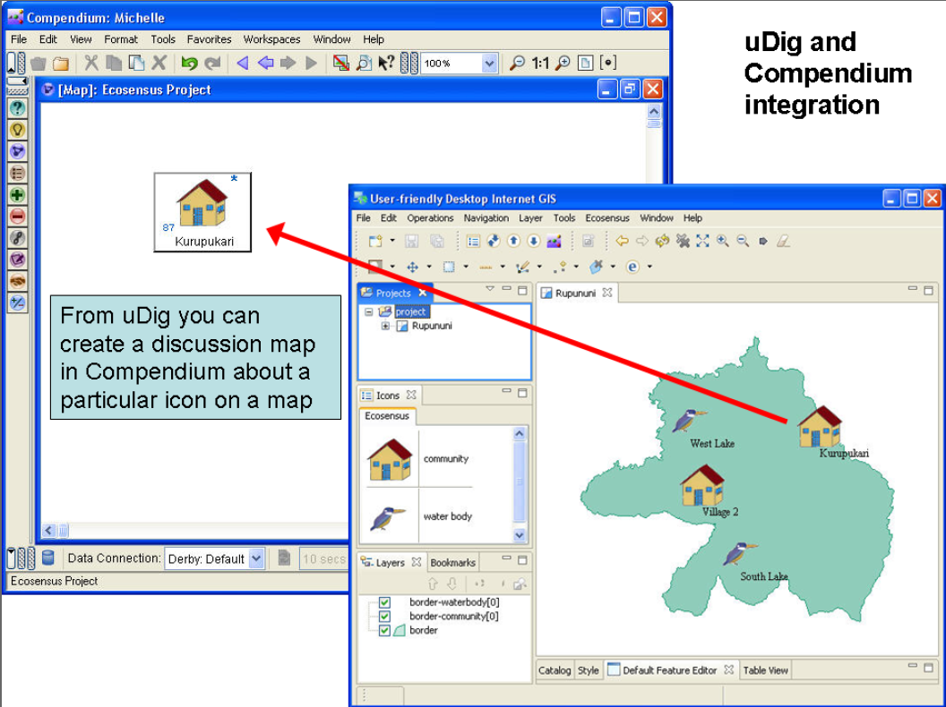
Open University of the UK – EcoSensus

Slide 36
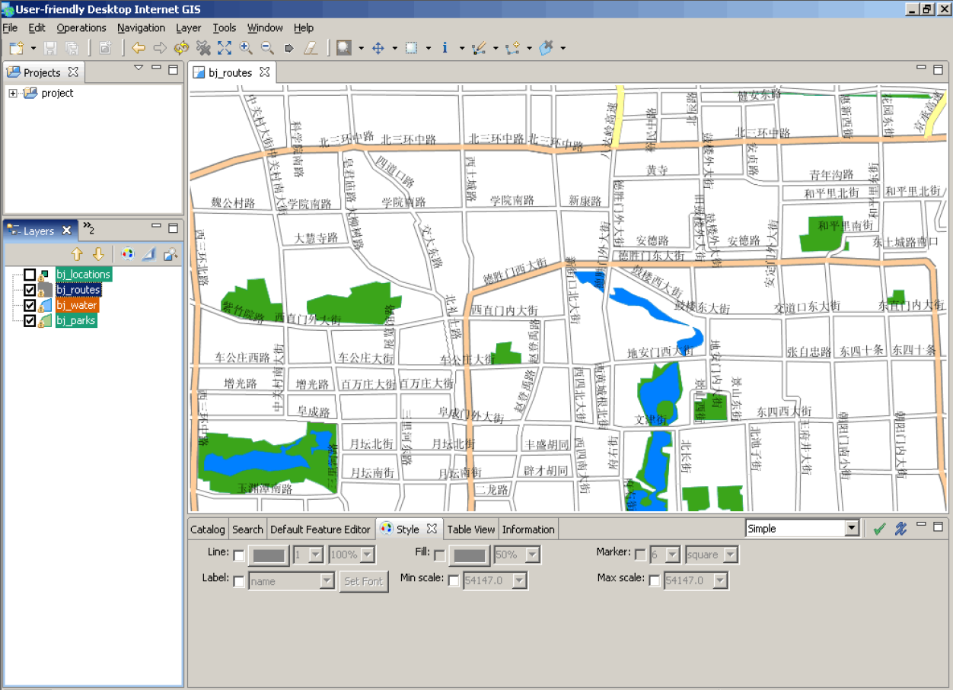
Souwhat.com

Slide 37
So Many Projects
Eurobios Routing
Line Cleaner
KuvioGIS
TAAKA
DivaGIS
Populations @ Risk
EU GeoVista
Souwhat.com
Jgrass
52º North
Axios's Spatial Ops
SOC Transformations
All the ones I was not allowed to talk about...

Slide 38
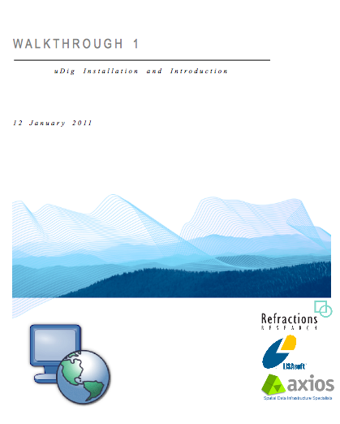
Walkthrough 1
Grab a friend
(or make a new one)
Grab a workbook
It's time to meet uDig

