Slide 1


DOM
Manipulation &
Events
Building an Interactive Product Catalog
Web Essentials Basics · Workshop 02
B.Tech in Full Stack AI & Cloud Innovation
01

Slide 2
Workshop Roadmap
100 minutes · discussion, live coding, and reflection
01
02
03
04
05
Introduction
& Project
Setup
Rendering
Products
using DOM
Making the
Catalog
Interactive
Managing
Products
using Forms
Search,
Filter, Sort &
Theme
Toggle
15 min
20 min
20 min
20 min
20 min
02

Slide 3
Workshop Outcomes
By the end of this session, learners will be able to:
01Explain how JavaScript interacts with
HTML through the DOM.
02Select and manipulate elements
using modern DOM APIs.
03Create, update, and remove
elements dynamically.
04Handle interactions with event
listeners and delegation.
05Validate form data before updating
the interface.
06Search, filter, sort, and switch the
page theme.
03

Slide 4
The Starting Question
“Imagine Amazon has 5 lakh products. Do
developers manually write HTML for every
product card?”
No.
It comes from a database.
JavaScript creates it.
04

Slide 5



The Document Object Model
HTML becomes a live tree when the browser loads the page.
document
document.body
productGrid
document is our entry
point
document.querySelector()
05

Slide 6

Rendering Products from Data
Data → DOM → UI
const products = [
{ id: 1, name: "Running Shoes",
category: "Footwear", price: 79
}
];
Instead of copying HTML,
JavaScript creates the
cards.
renderProducts(products);
querySelector · createElement ·
textContent · append
06

Slide 7
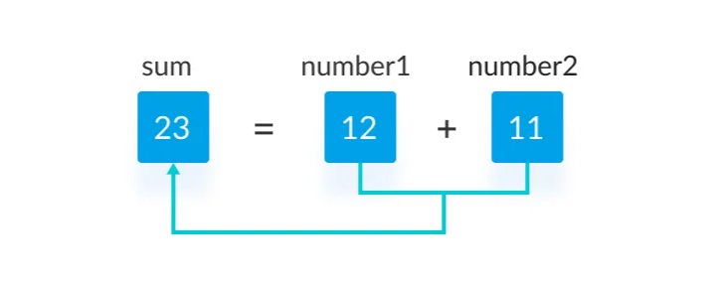
The Rendering Function
One reusable function keeps the interface in sync.
function renderProducts() {
grid.innerHTML = "";
products.forEach(product => {
const card = createProductCard(product);
grid.append(card);
});
Data → DOM → UI
}
Update the data, then re-render the
view.
07

Slide 8
Events & User Intent
A click is a message from the user to the application.
Event flow
button.addEventListener
( "click", handleDelete );
Button
Card
Grid
Events bubble upward through the
DOM.
event.target
Which element did the user interact
with?
That behavior becomes powerful when content
is dynamic.
08

Slide 9
Event Delegation
One listener on the grid can manage every product card.
Delete
grid.addEventListener(
'click', (event) => {
Grid listener
Favourite
const card =
event.target.closest
Open details
('.product-card');
handleAction(card);
});
Why use it?
Re-rendering removes old buttons and their listeners.
Delegation keeps one stable listener alive.
09

Slide 10
Forms & Validation
Data → Validate → Update Array → Re-render UI
Before the UI changes
Add Product
Check the name is present.
Product Name
Check the price is positive.
Category
Call preventDefault().
Price
On success, add to the array and reset.
Add product
10

Slide 11
Search, Filter & Sort
A useful catalog helps people find the right product quickly.
Search
Category
Price
input
change
sort()
filter()
filter()
re-render
Match a product name as
the user types.
Show only the chosen
category.
Order products from low
to high.
Every control changes the view by changing the data we render.
11

Slide 12
Theme Switching
JavaScript changes classes. CSS does the visual work.
themeButton.addEventListener
Light
Dark
( 'click', () => {
document.body.classList.toggle
( 'dark' );
});
12

Slide 13
Mini E-Commerce Catalog
One interface, many DOM concepts working together.
Data
Render
Interact
Refine
Products array
Create cards
Events & delegation
Search & sort
Add product
Delete / favourite
Switch theme
Form + validation
Event delegation
classList.toggle()
13

Slide 14
Workshop Deliverable
Build a working Mini E-Commerce Product Catalog.
+Dynamic product listing
+Add product form with validation
+Delete products
+Favourite products
+Product search
+Category filtering
+Price sorting
+Dark / light theme toggle
Optional: load more · debounced search · local storage
14

Slide 15

Reflection & Next Steps
“HTML gives structure, CSS gives
style, but JavaScript brings a
webpage to life.”
What is the DOM? What problem does event delegation solve?
Why do we re-render after updating data?
Thank you · Workshop 02
15

