Slide 1
Overview
1. Anaconda installation
2. Install git and Create a Github account
2. Why git is useful?
3. What is git ?
4. Types of Version Control Systems
5. How does git work?
6. What is GitHub?
7. Basic Linux Commands
8. git architecture
9. Quick example using git and GitHub
10. why python?
11. explaining jupyter notebook
12. basic python coding

Slide 2
ANACONDA INSTALLATION AND SETUP

Slide 3
Download Anaconda
Main website to downlaod - https://www.anaconda.com/products/individual
Installation guide for windows user - https://docs.anaconda.com/anaconda/install/windows/
Installation guide for Mac users - https://docs.anaconda.com/anaconda/install/mac-os/
Installation on Linux - https://docs.anaconda.com/anaconda/install/linux/

Slide 4
Git and GitHub

Slide 5
Git and GitHub setup
Download git - https://git-scm.com/downloads
Make account on GitHub

Slide 6
Why Git is useful?

Slide 7
Use cases
Consider this scenario:
You have a homework submission for today and the assignment is ready for the submission
While testing it you discovered a minor bug and decided to fix it
After attempting to do so, you accidentally changed a working code and got yourself in a big mess

Slide 8
You no longer remember what was and what wasn’t there
Now you realize that CTRL + Z wont solve your problem

Slide 9
What is GIT?
Git is the Version Control System(VCS)
- a way to manage file and directories
- track changes over time
- recall previous version
- ability to have unlimited number of developers working on the same code base
- Easily revert back your files if something happened

Slide 10
Version Control Systems
1. Centralised Version Control System (CVCS)
2. Distributed Version Control System (DVCS)

Slide 11
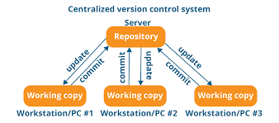

Slide 12
Pros
- CVCS is easier to learn
Cons
- cannot work offline
- slower as compared to DVCS
- no backup server goes down or it crashes
Examples for CVCS
- Clearcase and Subversion

Slide 13
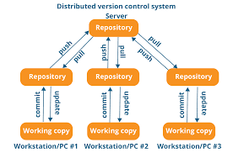

Slide 14
Pros
- can work offline
- faster as compared to CVCS
- can backup code easily if server crashes or goes down
Cons
- good with CLI (Command line interface)
Example – Git, Mercurial

Slide 15
What is repository?
“repo” = repository
Usually used to organize a single project
Repos can contain folders and files, images, videos, spreadsheet, and datasets – anything your project needs

Slide 16
Basic Linux Commands
1 . pwd (present working directory) – used to check the current directory you are working on
2. ls – list all the files and folders in the current directory
3. ls -al - list all the files and folders in the current directory including hidden files
4. cd (change directory) – to the change the directory

Slide 17
5. mkdir (make directory) – to make a new directory
- syntax – mkdir ‘directory name’
6. mv (move) – to move the directory from one folder to another
- syntax – mv ‘src directory name’ ‘dest directory name’
7. rmdir (remove directory name) - to remove a particular library
- syntax – rmdir ‘Dir name’

Slide 18
8. vim – powerfull text editor used in CLI (command line interface)
- syntax – vim <filename>
9. cat – open a file in CLI(command line interface)
- syntax – cat <filename>

Slide 19
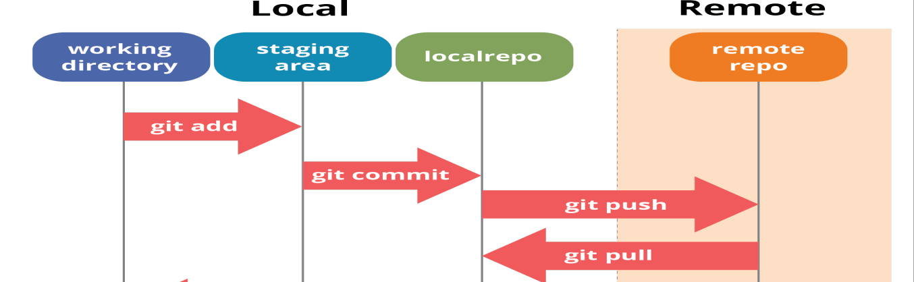
Git Architecture

Slide 20
Basic Git commands
To work with git commands open
- git bash for window users
- terminal for mac users
- terminal for linux users

Slide 21
1. Configure your users
- git config --global user.name “<name>”
- git config --global user.email “<email addr>”
2. check the configuration
- git config --global --list
3. setting core.autocrlf
- for window users
- git config --global core.autocrlf true
- For Mac / Linux user
- git config --global core.autocrlf input

Slide 22
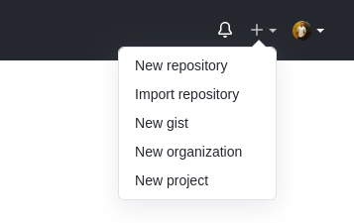
Creating repo on Github
1. Sign in into your GitHub Account
2. Click in the new repository to create a new repository

Slide 23


3. give the repository name
4. give the description if required
5. Select the visibility of the repo to world

Slide 24
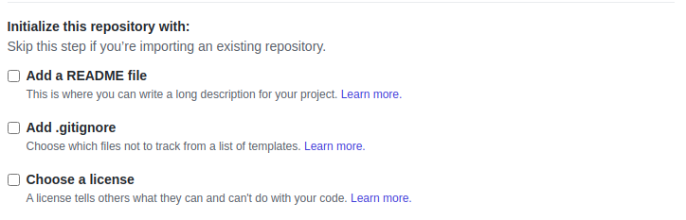

5. Assign the readme.md
6. Click on the create button to create the repo

Slide 25
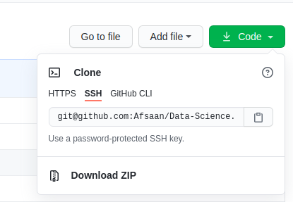
Clonning the repo
Click on the code button an copy the link under ssh

Slide 26
1. Create a folder in directory of your choice
2. write the below command to clone the repo
- git clone < link of the repo>
3. Create four folder inside a cloned repo
- Python
- Stats
- machine learning
- Assignmnet

Slide 27
4. create a python file inside a folder
- file1.py
- file2.py
5. check the status of the file
- git status
6. add the untracked file to that staging area
- git add <filename>
- git add <filename> <filename>
- git add .

Slide 28
Commit the files to put into the local repo
- syntax – git commit -m ‘<message>’
Push the files in the cloud repo
- syntax – git push origin master
Pull the files form the cloud repo
- syntax – git pull origin master

Slide 29
2nd way
To check all remote connection to our directory
  >> git remote -v
Link the remote repo with cloud repo
  >> git remote add origin <repo link>
To check the branch
>> git status
Rename the branch from master to main
  >> git branch -m master main
Push the code
>> git push -f origin main

Slide 30
Push Issue with windows
Go to Control Panel --> User Accounts --> Credential Manager
Click on Add a generic Crendential
  webiste -> www.github.com
  username -> github_username
  pass -> acces_token

