Slide 1


UVic-JFS
(Job Filtering Software)
Team 2: Eric Sela, Sahil Dawka, Jose Guerrero

Slide 2
How could Co-op + Career use innovative and digital solutions to improve domestic and international student employment opportunity outcomes?
Problem
Our User
Solution
Timeline

Slide 3
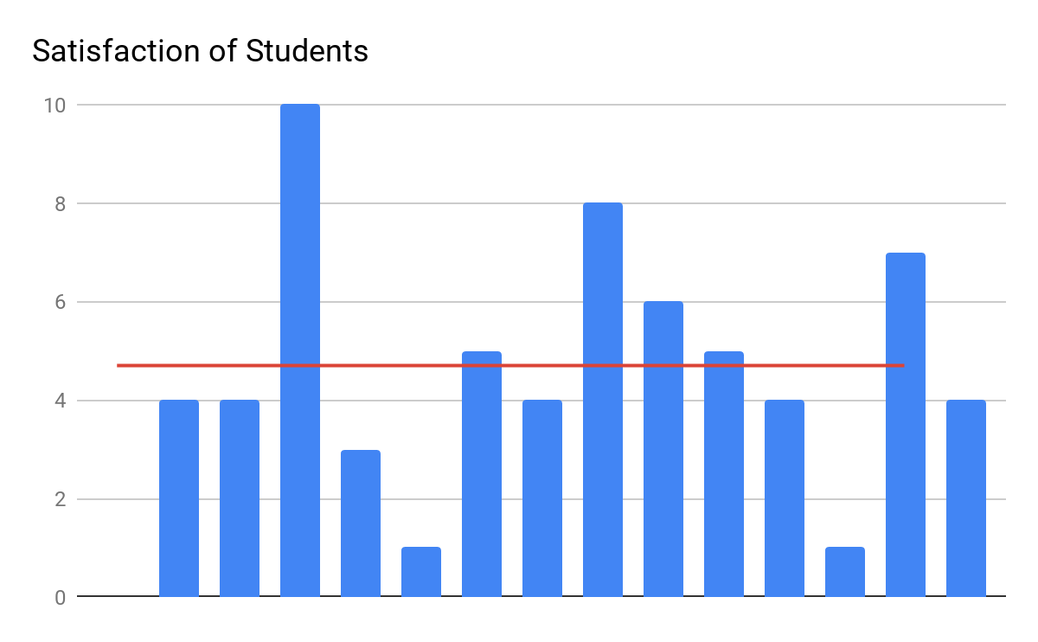
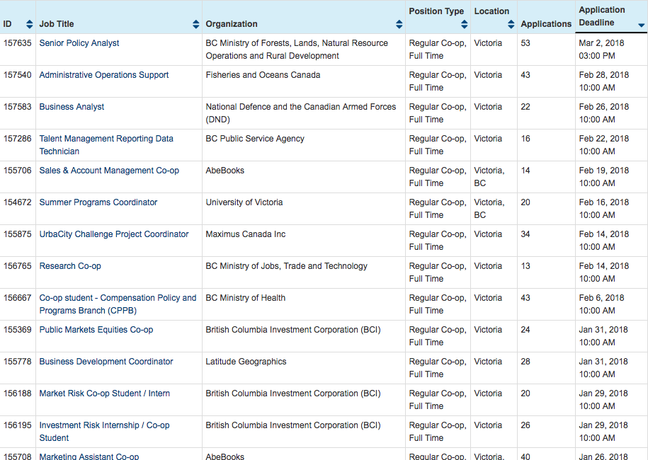
Problem
Our User
Solution
Timeline
Notes:
Students in general are dissatisfied with the coop and career site. Citing their frustration comes from a messy feeling job sorting system.

Slide 4
How could Co-op + Career use innovative and digital solutions to improve domestic and international student employment opportunity outcomes?
Problem
Our User
Solution
Timeline
UX discourages participation
No triggers for reactive people

Slide 5
Problem
Our User
Solution
Timeline
Language
Faculty
Our Students
Experience
Expectations
Notes:
Our students are diverse and their interests and needs are diverse’. Managing all of them is a tough task for coop and career coordinators. Uvic attracts students from all over the world. Sahil and I are exemplify how different students can have very different needs with a coop. ….

Slide 6
Problem
Our User
Solution
Timeline
Employment Funnel
Un-focused
In-experienced
Un-prepared
Definite
Professional
Equipped

Slide 7
Problem
Our User
Solution
Timeline
[Meta] Redirect student’s mental energy from Search to Apply
[Meta] Gamify process and spoon-feed resources
Personalized filtering / recommendation (anonymous)
Categorized sorting - Dream | Reach | Safe
Goal setting (number of applications to send out)
Auto-prioritization + Reminders/Calendar export
Tutorial / Test / Questionnaire
Materials Peer Review
Notes:
No one-shot solution.. Have to try and evaluate.. But thanks to design process, we know what we should try

Slide 8
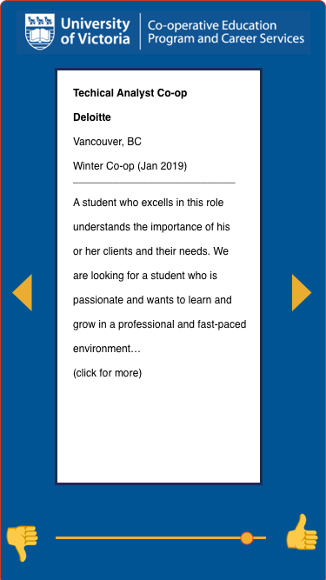
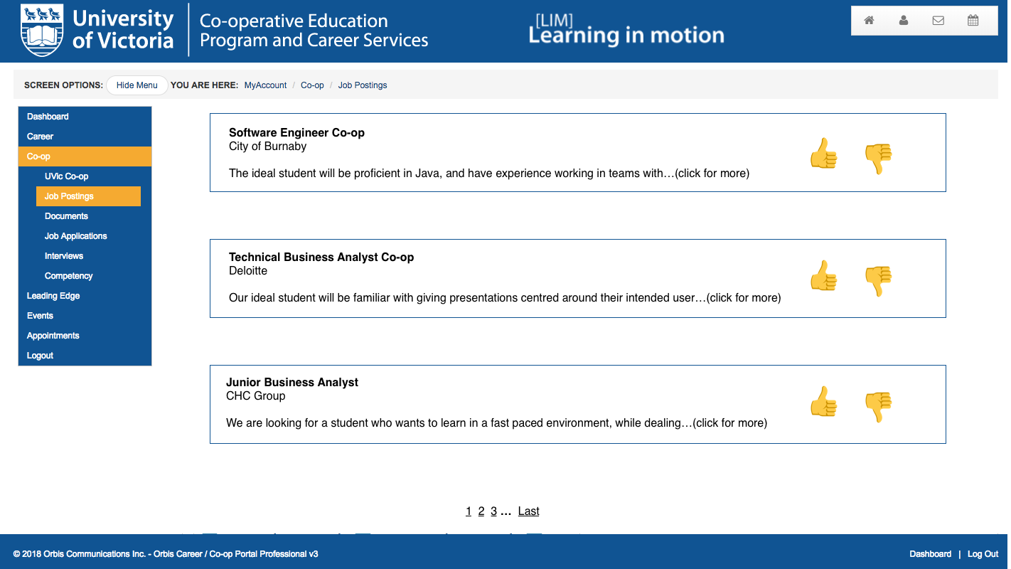
Problem
Our User
Solution
Timeline

Slide 9
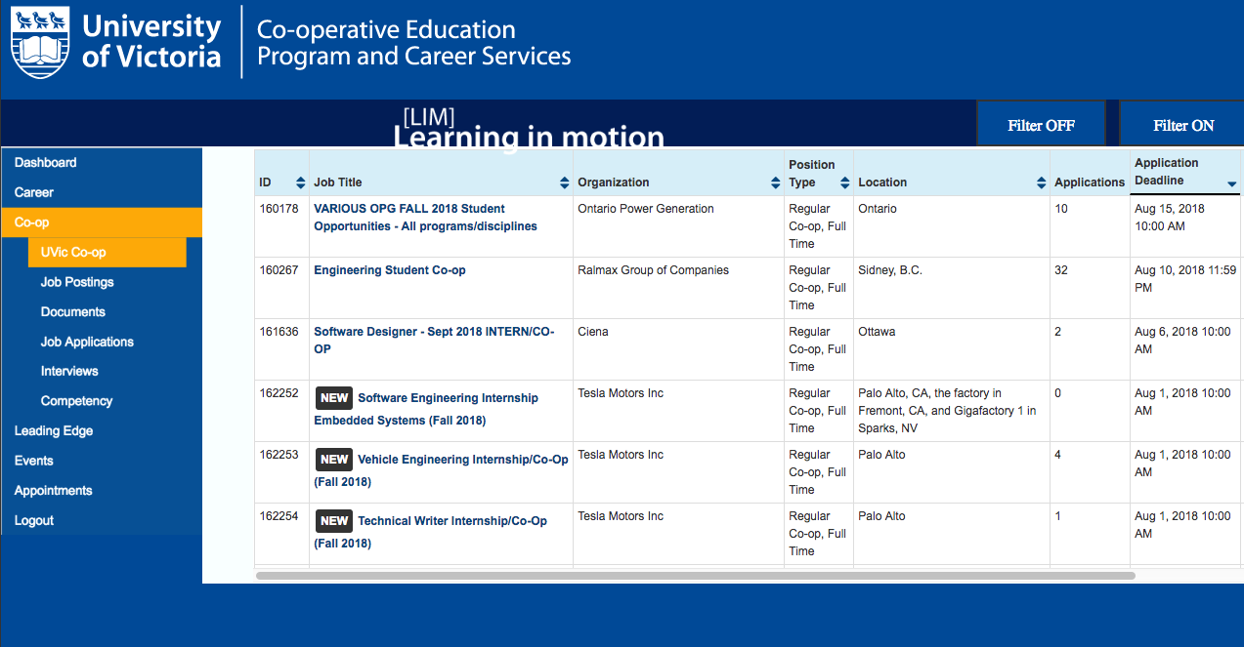
Problem
Our User
Solution
Timeline

Slide 10
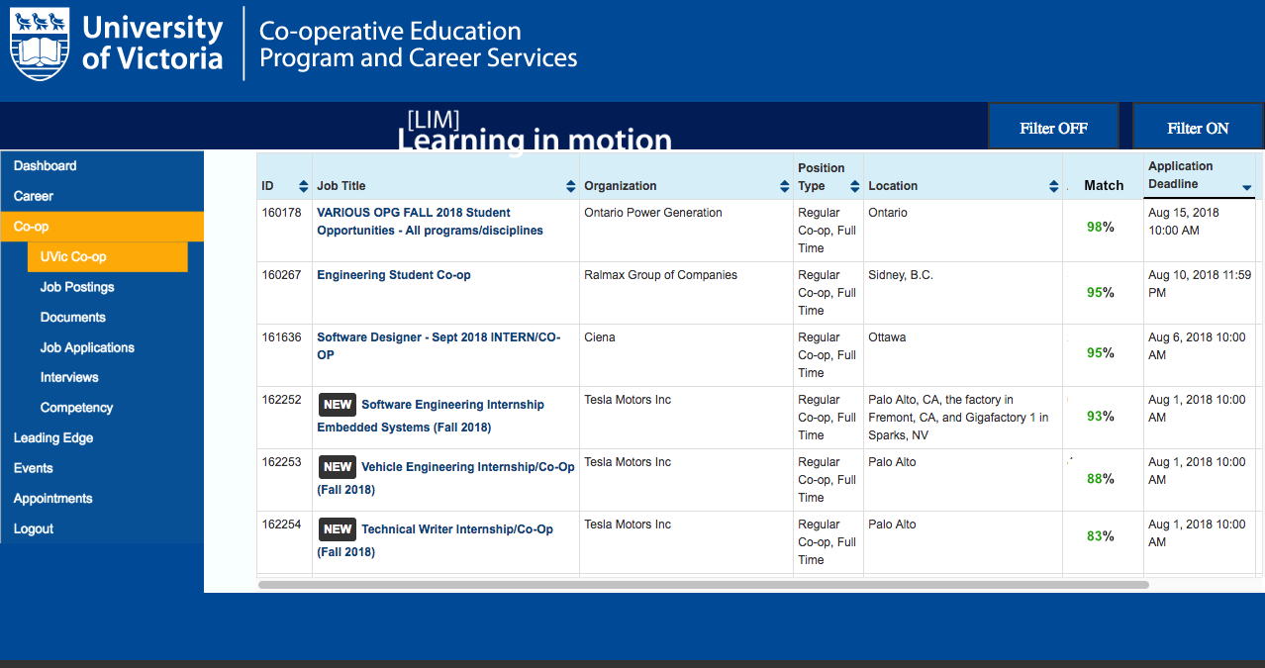
Problem
Our User
Solution
Timeline

Slide 11
Problem
Our User
Solution
Timeline
Present solution
Uvic accepts proposal and moves ahead with enhanced job filtering to match students to their ideal role.
UVic Coop and Career rolls out filtering
Students engage with filter and matching software during coop application process for summer 2019 jobs.
Future Expansion
September
Summer 2019
June
January 2019
Uvic Computer Science Student
UVic hires coop student to work on integrating solution. In one work term this student will develop valuable skills and contribute to UVic’s vision.
Gather feedback
Gather feedback from students to allow for refining algorithm.
Notes:
Key here is to drive home point that our funnel catches more students at one end, and grows them to target their goals, and meet the goals of the employer. We drive supply, which drives demand and vice versa. The more students we effectively grow and match the more employers want to list on LIM and therefore the more students what to learn and grow.

Slide 12

Problem
Our User
Solution
Timeline
Supply
Demand
Notes:
Key here is to drive home point that our funnel catches more students at one end, and grows them to target their goals, and meet the goals of the employer. We drive supply, which drives demand and vice versa. The more students we effectively grow and match the more employers want to list on LIM and therefore the more students what to learn and grow.

Slide 13
UVic-JFS
(Job Filtering Software)
Thank you
Questions and Answers

