Slide 1
uPortal Error Reporting

Slide 2
What to say?
What reporting is desired?
How is this reporting presently attained?
How might* it be done better?
(* Might == Will if at all possible this week.)

Slide 3
Some musings…
Bear with me here…

Slide 4
Desired Error Reporting
Errors and exceptions in Portals are Different.
Best-effort, self-recovering, failure-tolerant components
Often, user doesn’t know there’s a problem.

Slide 5
Yesterday’s Weather
No, not the XP term
DocumentCacher and the Weather Channel story.

Slide 6
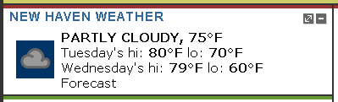
Weather channel

Slide 7
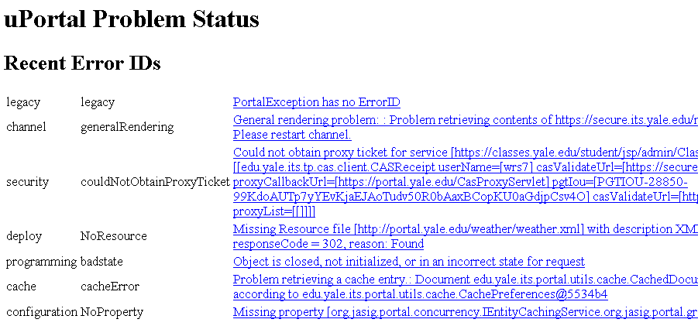
Wouldn’t it be groovy if…
We could look inside a running uPortal and see what’s been amiss lately?

Slide 8
/problems servlet

Slide 9
Tell me about your problems…
Logging, certainly
Component-level reporting (Proposed PropertiesManager, e.g.)
Failure-response components, e.g. CError channel
And the dirty trick:

Slide 10
A Dirty Trick
Instantiating PortalException has side effect of reporting exception to ProblemsManager

Slide 11
Current Implementation
Creates an UndeclaredPortalException
(Undeclared)PortalException instances have ErrorID attribute
ErrorID is key to: categorization of error, templated error message

Slide 12
Custom Exceptions
As Convenience Implementations of the necessary calls to (Undeclared)PortalException constructor to make this work.

Slide 13
Logging flag
(Undeclared)PortalExceptions bear logging flag to help ProblemsManager decide what/how to report about them.

Slide 14
Going Forward
ProblemsManager behind interface
To allow multiple, custom implementations to meet differing error reporting needs

Slide 15
Revisiting ErrorIds
ErrorIDs are:
  Key to categorization
  Key to parameterized message

Slide 16
1:1 mappings
Messages to ErrorIDs
Exceptions to ErrorIDs
Convenience Implementation pattern and ErrorIDs

Slide 17
More traditional Exception hierarchy
ErrorID roles can be fulfilled by the fully qualified name of the IPortalException implementing class
  Key to categorization
  Key to templated message

Slide 18
Where is the value
Value in the custom Exception class, with its own documentation. Potentially special attributes bearing evidence from the error – which could be consumed in a sufficiently sophisticated ProblemsManager and would be available for a sufficiently sophisticated Catch.
Value in templating and I18ning the Exception messages.

Slide 19
MissingPropertyException
public MissingPropertyException( String propertyName);
public BadPropertyValueException(String propertyName, String expectedType, String actualValue);

Slide 20
For uPortal 3
Lose the ErrorIDs
uPortal exception hierarchy extending from PortalException and UndeclaredPortalException
Custom exceptions know how to obtain (from Spring?) their template message and merge in their parameters

Slide 21
For uPortal 3
Exceptions report themselves on instantiation to an IProblemsManager implementation.

