Slide 1

Persistence Strategy for uPortal 3
Mike DeSimone
the r-smart group
mike@rsmart.com

Slide 2
Summary
Quick review of uPortal 2.x persistence
Candidates for v3
Code samples

Slide 3
uPortal v2.x Persistence
Straight low-level JDBC
1 service class (provides getConnection, etc.)
3-4 classes sort of roughly divided into function areas
1 of these is large (3k lines!)
Evolution leading to maintainability challenges

Slide 4
uPortal v2.x Persistence Issues
Some recent issues:
  ResultSet’s left open
  Abandoned connections
Missing keys/indices in generated DDL (xsl fix)
Performance issues (remove extra row copying during login)

Slide 5
Deciding for v3
Why change
Choosing the DAO model
Goal: Separate business logic from data access
Enable easy substitution of alternatives
Leverage Spring’s dependency injection (was: IoC)

Slide 6
Deciding for v3
Candidates to implement: ORM, Spring support, no change
ORM: JDO, Hibernate
iBATIS SqlMaps
Spring JDBC support

Slide 7
Comparing Persistence (iBATIS)
+ has a somewhat simpler xml configuration setup than hibernate, but not trivial
- seems geared towards persisting objects that have basic types (int, string), although one can configure more complex object persistence
- stability & longevity are unknowns to me

Slide 8
Comparing Persistence (Hibernate)
requires many fewer lines of java code for many operations
+ provides caching of objects & lazy-initialization, among other performance enhancements
- requires extensive, fairly complex xml configuration files to perform the object <-> relational mapping
+ understands many major DBMS sql dialects; generates SQL automatically for the database schema & related queries
- has a hefty learning curve for effective use

Slide 9
Comparing Persistence (Spring JDBC)
+ pretty close to vanilla JDBC with some features to minimize try/catch craziness & to handle connections automatically.
- requires quite a bit of Java code to implement the persistence, but not much xml configuration
- does not provide any sort of caching

Slide 10
Factors in choosing a “winner”
Nobody’s a “luser”
Easier than JDBC?
Maturity, Stability
Community vibrancy/activity
Minimize barriers to future contributors

Slide 11
Spring JDBC support
Package org.springframework.jdbc.object
allows DB access in OO manner
Execute queries and get the results back as a list containing business objects with the relational column data mapped to the properties of the business object. (from spring doc)

Slide 12
Spring JDBC support
Extend MappingSqlQuery for Select’s
Extend SqlUpdate for insert, update
Implement mapRow to map relational data to Java objects
Inject the datasource
Transaction support is transparent to code

Slide 13
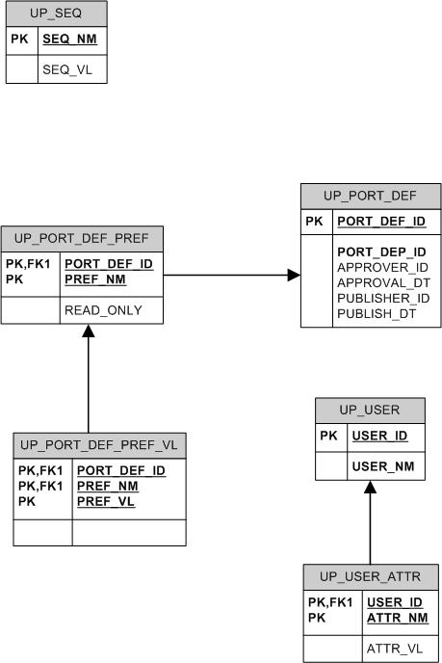
Data Model Snippet
Focus on UP_PORT_DEF_PREF for this example

Slide 14
Spring Config XML
<bean id="portletDefinitionDaoTarget" class="org.jasig.portal.portlet.dao.spring.SpringPortletDefinitionDao">
<property name="dataSource"><ref bean="dataSource"/></property>
<property name="incrementer"><ref bean="portletDefIncrementer"/></property>
</bean>

Slide 15
UP_PORT_DEF_PREF dao example
Add transaction manager; no Java impact
<bean id="portletDefinitionDao" class="org.springframework.transaction.interceptor.TransactionProxyFactoryBean">
<property name="transactionManager"><ref bean="transactionManager"/></property>
<property name="target"><ref local="portletDefinitionDaoTarget"/></property>
<property name="transactionAttributes">
<props>
<prop key="set*">PROPAGATION_REQUIRED</prop>
</props>
</property>
</bean>

Slide 16
UP_PORT_DEF_PREF dao example
constructor (ds injected by spring framework):
PortletDefPrefQuery(DataSource ds) {
super(ds, "SELECT " + COL_PREF_NAME + "," + COL_READ_ONLY + " FROM " + TBL_PORTLET_DEF_PREF + " WHERE " + COL_DEF_ID + "=?");
super.declareParameter(new SqlParameter("def id", Types.INTEGER));
compile();

Slide 17
UP_PORT_DEF_PREF dao example
mapRow
protected Object mapRow(ResultSet rs, int rowNum) throws SQLException {
IPreference pref = new PreferenceImpl();
pref.setName(rs.getString(COL_PREF_NAME));
pref.setReadOnly(rs.getBoolean(COL_READ_ONLY));
return pref;
}
Spring framework passes in result set

Slide 18
Conclusion
Using DAO design pattern for more flexibility
Spring JDBC improves productivity & decreases common straight JDBC coding errors
Code to interfaces

