Slide 1


Testing and Proving uPortal’s Scalability at the Sun iForce Center
December 9, 2002
UNICON / IBS:
Adam Rybicki
Michael Erdely
Sun Microsystems:
Jeff Weiss

Slide 2

Agenda
Test Objectives
About iForce Centers
Content Selection Criteria
Test Environment
How We Tested?
Results
Conclusions
Questions

Slide 3

Test Objectives
To prove that the uPortal framework does not prevent scalability
NOT to prove that every channel will scale the same way
uPortal represents J2EE’s presentation layer—not the business logic layer

Slide 4

Sun’s iForce Center Mission
To addresses customer business objectives by helping to reduce risk and speed time to implementation of solutions that help lower their total cost of ownership and increase the productivity of their assets

Slide 5
Sun’s iForce Centers
Assessments
  Evaluate your business processes
  Identify areas for improvement.
Solution Demonstrations
  Hardware and software products for a custom demos
Proof-of-Concepts (PoC)
  Prototype business solutions matched to your needs.
  Test to see if proposed solution is viable.
Sizing and Tuning
  Together we will spec out the optimal configuration of hardware and software to serve your business.
http://www.sun.com/executives/iforce/

Slide 6

Content Selection Criteria
Select applications “heavy” in presentation and “light” in business logic
Access to external data eliminated
Mix applications that have business logic with those that only present data
Applications with business logic should utilize back-end servers
No way to simulate legacy systems
No application accessed the database server, but frequent logins simulated that type of application

Slide 7
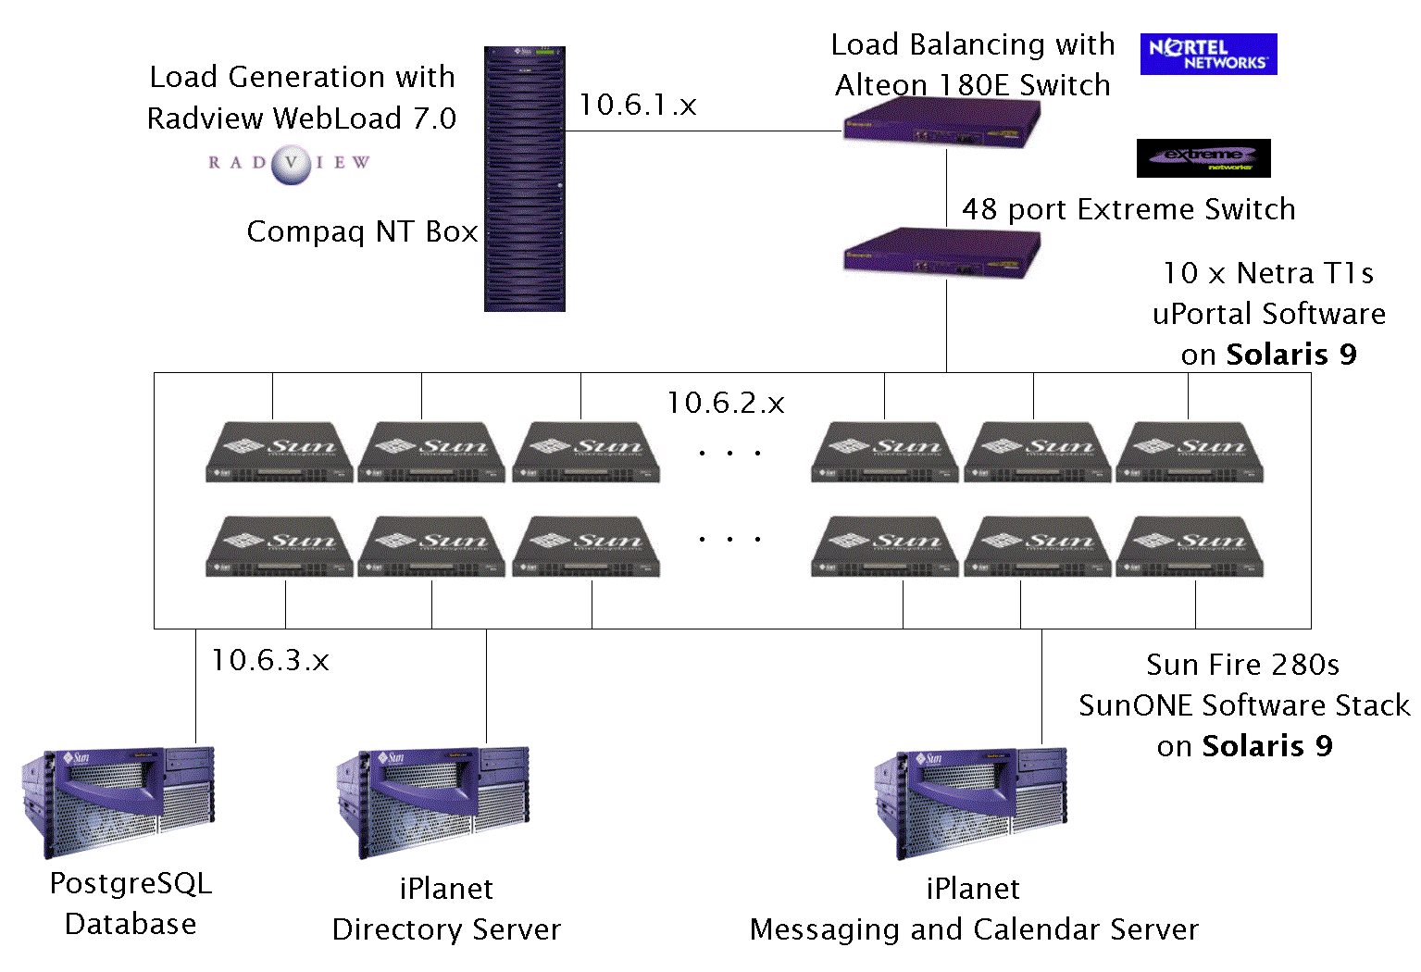
Test Environment

Slide 8
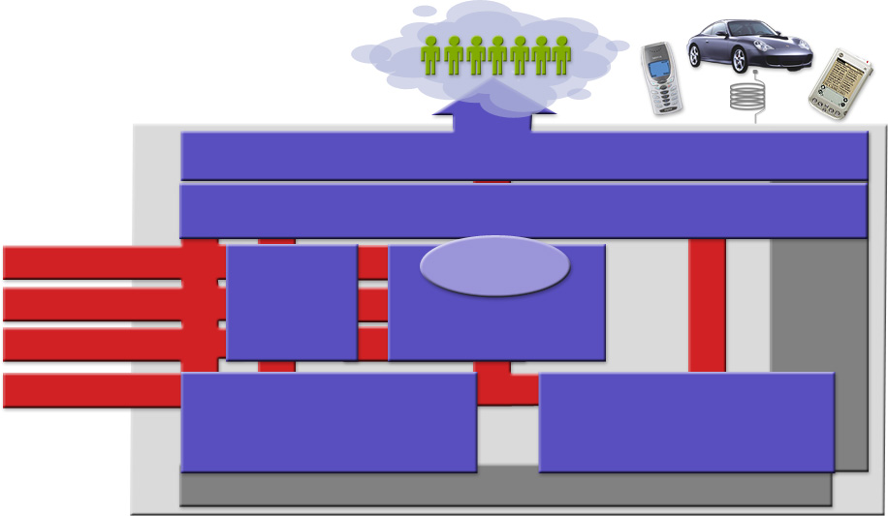
Sun ONE Product Stack
Community
Services
uPortal Server
Information
Sun ONE Directory Server
Assets
Data
Custom
Sun ONE
Business Logic
Applications
Integration
Sun ONE
Sun ONE Studio
Server
Application and
Reports
Web Servers
Transactions
Sun ONE
Communication Services
StarOffice
Mail Calendar
Solaris
Operating Environment
TM

Slide 9

How We Tested
Database was preloaded with 25,000 users
A simulated session consisted of:
  Visit the initial page
  Logon
  Visit every tab
  Interact with Webmail and Calendar
  Logout
Every container was “primed” by manually logging on and visiting every tab
10 new virtual users added every minute per server
Random delays (0-10 seconds) between simulated clicks
Tests ended after the response time was over 10 seconds

Slide 10
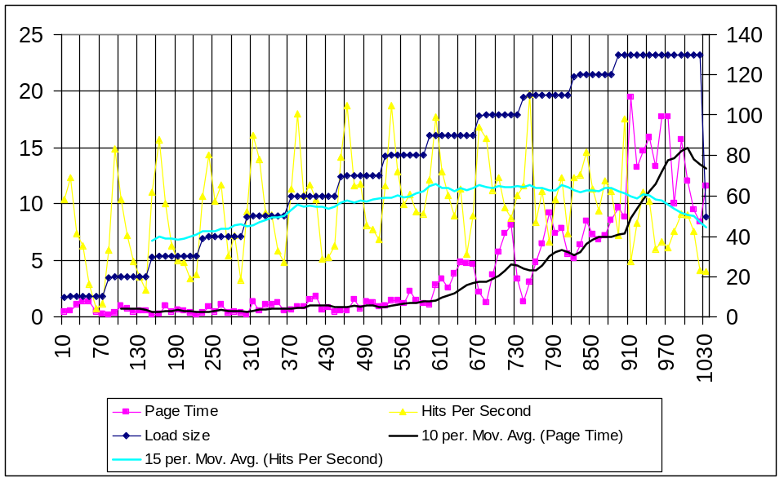
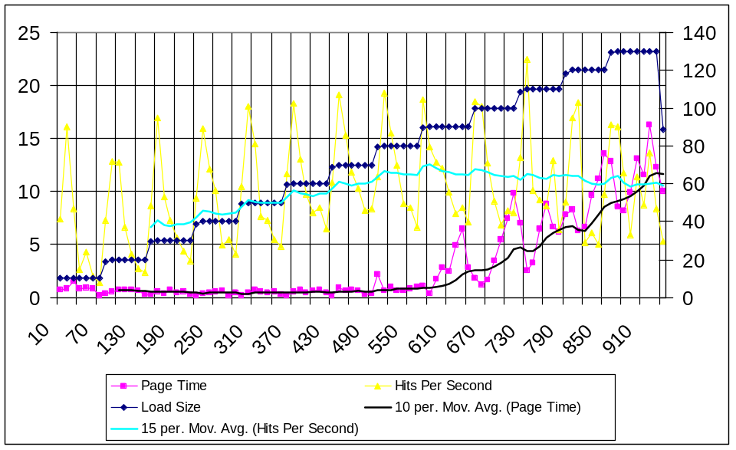
Results
1 Tomcat
1 Sun ONE

Slide 11
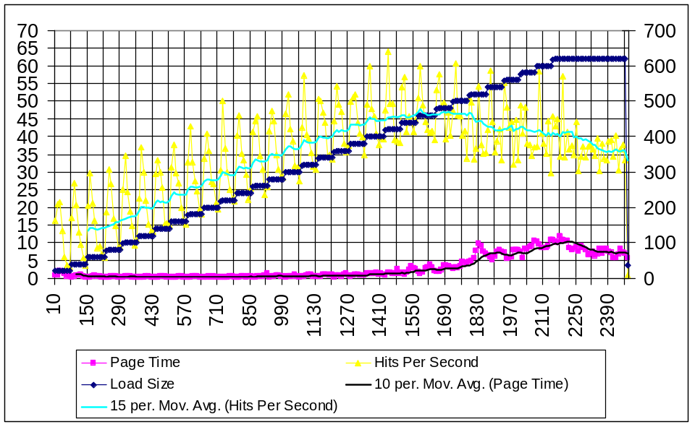
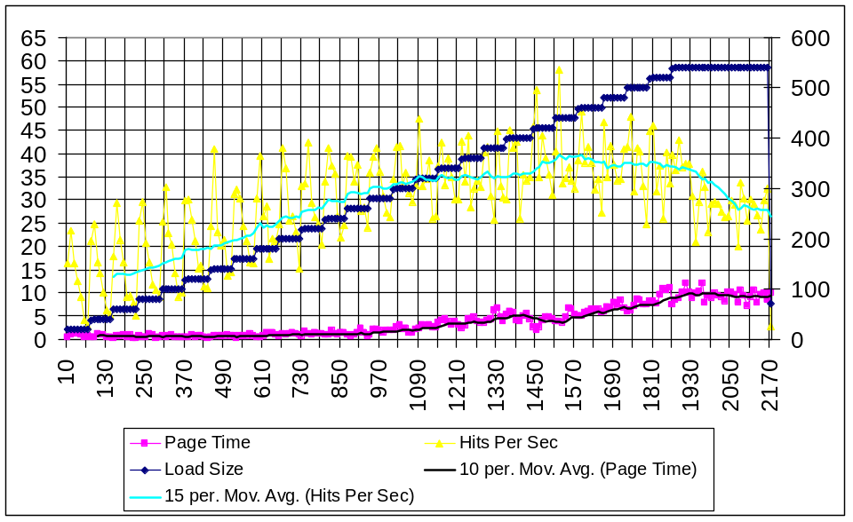
Results
4 Tomcats
4 Sun ONEs

Slide 12
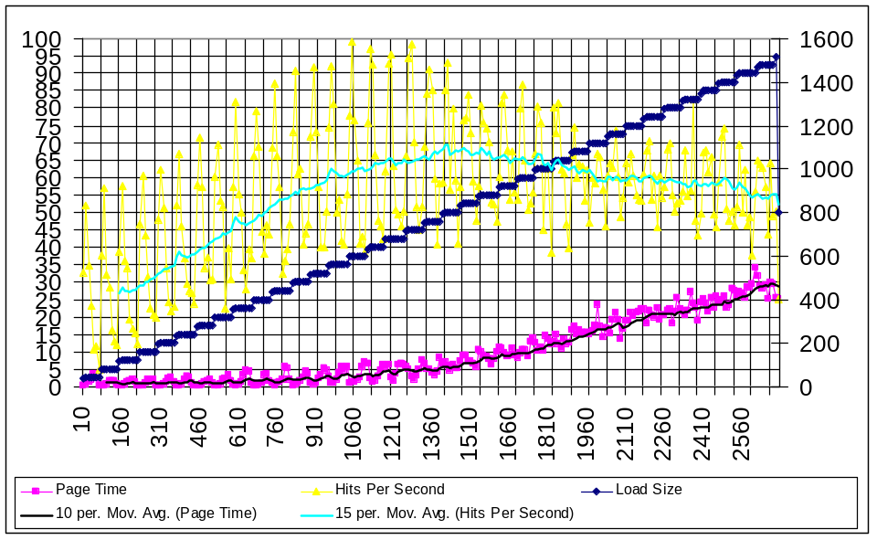
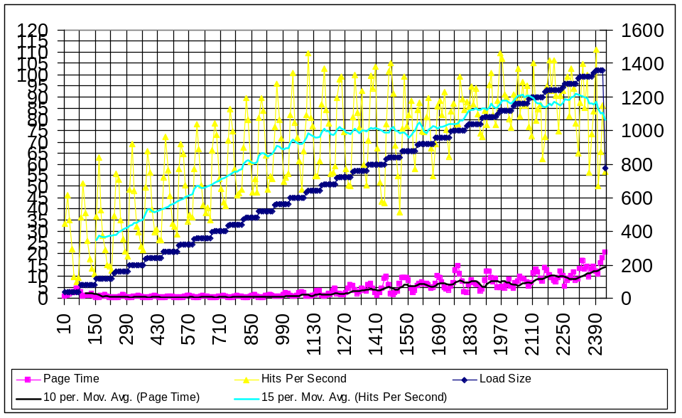
Results
8 Tomcats
8 Sun ONEs

Slide 13

Conclusions
THESE RESULTS ARE VALID ONLY FOR THIS SPECIFIC CONFIGURATION
In contrast to previous versions, 2.0.2 is very stable and much more scalable
Database must be well-tuned
More throughput could be obtained from Sun ONE servers, if we spent time tuning them
uPortal and Sun ONE servers put more load on the Sun ONE LDAP server than expected

Slide 14
Conclusions
uPortal pages with many channels (more than 10 on a page) create too many threads
We should work on improving the logon processing
Web containers were not intended to house applications, but their presentation only

Slide 15
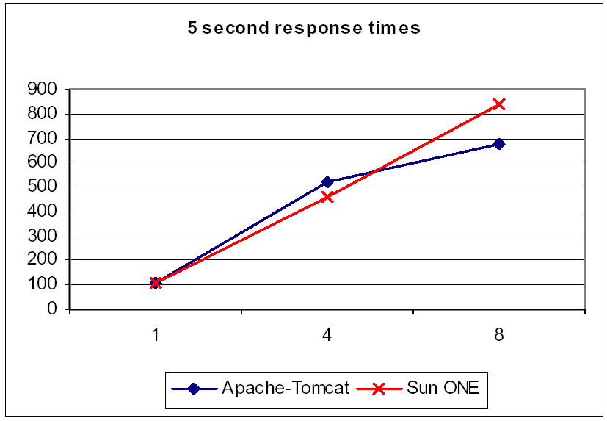
Conclusions

Slide 16
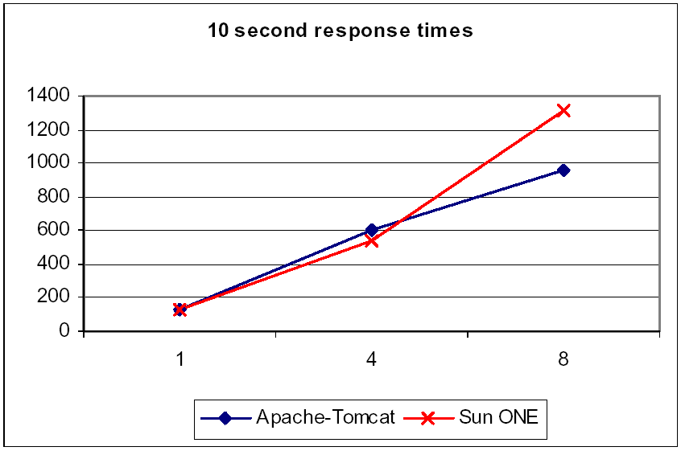
Conclusions

Slide 17
Questions?
arybicki@interactivebusiness.com
mjerdely@interactivebusiness.com
jeff.weiss@sun.com
http://www.uportal.biz
http://www.sun.com/executives/iforce/centers/
http://www.sun.com/software/index.html

