Slide 1
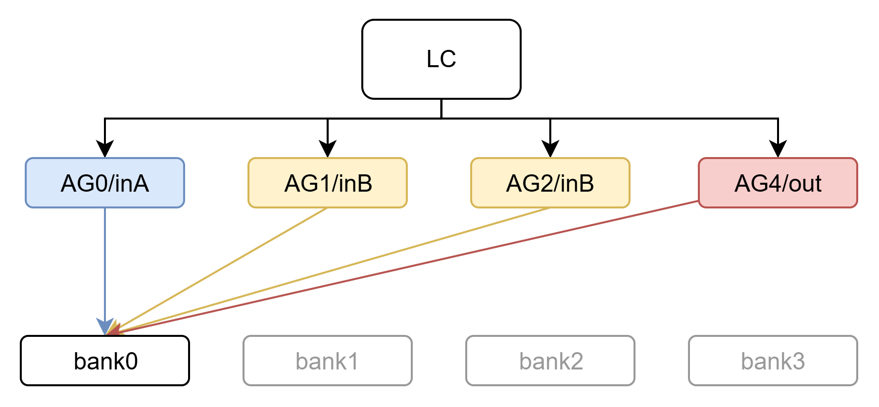
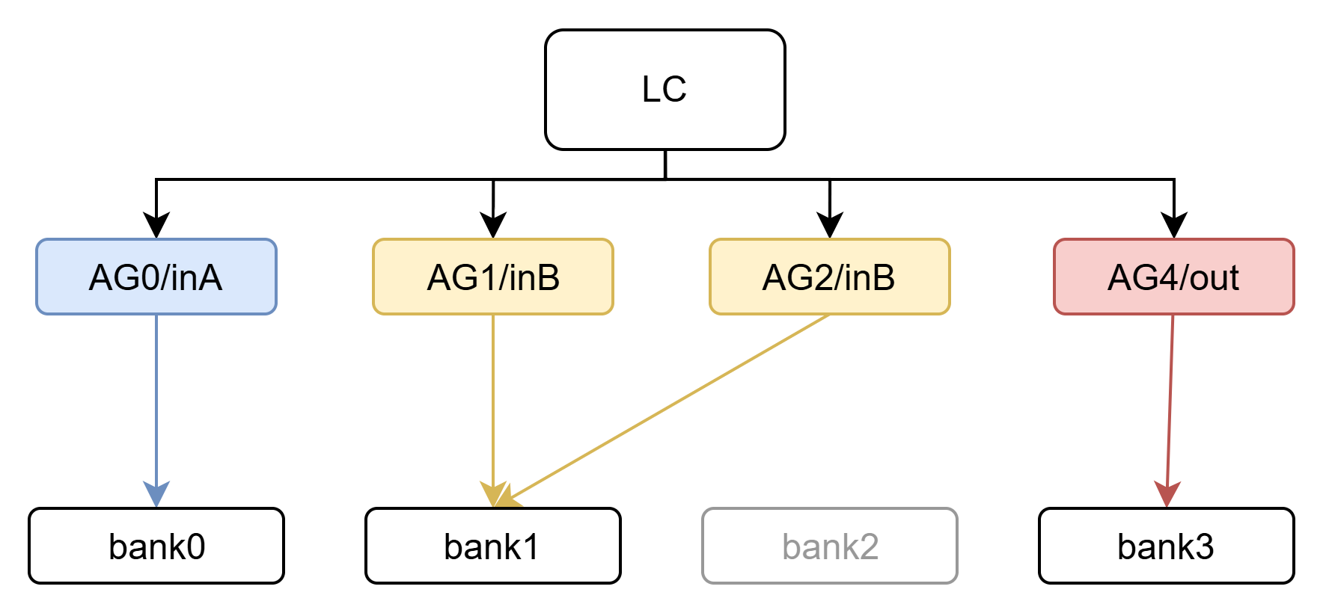
ring_gemm_M64N128K16_4slices 单算子性能表
k小，data reuse少，写回用时长
metric
value
value
analytical_latency_cycles
1100
780
hardware_measured_cycles
1084
819
simulator_error_vs_measured(%)
1.48%
-4.76%
roofline_compute_utilization(%)
100.00%
100.00%
analytical_compute_utilization(%)
23.27%
32.82%
measured_compute_utilization(%)
25.00%
31.26%
roofline_bandwidth_utilization(%)
81.25%
81.25%
analytical_bandwidth_utilization(%)
18.91%
26.67%
measured_bandwidth_utilization(%)
20.31%
25.40%
Slide 1 · 单算子性能表

Slide 2
ring_gemm_4slices 不同size性能表
roofline_bandwidth_utilization
= roofline_limit / (peak_bandwidth * arithmetic_intensity)
roofline_limit= min(peak_compute, peak_bandwidth * AI)
metric
M64N128K16
M32N128K1024
analytical_latency_cycles
780
10296
hardware_measured_cycles
819
10291
simulator_error_vs_measured(%)
-4.76%
0.05%
roofline_compute_utilization(%)
100.00%
100.00%
- B-side row-switch bubbles:
1792 cycles (17.4%)
- tail psum + writeback drain:
312 cycles (3.0%)
analytical_compute_utilization(%)
32.82%
79.56%
measured_compute_utilization(%)
31.26%
79.60%
roofline_bandwidth_utilization(%)
81.25%
32.03%
analytical_bandwidth_utilization(%)
26.67%
25.49%
measured_bandwidth_utilization(%)
25.40%
25.50%
Slide 1 · 单算子性能表

Slide 3
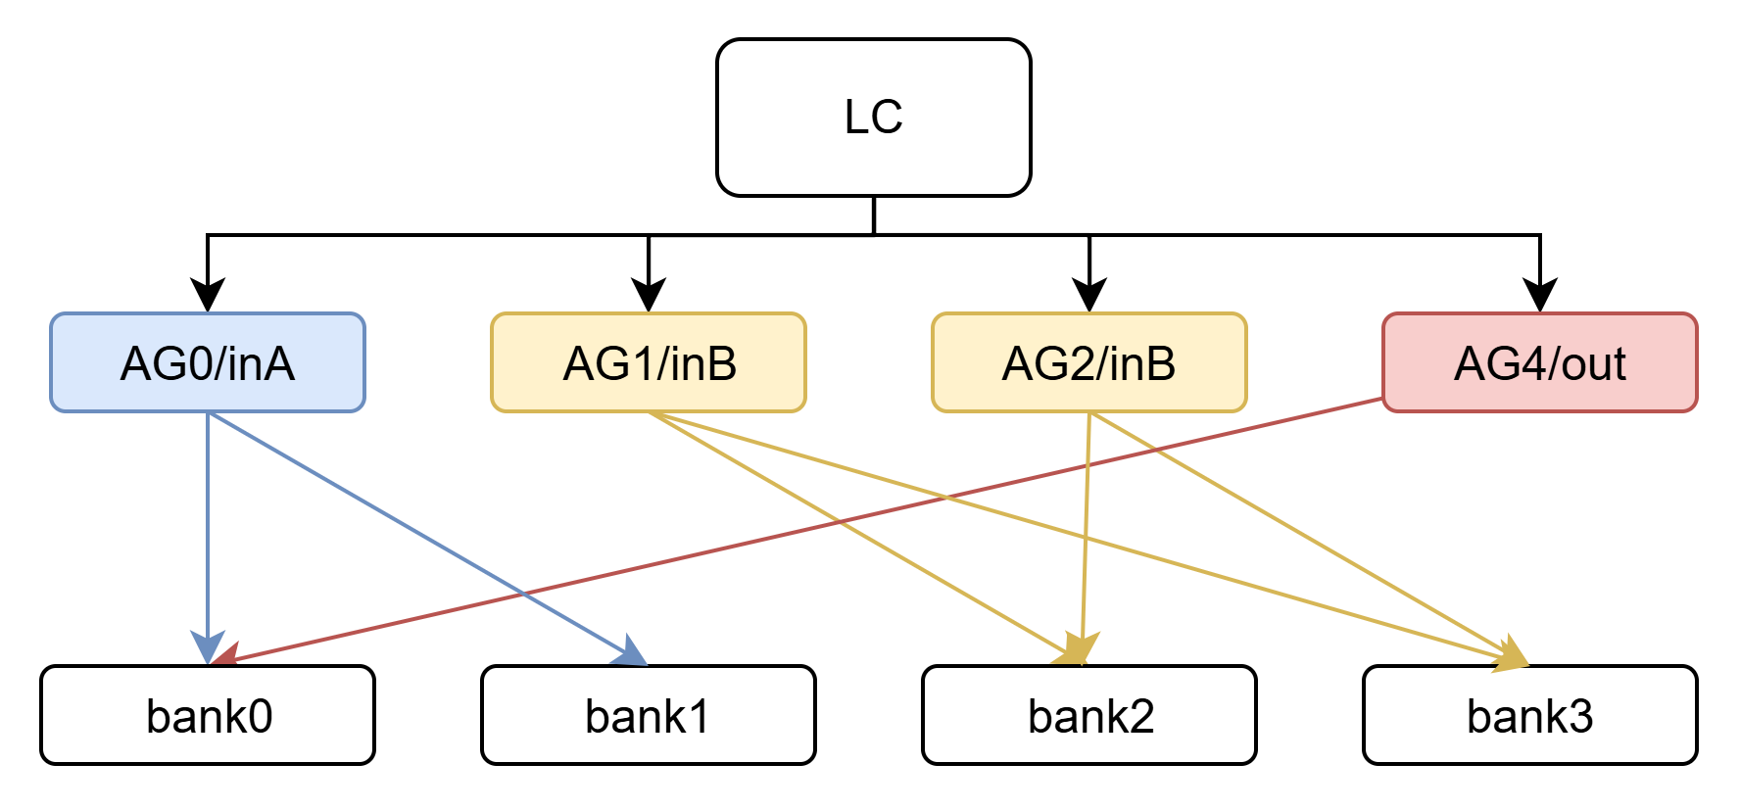
ring_gemm_4slices 不同配置性能表
metric
M32N128K1024
M32N128K1024
roofline_latency_cycles
8192
8192
analytical_latency_cycles
10296
hardware_measured_cycles
10291
9005
simulator_error_vs_measured(%)
0.05%
roofline_compute_utilization(%)
100.00%
100.00%
analytical_compute_utilization(%)
79.56%
measured_compute_utilization(%)
79.60%
90.97%
roofline_bandwidth_utilization(%)
32.03%
32.03%
analytical_bandwidth_utilization(%)
25.49%
measured_bandwidth_utilization(%)
25.50%
29.14%
Slide 1 · 单算子性能表

Slide 4
smallsize_model: ring_gemm_28slices 不同配置性能表
metric
M32N1792K896
M32N1792K896
roofline_latency_cycles
14336
14336
analytical_latency_cycles
18764
hardware_measured_cycles
19607
15532
simulator_error_vs_measured(%)
-4.30%
roofline_compute_utilization(%)
100.00%
100.00%
- B-side event-ready bubbles:
858 cycles (5.5%)
- completion tail:
326 cycles (2.1%)
analytical_compute_utilization(%)
76.40%
measured_compute_utilization(%)
73.12%
92.24%
roofline_bandwidth_utilization(%)
26.79%
26.79%
analytical_bandwidth_utilization(%)
20.46%
measured_bandwidth_utilization(%)
19.58%
24.71%
Slide 1 · 单算子性能表

Slide 5
ring_gemm 性能分析方法图
loop nest → template tile → load event → microtile timeline → final bounds
ring_gemm_bias.json Global: M=64, N=128, K=16 Local: A=64×4, B=16×32, Out=64×32
event规模 A events = 4 B events = 16
关键瓶颈 memory = 1100 ring = 612
最终延迟 latency = 1100
测量值
latency = 1024
根据 loop nest 生成events，再让 A/B/ring/PE/psum/writeback 在时间线上相互约束。
loop nest
template tiles
load events
microtile timeline
final bounds
Slide 2 · 总览

Slide 6
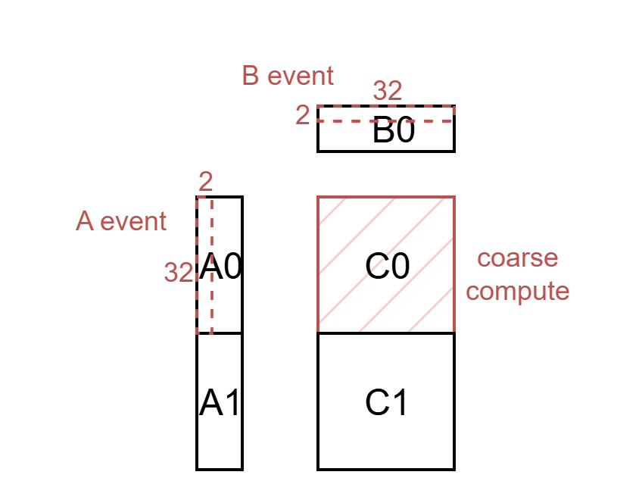
Loop Nest 抽象模型：不同于通用算子，专用算子中的tensor tile会重复访问
A load scope (M_0, N_0, KM_0) 2 × 1 × 2 = 4 events
抽象语义 • A 的event重复由 (M_0, N_0, KM_0) 决定 • B 的event重复由 (M_0, N_0, KN_0 / k_tile) 决定
• 这个 loop tree 导致请求个数不是由tensor footprint本身决定，而是会 request multiplicity
B load scope (M_0, N_0, k_tile) 2 × 1 × 8 = 16 events
for M_0 in range(2) for N_0 in range(1) for KA_0 in range(2) ag0(...) # A loads for KB_0 in range(8) ag1(...) ag2(...) # B loads ag4(...) # writeback
writeback scope output tile complete 2 write groups
Slide 3 · loop scope 决定 event multiplicity

Slide 7
Template Tile → Load Event：几何唯一块如何变成真实事件
footprint requests A=32 B=64 W=256
_split_requests_exact()
template tiles A=4, B=8, Out=2
_expand_ring_gemm_load_events()
load events A=4 B=16
A template tiles T0=(M[0:32],K[0:2]) T1=(M[0:32],K[2:4]) T2=(M[32:64],K[0:2]) T3=(M[32:64],K[2:4])
B template tiles 8 unique K-slices over N[0:32] each tile = 2×32 = 128B = 8 req 几何上只有 8 个 unique B tiles
event semantics A: 4 template tiles → 4 load events B: 8 template tiles → 16 load events 因此： b_requests=64 只是 footprint expanded_b_requests=128 才是执行真实请求流
Slide 4 · template tile 与 load event 是两个层次

Slide 8
资源约束图：ping/pong、ring-ready、PE、psum 如何共同决定 coarse_start
A ping / pong
A local ready
ring_ready = A ready + hop
B ping / pong
B ready
coarse_start = max(PE, ring, B, psum)
PE compute
psum ping / pong
PE available
psum slot ready
当前实现里：A slot 要等最后一个 ring-hop 消费完才释放；B slot 在当前 coarse compute 后即可释放。
Slide 5 · coarse_start 由多资源依赖共同决定

Slide 9
bank-level 简化模型：事件如何进入 memory timeline
A/B load event group (one event = many requests)
future_reads / future_writes
ready queues by bank
per-bank service (row / phase / drain)
group ready (full-group completion)
bank timeline 抽象过程 1. event 的 requests 先挂到 future_reads / future_writes 2. release_cycle 到了之后，按 bank_id 进入 ready queues 3. per-bank timeline 决定每条 request 何时完成 4. 只有当同一 group 的全部 requests 都完成时，才写 completion_by_group[group_key] 5. 这个完成时间就是 event ready time
当前仍然简化 • ring_gemm 没完全复用 ordinary operator 的 controller / arbiter 语义 • bank 侧是 lighter event loop，不是显式 arbiter1 / arbiter2 竞赛 • 但它已经足够提供 A/B ready、writeback completion 和 memory_timeline 的关键路径
A event 0 8 requests release = 0 ready = 28
B event 0 8 requests release = 0 ready = 88
当前已准确表达 • request 按 release_cycle 注入 • bank 内 row / phase 状态 • write buffer occupancy + forced drain • group ready = full-group completion • A/B/writeback event completion 反馈到上层 timeline
Slide 6 · 当前 memory model 的准确性与边界

Slide 10
一个 output tile 内部：A/B event ready 与 coarse compute 时间
output tile 0 M[0:32], N[0:32]
1) A event
A event0
ring
ready
ring
ready
ring
ready
A event1
ring
ready
ring
ready
ring
ready
local-ready + ring-ready
local ready 28
ring ready 32
ring ready 108
ring ready 124
local ready 44
ring ready 48
ring ready 172
ring ready 192
2) B event
B0
B1
B2
B3
B4
B5
B6
B7
B local-ready
ready 88
ready 104
ready 120
ready 136
ready 152
ready 168
ready 184
ready 200
coarse k=0
coarse k=1
coarse k=2
coarse k=3
coarse k=4
coarse k=5
coarse k=6
coarse k=7
3) coarse compute
start / end
start 88
start 104
start 120
start 136
start 152
start 168
start 184
start 200
end 104
end 120
end 136
end 152
end 168
end 184
end 200
end 216
coarse 粒度：A(32×2) × B(2×32) 对一个 32×32 output tile 的单个 K-slice 做累加。A/B event 只负责给出 ready；coarse_start 才是 compute 真正开始的时间。
final latency = max(compute_pipeline, ring, memory, AG)
Slide 7 · A/B event ready 与 coarse compute 时间要分开看

Slide 11
最终瓶颈选择：谁最后结束，谁决定 latency
compute 256
AG issue 256
ring 48
memory 1100
latency 1100
max(compute_pipeline, ring_timeline, memory_timeline, ag_issue) → 最晚结束者决定 latency
Slide 8 · final bound selection

