Slide 1
01 / Overview
普通算子性能分析全景图
把模拟器看成多层对象之间的投影关系：逻辑张量先投影成请求几何，再投影成 bank 局部状态与控制器闭环，最后汇总成 latency。
Logical tensor space
AG release lanes
Global controller
dispatch + arbitration window
00
01
02
03
04
logical tensor tiles
AG0 / read-A
now | pending_writes | slice_blocked | forced_drain
10
11
12
13
14
edge traversal order
req0
req1
req2
issue_rate gated
20
21
22
23
24
Bank 0
Bank 1
Bank 2
Bank 3
30
31
32
33
34
same op, different remap -> different landing geometry
open_row = r12
phase = R
ready_q | write_q
row_hits accumulate
open_row = r07
phase = R
ready_q | write_q
few row switches
open_row = r04
phase = W
write pressure visible
phase switch pending
open_row = r19
phase = R
sparse arrivals
arbiter2 likely
AG1 / read-B
req0
req1
req2
AG4 / writeback
per-bank local state
global time loop
wb0
wb1
wb2
ready_q + write_q
one step updates local + global

Slide 2
02 / Materialization
从logical Tensor 到 Physical address
Logical access pattern
Physical landing geometry
address remapping
00
01
02
03
04
logical tensor tiles
bank 0
bank 1
10
11
12
13
14
edge traversal order
r12 | c1,2,3
r07 | c4,5
20
21
22
23
24
same op, different remap -> different landing geometry
bank 2
bank 3
30
31
32
33
34
r04 | c0,1
r19 | c2

Slide 3
03 / Stream Diagnosis
单 stream 几何诊断：热点、row locality 与 bank 打散
hotspot bank = deeper fill + denser requests
good row locality = long row bands
bank spread = column heights flatten out
Hotspot banks
Row locality
Bank spread
Bank 0
Bank 1
Bank 2
Bank 3
localized stream
fragmented stream
concentrated
balanced
most requests pile here
medium pressure
light traffic
almost idle
b2
b3
b1
b0
b1
b2
b3
long bars mean same-row runs stay alive
broken bars imply frequent row changes
b0
few tall columns -> hotspot-prone
flat skyline -> requests are spread
它对应哪些字段
hotspot 对应 raw_bank_max_cycles / bank_cycles；row 连续性对应 bank_stats.misses 与 row_switch_penalty_cycles；柱高均匀度对应 active_banks、round_robin_score、same_bank_run_lengths。

Slide 4
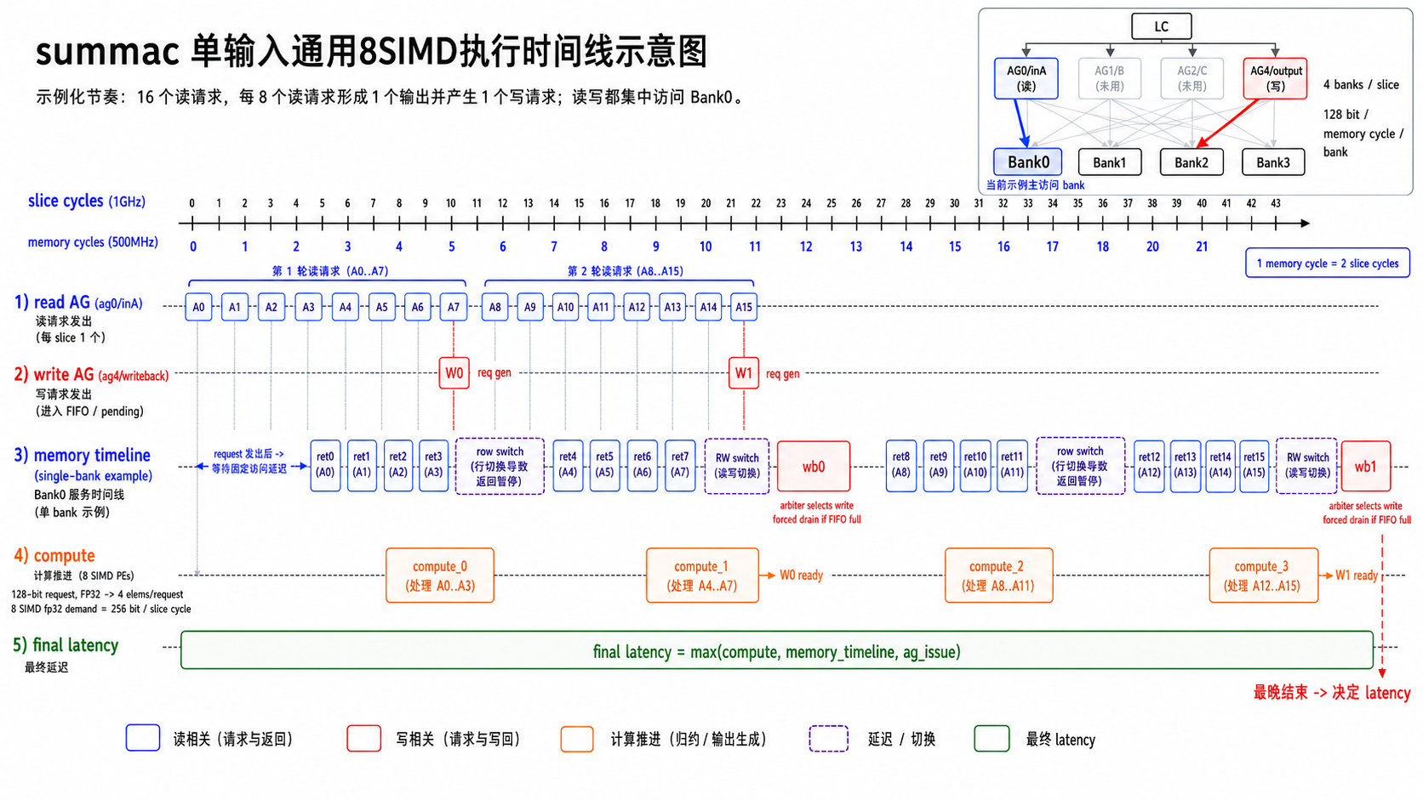
04 / Bounds
Latency

Slide 5
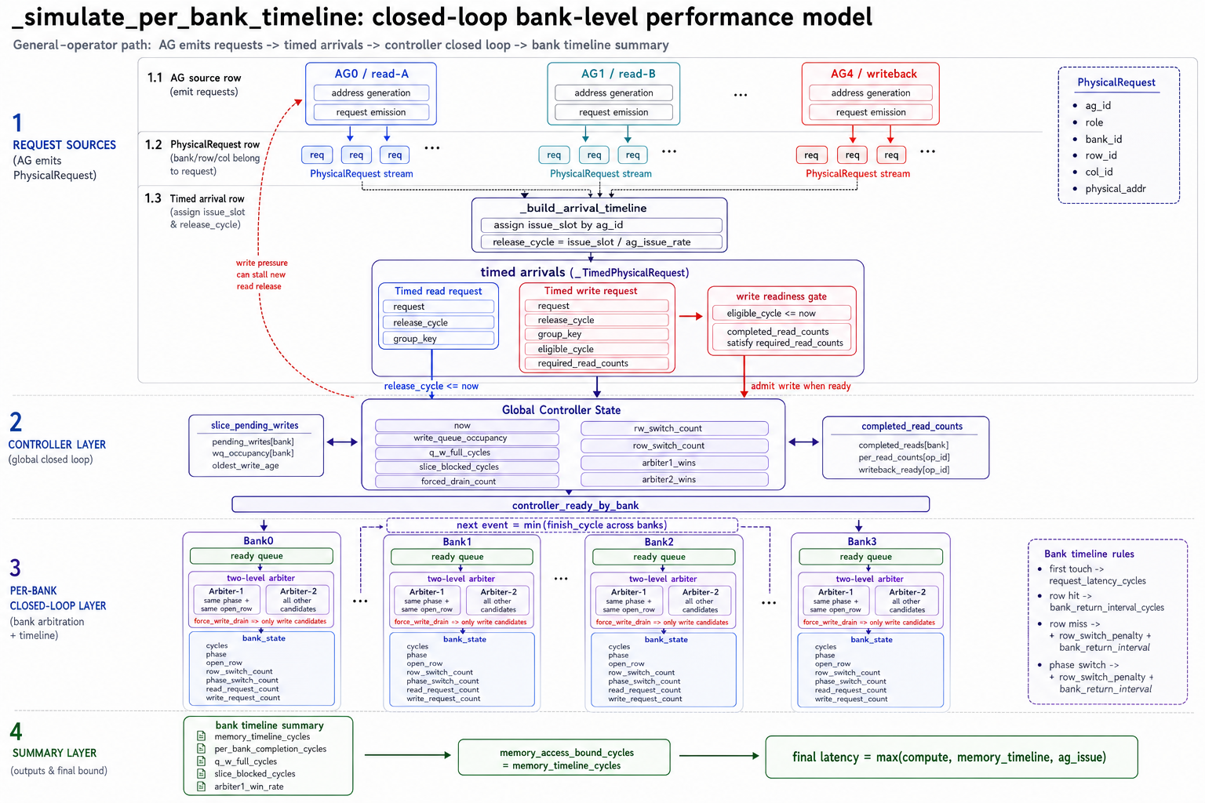
05 / Controller
4-bank Controller + 单 bank 仲裁 + writeback pressure
每个 bank 都有自己的 open_row 和 phase，但调度器是在一个共享时间轴上推进这些 bank

Slide 6
06 / Readout
输出指标阅读图：报告字段、物理意义、典型解释
最后一页适合做成映射图，而不是继续堆步骤。这样听众会知道每个数字该往哪个物理机制上挂。
报告字段
物理意义
典型解释
memory_timeline_cycles
谁在主导总周期
timeline 高于 compute -> memory 主导
rw_switch_count
phase 是否频繁抖动
rw_switch 多 -> phase penalty 重
row_switch_count
row locality 是否差
row_switch 多 -> 请求落点打散
arbiter1_wins / arbiter2_wins
continuation bias 有没有吃到
arbiter2 高 -> continuation lane 常空
q_w_full_cycles / slice_blocked_cycles / forced_drain_count
写压是否已经反压回读流
blocked + drain 高 -> 写回闭环成为主要瓶颈
建议阅读顺序
建议收尾案例
先判断谁是主导 bound，再看 bank_timeline 指标，最后再和 hardware_measured_cycles 对照，区分是总量误差还是机制误差。
优先用 rmsnorm_mul_withbaseaddr 或 summac_64_64_withbaseaddr，把“请求分布 -> 仲裁 -> backpressure -> latency”完整走一遍。

