Slide 1

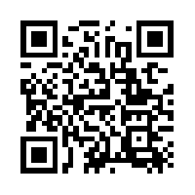
Quantum Communications Group
Key Management Layer
ITU-T Y.3803/3804
Group Coordinator:
Armando Nolasco Pinto
anp@ua.pt
Diogo Matos
Group Websites:
https://www.it.pt/Groups/Index/72
LinkedIn: https://www.linkedin.com/company/quantum-communications-group-it-av/

Slide 2
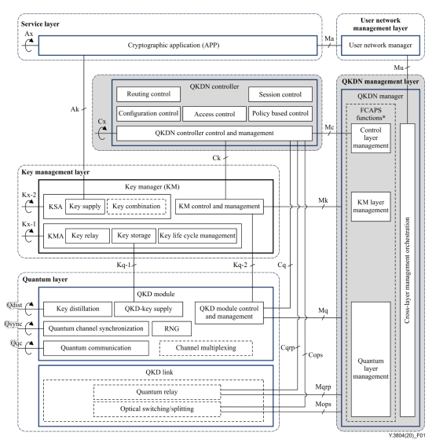
Functional elements

Slide 3
Main entities
KMA (Key Management Agent) - it receives keys from QKD modules, and interconnects the QKD nodes by key relay;
KSA (Key Supply Agent) - interfaces with the cryptographic application, realizing the function of key supply;
QKDN controller - controls the quantum layer, the key management layer, and supports the functions of the QKDN management layer and the service layer.

Slide 4
QKDN controller
Controls the quantum layer, the key management layer, and supports the functions of the QKDN management layer and the service layer;
The QKDN controller performs the following functions:
Routing control
Configuration control
Policy-based control
Access control
Session control

Slide 5
KEY ACQUISITION & AUTH & STORAGE
KMA receives QKD-key file (key material + metadata) and stores it in a temporary buffer;
One KMA of the pair sends to the matching KMA a key authentication request by sending the hash value of the key file and the key id;
The other KMA compares the hash value with the one computed by itself. If the code coincide with each other, sends a successful auth message back;
Both store the buffered keys as key data.
NOTE - A similar process is necessary (because of the possibility of error on the key relay) between KSA’s before providing the key to the apps.

Slide 6
Reception of key request from cryptographic application
Control of reception of key request(s) by the KSA can be supported by the QKDN controller;
Their certificate can be issued by an access control function;
KSA and the apps need to authenticate themselves to the QKDN controller;
Is recommended that KSA’s and KMA’s in the same node authenticate each other before any operation;

Slide 7
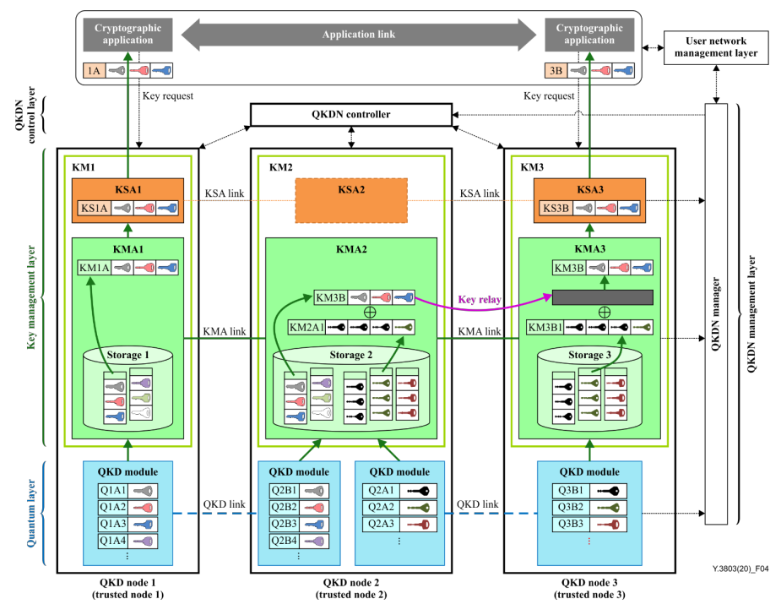
Key relay
Alice and Bob might be in different QKDN nodes that don’t share any QKD module (KM1 and KM3 respectively).
Key relay need to happen because the two KMA’s don’t share the same key source.
Process managed by the QKDN controller

Slide 8
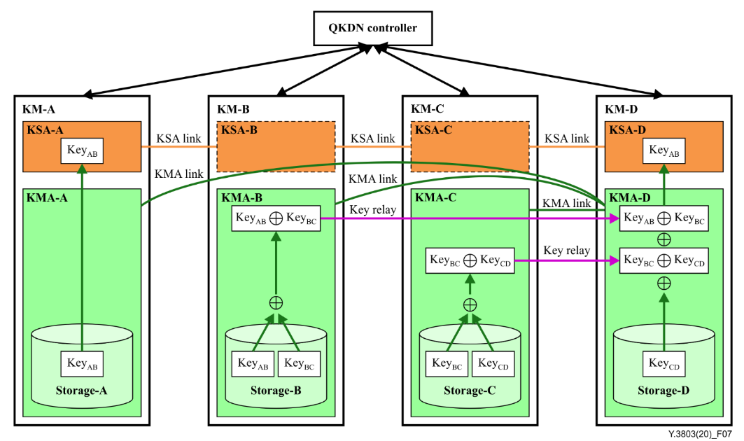

Slide 9
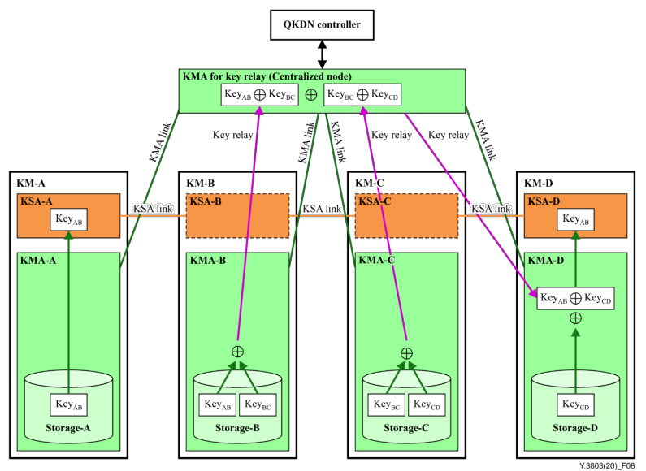
Key relay - centralized key relay node solution

Slide 10
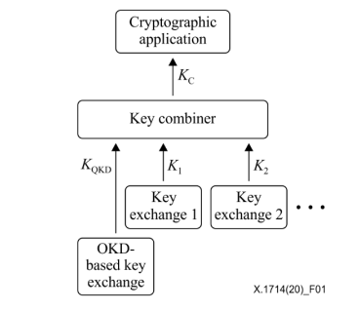
Key relay - key combination
K_{QKD} - quantum key (relayed or not)
K_{n} - key (always smaller than K_{QKD} ) provided by any kind of method allowing the exchange of symmetric keys between two nodes, including cryptographic means and physical means
The key combiner can be as simple as a XOR operation between all the input keys

Slide 11
Key relay - rerouting
Rerouting of key relay should be carried out, depending on the status of the key management layer
or the quantum layer, to try to ensure continued availability of key supply.
The QKDN controller acquires the information on key management (consumption rates, link status, etc) as well as status information of the QKD module and optionally of the QKD link from the QKD modules.
Rerouting methods directed from the QKDN controller:
Manual: A key relay route is set manually on the KMAs;
Fixed rate: Based on the key generation rates of the QKD links;
Data-traffic adaptive: The KMAs perform key relay automatically based on recent statistical records of key relay traffic;
Scheduled: When it is possible to predict changes of a certain condition key relay is scheduled in advance.

Slide 12
Key supply from KSAs to cryptographic applications
KMA sends the key to the KSA;
KMA records its metadata in its storage, and may send metadata to the QKDN manager;
KSA might retain some metadata such as the cryptographic application name, application source and destination IDs, KSA-key ID, and KSA-key length and supply timestamp;
Finally, before delivering the key to the app, each KSA of the node pair need to verify if the key is exactly the same. It’s done by comparing the KSA-key ID and the hash of key.

