Slide 1

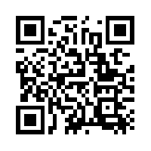
Quantum Communications Group
Key Management Layer
ETSI GS QKD 004
ETSI GS QKD 014
Group Coordinator:
Armando Nolasco Pinto
anp@ua.pt
Group Websites:
Diogo Matos
https://www.it.pt/Groups/Index/72
LinkedIn: https://www.linkedin.com/company/quantum-communications-group-it-av/

Slide 2
ETSI GS QKD 004

Slide 3
GOAL
Specify a API between QKD(Quantum Key Distribution) key manager and the applications

Slide 4
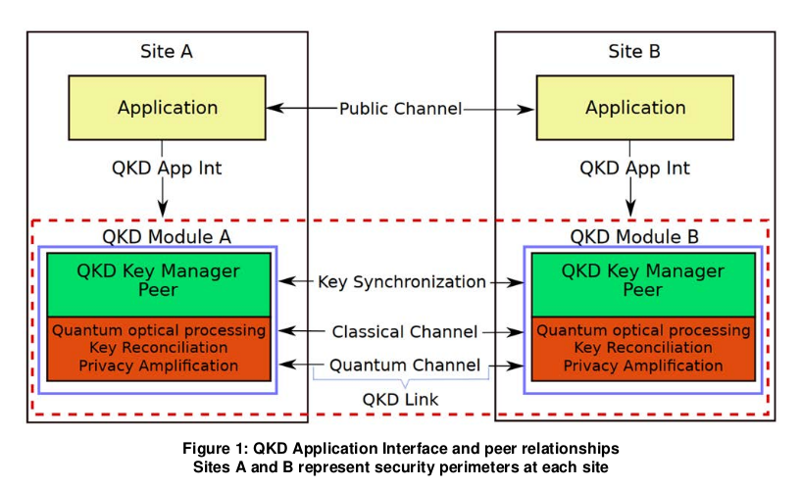

Slide 5
QKD Application Interface API Specification
OPEN_CONNECT - Reserve an association (Key_stream_ID) for a set of future keys at both ends of the QKD link through this distributed QKD key management layer and establish a set of parameters that define the expected levels of key service. Blocking request with timeout;
CLOSE - Terminate the association established for this Key_stream_ID. No further keys shall be allocated for this Key_stream_ID after the association has been closed. Any unused keys will be held until the termination happens at the other end of the link or until the Time To Live (TTL) QoS parameter expires.
GET_KEY - obtain a specific amount of key material for a given Key_stream_ID. The function returns the requested key, along with an index value for synchronization purposes, and may also include metadata if requested. The QKD key manager is responsible for reserving and synchronizing the keys at both ends of the QKD link. The function returns with a status indicating success or failure.

Slide 6
GENERIC INTERFACE
Interface QKD (
OPEN_CONNECT (in source, in destination, inout QOS, inout Key_stream_ID, out status);
GET_KEY (in Key_stream_ID, inout index, out Key_buffer, inout Metadata, out status);
CLOSE (in Key_stream_ID, out status);
)

Slide 7
Quality of Service parameters
Key_chunck_size - length of the key buffer, in Bytes, requested by the app.
Max_bps - Maximum key rate, in bps, requested by the app.
Min_bps - Minimum key rate, in bps, requested by the app.
Jitter - Maximum expected deviation for key delivery.
Priority - Priority of the request (to be defined).
Timeout - time, msec, after which the call will be aborted, returning an error.
Time to live (TTl) - Time, in seconds, after which the keys for this KSID shall be erased from the application’s dedicated key store.
Metadata mimetype - The mimetype (“application/json”, for example) of the metadata to be delivered by the KM on each GET call.

Slide 8
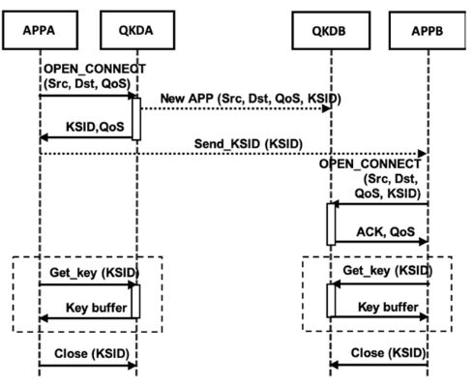
Sequence diagram - Undefined KSID in a single link scenario

Slide 9
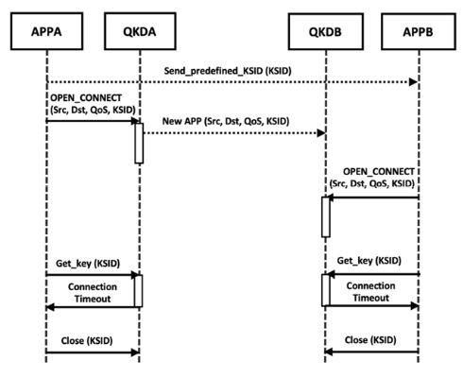
Sequence diagram - Predefined KSID and failed get key call in a
single link scenario

Slide 10
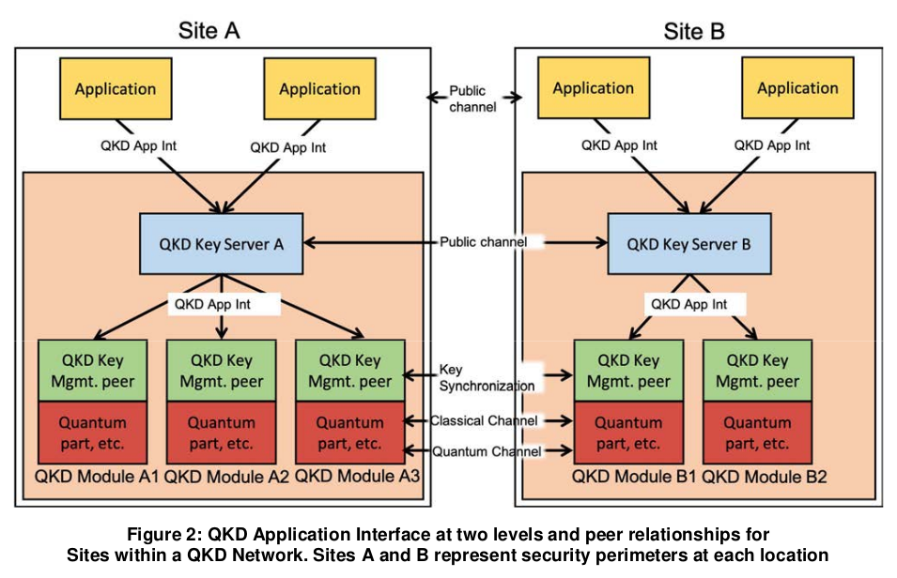
QKD network

Slide 11
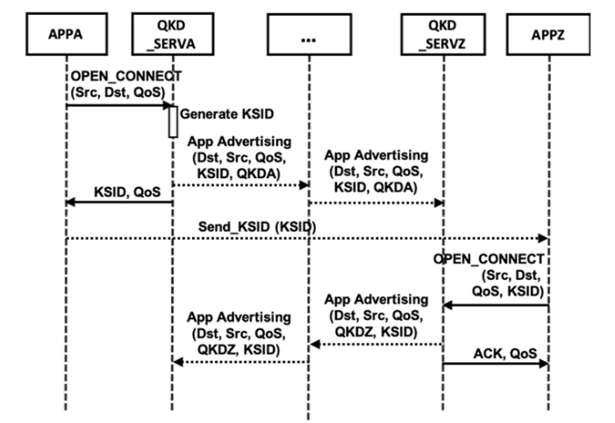
Sequence diagram - Application discovery in a QKD network

Slide 12
ETSI GS QKD 014

Slide 13
Goal
Specify a REST-based API, a simple request and response style API between a SAE(Secure Application Entity) and a KME(Key Management Entity).

Slide 14
Why?
Allows application developers to make simple method calls to a QKD network and to be delivered key material. It is intended to allow interoperability of equipment from different vendors.
Improves security

Slide 15
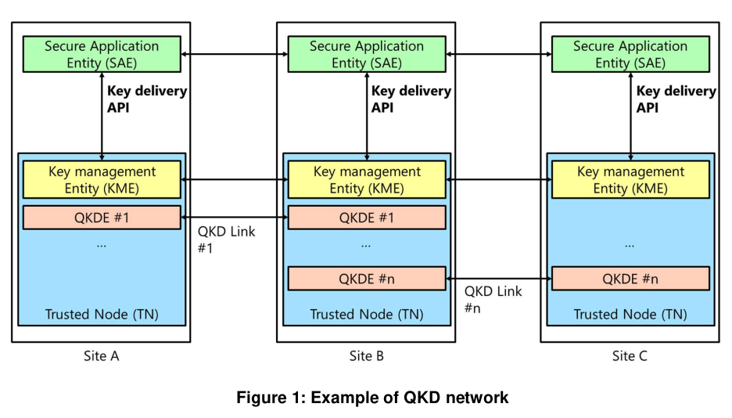

Slide 16
Basic requirements
Each KME shall have a unique ID (KME ID). A KME ID shall be unique in a QKD network;
Each SAE shall have a unique ID (SAE ID). A SAE ID shall be unique in a QKD network;
SAEs make HTTPS requests to KMEs to get keys and status information;
KMEs shall authenticate each request and identify the unique SAE ID of the calling SAE;
Data in the message body of HTTPS requests from SAE to KME and HTTPS responses from KME to SAE shall be encoded in JSON format;
Multicast compatible;

Slide 17
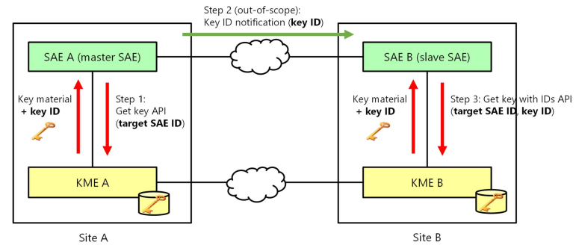

Slide 18
Authentication
SAE shall connect to KME using HTTPS protocols;
Mutual authentication between SAE and KME shall be performed;
SAE shall verify the validity of a certificate the KME possesses and shall confirm the KME ID of the KME it is connecting to, based on the certificate;
KME shall verify the validity of a certificate the SAE possesses and shall confirm the SAE ID of the connecting SAE based on the certificate.

Slide 19
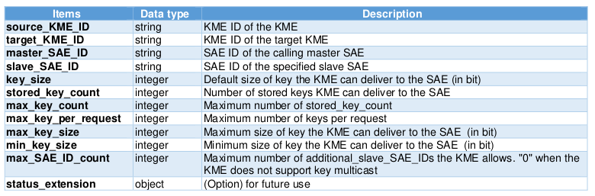
Get status request (GET)
Returns Status from a KME to the calling SAE. Status contains information on keys available to be requested by a master SAE for a specified slave SAE.
https://{KME_hostname}/api/v1/keys/{slave_SAE_ID}/status
Response data model

Slide 20
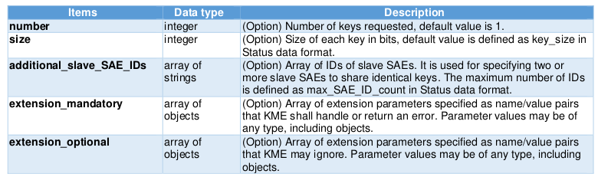
Get key request (POST or GET )
Returns Key container data from the KME to the calling master SAE. Key container data contains one or more keys. The slave SAE specified by the slave_SAE_ID parameter may subsequently request matching keys from a remote KME using key_ID ids from the returned Key container.
POST -> https://{KME_hostname}/api/v1/keys/{slave_SAE_ID}/enc_keys
GET -> https://{KME_hostname}/api/v1/keys/{slave_SAE_ID}/enc_keys?number={n}&size={s}
POST request data model

Slide 21
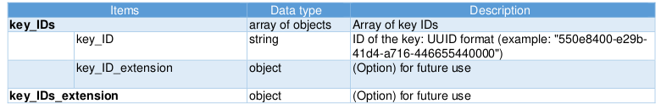
Get key with key IDs request (POST or GET)
Returns Key container from the KME to the calling slave SAE. Key container contains keys matching those previously delivered to a remote master SAE based on the Key IDs supplied from the remote master SAE in response to its call to Get key.
POST -> https://{KME_hostname}/api/v1/keys/{master_SAE_ID}/dec_keys
GET -> https://{KME_hostname}/api/v1/keys/{slave_SAE_ID}/dec_keys?key_ID={UUID}
POST request data model

