Slide 1
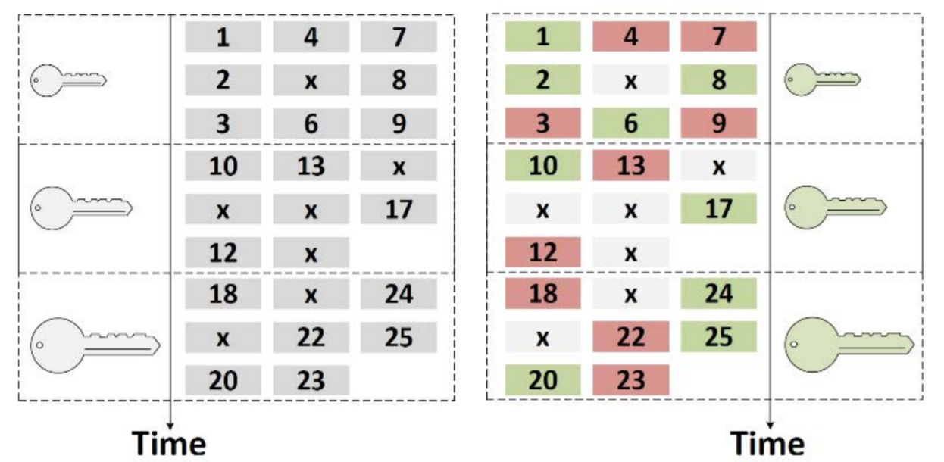
Symmetric Keys
Sifted
Keys
Symmetric Keys
Sifted
Keys
DV-QKD Tx
DV-QKD Rx
QRNG
QRNG
DEMUX 1:2
Classical Channel
Basis
Data
Basis
Data
DV-Polarization Tx
DV-Polarization Rx
Quantum Channel
1 | 4 | 7
2 | 5 | 8
3 | 6 | 9
1 | 4 | 7
2 | 5 | 8
3 | 6 | 9

Slide 2
Sink
Sink
Sink
QBER
Symmetric Keys
Sifted Keys
Sifted Keys
Symmetric Keys
Binary Source
DV-QKD Tx
IP Tunnel
IP Tunnel
DV-QKD Rx
Binary Source
Binary Source
IP Tunnel
IP Tunnel
Basis
Data
Basis
Data
DV-Polarization Quantum Channel Emulator

Slide 3
APPA
KMA
QKSA
QKSB
KMB
APPB
QKD_OPEN()
key_handle
QKD_OPEN(key_handle)
QKD_CONNECT_BLOCKING()
QKD_CONNECT_BLOCKING()
Verification(key_handle)
Verification(key_handle)
Classical Channel
Connection OK
OK
OK
Connection OK
Bitstream transfer
Quantum Channel
Bitstream transfer
QKD_GET_KEY()
QKD_GET_KEY()
key_buffer
key_buffer
QKD_CLOSE()
QKD_CLOSE()

Slide 4
APPA
KMA
QKSA
QKSB
KMB
APPB
OPEN_CONNECT(
Src,Dst,QoS)
Verification
OK
Verification
OK
KSID, QoS
KSID, QoS
Verification
OPEN_CONNECT(
Src,Dst,QoS,KSID)
OK
Verification
OK
ACK, QoS
GET_KEY(KSID)
GET_KEY(KSID)
Bitstream transfer
Quantum Channel
Bitstream transfer
Key_buffer
Key_buffer
CLOSE(KSID)
CLOSE(KSID)

Slide 5
APPA (Alice)
APPB (Bob)
KMA
QKSA
QKSB
KMB
QOKD_OPEN()
key_handle
QOKD_OPEN(key_handle)
QOKD_CONNECT_BLOCKING()
QOKD_CONNECT_BLOCKING()
Verification(key_handle)
Verification(key_handle)
Classical Channel
Connection OK
OK
OK
Connection OK
Bitstream transfer
Quantum Channel
Bitstream transfer
QOKD_GET_KEY()
QOKD_GET_KEY()
key_buffer
key_buffer
QOKD_CLOSE()
QOKD_CLOSE()

Slide 6
App
IP Tunnel
Key Manager API
Peer Key Manager
key_handle
status
QoS
key_handle
IP Tunnel
destination
status
status
key_buffer
key_handle
QKD_OPEN()
key_handle
timeout
status
QKD_CONNECT_BLOCKING()
QKD_GET_KEY
()
QKD_CLOSE()
Verification
Bitstream
QKD System

Slide 7
App A
IP Tunnel
App B
key_handle
key_handle
key_handle
destination
status
key_handle
destination
status
QoS
timeout
key_buffer
QoS
timeout
key_buffer
Key Manager A
Synchronization
information
IP Tunnel
Synchronization
information
Key Manager B
verification
bitstream
bitstream
verification
QKD System

Slide 8
App A
App B
Message
API Call
API Call
Key Manager A
Key Manager B
Message
Bitstream
Bitstream
QKD System A
QKD System B
Quantum communication

Slide 9
Peer Key Manager
Message Processor Receiver
App
QKD System
App Message Handler
KM Message Handler
QKD Message Handler
Message Processor Transmitter
App
QKD System
Peer Key Manager

Slide 10
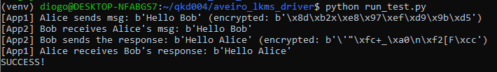

Slide 11
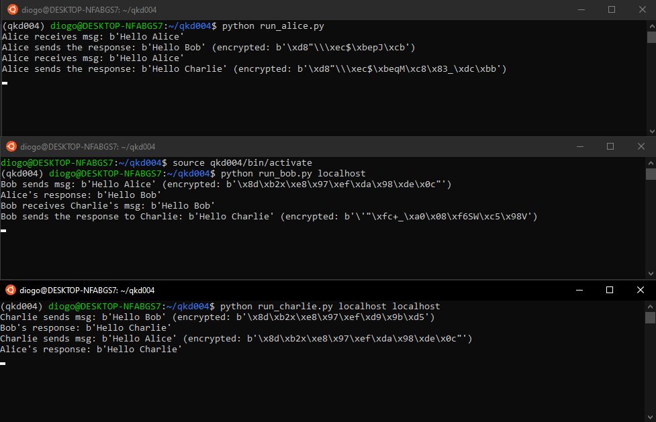

Slide 12
App A
Get_Key()
Key Buffer, error_chance
Raw Key Manager
Key Buffer
Key Generator

Slide 13
Request:
source_ size
source
destination_size
destination
qos_size
qos
has_key_ stream_id
key_ stream_id
3 bytes
2-24 bytes
3 bytes
2-24 bytes
2 bytes
284 bytes
1 byte
16 bytes
Response:
status
has_key_ stream_id
key_ stream_id
qos_size
qos
4 bytes
1 byte
16 bytes (optional)
2 bytes
284 bytes (optional)

Slide 14
Request:
ksid
index
metadata_size
metadata
16 bytes
4 bytes
3 bytes
2-32 bytes (optional)
Raw key error chance could be here
Response:
status
key_ buffer_size
key_ buffer
has_ index
index
metadata_size
metadata
4 bytes
14 bytes
2-32 bytes
1 byte
2-32 bytes
4 bytes
2-32 bytes

Slide 15
Request:
ksid
16 bytes
Response:
status
4 bytes

Slide 16
TCP Socket
Alice (Application) (Python)
Encrypted messages
Bob (Application) (Python)
encrypt(), decrypt(), get_key(), get_key_bytes()
encrypt(), decrypt(), get_key(), get_key_bytes()
Application Class (Python)
Application Class (Python)
open_connect(), get_key(), close()
open_connect(), get_key(), close()
Application Driver (Python)
Application Driver (Python)
ETSI 004
TCP Socket
TCP Socket
Bitstream, BER
Bitstream, BER
LKMS Raw
Keys Node 1
LKMS Raw
Keys Node 2
BER
Turned_ON
BER
Turned_ ON
BSC
BSC
Random Number
Generator
Same seed !
Random Number
Generator

Slide 17
API Call parameters
JSON
Serialization
Request through socket
Process results
C++ Objects
Parsing
Get response through socket

