Slide 1
Intelligent Utility Billing & GIS Management System
Automated Metering, Digital Invoicing, Leaflet GIS Mapping, and Gmail Notifications

Slide 2
Utility Management System
Submitted By:
Name: Jasika Noor
ID: 22CSE002
Session: 2022-2023
Year: 3rd
Semester: 1st
Department: Computer Science and Engineering
Submitted To:
Dr. Mrinal Kanti Baowaly
Associate Professor
Department of Computer Science and Engineering

Slide 3
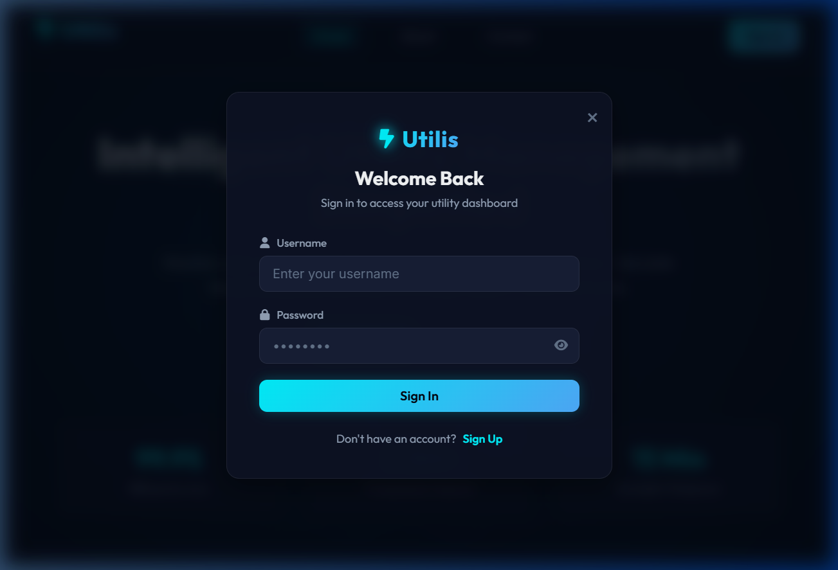
The Problem Statement
Manual, paper-based readings lead to frequent billing errors.
Lack of online verification options causes customer payment disputes.
Slow complaint channels delay emergency repairs for leaks and outages.
Admins have no geographic view (GIS) to trace consumption zones.

Slide 4
Project Objectives
Billing: Build an automated Express.js engine for utility calculations.
GIS Maps: Create Leaflet.js maps to display outage and consumption hotspots.
Verification: Generate secure QR codes on bills for quick public checks.
Alerts: Send automatic Gmail reminders and invoice PDF copies.

Slide 5
System Architecture & Tech Stack
Frontend: Vanilla JavaScript, Glassmorphic CSS, Chart.js, and Leaflet.js.
Backend: Node.js and Express.js REST API with clean role-based routing.
Notifications: Nodemailer Gmail SMTP relay integration for automated alerts.
Database: MySQL relational schema optimized with client connection pooling.

Slide 6
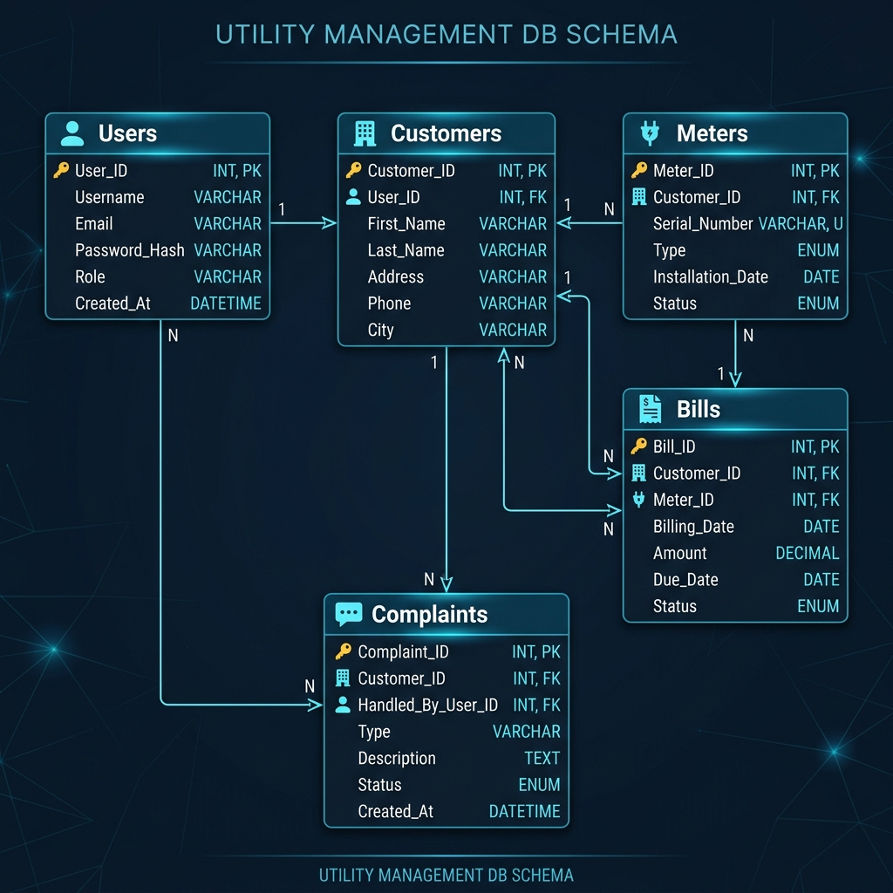
Database Schema
Powered by MySQL for transactional safety and speed.
One customer can register and manage multiple utility meters.
Invoices track billing history, readings, and secure hash tokens.
Tickets link customer complaints directly to assigned repair crew.
Log tables audit outgoing email notification delivery status.

Slide 7
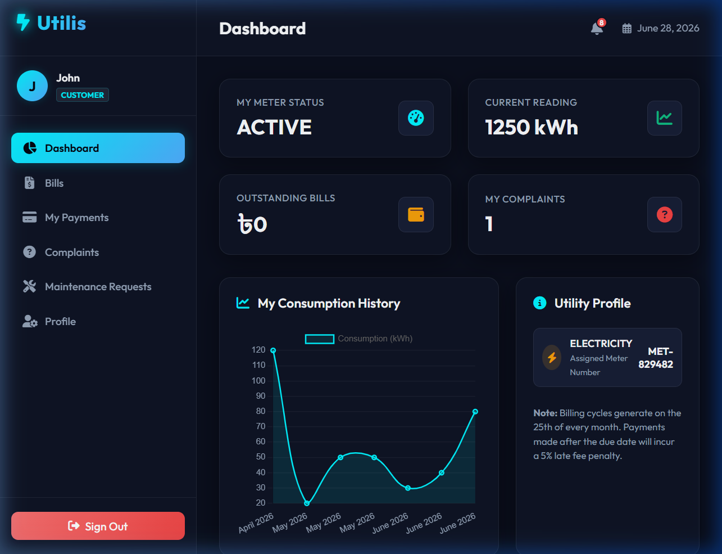
Feature: Interactive Dashboard
Customer View: Shows active meters, unpaid bills, and billing status.
Admin view: Monitors active connection counts and technical staff tasks.
Usage trends: Renders dynamic Chart.js graphs tracking monthly use.
Billing Control: Allows admins to run batch utility calculations with one click.

Slide 8
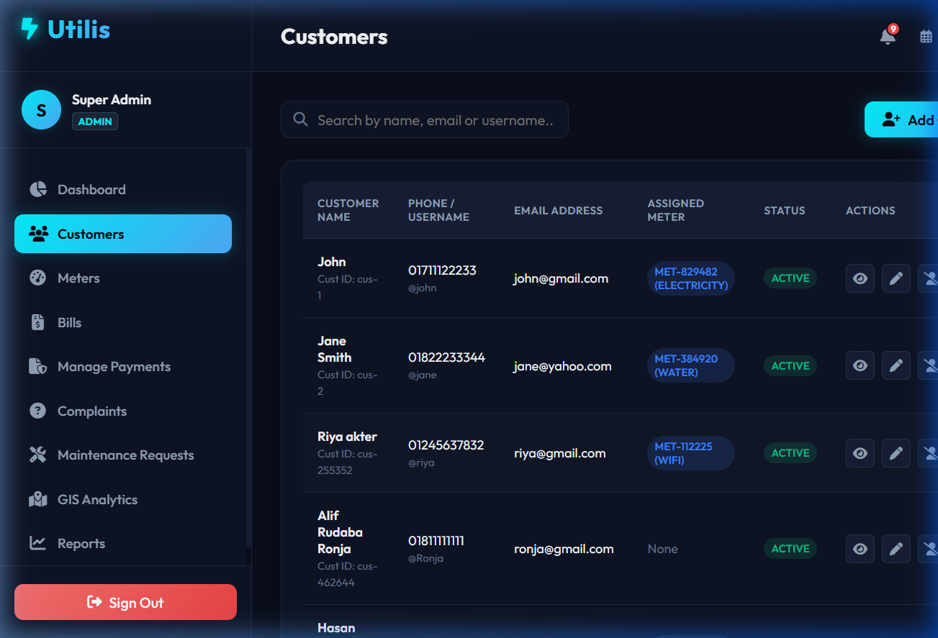
Feature: Meter & Customer Directory
Profiles: Central database containing client names, phones, and locations.
Meter Linking: Assigns serial-numbered meters directly to clients.
Easy Filter: Filter connections by type (Electricity, Water, Gas, WiFi).
Logs: Displays direct usage history for each registered customer.

Slide 9
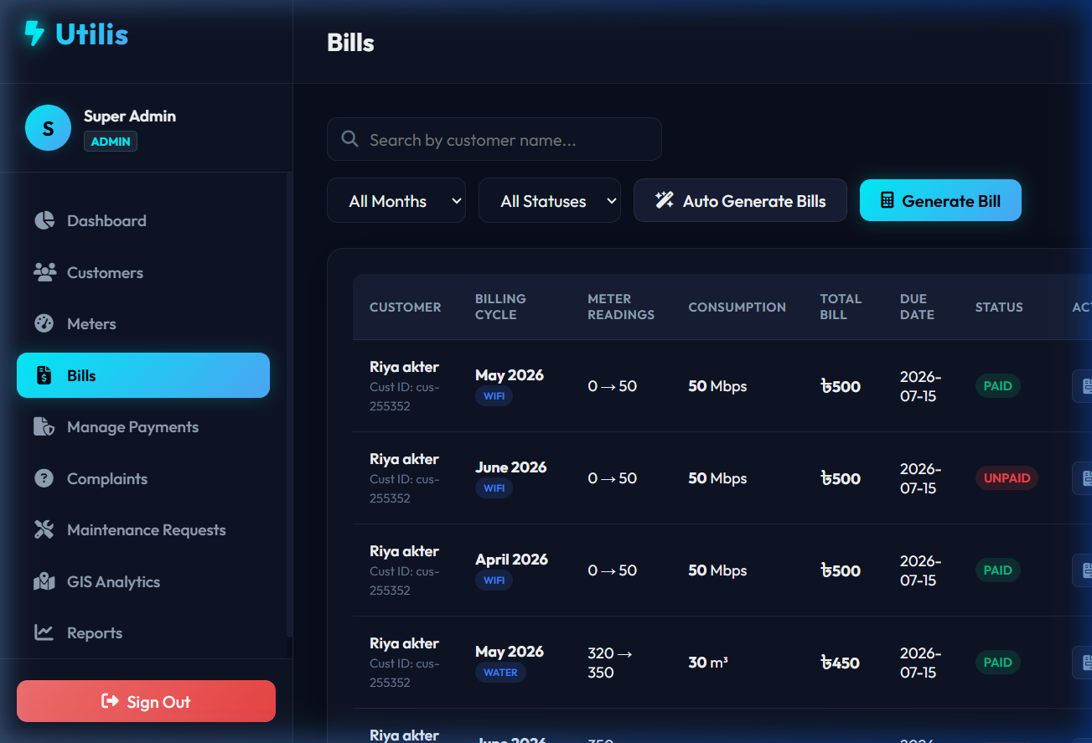
Feature: Billing & Invoicing Engine
Auto Calculation: Computes bill amounts instantly using tariff tiers.
Batch billing: Generates monthly bills for all active meters in seconds.
Digital Invoices: Creates structured, mobile-responsive HTML/CSS prints.
Ledger update: Updates payment statuses to 'paid' immediately upon approval.

Slide 10
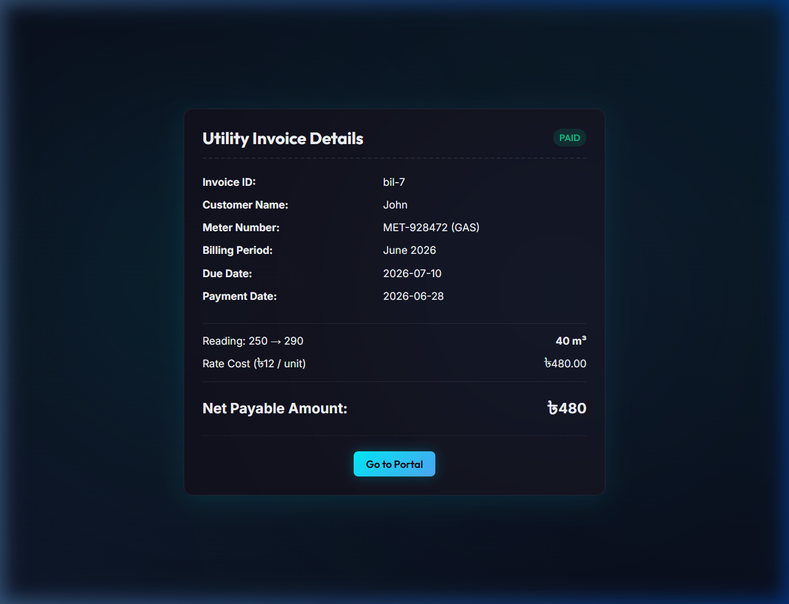
Feature: QR Code Verification
QR Codes: Embeds unique verification links directly on digital bills.
Mobile scan: Customers scan the code with their smartphone camera.
Secure Route: Redirects to a public unauthenticated details page.
Instant Check: Allows instant validation without logging into the system.

Slide 11
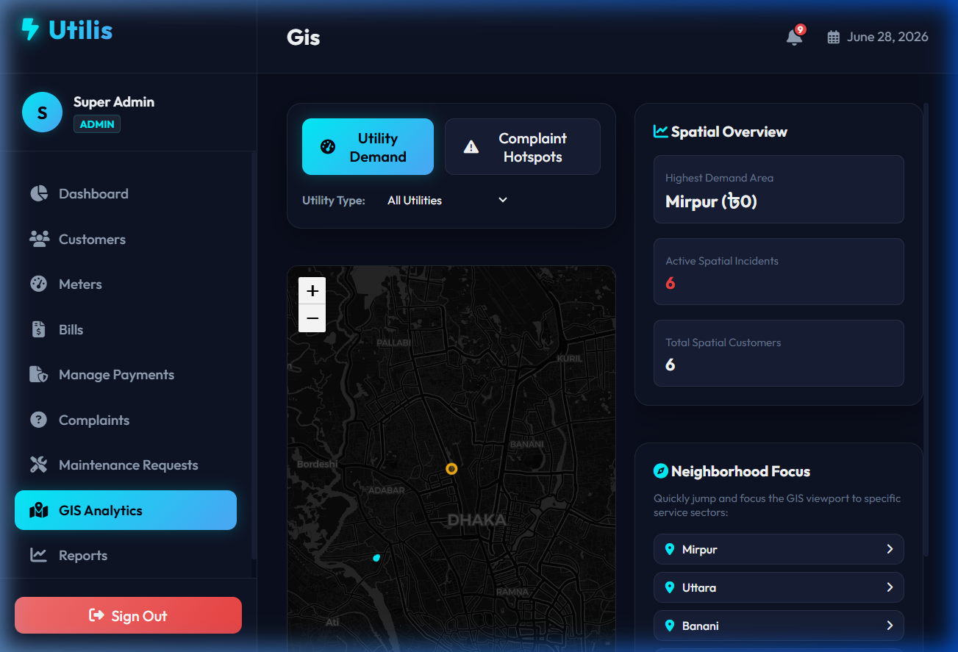
Feature: Geographic GIS Analytics
Dhaka Map: Renders interactive dark-themed maps using Leaflet.js.
Billing demand: Yellow map circles scale up to show high consumption.
Outage Markers: Plots active leaks and reports as red map pinpoints.
Rapid dispatch: Helps admins locate field crew nearest to incident targets.

Slide 12
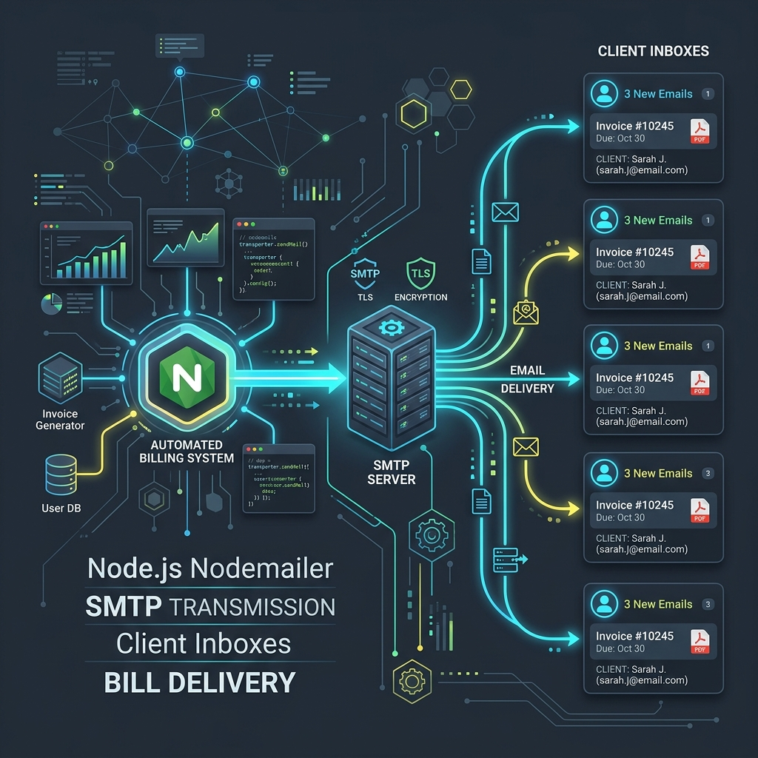
Feature: Automated Email Engine
Nodemailer SMTP: Dispatches HTML invoices directly to customer inboxes.
Overdue Alerts: Background task checks for bills due in 1-2 days.
Gmail Warnings: Delivers email reminder warnings to prompt payments.
Audit Trail: Logs email delivery status for diagnostic maintenance.

Slide 13
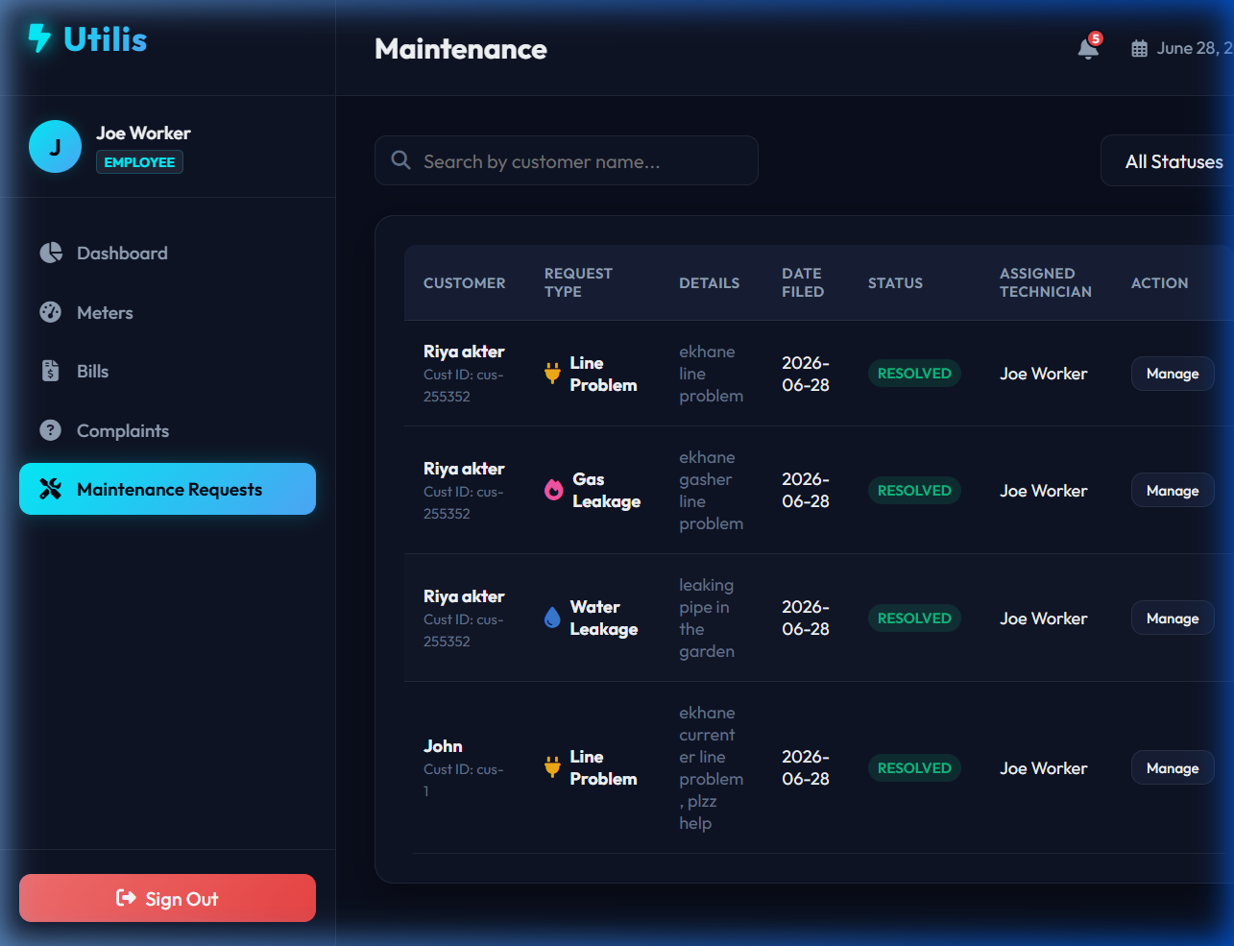
Feature: Operations & Maintenance
Tickets: Customers report outages, utility leaks, or payment issues.
Technician log: Field crew logs in to view lists of assigned repair jobs.
Progress Check: Tracks repairs seamlessly (Pending -> In Progress -> Resolved).
Communication: Connects admins, technicians, and customers in real-time.

Slide 14
Challenges & Solutions
Email Latency: SMTP tasks slowed down the server response. Solution: Sent emails asynchronously in the background.
SPA Navigation: Browser back/forward buttons broke routing. Solution: Implemented a lightweight Hash Router in JavaScript.
Database Load: Slow queries under concurrent traffic. Solution: Set up connection pooling to optimize MySQL speed.

Slide 15
Thank You
Utility Management System successfully demonstrates a modern, secure, and spatial-aware utility management ecosystem.
Powered by Express, Leaflet.js, and MySQL.
Questions?

