Slide 1
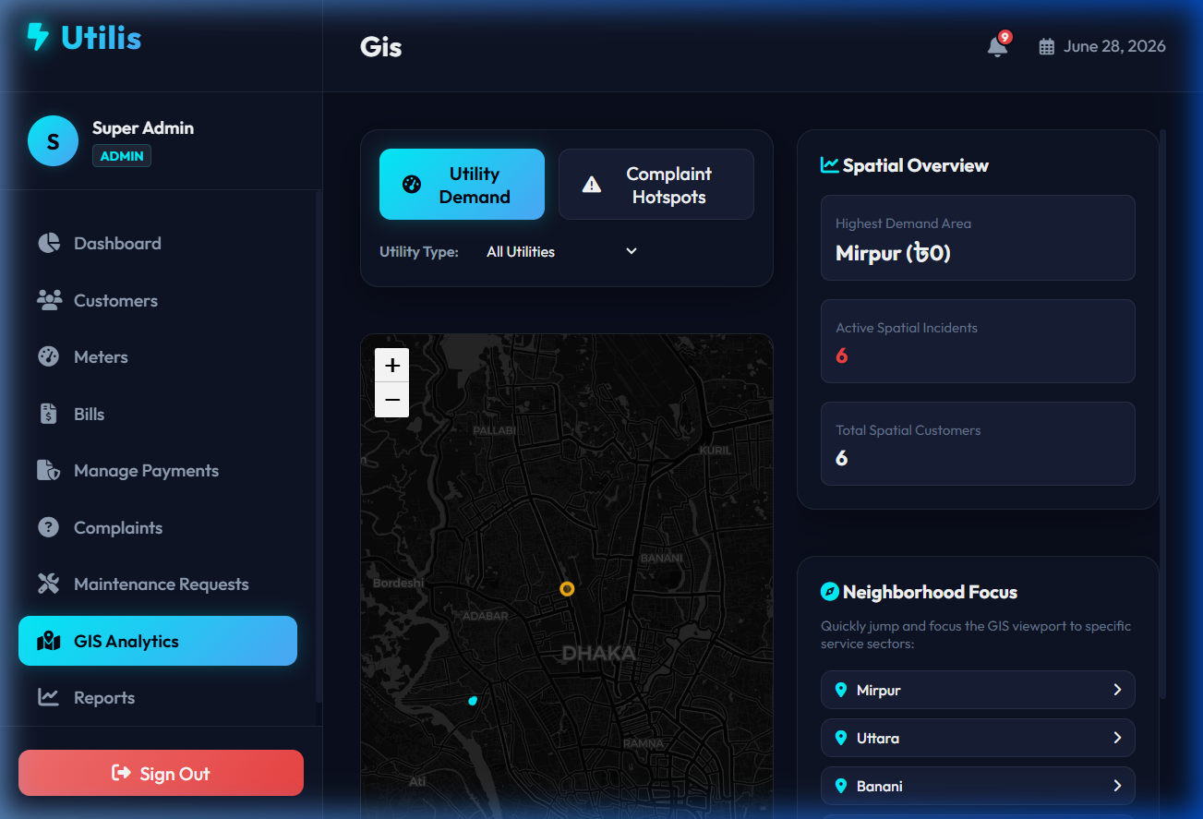
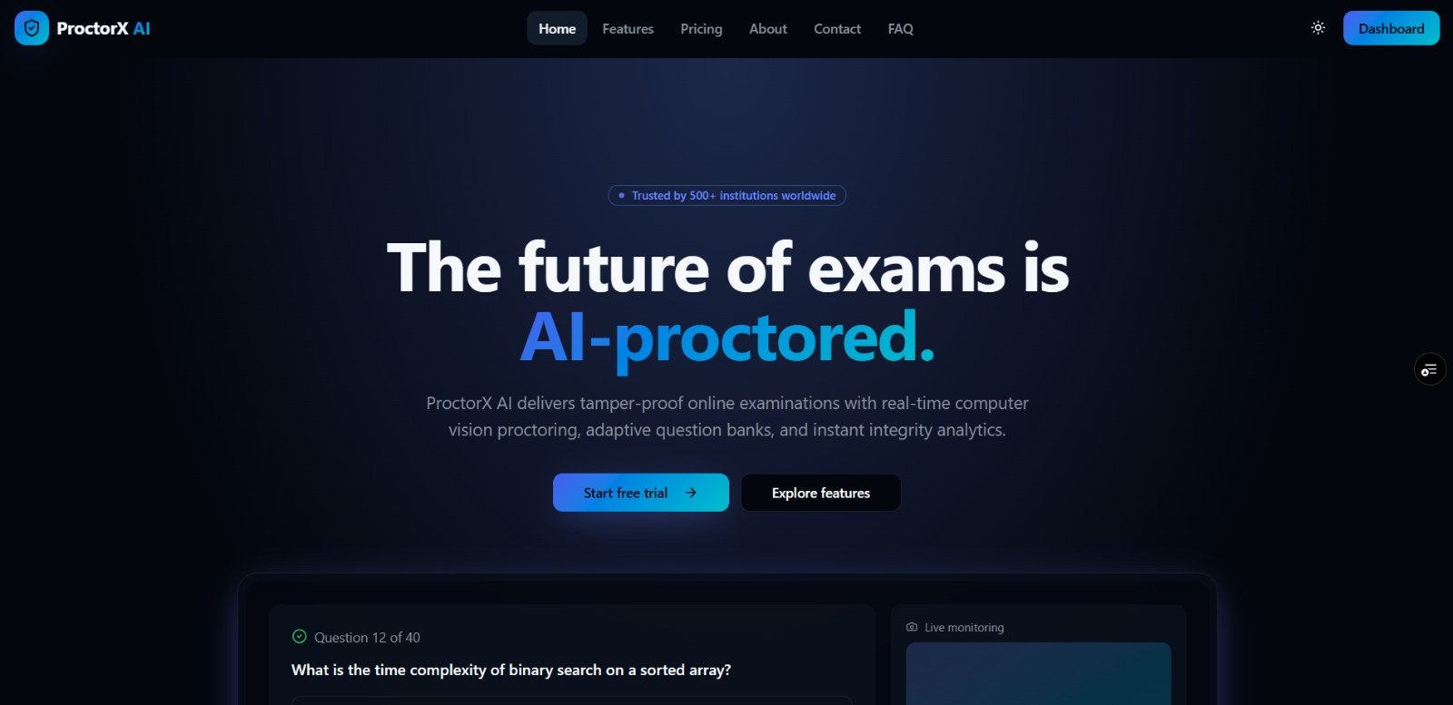
Welcome To ProctorX AI

Slide 2
Project name: ProctorX AI
Online Examination System with Proctoring
Team member :
NAME : MD. NAHID HOSSAIN
ID : 21CSE014
SESSION : 2021-2022
DEPT : CSE
NAME : MD. RIFAT ISLAM RIZVI
ID : 21CSE029
SESSION : 2021-2022
DEPT : CSE

Slide 3
Introduction
ProctorX AI is an intelligent online examination and learning management system designed to ensure secure, efficient, and fair online assessments. The platform integrates AI-based proctoring, automated evaluation, and learning support tools into a single solution.
It provides dedicated panels for Students, Teachers, and Administrators, along with features such as AI Tutor, Study Planner, AI Quiz Generation, Webcam Monitoring, Tab-Switch Detection, Integrity Score Tracking, and Real-Time Proctoring Alerts.
The system was developed following the Software Development Life Cycle (SDLC) methodology to ensure reliability, security, and scalability.

Slide 4
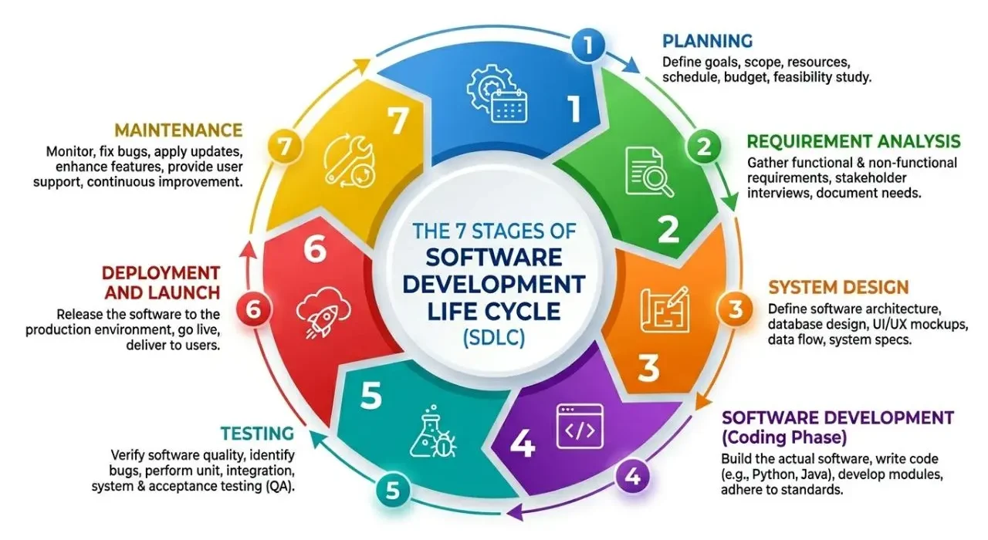
SDLC life cycle :

Slide 5
Planning :
Planning Phase
Identified the need for a secure and intelligent online examination system.
Defined project goals, scope, and target users (Students, Teachers, and Administrators).
Planned key features such as AI Proctoring, AI Tutor, Study Planner, AI Quiz, and Result Management.
Selected suitable technologies and development resources.
Established the project timeline and development roadmap.
Outcome: A clear project plan was created to guide the development of ProctorX AI efficiently and systematically.

Slide 6
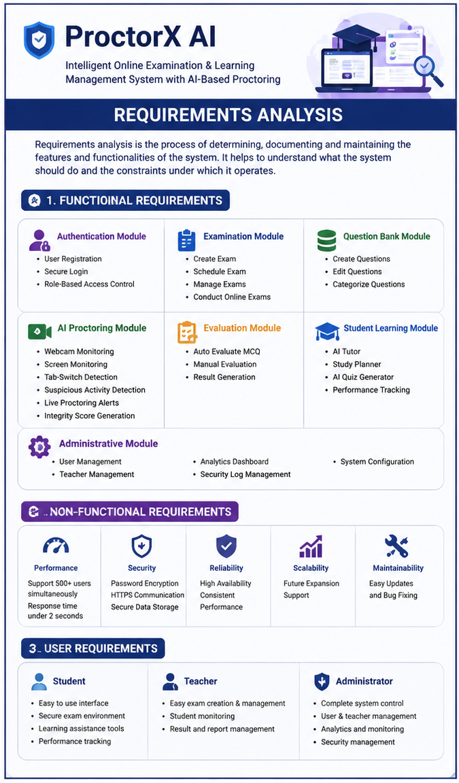
Requirement analysis :
Requirements Analysis
Identified functional and non-functional requirements of the system.
Defined user roles: Student, Teacher, and Administrator.
Gathered requirements for exam management, question bank, result processing, and user management.
Specified AI-based features such as Webcam Monitoring, Tab-Switch Detection, Integrity Score Tracking, AI Tutor, Study Planner, and AI Quiz Generation.
Established security, performance, scalability, and reliability requirements.

Slide 7
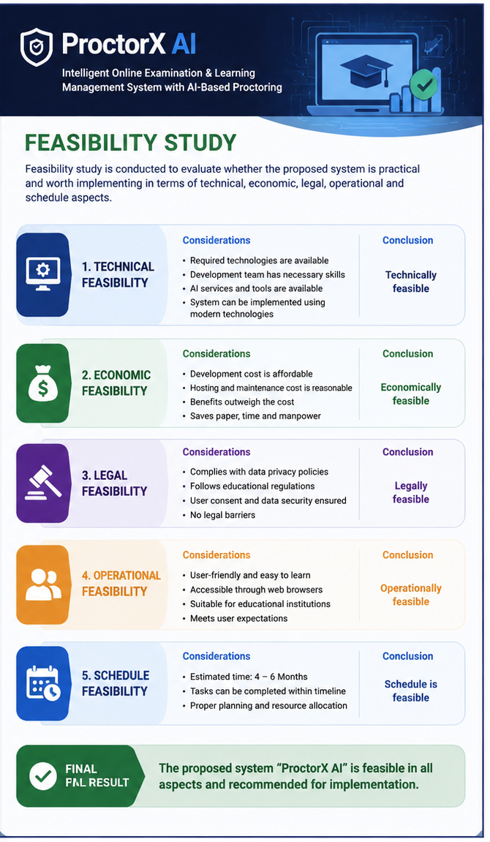
Feasibility study :
Feasibility Study
Evaluated the project from technical, economic, legal, operational, and schedule perspectives.
Confirmed that required technologies such as React.js, Django, PostgreSQL, and AI-based monitoring tools are available.
Analyzed development and maintenance costs, which are affordable compared to the long-term benefits.
Ensured compliance with data privacy, security, and educational regulations.
Verified that the system is user-friendly and can be developed within the planned timeline.

Slide 8
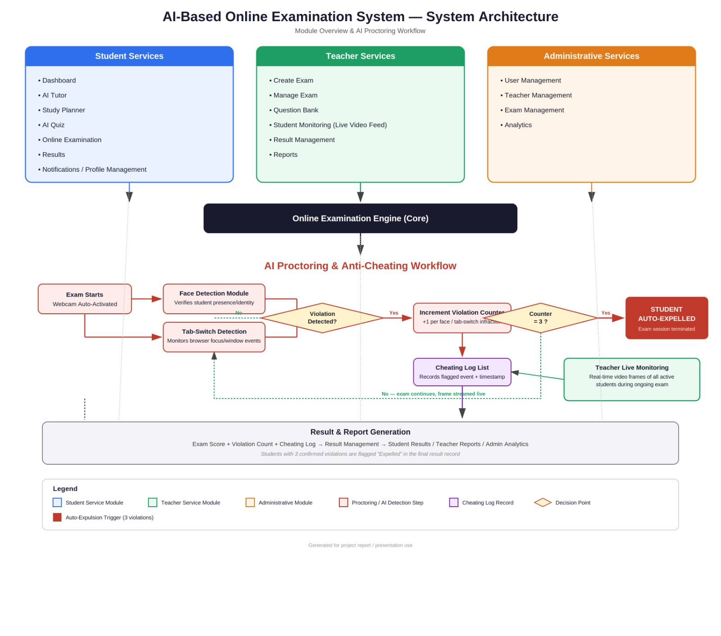
Design:
System Design
Designed a three-tier architecture consisting of Presentation Layer, Business Logic Layer, and Data Layer.
Created separate interfaces for Students, Teachers, and Administrators.
Designed key modules including Authentication, Examination Management, Question Bank, AI Proctoring, Evaluation, and Reporting.
Structured the database to manage users, exams, questions, results, and monitoring records efficiently.
Developed responsive and user-friendly dashboards for better usability and system management.

Slide 9
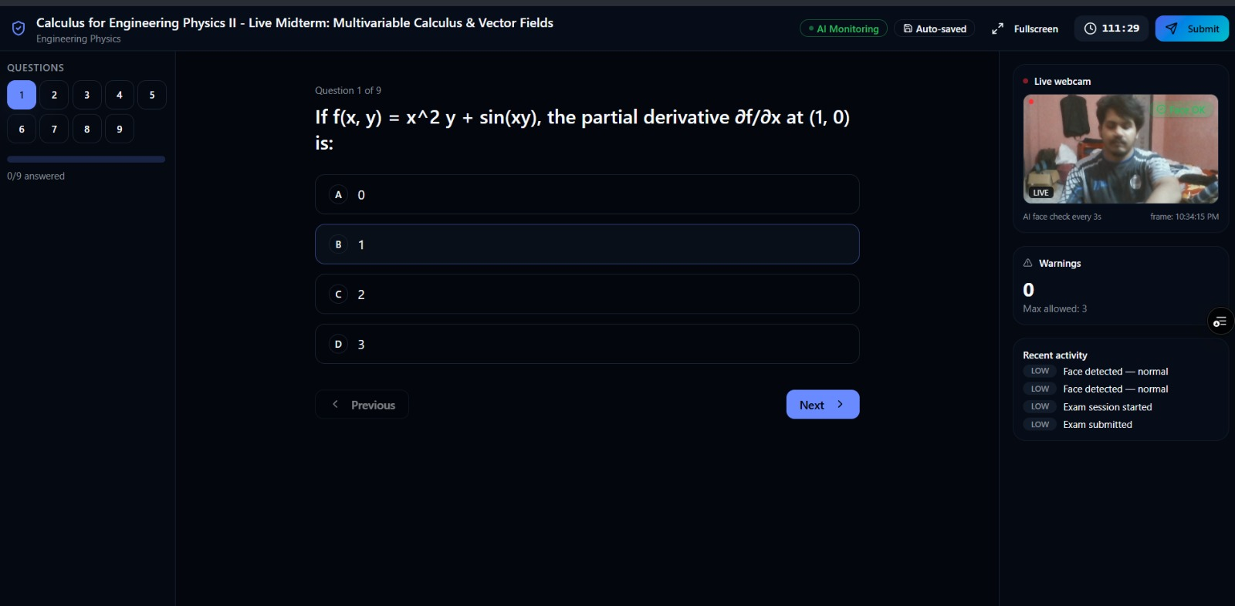
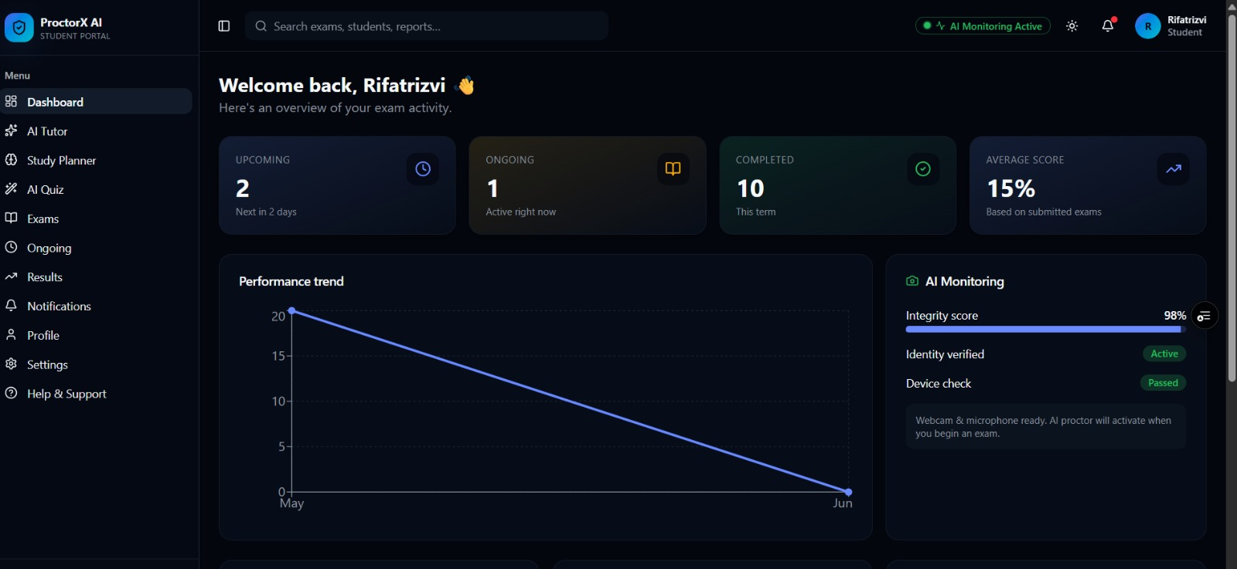
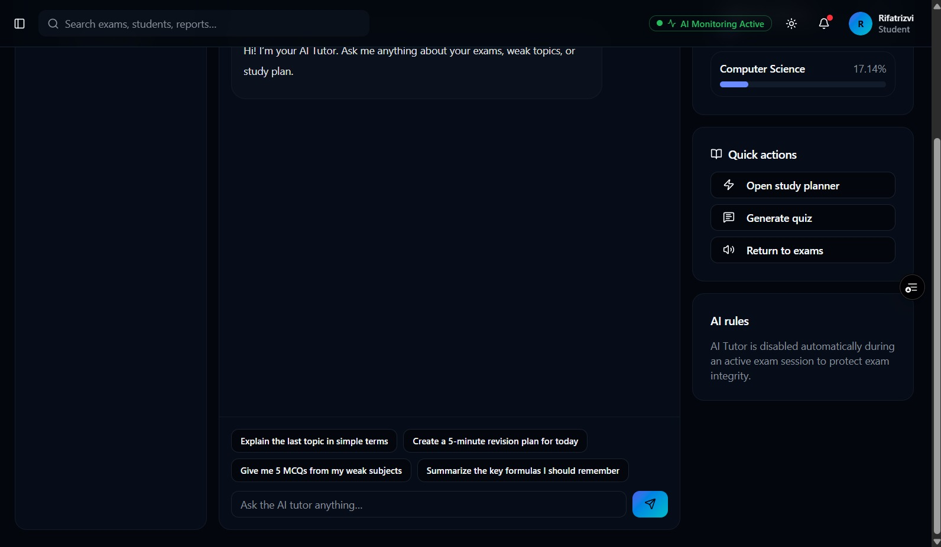
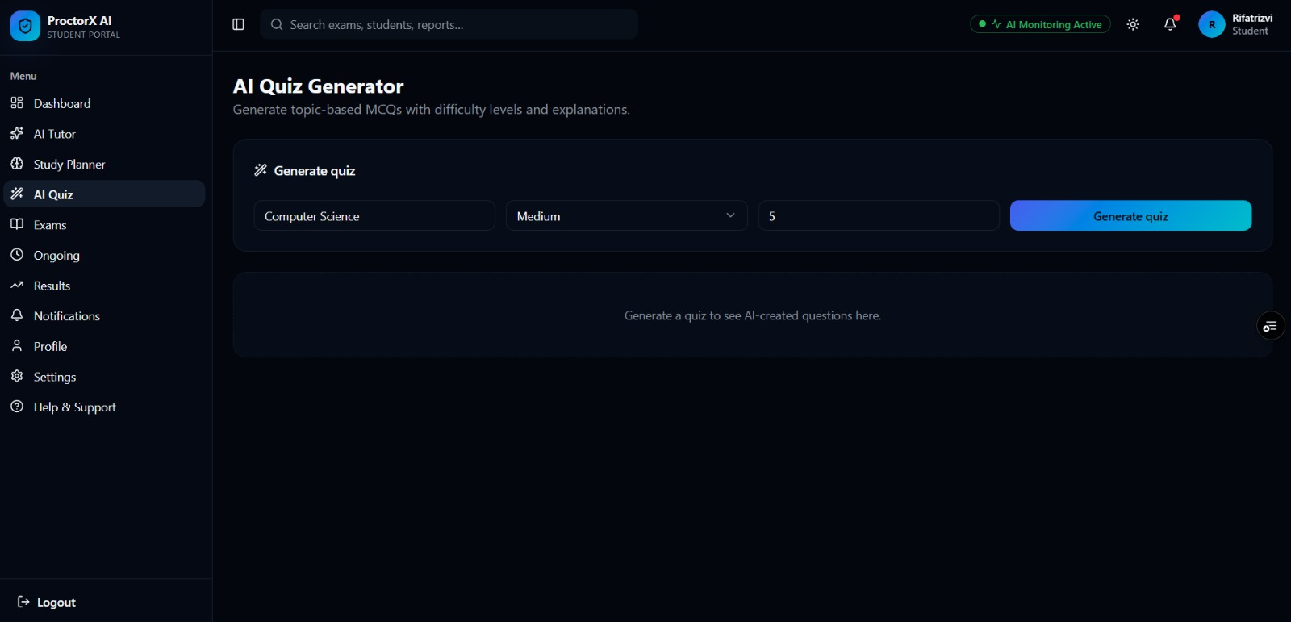
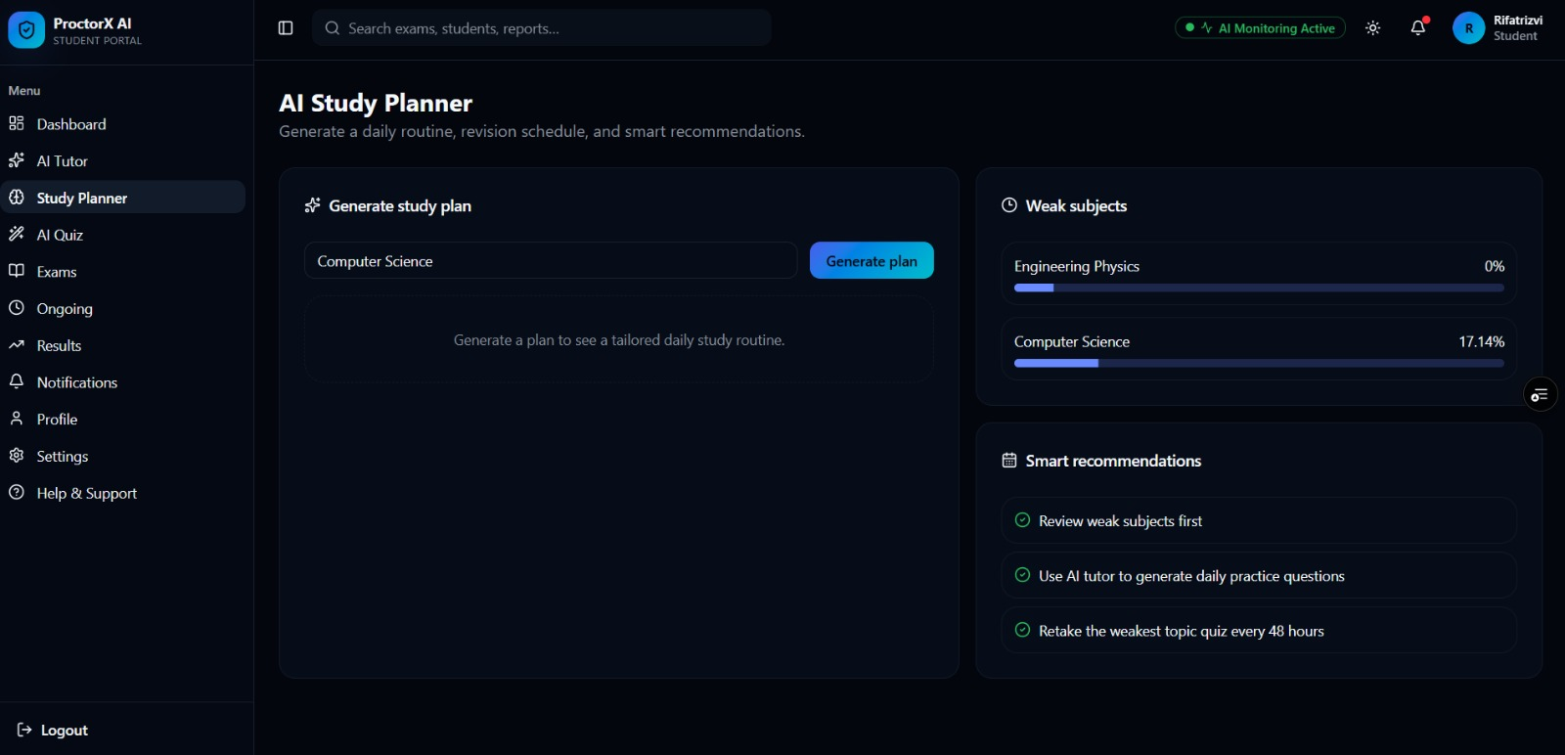
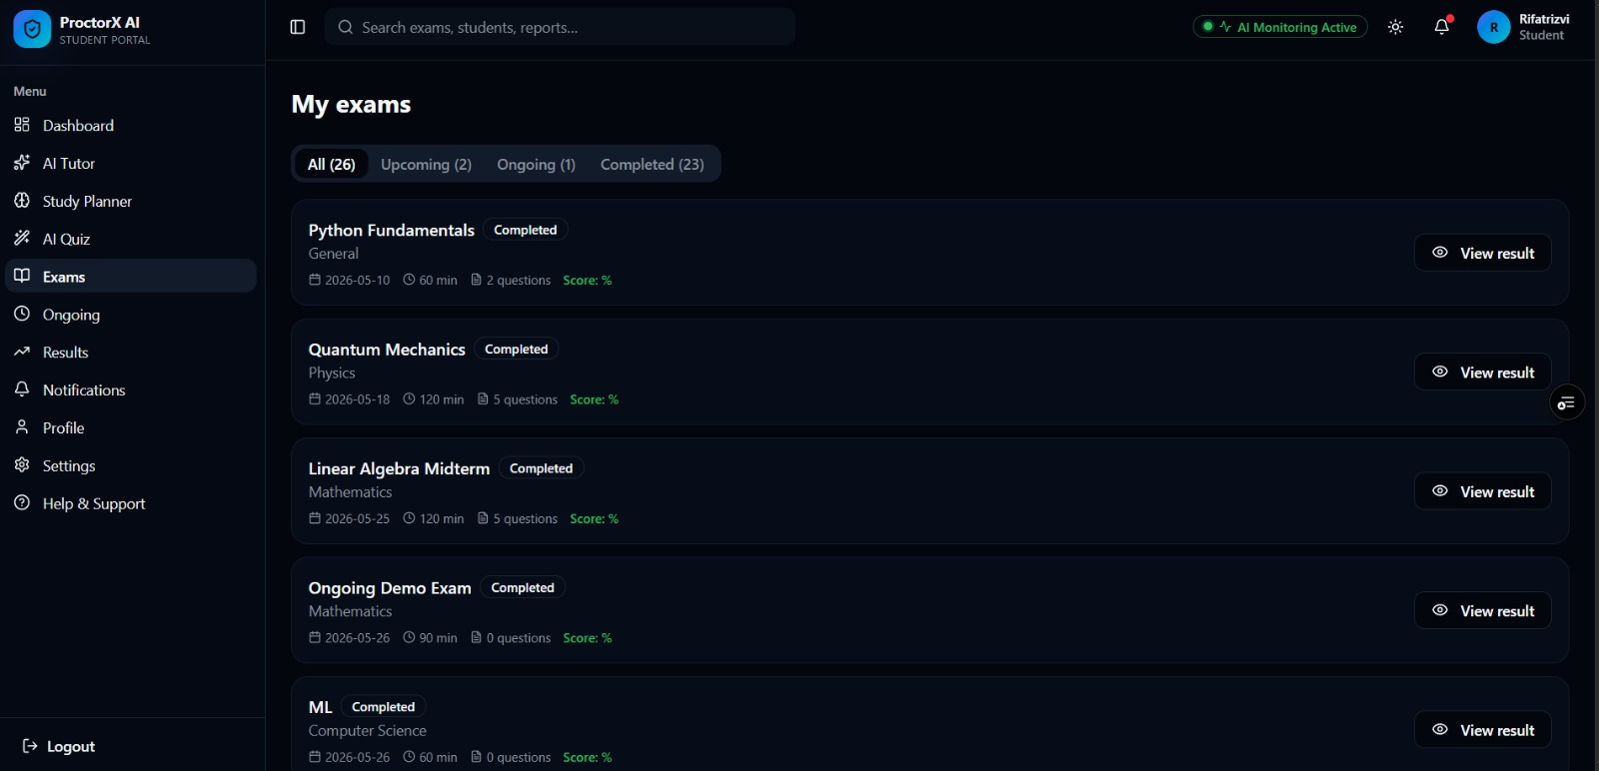
Building and implementation :
Student section :

Slide 10
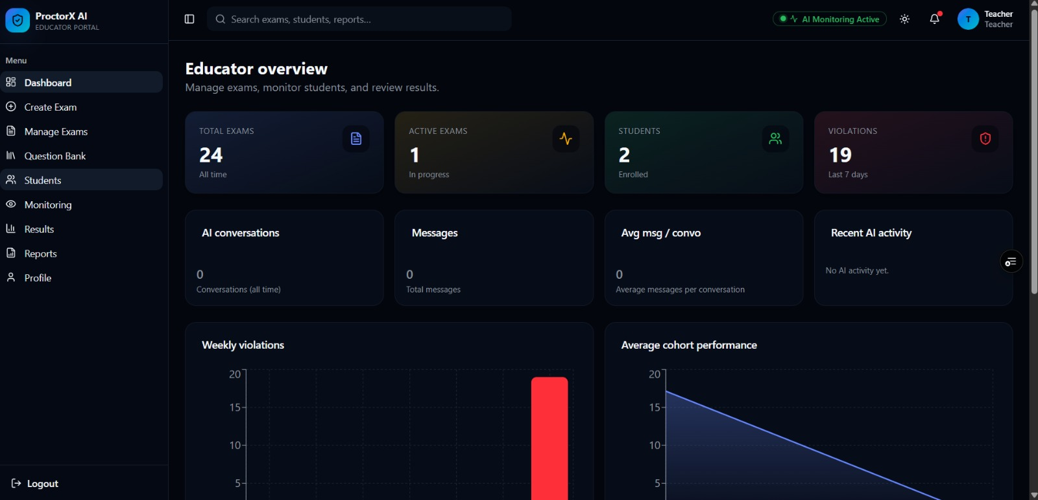
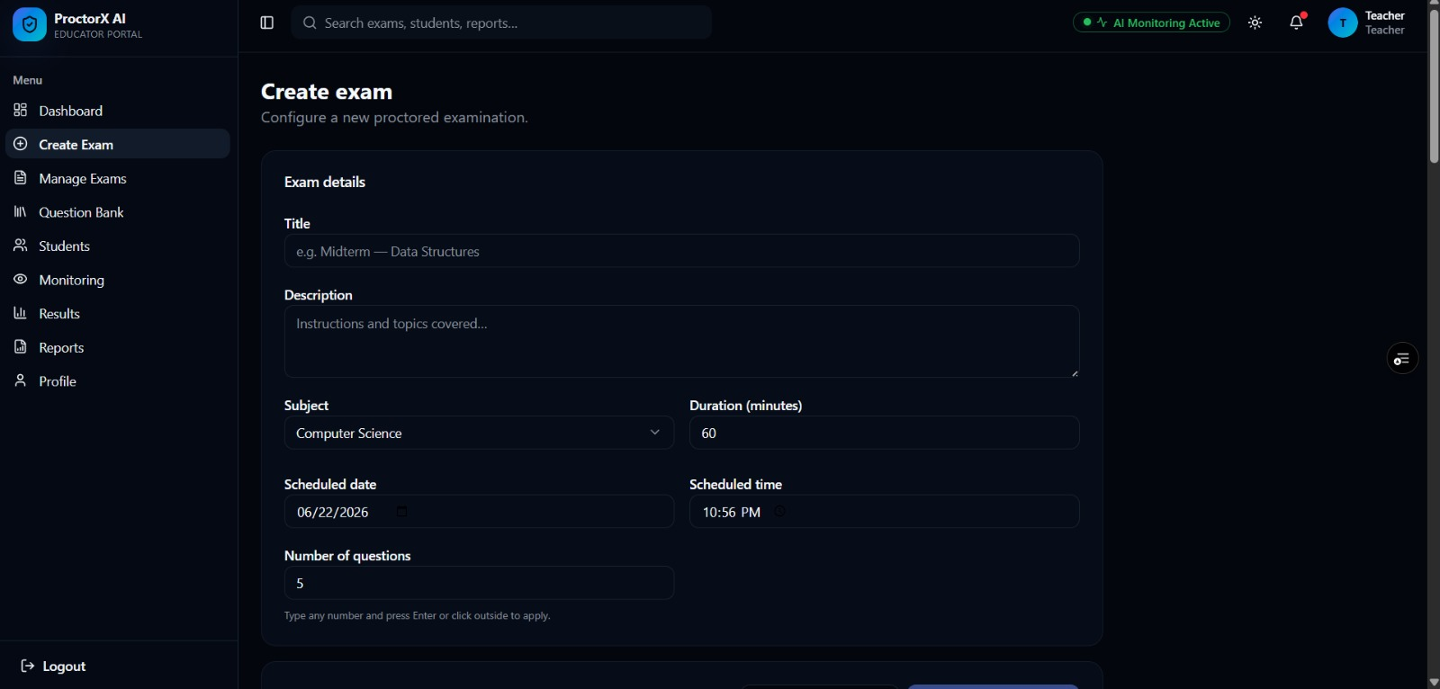
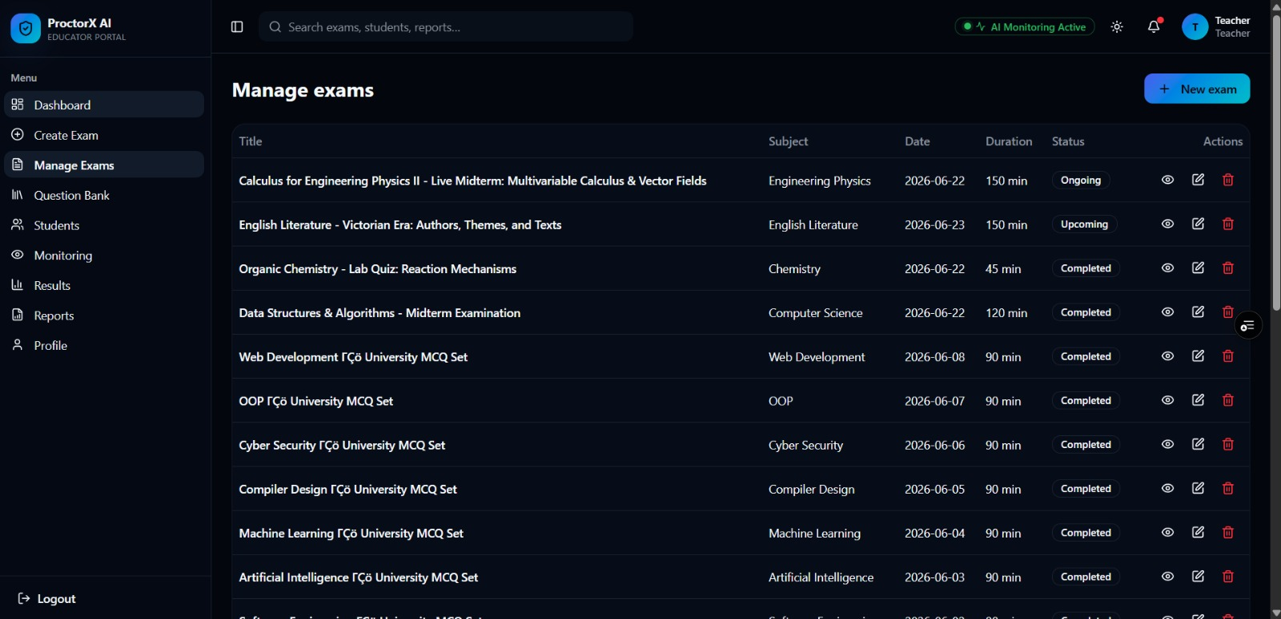
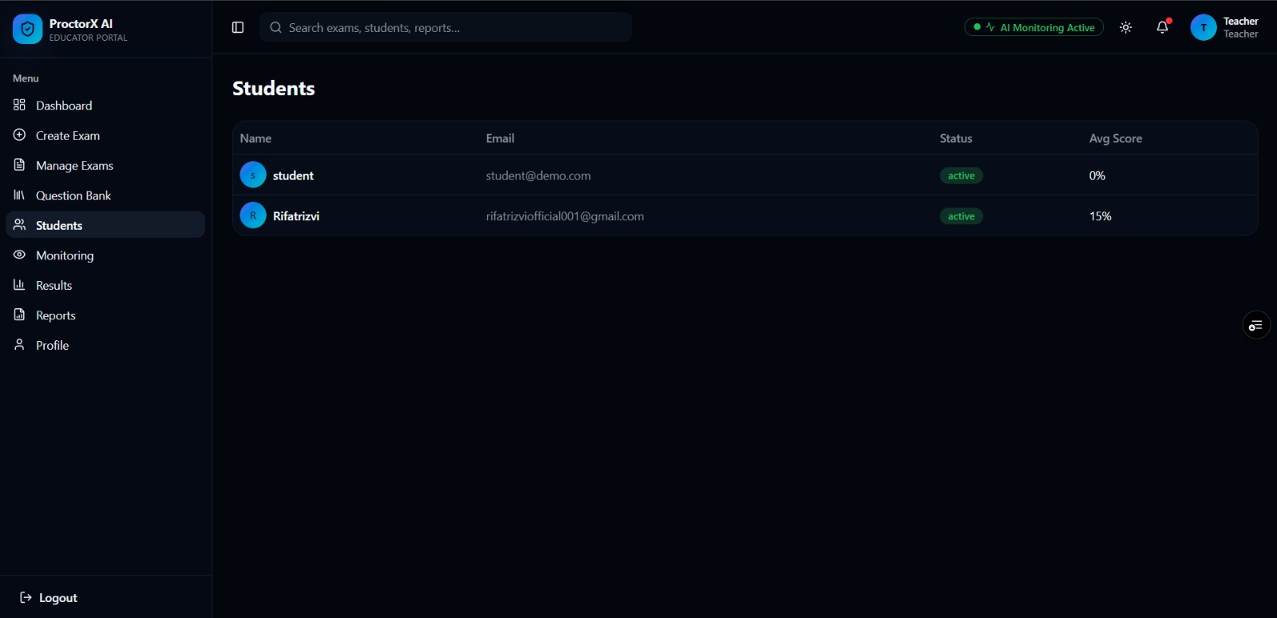
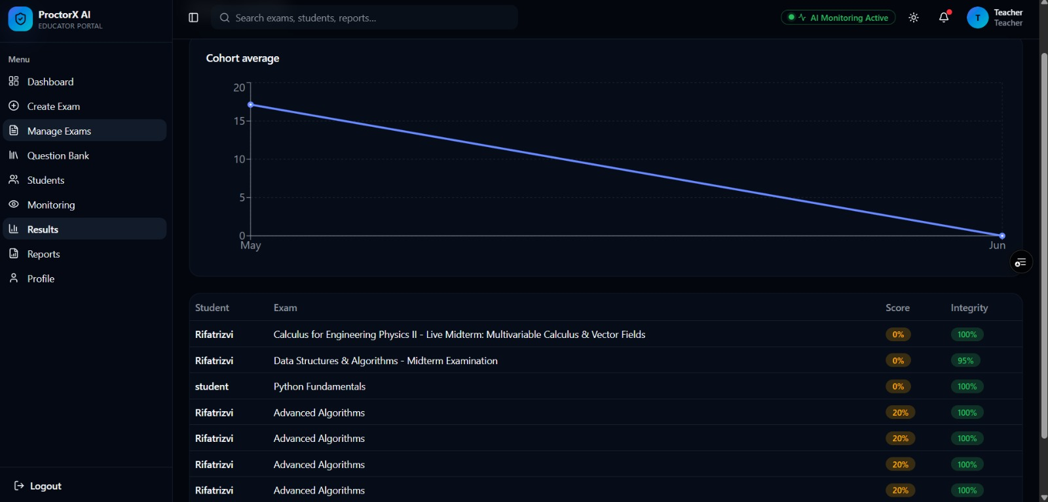
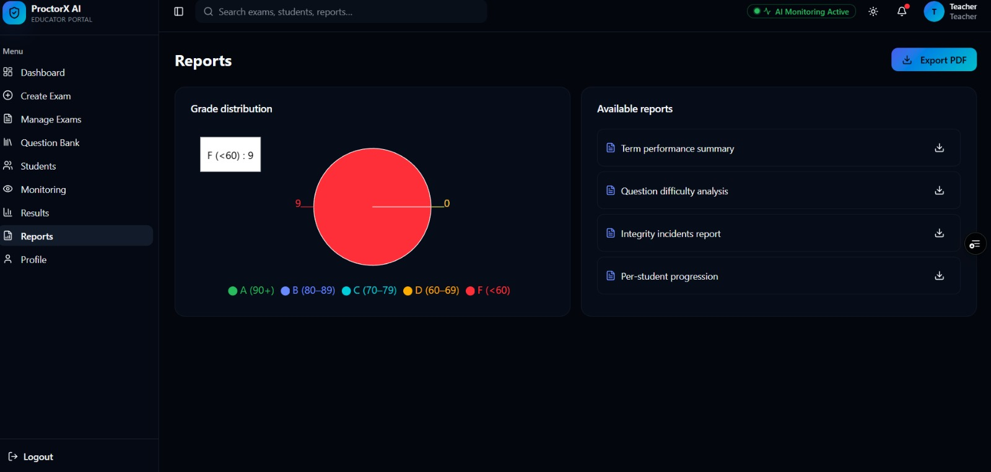
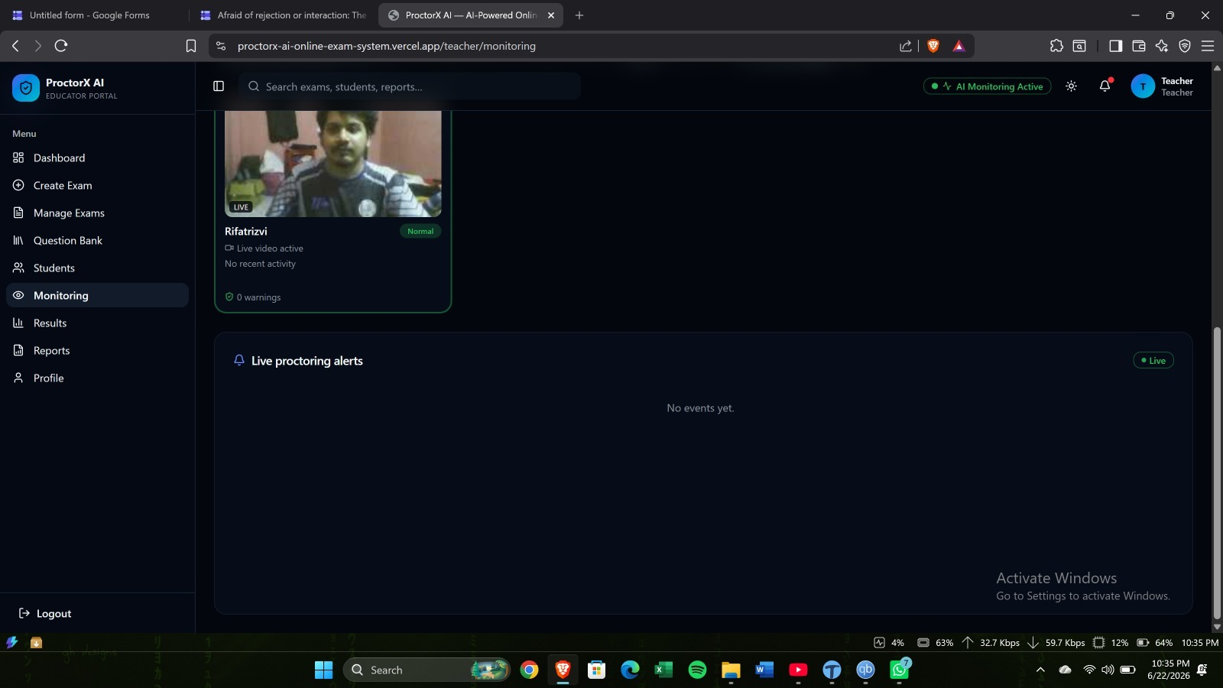
Teacher section :

Slide 11
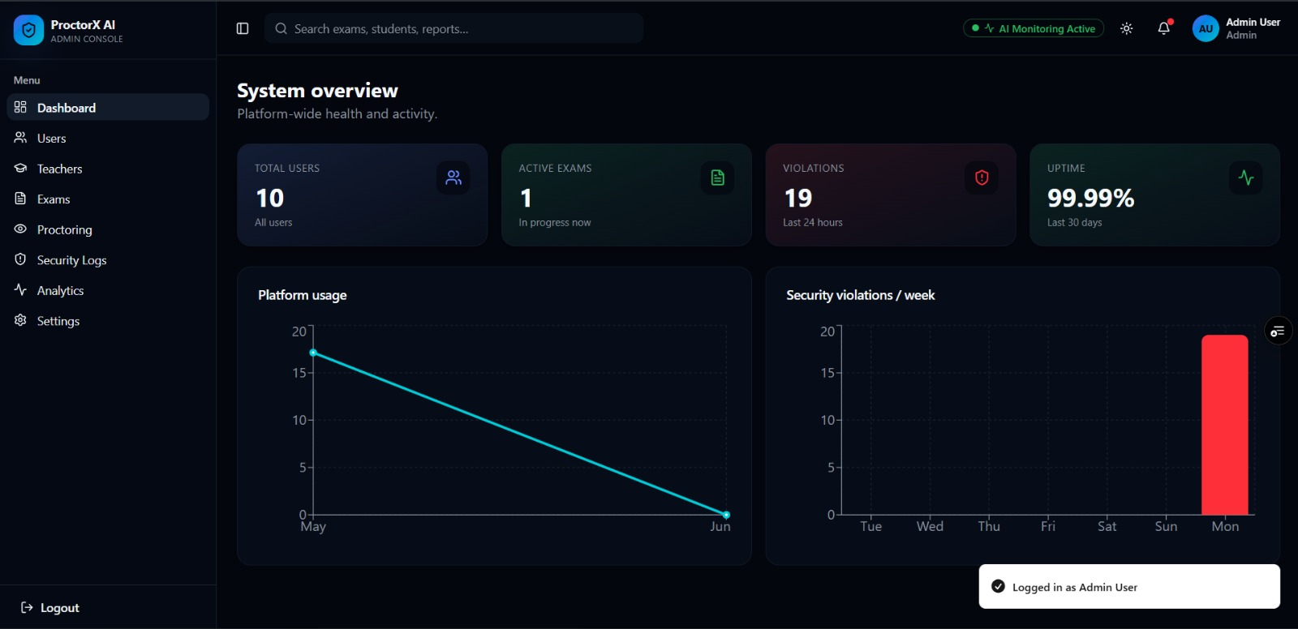
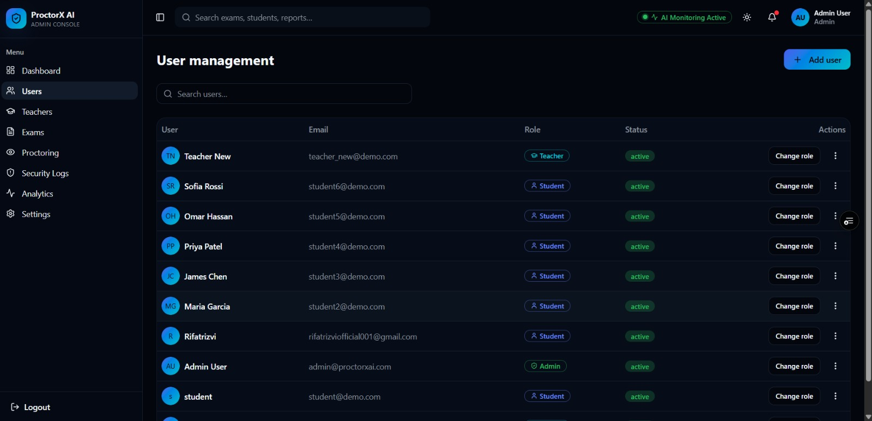
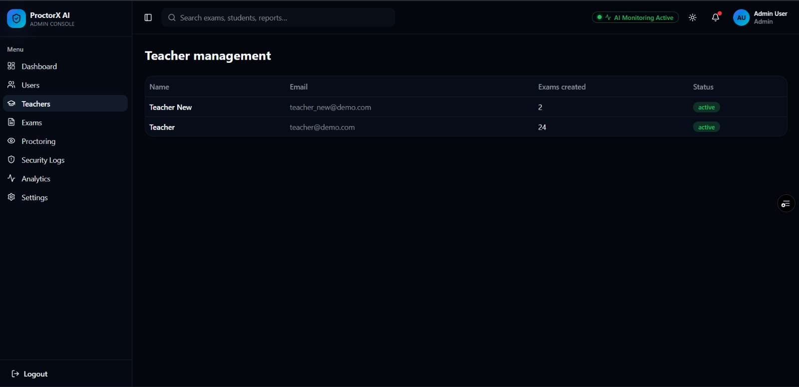
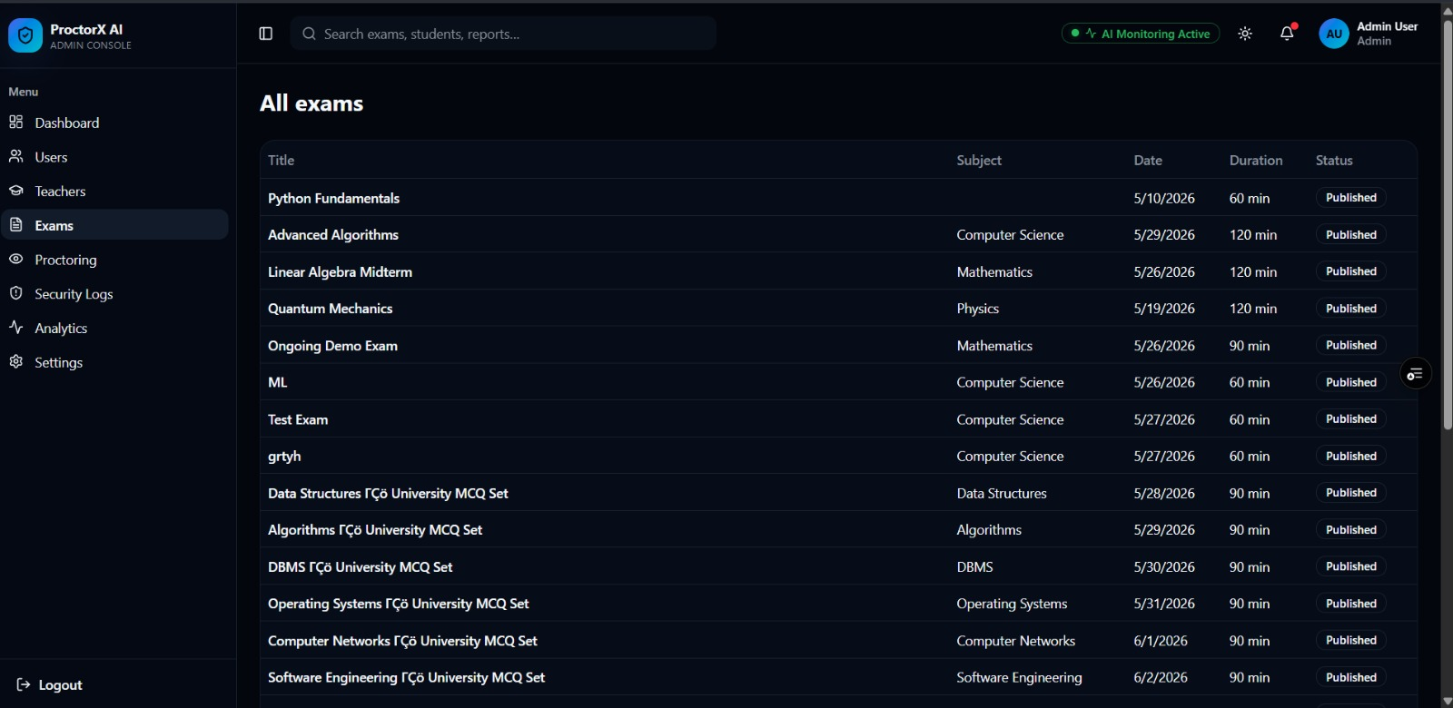
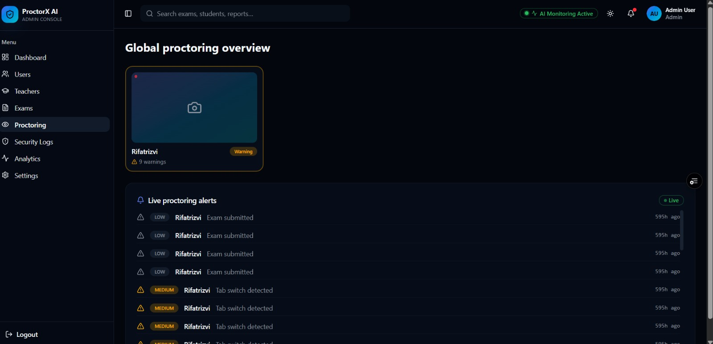
Admin section :

Slide 12
Testing :
Testing Phase
Conducted Unit Testing to verify individual modules such as Authentication, Exam Management, and AI Proctoring.
Performed Integration Testing to ensure smooth communication between different system modules.
Executed System Testing to validate the complete functionality of the platform.
Carried out Security Testing to verify user authentication, data protection, and access control.
Performed User Acceptance Testing (UAT) with Students, Teachers, and Administrators to ensure the system meets user requirements.

Slide 13
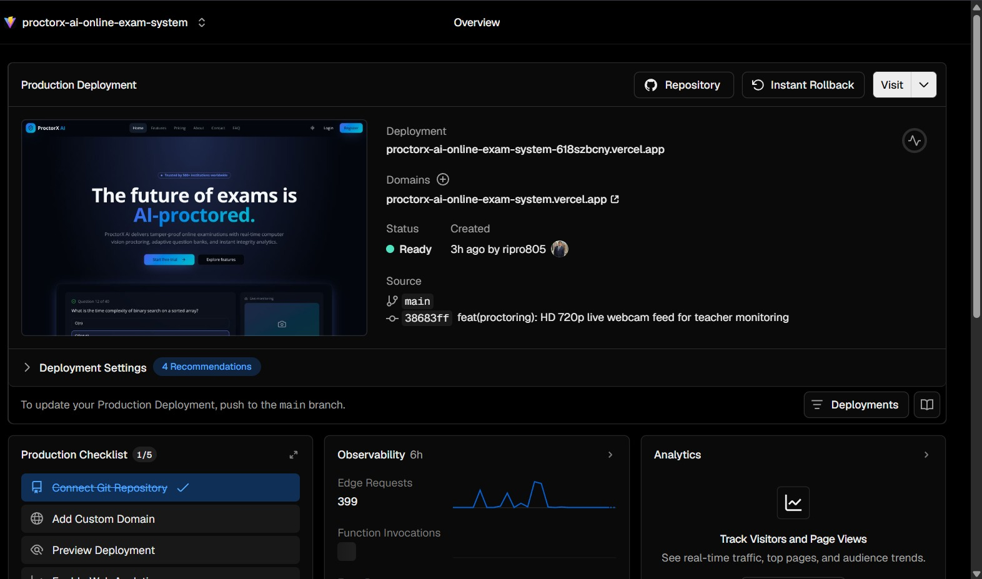
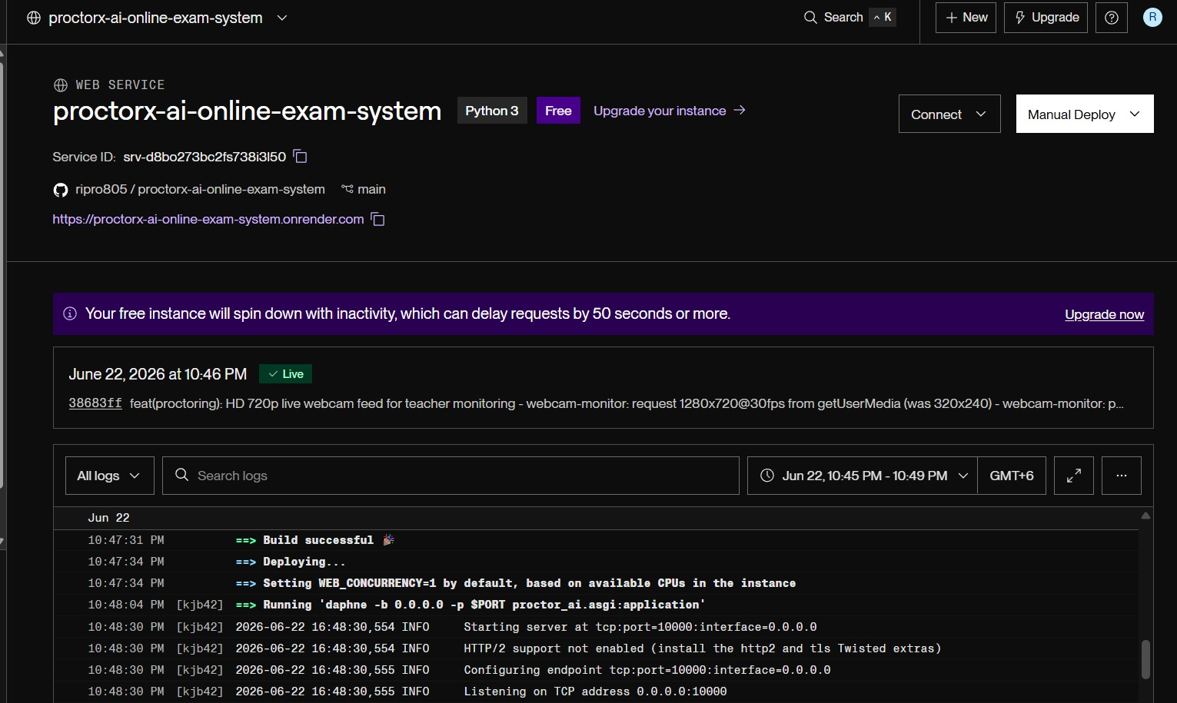
Deployment :
Deployment Phase
Configured the production server and database environment.
Deployed the application to a secure web hosting platform.
Implemented SSL/HTTPS for secure communication and data protection.
Created and configured user accounts for Students, Teachers, and Administrators.
Verified system performance, accessibility, and security before public release.
The frontend is deployed on Vercel, and the backend is deployed on Render.

Slide 14
Maintenance:
Maintenance Phase
Regularly monitored system performance and security.
Fixed bugs and resolved issues reported by users.
Updated system features and improved functionality based on feedback.
Performed database maintenance, backup, and recovery operations.
Applied security patches and software updates to ensure system reliability.

Slide 15
Conclusion :
ProctorX AI successfully provides a secure, intelligent, and efficient online examination environment.
The system integrates AI-based proctoring, automated evaluation, and learning support features into a single platform.
Dedicated Student, Teacher, and Admin panels improve usability and system management.
The implementation of SDLC ensured a structured development process, resulting in a reliable and scalable solution.
ProctorX AI enhances examination integrity, reduces administrative workload, and supports modern digital education.

Slide 16
Thank you all

