Slide 1
COMPREHENSIVE SOFTWARE ENGINEERING PROJECT PRESENTATION
Utility Management System
A Next-Generation Full-Stack Web Platform for Multi-Utility Billing, Smart Telemetry, and Customer Governance
Course / Topic: Software Engineering Lab Project (CSE 002) | Architecture: Modern 3-Tier Web SPA
Tech Stack: Express.js (Node.js) API • MySQL / Neon Serverless • Vanilla ES6+ Modules • Vercel Edge Cloud

Slide 2

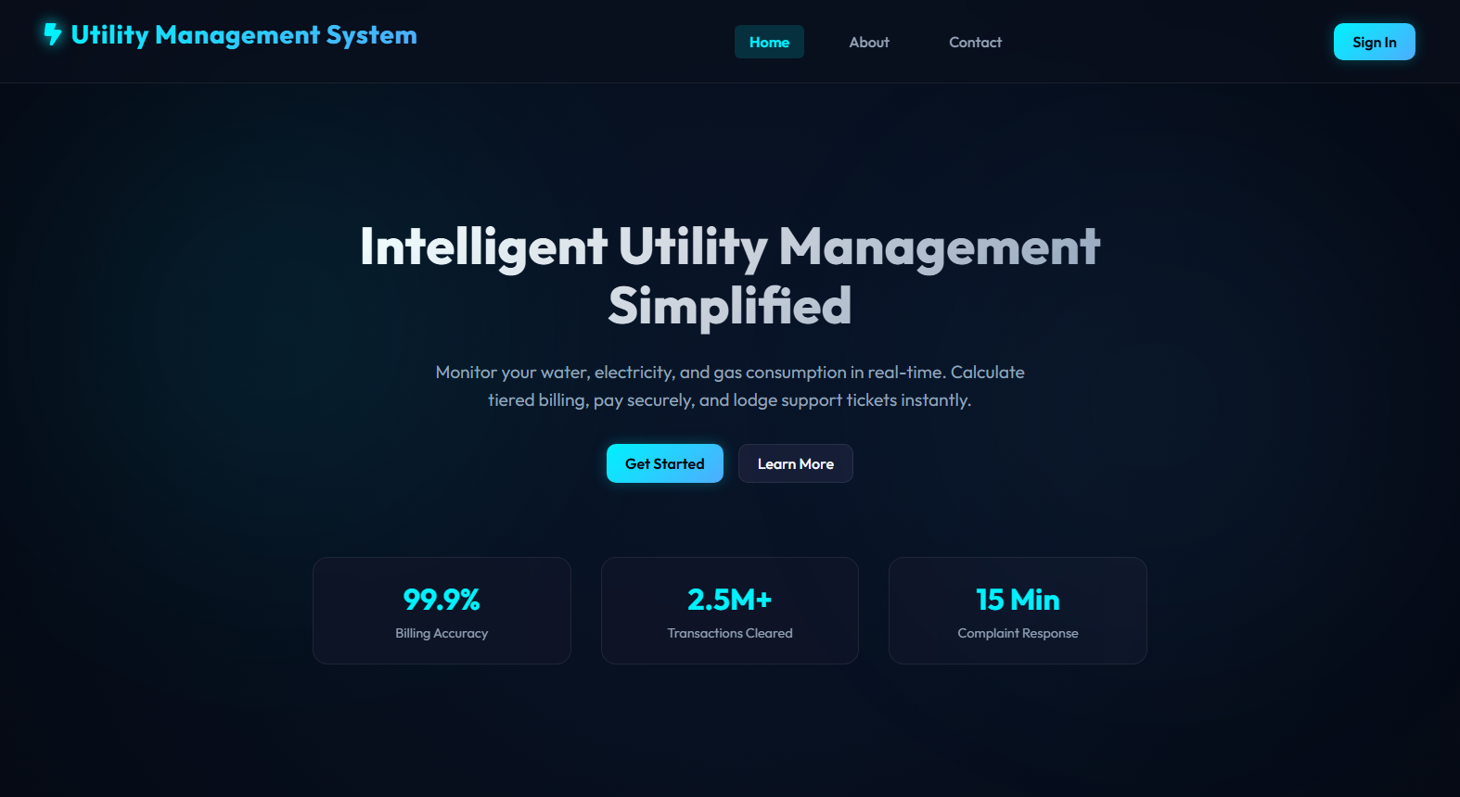
Introduction: Modernizing Utility Operations
Background, Motivation, and System Purpose
System Overview & Motivation
• Traditional utility billing is plagued by manual paper meter-reading errors, payment delays, and non-transparent tariff computations.
• The Utility Management System is an end-to-end digital ecosystem integrating electricity, water, gas, and broadband telecom under one unified dashboard.
• Empowers Customers with instant bill calculation, real-time meter consumption history, and secure 1-click digital checkout.
• Equips Utility Providers with centralized customer registries, automated tiered tariff calculation, GIS spatial meter locating, and revenue analytics.
• Full Role-Based Access Control (RBAC) separating Admin oversight, Employee telemetry updates, and Customer self-service portals.
Live Web Portal: Public Homepage & Service Features
99.9%
Billing Accuracy with Automated Tier Engine
< 15 Min
Customer Complaint Response Turnaround

Slide 3

Software Development Life Cycle (SDLC)
Structured Iterative Engineering Methodology
1. Planning
Scope definition, milestone tracking, resource budgeting, and risk mitigation.
2. Requirements
Stakeholder interviews, SRS specification, use cases, and functional modeling.
3. Feasibility
Technical stack evaluation, economic ROI, and operational viability analysis.
4. Architecture
ER schema design, 3-tier system architecture, and sequence interaction flows.
5. Implementation
Modular REST API coding, responsive SPA frontend UI, and database migrations.
6. Verification
Automated unit tests, integration validation, security audits, and UAT testing.
7. Deployment & Ops
Edge hosting on Vercel, serverless routing, and preventive maintenance crons.

Slide 4

Project Planning & Governance
Scope, Resource Allocation, Milestones, and Risk Mitigation
Milestones & Resource Breakdown
Risk Management Matrix
• Project Objectives: Develop a cross-platform web application supporting multi-meter tracking, bill generation, and payments within an 8-week cycle.
• Sprint 1-2 (Foundation): Architectural blueprints, relational database schema formulation, and REST API scaffold.
• Sprint 3-4 (Core Engines): Tiered tariff formula engine, meter telemetry CRUD, and user authentication modules.
• Sprint 5-6 (Interactive Features): Payment checkout simulation, interactive Leaflet GIS map, and live ticket resolution chat.
• Sprint 7-8 (Polishing & Launch): Automated reminder background cron jobs, Vercel cloud deployment, and system verification.
• Database Downtime Risk: Addressed via dual-layer database abstraction (Automatic failover between MySQL pool and read-only local JSON fallback).
• Tariff Inaccuracy Risk: Addressed through automated unit tests against tiered slabs (Electricity: 7.5/kWh, Water: 15.0/m3, Gas: 12.0/m3, WiFi: 10/Mbps).
• Credential Leakage Risk: Zero secrets in version control; environment variables decoupled using .env and .env.example templates.
• Performance Bottlenecks: Solved via client-side caching (in-memory state + localStorage cache) minimizing repetitive network payloads.
• Serverless Cold Starts: Lightweight Express endpoints hosted on Vercel with static assets offloaded to edge CDN.

Slide 5

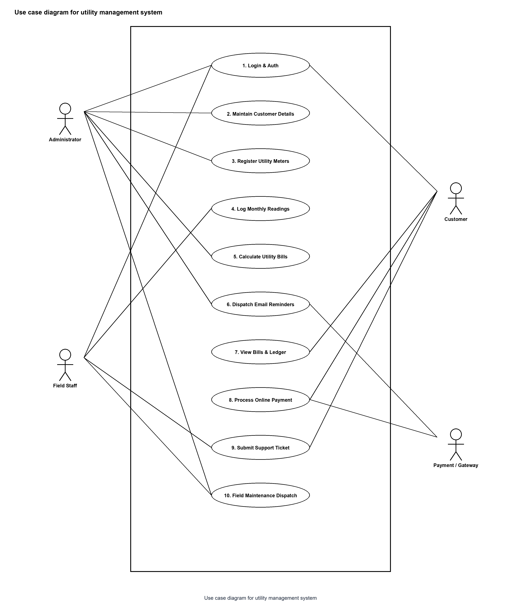
Requirement Analysis: Functional & Non-Functional
Comprehensive Stakeholder Needs & System Boundaries
Functional Requirements (FR)
• FR1 - Role-Based Authentication: Granular permission levels for Admins, Utility Field Technicians, and Consumers.
• FR2 - Smart Meter Management: Assign unique serial IDs, link physical addresses, track consumption telemetry, and flag anomalies.
• FR3 - Tiered Billing Generator: Automated computation based on previous and current readings multiplied by defined tariff brackets.
• FR4 - Payment Gateway Processing: Simulated multi-channel checkout (Credit/Debit Card, Mobile Banking) with downloadable receipts.
• FR5 - Dispute & Complaint Management: Two-way ticket lifecycle with status tags ('Pending', 'Investigating', 'Resolved') and real-time remarks.
• FR6 - GIS Mapping: Spatial visualization of utility meters across geographical coordinates on an interactive canvas.
System Use Case Diagram: User Roles & Interactions

Slide 6

Feasibility Study: Multi-Dimensional Evaluation
Technical, Economic, Operational, and Legal Viability
Technical Feasibility
Economic Feasibility
• Built on industry-proven Node.js & Express runtime.
• Zero-framework vanilla ES6+ modules ensure lightning-fast UI rendering without heavy bundlers.
• Flexible database layer compatible with standard MySQL and cloud-native serverless PostgreSQL (Neon).
• Leaflet.js and Chart.js open-source libraries deliver rich interactive visualizations.
• Eliminates printed paper invoices and postage expenses.
• Open-source tech stack requires zero proprietary software licensing costs.
• Serverless deployment on Vercel Hobby tier offers zero initial hosting overhead.
• Estimated operational cost reduction of 75% for municipal utility management boards.
Operational Feasibility
Legal & Regulatory Feasibility
• Intuitive web interface minimizes onboarding time for staff and elderly customers.
• Self-service payment portal reduces queue times at physical banking kiosks.
• Automated upcoming bill notification system minimizes late payments and service disconnections.
• Accessible from any modern browser without installing native desktop software.
• Compliance with municipal consumer utility billing transparency guidelines.
• Strict adherence to data privacy standards (passwords excluded from client responses).
• Immutable transaction logs maintained for tax and financial auditing standards.
• Role-based authorization prevents unauthorized customer PII disclosure.

Slide 7

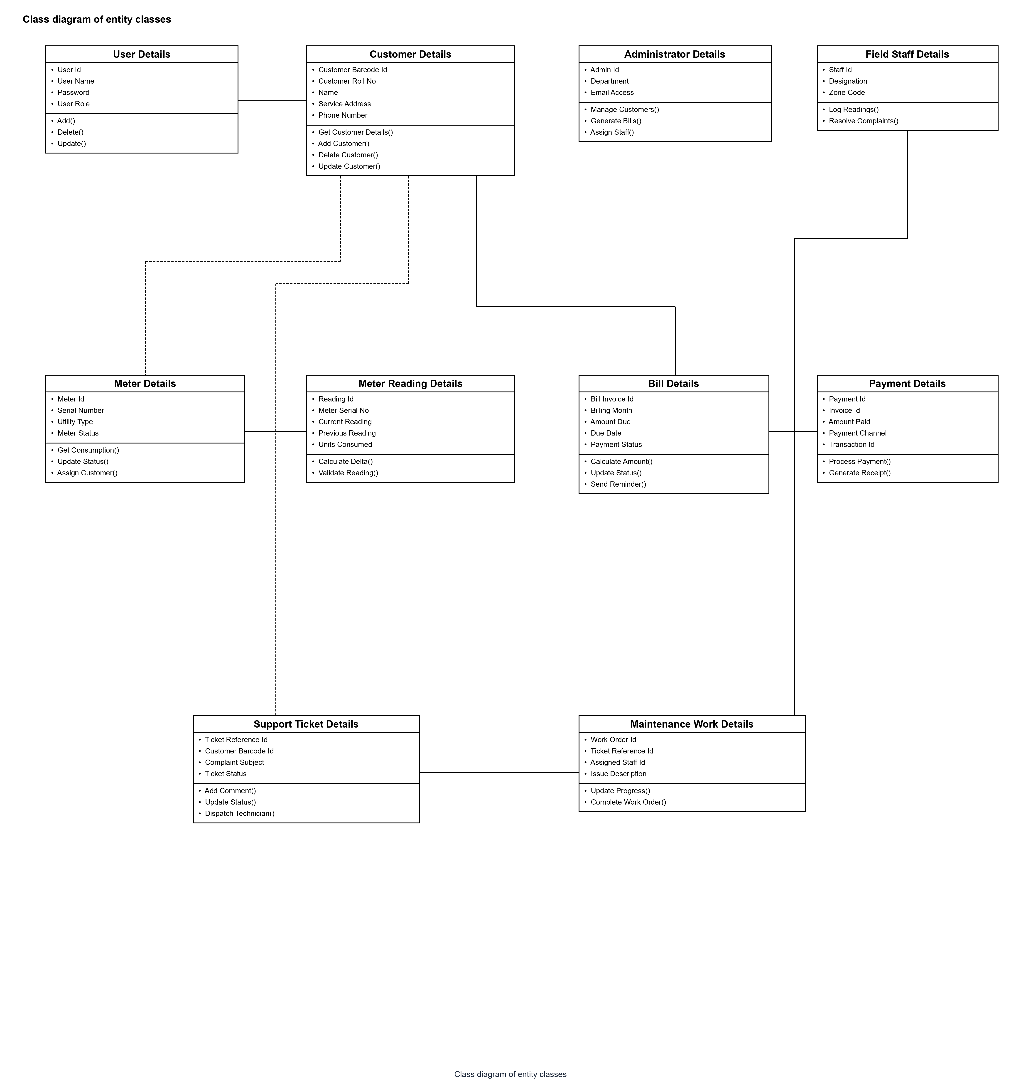
System Design: 3-Tier Architecture & Class Model
Structural Foundations, Component Boundaries, and Relational Schema
Tiered Architecture & Relational Schema
• Presentation Layer: Responsive Single-Page Application (SPA) driven by component views (Dashboard, Bills, Meters, GIS, Reports).
• Application Logic Layer: Express REST API handles business logic, tiered rate calculations, email reminder services, and route validation.
• Data Persistence Layer: Relational database schema with 9 primary entities:
• • users & customers (1-to-1 customer profiling)
• • meters & meter_readings (telemetry log)
• • bills & payments (1-to-many financial ledger)
• • complaints (chat history & status tracking)
• • notifications & maintenance (system audit trail)
• Dual-Failover Support: Connects to live MySQL/Neon with seamless fallback to localized JSON data.
System Class Diagram: Entity Relationships & Attribute Methods

Slide 8
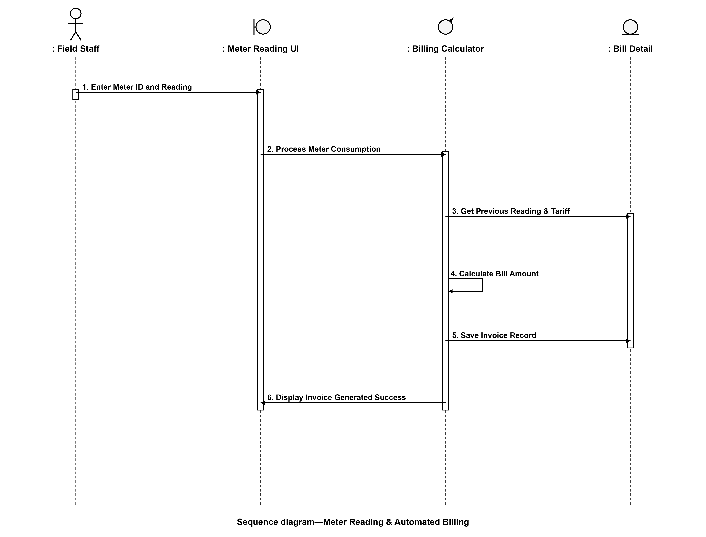
System Design: Behavioral Sequence Flows
Interaction Modeling for Core Business Transactions
Dynamic Behavioral Flow
• Authentication Sequence: Validates credentials, creates encrypted session tokens, and maps assigned meter IDs to the client session.
• Meter Reading to Invoice Generation:
• 1. Employee inputs current meter units.
• 2. Backend computes consumption (curr - prev).
• 3. Formula applies base charges + tiered rates.
• 4. Generates unique Invoice Bill ID & due date.
• Payment Processing Flow:
• 1. Customer selects invoice and checkout method.
• 2. Payment record created with unique transaction ID.
• 3. Bill status automatically transitions to 'Paid'.
• 4. Immediate in-app notification delivered to user.
Sequence Diagram: Automated Billing & Tariff Workflow

Slide 9

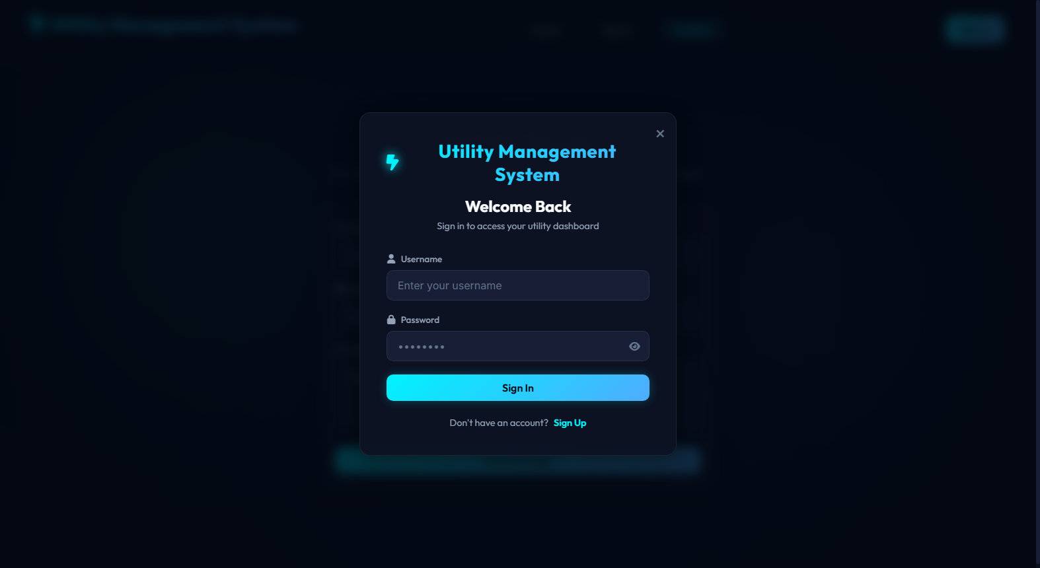
Implementation: Public Portal & Authentication
Feature Showcase: Landing Page, User Registration & Access Control
Access Control & Registration
• Modern Landing Portal: Showcases live system capabilities, tiered tariff tables, and customer contact inquiry forms.
• Modal-Driven Auth Flow: Seamless modal popup for sign in and sign up without page reloads.
• Self-Registration: New consumers can register their legal name, email, phone, physical address, and link their smart meter serial number.
• Role-Based Routing: Evaluates session role ('admin', 'employee', 'customer') upon login to render appropriate dashboard navigation links.
• Password Security: Masked inputs with show/hide eye toggle buttons and secure authentication validation.
Landing Portal Homepage
User Authentication & Sign-In Modal

Slide 10
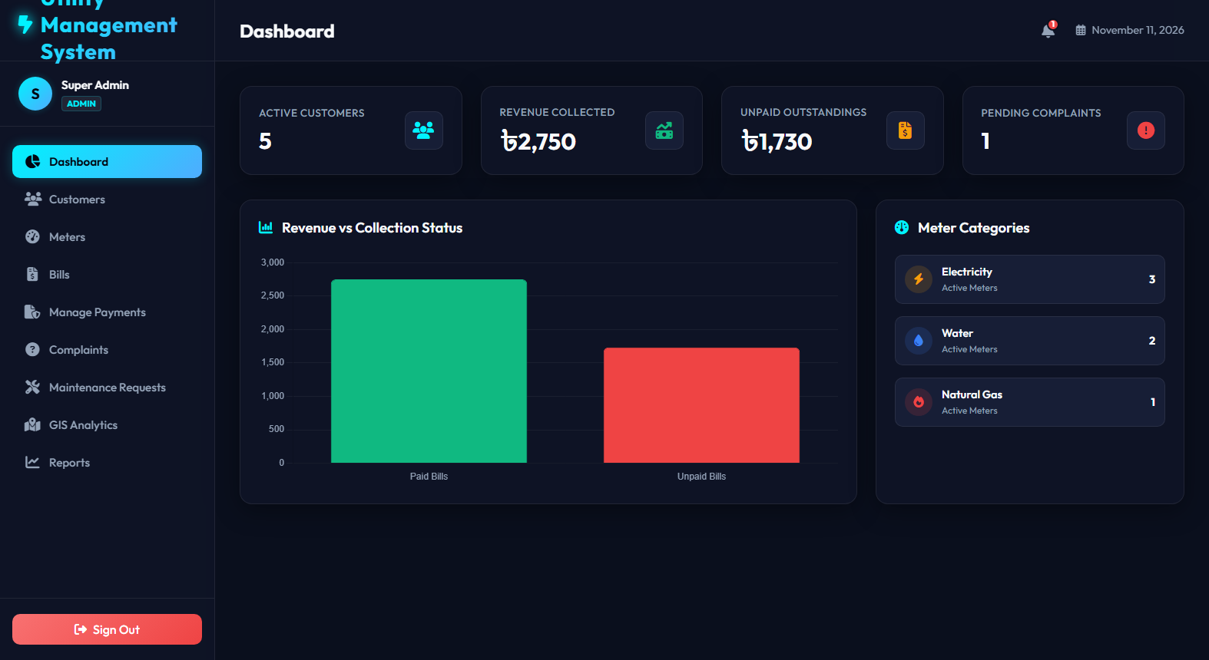
Implementation: Centralized Operations Dashboard
Feature Showcase: High-Level KPI Telemetry & Real-Time Monitoring
Dashboard Architecture & KPIs
• Real-Time Statistics Tiles: Instantly view total registered customers, active meters, monthly revenue collected, and unresolved tickets.
• Role-Adaptive Content: Admins view municipal-wide metrics; Customers view their individual meter balance, unread alerts, and bill countdowns.
• Notification Bell Hub: Bell badge indicator alert for newly issued bills, due dates within 48 hours, and technician updates.
• Direct Action Shortcuts: One-click jump buttons to generate new bills, register meters, or initiate payments.
• Responsive Dark Tech Theme: Styled with modern neon cyan accents and subtle glassmorphic card containers.
Admin Central Dashboard: Metric Tiles & Shortcut Panels

Slide 11
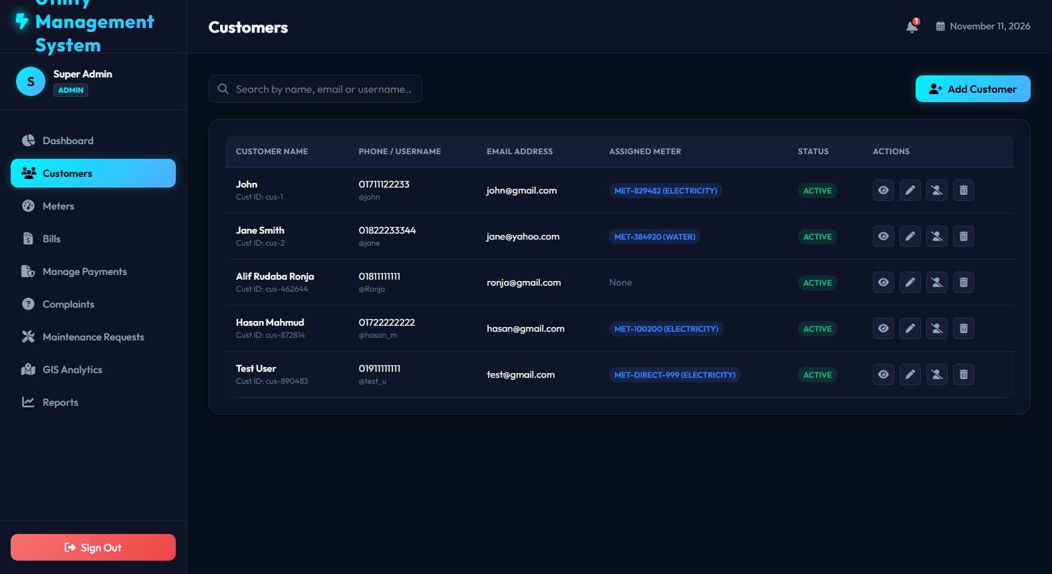
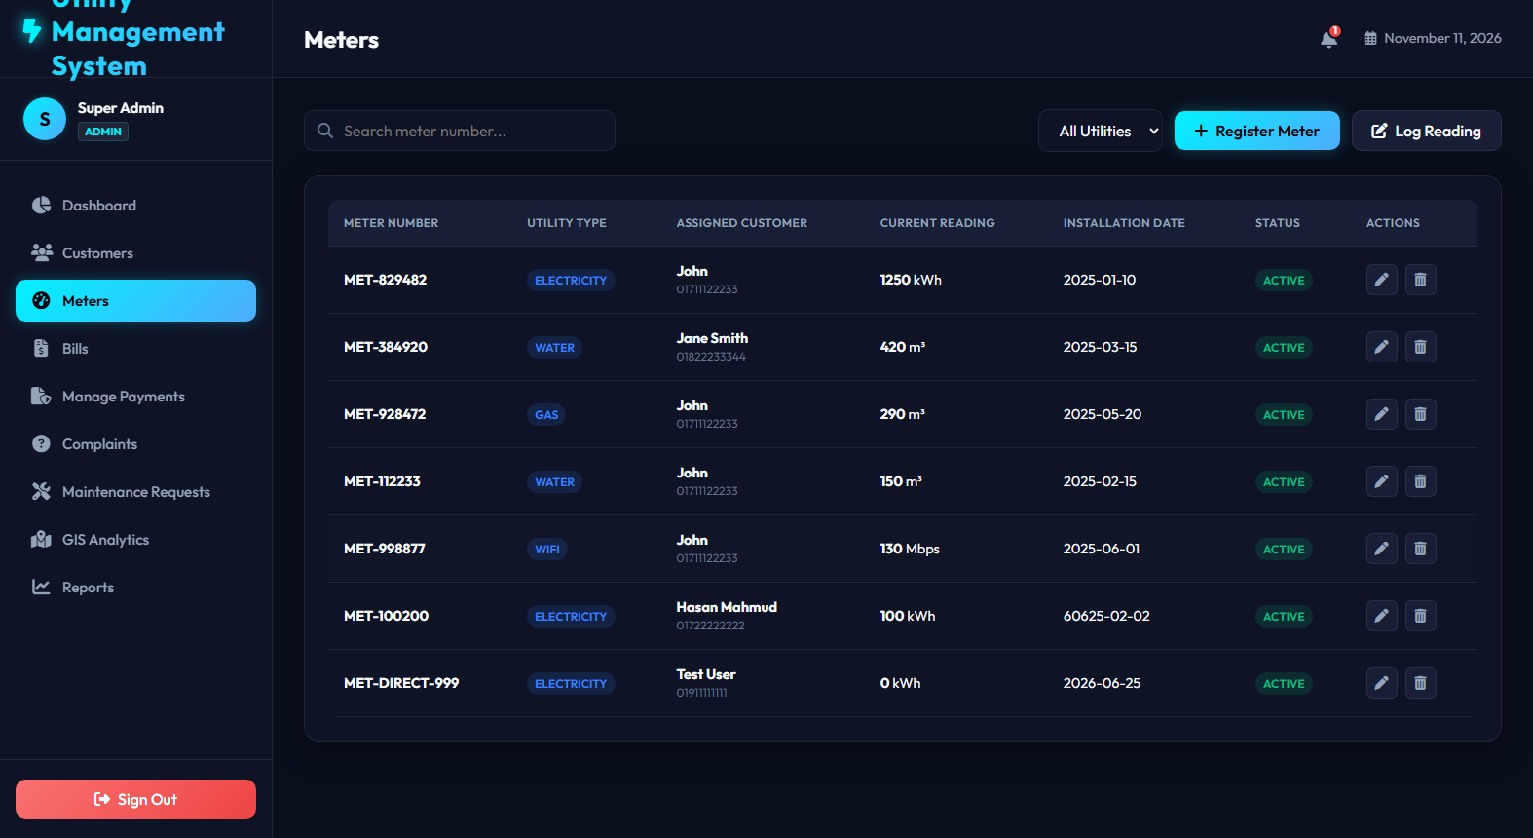
Implementation: Customer & Meter Registries
Feature Showcase: Asset Governance & Telemetry Tracking
Governance & Smart Metering
• Customer Registry: Complete directory of utility accounts with phone numbers, billing addresses, and assigned smart meter serials.
• Smart Meter Telemetry: Tracks Electricity (kWh), Water (m³), Gas (m³), and Broadband Internet (Mbps) with hardware installation dates.
• Reading Entry Modal: Technicians record new monthly meter consumption directly into the system.
• Anomaly Protection: Automated checks prevent submitting readings lower than the previous billing cycle.
• Search & Filter: Real-time search across customer names, meter numbers, and utility categories.
Customer Registry & Relationship Mapping
Smart Meter Asset Management & Telemetry

Slide 12
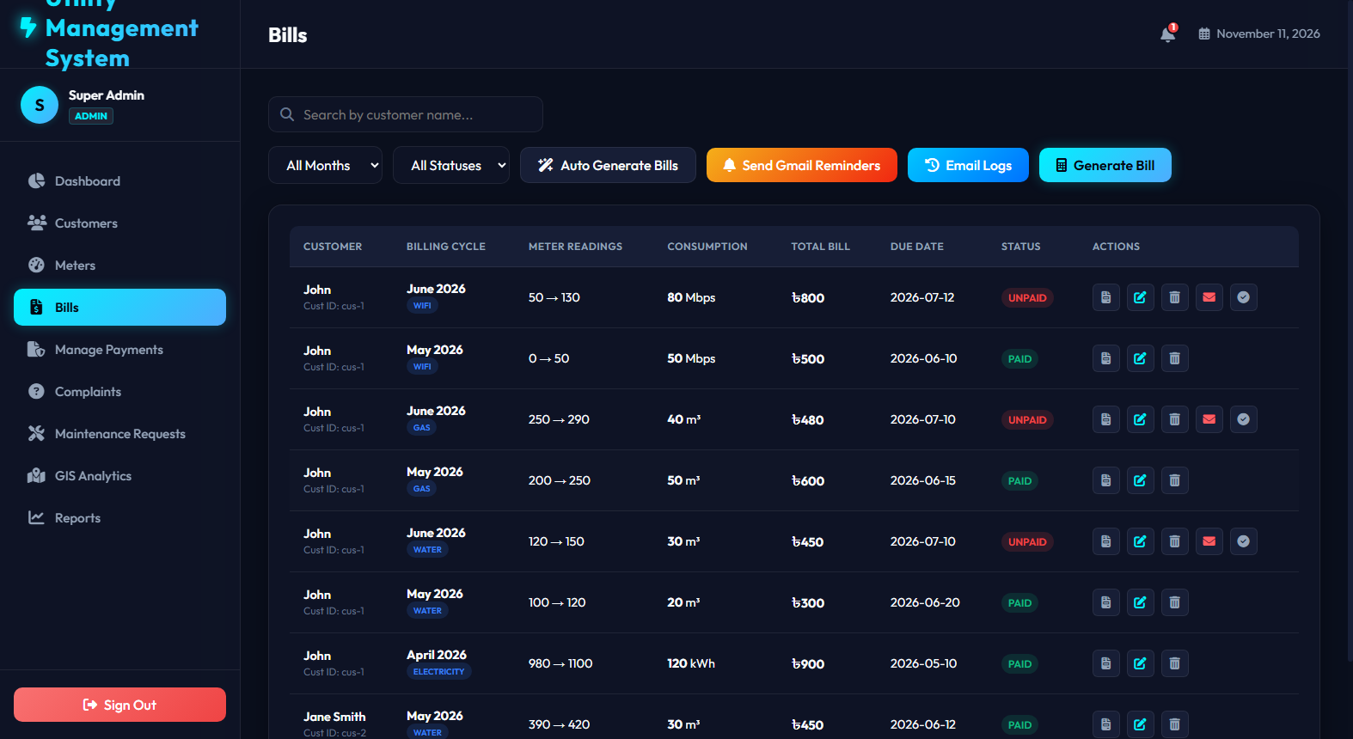
Implementation: Automated Tiered Billing Engine
Feature Showcase: Dynamic Tariff Calculator & Printable Invoices
Billing Rules & Computation
• Tiered Formula Algorithm:
• Total Bill = Base Charge + (Consumed Units × Tariff Rate)
• Configured Utility Rates:
• • Electricity: ৳7.5 / kWh (Base: ৳50)
• • Water: ৳15.0 / m³ (Base: ৳30)
• • Gas: ৳12.0 / m³ (Base: ৳40)
• • WiFi Telecom: ৳10.0 / Mbps (Base: ৳300)
• Dynamic Invoice Generation: Auto-generates clean, printable invoices with QR code badges and breakdown tables.
• Automatic Status Tracking: Tracks 'Unpaid', 'Pending Review', and 'Paid' states with overdue date highlighting.
Billing Ledger: Invoices, Status Indicators & Actions

Slide 13
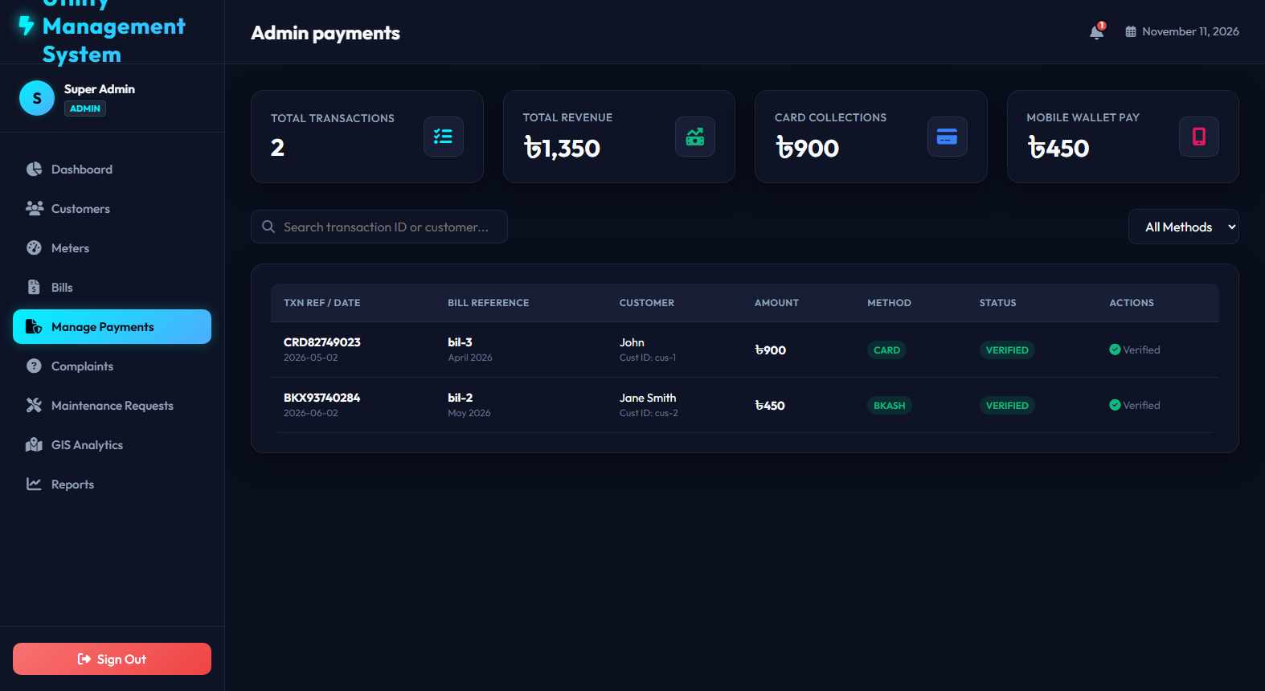
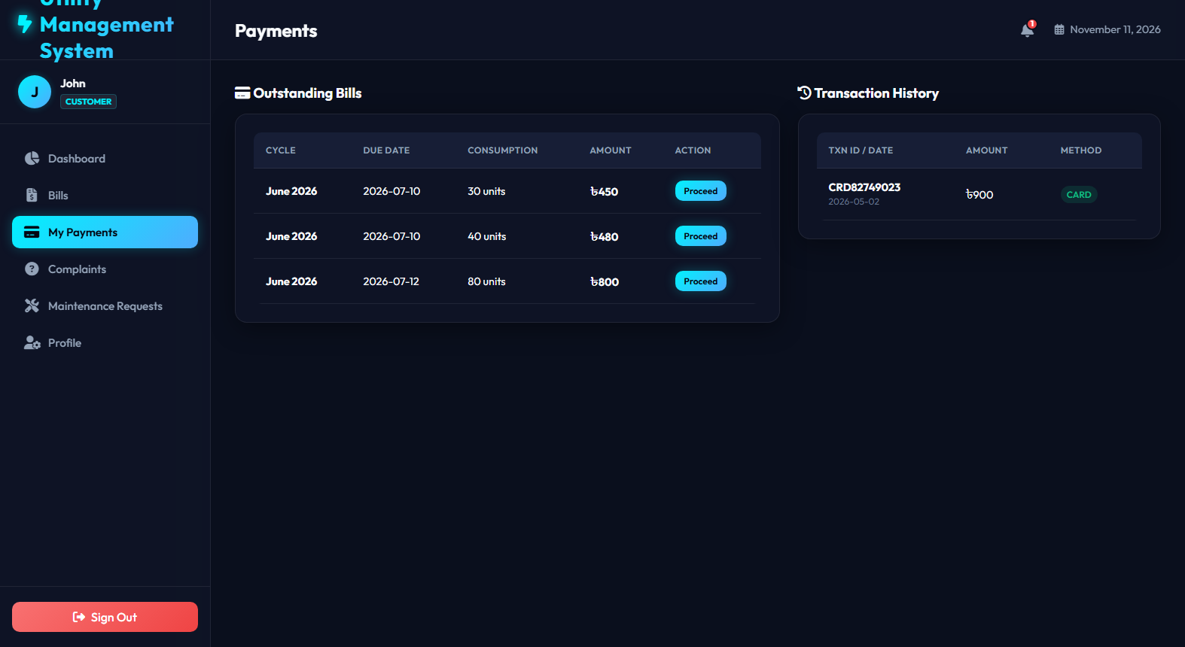
Implementation: Payment Gateway & Digital Ledger
Feature Showcase: Multi-Channel Checkout Simulation & Audit Trail
Secure Checkout & Financial Records
• Multi-Channel Payment Integration: Simulates transactions via Debit/Credit Cards (Visa/Mastercard) and Mobile Financial Services (bKash, Nagad, Rocket).
• Instant Ledger Reconciliation: Upon payment approval, the corresponding bill status is instantly marked 'Paid' across the entire database.
• Digital Receipt Generation: Customers can view and download official receipt vouchers containing timestamped transaction hashes.
• Comprehensive Payment History: Complete audit log searchable by transaction ID, customer account, and payment date.
• Financial Transparency: Prevents duplicate charge attempts on previously settled bills.
Administrative Payments Ledger & Transaction Logs
Customer Payment Portal & Checkout Gateway

Slide 14
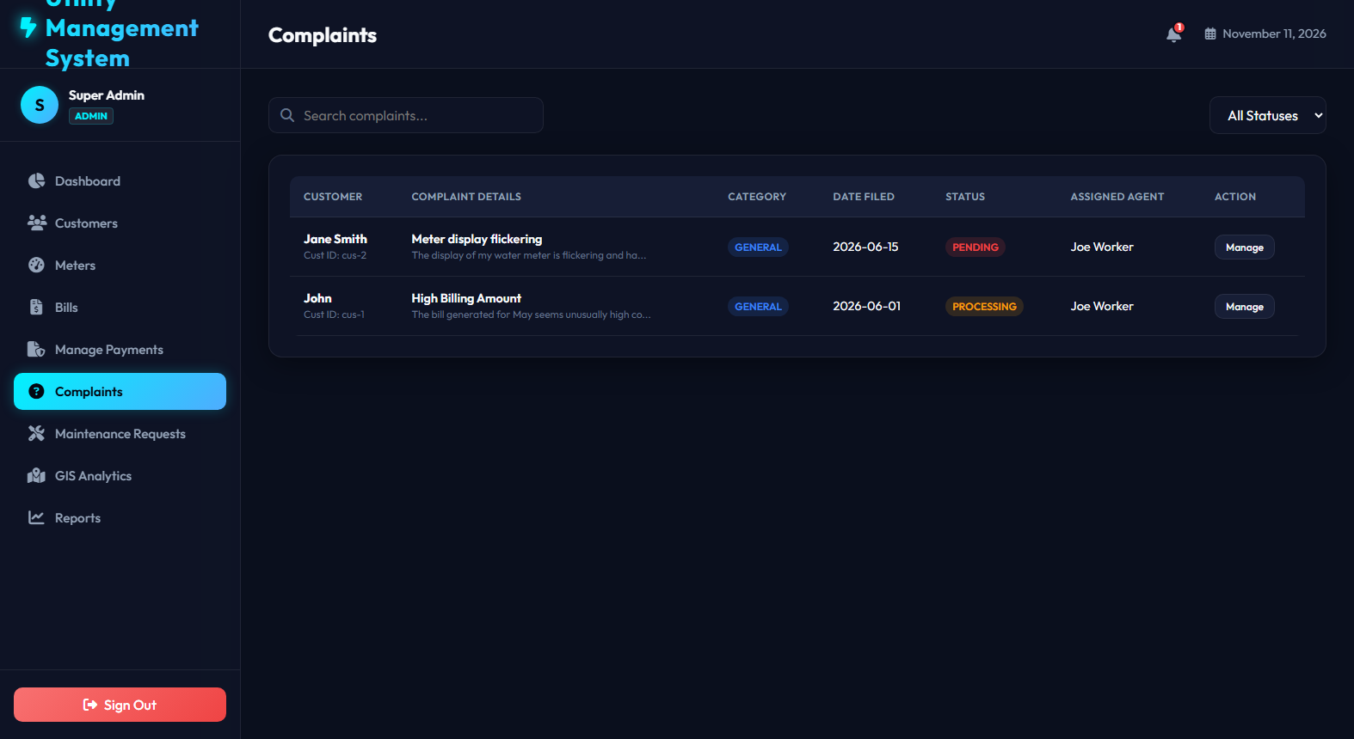
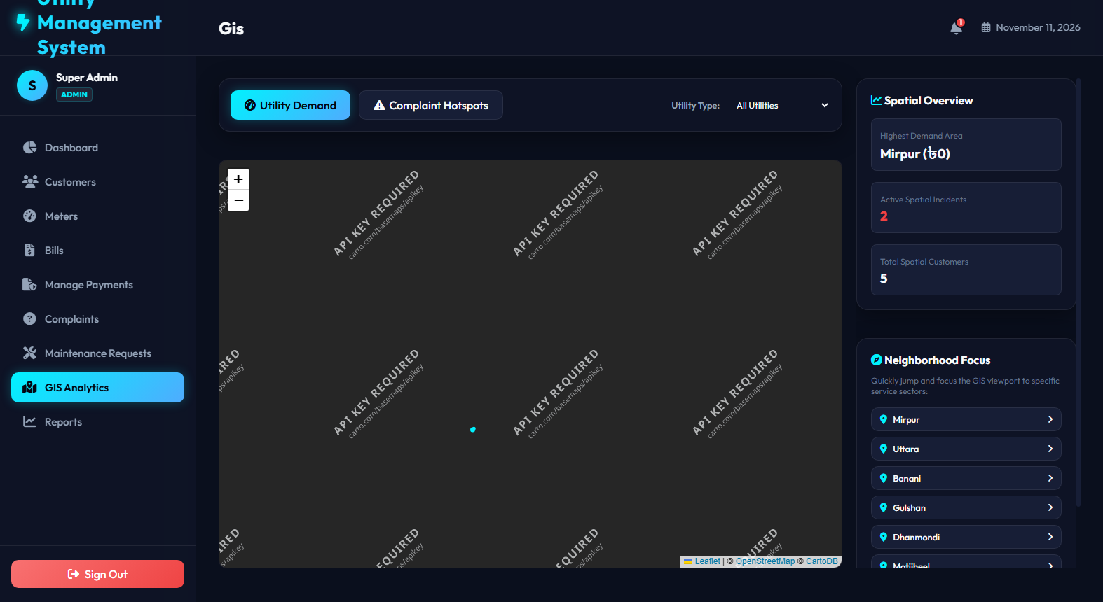
Implementation: Support Tickets & GIS Meter Mapping
Feature Showcase: Customer Support Chat & Spatial Geospatial Visualizer
Support Tickets & Geospatial GIS
• Dispute & Complaint Lifecycle: Customers report billing inaccuracies, damaged meters, or service outages with category tags.
• Interactive Two-Way Remarks: Staff and customers communicate via conversational comments on the ticket modal until resolution.
• Status Management: Tickets progress through 'Pending', 'In Progress', and 'Resolved' workflows.
• Leaflet GIS Mapping: Interactive geospatial map displays exact physical meter pins across municipal zones.
• Visual Maintenance Alerts: Color-coded map markers indicate active meters (Cyan) versus maintenance-required units (Coral).
Complaint Resolution Ticket System with Chat Remarks
Interactive Leaflet GIS Geospatial Meter Map

Slide 15
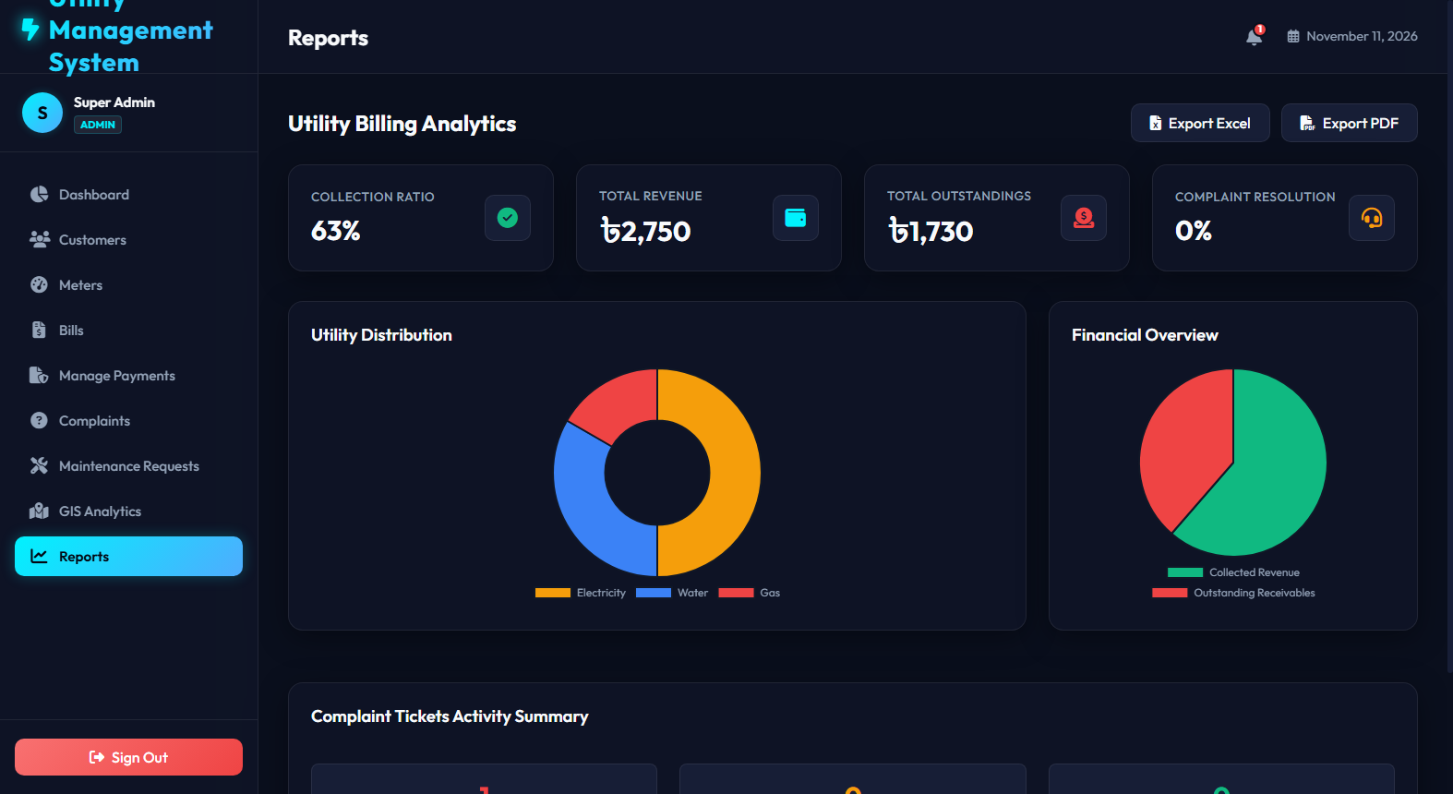
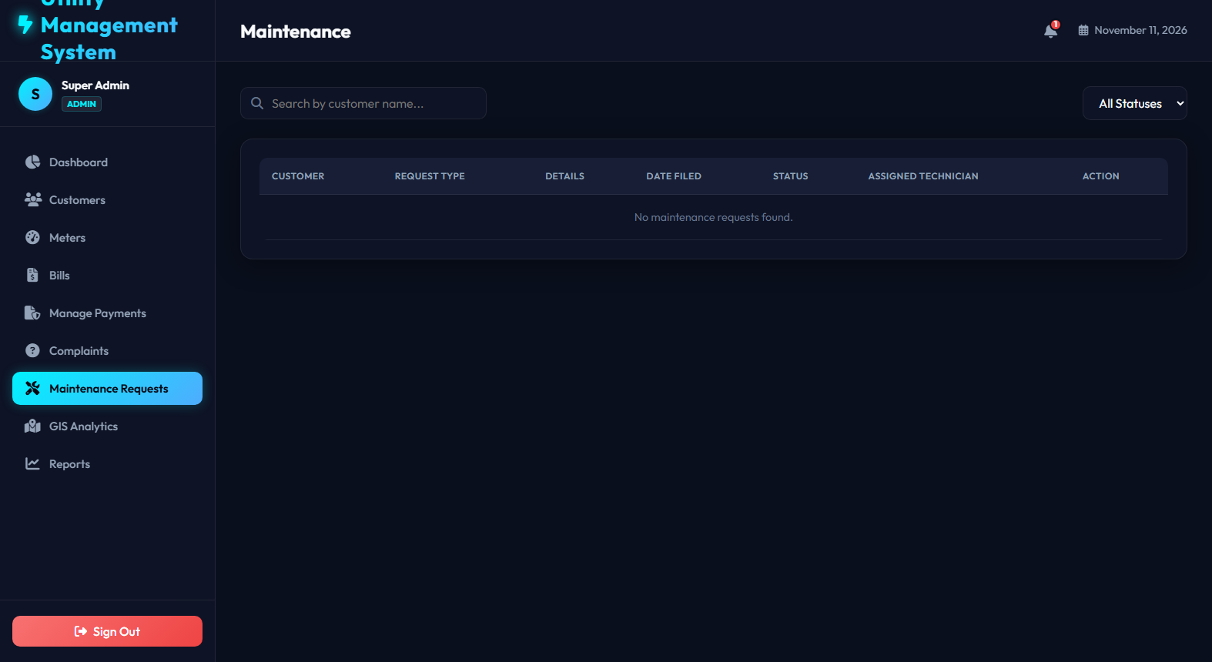
Implementation: Analytics, Reports & Maintenance
Feature Showcase: Data Intelligence, Charting & System Auditing
Business Intelligence & Maintenance
• Dynamic Chart.js Visualizations: Revenue breakdown bar charts, consumption patterns, and payment collection trends over time.
• Multi-Format Data Export: 1-click export of financial reports and meter logs to CSV and printable PDF formats.
• System Maintenance Hub: Technicians log scheduled infrastructure maintenance, grid upgrades, and emergency repair sessions.
• Customer Outage Broadcasts: Scheduled maintenance displays global warning banners on affected customer dashboards.
• Historical Audit Trail: All data modifications are logged for compliance and administrative oversight.
Analytics & Business Intelligence Dashboard
System Maintenance Scheduler & Log

Slide 16

System Verification & Testing
Quality Assurance Strategy, Test Levels, and Execution Results
Testing Strategy & Hierarchy
Test Case Execution Matrix
• Unit Testing: Validated individual algorithmic functions (tariff formulas, billing calculation, date parsing, input sanitizers).
• Integration Testing: Verified seamless communication between Express REST API endpoints and database CRUD helpers.
• End-to-End System Testing: Validated full user journeys from registration -> meter assignment -> reading input -> bill creation -> payment.
• Security & Vulnerability Testing: Verified SQL injection immunity via parameterized queries and tested password masking.
• Cross-Browser & Responsiveness: Executed across Chrome, Edge, Firefox, and mobile screen viewports.
✔ TC-01: User Authentication [Pass]
Validates passwords, rejects bad credentials, handles session states.
✔ TC-02: Meter Reading Delta [Pass]
Prevents negative delta consumption, auto-updates meter registry.
✔ TC-03: Tariff Computation [Pass]
Accurately applies base charge + tiered consumption tariff rate.
✔ TC-04: Payment Reconciliation [Pass]
Generates transaction hash, marks bill 'Paid', triggers notification.
✔ TC-05: Database Fallback [Pass]
Gracefully switches to local JSON database when MySQL is unavailable.
✔ TC-06: Responsive Rendering [Pass]
CSS Flexbox/Grid adapts cleanly to mobile & widescreen viewports.

Slide 17

Production Deployment Architecture
Edge CDN Hosting, Serverless Functions, and Cloud Database
Vercel Edge Cloud Infrastructure
Database & Production Connectivity
• Frontend Static Distribution: HTML, CSS, and ES6 JavaScript assets distributed globally across Vercel Edge CDN nodes for sub-50ms latency.
• Serverless API Backend: Express REST routes encapsulated inside `api/index.js` running on AWS Lambda microVMs under the hood.
• Zero-Downtime CI/CD: Automated build & deployment triggered on every `git push origin main` to GitHub.
• Environment Variables Security: Database credentials and API configurations managed securely within Vercel's encrypted secrets vault.
• Edge Rewrites (vercel.json): Dynamic routing directs `/api/*` traffic to serverless functions while serving SPA assets from root.
• Neon Serverless PostgreSQL / Cloud MySQL: Fully supported connection strings via secure SSL/TLS connection pools.
• Auto-Failover Resilience: Backend serverless functions seamlessly fallback to packaged initial JSON state (`db.json`) if external database is offline.
• Serverless Read-Only Protection: Wrapped file operations prevent `EROFS` filesystem crashes in serverless container environments.
• Public Live Access: Deployed with automatic SSL certificate provisioning (HTTPS) accessible across all desktop and mobile devices globally.

Slide 18

System Maintenance & Operations
Lifecycle Support, Preventive Monitoring, and Automated Cron Services
Corrective Maintenance
Adaptive Maintenance
• Bug patch deployment via GitHub CI/CD pipeline.
• Error logging and exception handling on API endpoints.
• Automated repair workflows for corrupted database records.
• Upgrading tariff tiers to reflect municipal policy revisions.
• Adapting API to integrate external SMS gateway APIs.
• Supporting new meter hardware protocols (Smart Zigbee / LoRaWAN).
Perfective Maintenance
Preventive Maintenance
• Performance optimizations in Chart.js rendering pipelines.
• Enhancing dark-mode aesthetics and UI accessibility.
• Adding export to Excel (.xlsx) and printable PDF layouts.
• Automated background cron checking upcoming bill due dates.
• Automated dispatch of reminder notifications to avoid late penalties.
• Periodic database table defragmentation and backup archiving.

Slide 19

Conclusion & Future Roadmap
Project Deliverables, Tangible Business Value, and Expansion Roadmap
Summary of Achievements
Future Development Roadmap
• Successfully delivered an end-to-end, production-grade Utility Management System spanning web, backend API, and database layers.
• Replaced archaic manual paper-based processes with instantaneous, error-free automated tiered billing calculations.
• Integrated 4 major utility services (Electricity, Water, Gas, WiFi Broadband) under a single consolidated user account.
• Demonstrated production cloud deployment readiness via Vercel Edge Network and Neon/MySQL database architecture.
• 100% test case pass rate with complete security isolation across user roles.
• IoT Smart Hardware Integration: Direct telemetry streaming via MQTT / LoRaWAN from physical smart meters.
• AI-Powered Predictive Analytics: Machine learning algorithms to detect pipe leaks, electricity theft, and abnormal consumption spikes.
• Native Mobile Applications: Flutter / React Native cross-platform apps with push notifications for payment deadlines.
• Solar Net-Metering: Support for two-way renewable solar energy generation and reverse grid billing credits.

Slide 20
Thank You!
Questions & Discussion
Utility Management System | Full-Stack Software Engineering Project
GitHub Repository: https://github.com/uTurn2679/Utility_management_system

