Slide 1

Proximity Antenna Training for 13.56 MHz
Directly matched antenna

Slide 2
Directly matched antenna
Directly matched antenna
RC500
RC400
(or
other
Reader)
Rx
Rx-
Circuit
Tx
Matching
Matching
Antenna
Z=700Ω
Z=700Ω
EMC-
Filter

Slide 3

Directly matched antenna
Requirements:
!
1) Matching
load impedance = 700Ω
1) Matching
2) Resonance
2) Resonance
3) Tuning
resonance at 13.56 MHz
4) Q-factor
4) Q-factor
quality factor ≈ 35
quality factor ≈ 100
5) Finetuning
6) Receive Circuit

Slide 4
Directly matched antenna
Guideline:
1) Matching
Design a coil
Calculate the parallel capacitance
Tune resonance and impedance
Connect antenna to the RC500
  Tune again
Check (and adjust) the Q-factor
Finetune resonance and impedance
Find the values for Rx-circuit
2) Resonance
3) Tuning
3) Tuning
4) Q-factor
4) Q-factor
5) Finetuning
5) Finetuning
6) Receive Circuit
6) Receive Circuit

Slide 5
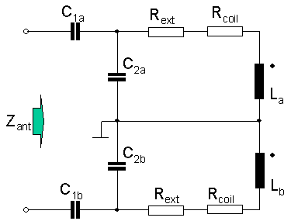
Directly matched antenna
Complete antenna
Antenna
Coil

Slide 6


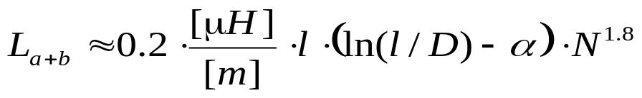
Directly matched antenna
Antenna coil
L and R of the antenna coil shall be measured
at 13.56 MHz (impedance analyser or L-C-R Meter).
R_{Coil}
@13.56 MHz!
L_{a}
Estimation:
L_{a+b} = L: coil inductance
l: length of the conductor circular: l = 2*π*r (r=coil radius)
square l = 4*a (a lateral length)
d: diameter of the conductor
N: number of turns
α: shape factor α =1.07 for circular coils
α=1.54 for square coils
L_{b}
R_{Coil}

Slide 7
Directly matched antenna
Antenna coil
R_{Coil}
1.5
L [µH]
1
L_{a}
0.5
0
5
10
15
20
antenna radius [cm]
2
L_{b}
R_{Coil}
N
1
0
5
10
15
20
antenna radius [cm]

Slide 8
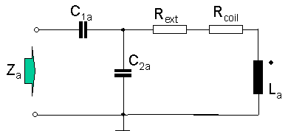
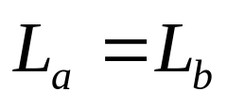
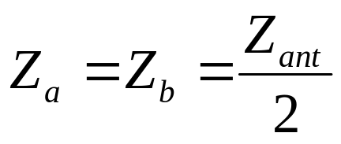
Directly matched antenna
Simplification
Due to the symmetrical circuitry of the whole antenna
the antenna can be simplified:

Slide 9
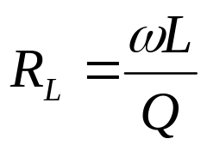
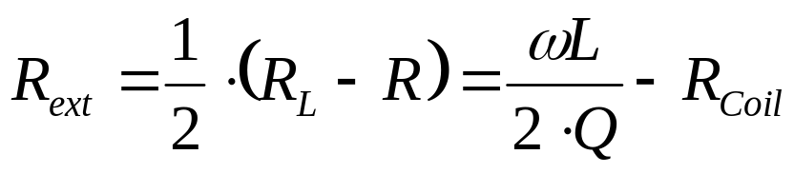
Directly matched antenna
Calculate the external resistor
MIFARE Q = 35
I*CODE Q = 100
General:
Consider the power consumption!

Slide 10
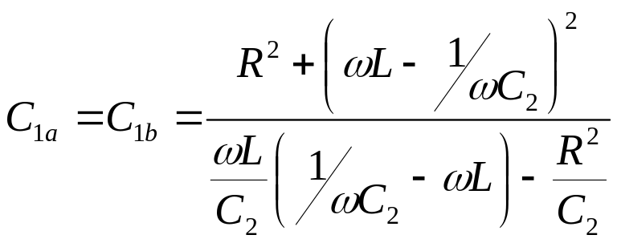
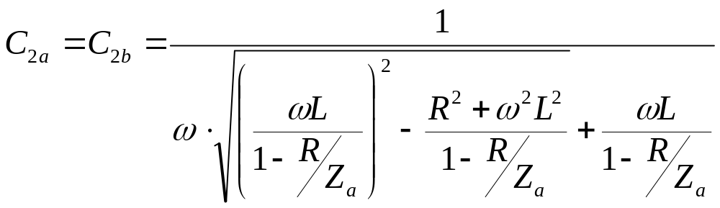

Directly matched antenna
Calculate the capacitors
with
Remark: there is an Excel-Sheet available, that supports this calculation.

Slide 11






Directly matched antenna
Estimation: Startvalues for the tuning
1
2
measured
calculated

Slide 12
Directly matched antenna
Tune resonance and impedance
Start
tune phase to 0° ± 10° with C2
possible ?
no
f_{res}>13.56MHz ?
yes
increase
C2
yes
no
yes
Z < Z_{ant}-10%?
decrease
C2
decrease C1
no
yes
Z >Z_{ant}+10% ?
no
Tuning OK
|Z|=Z_{ant} ± 10%
phase=0° ± 10°
increase C1

Slide 13
Directly matched antenna
Tune resonance and impedance
3500
80
13.56 MHz
3000
60
2500
40
2000
20
1500
0
|Z_{in}| [Ω]
phase [deg.]
2000
-20
1500
Z_{ant}
-40
1000
-60
500
-80
phase
0
-100
10
11
12
13
14
15
16
17
18
f [MHz]

Slide 14
Directly matched antenna
Connect Antenna to the RC500
Guideline:
Design a coil
Calculate the parallel capacitance
Tune resonance and impedance
Connect antenna to the RC500
  Tune again
Check (and adjust) the Q-factor
Finetune resonance and impedance
Find the values for Rx-circuit

Slide 15
Directly matched antenna
Tune resonance and impedance
Start
Matching
Circuit
Antenna
Find d_{max}
R
C_{1a}
Add ΔC
ΔC < 10 pF
C_{2a}
Find d_{max}
ΔC
L_{a}
yes
distance
increased ?
C_{2b}
L_{b}
decrease C2
no
C_{1b}
R
no ΔC
is added
yes
no
remove ΔC
add 2* ΔC to C2a
add 2* ΔC to C2b

Slide 16
Directly matched antenna
Checking the Q-Factor
PHILIPS
2.5µs
Channel A:
500mV/DIV
Timebase:
1µs/DIV
95%
send
request command
“Antenna Loop”
A
Reader

Slide 17
Directly matched antenna
RC500 Serial Signal Switch
0
1
2
3
Modulator
Source Switch
Serial Data OUT
Envelope
Miller Coder
Modulator
Driver
Tx
Decoder
Source Switch
Mfin Pin3
Serial
Data
IN
0
1
2
3
Manchester OUT
Subcarrier
Demodulator
Carrier
Demodulator
Manchester
Decoder
Rx Pin 29
Manchester
w. Subcarrier
Envelope
Mfout Pin 4
MFout
Select Switch
Transmit NRZ
RFU
Subcarrier
Demodulator
7 6 5 4 3 2 1 0
0 1
Digital Test Signal

Slide 18
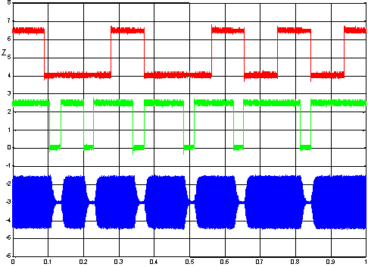
Directly matched antenna
Checking the Q-Factor
RC500 test signals
Pin 4 (3):
Transmit NRZ
2V/Dev.
Pin 4 (2):
Envelope
2V/Dev.
RFOut
0.5V/Div.
time in msec

Slide 19
Directly matched antenna
Check
Guideline:
Design a coil
Calculate the parallel capacitance
Tune resonance and impedance
Connect antenna to the RC500
  Tune resonance and impedance
Check (and adjust) the Q-factor
Finetune resonance and impedance
Find the values for Rx-circuit

Slide 20
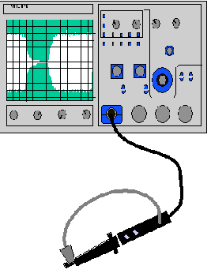


Directly matched antenna
Check the cards answer
Startvalue:
Insert RX-Circuitry
Check the card’s answer with oscilloscope (trigger on Pin 4, Envelope)
Get the max. operating distance
“Antenna-Loop”
send
request command
Check the received signal at the RC500 (Pin 4, Manchester)
Reader
Adjust R1 (valid Manchester at min. and max operating distance)
Attention: Input voltage at Pin 29 (Rx) shall not exceed ± 1.5V!

Slide 21
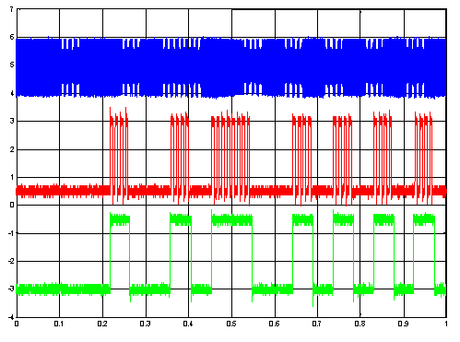
Directly matched antenna
Checking the Q-Factor
RC500 test signals
RFOut
1V/Dev.
Pin 4 (4):
Manchester
with Subcarrier
2V/Dev.
Pin 4 (5):
Manchester
2V/Dev.
time in msec

Slide 22
Directly matched antenna
Summary
1) Matching
Design a coil
Calculate the parallel capacitance
Tune resonance and impedance
Connect antenna to the RC500
  Tune resonance and impedance
Check (and adjust) the Q-factor
Finetune resonance and impedance
Find the values for Rx-circuit
2) Resonance
3) Tuning
3) Tuning
4) Q-factor
4) Q-factor
5) Finetuning
5) Finetuning
6) Receive Circuit
6) Receive Circuit

