Slide 1

Proximity Antenna Training for 13.56 MHz
Proximity Reader Antenna:
Design Example

Slide 2
EMC-Filter + Impedance Matching to 700Ω
(given parameters)
RC 500
Rx-Circuit
RC 400
RX
R
1
C
VMID
3
R
2
C
4
AVSS
TX1
L
0
Tx-Circuit
C
0
GND
Z ≈ 700 Ohm
TVSS
C
0
L
0
TX2
Tx-Circuit:
L₀ = 1 μH
C₀ = 136 pF
Rx-Circuit:
R₁ = 2,2 kΩ
R₂ = 820 Ω
C₃ = 15 pF
C₄ = 100 nF

Slide 3
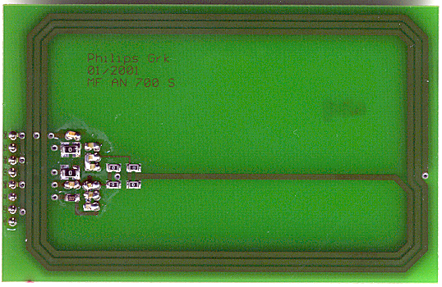
Antenna Coil
= open
= short

Slide 4
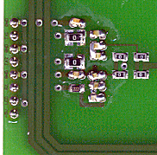


Antenna Coil
R_{Coil}
L_{a}
L_{b}
R_{Coil}
Results of the measurement
(impedance analyser or L-C-R Meter):
@13.56 MHz!

Slide 5
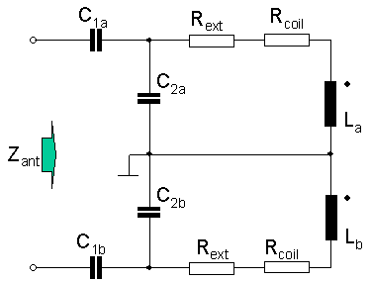
Calculation

Slide 6
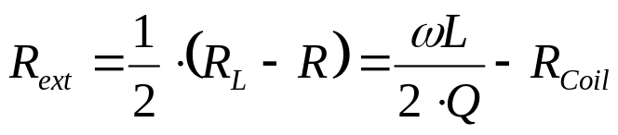
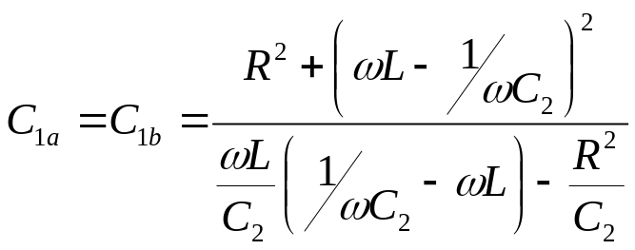
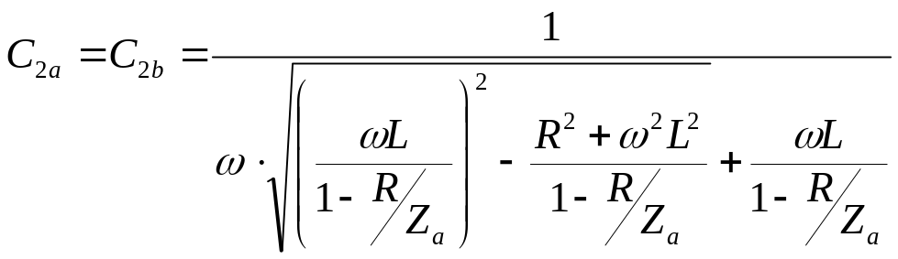
Calculation

Slide 7
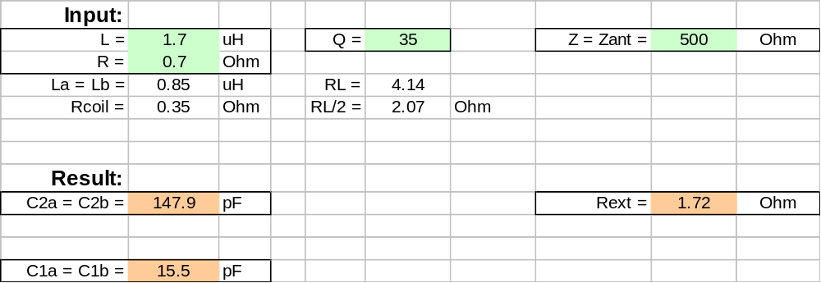
Calculation

Slide 8



Calculation
Due to the measurement uncertainty this value maybe not accurate.
(Probably the exact value is lower!) Check the Q-factor!!!

Slide 9
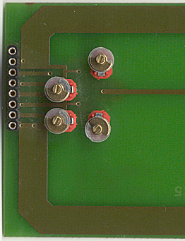
Tuning
C_{2a}
C_{1a}
C_{1b}
C_{2b}

Slide 10
Result
See the Training!!!

