Slide 1

© Philipp Arnoldt
Verifiable Decentralized Federated Machine Learning
and Inference for AI Agent Systems
Ramon Mehrpoya
Master's Thesis
Notes:
This presentation introduces VITA-FL, a prototype that connects verifiable decentralized federated learning to attested inference in an AI-agent system. It presents how the model, its production process, and its use during inference can be bound into one verifiable path.

Slide 2
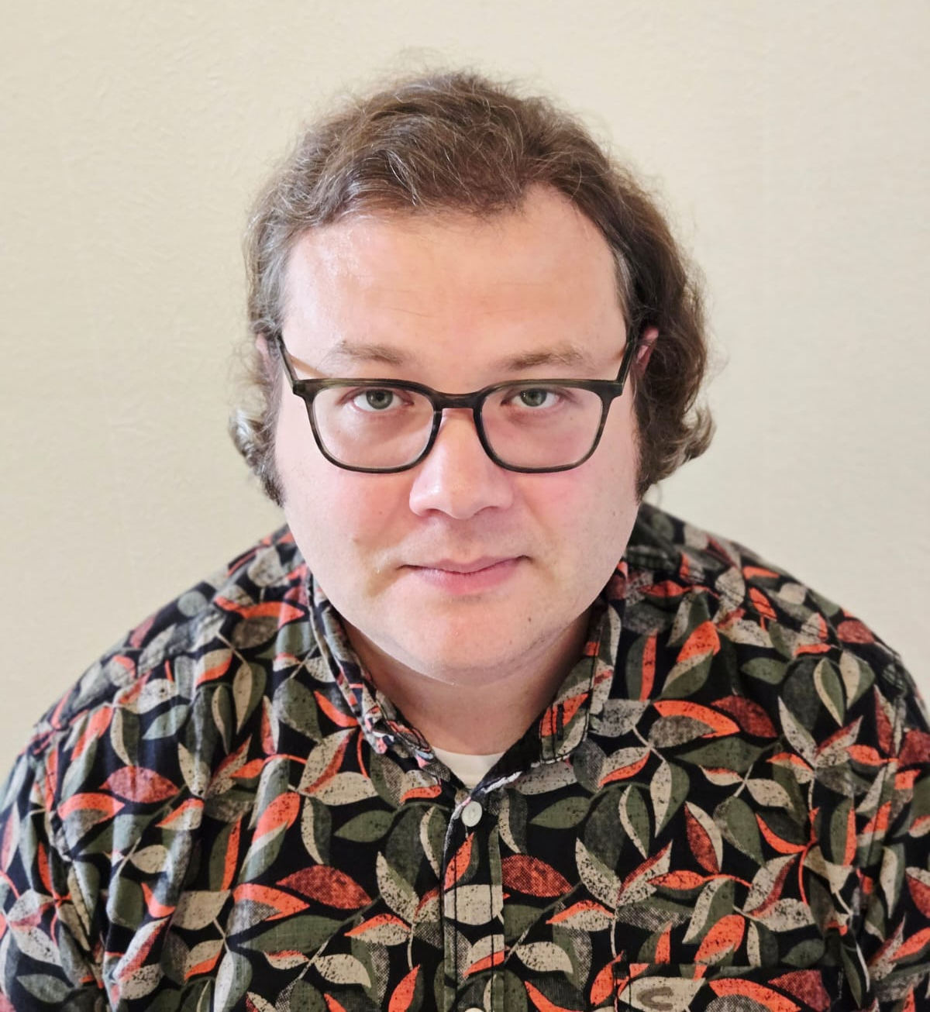
About me
ACADEMIC BACKGROUND · PROJECT EXPERIENCE · MASTER'S THESIS
Ramon Mehrpoya
ACADEMIC BACKGROUND
Bachelor's degree in Business Informatics · TU Berlin
Master's thesis candidate · Computer Science · TU Berlin
PROJECT EXPERIENCE AT ISE, TU BERLIN
GAIA-X 4 PLC-AAD
ZOKRATES PLUS
ZODIAC
ZK
THESIS PROTOTYPE
VITA-FL
Verifiable Inference and Trust Architecture
for Federated Learning
Page 2
Ramon Mehrpoya | Master's Thesis | Verifiable Decentralized Federated Machine Learning and Inference for AI Agent Systems | VITA-FL
19 August 2026
Notes:
Before turning to the research problem, I want to briefly introduce my background. I am a Computer Science master's thesis candidate at TU Berlin and hold a bachelor's degree in Business Informatics. At ISE, my focus in Gaia-X 4 PLC-AAD was blockchain and encryption. ZoKrates Plus brought together zero knowledge, trusted execution, remote attestation, and decentralized federated learning. ZODIAC focused on AI agents and MCP tools. These three strands led directly to VITA-FL: Verifiable Inference and Trust Architecture for Federated Learning.

Slide 3

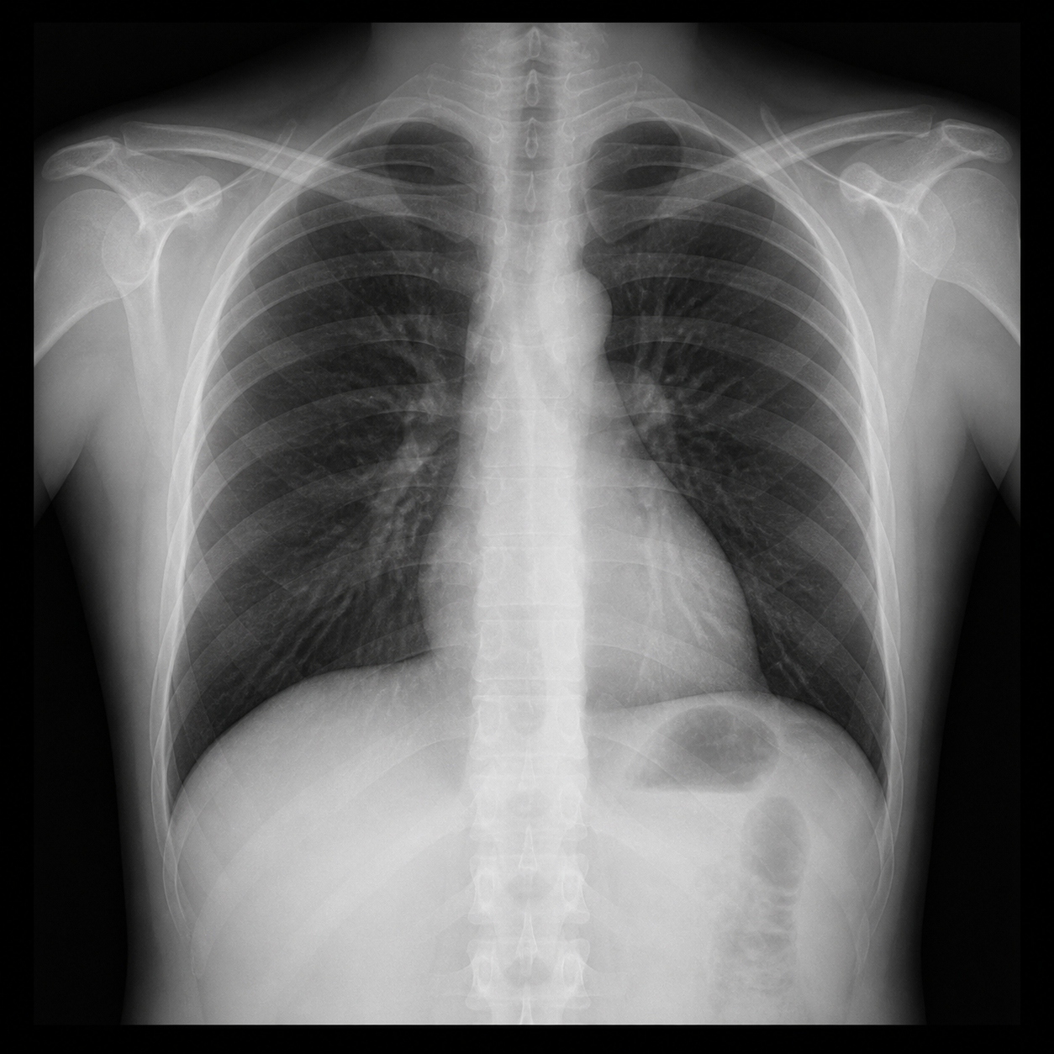
A plausible result is not evidence
STARTING POINT: THE PHYSICIAN'S REQUEST
THE TEMPTING SHORTCUT
“Can’t I just
ask an AI?”
“Analyze this
chest X-ray.”
Page 3
Ramon Mehrpoya | Master's Thesis | Verifiable Decentralized Federated Machine Learning and Inference for AI Agent Systems | VITA-FL
19 August 2026
Notes:
Imagine a physician with a chest X-ray asking: Can't I just ask an AI? The AI can return a fluent and plausible result, but the response does not show whether it used the intended X-ray, the current model publication, or an attested inference path. The question is therefore not merely whether AI can answer, but whether the answer is backed by inspectable evidence.

Slide 4

A trustworthy answer needs verifiable infrastructure
THE COMPUTER SCIENTIST'S RESPONSE
REQUIRED SYSTEM ARCHITECTURE
THE ENGINEERING RESPONSE
“Then we need more
than an AI model.”
ZK
Page 4
Ramon Mehrpoya | Master's Thesis | Verifiable Decentralized Federated Machine Learning and Inference for AI Agent Systems | VITA-FL
19 August 2026
Notes:
The computer scientist's response is that a plausible model output is not enough. Trust must be engineered across the complete path: signed medical data enters an attested decentralized training process, the current model state is resolved from an authoritative publication, inference runs in a measured environment, and the resulting tool evidence is recorded in a transparency log. This requirement motivates the research gap on the next page: the individual mechanisms exist, but the challenge is to compose them into one user-inspectable system.

Slide 5
Research gap and research questions
RESEARCH POSITIONING
DFL
?
AGENT
?
INFERENCE
Model production
Tool orchestration
Attested execution
Focus: attestation-based DFL → inference → verifiable agent use.
RQ 1:
RQ 1.1:
RQ 1.2:
Trustworthy integration
Integrity & availability
Verifiable inference
Page 5
Ramon Mehrpoya | Master's Thesis | Verifiable Decentralized Federated Machine Learning and Inference for AI Agent Systems | VITA-FL
19 August 2026
Notes:
The main research question asks how DFL models can be integrated into AI agent-based system architectures while preserving trustworthiness across the complete training and inference pipeline. The first sub-question focuses on integrity and availability during verifiable DFL training. The second asks how inference and model predictions can be made verifiable, for example through cryptographic proofs of execution. Existing work already connects lifecycle stages, as shown on the following comparison slide. The thesis studies a concrete attestation-based implementation and its trust assumptions; it does not claim to be the first end-to-end verifiable AI system.

Slide 6
Several hospitals. One shared model.
MOTIVATION · LEARNING TOGETHER, KEEPING PATIENT DATA LOCAL
Hospital consortium
Jointly trained
Later use
H
H
H
Hospital A
Hospital B
Hospital C
Complementary datasets
Patient data stay local
Custom-trained model
for chest X-rays
Physician accesses the model
through an AI assistant
Shared control during training. Evidence for each prediction.
Page 6
Ramon Mehrpoya | Master's Thesis | Verifiable Decentralized Federated Machine Learning and Inference for AI Agent Systems | VITA-FL
19 August 2026
Notes:
Imagine a hospital consortium developing a chest X-ray model together. Each institution contributes experience from its own patient population while keeping the underlying records local. The three hospitals illustrate a wider consortium; they are not the participant count of the prototype evaluation. The hospitals also want shared control over participation and model development, confidence that contributions are processed correctly, and a way to continue if the participant coordinating training becomes unavailable. Later, a physician accesses this custom-trained specialist model through an AI assistant. The value of joint training depends on being able to establish that this model processed the submitted image and produced the reported result. The arrows summarize model development and later use; they do not depict patient-data transfers or an implementation architecture. This is the motivating scenario from Chapter 1, not a claim of clinical validation.

Slide 7
Prior work: system coverage and verification
DFL
Agent
EXISTING LIFECYCLE LINKS · DIFFERENT EVIDENCE AND TRUST ASSUMPTIONS
WORK
SYSTEM COVERAGE
VERIFICATION MECHANISMS
Remote attestation
DFL
Inference
Agent
Transparency
Log
ZKP
TEE
Quote
verification
RTMR3
replay
Lee, Heiss et al. · 2024
DFL
Ebrahimi et al. · 2024
DFL
Voltran · 2024
Aggregate
SGX RA
Hartmann · 2024
DFL
Simulated
ZKML · 2024
Inference
ZkAudit · 2024
Audits
Balan et al. · 2025
DFL
Inference
AIR-02 · draft + demo
Receipts
Platform RA
VET · 2025
API trace
Agent
Sello · 2026
Tools
Receipts
VITA-FL · this thesis
DFL
Inference
Agent
Receipts
Implemented
Discussed / framework
Not described
Page 7
Ramon Mehrpoya | Master's Thesis | Verifiable Decentralized Federated Machine Learning and Inference for AI Agent Systems | VITA-FL
19 August 2026
Notes:
Reading this slide: System coverage distinguishes DFL, inference, agents, and a transparency log. General training proofs do not automatically count as DFL; an execution transcript, provenance database, or model ledger does not automatically count as a transparency log for inference/tool statements. The columns are not an exhaustive capability list. Filled blocks/dots mean implemented or evaluated in the described prototype. Outlines mean discussed, proposed, or framework options. A dash means not described as a mechanism of the checked work, not proof of absence from every related implementation. ZKP includes the zero-knowledge proofs used by each system, including certificate or transcript proofs; it is not limited to ML computation. Proof scope remains specific to each row. Paper names link to primary sources. The representative selection is not a systematic literature review or a security ranking. Quote verification and RTMR3 replay are grouped under remote attestation as two selected checks, not an exhaustive definition of attestation. RTMR3 is specific to the TDX measurement path.
Lee, Heiss et al., End-to-End Verifiable Decentralized Federated Learning (ICBC 2024), https://arxiv.org/html/2404.12623v1, sections V–VII: Groth16 zkSNARKs with ZoKrates cover registration and per-round signed-data provenance, device binding, and local update computation. A smart contract verifies local updates and performs aggregation. Their device attestation is not TEE remote attestation. End-to-end refers to the learning workflow; downstream inference and agent execution are not described.
Ebrahimi, Sober, Hoang, Ileri, Sanders and Schulte, Blockchain-Based Federated Learning Utilizing Zero-Knowledge Proofs for Verifiable Training and Aggregation (IEEE Blockchain 2024), pp. 54–63, https://doi.org/10.1109/Blockchain62396.2024.00017. The author's companion implementation, https://github.com/ElmiraEbrahimi/Veriblock-FL, supplies separate ZoKrates zk-SNARK circuits for local training and global aggregation, with Solidity proof verification. Model parameters remain off chain; the ledger holds hashes and global-model IPFS references. FederatedModel.sol, getStakeWinnersAndSelectedAggregatorIndex, and devices/middleware/aggregator_selection.py implement changing off-chain aggregators. Hence DFL and ZKP are filled as implemented. The checked implementation does not describe a served inference/agent lifecycle, a tool/inference-receipt transparency log, TEEs, quote verification or RTMR3 replay. A model ledger is not the receipt transparency log meant by this slide. Both training and aggregation are already verifiable here; VITA-FL's distinction is its TEE/remote-attestation mechanism and its continuation to inference, agent use and receipts. The classification was checked against the public companion implementation; the publisher full text was inaccessible, so no paper section numbers or exact historical code correspondence are asserted.
Voltran (2024), https://arxiv.org/html/2408.06885v1, sections III-C, IV, VII: Intel SGX aggregation with remote attestation and encrypted channels; enclave-result signatures are checked on chain. A trusted committee provisions signing keys. The focus is confidential distributed aggregation within FL, not later inference or agent use. On-chain result-signature checks are not on-chain RA. The Quote verification cell reads SGX RA because RA is used and evaluated (Appendix D-C), but concrete quote fields, certificate/collateral checks, and verifier implementation are not specified. This is not a claim that Voltran omits quote verification. Its model ledger is not a separate tool/inference-receipt transparency log. No TDX/RTMR3 replay is described.
Hartmann (2024), Advancing the Efficiency of Verifiable Decentralized Federated Learning, TU Berlin master's thesis: the original implementation is present in the vita-fl Git history at 3362a185929b355b69099f2819b8b42638055957 (Johann Hartmann, 5 October 2024). Worker training and aggregation use TEEs with smart-contract coordination. RISC Zero proves certificate-signature verification in the simulated attestation path, not ML training or aggregation; the filled ZKP marker refers to that certificate proof. In remote_attestation/methods/guest/src/bin/verify_ar.rs, lines 74–142 parse CA/VCEK certificates, verify an RSA-PSS/SHA-384 signature, and commit a Boolean result; the guest does not consume a hardware report or app measurements. remote_attestation/apps/src/bin/publisher.rs, lines 167–174, selects Groth16 proving. The Simulated cell distinguishes this registration design from authenticated production hardware quotes. cloud_setup/terraform/main.tf configures an AMD SEV-SNP VM. No downstream inference/agent/transparency-log path or RTMR3 replay is described in the examined predecessor. The original thesis PDF and a public publication URL were not available locally; the bibliography entry is hartmann2024dfl.
ZKML (EuroSys 2024), https://ddkang.github.io/papers/2024/zkml-eurosys.pdf, sections 2–4 and 8–9: implemented halo2-based compiler and inference-proof optimizations. Table 2 also lists CNN training as supported; section 4.4 explicitly makes training proofs a non-focus. Thus the single inference stage on this slide does not mean training is impossible. Attested sensors are mentioned as a combinable input source, not a deployed TEE/TDX inference attestation mechanism.
ZkAudit, Trustless Audits without Revealing Data or Models (ICML 2024), https://proceedings.mlr.press/v235/waiwitlikhit24a.html and https://arxiv.org/html/2404.04500v1, sections 3–6: ZkAudit-T proves training with committed data/weights; ZkAudit-I proves later audit functions using the same bindings, including inference in the implemented audits. This is an implemented training-to-audit lifecycle link, although generic training is not a column in this version of the slide. There is no agent or DFL coordination protocol. The Inference cell reads Audits to distinguish this application from a served native inference API. Published commitments do not themselves establish a transparency log.
Balan et al., A Framework for Cryptographic Verifiability of End-to-End AI Pipelines (2025), https://arxiv.org/html/2503.22573v1, sections 3–5: conceptual linkage of data, training, evaluation, inference, and unlearning through signatures, commitments, and ZKPs. Section 4.2.2 explicitly discusses decentralized FL approaches, including PTDFL; the outlined DFL cell refers to this discussion, not an own implemented DFL protocol. The slide shows selected parts of that broader lifecycle. This is a framework and tooling analysis, not a new fully implemented pipeline. The outlined ZKP marker denotes the framework's discussion and mapping of existing ZKP approaches. The outlined TEE marker refers only to related verifiable-database techniques discussed in section 5.1; no own remote-attestation or image-measurement verification pipeline is specified. The discussed DECORAIT blockchain metadata registry is not a specified transparency service with verified inclusion receipts in this framework.
AIR revision 02, Attested Inference Receipt: A COSE/CWT Profile for Confidential AI Inference, https://www.ietf.org/archive/id/draft-tsyrulnikov-rats-attested-inference-receipt-02.html, sections 7.2–7.3 and 14: an Internet-Draft with a demonstration implementation, EphemeralML. Filled cells refer to the reported receipt emission/verification and TEE execution, not to a finalized standard. The Platform RA cell summarizes platform-specific attestation: full single-document AIR provenance is implemented for Nitro; TDX/GCP evidence remains split across boot-time and transport/platform verification paths. Full single-document TDX validation is future work. The profile explicitly specifies TDX/DCAP quote checks, and can carry RTMR3 measurements, but does not specify replay of a dstack application event log. An external transparency log is outside the current profile (section 11.4). No DFL or agent workflow is established by the receipt format.
VET Your Agent (2025 preprint), https://arxiv.org/html/2512.15892v1, sections 6–10 and Appendix A: framework plus evaluated implementation. TLSNotary/Web Proofs bind API transcripts; VeriTrade combines a Claude API trace with a TEE proxy. A self-hosted Intel TDX notary is evaluated. The filled ZKP marker refers to interactive ZK proofs inside TLSNotary/MPC-TLS for TLS records and plaintext, confirmed in the pinned alpha.12 verifier: https://github.com/tlsnotary/tlsn/blob/v0.1.0-alpha.12/crates/verifier/src/lib.rs#L253. Exported Web Proofs rely on the notary; they do not prove LLM inference arithmetic. SNARK/STARK computation proofs remain framework options. RA is discussed, but concrete quote/certificate/app-policy verification and RTMR3/dstack replay are not specified. This does not mean VET never uses attestation. Locally collected traces are not an append-only transparency log with inclusion proofs; selective-disclosure and freshness limitations remain.
Sello / Figuera (2026), Notarized Agents: Receiver-Attested Confidential Receipts for AI Agent Actions, https://arxiv.org/html/2606.04193v1, sections 4, 6–7: the receiving service signs owner-encrypted tool receipts and publishes them to a transparency log. The reference implementation and cryptographic microbenchmarks use a local mock log; hosted-log submission latency is not measured first-party. Filled cells describe this implemented receipt lifecycle, not a production deployment or proof of all agent reasoning. Receiver-attested means service signatures, not TEE remote attestation. Suppression before a call reaches the receiver and receiver collusion remain outside the guarantee. The protocol does not by itself verify ML inference arithmetic.
VITA-FL: native training, aggregation, and inference use TEEs and bound evidence rather than ZK proofs of those ML computations. The evaluated runtime also uses no ZK proof for admission: AutomataDcapTdxV4Attestation.sol rejects verifyAndAttestWithZKProof with ZK_Verification_Not_Supported, and DeviceRegistry.sol calls verifyAndAttestOnChainWithRtmr3EventLog. The ZKP dash concerns this operational prototype, not the thesis's discussion of explored alternatives. Full TDX/DCAP quote-signature, certificate, QE, and TCB verification occurs at admission. The image policy parses the exact app_compose preimage, derives its compose hash and immutable image digest, checks the approved image/base-runtime policy, and replays the ordered RTMR3 event chain against the authenticated quote. RTMR3 alone does not identify an image, and replay alone does not authenticate a quote. This dstack/TDX-specific mechanism is an implementation distinction, not a general security advantage over SGX or ZKPs. See https://docs.phala.com/phala-cloud/attestation/verify-your-application. For each inference the agent verifies signed AIR bindings and RTMR3 consistency, but does not authenticate the quote signature or validate the DCAP certificate/collateral chain: dcap_collateral_verified is false. It relies on prior receiver admission and the registered receipt key. The Agent stage means authenticated tool receipts, deterministic model resolution, and recorded inference evidence, not a proof of all LLM reasoning. The Transparency Log cell refers to receiver-published Sello-style tool receipts and inclusion checks, not the training ledger alone. This part builds on existing work: Sello, https://arxiv.org/abs/2606.04193, and the SCITT architecture, https://www.rfc-editor.org/rfc/rfc9943.html. Local code references: vita-fl/smart_contracts/src/attestation/AutomataDcapTdxV4Attestation.sol and vita-fl/agent/tee_inference_client.py.
Technical background references: SCITT / RFC 9943, https://www.rfc-editor.org/rfc/rfc9943.html, defines signed statements, registration policy, verifiable data structures, and inclusion receipts. It is a transparency architecture rather than a DFL/agent system. Phala/dstack application verification, https://docs.phala.com/phala-cloud/attestation/verify-your-application, supplies the technical precedent for quote authentication, manifest/digest policy, and RTMR3 replay. VITA-FL applies those mechanisms; it does not introduce RTMR3 image binding.
Takeaway: lifecycle connections already exist. VITA-FL studies an attestation-based DFL-to-inference integration with agent evidence and concrete image-policy checks. No first-system claim, no exhaustive research-gap proof, and no measured TEE-vs-ZKP performance advantage follow from this comparison. Sources checked 20 September 2026.

Slide 8
FL and DFL: who trains, who coordinates?
DFL
Agent
FEDERATED LEARNING · DECENTRALIZED COORDINATION · ROLES AND RESPONSIBILITIES
Centrally coordinated FL
DFL used in VITA-FL
Permanent central coordinator
Each participant can take the aggregator role
Fixed server
Aggregator
Round 1
Round 2
Round 3
A
A
A
Worker A
Worker B
Worker C
B
C
B
C
B
C
A aggregates
B aggregates
C aggregates
Both keep training records local and exchange model parameters.
WORKER · LOCAL TRAINING
AGGREGATOR · SHARED MODEL
1. Start from the shared global model.
1. Collect and check contributions.
2. Train on local data → local model.
2. Combine the accepted local models.
3. Submit the local model / parameter update.
3. Publish the next global model.
Page 8
Ramon Mehrpoya | Master's Thesis | Verifiable Decentralized Federated Machine Learning and Inference for AI Agent Systems | VITA-FL
19 August 2026
Notes:
Federated learning lets participants train a model together while retaining their records locally. DFL is a decentralized form of FL; the left diagram specifically shows centrally coordinated FL. A global model is the shared starting model of a round. A worker is the computing process at a participant, for example a hospital. It starts from that model, trains on local records, and submits its local parameter set or update. The aggregator collects and checks contributions, combines accepted local models, and publishes the next global model. The arrows on the left represent model exchange, never raw patient records. A permanent central server holds the coordination role; continued progress depends on it or an explicit replacement mechanism. On the right, the same participants A, B, and C appear in three successive rounds. Red identifies the aggregator: first A, then B, then C. The other participants perform local training. The horizontal arrows indicate progression between rounds. This is an illustrative assignment sequence, not a mandatory round-robin schedule. Weighted selection can also choose the same aggregator in consecutive rounds. Each eligible participant can assume the role under VITA-FL's shared contract rules. A stalled aggregator can be replaced through the recovery protocol. Rotation alone does not establish availability: decentralization requires agreement and recovery rules and retains infrastructure dependencies. Other DFL designs use peer-to-peer mixing instead of a single rotating aggregator. In the prototype, the current aggregator does not train during its aggregation round: six participants therefore provide five local models. Contribution checks enforce protocol rules; they do not establish that training data are benign. Sources: thesis Chapter 2, Section 2.1; McMahan et al., AISTATS 2017, https://arxiv.org/abs/1602.05629; Martínez Beltrán et al., IEEE Communications Surveys & Tutorials 2023, https://doi.org/10.1109/COMST.2023.3315746.

Slide 9
VITA-FL: from training to verifiable use
DFL
Agent
Load model
Workers
Local training
Agent
Global model
MCP
Result
Published
model
Local
updates
IPFS
Inference
Tool receipt
DFL
Model files
Blockchain
Model reference
Transparency
log
Aggregator
Phala
Combine updates
Remote attestation check
Publish model
Page 9
Ramon Mehrpoya | Master's Thesis | Verifiable Decentralized Federated Machine Learning and Inference for AI Agent Systems | VITA-FL
19 August 2026
Notes:
Lifecycle overview before the detailed architecture. Workers train locally and send encrypted local updates directly to the current aggregator over authenticated HTTPS. The aggregator combines the updates, stores the encrypted global-model bundle in IPFS, and finalizes its references on blockchain. Workers resolve the finalized reference and load the model from IPFS for the next training round. The Global model segment therefore represents both publication and retrieval. The blockchain also coordinates rounds and records accepted submission commitments; those interactions are abstracted here. Aggregation is an assigned participant role, and selection can choose the same participant in successive rounds.
A finalized model can also be used for inference. The Published model arrow summarizes the receiver resolving its authoritative blockchain reference and retrieving the corresponding IPFS bundle. The agent invokes the inference service through MCP and receives its result. The receiver publishes the tool receipt to the separate transparency log. Domain evidence binds the model, inference input, and output; log inclusion alone does not verify computation. Admission and retained signing identities underpin execution; this overview does not imply a fresh full DCAP check for every call. No inference-to-training feedback is implied. The circle groups functions, not a shared TEE or trust boundary.
Prototype references: vita-fl/dfl/node_server/src/server.ts:463-533,672-702,2110-2180,2313-2330; vita-fl/dfl/node_server/src/ipfs.ts:315-346,380-435; vita-fl/smart_contracts/src/core/GMStorage.sol:180-248; vita-fl/smart_contracts/src/core/AggregatorSelection.sol:171-195.
The Phala remote attestation check below Inference represents appraisal of the receiver's TDX quote through the Phala verifier. The agent consumes the verification result and checks the expected deployment policy. The connector indicates evidence verification, not an additional training step.

Slide 10
VITA-FL: two responsibility blocks
DFL
Agent
DFL BLOCK
BLOCKCHAIN / IPFS
AGENT AND INFERENCE BLOCK
DATA
WORKER TEE
LEDGER
RECEIVER TEE
MCP
LOG
Signed
input
Attested
training
Finalized
model reference
Resolve
and infer
Bounded
tools
Receipts /
evidence
IPFS
Signed, encrypted
model bundle
Produces the model
The agent orchestrates tools and evidence.
Page 10
Ramon Mehrpoya | Master's Thesis | Verifiable Decentralized Federated Machine Learning and Inference for AI Agent Systems | VITA-FL
19 August 2026
Notes:
Green denotes model production; purple denotes blockchain and IPFS; blue denotes agent orchestration, inference and evidence logging. The DFL and agent/inference responsibilities remain separate; shared infrastructure is not a third execution responsibility. These boxes are functional groups, not deployment or attestation boundaries.
Ledger -> Receiver TEE supplies the finalized model reference: CIDs, round and publisher key. IPFS -> Receiver TEE supplies the signed, encrypted model bundle and associated artifacts. The receiver independently resolves, retrieves and verifies them. Purple arrowheads depict incoming information; the receiver initiates retrieval. The ledger does not upload model bytes to IPFS. DFL publication arrows summarize the active aggregator publishing artifacts and their references.
Local code references: vita-fl/tee_inference/service/model_source.py:218; vita-fl/agent/blockchain_source.py:354,544. The MCP/log chain is the existing slide's compact view of tools and evidence, not a detailed call-sequence diagram.

Slide 11
Decentralized training across hospitals
DFL
Agent
LOCAL DATA · SHARED MODEL · VERIFIABLE COORDINATION
H
Hospital A
H
Hospital B
DATA FLOW
Local training
Local training
Encrypted model
Signed update
CURRENT ENCRYPTED
Publication
GLOBAL MODEL
Aggregator rotation
•
H
Hospital E
Resolved from the ledger
H
Hospital C
Local training
Local training
Aggregated publication
H
Hospital D
Local training
Temporary aggregator
Page 11
Ramon Mehrpoya | Master's Thesis | Verifiable Decentralized Federated Machine Learning and Inference for AI Agent Systems | VITA-FL
19 August 2026
Notes:
This slide illustrates one decentralized training round across five independent hospitals. Each hospital keeps its raw X-rays local and runs an admitted training worker. The current encrypted global model is distributed to the workers, while their signed and round-bound model updates converge on the temporary aggregator, shown here as Hospital D. That aggregator publishes the next global model. The orange clockwise arrows denote rotation of the temporary aggregator role between rounds; they do not represent patient-data transfer between hospitals.

Slide 12
Why TEE/RA for the operational path?
DFL
Agent
TWO INDEPENDENT ZK RELATIONS—NOT ONE NEURAL-NETWORK CIRCUIT
RELATION SCOPE The proof would need to cover the surrounding cryptographic workflow as well as the tensors.
WORKER TRAINING AS A ZK RELATION
EVERY ROUND
DCAP ADMISSION AS A ZK RELATION
PER ADMISSION
STATEFUL TRAINING TRANSITION
QUOTE AND MEASUREMENT APPRAISAL
● Resolve the exact parent model, round policy, and signed training inputs
● Decrypt model material and verify signatures, commitments, hashes, and nonces
● Encode forward/backward passes, optimizer state, and tensor updates
● Hash, sign, encrypt, wrap, and package the resulting update for the aggregator
● Parse Quote V4, TD report, certificate chain, QE identity, and TCB information
● Verify P-256 signatures, hashes, revocation material, freshness, and appraisal policy
● Replay every ordered application event into RTMR3 and match the quoted value
● Bind REPORTDATA, Compose, image, registry, caller, role policy, and one-time nonce
VITA-FL DECISION TEE/RA keeps both relations native and stateful; ZK remains useful for narrow encoded claims.
Scope statement—not a measured TEE-over-ZK speedup. Sources: RFC 9334 · Intel TDX/DCAP · Chen et al., EuroSys ’24.
Page 12
Ramon Mehrpoya | Master's Thesis | Verifiable Decentralized Federated Machine Learning and Inference for AI Agent Systems | VITA-FL
19 August 2026
Notes:
Two independent relations explain why VITA-FL does not use a zero-knowledge proof as its operational worker path. A complete training proof would cover much more than the neural network: it would need the exact parent and policy, signed-input checks, decryption and signature checks, the iterative optimizer transition, and the hashing, signing, encryption, key wrapping, and package formation performed after training. That proof is needed for every worker transition in every round. Separately, proving DCAP registration would require quote and certificate parsing, cryptographic signature and hash verification, collateral and TCB appraisal, and a complete ordered RTMR3 replay with REPORTDATA and enrollment bindings. VITA-FL instead executes these stateful relations natively inside measured TDX workloads and appraises remote-attestation evidence. This is a relation-scope argument, not an empirical claim that TEEs are universally faster than ZK. ZK remains suitable for narrow, precisely encoded claims. References: IETF RFC 9334; Intel TDX/DCAP documentation; and Chen et al., ZKML, EuroSys 2024, https://doi.org/10.1145/3627703.3650088.

Slide 13
From worker image to on-chain policy
DFL
Agent
GITHUB ACTIONS
GitHub push
Worker tests
Build → GHCR
Terraform
Worker code
TS / JS · policy and rounds
Image Digest
GitHub env: phala
Python · data and receipts
worker_image
Pinned worker image
PHALA / DSTACK
RUNNING BLOCKCHAIN
Contracts container
Extract digest
DeviceRegistry
EXPECTED_WORKER_IMAGE
expectedWorkerImageDigest = Digest
Owner transaction
ghcr.io/…@sha256:Digest
setExpectedWorkerImageDigest(bytes32)
Page 13
Ramon Mehrpoya | Master's Thesis | Verifiable Decentralized Federated Machine Learning and Inference for AI Agent Systems | VITA-FL
19 August 2026
Notes:
This shortened slide ends at provisioning the expected worker image digest in DeviceRegistry on the running blockchain. Later remote-attestation checks are outside the visible scope.
A worker-code push triggers the configured GitHub Actions publisher. TypeScript is compiled; JavaScript tests cover policy and model/key/round binding. Python tests include tampered data and forged receipts. These tests precede the Docker Buildx build of dfl/Dockerfile and publication to GHCR. Digest denotes the immutable registry image digest, not a Git commit or a local Docker image configuration ID. The deployment job for GitHub environment phala passes the exact repository@sha256:Digest reference and source revision to Terraform. GitHub Actions executes the build and deployment job; GitHub Deployments records the deployment. Auto-deploy requires the configured branch and PHALA_AUTO_DEPLOY=true.
Terraform passes var.worker_image into the contracts Compose template as EXPECTED_WORKER_IMAGE. The variable contains the complete pinned worker image reference. It does not replace the contracts container image, and Terraform does not send image bytes through this environment variable. Phala/dstack runs the contracts container using its own separately configured image.
In the prototype, smart-contracts waits for healthy Anvil and uses RPC_URL=http://anvil:8545. starter_docker.sh deploys the contracts, obtains DEVICE_REGISTRY_ADDRESS, extracts the 64-hex-digit image digest from EXPECTED_WORKER_IMAGE, validates it, and sends an owner-signed transaction calling setExpectedWorkerImageDigest(bytes32). DeviceRegistry stores it in bytes32 public expectedWorkerImageDigest. The setter is owner-only and cannot change the policy after the run roster is committed. The diagram therefore depicts bootstrap policy provisioning, not arbitrary updates to a committed registry.
Sources checked 20 September 2026:
vita-fl/.github/workflows/publish-dfl-worker.yml:50-83,95-107,119-134
vita-fl/.github/workflows/deploy-phala.yml:26-86
vita-fl/phala/main.tf:166
vita-fl/phala/dstack-compose.contracts.phala.tftpl:64-75,102
vita-fl/smart_contracts/starter_docker.sh:229-237,598-602,1150-1163
vita-fl/smart_contracts/src/core/DeviceRegistry.sol:41,93-97
Only source inspection and slide generation were performed; no deployment or on-chain transaction was executed.

Slide 14
Verify the deployed worker image
DFL
Agent
SUBMIT APP_COMPOSE, EVENT LOG AND TDX QUOTE TOGETHER FOR ON-CHAIN VERIFICATION
WORKER TEE / DSTACK
ON CHAIN · DeviceRegistry + DCAP verifier
app_compose
Compare image Digest with stored policy
…@sha256:Digest
DeviceRegistry.expectedWorkerImageDigest
SHA-256(app_compose) = compose-hash event
Event log
Replay the RTMR3 event chain
Verified
worker
Ordered runtime events
Start at zero · SHA-384 extend every event
Replayed RTMR3 = authenticated quote RTMR3
All checks
pass
TDX Quote
Verify quote authenticity and bindings
RTMR3 · REPORTDATA
Intel signatures · TCB · base-runtime measurements
REPORTDATA: participant · keys · nonce
Page 14
Ramon Mehrpoya | Master's Thesis | Verifiable Decentralized Federated Machine Learning and Inference for AI Agent Systems | VITA-FL
19 August 2026
Notes:
The previous slide provisions the expected worker-image Digest in DeviceRegistry. This slide explains how the independently supplied live evidence is checked against that policy.
The worker obtains exact measured app_compose bytes, an ordered RTMR3 event log and a TDX Quote V4 from dstack. It performs preliminary consistency checks and submits all three in a single DeviceRegistry.registerDeviceWithAttestedAppCompose transaction, signed by its TEE action authority. The quote is supplied alongside the log; replay does not create the quote. The arrows are evidence dependencies, not an instruction to execute the Solidity functions in this visual order.
Everything inside the purple boundary is checked on chain. DeviceRegistry derives the pinned image Digest, SHA-256 of the exact app_compose bytes, and the normalized worker-policy hash. It compares the Digest with expectedWorkerImageDigest and requires an allowed worker policy. The state field contains the 32-byte Registry image digest extracted from the CI-provisioned immutable reference. The event log contains a compose-hash event, not the image Digest itself.
DeviceRegistry calls AutomataDcapTdxV4Attestation, the DCAP verifier. It authenticates the TDX quote through the Intel-rooted PCK certificate chain and quote/QE signatures, collateral and TCB appraisal, and checks the expected MRTD and RTMR0–2 base-runtime measurements. The verifier requires exactly one compose-hash event matching SHA-256 of the exact app_compose preimage. It replays the ordered RTMR3 runtime events with SHA-384 from a 48-byte all-zero initial value, including event-type and event-digest checks, and compares the result with the RTMR3 authenticated in the quote body. App-compose hashing and RTMR3 extension use different hash functions.
DeviceRegistry also verifies enrollment authorization and REPORTDATA binding to the registration fields, including participant, action authority, RSA public key, receipt key where applicable, workload, endpoints and fresh nonce. Successful admission therefore requires the conjunction of quote authenticity, trusted base runtime, allowed image and workload policy, event-log binding/replay, and enrollment/key binding. The source image policy and trusted runtime remain trust assumptions; an authenticated image does not itself prove data quality or bug-free training.
Source map, local prototype checked 20 September 2026:
vita-fl/dfl/node_server/src/server.ts:977–1001,1844–1866
vita-fl/dfl/node_server/src/bc_client.ts:1146,1226
vita-fl/smart_contracts/src/core/DeviceRegistry.sol:308–344,428–434,487–503
vita-fl/smart_contracts/src/attestation/AppComposeImage.sol:831
vita-fl/smart_contracts/src/attestation/AutomataDcapTdxV4Attestation.sol:151–171,310,458–506

Slide 15
Key use at the system interfaces
DFL
Agent
dstack GetKey(path): action, wrapping and receipt keys
Worker TEE
Blockchain
Receipt log
Protocol transactions
Update commitments
Aggregation statements
Derived
secp256k1
Sello
Ed25519
Signed tool-action receipts
Recording and audit trail
Model exchange
Random
RSA-3072
AIR
Ed25519
Agent
Sign model packages
Unwrap symmetric keys
Verify signed inference
evidence (AIR)
Derived AES-GCM seals RSA state
Page 15
Ramon Mehrpoya | Master's Thesis | Verifiable Decentralized Federated Machine Learning and Inference for AI Agent Systems | VITA-FL
19 August 2026
Notes:
Actor map: a worker holds separate keys for blockchain actions, model exchange, tool receipts, and inference evidence. The AES sealing key is internal custody of a randomly generated RSA key. Model payload bytes use separate symmetric encryption keys.
This slide expands the former key-derivation half into three distinct operational purposes. dstack KMS authorization and VITA-FL on-chain worker admission are separate checks. DeviceRegistry does not release the KMS secrets; the visual sequence of the two slides is explanatory, not a boot-order dependency.
The attested dstack KMS protects root material and authorizes the application under its workload policy. Within the guest, the application calls GetKey through /var/run/dstack.sock. The application root and requested derivation path scope the returned material. VITA-FL then applies purpose-specific derivation and context. Same image alone is insufficient to guarantee the same key: the application root/KMS context, path and additional derivation context must also remain stable. The optional GetKey purpose concerns signature-chain metadata; distinct paths separate key bytes. Returned material is available in workload memory and must be protected there.
ACTION SIGNING: vita-fl/participant-ethereum-action/v1 returns material used with HMAC-SHA-256 and participant, chain ID and DeviceRegistry address context to derive a valid secp256k1 scalar. The action authority signs authorized protocol transactions, is re-derived for signing, and is checked against the startup address. The action signer rejects value transfers.
MODEL-KEY CUSTODY: vita-fl/participant-rsa-wrap/v1 returns material from which HKDF-SHA-256 derives an AES-256-GCM wrapping key. The participant RSA-3072 key is generated randomly when sealed state does not exist; it is not deterministically derived from dstack. The AES key seals the PKCS#8 private key with participant identity as associated data. Existing sealed state is unsealed on restart. Stable RSA identity requires retaining that sealed state; re-deriving the wrapping key alone cannot recreate a lost random RSA key. The RSA key signs/decrypts model artifacts and allows the inference worker to decrypt the published model bundle. Persistent storage contains sealed state, while working PEM files reside in /run/vita-fl tmpfs.
RECEIPT SIGNING: The current Sello receiver uses vita-fl/sello/tee-inference/v1, with HMAC-SHA-256 and participant/chain/registry/service context producing an Ed25519 seed. The Python receiver independently derives the same signing identity. AIR evidence uses a separate master-thesis/air-v1 path and Ed25519 key. The two protocols do not share a single receipt key. Their detailed paths are left in notes so the slide can concentrate on the shared key-derivation principle.
The action authority, RSA public key and inference worker's Sello receipt public key are bound into quote REPORTDATA during DeviceRegistry enrollment, connecting these operational identities to the verified workload on the preceding slide. AIR binds its own receipt public key and manifest/request context in separate inference evidence. Private key bytes are not written into the registry.
Source map, local prototype checked 20 September 2026:
vita-fl/dfl/node_server/src/action_key.ts:10–11,65–101,185,217
vita-fl/dfl/node_server/src/participant_key.ts:14,81,164–178,247–279
vita-fl/dfl/node_server/src/sello_key.ts:5,61,92
vita-fl/agent_receipts/dstack_key.py:32,91
vita-fl/tee_inference/service/attestation.py:56–71
vita-fl/dfl/node_server/src/server.ts:1834–1866,2893–2915
vita-fl/smart_contracts/src/core/DeviceRegistry.sol:342–344
vita-fl/phala/README.md:460,477–484
Concrete uses reviewed for the alternatives: the secp256k1 action key signs protocol transactions, local-update commitments and aggregation statements. The random RSA-3072 key signs model packages and unwraps the symmetric encryption keys used for model transport. The derived AES-256-GCM sealing key protects RSA private-key state on disk; it is distinct from the fresh symmetric keys used to encrypt model bytes. Sello uses Ed25519 to sign receiver-created tool-action receipts submitted to the transparency log; AIR uses a separate Ed25519 key to sign inference evidence verified by the agent. The log proves recording; it does not independently prove computation. Public action, RSA and Sello identities are enrollment-bound; AIR has a separate inference-quote binding.

Slide 16
Weighted aggregator selection
DFL
Agent
PARTICIPATION RAISES PROBABILITY WITHOUT EXCLUDING NEWCOMERS
P(worker i) = (score_i + 1) / Σ(score_j + 1)
WORKER A
WORKER B
WORKER C
WORKER D
score 0 → weight 1
score 1 → weight 2
score 3 → weight 4
score 6 → weight 7
7.1%
14.3%
28.6%
50.0%
1 · HASH DRAW CONTEXT r = uint256(keccak256(prevrandao, timestamp, block number, round, current aggregator public address))
2 · DRAW ONE TICKET
3 · MAP TO CUMULATIVE INTERVAL
ticket = r mod W = r mod 14 ∈ {0, …, 13}
A: 0 · B: 1–2 · C: 3–6 · D: 7–13 | Example: 5 → C
prevrandao pseudorandom value: https://eips.ethereum.org/EIPS/eip-4399
Page 16
Ramon Mehrpoya | Master's Thesis | Verifiable Decentralized Federated Machine Learning and Inference for AI Agent Systems | VITA-FL
19 August 2026
Notes:
Each authorized worker receives weight score plus one. In the example the weights sum to 14, so the displayed probabilities are one, two, four, and seven divided by 14. For the normal selection, the contract hashes prevrandao, the block timestamp, block number, round, and the current aggregator public address. The resulting 256-bit value is converted to an integer and reduced modulo the total weight. This produces one ticket from zero through 13. The ticket is then mapped into the cumulative intervals in the displayed worker order: A receives zero, B one through two, C three through six, and D seven through 13. A ticket of five therefore selects Worker C. The interval widths—not the hash itself—create the probabilities. prevrandao is the EVM-accessible beacon-chain RANDAO value specified by EIP-4399 and is pseudorandom rather than an unbiased randomness oracle. Source: https://eips.ethereum.org/EIPS/eip-4399.

Slide 17
Quorum recovery when an aggregator stalls
DFL
Agent
ABORT THE ATTEMPT · PRESERVE THE LAST FINALIZED MODEL · SELECT A SUCCESSOR
SIGNED TIMEOUT REPORTS
FIRST REPORT
FREEZES E
ROUND r
W1
ABORT r
WEIGHTED
TRAINING
q = ceil(E × 50 / 100)
q reached
SUCCESSOR
DRAW
AGGREGATOR
STALLED
W2
penalize · record
advance to r+1
ROUND r+1
W3
50% quorum
of eligible reporters
new aggregator
repeated lack of progress
action key binds exact
round + aggregator
duplicates reject
NO M(r)
failed address excluded
PRESERVED MODEL STATE
M(r−1) remains authoritative throughout recovery
× M(r) was never finalized
M(r−1)
parent of round r+1
No blockchain rewind: the failed attempt is abandoned and the previous finalized model is preserved.
Page 17
Ramon Mehrpoya | Master's Thesis | Verifiable Decentralized Federated Machine Learning and Inference for AI Agent Systems | VITA-FL
19 August 2026
Notes:
Recovery starts only after registered worker TEEs report the exact current round and aggregator. The first accepted report freezes the eligible non-aggregator reporter set and the required quorum; the default threshold is the ceiling of fifty percent. At quorum, the contract penalizes the failed aggregator, marks the attempt aborted, advances the raw round, and selects a replacement from the current authorized set while excluding the failed address. This is not a blockchain rollback: the last atomically finalized model remains authoritative. The quorum authenticates reports but does not objectively prove global unreachability.

Slide 18
Who does what during aggregation?
DFL
Agent
Workers
Aggregator TEE
IPFS
Blockchain
Receive + verify
Record commitments
Accept commitments
Hashes and signatures
Worker · model hash
Signed, encrypted
local models
Check input set
Frozen input set
Aggregator closes
Exact files + exact count
Freeze fingerprint + count
Compute FedAvg
Store bundle
Finalize round
Equal mean per parameter
Encrypt + sign output
Model · signature
recipient keys
Verify signed statement
Publish CIDs · advance
Signed statement + IPFS CIDs · one transaction
Page 18
Ramon Mehrpoya | Master's Thesis | Verifiable Decentralized Federated Machine Learning and Inference for AI Agent Systems | VITA-FL
19 August 2026
Notes:
This slide follows the participating actors. Worker packages go directly to the aggregator, commitments and closure are on chain, computation stays in the TEE, and IPFS holds the encrypted publication before finalization.
These diagrams show a regular training round, not round-0 bootstrap. The aggregation rule is equal-weight FedAvg, with no validation-loss gate in the active policy.
Workers send encrypted, signed local-model packages directly to the current aggregator over authenticated HTTPS. These local updates are not stored in IPFS. The receiver verifies package signatures and expected context, decrypts the package, compares its plaintext model hash with the worker commitment, and records the worker's action-key-signed commitment on chain through GMStorage. One logical worker has at most one consistent accepted submission.
The selected aggregator closes the input window only when the policy-required minimum is reached. AggregationPolicy freezes an ordered input fingerprint and explicit accepted count. inputRoot is a rolling Keccak accumulator over accepted worker/commitment pairs in admission order, not a Merkle root. Closing disallows further submissions. Deadline expiry does not automatically close the round or bypass the minimum. The visible phrase frozen input set means this fingerprint plus count and per-worker records; it is not an on-chain copy of the model tensors.
Within the TEE, server.ts stages authorized model files whose SHA-256 hashes match the corresponding on-chain records and rechecks the hashes after copying. The local file count must exactly equal the immutable accepted count. Python then sorts unique worker-address filenames canonically, loads all staged models, checks the count, and computes the arithmetic mean of every corresponding state-dict tensor with equal weight per accepted model. This ordering is distinct from admission order in the rolling input commitment. Invalid or incomplete inputs block aggregation. Deterministic execution here refers to the pinned implementation and ordered inputs, not universal bitwise reproducibility across arbitrary hardware or software environments.
The resulting model is RSA-signed, encrypted in an AES-GCM model bundle, and published to IPFS together with its encrypted-bundle signature and per-recipient key bundle. The aggregator obtains all three CIDs before creating the aggregation statement. The action key signs an EIP-712 statement binding round, aggregator, input fingerprint/count, algorithm/policy, output model and bundle hashes, publication hash over the three CIDs, and nonce. The signature domain binds chain ID and GMStorage. This action signature is separate from the RSA model-package signature.
GMStorage.finalizeRoundWithAggregation validates current aggregator authorization, closed inputs, nonempty references and hashes, and unpublished round state. AggregationPolicy reconstructs the statement using stored frozen inputs and policy, then verifies the registered action-key signature. Solidity does not rerun FedAvg; correct computation is trusted to the previously attested application holding that key. The single finalization transaction records model references/evidence, marks the round complete, updates counters and advances the round. IPFS publication happened earlier and is not atomic with the blockchain transaction. Next-aggregator selection is a subsequent call, not part of this finalization transaction.
Source map, checked against local prototype on 20 September 2026:
vita-fl/dfl/node_server/src/server.ts:625–702,1310–1365,1930–2004,2229–2330,2786–2828
vita-fl/dfl/neural_network/cli.py:1248–1320
vita-fl/dfl/node_server/src/ipfs.ts:300–367
vita-fl/dfl/node_server/src/bc_client.ts:542–650
vita-fl/smart_contracts/src/core/GMStorage.sol:180–248,294–373
vita-fl/smart_contracts/src/core/AggregationPolicy.sol:16,203–215,260–305
vita-fl/smart_contracts/src/core/AggregatorSelection.sol:169–195

Slide 19
The agent cannot choose the model
DFL
Agent
LEDGER = AUTHORITY · IPFS = UNTRUSTED BYTES · RECEIVER = VERIFICATION
AGENT REQUEST
PREPARE CURRENT MODEL
no path · no CID · no round · no publisher
LEDGER
MEASURED RECEIVER
IPFS
FINALIZED STATE
UNTRUSTED STORAGE
1 RESOLVE
2 RETRIEVE
3 VERIFY
round + publisher
key snapshot
model CID
signature CID
key-bundle CID
latest finalized
ledger tuple
named CIDs
unwrap + decrypt
hashes · round
publisher · key snapshot
encrypted model
publisher signature
recipient key envelope
defines what is current
INSTALL THE EXACT MODEL—OR REJECT
may be stale, unavailable, or hostile
Reject local paths, stale CIDs, alternative publishers, and hash mismatches.
Page 19
Ramon Mehrpoya | Master's Thesis | Verifiable Decentralized Federated Machine Learning and Inference for AI Agent Systems | VITA-FL
19 August 2026
Notes:
The agent triggers preparation but never chooses the model. It sends no local path, CID, round, or publisher identity. The measured receiver first resolves the latest finalized publication from the ledger, including the current round, publisher and key snapshot, and the model, signature, and recipient-key-bundle CIDs. IPFS is only untrusted storage for the referenced bytes; it is not an authority. The receiver fetches exactly those objects, unwraps Worker 0's recipient key, decrypts the model, and verifies content hashes, round, publisher signature, and key snapshot. Inference proceeds only when ledger identity, retrieved bytes, and publisher proof agree. A local path, stale CID, alternative publisher, or mismatching object is rejected.

Slide 20
Sello and AIR: two layers of evidence
DFL
Agent
CURRENT VITA-FL IMPLEMENTATION
Sello checks the tool interaction. AIR binds the numeric inference.
Sello
Tool interaction
AIR
Attested Inference Receipt
1
An authorised agent may call
1
Model, input and result stay linked
mTLS + token: identity, Inference TEE,
scope, certificate, expiry; job ownership.
Ed25519 signs their hashes and the quote hash.
2
A signed record of the tool call
2
The receipt key is bound to the quote
Inference TEE signs action, input/output hashes,
token reference and result status.
REPORTDATA: key + manifest + request.
The AIR signature binds the result.
3
The receipt body stays encrypted
3
Deployment policy is checked
HPKE seals the Sello receipt for the owner.
Replay RTMR3; compare Compose, image digest,
chain, contracts and RPC.
Inference TEE logs Sello before reply
Agent verifies Transparency Log
and logs AIR
SHARED LOG
Sello-inspired profile · Figuera (2026)
AIR-style profile · Tsyrulnikov, Internet-Draft 02 (2026)
Page 20
Ramon Mehrpoya | Master's Thesis | Verifiable Decentralized Federated Machine Learning and Inference for AI Agent Systems | VITA-FL
19 August 2026
Notes:
SELLO AND AIR — TASKS AND GUARANTEES
SOURCE: Juan Figuera, Notarized Agents: Receiver-Attested Confidential Receipts for AI Agent Actions (2026), arXiv:2606.04193v1. https://arxiv.org/abs/2606.04193
The paper moves receipt production to the receiving service, encrypts receipt contents for an independent owner, and combines witnessed logging with owner discovery by token reference.
CURRENT VITA-FL IMPLEMENTATION (23 September 2026): The three fixed operations are model-bundle fetch, ChestMNIST image selection, and inference. The receiver hashes the exact canonical tool input and raw response, HPKE-encrypts the receipt body, and signs its COSE_Sign1 envelope with a dedicated Ed25519 key. The receiver publishes to SCITT before releasing a successful response. The agent verifies the signature, decrypts the receipt, checks byte commitments and verifies the SCITT publication bundle. A log failure yields HTTP 503; already performed computation is not rolled back. The Sello inference input is a job_id object, not the image pixels. Pixel-level evidence is in the separately published AIR bundle.
VITA-FL ADDITIONS: dstack-derived receiver key, bound at DCAP admission to Worker 0 and its endpoint in DeviceRegistry; mandatory mTLS; short-lived JWS with audience, action scopes, certificate thumbprint and matching subject. This is transport identity, not attestation of agent code. A random jti is not a one-use store and the token is not bound to the request Digest.
DEVIATIONS / LIMITS: SCITT/CCF runs as one virtual node with no witness cosigning or independent log-key pin. Retrieval follows a returned publication URL; there is no owner discovery service indexed by token reference. Owner HPKE private key and token-issuer signing seed are configured in the agent runtime: the independent-owner threat boundary is therefore not preserved against compromise of that runtime. Domain evidence remains a separate layer. These slides describe the local implementation, not a newly deployed or evaluated run.
CODE: vita-fl/agent_receipts/sello_v1.py; agent_receipts/environment.py; agent_receipts/receiver_log.py; agent_receipts/scitt.py; agent_receipts/dstack_key.py; agent/sello_client.py; tee_inference/service/app.py; transport_security/peer.py; phala/dstack-compose.contracts.phala.tftpl.
SOURCE: B. Tsyrulnikov, Attested Inference Receipt (AIR): A COSE/CWT Profile for Confidential AI Inference, Internet-Draft 02, 5 July 2026. https://www.ietf.org/archive/id/draft-tsyrulnikov-rats-attested-inference-receipt-02.html
This is a work-in-progress draft, not a peer-reviewed paper or RFC. It defines signed single-inference evidence and distinguishes receipt validation from platform attestation appraisal.
CURRENT VITA-FL IMPLEMENTATION (23 September 2026): Native ChestMNIST inference uses deterministic CBOR request, response and model-manifest bytes. A dedicated dstack-derived Ed25519 key signs the AIR-style COSE/CWT receipt. The model Digest is the manifest Digest; that manifest binds the separately available DFL model artifact. The receipt contains commitments, not the original model weights or pixels. The returned domain bundle additionally contains exact numeric request/response bytes, manifest, receipt/key, quote, REPORTDATA, ordered event log and measured app_compose. The agent verifies the bundle and separately publishes it to SCITT. This published bundle contains the input pixels in plaintext; receipt hashing does not make this bundle confidential.
KEY / WORKLOAD BINDING: The 64-byte TDX REPORTDATA contains a domain-separated hash of the AIR public key and model-manifest Digest, followed by the request Digest. A fresh quote is requested per inference; its Digest is included in the AIR receipt. The verifier checks the AIR signature, request/response/manifest/nonce bindings, REPORTDATA, ordered SHA-384 RTMR3 replay, measured Compose, expected worker-image Digest and deployment policy. This is domain evidence for the numeric DFL inference, not evidence of the agent's LLM prompt or Ollama reasoning.
DEVIATIONS / LIMITS: The per-call verifier explicitly returns dcap_collateral_verified=False. It does not authenticate the individual quote's Intel signature/certificate chain, TCB or revocation collateral; it relies on separately admitted Worker 0 and its registry-bound Sello receiver identity. It also does not reconcile all signed measurement-map values with the quote registers. The REPORTDATA layout is VITA-FL-specific; it differs from revision 02's illustrated TDX key-binding construction. The nonce is generated by the receiver, not the verifier, and there is no seen-cti store; the 300-second issue-time policy (30-second skew) gives recentness, not full replay protection. Describe the profile as AIR-style. Signature and attestation do not establish model accuracy or prove the forward-pass arithmetic independently of trusted execution.
CODE: vita-fl/tee_inference/air/v1.py; tee_inference/service/attestation.py; tee_inference/service/jobs.py; tee_inference/protocol/v1.py; agent/tee_inference_client.py; agent/scitt_client.py.
USER REQUEST: Explain together, on one slide, the implemented responsibilities and guarantees of Sello and AIR. This is the current prototype, not the proposed RA-TLS + Phala API extension.
EXACT TASKS AND ENFORCED CHECKS
AIR data integrity: Ed25519 signature and SHA-256 commitments to the exact deterministic-CBOR model manifest, complete numeric inference request, response and quote. Substitution is detected relative to the authenticated signing identity. The manifest commits to model artifacts; model weights themselves are not placed inside the receipt.
AIR quote binding: REPORTDATA = SHA256("MasterThesis.AIR.key.v1" || AIR_public_key || manifest_hash) || request_hash. The response is bound by the AIR signature, not directly by the existing REPORTDATA. The receipt also hashes the quote.
AIR configuration: RTMR3 is replayed from the ordered event log. Compose hash, expected image digest and configured Chain-ID, GMStorage, DeviceRegistry and RPC endpoint are compared. This is quote-field consistency and deployment policy checking; per-inference Intel quote cryptography remains unverified.
Sello authorization: mandatory PKI mTLS plus signed, short-lived token; agent subject, receiver origin/audience, allowed action scope, certificate thumbprint and expiration must match. Jobs belong to the authenticated subject. This transport is not RA-TLS.
Sello response evidence: admitted receiver's Ed25519 signature binds action, exact logical tool input hash, exact output hash, token reference and result status. Agent compares them to the actual invocation. For run inference, tool input is the canonical job_id object, while output is the complete AIR evidence bundle. It is not evidence about the LLM's reasoning or original chat prompt.
Sello confidentiality: HPKE encrypts the receipt body for the owner. Signature covers the encrypted receipt; public envelope metadata remain visible. The owner private key and token issuer seed are currently in the agent runtime.
Publication: receiver publishes Sello before releasing a successful response; agent verifies Sello and its SCITT receipt, checks AIR and separately registers the AIR bundle. No successful verified tool result is released on publication failure. Computation precedes publication and is not rolled back when logging fails.
SCOPE OF GUARANTEES
Current AIR verifier reports dcap_collateral_verified=False. Prior on-chain admission and registry-bound receiver identity remain trust inputs. It does not reconcile every signed measurement-map entry with the quote. AIR nonce is receiver-generated, and neither AIR nor Sello provides an exactly-once execution guarantee.
The separate AIR bundle contains unencrypted input and output bytes. HPKE privacy applies only to the Sello receipt. SCITT is a single CCF Virtual Mode node without independent witnesses or a pinned log key; development TLS disables server certificate verification and the Phala log uses tmpfs. Registration proves inclusion against the obtained service keys, not permanent availability or a globally unique history. No medical accuracy or independent arithmetic proof is claimed.
LAYOUT: All diagrams are native, editable PowerPoint shapes. Approved comparison integrated as Page 20 of the main presentation. Colour role: blue = Sello/tool interaction; green = AIR/numeric DFL inference; purple = shared logging.

Slide 21
Block 2: agent-mediated attested inference
DFL
Agent
THREE BOUNDED MCP OPERATIONS, FOUR LOG RECORDS
AGENT SERVICE
INFERENCE TEE
TRANSPARENCY LOG
1 TEE BUNDLE FETCH
Resolve and verify the current model bundle
Publish receiver receipt before output
2 TEE IMAGE PICK
Create receiver-owned image state
Publish receiver receipt before output
3 TEE INFERENCE
Run native inference and emit AIR/TDX evidence
Publish receiver receipt before output
The agent service validates and publishes the complete inference bundle
3 × receiver-signed tool receipts + 1 × complete inference bundle = 4 log records
Page 21
Ramon Mehrpoya | Master's Thesis | Verifiable Decentralized Federated Machine Learning and Inference for AI Agent Systems | VITA-FL
19 August 2026
Notes:
The language-model agent can invoke only three bounded TEE operations. For each successful call, the deterministic inference receiver signs the exact input and output and publishes the receipt before returning the result. After inference, deterministic code in the agent service validates the complete AIR and TDX evidence bundle and publishes that bundle separately. The transparency log records inclusion and order; it does not itself decide whether the inference or attestation evidence is semantically valid.

Slide 22
Independent audit: verify the evidence—not the UI
DFL
Agent
RECORDED? → AUTHENTIC? → ACCEPTABLE UNDER POLICY?
INFERENCE APPRAISAL
Does the attested workload satisfy trusted policy?
POLICY
AUDIT DEPTH
RECEIPT AUTHENTICITY
Did the receiver sign this request and response?
OWNER DATA
LOG PROOF
Was this exact signed statement recorded?
PUBLIC
AUDITOR NEEDS exported statements · pinned historical keys · appraisal policy
Page 22
Ramon Mehrpoya | Master's Thesis | Verifiable Decentralized Federated Machine Learning and Inference for AI Agent Systems | VITA-FL
19 August 2026
Notes:
An independent audit requires exported artifacts rather than only a transaction identifier or browser view. First, the auditor verifies the CCF receipt and Merkle inclusion path against a historical SCITT service key archived outside the log, recovering the exact signed statement and its log position. Second, anyone with the pinned receiver key can verify the signature over the encrypted Sello-style envelope, but its confidential action, status, and input/output hashes remain owner-scoped. Full content verification requires the original authorization JWS, issuer key, owner HPKE private key, and exact request and response. Third, the separate inference-evidence record contains the request, response, AIR-inspired receipt, quote, event log, measured Compose, model manifest, and REPORTDATA. The auditor can recheck signatures and hashes, reconstruct REPORTDATA, and replay RTMR3, but must supply a trusted policy snapshot. A full retrospective DCAP appraisal also needs the quote-time certificate chain, revocation material, QE identity, TCB information, and appraisal policy. The evaluated log was a single-node CCF Virtual-Mode service, so durable independent auditing additionally depends on exporting statements and pinning the contemporaneous service key.

Slide 23
Cryptographic chain of custody
DFL
Agent
WHO PRODUCED IT · WHO MAY READ IT · WHICH EXACT BYTES ARE BOUND
01 MEDICAL INPUT
02 PARTICIPANT TEE
03 WORKER UPDATE
04 GLOBAL MODEL
05 INFERENCE + LOG
SIGN
BIND
+ SEAL
ENCRYPT
+ SIGN
WRAP
+ FINALIZE
VERIFY
+ RECORD
Device + radiologist
RSA-2048 / SHA-256
secp256k1 action key · RSA-3072 custody
REPORTDATA + RTMR3
AES-CBC · RSA-OAEP
package signature · EIP-712
AES-GCM · per-recipient OAEP
aggregator signature · IPFS CID
AIR/TDX · HPKE receipt
ES256 statement · CCF receipt
Each transition preserves exact-byte binding; confidentiality and authorization change with the object and recipient.
TLS protects transport hops; application signatures, recipient encryption, and ledger/log bindings survive intermediary storage.
Page 23
Ramon Mehrpoya | Master's Thesis | Verifiable Decentralized Federated Machine Learning and Inference for AI Agent Systems | VITA-FL
19 August 2026
Notes:
The chain begins with independent device and radiologist RSA signatures. Inside an admitted participant TEE, an application-bound secp256k1 action key authorizes protocol mutations and a random RSA-3072 participant key is sealed with dstack-derived material. Worker updates are encrypted for the current aggregator and signed over their round context. The global model is signed, encrypted with AES-GCM, and wrapped separately for every authorized recipient before IPFS publication and atomic ledger finalization. The native inference receiver inside the Worker 0 TEE verifies that tuple and emits AIR and receiver receipts; the agent verifies them before the full bundle is recorded in the transparency log. CBC confidentiality on worker updates relies on the surrounding signature and hash bindings for integrity.

Slide 24
Local evaluation, deployed system
DFL
Agent
EVALUATION · HOW THE TOOLS WORK TOGETHER
The test driver stays outside VITA-FL and checks its observable behavior.
EXPERIMENT HOST
PHALA DEPLOYMENT
API / RPC
SMEW
SMA
vita-fl-td
VITA-FL
Campaigns
Measured run
Assertions
Training · inference
contracts · evidence
Evidence
Time series for run window
Reports + Marimo
Prometheus
Compare saved runs
Recorded system metrics
SMA retrieves the time series for its measurement window after the scenario ends.
Page 24
Ramon Mehrpoya | Master's Thesis | Verifiable Decentralized Federated Machine Learning and Inference for AI Agent Systems | VITA-FL
19 August 2026
Notes:
APPROVED EVALUATION ARCHITECTURE — EXPERIMENT HOST AND PHALA
PURPOSE AND SCOPE
Meta-level architecture of the current evaluation workflow, checked against local
implementation on 27 September 2026. This slide describes responsibilities and
execution boundaries, not the outcome of a new run or a measured success rate.
It introduces the evaluation section before the historical 24-round Phala run.
That historical experiment is separate evidence; this slide does not claim it
was conducted with the current SMEW/SMA/test-driver workflow.
COMPONENT ROLES
SMEW (Sustainability Measurement Experiment Workflow) defines campaign matrices
and repetitions, distributes runs to daemons, supervises the measurement process,
collects reports and validates completeness and overall status. The orchestrator
can be hosted separately from the daemon. Diagrams group both under SMEW.
SMA (Sustainability Measurement Agent) starts vita-fl-td as a local subprocess,
records a measurement window with configured pre/post time, collects process
metadata and result files, and fetches Prometheus range-query data for that window
after execution. Prometheus performs the continuous scrape; SMA is not a sensor.
vita-fl-td drives the deployed system through its real control API, chain RPC and
cloud-agent endpoints; selected fault scenarios also use the Phala API. It checks
scenario-specific assertions, on-chain events and published evidence. When audit
is enabled, it re-verifies SCITT, AIR/TDX and Sello evidence from the transparency
log. It reuses production verifier primitives and obtains fresh Phala quote
appraisals; it does not implement an independent Intel DCAP verifier.
VITA-FL is the deployed system under test: distributed training and aggregation,
agent tools, attested inference, contracts, storage, transparency log and metrics.
The test driver controls a predeployed system; it does not deploy the cloud stack.
EXECUTION AND DATA FLOWS
In the evaluated Phala setup, SMEW daemon, SMA and the test driver execute on the
experiment host; VITA-FL and its Prometheus monitoring execute in Phala. Other
Docker profiles and a separately hosted SMEW orchestrator are possible.
SMEW daemon -> SMA: launch and supervise a parameterized run.
SMA -> TD: start a subprocess scenario and await its completion.
TD -> VITA-FL: API/RPC control and configured fault injection.
VITA-FL -> TD: state, events and published evidence for assertions.
VITA-FL -> Prometheus: exported progress, operating and gas metrics.
Prometheus -> SMA: time series queried for the recorded run window.
TD -> SMA -> SMEW reports: verdict, checks, JUnit and archived run artifacts.
Saved reports -> SMEW Marimo notebook: compare and visualize completed runs.
Marimo does not start the campaign or re-run the cryptographic verification.
INTERPRETATION LIMITS
A successful subprocess exit alone is not a passed system evaluation. TD supplies
semantic verdicts and evidence; SMEW also requires a successful measurement run
and a valid report. Configured assertions determine the claim supported by a run.
SMA's name does not imply energy measurement: this integration uses exported
Prometheus metrics (including training progress and gas use), not measured Joules.
The diagrams simplify internal VITA services and do not represent every API call.
VITA-FL is a separate deployed system, not a subprocess of the local test driver.
Solid neutral arrows mean launch/control, blue arrows mean evidence/report return,
and dashed purple arrows show metric collection and retrieval of time series.
SOURCE MAP (workspace-relative):
SMEW/README.md
SMEW/smew/daemon.py
SMEW/smew/runner.py
SMEW/smew/analysis/vita_fl.py
SMEW/reporting.py
sustainability-measurement-agent/sma/sma.py
vita-fl-td/README.md
vita-fl-td/src/vita_fl_td/cli.py
vita-fl-td/src/vita_fl_td/runner.py
vita-fl-td/src/vita_fl_td/transparency_audit.py

Slide 25
One end-to-end Phala FedAvg run
DFL
Agent
CURRENT EQUAL-WEIGHT FEDAVG PATH · SIX WORKER TEES · TWO INFRASTRUCTURE TEES · 24 FEDERATED ROUNDS
6
24/24
5
120
0
0
TEE WORKERS
ROUNDS
UPDATES / ROUND
TRAINS + TRANSFERS
ABORTED ATTEMPTS
GAP RECOVERIES
RUN CLOCK
ROUND-25 TEE INFERENCE
ANVIL GAS ACCOUNTING
11.49 min
2.839 ms
616,141,147 gas
29.97 s mean evaluation interval
5,010 B quote · 10 RTMR3 events
6/6 registrations · 472,240,960 gas
RUN CAPACITY
TRAINING
INFRASTRUCTURE
Tier 1: at most 8 active TEEs
6 workers · 6 × 13,078 = 78,468 samples
2 CVMs · contract/control runtime + Ollama
Page 25
Ramon Mehrpoya | Master's Thesis | Verifiable Decentralized Federated Machine Learning and Inference for AI Agent Systems | VITA-FL
19 August 2026
Notes:
This is the sole evaluation run reported by the thesis, journal, and presentation. It executed the current deterministic equal-weight FedAvg path. Six Phala tdx.small confidential VMs used fresh measured worker profiles: Worker 0 combined training and native inference, while Workers 1 through 5 were training-only. After one bootstrap completion, the evaluated Tier-1 account permitted at most eight concurrently active TEEs. Six slots were therefore assigned to workers, while the other two ran the contract/control runtime and the Ollama service. The 78,468 ChestMNIST training samples were split evenly across the six workers, producing six shards of 13,078 samples. This is a run-specific capacity decision rather than a protocol limit or a scalability claim. All 24 requested federated rounds succeeded. Every round received all five expected client updates, giving 120 local training completions and 120 transfers, with no aborted round attempt. The run recorded no aborted attempt or selection-gap recovery. The 24 model evaluations span 689.22 seconds, or 29.97 seconds between evaluations on average. The final round-25 model was then consumed through the measured TEE inference path in 2.839 milliseconds; its evidence contains a 5,010-byte quote and ten RTMR3 events and was bound to receiver receipts and a transparency record. The verifier scope covered the AIR signature, REPORTDATA, RTMR3 replay, measured Compose, pinned image, contract endpoint, and trust-root policy; quote collateral was not independently marked as verified in this record. Receipt-level reconciliation in the observability export accounts for all six registrations. The 329 unique transactions and 616,141,147 gas quantify the simulated Anvil EVM protocol execution, including 472,240,960 gas for RTMR3 registration.

Slide 26
CI checks and external system tests
DFL
Agent
EVALUATION · CI COVERAGE AND EXTERNAL TEST CONFIGURATION
CI · 878 definitions
External · 8 modes + audit
Unit / component / integration · GitHub Actions
SMEW → SMA → vita-fl-td · deployed VITA-FL in Phala
Learning & model integrity
78
Settings · configuration
Data splits · aggregation math · model bindings
Save/read parameters; reject invalid deadlines
Round control & recovery
117
Lifecycle · normal / inference
Local timer · input closure · quorum · publication
Complete training; use and verify the finalized model
Identity & secure transport
240
Collection · early / partial / zero
Admission · quotes · keys · TLS · authorization
Inference & agent workflow
49
Close early, publish partial inputs, or recover from zero
MCP tools · job ownership · TEE/ZK workflow
Recovery · aggregator outage
Receipts & provenance
64
Stop CVM; 1/3 → 2/3 → 3/3 votes; elect a replacement
AIR / Sello / SCITT · signatures · data provenance
Security · access and contract guards
Runtime control & telemetry
107
16 checks: access, contracts + positive inference
Configuration · upload gates · worker telemetry
Evidence · published receipt audit
Deployment & packaging
223
Image policy · revision order · Docker / Terraform
17 checks: SCITT, AIR/TDX, sessions and Sello
Phala training profile: 6 workers · 5 successful rounds · client limit 5 · 45 s deadline. Counts ≠ passed runs.
Page 26
Ramon Mehrpoya | Master's Thesis | Verifiable Decentralized Federated Machine Learning and Inference for AI Agent Systems | VITA-FL
19 August 2026
Notes:
SELECTED VARIANT A — CI CHECKS AND EXTERNAL SYSTEM TESTS
PURPOSE
Approved replacement for Page 26. The left catalog combines unit/component and
local integration tests under CI, grouped by the subject under test. The right
catalog explains external scenario types and their expected responses. Counts
refer to implementations, not passed executions or independent samples.
The source/configuration snapshot is dated 27 September 2026. No test or cloud
campaign was executed to build this slide. The adjacent historical 24-round
Phala experiment remains separate evidence; it is not attributed to the current
SMEW/SMA/test-driver profile.
CI BOUNDARY AND COUNTING
878 unique CI-selected declarations: 617 Python, 145 Solidity and 116 Node tests.
The seven groups are mutually exclusive assignments of test source areas. Each
declaration counts once; parametrization, loops, repeated workflow invocations
and subtests are not expanded. Conditional skips remain included. The scope is
vita-fl/.github/workflows/ci.yml and the explicit test entrypoints it selects.
The node job installs Foundry and requires the Anvil transaction tests. The CI
runs on GitHub-hosted Ubuntu for push/PR on main and phala_app_key or manual
workflow dispatch. Lint, formatting, build steps and the two runtime readiness
checks for Anvil/IPFS are additional pipeline checks, excluded from the 878.
The previous 808 inventory is historical. No new unit/integration split is
asserted: new tests require fresh assertion-level classification if that split
is ever needed again. Unit/component/integration are merged by explicit request.
Tests of the TD, SMEW and SMA tools are not silently added to the vita-fl CI count.
EXTERNAL SCOPE AND CONFIGURATION
The TD has nine CLI modes. Eight are considered here: configuration, normal,
early, partial, zero, recovery, inference and security. The optional manipulation
mode is excluded according to the user's requested scope. Tool-order attacks are
also excluded. Eight implemented modes do not mean eight passed live scenarios.
The selected local Phala profile has six workers, five successful training rounds,
client limit five, epoch one, a 45-second collection deadline, a 3600-second
scenario deadline, one-second polling, deployed-agent inference, participant
coverage and required transparency audit. Configuration is a setup-only check;
the five-round setting applies to training scenarios. train_before_inference is
enabled for the inference-only mode in this profile. Bootstrap and aborted
attempts are excluded from the five successful rounds. Other runs can vary the
parameters, so the profile is not attributed to every historical result.
SMEW schedules campaigns/repetitions and validates reports; SMA supervises the
local TD subprocess and retrieves Prometheus data for the run window. The TD
drives the remote VITA-FL deployment, checks assertions and produces the verdict.
No general energy measurement is claimed. Measurements currently include round
progress, aborted attempts and transaction gas.
EXTERNAL ORACLES
configuration: five training parameters round-trip; invalid timeouts are rejected
with HTTP 400 and the saved configuration remains unchanged.
normal: completed nonempty rounds, count/root/policy consistency, unchanged frozen
roster and all-six-worker participation; finalized-model inference is verified.
early/partial/zero: a cooperative admin-controlled upload gate at the deployed
receiver limits accepted clients in the first training round. Respectively 5,
2 or 0 accepted inputs establish early closure, exact partial publication after
the deadline, or no publication followed by quorum recovery. This is explicit
test instrumentation; the gate is not described as a network outage. The receipt
of a gate command alone does not establish the expected contribution set.
recovery: stop and confirm the selected aggregator CVM, observe three distinct
eligible reports out of five voters, keep the old state below quorum, then prove
abort/reselection on the third vote and successful resumed publication. Restore
the CVM; cleanup failure invalidates the run. The local aggregator timer is not
replaced or advanced by the driver. Contract vote conditions remain separate.
security: 16 required checks comprise five UI/control checks, four read-only EVM
guards, one positive inference control and six inference authorization negatives.
EVM guards use eth_call; they do not submit an attack transaction. Wrong reasons,
TLS/network errors and unavailable positive controls do not count as rejection.
Audit: 17 additional checks are 10 SCITT publisher/inclusion checks, one AIR/TDX,
three attestation sessions and three Sello receipts. Re-fetch published bytes,
verify bindings to this run and local trust policy, decrypt owner-authorized
Sello context and request fresh Phala quote appraisal. This is independent
execution using production verifier primitives, not an independent Intel DCAP
implementation or a reconstruction of the original TLS/PoP handshake.
The audit spans inference-enabled scenarios; it is not a ninth scenario mode.
16 security checks and 17 audit checks are not added to the scenario count.
INTERPRETATION
This slide inventories configured tests, not clinical quality, LLM reasoning,
load capacity or complete coverage of Chapter 4 threats. Configuration and code
availability are kept separate from observed live outcomes. Existing reports
contain a five-round Recovery PASS and a complete 17-check audit; early, partial,
zero and security must not be described as demonstrated successes from that run.
Some code properties have no live fault probe.
SOURCE MAP
Full current CI declaration manifest and source hashes: ci-inventory.json.
External scenario groups and public configuration: external-scope.json.
Presentation-facing labels/mapping: slide-data.json.
vita-fl/.github/workflows/ci.yml
vita-fl-td/src/vita_fl_td/config.py
vita-fl-td/src/vita_fl_td/runner.py
vita-fl-td/src/vita_fl_td/quorum.py
vita-fl-td/src/vita_fl_td/security_bridge.py
vita-fl-td/src/vita_fl_td/transparency_audit.py
vita-fl-td/docs/security-scenarios.md
vita-fl-td/docs/transparency-audit.md
SMEW/README.md
sustainability-measurement-agent/sma/sma.py
GROUP COUNTS
Learning & model integrity: 78 — Data splits · aggregation math · model bindings
Round control & recovery: 117 — Local timer · input closure · quorum · publication
Identity & secure transport: 240 — Admission · quotes · keys · TLS · authorization
Inference & agent workflow: 49 — MCP tools · job ownership · TEE/ZK workflow
Receipts & provenance: 64 — AIR / Sello / SCITT · signatures · data provenance
Runtime control & telemetry: 107 — Configuration · upload gates · worker telemetry
Deployment & packaging: 223 — Image policy · revision order · Docker / Terraform
Inventory paths are relative to presentation/concepts/test-evaluation/ci-external/.

Slide 27
What changed over the 24 federated rounds?
DFL
Agent
EQUAL-WEIGHT FEDAVG · FIVE COMPLEMENTARY VIEWS OF MODEL BEHAVIOR
Unweighted test BCE
Macro AUROC
Macro F1
Lower is better · best 0.330 at global round 24
Higher is better · best 0.720 at global round 13
Higher is better · best 0.195 at global round 8
0.42
0.70
0.19
0.39
0.65
0.36
0.60
0.17
0.33
0.50
chance
0.15
0.30
2
6
11
18
25
2
6
11
18
25
2
6
11
18
25
Global model round
Global model round
Global model round
Label-wise accuracy
Exact match
Negative-dominated · final 85.86% · interpret with the baseline
All 14 labels must match · best 32.75% · final 26.02%
89%
32%
88%
30%
87%
27%
86%
25%
2
6
11
18
25
2
6
11
18
25
Global model round
Global model round
Page 27
Ramon Mehrpoya | Master's Thesis | Verifiable Decentralized Federated Machine Learning and Inference for AI Agent Systems | VITA-FL
19 August 2026
Notes:
The plots show every learned global model from the sole Phala run: federated rounds 1 through 24 produce global-model rounds 2 through 25. Binary cross-entropy is the mean probabilistic error over fourteen independent labels, so lower is better. It falls from 0.414148 to its minimum of 0.329733 at global round 24 and ends at 0.332544. Macro AUROC evaluates per-label ranking and weights every label equally; 0.5 is chance and 1 is ideal. It rises from 0.655573 to 0.720301 at round 13 and ends at 0.711352, providing non-random ranking evidence. Macro F1 is the per-label harmonic mean of precision and recall; it reaches 0.195377 at global round 8 and ends at 0.177471. Label-wise accuracy starts at 88.6936 percent and ends at 85.8592 percent. Exact match requires all fourteen binary labels of a sample to be correct simultaneously; it peaks at 32.7509 percent and ends at 26.0242 percent. Because only 5.2569 percent of label positions are positive, both accuracy curves are dominated by negatives and must be read with the all-negative baselines on the next slide. Every point belongs to the same current equal-weight FedAvg model lineage.

Slide 28
Why do the headline scores look modest?
DFL
Agent
CURRENT FEDAVG RUN · IMBALANCE MAKES AUROC AND F1 MORE INFORMATIVE THAN ACCURACY
TEST LABEL POSITIONS
BASELINE VS FINAL MODEL
ALL-NEGATIVE
VITA-FL r25
WHY F1 REMAINS LOW
•
rare positive labels
LABEL ACC.
94.74%
85.86%
5.26% positive
94.74% negative
one fixed 0.5 threshold
•
A classifier that always predicts 'negative' already scores 94.74% label accuracy.
EXACT MATCH
53.17%
26.02%
•
two local epochs
MACRO F1
0.000
0.177
•
compact two-convolution CNN
MACRO AUROC
0.500
0.711
Interpretation: lower raw accuracy is compatible with learning positives; AUROC 0.711 shows ranking signal, while F1 0.177 calls for label-specific threshold calibration.
Functional distributed-learning evidence — not a clinical validation.
Page 28
Ramon Mehrpoya | Master's Thesis | Verifiable Decentralized Federated Machine Learning and Inference for AI Agent Systems | VITA-FL
19 August 2026
Notes:
Only 16,510 of 314,062 label positions in the ChestMNIST test split are positive, a rate of 5.2569 percent. Therefore an all-negative classifier obtains 94.7431 percent label-wise accuracy and 53.1717 percent exact match, while its macro F1 is zero and its AUROC is 0.5. Those two raw accuracy measures are dominated by correct negatives and are not suitable headline success metrics. The final model has lower label accuracy, 85.8592 percent, and lower exact match, 26.0242 percent, because positive class weighting deliberately makes positive predictions instead of choosing the trivial all-negative shortcut. Its macro AUROC of 0.711352 demonstrates non-random per-label ranking. Its macro F1 of 0.177471 and micro F1 of 0.262582 are modest because rare labels are evaluated with one fixed 0.5 threshold after only two local epochs in a compact CNN. The next learning step is label-specific threshold calibration and repeated model-selection experiments. The current result supports the claim that the distributed and verifiable pipeline learned a measurable signal; it is not evidence of clinical validity or diagnostic utility.

Slide 29
Conclusion and outlook
DFL
Agent
COMPOSED EVIDENCE WORKS · NEXT: STRENGTHEN SOURCE-TO-DEPLOYMENT TRUST
CORE CONCLUSION
VITA-FL composes scoped evidence from decentralized model production
to agent consumption.
Reproducible proof of concept—not a trustless or clinically validated platform.
DEMONSTRATED
NEXT
✓
✓
✓
VITA-FL
→
→
→
PoC
SIGNED INPUT
DFL MODEL
ATTESTED USE
SUPPLY CHAIN
INDEPENDENT LOGS
ASSURANCE AT SCALE
independent provenance
closed set + atomic handoff
TDX/AIR + receipts + SCITT
source→build · SBOM · signatures
witness · gossip · anchoring
poisoning · native DICOM · repeated runs
Future-work milestones strengthen the chain; they are not demonstrated properties of the prototype.
Thank you · Questions?
Page 29
Ramon Mehrpoya | Master's Thesis | Verifiable Decentralized Federated Machine Learning and Inference for AI Agent Systems | VITA-FL
19 August 2026
Notes:
The conclusion is specific to the sole evaluated systems path: six admitted TDX workers completed all 24 requested FedAvg rounds, the final model reached macro AUROC 0.711 and macro F1 0.177, and Worker 0 consumed that model through the measured inference path. The modest F1 reflects rare ChestMNIST positives, one fixed 0.5 threshold, two local epochs, and the compact CNN. VITA-FL connects the ledger-authoritative model, encrypted and signed handoff, TDX/AIR inference evidence, three receiver-signed tool receipts, and SCITT recording without making the conversational model a root of trust. Exact identities, freshness values, artifacts, inputs, and outputs are checked across component boundaries and mismatches fail closed. The prioritized outlook follows Chapter 8. First, the image digest needs a complete signed source-to-build-to-deployment chain through reproducible or attestable builds, signed provenance, verified software bills of materials, image signatures, vulnerability gates, and digest-pinned automation. Second, transparency should move to independent operators with durable replication, witnessed or gossiped checkpoints, external anchoring, and split-view testing. Third, assurance should expand to robust aggregation and poisoning tests, native DICOM provenance, purpose-specific inference identities with attested key delegation, larger and batched inference, and repeated failure-injection runs. These are future-work items, not demonstrated properties. The result remains a reproducible proof of concept rather than a production-ready or clinically validated platform.

Slide 30
Training and inference share one verified image
DFL
Agent
Worker 0 · TEE
One protected application
MCP Tool request
ONE dfl-worker CONTAINER · ONE IMAGE DIGEST
DFL
Inference
Result +
evidence
Train · aggregate · publish
Load model · predict · sign
Agent
Shared RSA key · separate signing keys
AIR
Sello
Transparency
Log
No private keys sent to the agent
Page 30
Ramon Mehrpoya | Master's Thesis | Verifiable Decentralized Federated Machine Learning and Inference for AI Agent Systems | VITA-FL
19 August 2026
Notes:
A shows nested boundaries: the Worker 0 TEE contains one combined dfl-worker container, two service roles and their internal key material. The agent invokes inference and receives results/evidence through the API.
The active Phala deployment uses exactly one dfl-worker service and one immutable image reference per worker CVM. That image packages the Node DFL service, Python training code, native tee_inference code and agent_receipts. Worker 0 starts training services and the inference receiver as processes in the same container. Other workers contain the same code but do not start inference. This is not a pair of independent container images.
Inference can load encrypted model publications using the existing participant RSA private key inside the worker CVM. Node owns RSA initialization: it obtains a dstack-derived wrapping key, creates or unseals the random RSA key, and materializes temporary PEM files in /run/vita-fl. Inference uses the same runtime RSA file. RSA unwraps model-transport symmetric keys; it is not the receipt-signing key. Sello and AIR use separate Ed25519 signing keys. Paths/context separate cryptographic purposes but are not an isolation mechanism between processes with access to the same dstack socket. No private-key export to the external agent is part of the intended inference interface. The external agent receives results and signed evidence, and can request/use public verification material.
The joint OCI image Digest covers both training and inference code. The on-chain verifier derives the image Digest and role-policy hash from the measured app_compose, binds the Compose hash into the event log, replays RTMR3, and compares it with the certificate-verified TDX quote. Image and role-policy checks authorize participation. The parser requires one worker service and one image. Training-only and combined-inference policies are separately allowed; each CVM has its own Compose/event log/quote and potentially different final RTMR3.
SECURITY SCOPE: these diagrams show intended key custody under the approved application. On-chain admission is distinct from Phala KMS key-release authorization. Startup loads keys before entering the registration state machine. The repository does not independently bind managed-KMS release to DeviceRegistry image/role allowlists. If a malicious upgrade of the same app is authorized by the KMS under the same key root, refusing that version's on-chain registration alone cannot prevent it from retrieving keys. Actual deployed KMS/upgrade authorization was not inspected. Trusted image execution and KMS/upgrade policy are necessary assumptions; the TEE does not isolate approved processes from one another. Do not present these diagrams as unconditional protection against malicious same-app upgrades.
PER-INFERENCE VERIFICATION: the agent checks AIR signatures, context, report-data binding, replayed RTMR3, measured Compose and its expected image Digest. Terraform derives this expected inference Digest from worker_image. The per-call Python verifier reports dcap_collateral_verified=False; do not describe it as an independent complete DCAP validation for every request. Receiver admission and registry-bound identity provide additional trust context.
TOOL TRANSPORT: MCP Tool request labels the conceptual tool call. In the deployed agent, LangChain wrappers invoke imported functions from mcp_server.py; the remote inference request uses HTTP REST. This diagram does not claim a public MCP transport server on the worker.
Source map, checked against local prototype on 20 September 2026:
vita-fl/phala/dstack-compose.worker.phala.tftpl:1–18,34–37,87–104
vita-fl/phala/dynamic-workers/main.tf:67
vita-fl/phala/main.tf:180
vita-fl/dfl/Dockerfile:90–99
vita-fl/dfl/start_node_neural_network.sh:332–365
vita-fl/dfl/node_server/src/server.ts:1823–1868,2890–2923
vita-fl/dfl/node_server/src/action_key.ts:65–98
vita-fl/dfl/node_server/src/participant_key.ts:247–286
vita-fl/tee_inference/service/model_source.py:146–220
vita-fl/tee_inference/service/attestation.py:49–60,109–121
vita-fl/agent/blockchain_source.py:467–480
vita-fl/smart_contracts/src/core/DeviceRegistry.sol:487–490
vita-fl/smart_contracts/src/attestation/AppComposeImage.sol:588–592
vita-fl/agent/tee_inference_client.py:445–472,605–624

Slide 31
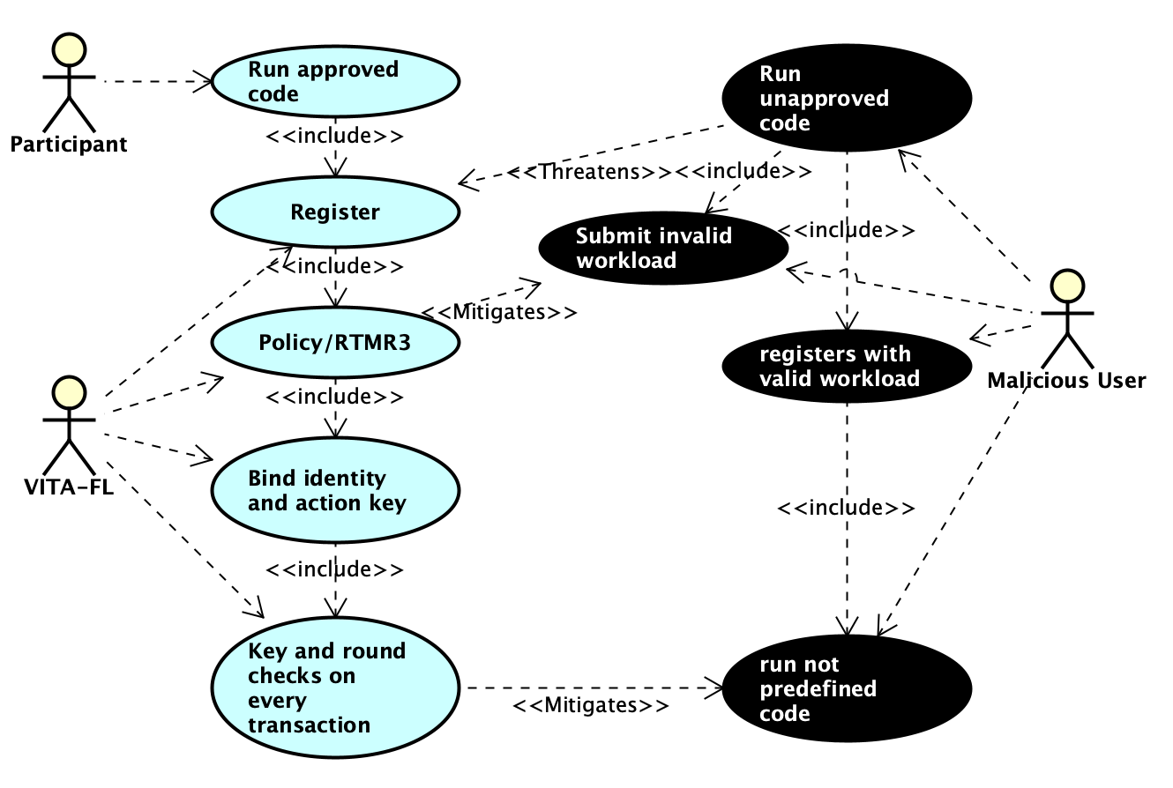
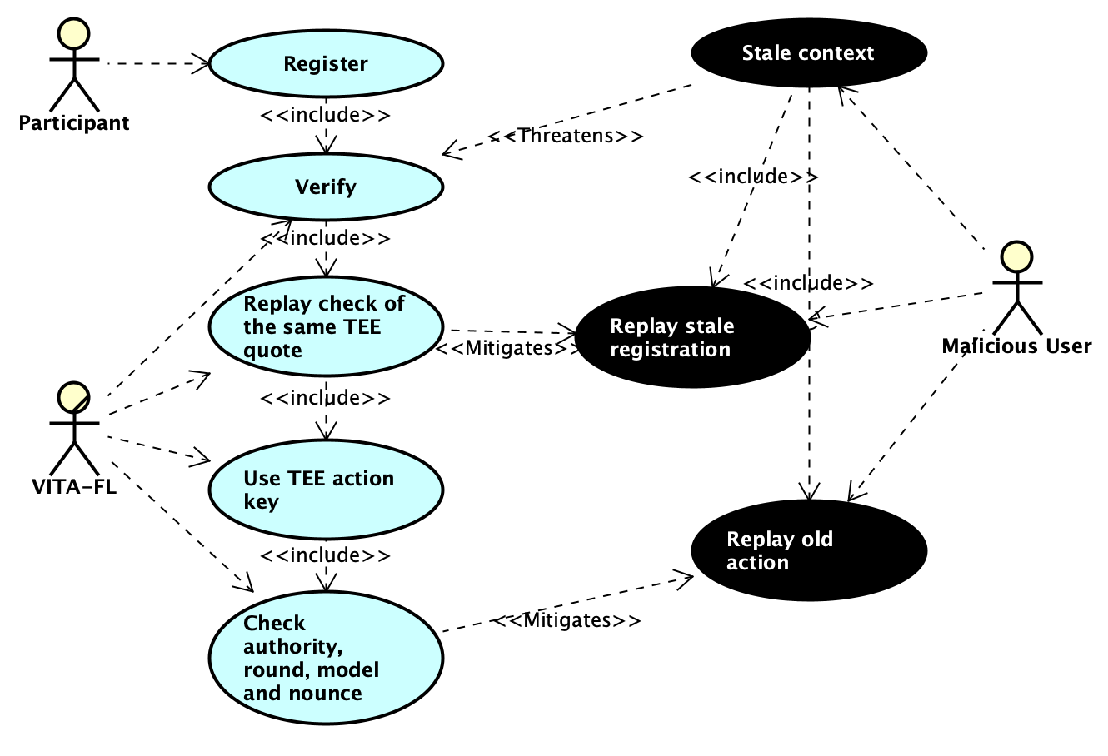
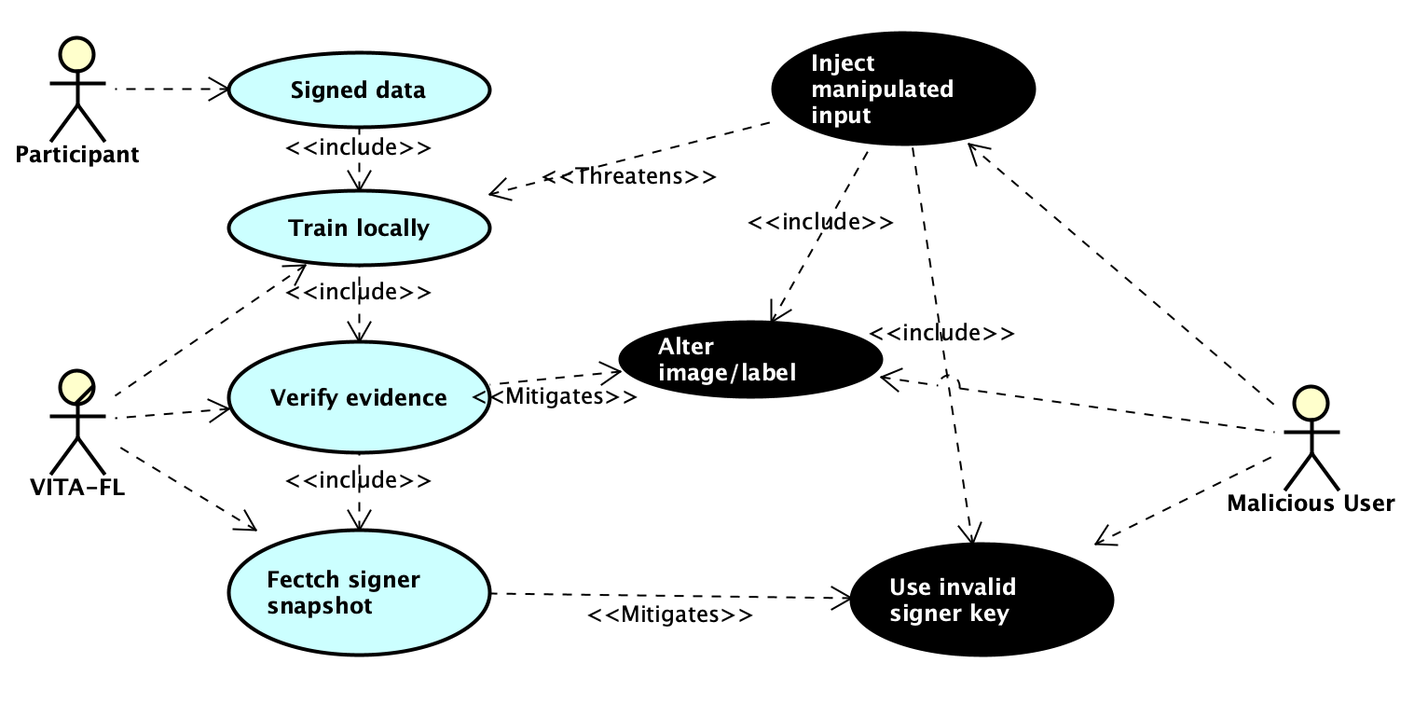
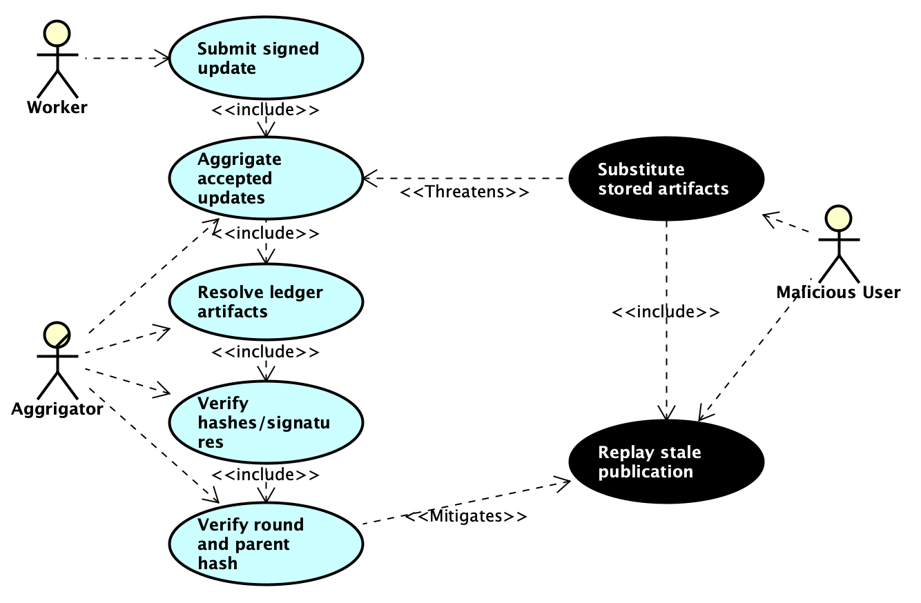
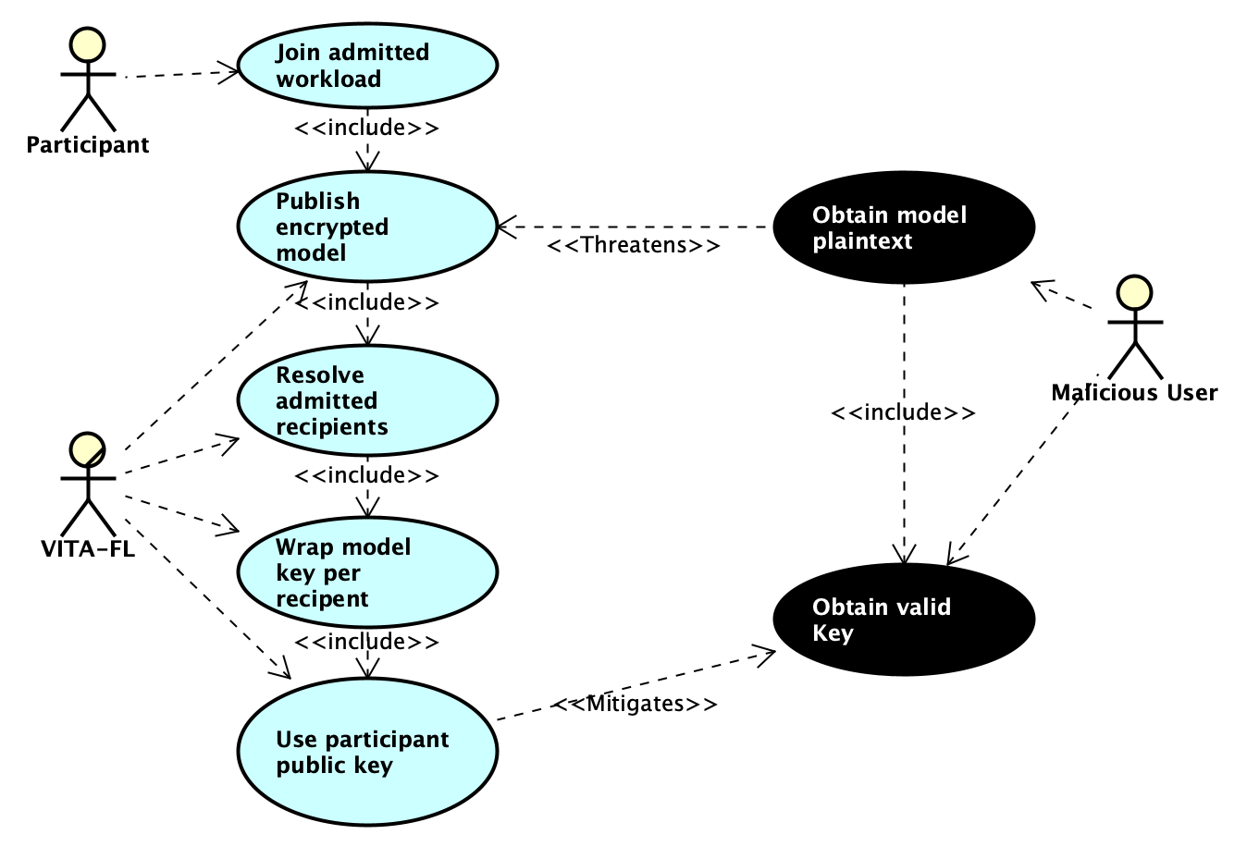
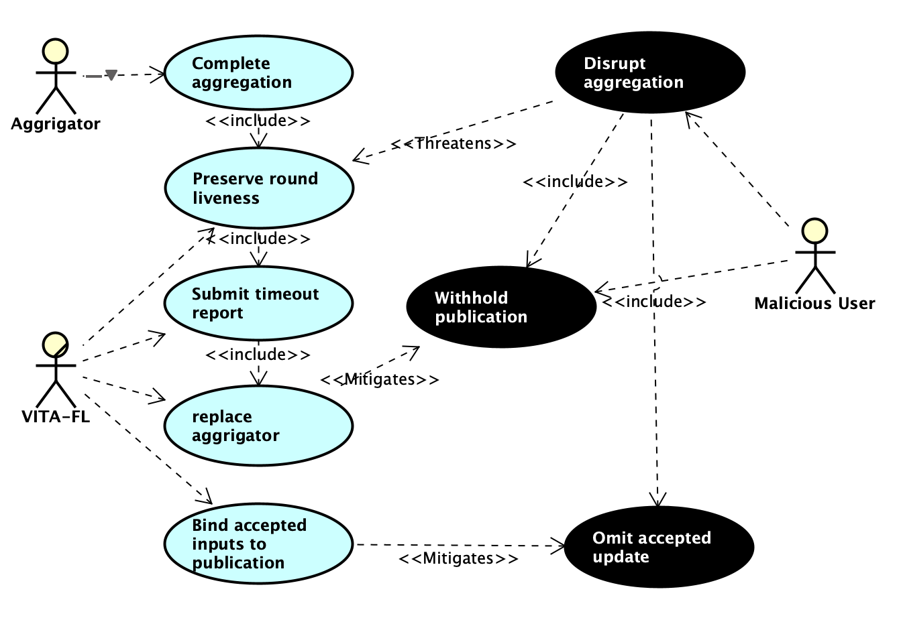
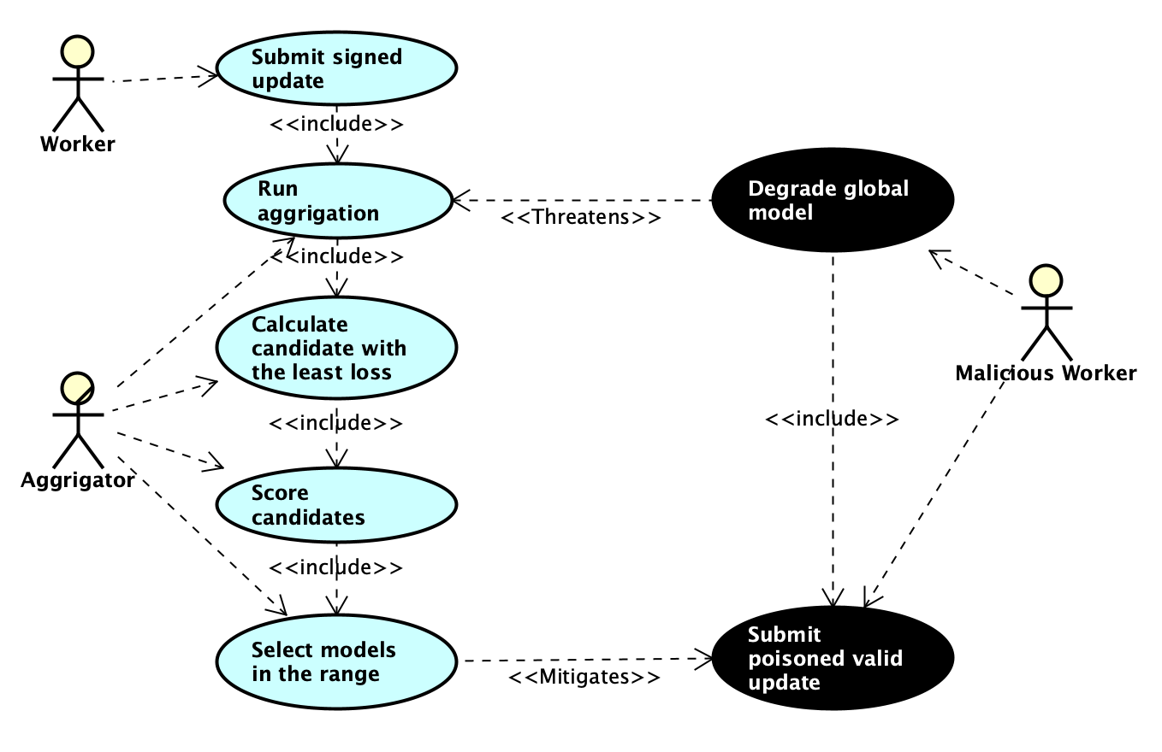
Use and misuse cases: DFL production
DFL
Agent
BACKUP · THREAT VIEWS T1–T7
T1 Admission / identity
T2 Replay / stale context
T3 Training-input provenance
T4 Artifact substitution
T5 Model/key disclosure
T6 Aggregator omission
T7 Valid malicious updates
Page 31
Ramon Mehrpoya | Master's Thesis | Verifiable Decentralized Federated Machine Learning and Inference for AI Agent Systems | VITA-FL
19 August 2026
Notes:
This backup slide summarizes the use and misuse case views for the DFL production path. The diagrams relate workload admission, replay protection, signed training inputs, artifact identity, model confidentiality, aggregator availability, and valid-but-malicious updates to their corresponding controls. The following backup slides show each diagram at full size.

Slide 32
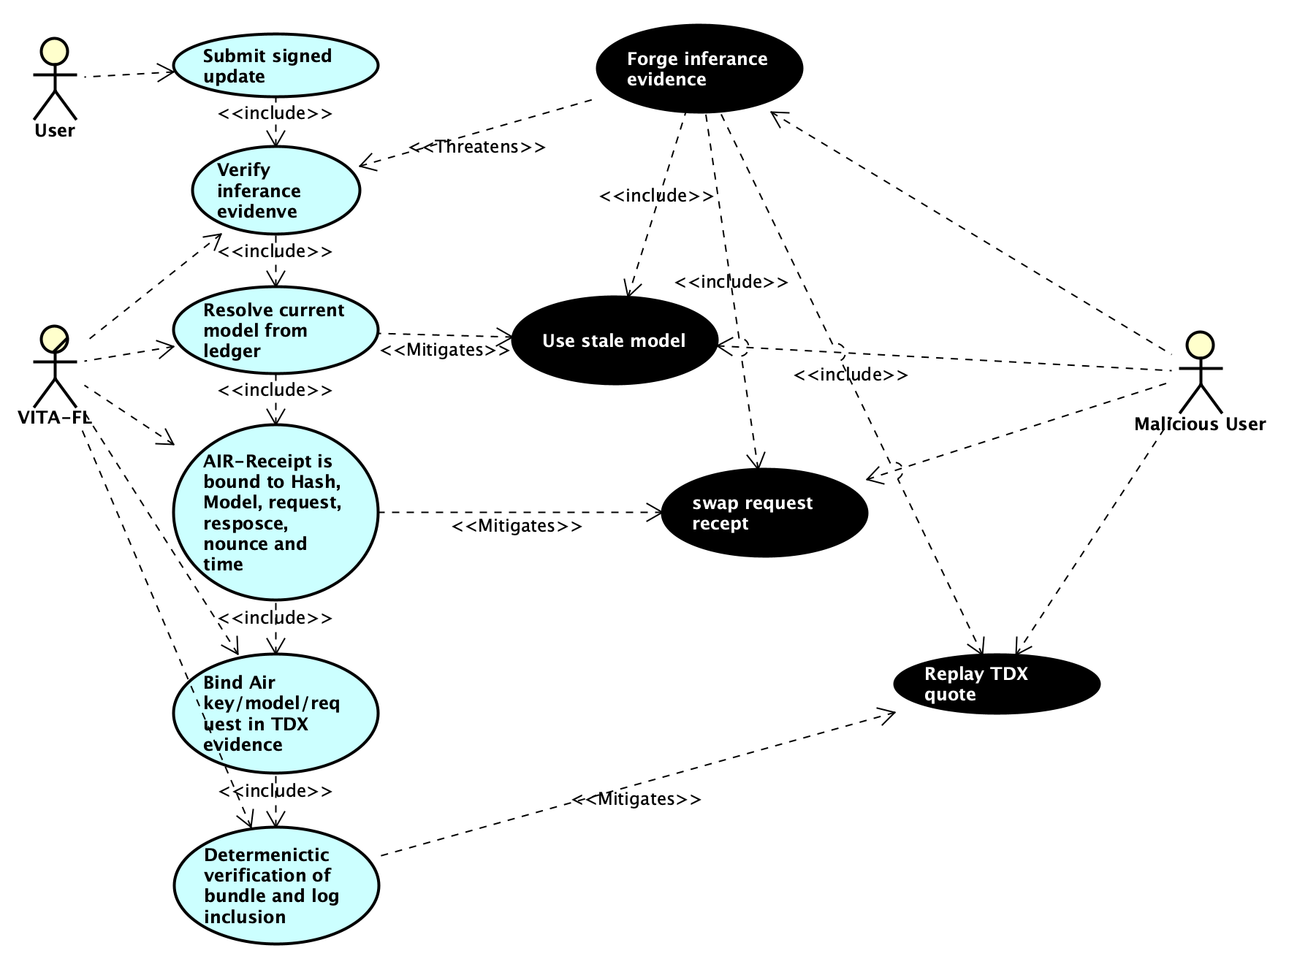
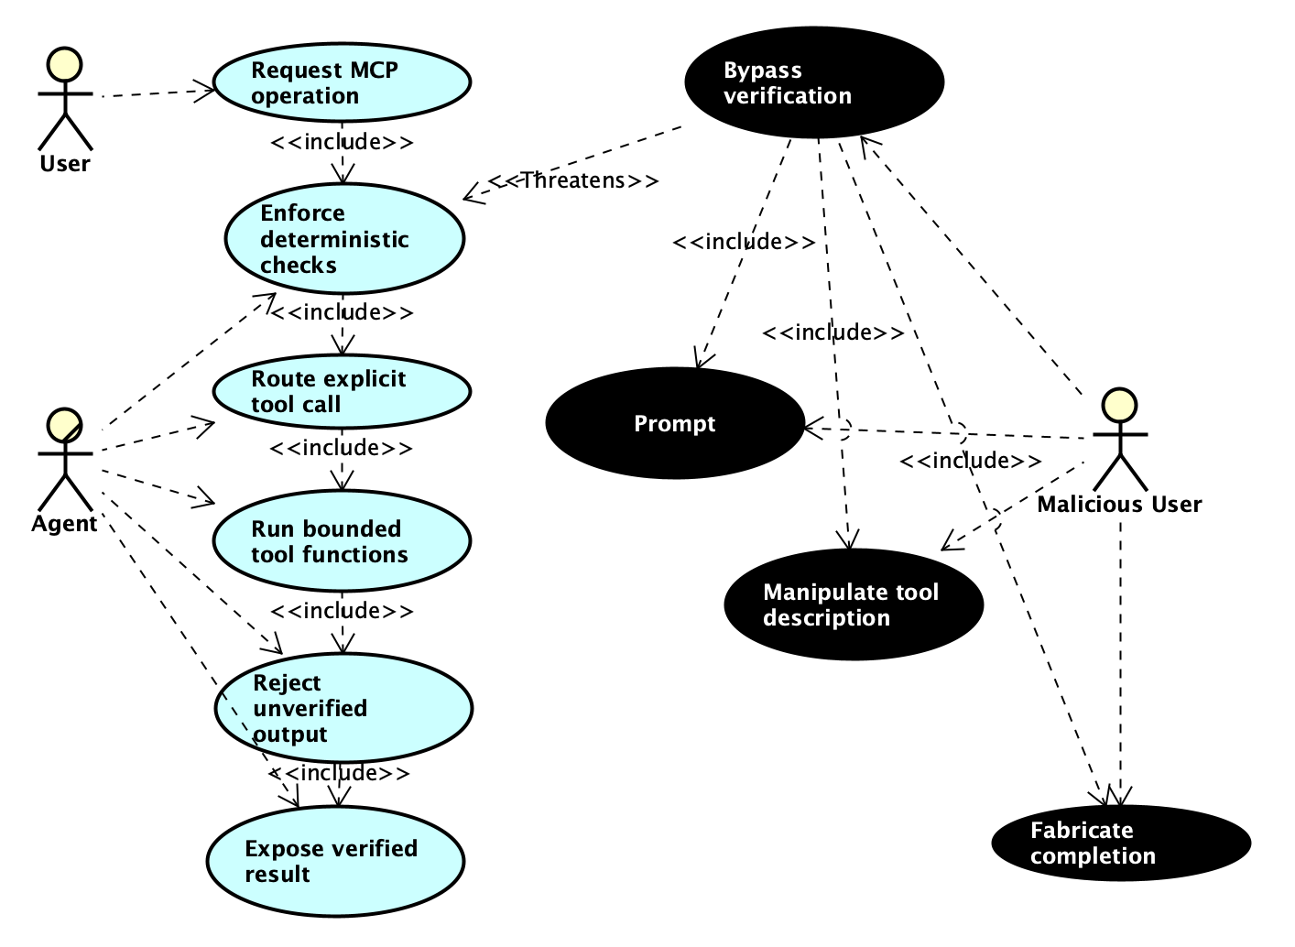
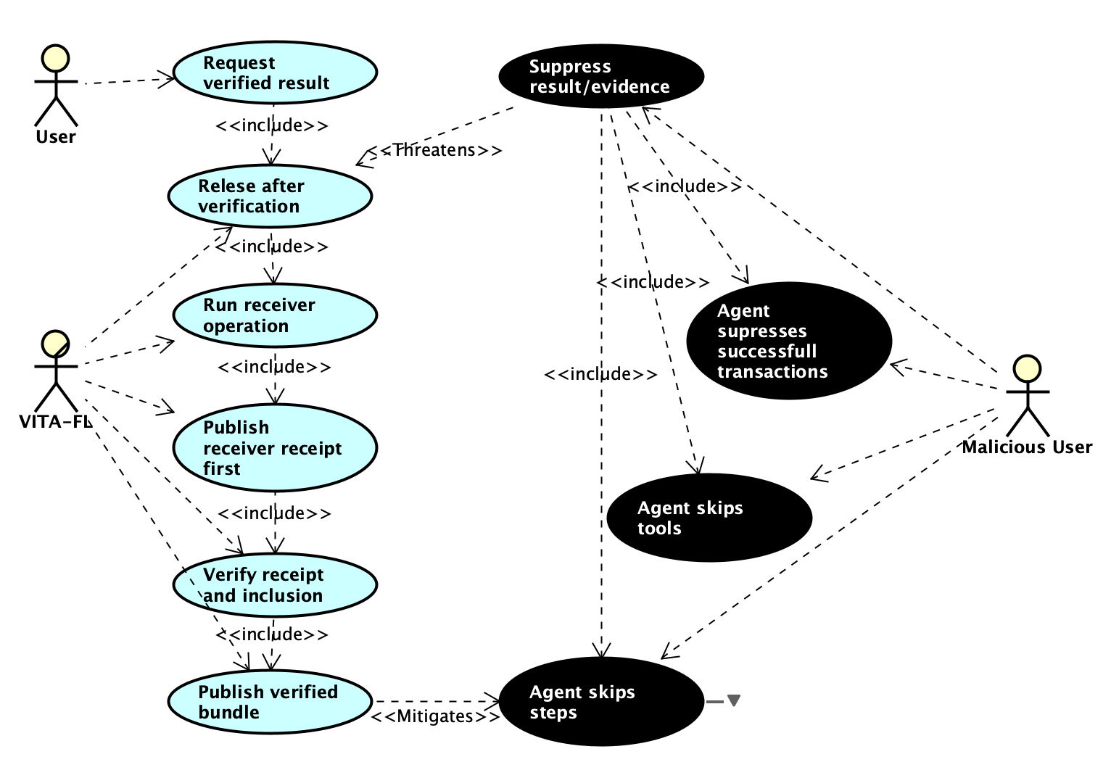
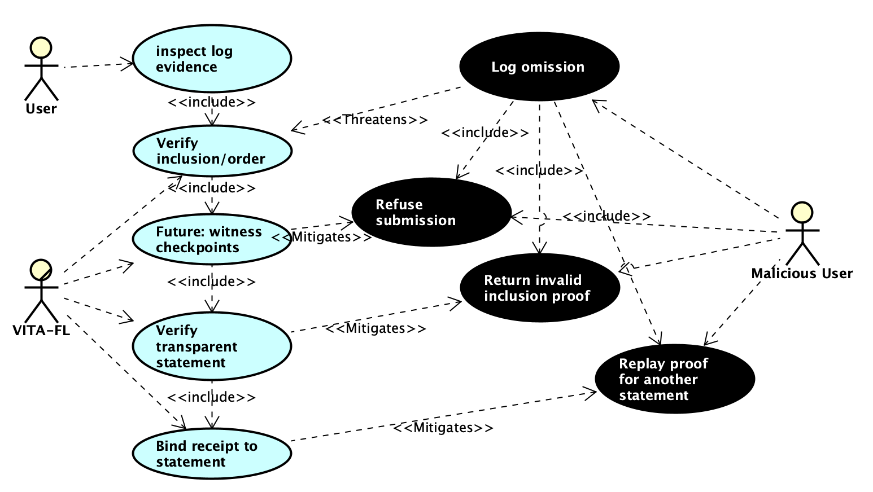
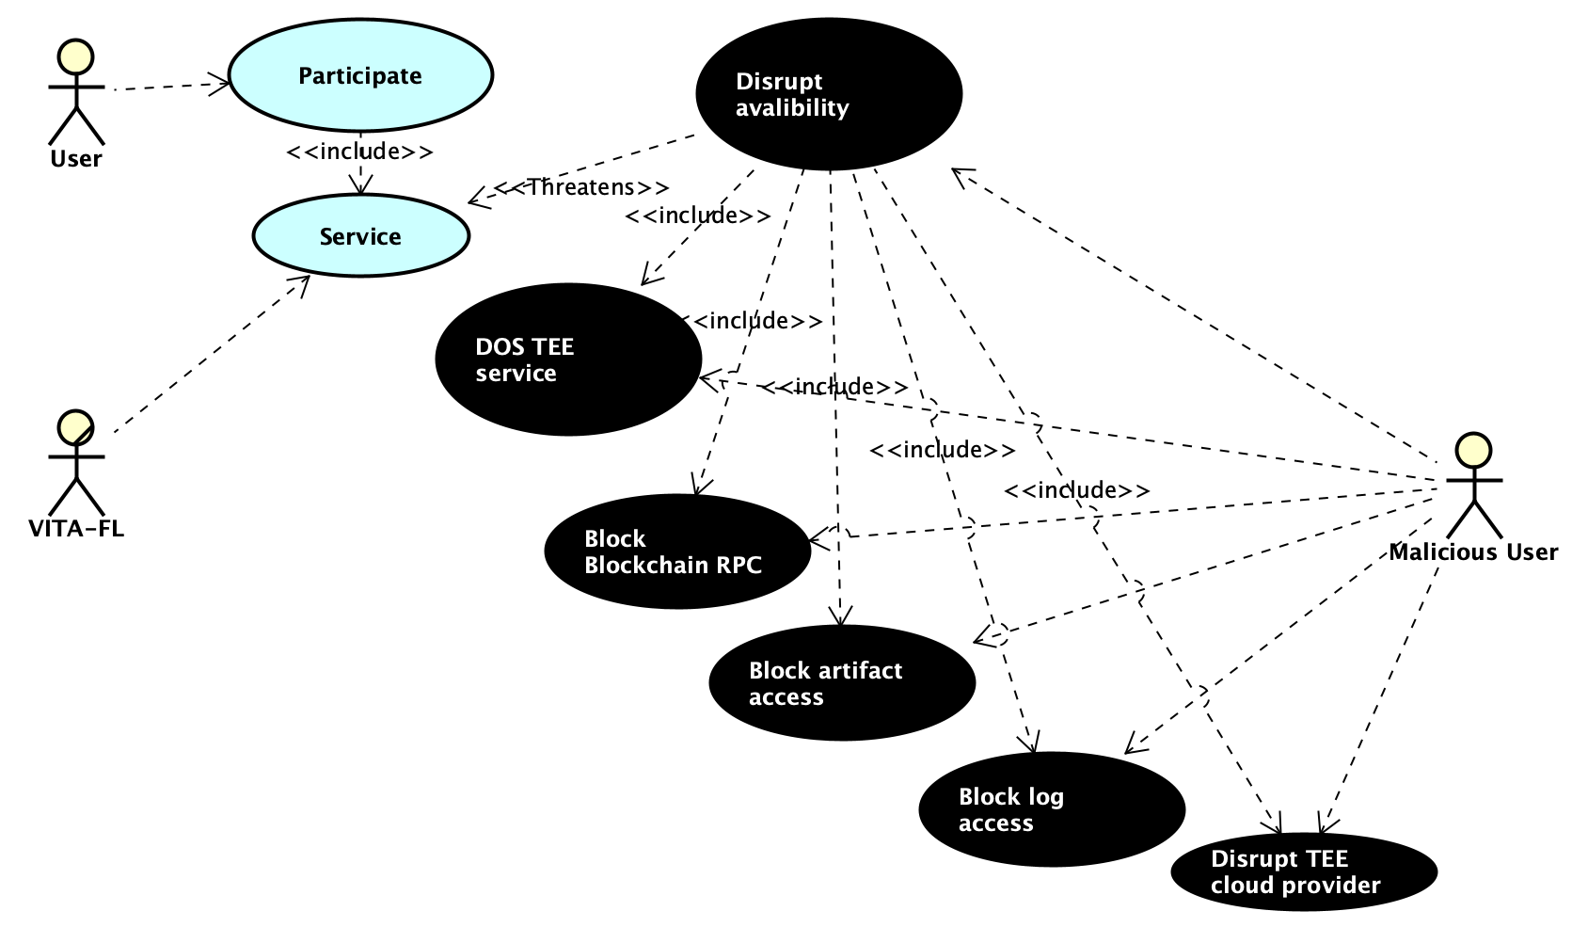
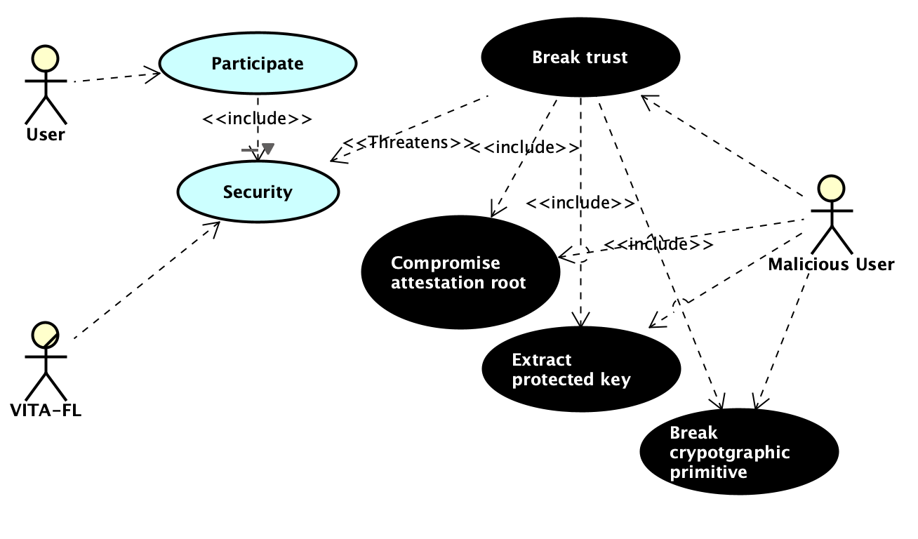
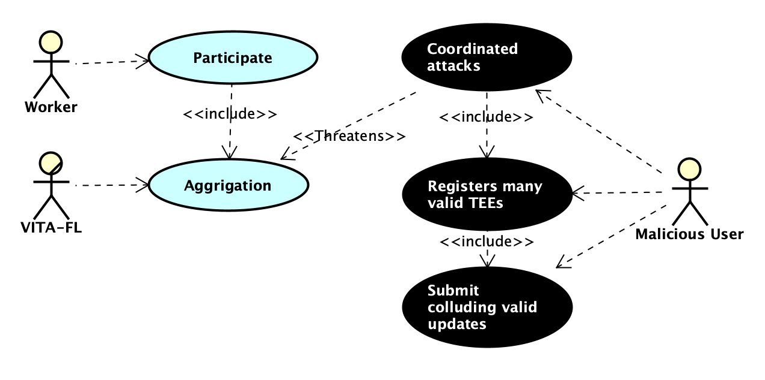
Use and misuse cases: agent and infrastructure
DFL
Agent
BACKUP · THREAT VIEWS T8–T14
T8 Inference evidence
T9 Agent/tool manipulation
T10 Evidence suppression
T11 Log omission/equivocation
T12 Infrastructure DoS
T13 Root/key compromise
T14 Systemic collusion
Page 32
Ramon Mehrpoya | Master's Thesis | Verifiable Decentralized Federated Machine Learning and Inference for AI Agent Systems | VITA-FL
19 August 2026
Notes:
This backup slide summarizes the use and misuse case views for the agent, attested inference, transparency log, and infrastructure path. The diagrams distinguish forged or suppressed evidence from log equivocation, denial of service, root compromise, and collusion by otherwise valid participants. The following backup slides show each diagram at full size.

Slide 33
T1 · Unauthorized workload admission or identity substitution
DFL
Agent
BACKUP · USE AND MISUSE CASE · DFL PRODUCTION
Page 33
Ramon Mehrpoya | Master's Thesis | Verifiable Decentralized Federated Machine Learning and Inference for AI Agent Systems | VITA-FL
19 August 2026
Notes:
This backup slide presents the full-size use and misuse case diagram for T1: Unauthorized workload admission or identity substitution. The corresponding threat specification and residual-risk discussion appear in Chapter 4 of the thesis.

Slide 34
T2 · Replay or stale-context reuse
DFL
Agent
BACKUP · USE AND MISUSE CASE · DFL PRODUCTION
Page 34
Ramon Mehrpoya | Master's Thesis | Verifiable Decentralized Federated Machine Learning and Inference for AI Agent Systems | VITA-FL
19 August 2026
Notes:
This backup slide presents the full-size use and misuse case diagram for T2: Replay or stale-context reuse. The corresponding threat specification and residual-risk discussion appear in Chapter 4 of the thesis.

Slide 35
T3 · Training-input or signer-policy manipulation
DFL
Agent
BACKUP · USE AND MISUSE CASE · DFL PRODUCTION
Page 35
Ramon Mehrpoya | Master's Thesis | Verifiable Decentralized Federated Machine Learning and Inference for AI Agent Systems | VITA-FL
19 August 2026
Notes:
This backup slide presents the full-size use and misuse case diagram for T3: Training-input or signer-policy manipulation. The corresponding threat specification and residual-risk discussion appear in Chapter 4 of the thesis.

Slide 36
T4 · Artifact substitution or stale publication
DFL
Agent
BACKUP · USE AND MISUSE CASE · DFL PRODUCTION
Page 36
Ramon Mehrpoya | Master's Thesis | Verifiable Decentralized Federated Machine Learning and Inference for AI Agent Systems | VITA-FL
19 August 2026
Notes:
This backup slide presents the full-size use and misuse case diagram for T4: Artifact substitution or stale publication. The corresponding threat specification and residual-risk discussion appear in Chapter 4 of the thesis.

Slide 37
T5 · Unauthorized model or key disclosure
DFL
Agent
BACKUP · USE AND MISUSE CASE · DFL PRODUCTION
Page 37
Ramon Mehrpoya | Master's Thesis | Verifiable Decentralized Federated Machine Learning and Inference for AI Agent Systems | VITA-FL
19 August 2026
Notes:
This backup slide presents the full-size use and misuse case diagram for T5: Unauthorized model or key disclosure. The corresponding threat specification and residual-risk discussion appear in Chapter 4 of the thesis.

Slide 38
T6 · Aggregator omission or availability failure
DFL
Agent
BACKUP · USE AND MISUSE CASE · DFL PRODUCTION
Page 38
Ramon Mehrpoya | Master's Thesis | Verifiable Decentralized Federated Machine Learning and Inference for AI Agent Systems | VITA-FL
19 August 2026
Notes:
This backup slide presents the full-size use and misuse case diagram for T6: Aggregator omission or availability failure. The corresponding threat specification and residual-risk discussion appear in Chapter 4 of the thesis.

Slide 39
T7 · Semantically malicious but valid data or updates
DFL
Agent
BACKUP · USE AND MISUSE CASE · DFL PRODUCTION
Page 39
Ramon Mehrpoya | Master's Thesis | Verifiable Decentralized Federated Machine Learning and Inference for AI Agent Systems | VITA-FL
19 August 2026
Notes:
This backup slide presents the full-size use and misuse case diagram for T7: Semantically malicious but valid data or updates. The corresponding threat specification and residual-risk discussion appear in Chapter 4 of the thesis.

Slide 40
T8 · Inference substitution or forged evidence
DFL
Agent
BACKUP · USE AND MISUSE CASE · AGENT AND INFERENCE
Page 40
Ramon Mehrpoya | Master's Thesis | Verifiable Decentralized Federated Machine Learning and Inference for AI Agent Systems | VITA-FL
19 August 2026
Notes:
This backup slide presents the full-size use and misuse case diagram for T8: Inference substitution or forged evidence. The corresponding threat specification and residual-risk discussion appear in Chapter 4 of the thesis.

Slide 41
T9 · Agent or tool manipulation
DFL
Agent
BACKUP · USE AND MISUSE CASE · AGENT AND INFERENCE
Page 41
Ramon Mehrpoya | Master's Thesis | Verifiable Decentralized Federated Machine Learning and Inference for AI Agent Systems | VITA-FL
19 August 2026
Notes:
This backup slide presents the full-size use and misuse case diagram for T9: Agent or tool manipulation. The corresponding threat specification and residual-risk discussion appear in Chapter 4 of the thesis.

Slide 42
T10 · Evidence or result suppression
DFL
Agent
BACKUP · USE AND MISUSE CASE · AGENT AND TRANSPARENCY
Page 42
Ramon Mehrpoya | Master's Thesis | Verifiable Decentralized Federated Machine Learning and Inference for AI Agent Systems | VITA-FL
19 August 2026
Notes:
This backup slide presents the full-size use and misuse case diagram for T10: Evidence or result suppression. The corresponding threat specification and residual-risk discussion appear in Chapter 4 of the thesis.

Slide 43
T11 · Transparency-log omission or equivocation
DFL
Agent
BACKUP · USE AND MISUSE CASE · AGENT AND TRANSPARENCY
Page 43
Ramon Mehrpoya | Master's Thesis | Verifiable Decentralized Federated Machine Learning and Inference for AI Agent Systems | VITA-FL
19 August 2026
Notes:
This backup slide presents the full-size use and misuse case diagram for T11: Transparency-log omission or equivocation. The corresponding threat specification and residual-risk discussion appear in Chapter 4 of the thesis.

Slide 44
T12 · Infrastructure denial of service
DFL
Agent
BACKUP · USE AND MISUSE CASE · CROSS-CUTTING RESIDUAL THREAT
Page 44
Ramon Mehrpoya | Master's Thesis | Verifiable Decentralized Federated Machine Learning and Inference for AI Agent Systems | VITA-FL
19 August 2026
Notes:
This backup slide presents the full-size use and misuse case diagram for T12: Infrastructure denial of service. The corresponding threat specification and residual-risk discussion appear in Chapter 4 of the thesis.

Slide 45
T13 · Cryptographic, key, or platform-root compromise
DFL
Agent
BACKUP · USE AND MISUSE CASE · CROSS-CUTTING RESIDUAL THREAT
Page 45
Ramon Mehrpoya | Master's Thesis | Verifiable Decentralized Federated Machine Learning and Inference for AI Agent Systems | VITA-FL
19 August 2026
Notes:
This backup slide presents the full-size use and misuse case diagram for T13: Cryptographic, key, or platform-root compromise. The corresponding threat specification and residual-risk discussion appear in Chapter 4 of the thesis.

Slide 46
T14 · Systemic collusion or economic manipulation
DFL
Agent
BACKUP · USE AND MISUSE CASE · CROSS-CUTTING RESIDUAL THREAT
Page 46
Ramon Mehrpoya | Master's Thesis | Verifiable Decentralized Federated Machine Learning and Inference for AI Agent Systems | VITA-FL
19 August 2026
Notes:
This backup slide presents the full-size use and misuse case diagram for T14: Systemic collusion or economic manipulation. The corresponding threat specification and residual-risk discussion appear in Chapter 4 of the thesis.

