Slide 1
Sprint 3
Retrieval

Slide 2
Module overview
Task: Identify and retrieve the closest object in a set to a query object of interest
Core concepts
Algorithms and models
Implementation on real dataset
Document representation
Distance metrics
Approximation algorithms
K- Nearest-Neighbors
Locality sensitive hashing
Wikipedia article
metagenomes
Sprint 3 - Retrieval

Slide 3
Task : Retrieving documents of interest
Sprint 3 - Retrieval

Slide 4
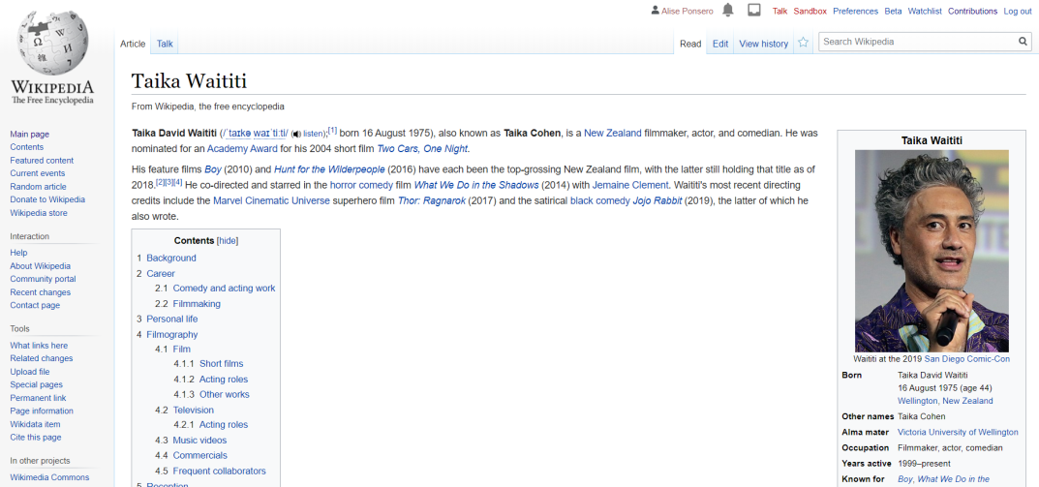
Task description
Reading a document of interest
How do I find other documents on the same topic ?
Can I retrieve another document that is on this topic ?
Sprint 3 - Retrieval

Slide 5
Task description – K-Nearest Neighbors search
Input:
query article ( wikipedia article on Taika Waititi x_{q} )
Corpus of documents ( set of wikipedia articles x_{N} )
Output:
k most similar articles ( article on Neo-Zelander movie maker x^{NN} )
K-nearest neigbors:
x^{NN} = {x^{NN1} , … , x^{NNk} }
For all x_{i} not in x^{NN}, distance(x_{i}, x_{q}) > max_distance(x_{q}, x^{NNk})
Sprint 3 - Retrieval

Slide 6
Task description – K-Nearest Neighbors search
Input:
query article ( wikipedia article on Taika Waititi x_{q} )
Corpus of documents ( set of wikipedia articles x_{N} )
Output:
k most similar articles ( article on Neo-Zelander movie maker x^{NN} )
K-nearest neigbors:
x^{NN} = {x^{NN1} , … , x^{NNk} }
For all x_{i} not in x^{NN}, distance(x_{i}, x_{q}) > max_distance(x_{q}, x^{NNk})
How do we calculate distances between documents?
How do we represent documents?
Sprint 3 - Retrieval

Slide 7
Concepts: Document representation
Sprint 3 - Retrieval

Slide 8

The bag of word model
The bag of word model is a simple representation of documents that:
Ignore the order of the words
Is simply a vector of word count
Word | Waititi | wrote | The | screenplay | and | directed | movie
# | 1 | 1 | 2 | 1 | 1 | 1 | 1
Issue :
Common words in the document « the », « a »… dominate important words like « film », « movie »…
« Waititi wrote the screenplay and directed the movie. »
Sprint 3 - Retrieval

Slide 9


The TF-IDF model
The TF-IDF (Term frequency – Inverse Document Frequency) representation allows to emphacize important words that :
Appears frequently in the document (local frequency)
… but are rare in the corpus of document (global frequency)
« movie », « New-Zealand »…
«The», « a»…
Sprint 3 - Retrieval

Slide 10
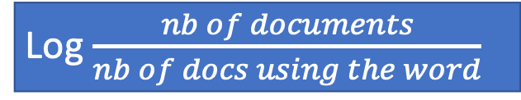
The TF-IDF model
The TF-IDF representation allows to emphacize important words that :
Appears frequently in the document (local frequency)
… but are rare in the corpus of document (global frequency
Term frequency
(word count/total)
Word | Waititi | wrote | The | screenplay | and | directed | movie
# | 1/8 | 1/8 | 1/4 | 1/8 | 1/8 | 1/8 | 1/8
Inverse document
frequency
Log $\frac{nb of documents}{nb of docs using the word}$
TF*IDF
Sprint 3 - Retrieval

Slide 11
The TF-IDF model
Document 1: « Waititi wrote the screenplay and directed the movie »
Document 2: « Waititi stars as Hitler in the new movie. »
Document 3: « The protesters achieved their demands for higher wages»
 | Word counts |  |  | Term frequency |  |  | IDF | TF-IDF
 | Doc1 | Doc2 | Doc3 | Doc1 | Doc2 | Doc3 |  | Doc1 | Doc2 | Doc3
Waititi | 1 | 1 | 0 | 0.125 | 0.125 | 0 | 0.176091259 | 0.176091259 | 0.176091259 | 0
wrote | 1 | 0 | 0 | 0.125 | 0 | 0 | 0.477121255 | 0.477121255 | 0 | 0
the | 2 | 1 | 1 | 0.25 | 0.125 | 0.125 | 0 | 0 | 0 | 0
screenplay | 1 | 0 | 0 | 0.125 | 0 | 0 | 0.477121255 | 0.477121255 | 0 | 0
and | 1 | 0 | 0 | 0.125 | 0 | 0 | 0.477121255 | 0.477121255 | 0 | 0
directed | 1 | 0 | 0 | 0.125 | 0 | 0 | 0.477121255 | 0.477121255 | 0 | 0
movie | 1 | 1 | 0 | 0.125 | 0.125 | 0 | 0.176091259 | 0.176091259 | 0.176091259 | 0
stars | 0 | 1 | 0 | 0 | 0.125 | 0 | 0.477121255 | 0 | 0.477121255 | 0
as | 0 | 1 | 0 | 0 | 0.125 | 0 | 0.477121255 | 0 | 0.477121255 | 0
Hitler | 0 | 1 | 0 | 0 | 0.125 | 0 | 0.477121255 | 0 | 0.477121255 | 0
in | 0 | 1 | 0 | 0 | 0.125 | 0 | 0.477121255 | 0 | 0.477121255 | 0
new | 0 | 1 | 0 | 0 | 0.125 | 0 | 0.477121255 | 0 | 0.477121255 | 0
protesters | 0 | 0 | 1 | 0 | 0 | 0.125 | 0.477121255 | 0 | 0 | 0.477121255
achieved | 0 | 0 | 1 | 0 | 0 | 0.125 | 0.477121255 | 0 | 0 | 0.477121255
their | 0 | 0 | 1 | 0 | 0 | 0.125 | 0.477121255 | 0 | 0 | 0.477121255
demands | 0 | 0 | 1 | 0 | 0 | 0.125 | 0.477121255 | 0 | 0 | 0.477121255
for | 0 | 0 | 1 | 0 | 0 | 0.125 | 0.477121255 | 0 | 0 | 0.477121255
higher | 0 | 0 | 1 | 0 | 0 | 0.125 | 0.477121255 | 0 | 0 | 0.477121255
wages | 0 | 0 | 1 | 0 | 0 | 0.125 | 0.477121255 | 0 | 0 | 0.477121255
Sprint 3 - Retrieval

Slide 12
Concepts: Distance metric
Sprint 3 - Retrieval

Slide 13
Choosing a similarity metric
How can we compare two documents ?
Document 1
« Waititi wrote the screenplay and directed the movie. »
Word | Waititi | wrote | The | screenplay | and | directed | movie
# | 0.18 | 0.48 | 0 | 0.48 | 0.48 | 0.48 | 0.48
Similarity between the word vectors?
Document 2
« Waititi stars as Hitler in the new movie. »
Word | Waititi | stars | as | Hitler | In | the | new | movie
# | 0.18 | 0.48 | 0.48 | 0.48 | 0.48 | 0 | 0.48 | 0.18
Sprint 3 - Retrieval

Slide 14
Euclidean distance
 | Word count
 | Doc1 | Doc2 | Doc3
Waititi | 0.18 | 0.18 | 0.00
wrote | 0.48 | 0.00 | 0.00
the | 0.00 | 0.00 | 0.00
screenplay | 0.48 | 0.00 | 0.00
and | 0.48 | 0.00 | 0.00
directed | 0.48 | 0.00 | 0.00
movie | 0.18 | 0.18 | 0.00
stars | 0.00 | 0.48 | 0.00
as | 0.00 | 0.48 | 0.00
Hitler | 0.00 | 0.48 | 0.00
in | 0.00 | 0.48 | 0.00
new | 0.00 | 0.48 | 0.00
protesters | 0.00 | 0.00 | 0.48
achieved | 0.00 | 0.00 | 0.48
their | 0.00 | 0.00 | 0.48
demands | 0.00 | 0.00 | 0.48
for | 0.00 | 0.00 | 0.48
higher | 0.00 | 0.00 | 0.48
wages | 0.00 | 0.00 | 0.48
Euclidian similarity is simply an element-wise product over the word vectors.
Dist(x_{i}, x_{q}) = (x_{i}[1]-x_{q}[1])² + … + (x_{i}[d]-x_{q}[d])²
Sprint 3 - Retrieval

Slide 15
Weighting different features – Scaled Euclidean
Some features are more relevant than others.
In a document you may want to put higher weights on words from title and abstracts rather than the main body…
Scaled Euclidean distance:
Dist(x_{i}, x_{q}) = a₁(x_{i}[1]-x_{q}[1])² + … + a_{d}(x_{i}[d]-x_{q}[d])²
Note: if setting weights as 0 or 1 is equivalent to feature selection
Sprint 3 - Retrieval

Slide 16
Cosine similarity
Very popular metric that use the cosine of the angle of the word vectors.
Bound between 0 and 1 for positive features.
Cosine Similarity (x_{q}-x_{i}) = cos(Θ)
Distance = 1 - Similarity
Notes:
Does not obey the triangle inequality property (not a real distance metric)
Low complexity – can easily be computed on large sparse vectors
Is normalized for document length
Feature 2
Θ
Feature 1
Sprint 3 - Retrieval

Slide 17
Other notes on metrics
Normalization is not always relevant (may make documents very dissimilar in size appear similar)
Large number of other metrics can be used (Jaccard, Bray-Curtis, rank-based, hamming…)
These different metrics can also be combined on different features
Word content of documents: Cosine
Nb of reads of documents: Euclidean
Sprint 3 - Retrieval

Slide 18
Implementation: wikipedia pages
Sprint 3 - Retrieval

Slide 19
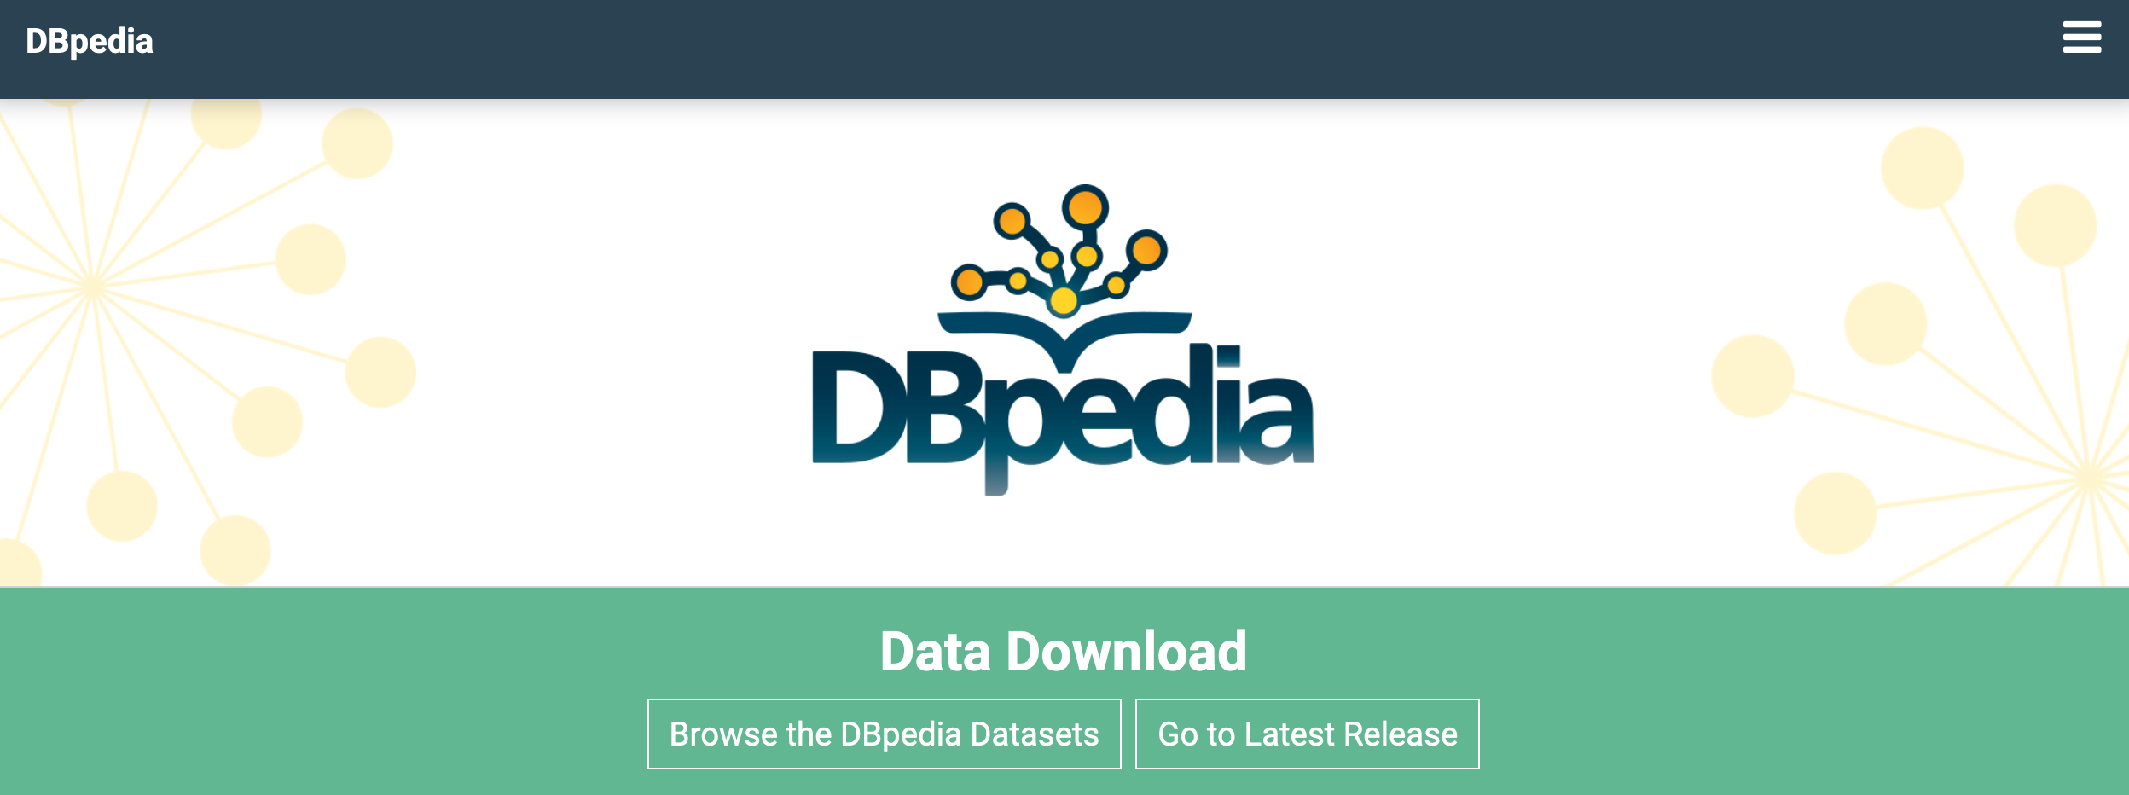
Implementation: Wikipedia pages
Corpus:
Abstract from biographies
of person born in New-Zealand
Tasks:
Compute Bag of words and TF-IDFs of Wikipedia pages
Compute Euclidean and Cosine distances between documents
Sprint 3 - Retrieval

Slide 20
Algorithm: k-NN search
Sprint 3 - Retrieval

Slide 21
K-NN overview
Initialize K to your chosen number of neighbors
For each example in the data
Calculate the distance between the query example and the current example from the data.
Add the distance and the index of the example to an ordered collection
Sort the ordered collection of distances and indices from smallest to largest (in ascending order) by the distances
Pick the first K entries from the sorted collection
Sprint 3 - Retrieval

Slide 22
Complexity of brute-force k-NN search
Given a query point, scan through each point
O(N) distances computations per 1-NN query
O(Nlogk) per k-NN query
How can we approximate the search?
We often need A nearest neighbor (not THE nearest, but close enough)
The document representation and metric choice is influencing the retrieved NN
Sprint 3 - Retrieval

Slide 23
Locality Sensitive Hashing
Feature 2
Feature 1
Sprint 3 - Retrieval

Slide 24
Locality Sensitive Hashing
Sign(Score(x)) = -1
Feature 2
Hash Table
a(Feature1) – b(Feature2)=0
Bin index | Score | List points
0 | -1 | {1,2,5,8,19…}
1 | +1 | {3,6,7,9,15…}
Sign(Score(x)) = +1
Feature 1
Sprint 3 - Retrieval

Slide 25
Locality Sensitive Hashing
Sign(Score(x)) = -1
Feature 2
Hash Table
a(Feature1) – b(Feature2)=0
Bin index | List points
0 | {1,2,5,8,19…}
1 | {3,6,7,9,15…}
Sign(Score(x)) = +1
Query point
Query point
Feature 1
How do we define the lines: random !
Sprint 3 - Retrieval

Slide 26
Locality Sensitive Hashing
Line 2
[0 0 0]
Line 1
[0 1 0]
Feature 2
Hash Table
[1 1 0]
Bin index | List points
[0 0 0] | {1,2,5,8,19…}
[0 1 0] | {3,6,7,9,15…}
[1 1 0] | {12,13…}
[1 1 1] | {14,16,17,…}
Line 3
[1 1 1]
Feature 1
How do we define the lines: random !
Sprint 3 - Retrieval

Slide 27
Locality Sensitive Hashing
Line 2
[0 0 0]
Line 1
[0 1 0]
Feature 2
Hash Table
[1 1 0]
Bin index | List points
[0 0 0] | {1,2,5,8,19…}
[0 1 0] | {3,6,7,9,15…}
[1 1 0] | {12,13…}
[1 1 1] | {14,16,17,…}
Line 3
Search Bin and next closest (flip 1 bit)
[1 1 1]
Feature 1
Algorithm :
Continue searching until computational budget is reached or
quality of NN good enough
Sprint 3 - Retrieval

Slide 28
Implementation: wikipedia pages
Sprint 3 - Retrieval

Slide 29
Implementation: Wikipedia pages
Corpus:
Abstract from biographies
of person born in New-Zealand
Tasks:
Retrieve k-NN for Taika Waititi using TF-IDF model
Euclidiean distance
cosine similarity
Sprint 3 - Retrieval

Slide 30
Applying document-based concepts to metagenomics
Sprint 3 - Retrieval

Slide 31
Metagenomes as documents
It is possible to apply these methods to compare metagenomes on their sequence content.
Document → Metagenome
Sentences → Reads
Words → Kmers (usually around 21bp)
k-mer | Counts
AATTTGTG | 3
TTGTTTGG | 17
TATTATTG | 0
AAAAAAA | 5
>read1
ATTGATTCGTATTCGTAGCGGTAACCGGTTA
>read2
TGATGCTAGGGCTTATAGCTTAGCGGTATCGG
Sprint 3 - Retrieval

Slide 32
de novo comparative metagenomic tools
The method allows to compute distances between metagenomes based on the complete sequence content.
Take into account the unknown fraction of the population
Do not require any taxonomic or functional annotation
Recent de novo comparative metagenomic tools:
MASH : Bag of word model, estimate a Jaccard distance between metagenomes
SIMKA: Bag of Word model, compute 10 different distances
LIBRA: Bag of word model, compute a cosine similarity
Sprint 3 - Retrieval

Slide 33
Implementation: HMP project
Corpus:
6 metagenomes from the HMP project
Tasks:
-> Bray-Curtis distances precomputed for 6 metagenomes using SIMKA (k-mer 25bp)
Retrieve k-NN for samples of interest using bag of word model
Sprint 3 - Retrieval

