Slide 1
White light interferometer measurements of Sony IMX455 detector [measured at Wyant College; cover glass removed]
Jacob P. Krell
2025/08/29

Slide 2
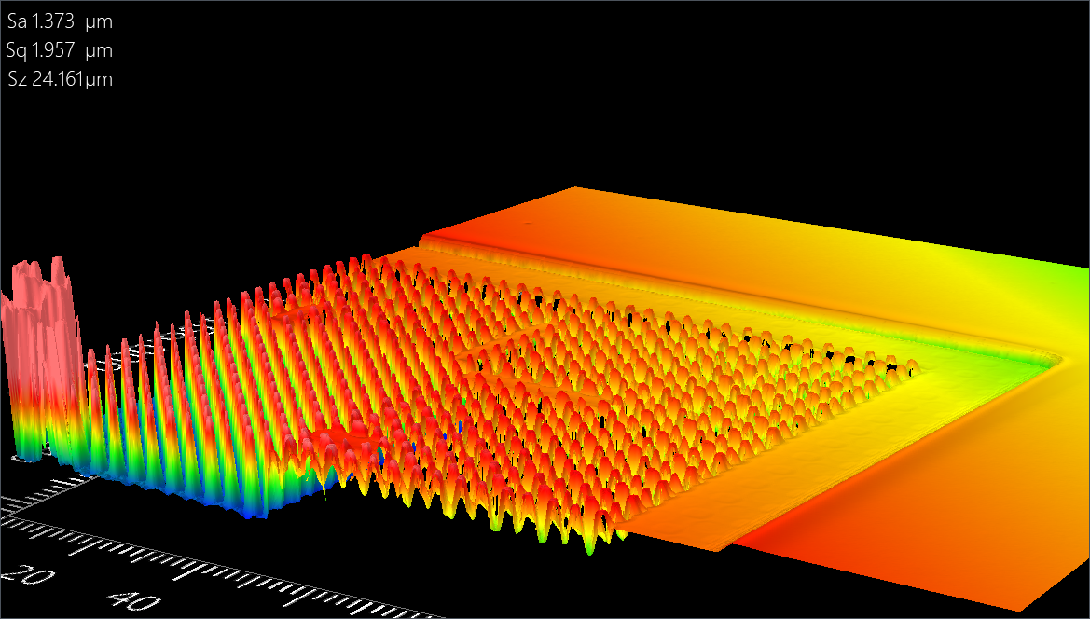
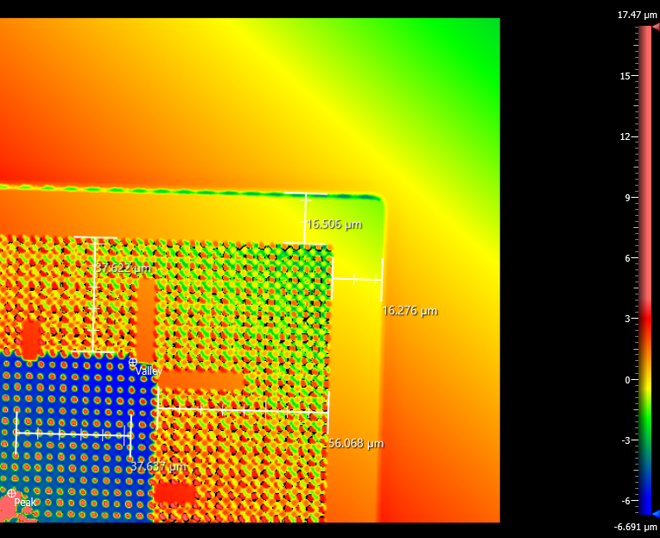
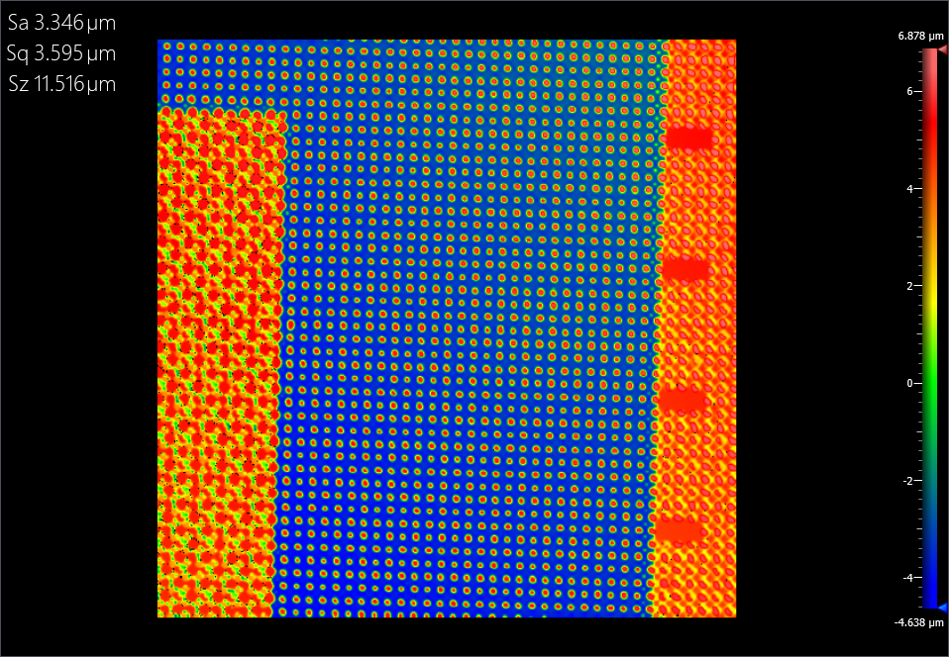
50x mag., top-right corner
Metal frame
Glass
Blue is not pixels
Pixels are here (not in above measurement)

Slide 3
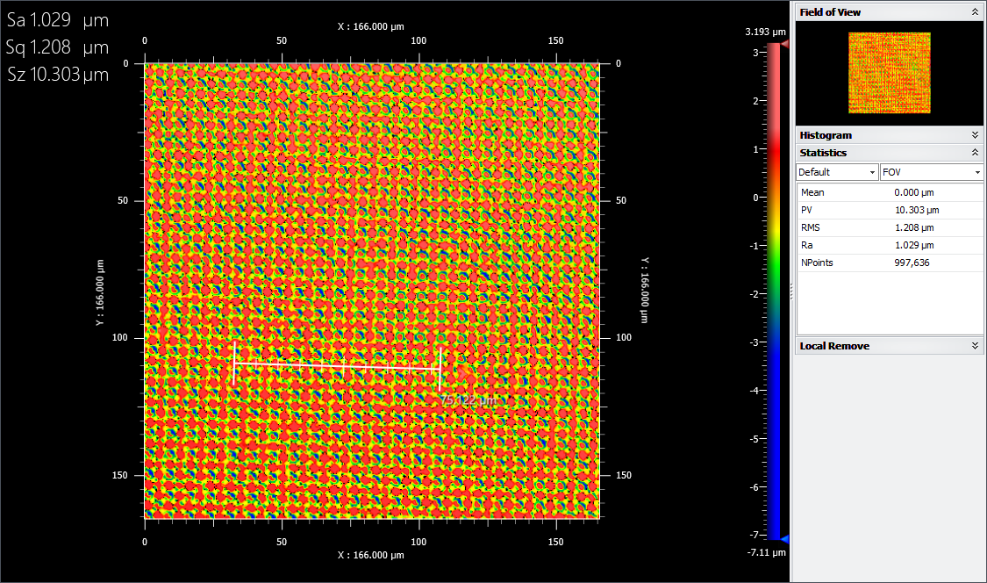
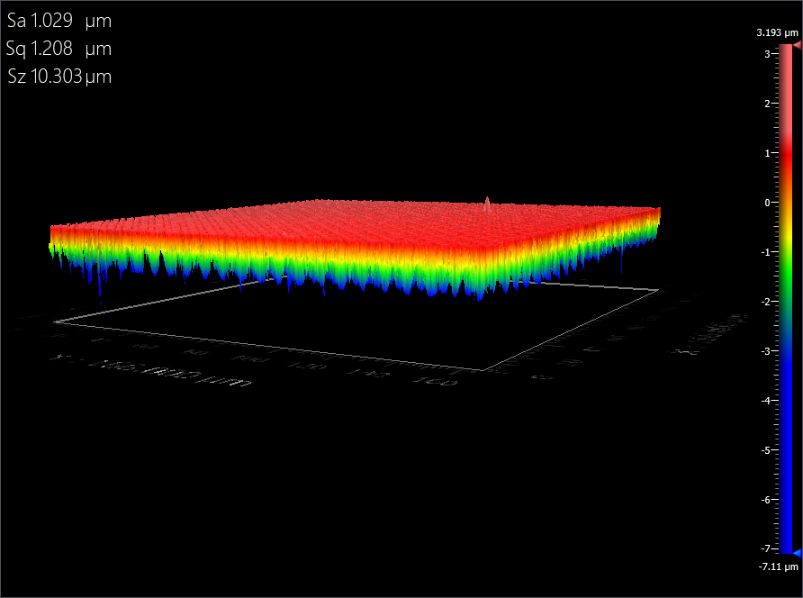
50x mag., center (pixels)

