Slide 1
Ongoing development notes for BRDF data processing
[exportable STP material]
Jacob P. Krell (jacobpkrell@arizona.edu)
2025/08/30 – 2025/11/19

Slide 2
Notes on BSDF processing
2025/08/30

Slide 3
Notes
Help docs reference article
  https://optics.ansys.com/hc/en-us/articles/43071107687699-Zemax-Tabular-BSDF-data-file-format
So, need total integrated scatter (TIS) but this is difficult to measure
  Synopsys (in Sec. 2) offers relation to BSDF:
    https://www.synopsys.com/glossary/what-is-total-integrated-scattering.html

Slide 4
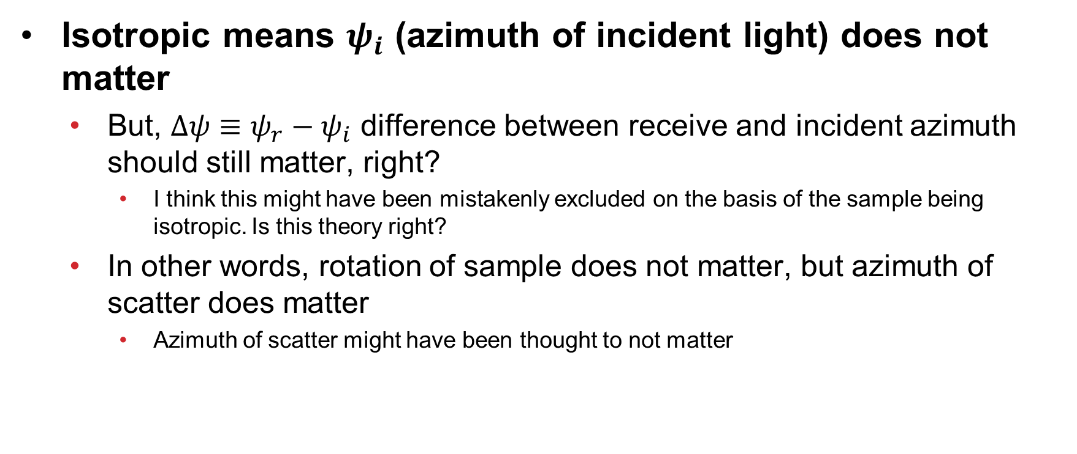
Caution
Isotropic means $ψ_{i}$ (azimuth of incident light) does not matter
  But, $Δψ≡ψ_{r}−ψ_{i}$ difference between receive and incident azimuth should still matter, right?
    I think this might have been mistakenly excluded on the basis of the sample being isotropic. Is this theory right?
  In other words, rotation of sample does not matter, but azimuth of scatter does matter
    Azimuth of scatter might have been thought to not matter

Slide 5
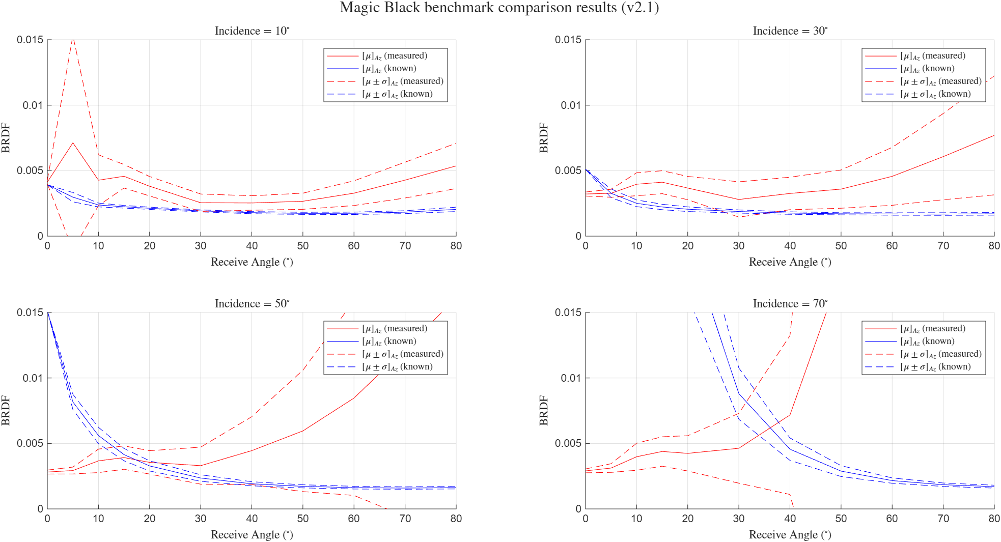
Results
2025/09/02

Slide 6
Development of conversion to Zemax

Slide 7
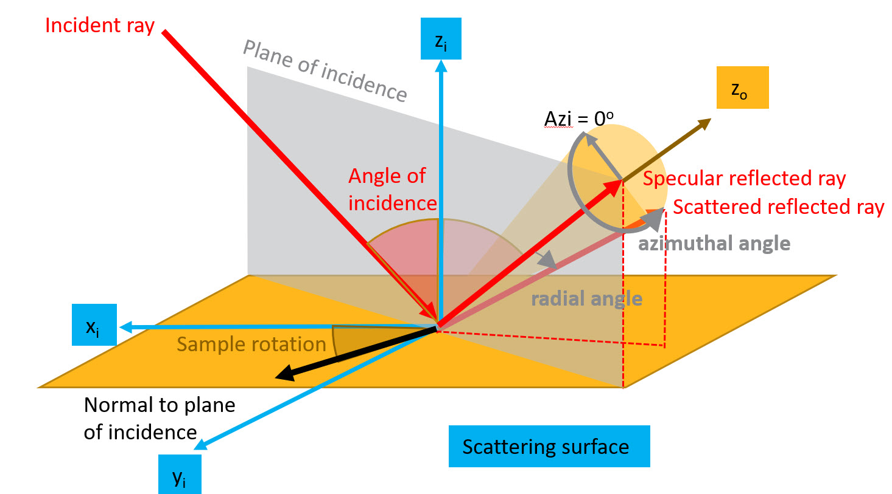
Coordinate definitions
https://optics.ansys.com/hc/en-us/articles/43071107687699-Zemax-Tabular-BSDF-data-file-format
*FRED just needs various radial angles at Azi = 0deg

Slide 8
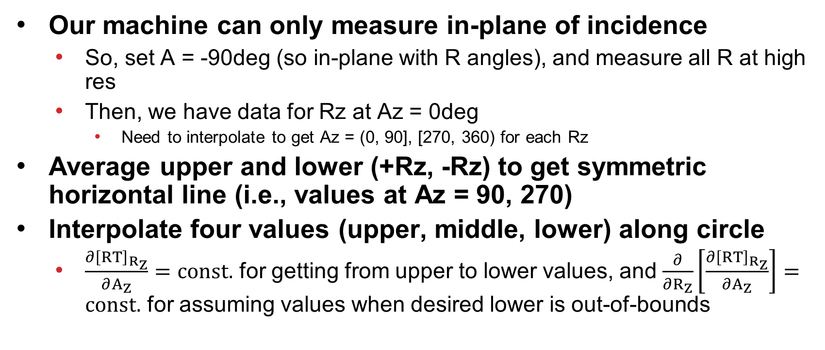
Interpolation strategy
Our machine can only measure in-plane of incidence
  So, set A = -90deg (so in-plane with R angles), and measure all R at high res
  Then, we have data for Rz at Az = 0deg
    Need to interpolate to get Az = (0, 90], [270, 360) for each Rz
Average upper and lower (+Rz, -Rz) to get symmetric horizontal line (i.e., values at Az = 90, 270)
Interpolate four values (upper, middle, lower) along circle
  $\frac{∂{\left[RT\right]}_{R_{Z}}}{∂A_{Z}}=const.$ for getting from upper to lower values, and $\frac{∂}{∂R_{Z}}\left[\frac{∂{\left[RT\right]}_{R_{Z}}}{∂A_{Z}}\right]=const.$ for assuming values when desired lower is out-of-bounds

Slide 9
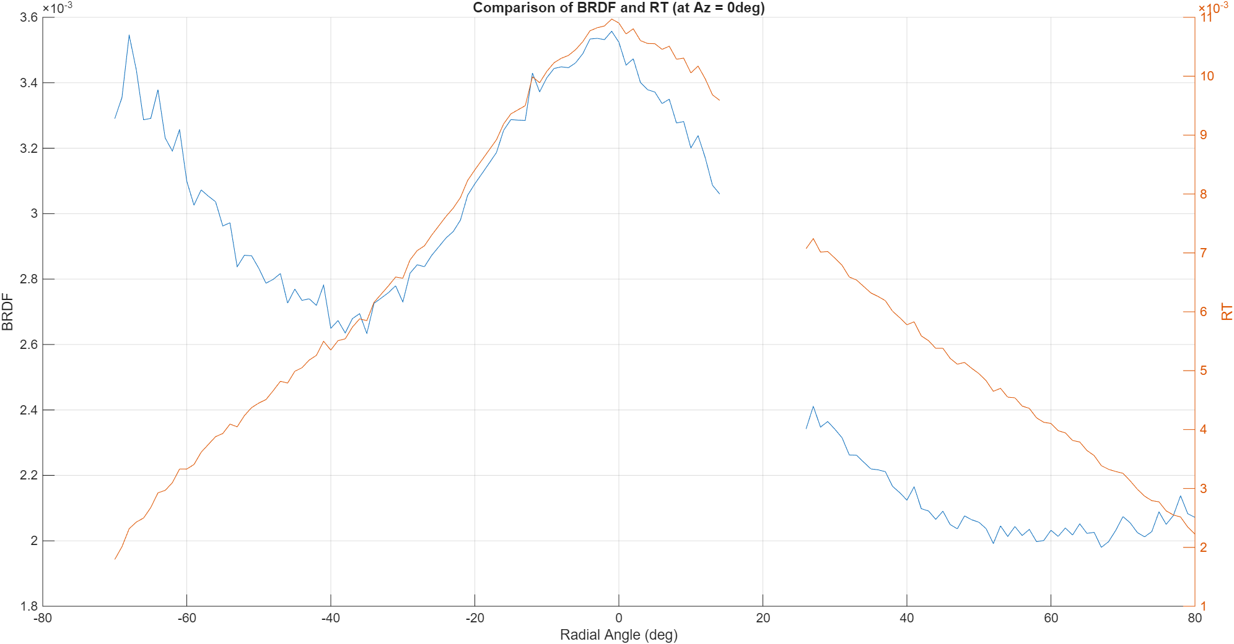
Interpolate BRDF or RT values ?
RT has more uniform change, use this

Slide 10
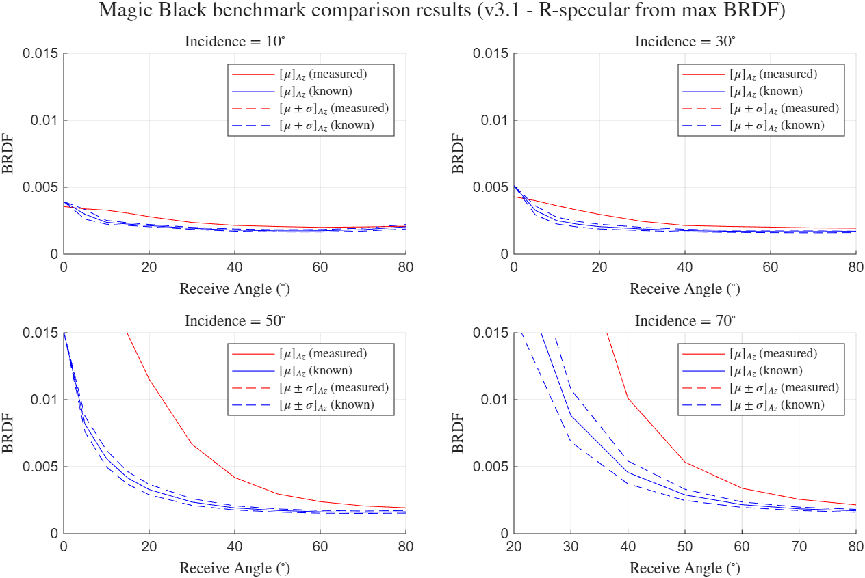
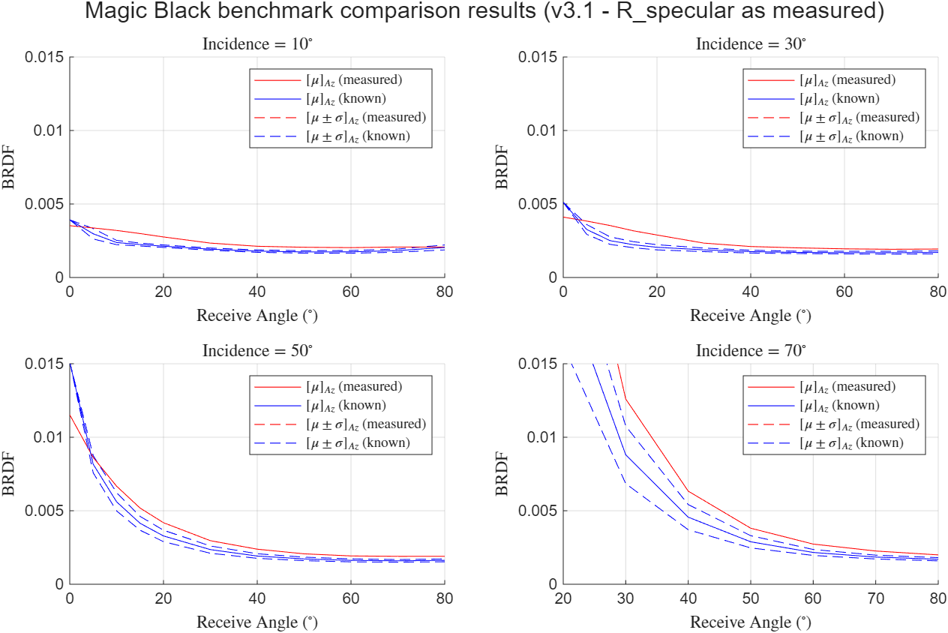
R_specular as measured or inferred from max BRDF ?
As measured
  See accuracy of plots

Slide 11
Previous plot was Azi = 0deg, and assumed uniform cone (i.e., all Azi have same RT as Azi=0)
I have since developed coordinate transformation of measured RT values to cone’s (Azi, radial) angle
  But, took all day yesterday and still not sure about math, but empirically coordinate transfers make sense

Slide 12
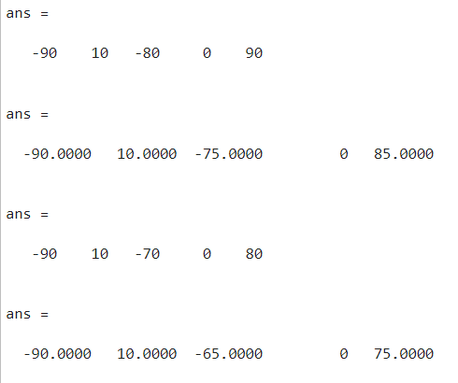
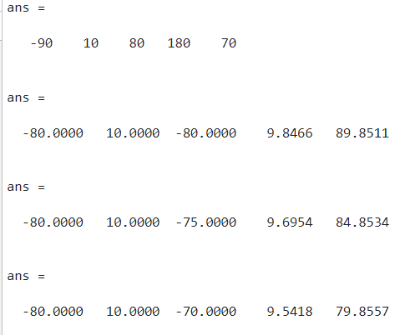
Empirically, transform is working
[A, I, R, Az, Rz]

Slide 13
Debugging coordinate transformation
2025/09/09

Slide 14
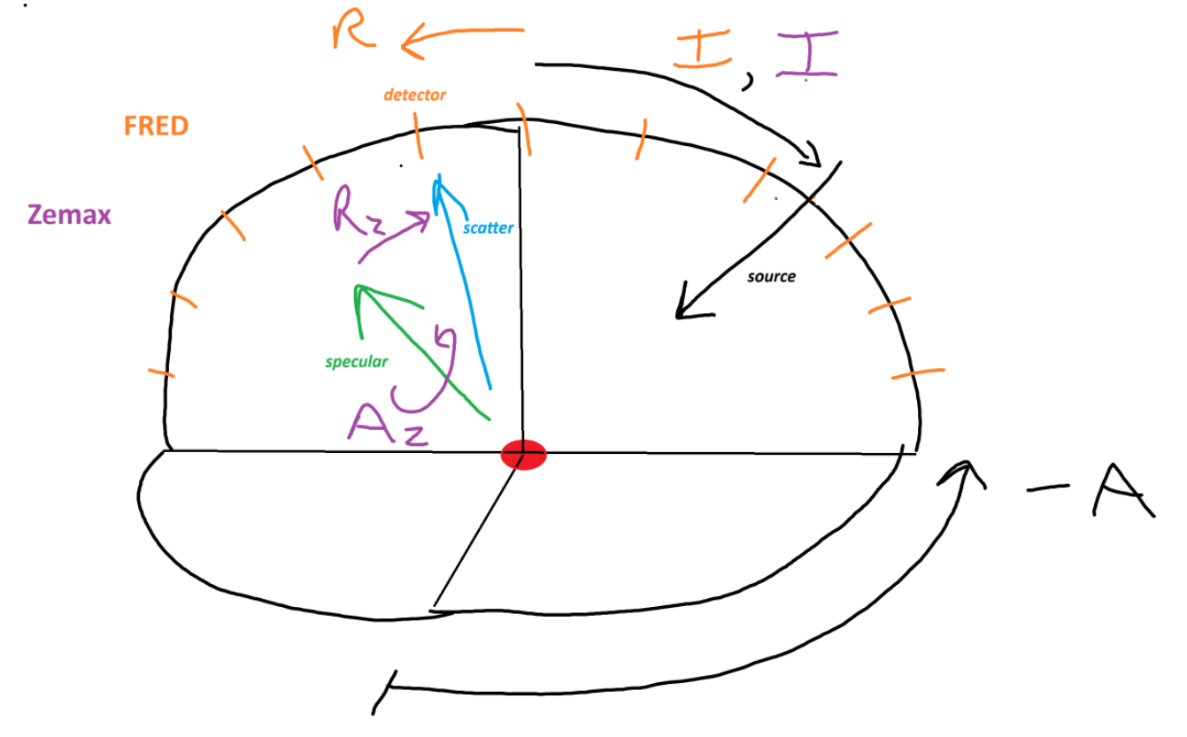

Slide 15
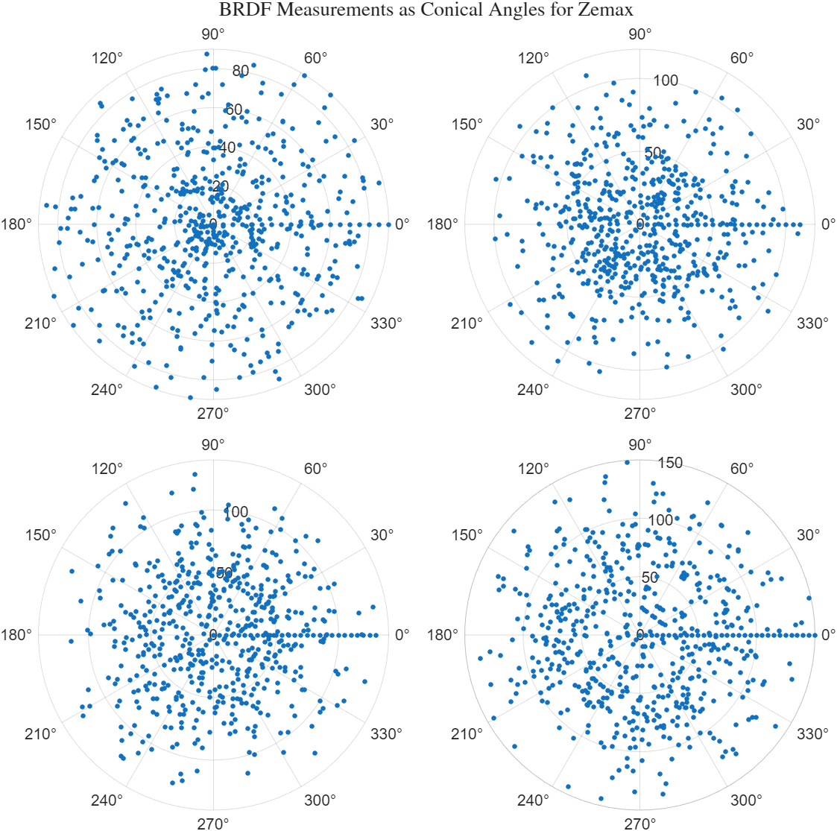
Measured:
A = [-90, 90];
R = [-80, 80];
I = 10deg
I = 30deg
I = 50deg
I = 70deg
FRED
R = -80:1:80
Zemax
Az = -90:10:90;
Rz = [0:5:20, 30:10: 80];
*maybe bug?… b/c Az = 180deg should be populated like Az = 0deg

Slide 16
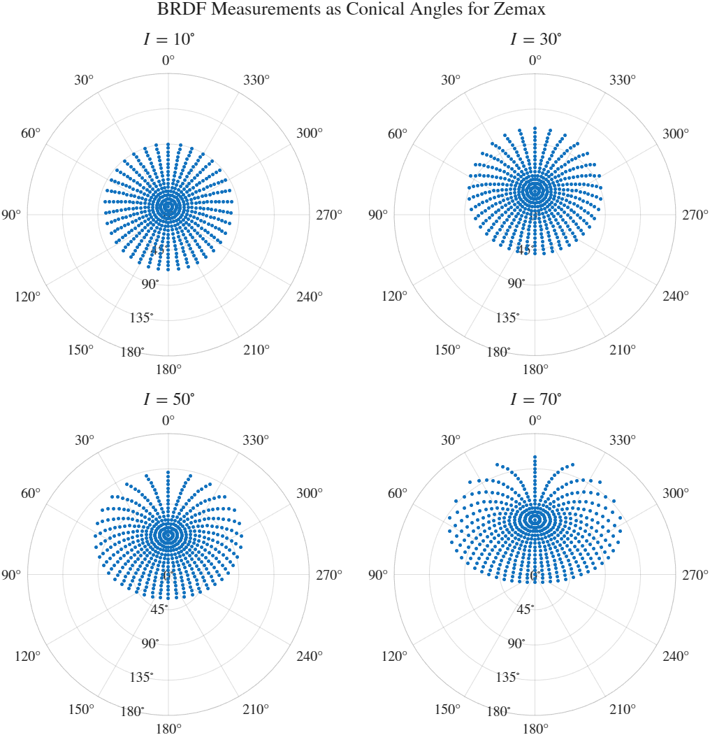
Measured:
A = [-90, 90];
R = [-80, 80];
FRED
R = -80:1:80
Zemax
Az = -90:10:90;
Rz = [0:5:20, 30:10: 80];
*bug fixed

Slide 17
Some more results / debugging

Slide 18
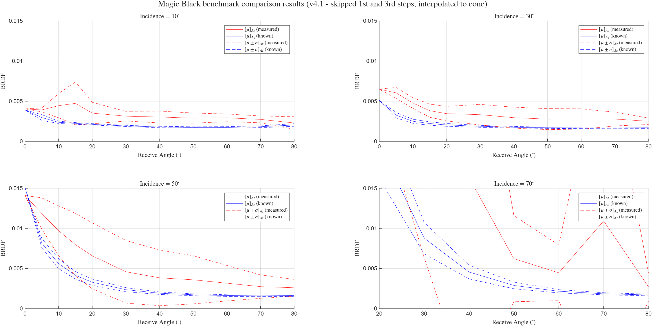

Slide 19
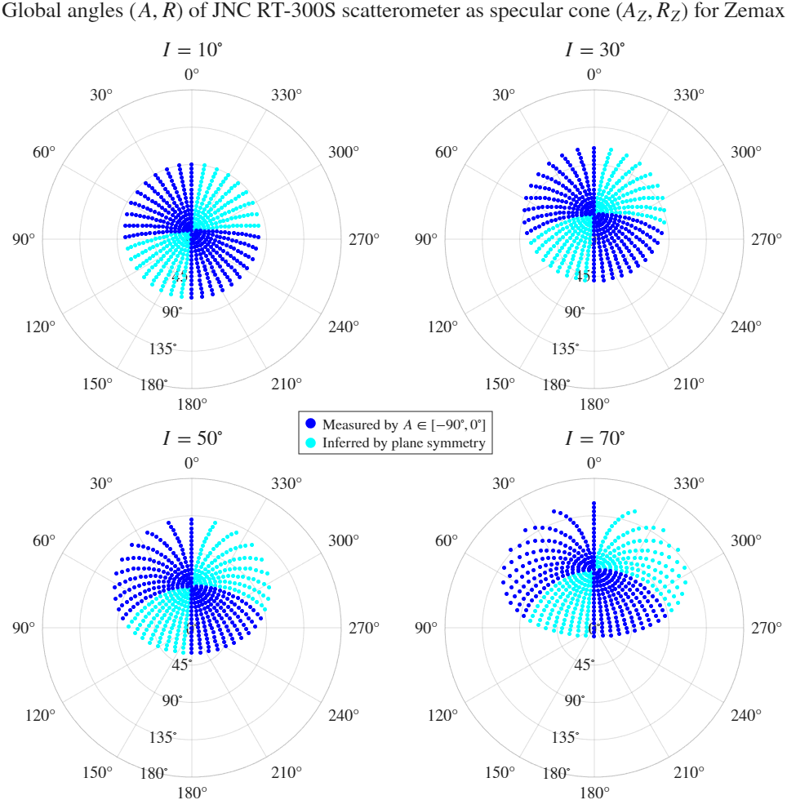
Coverage Plot
(Az, Rz) covered by:
  I = [10 : 20 : 70] deg
  A = [-90 : 10 : 90] deg
  R = [-80 : 5 : 80] deg

Slide 20
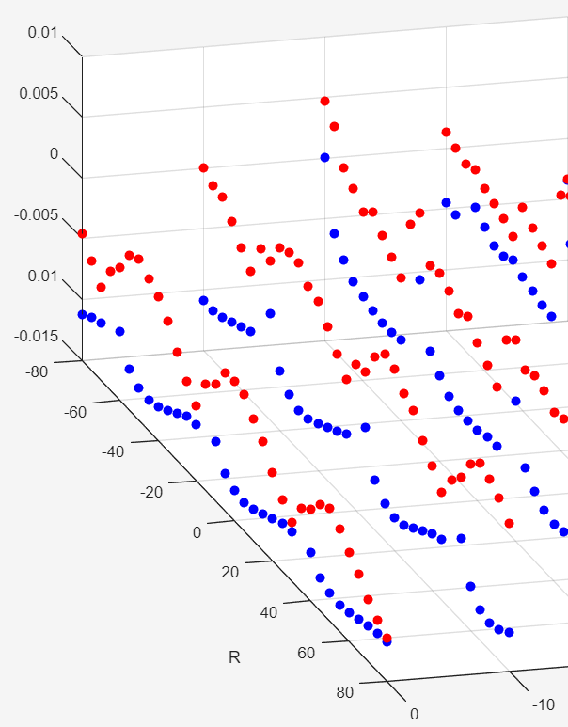
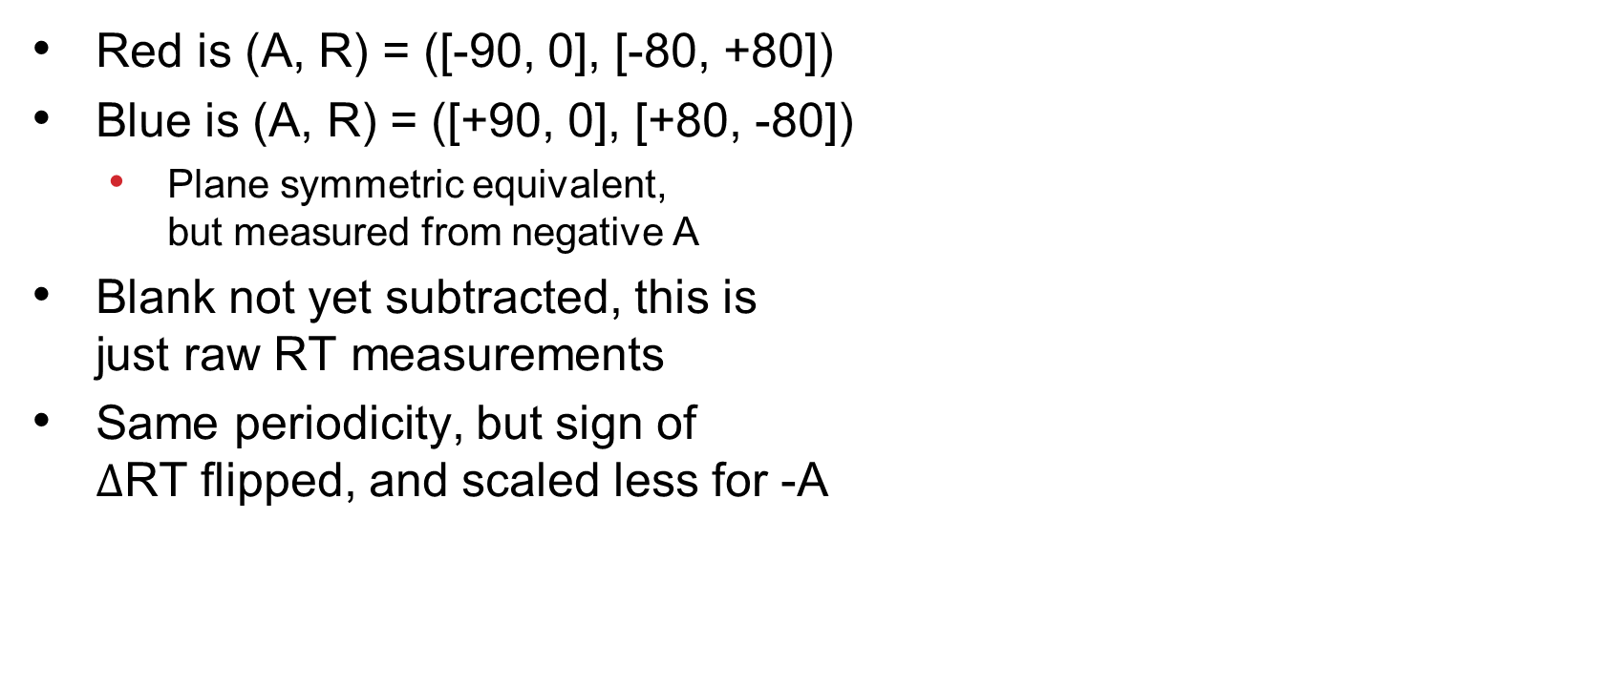
Prior to zero-ing
RT
Red is (A, R) = ([-90, 0], [-80, +80])
Blue is (A, R) = ([+90, 0], [+80, -80])
  Plane symmetric equivalent,
  but measured from negative A
Blank not yet subtracted, this is
just raw RT measurements
Same periodicity, but sign of
$Δ$RT flipped, and scaled less for -A
A

Slide 21
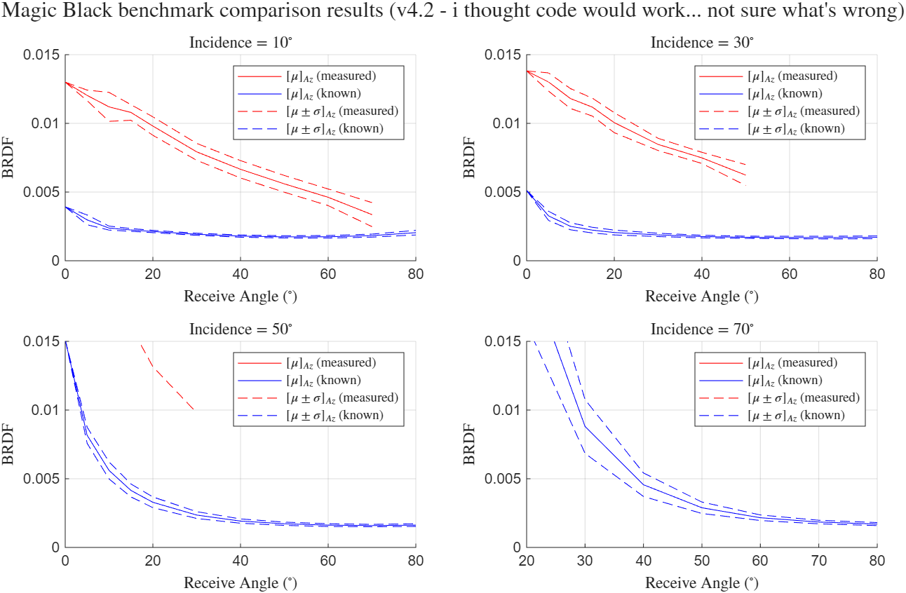
Thought code was good, got worse

Slide 22
Moving forward (for now)
Should we go with v3.1 for now?
  In my opinion, better to get it right the first time
    Avoid repeating analyses in future
  But, thought I had it and got worse

Slide 23
More debugging
2025/09/16

Slide 24
V4.3 = debugging v4.2
Recall v3.1 sort of worked… so start by checking if in-plane interpolation gives similar/same results
  Want this to be same, such that adding Az != 0 can be seen to increasingly degrade results from v3.1 to v4.2

Slide 25
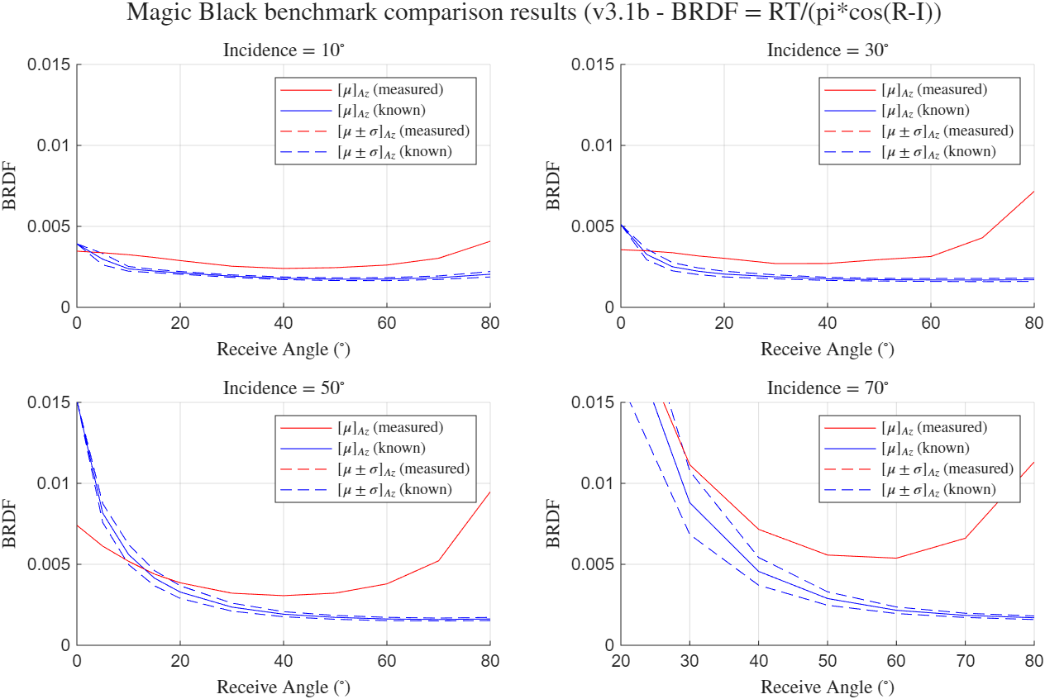
No azimuth correction needed, right?

Slide 26
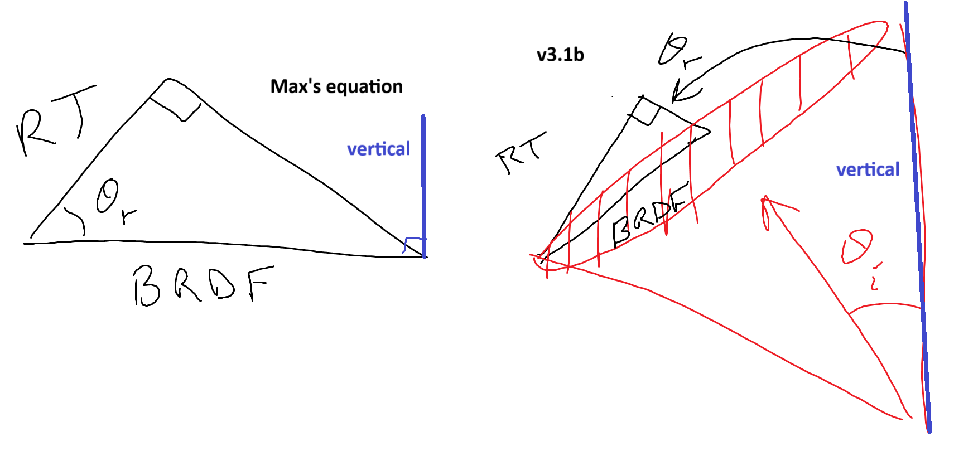
Do we need azimuthal correction?
(detector)
(detector)
From Jojo: Max’s setup is how BRDF is defined in chapter 6 of stray light textbook.
Then no
Then yes

Slide 27
Measurements given to Cameron and team, using v3.1 (incident plane only)
(these are initial results intended to provide team ability to do “ballpark” analysis… debugging the (Az, Rz) interpolation will follow for “official” results)
2025/09/17
Sample(s): NiTE on (1) steel, and (2) invar mounts

Slide 28
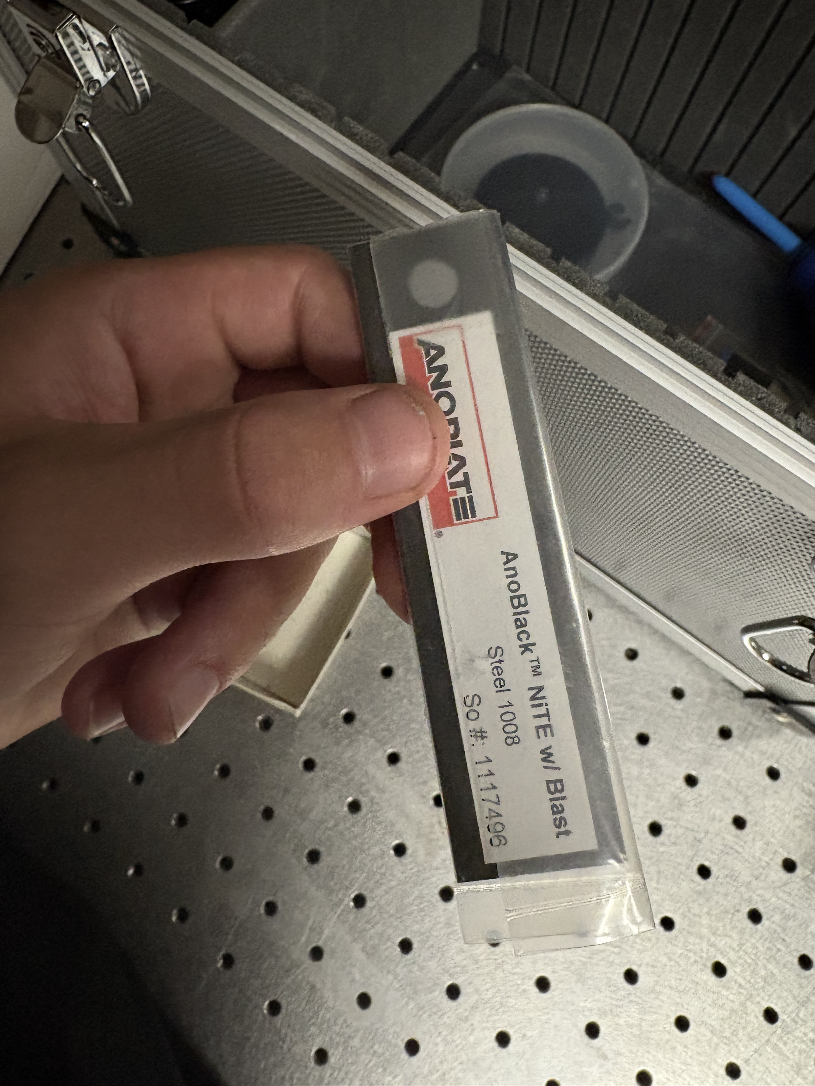
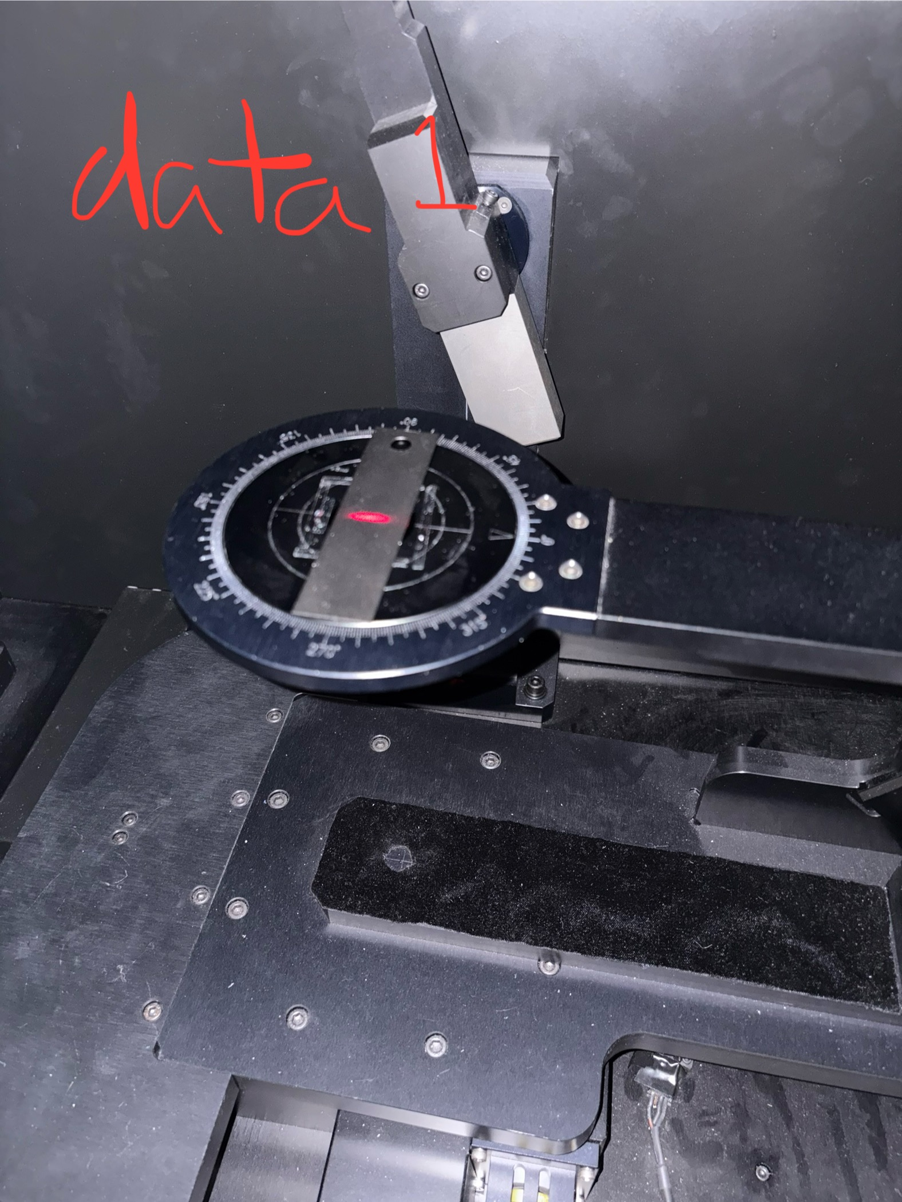
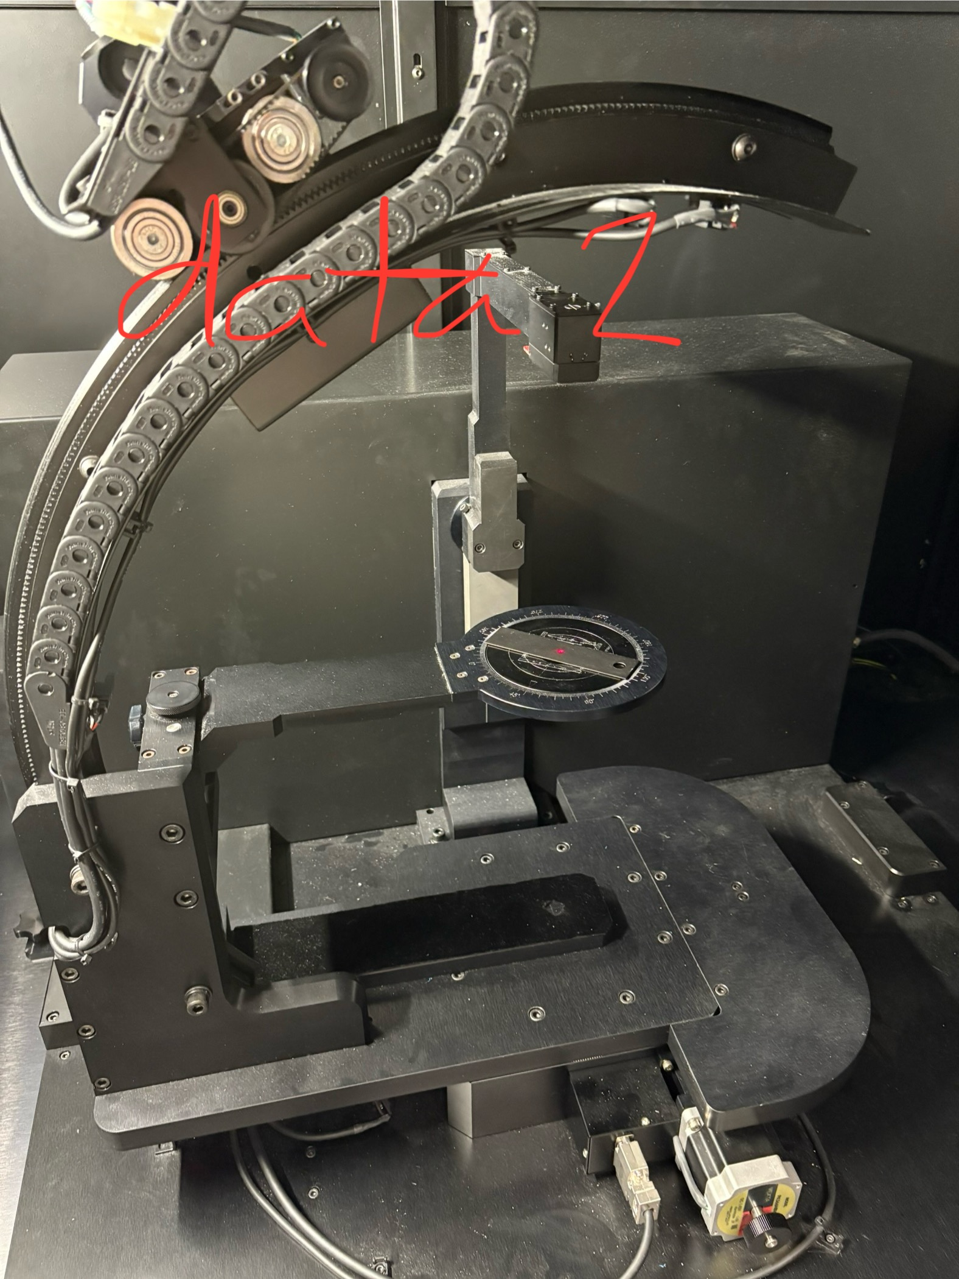
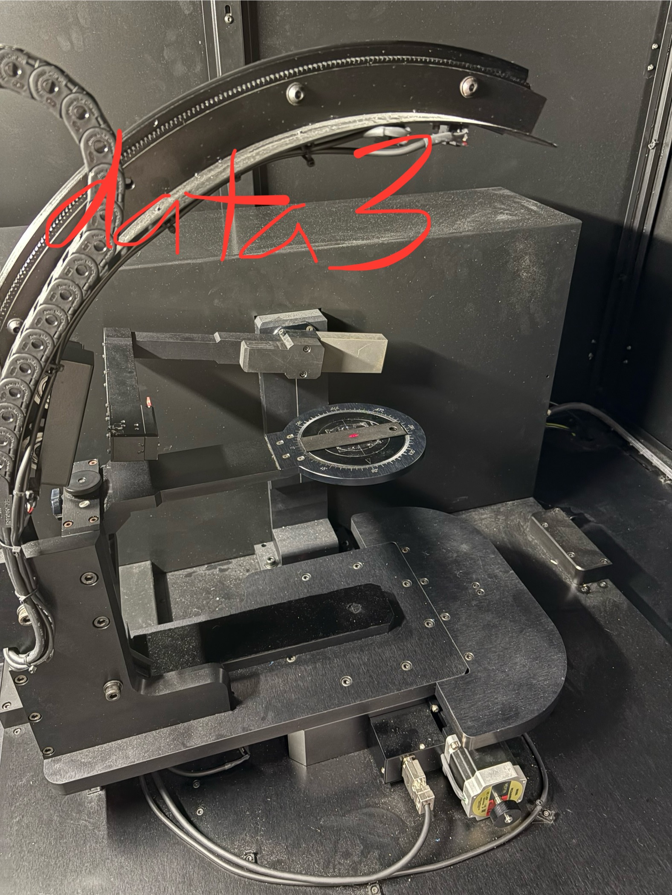



Samples – NiTE on steel
v1o0A
$ψ=0^{°}$
v1o0B
$ψ={45}^{°}$
v1o0C
$ψ=90^{°}$

Slide 29
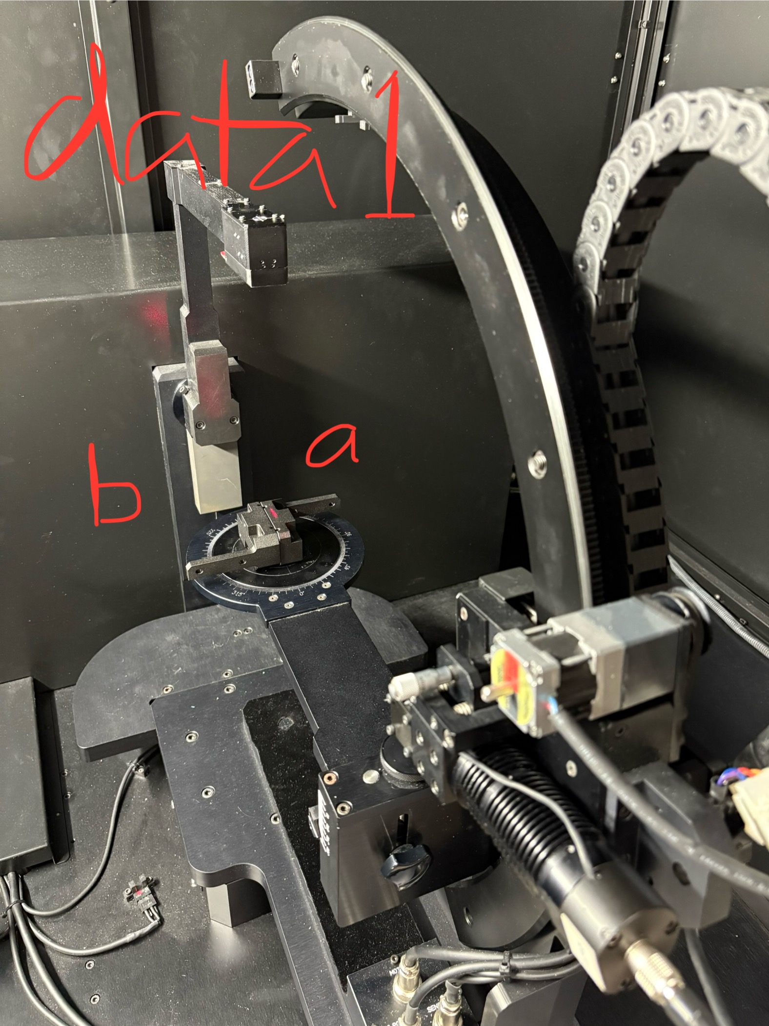
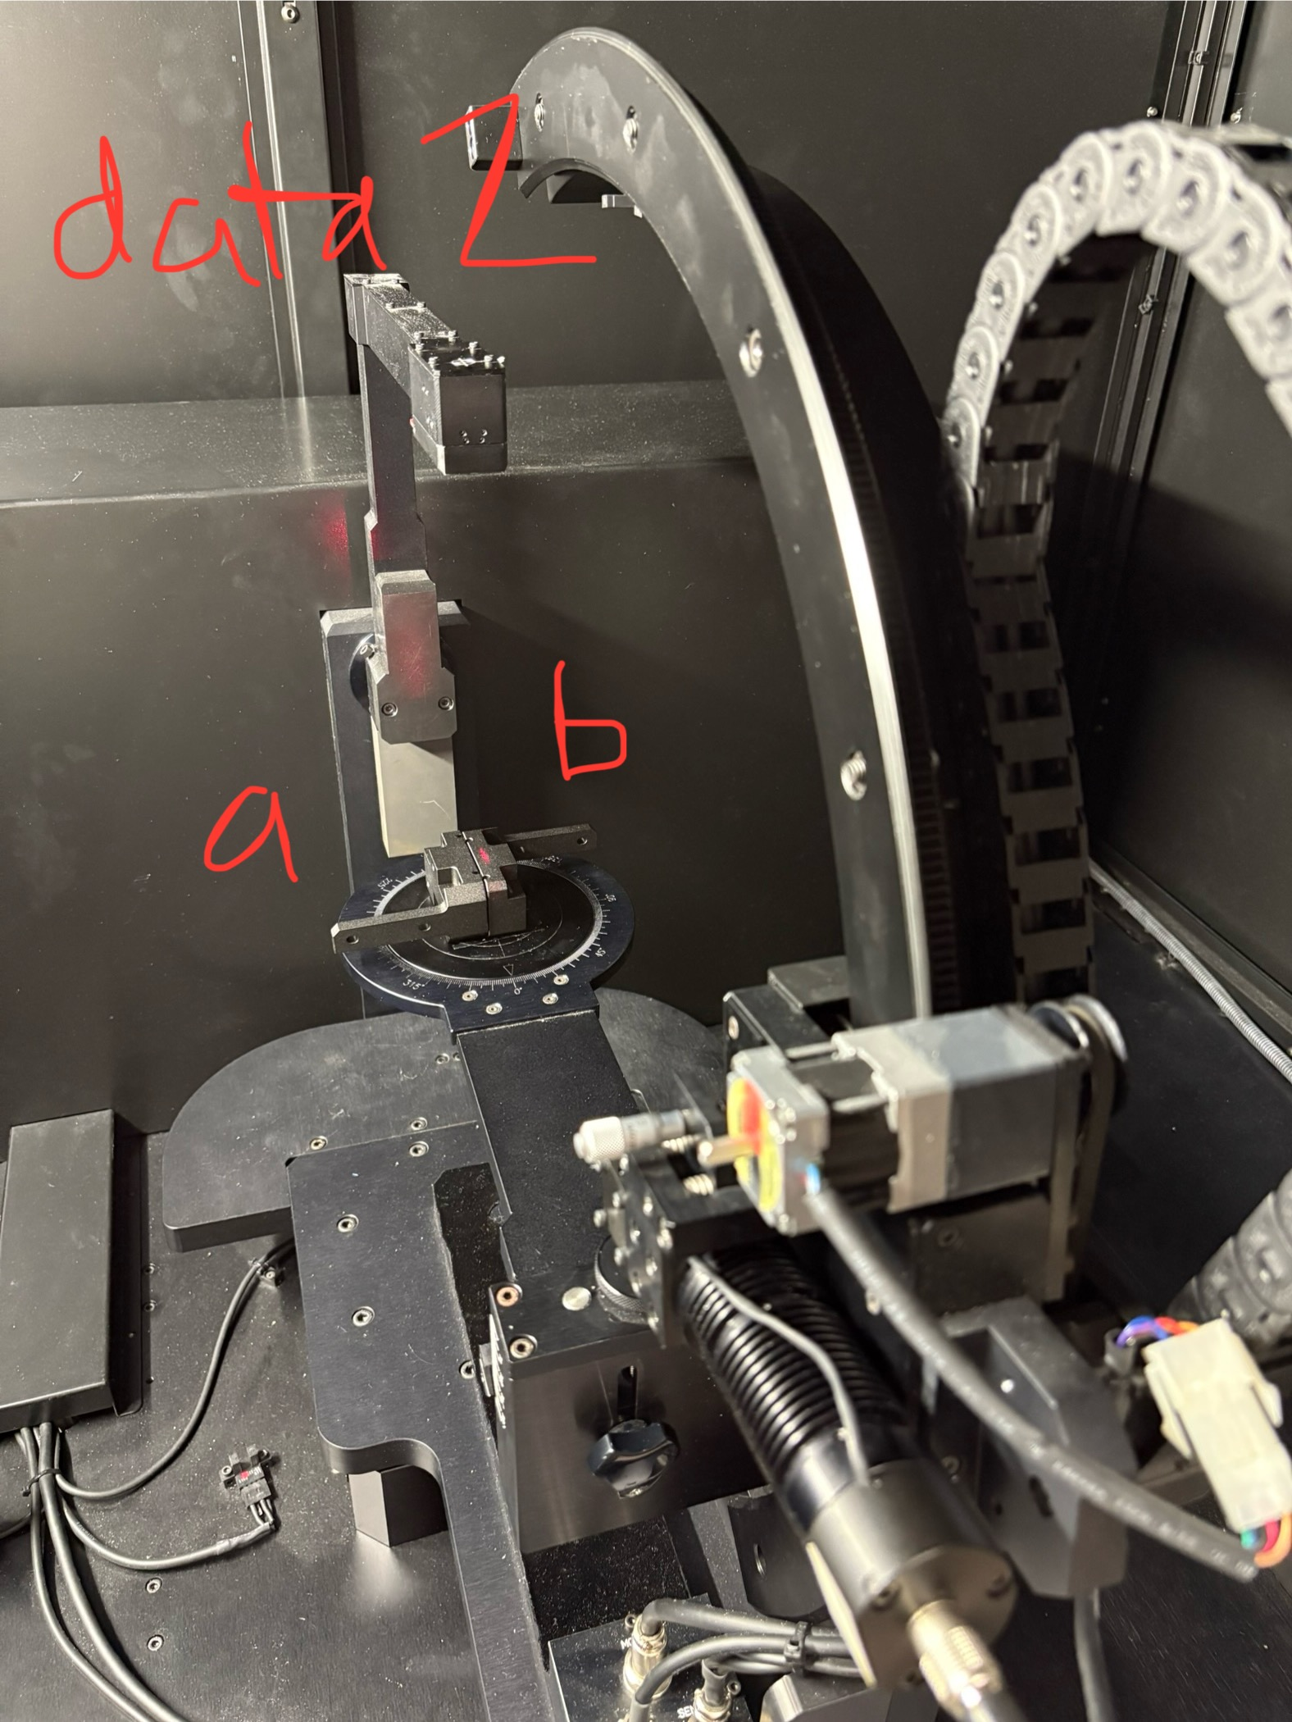
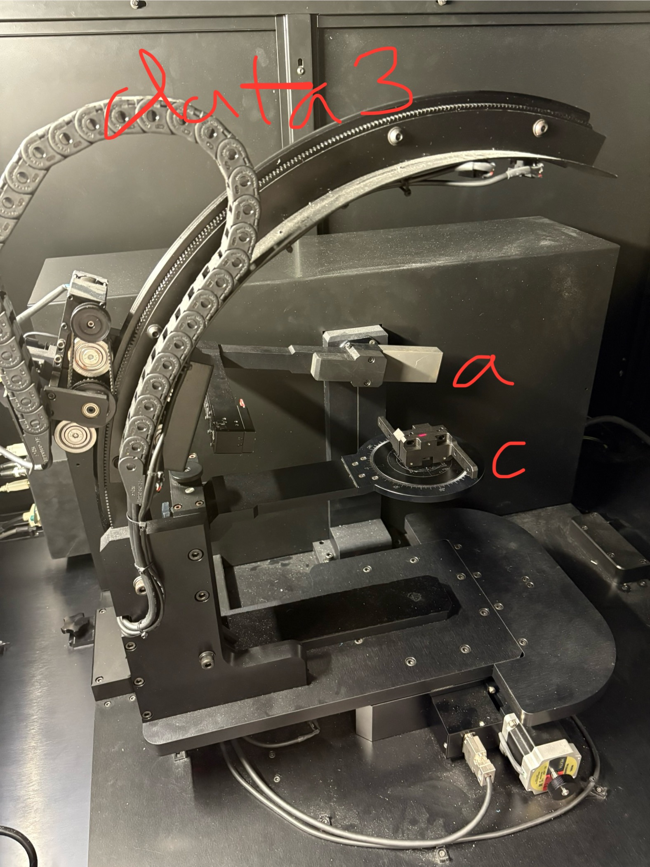
Samples – NiTE on invar
v1o0A
First mount
v1o0B
Second mount
v1o0C
Third mount

Slide 30
Recall v3.1 results
On single
Magic Black
measurement

Slide 31
Recall v3.1 method
1) measures in-plane only (i.e., A = -90)
  For Magic Black, R = [-80 : 1 : 80]
  For NiTE, R = [-80 : 5 : 80]

Slide 32
Repeating v3.1 but with “MagicBlack_v2o0_20250902” since that has same angles as NiTE
See matlab “BSDF_raw_to_processed_v4o2b_inplaneToZemax.m”
Only uses incident plane measurements
  A = +/- 90 to provide two “trials” of same sample rotation, R = all

Slide 33
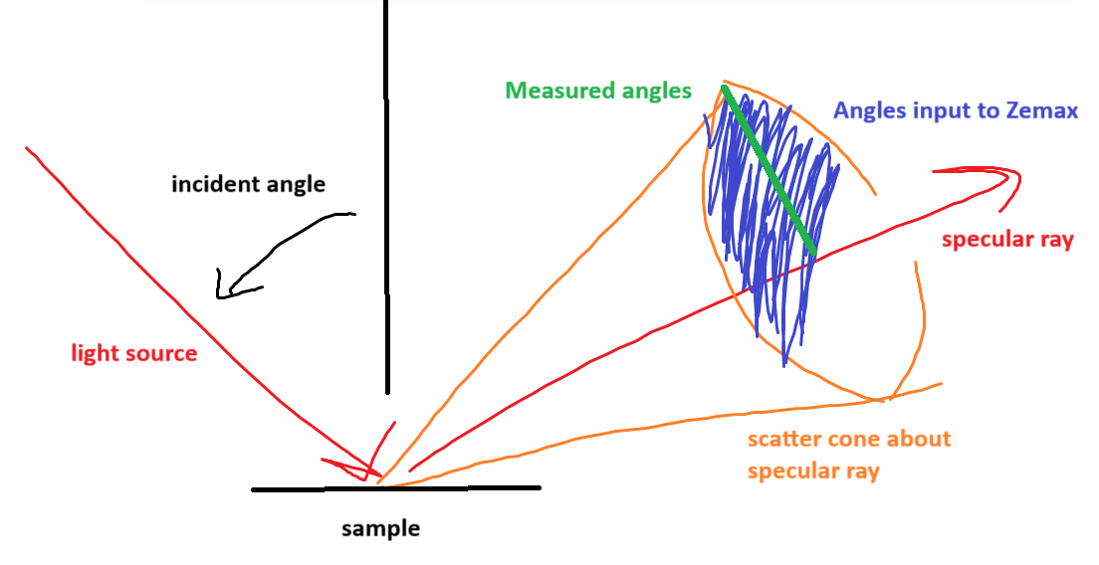
Assumption for v4.2b (“official” simplified in-plane method)
*assumption is that measured angles are constant throughout cone’s azimuth

Slide 34
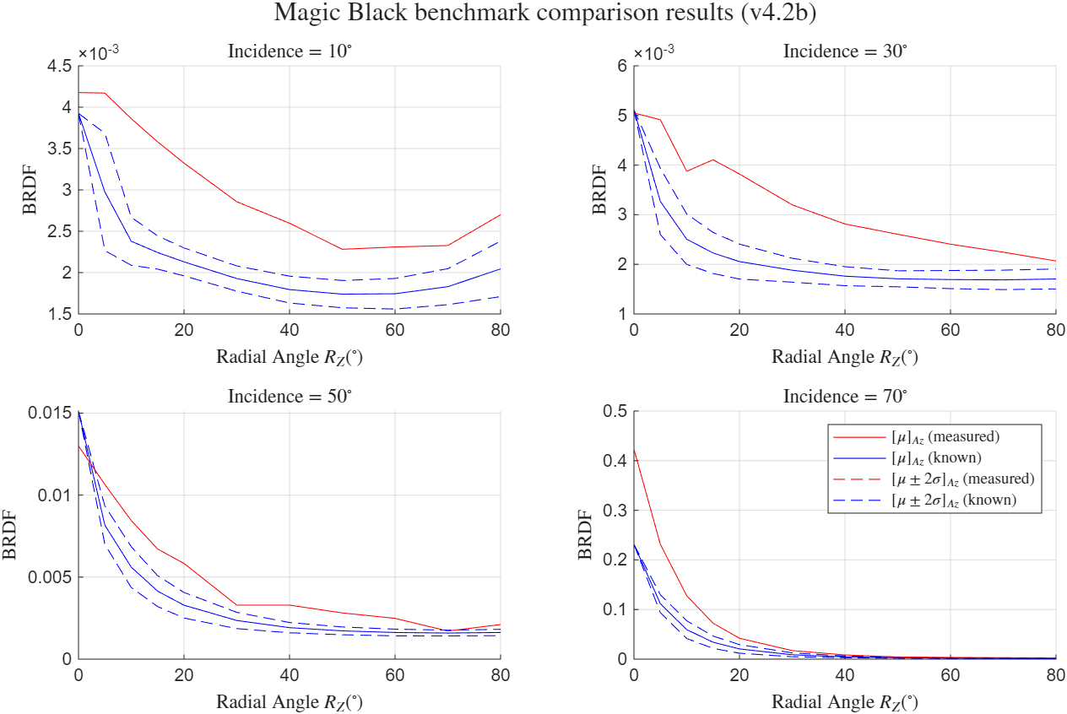
Results of v4.2b (“official” simplified in-plane method)
TRUE
SCALE

Slide 35
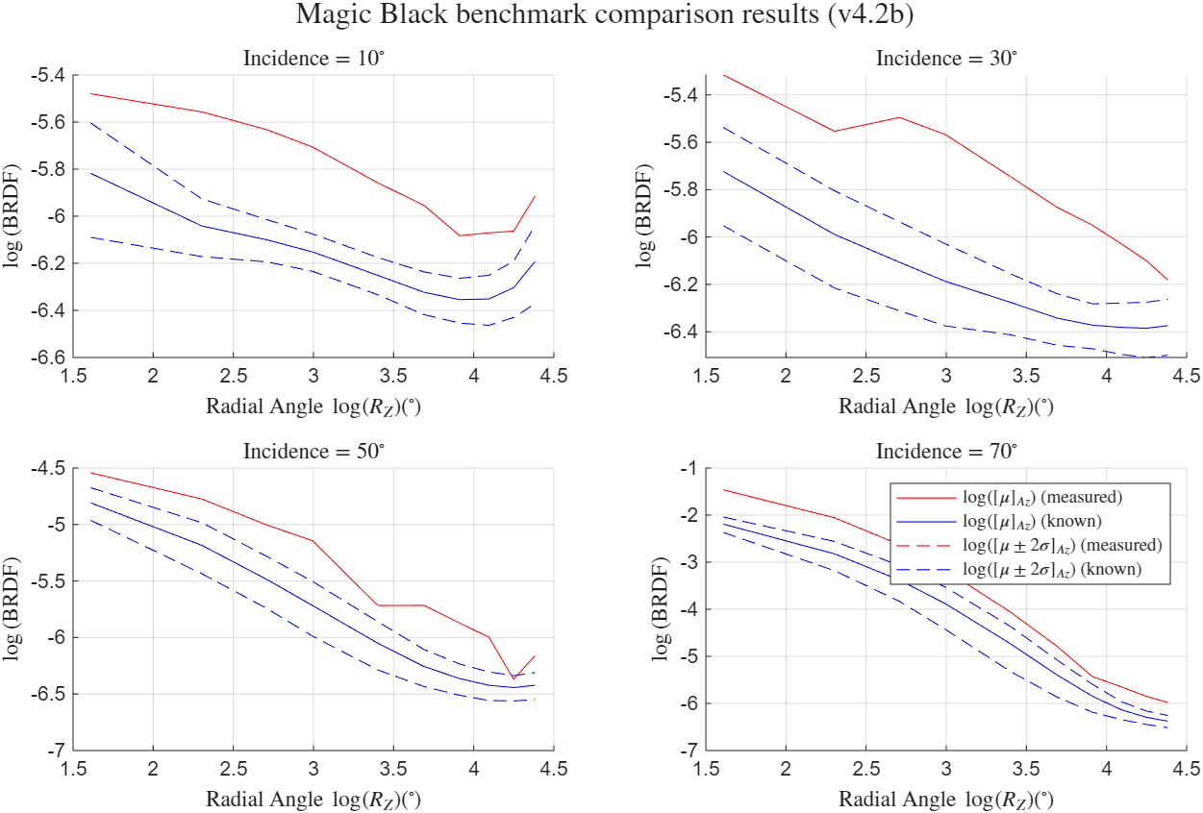
Results of v4.2b (“official” simplified in-plane method)
LOG
SCALE

Slide 36
Results of v4.2b (“official” simplified in-plane method) – TIS values
Incident angle | Known (“MagicBlack_VIS” in “Zemax/ScatterData”) | Measured and calculated with Max’s python script “masterBRDFcode”
10 deg | 0.005169 | 0.015229
30 | 0.0067297 | 0.019213
50 | 0.009598 | 0.047218
70 | 0.025526 | 0.357021

Slide 37
Assuming good enough,
For the TIS calculation,
  Performed via Max’s code “masterBRDFcode” (but as “masterBRDFcode_copyForTestJPK” where I just modified the file names….. And note the excel files are like “MagicBlack_v2o0_20250902_onlyAn90” where “onlyAn90” means I manually modified the excel file to only have A = -90)
  Then, I run the python script and manually copy the polynomial-fitted TIS values into the Zemax BRDF text file generated by the v4.2b MATLAB script
Then, can output NiTE steel,invar to Zemax

Slide 39
Measurement of non-isotropic detector
2025/09/--
Sample(s): detector

Slide 40
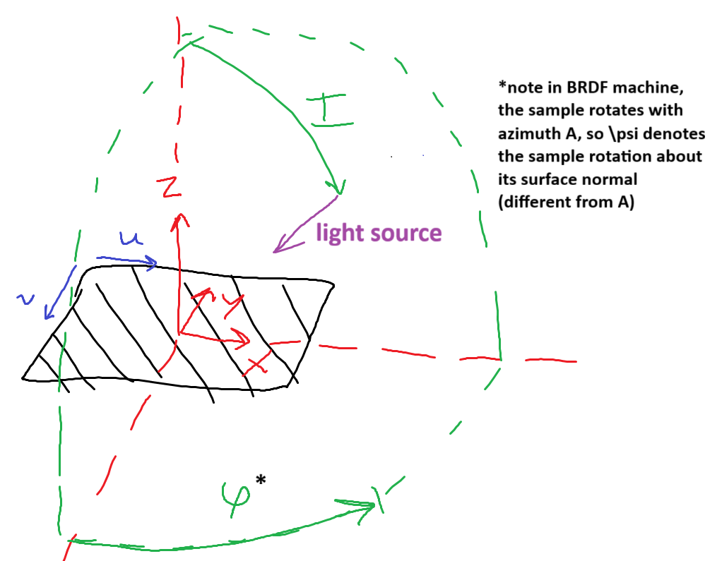

Slide 41
Debugging of isotropic interpolation to (Az, Rz)
2025/09/26
Presented 09/30

Slide 42
V4.3
What is convention of IAR_to_AzRz ?
  Outsources to ensure_AzRz_domain
    Was doing plane symmetry, but I changed it back to no exact angle
  Now, should be [0, 360), [0, 180]
Skipping 2nd correction because thinking first zeroing should satisfy this
  Rather, just making negative values into 0

Slide 43
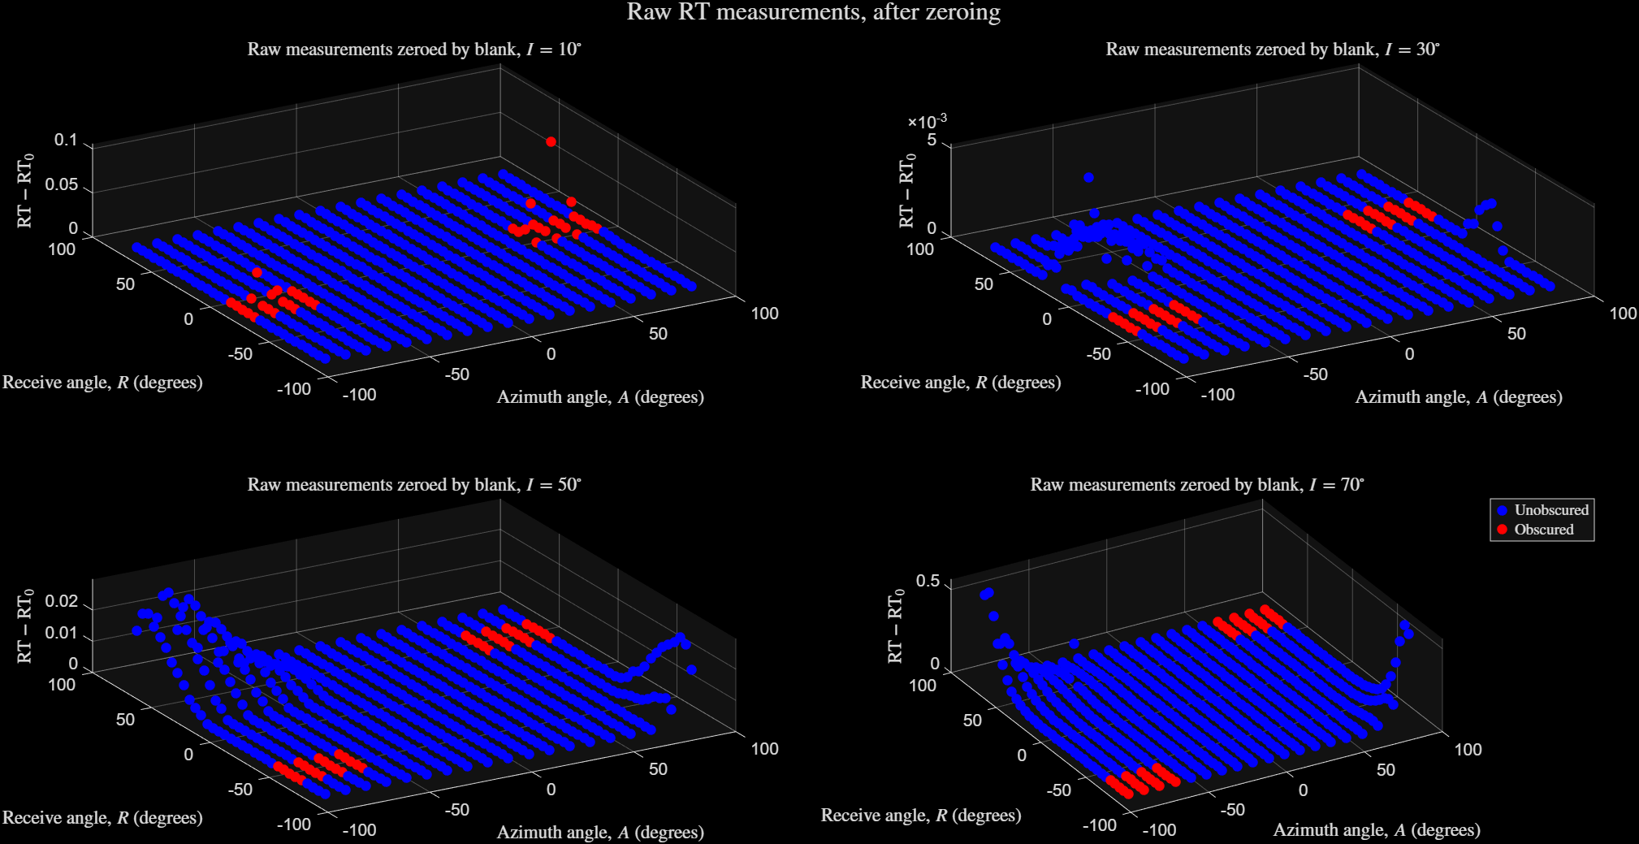
Comparison of +/- azimuth measurements – raw
DATA FROM:
“MagicBlack_v2o0_20250902.xls”
Should be equal and opposite, but is not

Slide 44
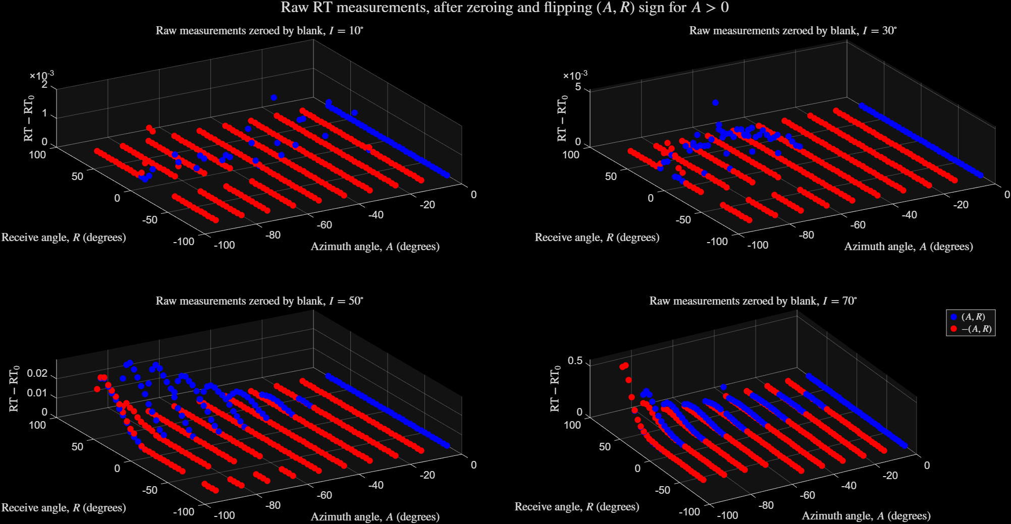
Comparison of +/- azimuth measurements – overlay
DATA FROM:
“MagicBlack_v2o0_20250902.xls”
Should be equal,
but is not

Slide 45
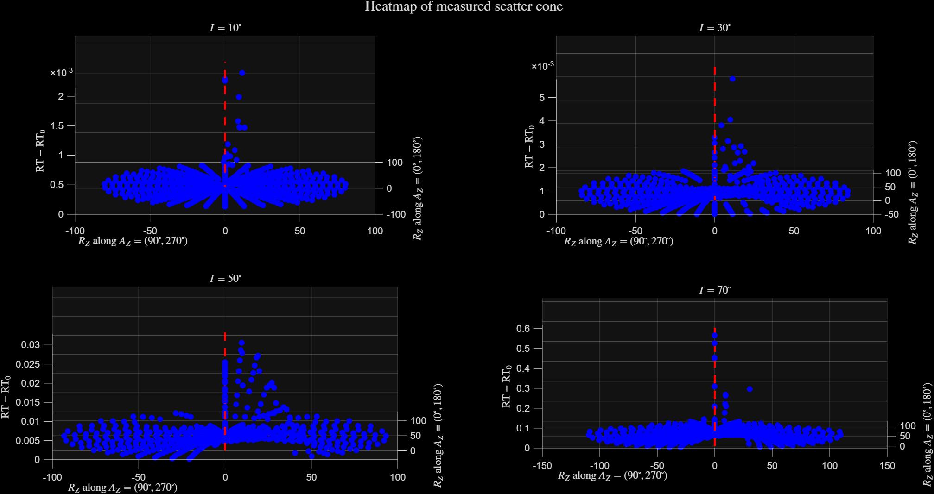
DATA FROM:
“MagicBlack_v2o0_20250902.xls”
Left/right has systematic error
Light source misaligned,
should be centered here

Slide 46
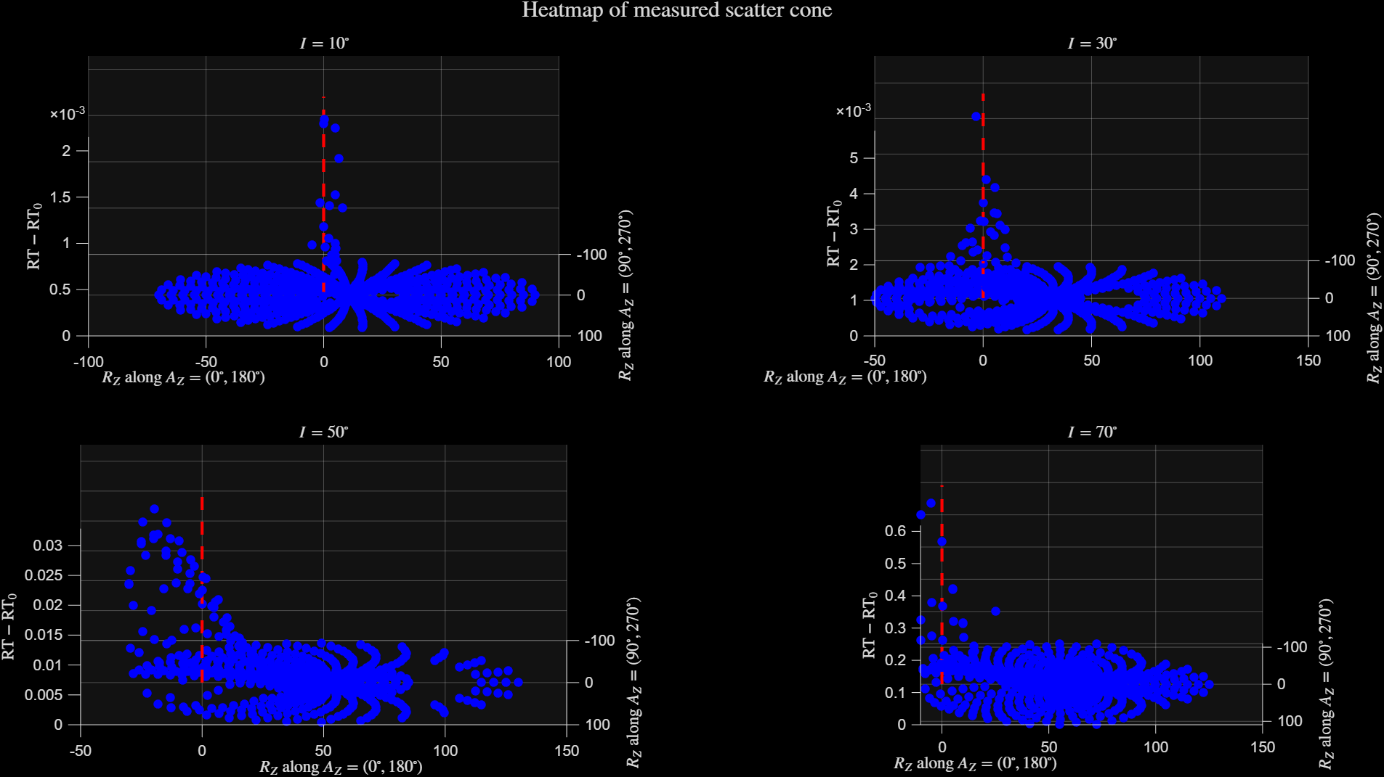
DATA FROM:
“MagicBlack_v2o0_20250902.xls”
Fore/aft
Ok, expected at steep incidence

Slide 47
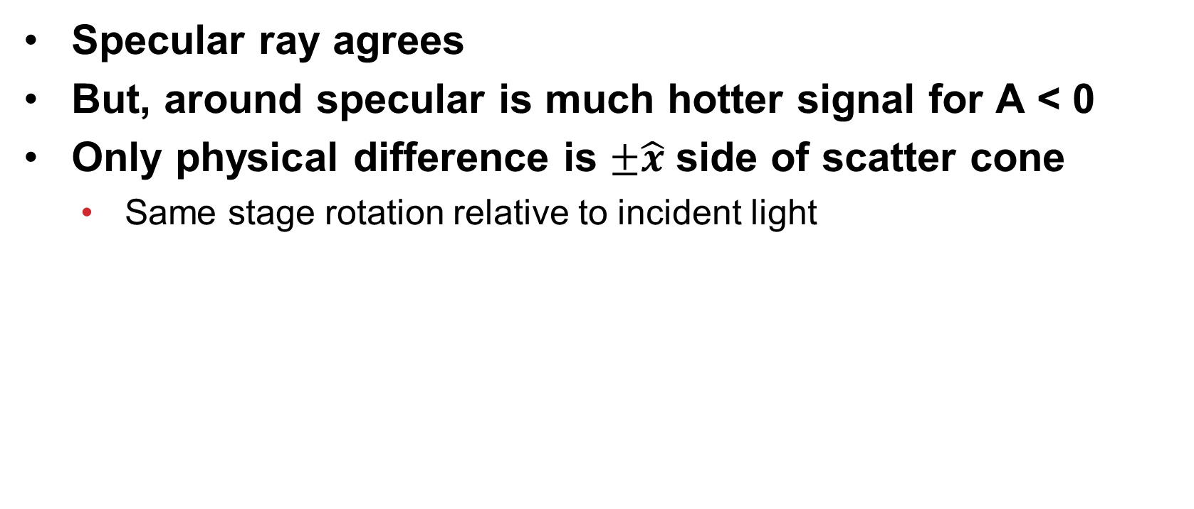
Comparison of +/- azimuth measurements
Specular ray agrees
But, around specular is much hotter signal for A < 0
Only physical difference is $±\hat{x}$ side of scatter cone
  Same stage rotation relative to incident light

Slide 48
BUT WAIT !!!
Likely that was due to poorly-aligned light source (since MagicBlack validation measurements taken prior to Joon’s fix to micrometer)
Actual measurements (i.e., other samples) had better alignment (perfect to my eye)

Slide 49
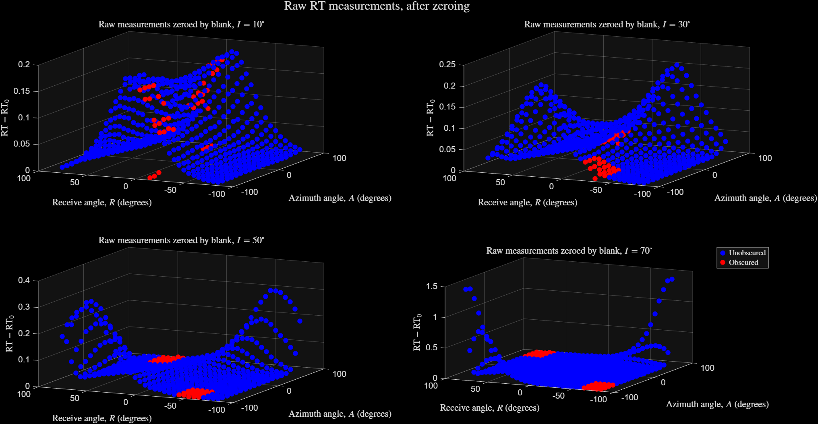
Comparison of +/- azimuth measurements – raw
DATA FROM:
“NiTE_on_invar_v1o0A_20250915.xls”
Should be equal and opposite, and they are

Slide 50
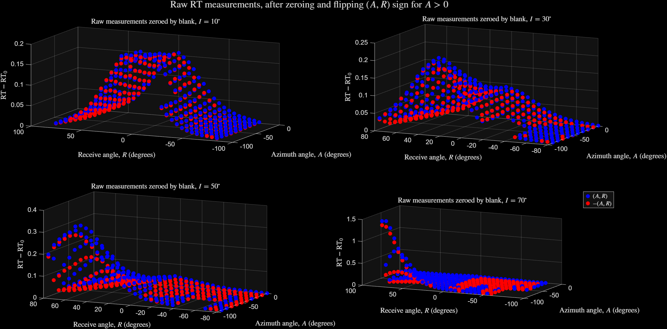
Comparison of +/- azimuth measurements – overlay
DATA FROM:
“NiTE_on_invar_v1o0A_20250915.xls”
Should be equal,
and they are

Slide 51
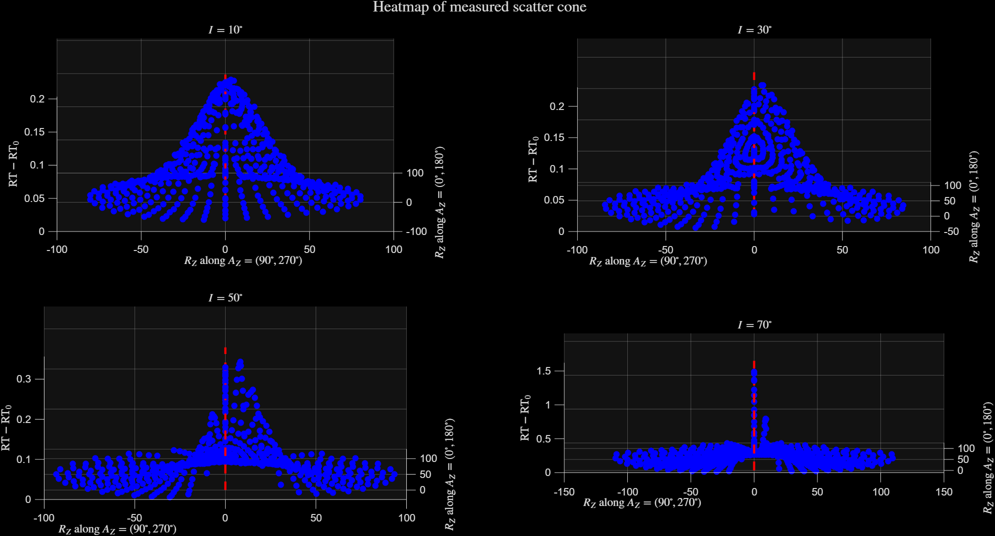
DATA FROM:
“NiTE_on_invar_v1o0A_20250915.xls”
Left/right has systematic error
Light source nearly centered

Slide 52
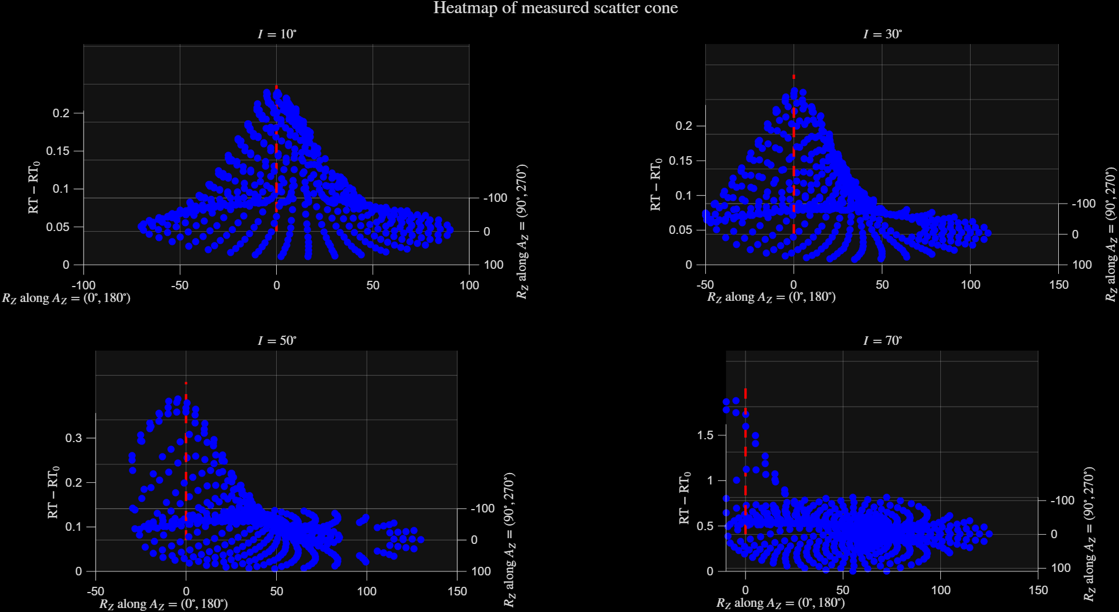
DATA FROM:
“NiTE_on_invar_v1o0A_20250915.xls”
Fore/aft
Ok, expected at steep incidence

Slide 53
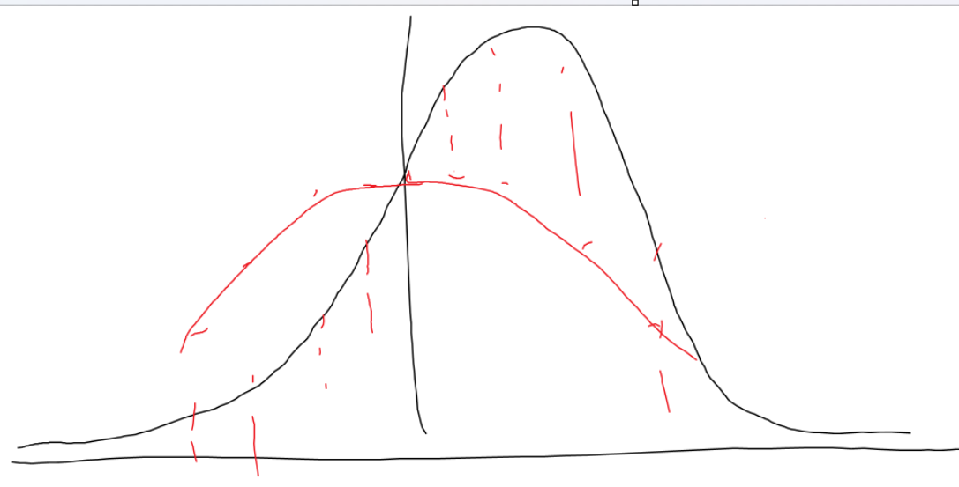
If misaligned left/right,
Cannot simply average to reduce alignment error
  Because measured black line becomes like averaged red line

Slide 54
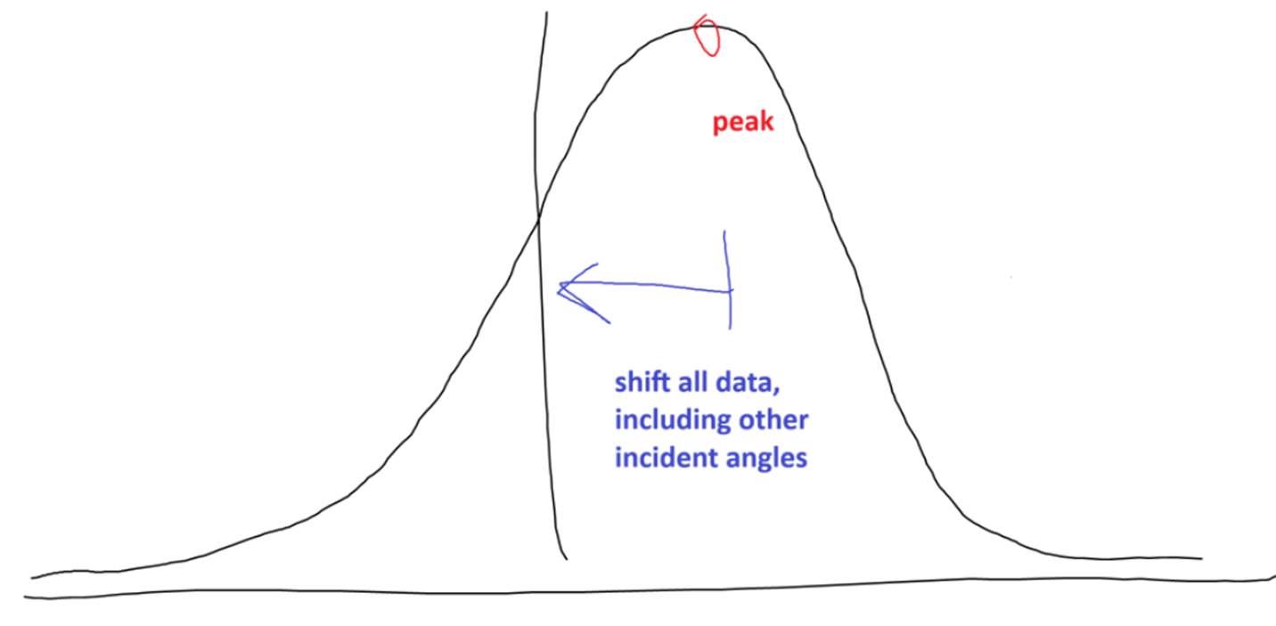
If misaligned left/right,
Rather, shift entire dataset by empirical peak RT value

Slide 55
DATA FROM:
“MagicBlack_v2o0_20250902.xls”
COPIED FROM EARLIER SLIDE
Left/right has systematic error
Light source misaligned,
should be centered here

Slide 56
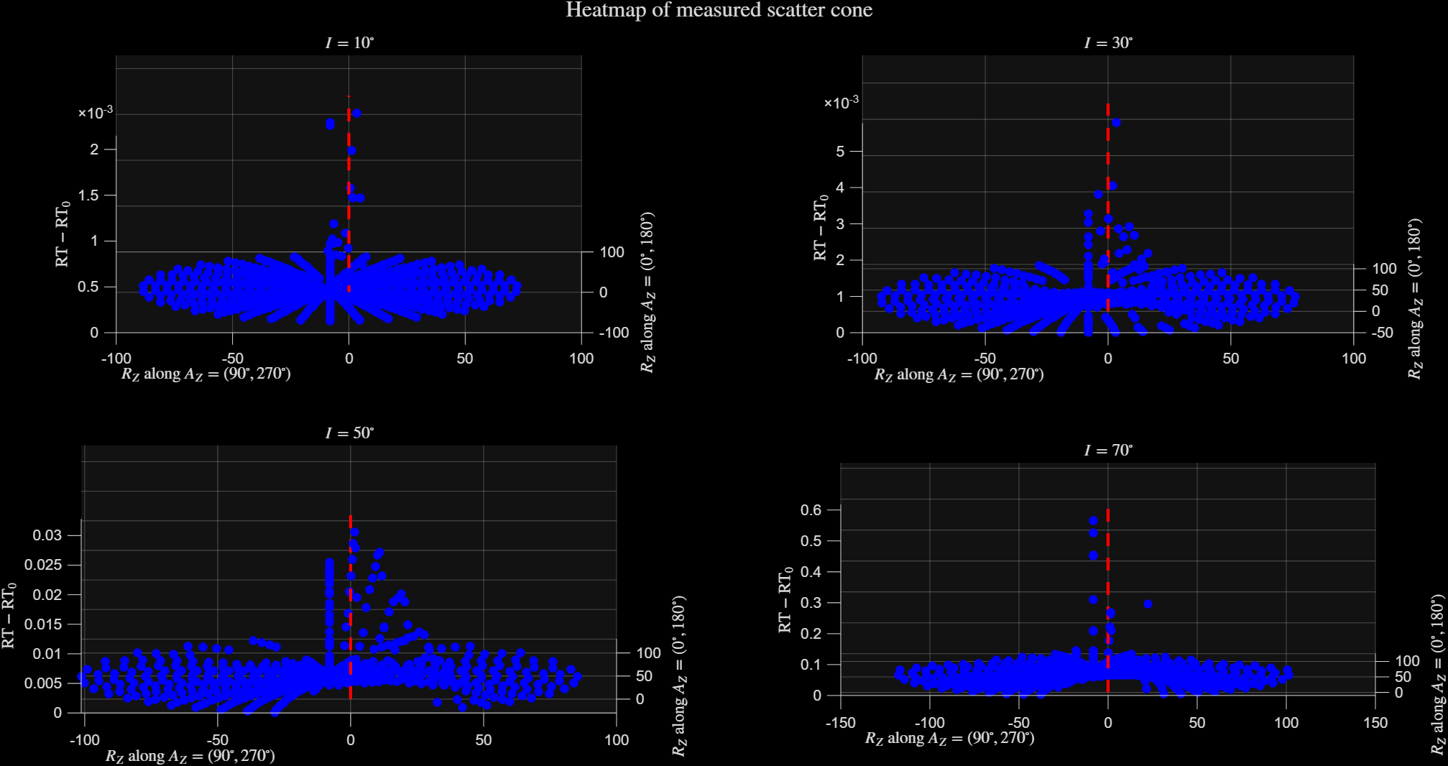
DATA FROM:
“MagicBlack_v2o0_20250902.xls”
SHIFTED !

Slide 57

DATA FROM:
“NiTE_on_invar_v1o0A_20250915.xls”
COPIED FROM EARLIER SLIDE
Left/right has systematic error
Light source nearly centered

Slide 58
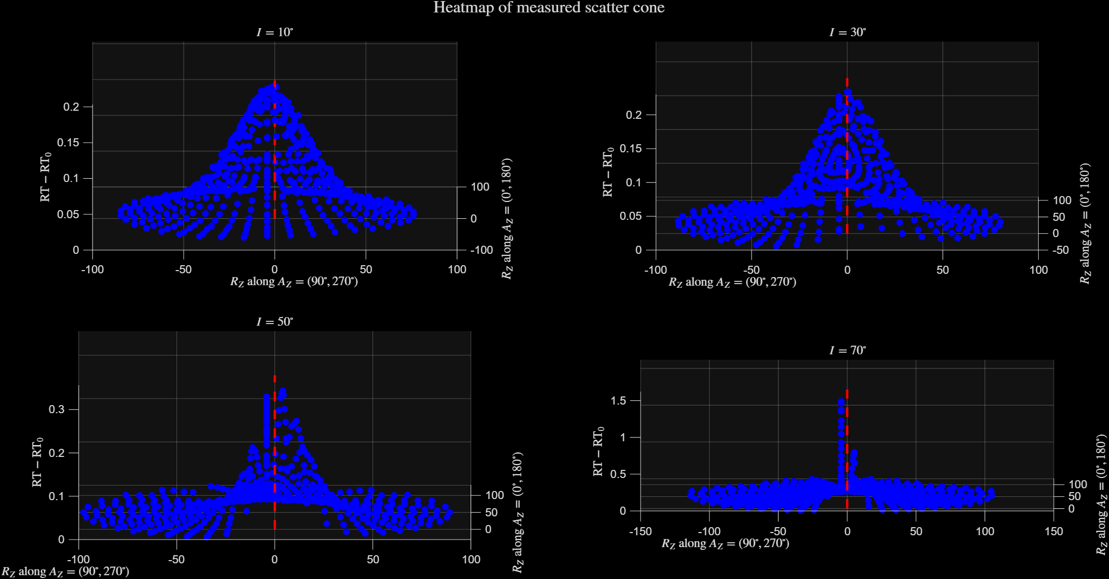
DATA FROM:
“NiTE_on_invar_v1o0A_20250915.xls”
SHIFTED !

Slide 59
Note about shifting
Should average all measurements made with same light source alignment
  x3: NiTE_on_invar
  x3: NiTE_on_steel
  x9: CMOS (but anisotropic might not give clear specular RT max)

Slide 60
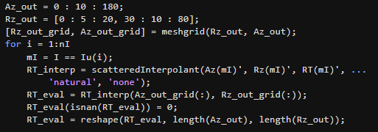
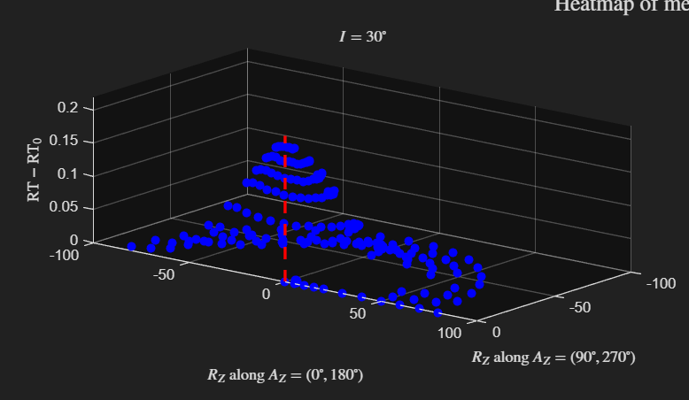
Now, onto interpolation of (Az,Rz)
DATA FROM:
“NiTE_on_invar_v1o0A_20250915.xls”
These are failing, otherwise looks good by inspection

Slide 61
Other
2025/09/26

Slide 62
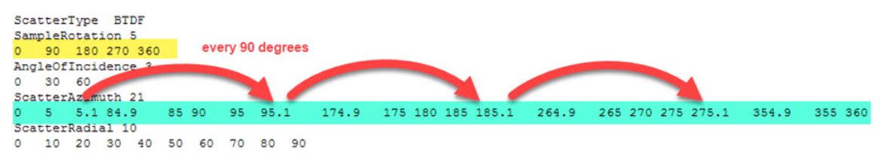
Note for anisotropic
https://optics.ansys.com/hc/en-us/articles/43071089490451-How-to-use-tabular-BSDF-data-to-define-the-surface-scattering-distribution
  Under “Interpolation”

Slide 63
Note for TIS
optics.ansys.com/hc/en-us/articles/43071132076435-How-to-create-a-user-defined-scattering-function
  Says integral for Rz should be 0 to pi/2, not 0 to pi

Slide 64
Note about Zemax / ScatterData
All BSDF files except BrownVinyl were generated by “Chen and Harel”
  These all say PlaneSymmetric, yet use [0, 90] U [270, 360) when docs make it clear symmetry should be [0, 180]
For BrownVinyl,
  BRDF = 0, when receive angle >80 deg

Slide 65
Debugging of isotropic interpolation to (Az, Rz)
[continued]
2025/09/30

Slide 66
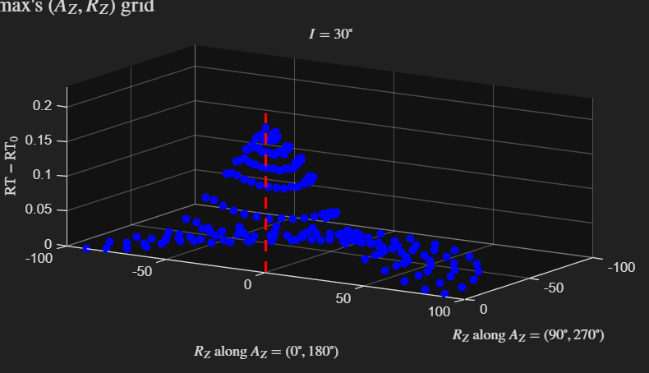
Now, onto interpolation of (Az,Rz)
Solved
  Bug was RT=nan where obscured, which impacted interpolation
  Also needed to reorder quadrants from [I, II, III, IV] to [-IV, I, II, III] to interpolate to [I, II], i.e., Az = [0, 360) to [-90, 270), for interpolation to [0, 180]
DATA FROM:
“NiTE_on_invar_v1o0A_20250915.xls”

Slide 67
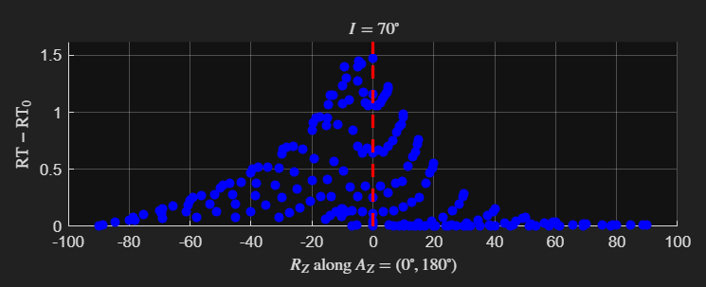
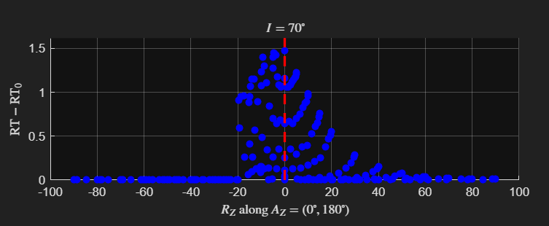
Manual setting of RT=0
For angles that would be transmission, i.e., below sample, need to manually set to 0
DATA FROM:
“NiTE_on_invar_v1o0A_20250915.xls”
These angles go into sample, and are nonzero because of extrapolation when interpolating to Zemax’s (Az,Rz) grid
Manually set to 0, but I use RT=0 at 90 whereas BrownVinyl does so at 80

Slide 68
Sanity check of successfully-debugged v4.3
2025/10/02

Slide 69
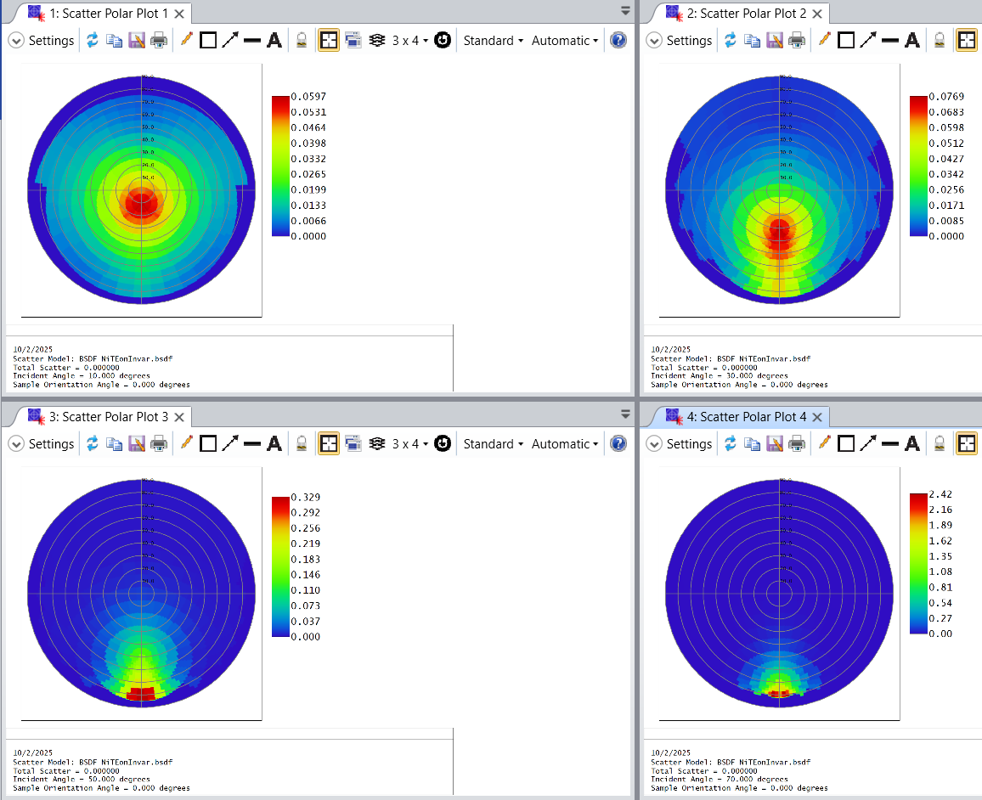
Zemax plots
Seems correct
  Captures specular behavior toward steeper incident angles
DATA FROM:
“NiTE_on_invar_v1o0A_20250915.xls”

Slide 70






But…
$$I={37}^{∘}$$
$$I={39}^{∘}$$
May need greater resolution of incident angles
  BrownVinyl template has:
    $I=[15 :5 :75]$
  Here, we have:
    $I=[10 :20 :70]$
Note how interpolates to nearest neighbor, which is 30 or 50 in plot… not smooth continuous interpolation
$$I={41}^{∘}$$
$$I={43}^{∘}$$
DATA FROM:
“NiTE_on_invar_v1o0A_20250915.xls”

Slide 71


BrownVinyl template
$$I={37}^{∘}$$
$$I={39}^{∘}$$
Finer resolution:
  $I=37$ interpolates to 35,
  $I=39,41$ to 40,
  $I=43$ to 45
Recall, our NiTE on Invar was:
  $I=37,39$ interpolates to 30,
  $I=39,41$ to 50
$$I={41}^{∘}$$
$$I={43}^{∘}$$
DATA FROM:
“BrownVinyl.bsdf”

Slide 72
First official release (v1.0) of library for our scatterometer
- Including Max’s whitepaper, Python script for incident plane, etc.
- But now, a ‘process_RT300S_data’ MATLAB script for outputting full scatter cone to Zemax format
Begun 2025/10/01

Slide 73
process_RT300S_data_v1o0.m
Copied from ‘BSDF_raw_to_processed_v4o3.m’, which successfully output to Zemax (but no automation, no averaging, etc.; just proof of concept)
  What process_RT300S adds that v4.3 lacked:
    Loading of multiple datasets, to average and return confidence bounds
    Cleaner code for user understanding
      Clear user-inputs section, the rest is automated
    Automation of comments, etc. for BSDF file output
    other

Slide 74

Averaging
Plane symmetry for isotropic treated as unique datasets
  -(A,R) = (A,R),
  just flipped about incident plane
Agrees well
Using average
DATA FROM:
“NiTE_on_invar_v1o0A_20250915.xls”,
“NiTE_on_invar_v1o0B_20250916.xls”,
“NiTE_on_invar_v1o0C_20250916.xls”

Slide 75
Deciding R cutoff
BrownVinyl sets BRDF=0 at |R| >= 80deg
Results a few slides ago was me doing |R| > 80
However, I suspected a bug since I expected a plane asymptote parallel to the scatter cone’s zx plane
  Rather, the asymptote was perpendicular to the radial direction at a consistent offset

Slide 76

Deciding R cutoff
Note R is conical about specular
  I expected something closer to xy plane tilted about sagittal axis
Receive angle R calculated from (I, Az, Rz)
DATA FROM:
“NiTE_on_invar_v1o0A_20250915.xls”,
“NiTE_on_invar_v1o0B_20250916.xls”,
“NiTE_on_invar_v1o0C_20250916.xls”

Slide 77

Deciding R cutoff
The R value declining conically causes artifacts in BRDF values because cos(R)→0
  BRDF = RT / (pi * cos(R))
DATA FROM:
“NiTE_on_invar_v1o0A_20250915.xls”,
“NiTE_on_invar_v1o0B_20250916.xls”,
“NiTE_on_invar_v1o0C_20250916.xls”

Slide 78

Deciding R cutoff
Cutting off at R>80,
  Based on R conical shape this makes sense, but physically not sure why green circled would be 0
    I’d expect blue line is like xy plane (sample surface) and so scatter would occur above it
DATA FROM:
“NiTE_on_invar_v1o0A_20250915.xls”,
“NiTE_on_invar_v1o0B_20250916.xls”,
“NiTE_on_invar_v1o0C_20250916.xls”

Slide 79

Deciding R cutoff
Nonetheless,
  trusting my (I, Az, Rz) to (A, R) coordinate transformation
  Knowing scatter at |R| > 90 is physically impossible
  BrownVinyl uses >=80 as cutoff
Therefore in my opinion we are justified to proceed with |R| > 80 as cutoff, with R from transformation
DATA FROM:
“NiTE_on_invar_v1o0A_20250915.xls”,
“NiTE_on_invar_v1o0B_20250916.xls”,
“NiTE_on_invar_v1o0C_20250916.xls”

Slide 80





Results
Global scale
$$I={10}^{∘}$$
$$I={30}^{∘}$$
DATA FROM:
“NiTE_on_invar_v1o0A_20250915.xls”,
“NiTE_on_invar_v1o0B_20250916.xls”,
“NiTE_on_invar_v1o0C_20250916.xls”
$$I={50}^{∘}$$
$$I={70}^{∘}$$

Slide 81

Results
Local scale
$$I={10}^{∘}$$
$$I={30}^{∘}$$
DATA FROM:
“NiTE_on_invar_v1o0A_20250915.xls”,
“NiTE_on_invar_v1o0B_20250916.xls”,
“NiTE_on_invar_v1o0C_20250916.xls”
$$I={50}^{∘}$$
$$I={70}^{∘}$$

Slide 82

Results
Global scale
$$I={10}^{∘}$$
$$I={30}^{∘}$$
DATA FROM:
“NiTE_on_steel_v1o0A_20250915.xls”,
“NiTE_on_steel_v1o0B_20250916.xls”,
“NiTE_on_steel_v1o0C_20250916.xls”
$$I={50}^{∘}$$
$$I={70}^{∘}$$

Slide 83

Results
Local scale
$$I={10}^{∘}$$
$$I={30}^{∘}$$
DATA FROM:
“NiTE_on_steel_v1o0A_20250915.xls”,
“NiTE_on_steel_v1o0B_20250916.xls”,
“NiTE_on_steel_v1o0C_20250916.xls”
$$I={50}^{∘}$$
$$I={70}^{∘}$$

Slide 84
TIS
Motivation:
  Zemax uses tabulated TIS values in ScatterPolar plot, i.e., it does not do its own calculation, so need data processing to be accurate

Slide 85

TIS
(this section is deriving for integration over more than just the incident plane)

Slide 86

TIS as full scatter cone
From before: https://www.synopsys.com/glossary/what-is-total-integrated-scattering.html
Green extended circle is full scatter cone that is physically possible (Rz goes up to 180 rather than 90)
Black circle is scatter cone given by Zemax BSDF file grid (Rz goes up to 90)

Slide 87


TIS as Zemax scatter cone
Redrawn to better visualize the differential area used for integration
  $dω=\sin\left(R_{Z}\right)dR_{Z}dA_{Z}$
  $\int_{A_{Z}=0}^{2π}{\int_{R_{Z}=0}^{π}{BRDF⋅dω}}$
Since using Zemax grid,
  Assume:
  $\int_{R_{Z}=π/2}^{π}{BRDF⋅dω=0}$
  Full cone would not make
  this assumption

Slide 88

TIS as Zemax scatter cone
Easier to integrate using Zemax grid since that data must exist in some well-organized format anyway; else must do additional processing on all RT measurements
But assumes BRDF=0 for Rz values not in grid
  Az = [0, 180], so multiplied by 2 in end (for full 360) → not a problem
  Rz = [0, 90] → problem, because fails to capture full energy as all scatter may really be in Rz = [0, 180]. Specifically, I believe scatter is possible where:
    $−({90}^{∘}−I)≤R_{Z}\cos\left(A_{Z}\right)≤{90}^{∘}+I$

Slide 89

TIS as Zemax scatter cone
Nonetheless, just using Rz up to 90deg, not 180deg
Only indexes Rz values in Zemax BSDF file grid, so outside of this is assumed BRDF=0

Slide 90

TIS as Zemax scatter cone
Then, need integral for specular beam
But this requires defining some nonzero beam width
Eventually, difference is TIS

Slide 91


TIS derivation of specular beam width
Need dR for integral
detector
Nonzero beam width
Sample (origin of RT-300S)

Slide 92
TIS sanity check
BSDF file from this data processing: ‘MagicBlack_JKrell_validation.bsdf’
Comparing against MagicBlack
  Which now I am skeptical of all BSDF files in Zemax except for BrownVinyl, because BrownVinyl was original and all others produced by same method
    For one thing, non-BrownVinyl files use Az = [0,90], [270,360) which is not how Zemax docs say plane symmetry gets applied in non sequential
Nonetheless, with rough approximation L=500mm for detector-arm length,
Incident angle | Known TIS | Measured TIS
10 | 0.005169 | 0.000001
30 | 0.0067297 | 0.000154
50 | 0.009598 | 0.007401
70 | 0.025526 | 0.055286
Begins lower, ends higher → that means miscalibrated even for rough L value

Slide 93
TIS sanity check
BSDF file from this data processing: ‘MagicBlack_validationTest.bsdf’
But looking at BRDF values, they show orders of magnitude difference
So, checking TIS again but with BRDF values from known MagicBlack
  Using Az=[0,90] from known MagicBlack, but copying and flipping that to Az=(90,180]; ignoring Az=[270,360) entries
Incident angle | Known TIS | Measured TIS (with L = 500mm) | Measured TIS (with L = 264mm)
10 | 0.005169 | 0.010848 | 0.010694
30 | 0.0067297 | 0.010490 | 0.010289
50 | 0.009598 | 0.011784 | 0.011189
70 | 0.025526 | 0.034612 | 0.025518
Again, still need to measure L; this is just to show relative changes between incident angles

Slide 94
TIS sanity check
BSDF file from this data processing: ‘ValidationTest_of_TIS_via_BrownVinyl.bsdf’
Measured L = 82mm
Using known BrownVinyl BRDF values for validation
Data produced via v1.0 with “FOR VALIDATION TESTING OF TIS AGAINST BROWNVINYL:” set to true
It appears BrownVinyl uses quarter-sphere (Az = [0,180])
  For the tabulated values here, I am reporting TIS / 2
Incident angle | Known TIS | Calculated TIS, using my TIS equation but BrownVinyl BRDF data
15 (BrownVinyl does not have 10) | 0.134506 | 0.108220
30 | 0.1371577 | 0.108966
50 | 0.1597279 | 0.135538
70 | 0.218906 | 0.234095

Slide 95



BRDF sanity check
$I={30}^{∘}$ for all
$$A_{Z}$$
I think only BrownVinyl in Zemax is correct
  Az = [0, 180], with plane symmetry
  MagicBlack has Az = [-90, 90], but Zemax docs do not define plane symmetry in this way (and physically, this is not how isometric works)
Measured MagicBlack is plotted with scale given by the Zemax one, showing similar behavior for |Az| < 90
NiTE on INVAR (measured)
BrownVinyl (via Zemax)
Note: MagicBlack sample was unknowingly damaged prior to measurement, because surface was wiped with cloth.
MagicBlack (measured)
MagicBlack (via Zemax)

Slide 96
Ideas to improve from v1.0 to v1.1
2025/10/06

Slide 97
Ideas
Plots crash sometimes (fail to generate)
Think from perspective of light source plane, seeing detector plane rotating azimuth
  Should then be easy to get TIS from full hemisphere
  Also, Rz can be expanded to 180
Account for shift when treating A=[-90,0] and A=[0,90] measurements as unique and averaging them (see ‘RT_iso_avg’ variable); currently, the shift gets ignored
  Will need to interpolate RT values on new [A,R] values to common [A,R] grid so may average
Decouple ‘mObscured’ from figure
Add Max’s thesis and whitepaper, with README markdown doc, to package
Does anisotropic do full 360 TIS ? Or just 180 x2 ? Fix this

Slide 98
Upcoming
(post 2025/10/07 meeting)
NS first to validate v1.0
Then, anisotropic
Measure with halogen

Slide 99
Anisotropic (v1.0, adapted)
2025/10/07

Slide 100






IMX455
$I={30}^{∘}$,
same scale
Missing quadrant about specular seems like bug
$$φ=0^{∘}≡sample rotation$$
$$φ={30}^{∘}$$
$$φ={60}^{∘}$$
$$φ={90}^{∘}$$

Slide 101










$$I={10}^{∘}$$
$$I={30}^{∘}$$
$$φ=0^{∘}$$
$$φ={30}^{∘}$$
$$φ=0^{∘}$$
$$φ={30}^{∘}$$
$$φ={60}^{∘}$$
$$φ={90}^{∘}$$
$$φ={60}^{∘}$$
$$φ={90}^{∘}$$

Slide 102




$$I={50}^{∘}$$
$$I={70}^{∘}$$
$$φ=0^{∘}$$
$$φ={30}^{∘}$$
$$φ=0^{∘}$$
$$φ={30}^{∘}$$
$$φ={60}^{∘}$$
$$φ={90}^{∘}$$
$$φ={60}^{∘}$$
$$φ={90}^{∘}$$

Slide 103








IMX455 filling [0,360] rotations from [0,90]
e.g., $I={30}^{∘}, Δ=20^{∘}$
measured
Flipped about incident plane, and sign of $Δ$
Only measured $φ∈[0^{∘}, {90}^{∘}]$
But Zemax requires full 360 to be defined
  So, I manually copied/mirrored the measured values like so:
Copied measured [0,90] to inferred [180,90) with Az = 360 – Az
  i.e., flipped order and flipped azimuth about incident plane
Copied new [0,180] to inferred (180,360]
  i.e., no flip required
Visualize rotating CMOS detector to understand this symmetry
$$φ=0^{∘}+Δ$$
$$φ={180}^{∘}−Δ$$
same
same
$$φ={180}^{∘}+Δ$$
$$φ={360}^{∘}−Δ$$

Slide 104


Slide 105
10/14 meeting – upcoming to-do:
Confirm IMX455 symmetry assumption is correct by sampling one or maybe two angles (not all); confirm at least once experimentally
Measure with halogen light source
Debug data processing for missing quadrant

Slide 106
Notes on anisotropic processing bugs
In BSDF file of IMX455,
  At Rz=0 should be constant BRDF value for all Az, but Az=0 has different value
    Looks true for all data blocks (all incident angles, all sample rotations)
  Az>270 for first data block is all 0 exactly… this is the “missing quadrant” bug seen in the “Scatter Polar Plot” figures

Slide 107
V1.1 Development
(what I’ve called v2 above, for anisotropic debugging)
2025/11/20

Slide 108
Github repo
Created “bsdf-tools” repo under LOFT github as public data processing tools
V1.0 of zip folder package reorganized for initialization of repo, with added files from local storage
V1.1 development is to debug anisotropic

Slide 109
Questions
Az \in [0, 360) or Az \in [0, 360] ?
  From zemax docs (linked article way above):
    “In order for the interpolation to work correctly, the Sample Rotation for anisotropic samples have to be defined from 0 to 360 degrees.”
      Not sure if this means 360] or 360)
      Whatever, just assume 360] and copy the values from Az=0… doesn’t hurt

Slide 110

Debugging why missing quadrant
All 0’s (exact) for those Az values
Comes from RT_eval in code
  0’s are forced here:
  Means “mTransmission” is wrong

Slide 111

Debugging why missing quadrant
“mTransmission” correction:
  Note the goal is to find angles that would be transmission through the sample surface, but in terms of Az and Rz angles
  Solution: need Az < 270 too, not just Az > 90

Slide 112
Debugging why Az=0 at Rz=0 has different value than other Az
Problem was I assumed:
  max(RT) = specular ray
Fixed by averaging actual specular ray measurements at (A,R) = (-90,+I) and (A,R) = (+90,-I)
  Doesn’t account for shift though, so assumed RT-300S alignment is good

Slide 114


Slide 115


$$I={10}^{∘}$$
$$I={30}^{∘}$$
$$φ=0^{∘}$$
$$φ={30}^{∘}$$
$$φ=0^{∘}$$
$$φ={30}^{∘}$$
$$φ={60}^{∘}$$
$$φ={90}^{∘}$$
$$φ={60}^{∘}$$
$$φ={90}^{∘}$$

Slide 116


$$I={50}^{∘}$$
$$I={70}^{∘}$$
$$φ=0^{∘}$$
$$φ={30}^{∘}$$
$$φ=0^{∘}$$
$$φ={30}^{∘}$$
$$φ={60}^{∘}$$
$$φ={90}^{∘}$$
$$φ={60}^{∘}$$
$$φ={90}^{∘}$$

Slide 117
Next up goals
2026/01/21

Slide 118
Wavelength dependence
There is a known trend where >~650nm significantly increases reflectance
  Reference:
    Marshall, J. et al, “Characterization of the Reflectivity of Various Black Materials”, Proceedings SPIE, Vol. 9147 (2014)
We have only 650 nm (and halogen) source currently
  So, probably want to do independent (not bsdf-tools) reflectance test

Slide 119


Wavelength dependence

Slide 120
Urgent
Check if RT-300S can output to ASAP
  J&C website claims they can
  ANSWER: RT-300S software has export options for JDV, LightTools, RAYWIZ, SPEOS
    But, I am skeptical that these export correctly – I have not checked yet (see files in “docs/RT300S_export_formats_20260126”)
Modify data processing to output to FRED format
  This is preferred over Excel-to-Zemax-to-FRED; just have Excel-to-Zemax as currently exists and modify to get Excel-to-FRED

Slide 121


FRED formatting
Note, Scott confirmed in 2026/04/10 email that CCW from +X is correct, as shown below. There is a different FRED doc that shows CCW from +Y, on the right, which seems to be false.
Formatting for Tabulated BSDF:
  Best resource currently found: https://support.photonengr.com/article/304-viavi-engineered-diffuser-bsdf
  That FRED script just merges the txt files, meaning the files are formatted for FRED already. Their format is:
    Polar incident (0) \tab azimuth incident (0)
      Polar scatter (0) \tab azimuth scatter (0) \tab BSDF value
      Polar scatter (0) \tab azimuth scatter (1) \tab BSDF value
      …
    Polar incident (0), azimuth incident (1)
      ...
Domain:
  Polar incident = 0 : 5 : 20
  Azimuth incident = 0 : 15 : 345
    Only 0 if polar incident = 0
  Polar scatter = 0 : 1 : 85
  Azimuth scatter = 0 : 1 : 359
(specular ray)
Diagram from “RPC Photonics BSDF Data format.PDF” file included in VIAVI download. The FRED script does not add or subtract 90 deg to the azimuth angles, implying FRED coordinates are identical.

Slide 122


Coordinate Transformation
From 2026/01/21 LOFT notebook,
FRED | RT-300S
$$θ_{i}$$ | $$I$$
$$φ_{i}$$ | $$−φ$$
$$θ_{s}$$ | $$|R|$$
$$φ_{s}$$ | $${90}^{∘}+A−φ+\left(1−sign\left(R\right)\right){(90}^{∘}), \\ or all real numbers if R=0$$

Slide 123

Validation checks
For constant $φ_{i}−φ_{s}$, BRDF($θ_{i},θ_{s}$) values should always be equal
  This is isotropic condition applied in FRED format – I am not sure if there is another way to do it so I made the txt file like anisotropic (full angle definitions) and copied measurements according to iso plane symmetry
Can create RT-300S in FRED, and for each (I = 10:10:70, A = -90:10:90) source position measure received rays at each R = -80:5:80
  In excel format to:
  Then normalize and scale #rays, and compare RMS deviation or something compared to measured RT or processed BRDF
A | -90 | -90 | … | -90 | -80 | -80 | … | -80 | -70 | … | 90 | -90 | … | 90
I | 10 | 10 | … | 10 | 10 | 10 | … | 10 | 10 | … | 10 | 30 | … | 70
R | -80 | -75 | … | 80 | -80 | -75 | … | 80 | -80 | … | 80 | -80 | … | 80
#rays | [FROM FRED SIMULATION]

Slide 124

Revising FRED format
(Applying isotropic plane symmetry, and $θ_{s}=0^{∘}$ with only one azimuth angle)
2026/02/03

Slide 125

Corrections
From Scott email 2026/02/03
Note also, scatter_azimuth only needs to be defined on [0, 180] deg… because those values are mirrored across the incident plane to (180, 360)… I am not sure if FRED will properly interpolate with this redundancy removed

Slide 126

From FRED help article
“FRED tabular BSDF format.PDF”

Slide 127
Refactor from
RT-300S → Zemax → FRED to
RT-300S → FRED → Zemax
2026/03/21

Slide 128
Motivation
In general, want code to be more modular (not single script(s), but various functions)
  Makes far more readable and debuggable
But, really want anisotropic in FRED, and other than cross-checking (in Zemax) the IMX455 data for RT-300S → Zemax → FRED with RT-300S → FRED → Zemax can RT-300S → FRED be confidently trusted, since RT-300S → Zemax is already trusted
  Not sure how to validate Zemax → FRED for anisotropic, so this refactor bypasses that

Slide 129
Results
Refactor seems to work well
  All coordinate transformations seem fine
  Zemax comparison is very similar
    Main limitation currently is the zemax interpolation assumptions, but the goal here was to validate RT-300S → FRED, so improving that interpolation is a future work

Slide 130

Interpolation to Zemax grid
Zemax interpolation assumptions still need to be worked out
  Here, we see that assuming max BRDF as the specular value causes bug (left) at large incidence

Slide 131
Validation test of anisotropic FRED
(1) To validate anisotropic RT-300S → FRED, doing the following:
  (2) Anisotropic RT-300S → Zemax was considered “trusted enough” to move forward with
  (3) Anisotropic FRED → Zemax is not yet validated
  Then, if (1) → (3) yields similar result as (2), both (1) and (3) may be considered “trusted enough” to the degree that (2) is
    And this increases trust that (2) is correct as well, because convergence on cross check

Slide 132













Validation test of anisotropic FRED
(recall prior IMX455 Zemax plots)
Prior
$$I={10}^{∘}$$
New
$$I={10}^{∘}$$
If anything, suggests bug in Prior at $φ=0^{∘}$.
But, that is explainable because raw measurements capture full hemisphere, and RT-300S → Zemax may not have averaged across XZ.
But, because assuming the sample has symmetry about its XZ plane, averaging the (1) and (2) regions is intentional for New.
Perhaps $φ=0^{∘}$ of Prior suggests the XZ symmetry assumption is poor for the IMX455, but that is a separate issue from the data processing validation test itself.
$$φ=0^{∘}$$
$$φ={30}^{∘}$$
$$φ=0^{∘}$$
$$φ={30}^{∘}$$
$$φ={60}^{∘}$$
$$φ={90}^{∘}$$
$$φ={60}^{∘}$$
$$φ={90}^{∘}$$

Slide 133





Validation test of anisotropic FRED
(recall prior IMX455 Zemax plots)
Prior
$$I={30}^{∘}$$
New
$$I={30}^{∘}$$
Same $φ=0^{∘}$ concern.
But now, also concern about $φ={90}^{∘}$ mirroring Prior → New.
Meaning, $φ_{Prior}=φ_{New}$, except at ${90}^{∘}$, where $φ_{Prior}=−φ_{New}$. Not sure why.
Since $φ∈[0^{∘}, {90}^{∘})$ agrees, and “specular” peak movement as $φ→{90}^{∘}$ seems to agree with New pattern, concluding New is actually correction to Prior.
$$φ=0^{∘}$$
$$φ={30}^{∘}$$
$$φ=0^{∘}$$
$$φ={30}^{∘}$$
$$φ={60}^{∘}$$
$$φ={90}^{∘}$$
$$φ={60}^{∘}$$
$$φ={90}^{∘}$$

Slide 134





Validation test of anisotropic FRED
(recall prior IMX455 Zemax plots)
Prior
$$I={50}^{∘}$$
New
$$I={50}^{∘}$$
$φ=0^{∘}$ here is good example of averaging across XZ assumption (again, separate issue from data processing itself). Note half BRDF scale.
Same $φ={90}^{∘}$ concern.
$$φ=0^{∘}$$
$$φ={30}^{∘}$$
$$φ=0^{∘}$$
$$φ={30}^{∘}$$
$$φ={60}^{∘}$$
$$φ={90}^{∘}$$
$$φ={60}^{∘}$$
$$φ={90}^{∘}$$

Slide 135




Validation test of anisotropic FRED
(recall prior IMX455 Zemax plots)
Prior
$$I={70}^{∘}$$
New
$$I={70}^{∘}$$
$φ=0^{∘}$ here is good example of averaging across XZ assumption (again, separate issue from data processing itself). Note half BRDF scale.
Same $φ={90}^{∘}$ concern.
$$φ=0^{∘}$$
$$φ={30}^{∘}$$
$$φ=0^{∘}$$
$$φ={30}^{∘}$$
$$φ={60}^{∘}$$
$$φ={90}^{∘}$$
$$φ={60}^{∘}$$
$$φ={90}^{∘}$$

Slide 136













Validation test of anisotropic FRED
(recall prior IMX455 Zemax plots)
All at $I={70}^{∘}$
Prior
New
Prior
New
Understanding the
$φ={90}^{∘}$ concern:
Not obvious at first glance, but if visualizing $φ=0^{∘},{180}^{∘}$ of New, it indeed is the expected result of the XZ sample symmetry assumption. (imagine a cylindrical XZ-symmetric optic as the sample, with tilt about Y axis).
Similarly, $φ={±90}^{∘}$ of New is the expected results of YZ symmetry assumption.
Visualizing from perspective of source helps, with scatter cone plane (plotted) seen from global 3D view. May generate clearer visualization in future.
$$φ={90}^{∘}$$
$$φ={90}^{∘}$$
$$φ=0^{∘}$$
$$φ=0^{∘}$$
$$φ={−90}^{∘}$$
$$φ=−{90}^{∘}$$
$$φ={180}^{∘}$$
$$φ={180}^{∘}$$

Slide 137

Validation test of anisotropic FRED
(recall prior IMX455 Zemax plots)
Conclusion:
  Zemax results qualitatively align very well, so RT-300S → FRED is validated
  Explanation of discrepancies:
    Quantitative differences may mostly be attributed to differences in the data processing’s interpolation routine
    Where results don’t qualitatively align (namely, $φ={90}^{∘}n$ where $n∈0, ±1, ±2, …$), we see a correction to unnoticed bugs in the RT-300S → Zemax routine, by visualizing what the expected results of XZ and YZ sample symmetry are, and seeing RT-300S → FRED → Zemax results match those expectations

Slide 138
Scatter plots of IMX455
(just for visualization)
2026/03/31

Slide 139










$$I={10}^{∘}$$
$$I={30}^{∘}$$
$$φ=0^{∘}$$
$$φ={30}^{∘}$$
$$φ=0^{∘}$$
$$φ={30}^{∘}$$
$$φ={60}^{∘}$$
$$φ={90}^{∘}$$
$$φ={60}^{∘}$$
$$φ={90}^{∘}$$

Slide 140










$$I={50}^{∘}$$
$$I={70}^{∘}$$
$$φ=0^{∘}$$
$$φ={30}^{∘}$$
$$φ=0^{∘}$$
$$φ={30}^{∘}$$
$$φ={60}^{∘}$$
$$φ={90}^{∘}$$
$$φ={60}^{∘}$$
$$φ={90}^{∘}$$

Slide 141
SPEOS format
2026/04/04

Slide 142
First pass
https://optics.ansys.com/hc/en-us/articles/18384793374227-Speos-BRDF-BTDF-and-BSDF-Formats

Slide 143
TIS calculation for Zemax, in FRED frame
2026/04/05

Slide 144

Revisiting Zemax’s TIS definition
Revisiting Zemax’s TIS definition, it appears some normalization constant is needed per RT-300S light source
  Because, need to know how much integrated BRDF exists for 100% reflectance/scatter
  Then, integrate full hemisphere of BRDF data (disregard the specular beam) and divide by that 100% reflectance/scatter integral result
https://optics.ansys.com/hc/en-us/articles/43071107687699-Zemax-Tabular-BSDF-data-file-format

Slide 145
Verifying new code fixing this
Most thorough way to verify is to get Zemax’s provided BrownVinyl BRDF data into FRED format
Then, calculate TIS with new code, and compare TIS values
However, that requires a “Zemax-to-FRED” routine… not worth developing (at least not now)
Instead, doing sanity checks
  Aside from assuming BRDF values are properly normalized (following Max’s thesis method or the “three correction” steps to get from RT-300S’s raw RT measurements to BRDF), only limitation is expected to be numerical implementation

Slide 146
Verifying new code fixing this
For isotropic, mirror about incident plane to get full hemisphere
Then, for either mirrored isotropic or for anisotropic, per incident angle polar and azimuth angles, mirror hemisphere about sample surface for sake of obtaining a full sphere
  Then, fit convex hull to full sphere, such that triangle mesh outlines the sphere (without triangles trying to cut across some interior plane, such as would be the case without full-sphere x,y,z coordinates)
  Get solid angle area of each mesh element (on unit sphere; not as flat triangle)
  Sum the products of solid angle area of with that mesh element’s average RT
  Divide by 2 to get from full sphere to hemisphere
    This will be TIS as defined by Zemax… after dividing by this same value obtained from a 100% reflecting/scattering sample… but assume that value would be 1 by assuming Max’s thesis method properly normalizes data

Slide 147
Verifying new code fixing this
This routine (at least for NiTE on INVAR, e.g.) shows same TIS (same absorption) for AOI = 10 deg and 30 deg
  Was expecting at least some increase in absorption, at least enough to overcome measurement noise and numerical calculation error
  But, the TIS at 30 deg is 0.064649 and at 10 deg is 0.064817, so there is actually a slight increase in absorption from 10 to 30 deg (attributable to noise)
So, need to verify this “increase in absorption” is not a bug, and this new TIS calculation is correct
Inspecting MATLAB code, nothing stood out
  So, as long as nearly identical absorption at 10 and 30 deg AOI is not cause for concern, nothing appears to be a bug

Slide 148
Aeroglaze measurement
2026/04/08

Slide 149
Discussion on measurement result
Initially, surface seems scratched, otherwise bug in code (but unexpected since code shown to work for NiTE samples and IMX455)
Or, might just be property of surface that “specular” beam splits into the two “upper” and “lower” regions seen in polar plots
CONCLUSION: the new blank reference “blank_v3o0_20260407.xls” is what is off
Also, there was bug in how sample and blank datasets without identical angles were reduced to their overlapping angles… but this appears not to fix the initial observation hence why blank reference was concluded to be the source of error

Slide 150



$$I={10}^{∘}$$
Aeroglaze with blank_v3 (prior to bug fix)
A only
B only
A and B
$$I={75}^{∘}$$

Slide 151





$$I={10}^{∘}$$
$$I={30}^{∘}$$
NiTE on INVAR shows same pattern
  Conclusion:
  this is result of “blank_v3o0_20260407.xls” data, not of sample data
So, reprocessing Aeroglaze with blank v2o0 data
NiTE on INVAR with blank_v3 (prior to bug fix)
$$I={50}^{∘}$$
$$I={70}^{∘}$$

Slide 152


$$I={10}^{∘}$$
Aeroglaze with blank_v2 (after bug fix)
A only
B only
A and B
$$I={70}^{∘}$$

Slide 153

$$I={10}^{∘}$$
Aeroglaze with blank_v3 (after bug fix)
A only
B only
A and B
$$I={70}^{∘}$$

Slide 154
Discussion
The “bug” was that a new method in data processing (in ‘process_rt300s.m’ function) was implemented to allow for sample and blank measurement files to not have identical angles, by masking-out non-overlapping angles
  However, this assumed the blank angles “encompassed” the sample angles, so only the extra blank angles were filtered out
  The “bug fix” was doing this both ways… so it was thought maybe this was why the “blank_v3o0_20260407.xls” file produced weird polar plots
    But, even after this fix, the plots look similar … so most likely it is this blank file itself that is inaccurate

Slide 155
Conclusion
Since “blank_v2o0_20250911.xls” is already trusted to behave well, using that for Aeroglaze (even though it is lower angular resolution)
But… should A, B, or (A and B) be used?
  ‘A’ is sample rotation of 0 deg
  ‘B’ is sample rotation of 45 deg
  The thought was that the sample was isotropic and therefore these two measurements could be averaged to give a more accurate overall result

Slide 156


Measurement setup
A → 0 deg sample rotation
B → 45 deg sample rotation

Slide 157







$$I={10}^{∘}$$
$$I={22}^{∘}$$
$$I={34}^{∘}$$
Aeroglaze with blank_v2 (after bug fix), A only
$$I={46}^{∘}$$
$$I={58}^{∘}$$
$$I={70}^{∘}$$

Slide 158

$$I={10}^{∘}$$
$$I={22}^{∘}$$
$$I={34}^{∘}$$
Aeroglaze with blank_v2 (after bug fix), B only
$$I={46}^{∘}$$
$$I={58}^{∘}$$
$$I={70}^{∘}$$

Slide 159

$$I={10}^{∘}$$
$$I={22}^{∘}$$
$$I={34}^{∘}$$
Aeroglaze with blank_v2 (after bug fix), A and B average
$$I={46}^{∘}$$
$$I={58}^{∘}$$
$$I={70}^{∘}$$

Slide 160
Conclusion
The Aeroglaze sample appears anisotropic
If assuming isotropic, probably want “A only”
“B only” looks like incident light is almost fully absorbed, and the red in the plot is driven more so from BRDF = RT/cos(R) → 0 as R → 90 deg, rather than driven by actual scattered light
[OUTDATED] Use: “Aeroglaze_9924Primer_2307Black_onAlum_Aonly_blank2.bsdf”
[CURRENT] 2026/04/13: the new “blank_v3o2_20260412” data is correct (RT in v3.0 and v3.1 have wrong order of magnitude); and, the new B2 data is correct (same order of magnitude error)
  Therefore, use “Aeroglaze_9924Primer_2307Black_onAlum_AandB2_blank3o2.bsdf”
    == “Aeroglaze_9924Primer_2307Black_onAlum.bsdf”
For v1.4.0, many of these files were deleted and only the final concluded result was preserved… see ‘dev’ or ‘refactor’ branches for different versions of Aeroglaze BSDF files and for the ‘blank’ (v3.0, v3.1) data referenced here

Slide 161
IMX455 Plane Symmetry Validation
2026/04/13

Slide 162
Validation setup
IMX455 data measured 0-90 deg sample rotation, assuming both XZ and YZ plane symmetries on the sample surface
To validate this assumption, measured 210 deg (to compare with 30 deg for YZ) and 330 deg (to compare with 30 deg for XZ, with data expected to be flipped about incident plane)
XZ test: pair 30 with 360-30 = 330 and flip data about XZ
YZ test: pair 30 with 30+180 = 210 and do NOT flip data

Slide 163





Results
$$ψ={210}^{∘}$$
$$ψ={30}^{∘}$$
$$I={30}^{∘}$$
$$I={50}^{∘}$$

Slide 164

Results
$$ψ={330}^{∘}$$
$$ψ={30}^{∘}$$
$$I={30}^{∘}$$
$$I={50}^{∘}$$

Slide 165
Conclusion
210 and 330 deg measurements don’t seem to show diffraction …….. Maybe need to re-measure ?
Otherwise, does not appear that the plane symmetry assumptions are good
  But, it is surprising the results appear to be so reflective / specular

Slide 166
Correction to IMX455 error
[the sample is actually IMX571]
2026/04/23

Slide 167
Comparison
Metric | IMX455AQK-C IMX455BQK-C IMX455ALK-C | IMX571BQR
CMOS active pixel type dots | 35 mm full size | APS size
Type | Back-illuminated; CMOS image sensor | (same)
Pixel shape | Square | (same)
Chip size [mm] | 40.961 x 31.108 | 27.780 x 22.302
Unit cell size [μm] | 3.76 x 3.76 | (same)
Optical black | H: Front 16 px, Rear 0 px; V: Front 22 px, Rear 0 px | (same)

Slide 168
Angles for Blacklab
[tradeoff between resolution and measurement time]
2026/05/20

Slide 169

Available filters
From “Blacklab_RSG_BRF_facility_overview_v4.pdf”

Slide 170
SPEOS format
2026/05/21 – 05/30

Slide 171
Notes
https://optics.ansys.com/hc/en-us/articles/18384793374227-Speos-BRDF-BTDF-and-BSDF-Formats
https://optics.ansys.com/hc/en-us/articles/35901706416019-Speos-Scattering-Surface-Format
For isotropic: *.brdf
For anisotropic: *.anisotropicbsdf
Python package for making files: https://speos.docs.pyansys.com/version/stable/examples/core/bsdf.html
Other Python package for (Zemax ←→ SPEOS)
  https://community.zemax.com/code-exchange-10/python-zemax-to-speos-bsdf-converter-version-in-progress-3760
  https://github.com/ansys/optical-automation/blob/main/ansys_optical_automation/application/BSDF_converter_example.py
Zemax has export option that should convert everything (including BRDF data files) to SPEOS format
  [I TRIED… IT DID NOT SEEM TO GENERATE NEW BRDF FILE]

Slide 172

Dev
File example:
  See 'Associated Files' of: https://optics.ansys.com/hc/en-us/articles/18384793374227-Speos-BRDF-BTDF-and-BSDF-Formats
Seems to be title and 0 (for non-binary file)
Seems to be arbitrary comment of however many lines
Seems to be marker ending the “comment” header
data

Slide 173
USE PYTHON PACKAGE
Initial attempt in MATLAB proved too difficult / cumbersome
See Python example:
  https://github.com/ansys/optical-automation/blob/main/ansys_optical_automation/application/BSDF_converter_example.py
My MATLAB dev was with goal of FRED → SPEOS
Python function is Zemax → SPEOS
So, workflow for SPEOS will be RT-300S → FRED → Zemax → SPEOS
Note SPEOS supports multiple wavelengths, but FRED uses one file per wavelength

Slide 174
Python package implemented
Not yet independently verified, but ‘bsdf-tools’ implementation follows ANSYS example
All monochromatic BSDF files converted to SPEOS for v1.5.0 repo release
  SPEOS supports multi wavelength, but I don’t yet have custom routine to load the multiple FRED files (one file for each wavelength) and combine in Python for single SPEOS file

Slide 175
Validation of Zemax to SPEOS conversion
2026/07/02

Slide 176
Comparison
Casey ran simulation in SPEOS mimicking RT-300S, for AnoBlackEC1onAlum
BRDF ≈ [SPEOS output] / cos(AOI)

Slide 177








SPEOS simulation results
$$I={10}^{∘}$$
Peak = 0.0328
$$I={30}^{∘}$$
Peak = 0.0393
$$I={50}^{∘}$$
Peak = 0.0817
$$I={70}^{∘}$$
Peak = 0.7359

Slide 178




Known data (in Zemax format)
$$I={10}^{∘}$$
Peak = 0.0348
$$I={30}^{∘}$$
Peak = 0.0428
$$I={50}^{∘}$$
Peak = 0.1407
$$I={70}^{∘}$$
Peak = 1.82

Slide 179
Debugging low TIS values
[flagged by Photon Engineering, comparing our Z307 BRDF data to RTX’s Z307 BRDF data and FRED’s Z306 model]
2026/08/09

Slide 180

Re-measure (of 76.4x254.0mm sample, not 12”x12”)
bsdf-tools’s Z307:
~2.4% near normal, ~4.6% near grazing.
RTX’s Z307:
~5.4% near normal, ~50% near grazing.
FRED’s Z306:
~4% near normal, ~24% near grazing.
bsdf-tool’s re-measured Z307 (right):
No significant change… (so keep using same “Aeroglaze_9924Primer_Z307Black_onAlum” file).
Thought maybe bug in blank dataset, so tried v2.0 blank file, but similar (side note: adds confidence that blank v3.2 agrees with blank v2.0)
Also… thought could be cosine factor bug; that is if RT-300S outputs BRF, and BRF = RT/cos(R), ... But 1/cos increases values not decreases
TIS = 2.5%
TIS = 2.6%
TIS = 6.2%
TIS = 6.3%

Slide 181

Moving forward
Need to know wavelength of RTX data and FRED model
    B/c expecting higher reflectivity in near IR
Except Z307 (light green) has near even reflectance across wavelength….
And expecting TIS to scale by
(RT_lambda2 / RT_lambda1)
factor…
But already noted TIS at normal vs TIS at grazing have different scale factors needed

Slide 182


Moving forward
Measure 12”x12” and see if results are same
  Yes, results are same
  Meaning error is in data processing (if assuming RTX and FRED’s Z306 are true)
TIS = 2.5%
Tried dividing BRDF by cos(incident angle) per intuition…..
Yields near grazing TIS of ~18%
Maybe this is solution, but need to confirm physics/math is expected
Also, if solution, still may need a linear addition constant to adjust zero-RT-floor from (2.6%, 18%) TIS to (2.6% + C, 18% + C) TIS
Currently subtracting blank RT from sample RT, then setting all new RT < 0 equal to 0
TIS = 2.6%
TIS = 6.1%
TIS = 17.8%

Slide 183

How RT floor changes TIS
If adding constant to all RT, how does that drive TIS integral?
$$TIS= \frac{1}{π}\int_{hemisphere}{RT dΩ}$$
$$⟹TIS^{′}=\frac{1}{π}\int_{hemisphere}{RT′ dΩ}=\frac{1}{π}\int_{hemisphere}{a\left(RT+C\right)dΩ}$$
where $TIS′$ is corrected $TIS$, $RT′$ is corrected $RT$, $a$ is scale factor, $C$ is floor.
$$=\frac{1}{π}\left(a\int_{hemisphere}{RT dΩ}+aC\int_{hemisphere}{dΩ}\right)$$
$$=aTIS+\frac{aC}{π}2π=aTIS+2aC$$
Assuming (RT+C) needs no scale factor, then a=1, $⟹TIS^{′}=TIS+2C$.
So, floor yields linear (2.5%, 6.1%) + 2C, but needed non-linear to approach (~5%, ~25-50%).

Slide 184

Moving forward
BRDF values only change if $C≠0$ or if using $1/\cos{θ_{i}}$
  And, need to both to get from ~(2.6%, 17.8%) + 2C to ~(5%, 20%), which still under quantifies grazing
Did PE flag low TIS based on internal FRED TIS calculation (or bsdf-tools calculation)? Because need bsdf-tools to agree with FRED, and FRED only changes if BRDF changes.
  Scott flagged based on FRED’s internal calculation
  So, suggests original TIS calculation was correct since bsdf-tools had TIS similar to what Scott flagged
TIS Calculation – revisited
At normal incidence, can approximate using surface RMS as: ${\left(\frac{4πσ}{λ}\right)}^{2}$
  From CSI measurements, $σ=2.025 μm$
  $⟹TIS_{AOI≈0}≈{\left(\frac{4π\left(2.025μm\right)}{630nm}\right)}^{2}=1631.5$ ------- nevermind, only for smooth (polished) surfaces
For (8%, 19%) to show up in FRED, would need to put BRF values not BRDF (effectively introducing the pi factor added to ‘calculate_TIS.m’); but surprising if true

Slide 185


Attempt removing 1/cos(R)
Decreases BRDF values and decreases TIS. Integrand becomes:
  $BRDF\cos{θ_{s}}=\frac{RT}{π\cos{θ_{s}}}\cos{θ_{s}}=\frac{RT}{π}$
  $BRDF^{′}\cos{θ_{s}}=\frac{RT}{π}\cos{θ_{s}}≤\frac{RT}{π}$
This is not solution.

Slide 186



Comparison to Max’s data
Figure 12 of Max’s RT-300S Whitepaper
Same sample, same methodology;
all repeated following Whitepaper
(new calibration file, new laser alignment, etc.)
Conclusion
RT-300S is calibrated according to prior methodology
Moving forward
Fine-tune calibration/processing method
Or look for other explanations (e.g., low angular sampling near specular… but seems unlikely to drive ~30% vs. ~6% TIS difference)
Different Z307 sample (12”x12”);
Similar result

Slide 187
Aeroglaze Z306 data
[from Photon Engineering’s FRED Z306 binomial model, processed into FRED then Zemax format via bsdf-tools]
2026/08/13

Slide 188









Zemax conversion as expected
$$I=0^{∘}$$
$$I={15}^{∘}$$
$$I={30}^{∘}$$
$$I={45}^{∘}$$
TIS 6.2%
TIS 6.2%
TIS 6.8%
TIS 7.5%
Zemax file: “Aeroglaze_Z306_from_PEs_FRED_binomial_model_20260811_6percNormTIS.bsdf”
$$I={60}^{∘}$$
$$I={70}^{∘}$$
$$I={80}^{∘}$$
$$I={89.9}^{∘}$$
TIS 10%
TIS 13%
TIS 19%
TIS 24%

Slide 189
[cont.] Speos validation
2026/08/28

Slide 190


‘main_v1o2.m’
Assuming speos output is W/sr
Then,
  $f_{r}=\frac{I_{r}}{P_{inc}\cos{θ_{r}}}$, where $P_{inc}$ is total incident power (which Casey set to 1 W in speos simulation)
Assuming the x,y values of the speos output is of an arbitrary grid overlayed on top of a polar plot, then:

Slide 191

‘main_v1o2.m’
If however x,y are actually global values (meaning bird’s eye view of hemisphere, not hemisphere projected to polar plot), then:
X,y as grid overlayed on top of polar plot shows greater agreement with known BRDF, so assuming speos output a polar plot (i.e., NOT this one)

Slide 192





Slide 193
Blacklab – small FOV
[comparison of 3”x6” NiTE on Invar with 12”x12”]
2026/09/25

Slide 194

Comparison
Adding new file to SPIE plot:
  Small FOV on 3”x6”: ./data/raw/blacklab/lazuli/control_set/AnoBlackNiTE_on_INVAR36_3x6in/vnir/20260909_LOFT_Anoblack_NITE_3x6_smallFOV/20260909_LOFT_Anoblack_NITE_3x6_smallFOV_sample.txt
Slightly better, but not by much; more noticeable improvement at longer wavelength

Slide 195
Magic Black – remeasured on least-worst section of damaged sample
2026/10/18

Slide 196





Previous magic black measurement
$$I={10}^{∘}$$
$$I={30}^{∘}$$
$$I={50}^{∘}$$
$$I={70}^{∘}$$
New magic black measurement

