Slide 1
Coordinates of RT-300S and FRED
Jacob P. Krell (jacobpkrell@arizona.edu)
2026/01/27

Slide 2
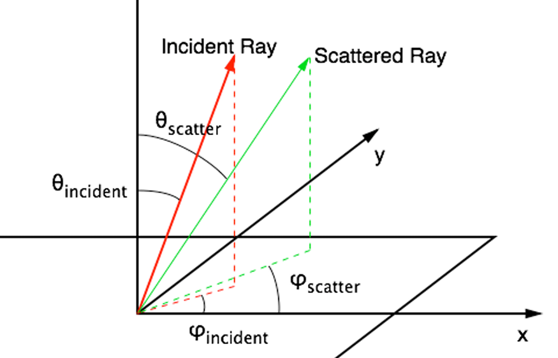
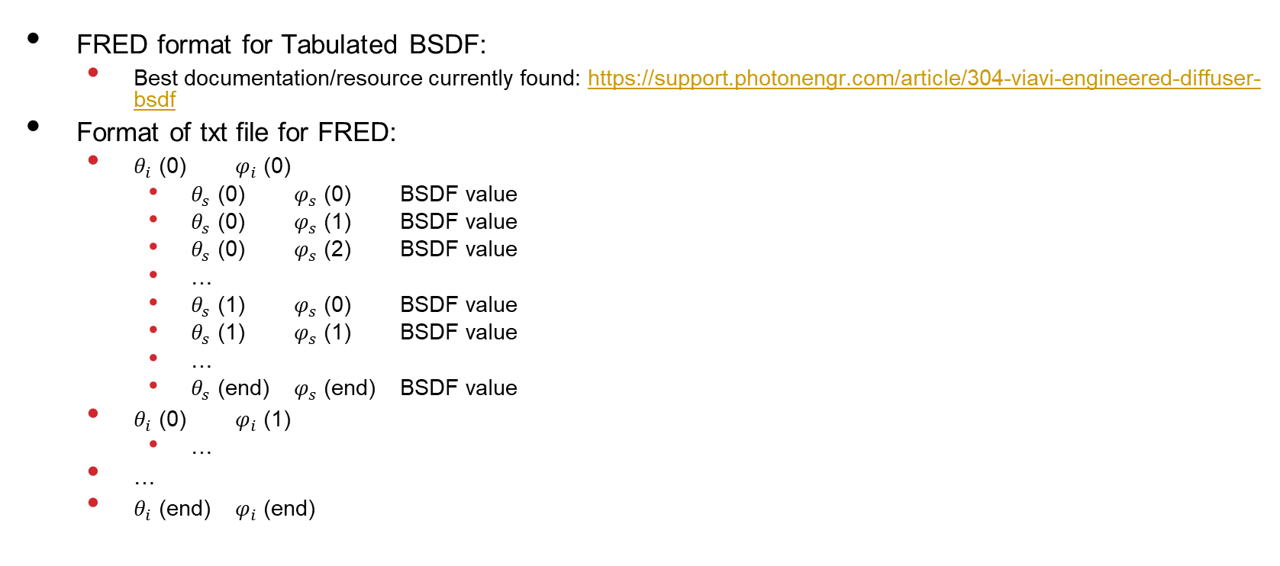
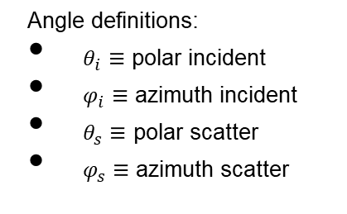
FRED format
FRED format for Tabulated BSDF:
Best documentation/resource currently found: https://support.photonengr.com/article/304-viavi-engineered-diffuser-bsdf
Format of txt file for FRED:
$θ_{i}$ (0) $φ_{i}$ (0)
$θ_{s}$ (0) $φ_{s}$ (0) BSDF value
$θ_{s}$ (0) $φ_{s}$ (1) BSDF value
$θ_{s}$ (0) $φ_{s}$ (2) BSDF value
…
$θ_{s}$ (1) $φ_{s}$ (0) BSDF value
$θ_{s}$ (1) $φ_{s}$ (1) BSDF value
…
$θ_{s}$ (end) $φ_{s}$ (end) BSDF value
$θ_{i}$ (0) $φ_{i}$ (1)
…
…
$θ_{i}$ (end) $φ_{i}$ (end)
Angle definitions:
$θ_{i}≡$ polar incident
$φ_{i}≡$ azimuth incident
$θ_{s}≡$ polar scatter
$φ_{s}≡$ azimuth scatter
Fig 1. FRED angle definitions.

Slide 3
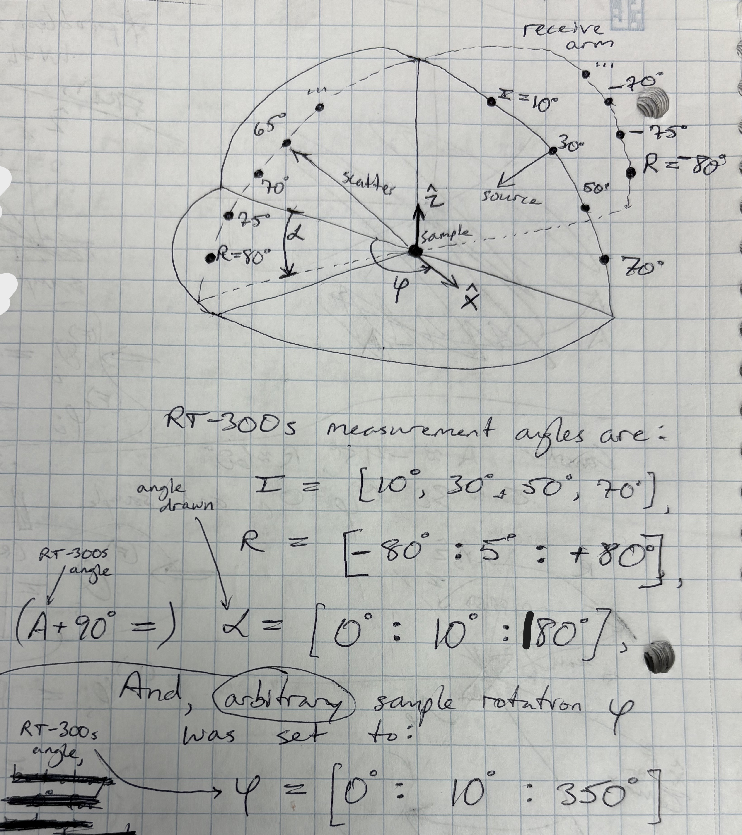

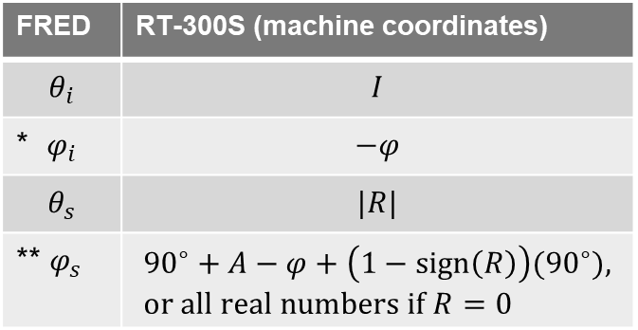
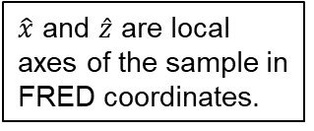
Coordinate transformation
$\hat{x}$ and $\hat{z}$ are local axes of the sample in FRED coordinates.
From 2026/01/21 LOFT notebook,
FRED | RT-300S (machine coordinates)
$$θ_{i}$$ | $$I$$
* $φ_{i}$ | $$−φ$$
$$θ_{s}$$ | $$|R|$$
** $φ_{s}$ | $${90}^{∘}+A−φ+\left(1−sign\left(R\right)\right){(90}^{∘}), \\ or all real numbers if R=0$$
*$φ$ is manually-set stage rotation;
**the (1-sign(R))(90) just adds 180 if R<0.
Arbitrary because not actually measured, just hard-coded in FRED to manually force isotropic behavior – not sure if “isotropic setting” exists like in Zemax bsdf format

