Slide 1
Drainage Threshold
Horton Strahler Order
Local Slope
Maximum Relief
Lakes

Slide 2
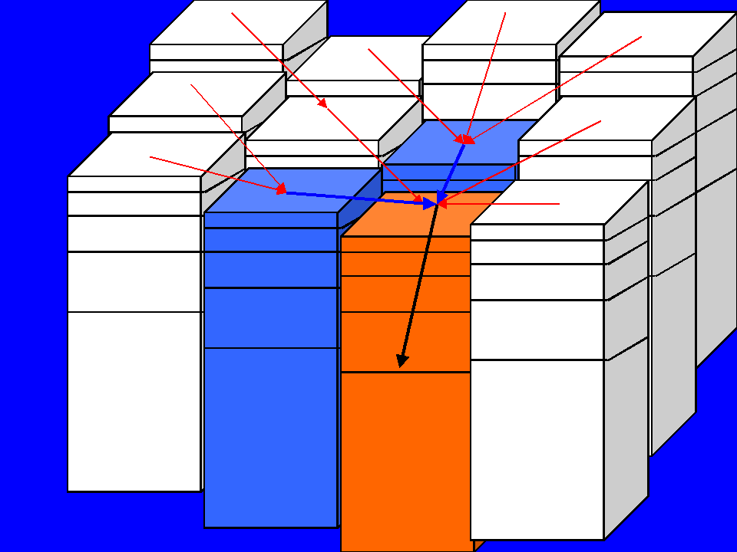
Horton Strahler Order Number
Based upon 'local slope'
Order increases when 2 like orders converge (2 + 2 = 3; 1+2 = 2)
“Pruning” results drainage patterns that closely match reality

Slide 3
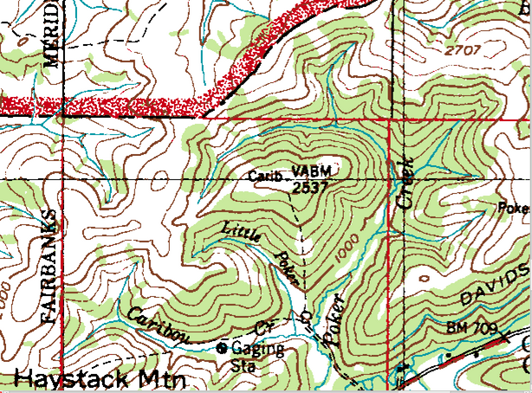
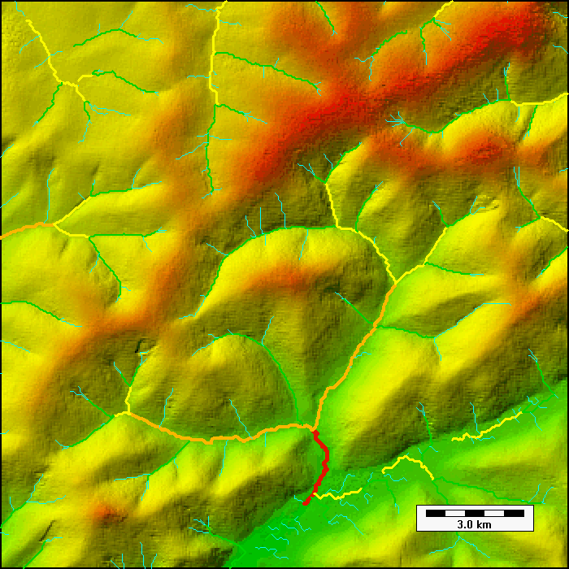
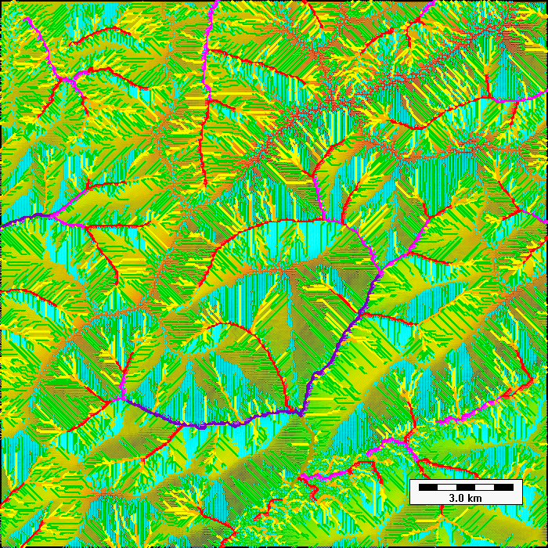
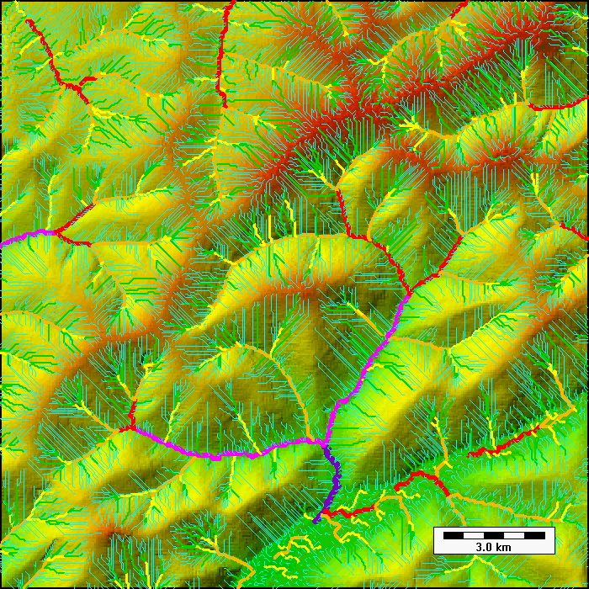
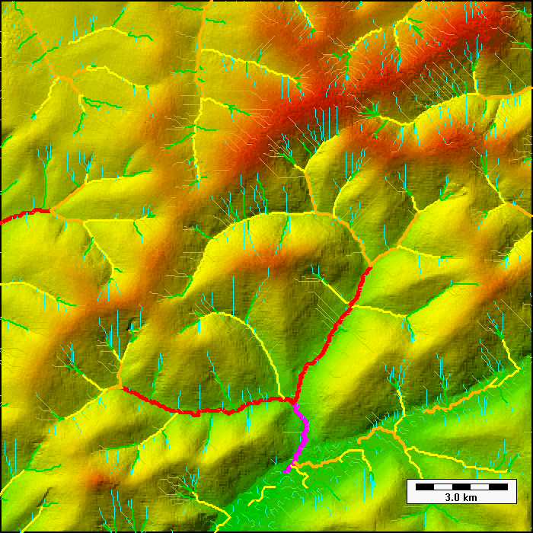

Slide 4
Drainage Threshold
Horton Strahler : 4
Local slope : 0.1
  (0.5 – 0.7 m elevation change over 5-7 meter horizontal distance)
If max elevation difference > 4m, the drainage threshold was exceeded at all locations (>0.75 * maximum elevation).
Areas designated as lakes : automatically below DT

Slide 5
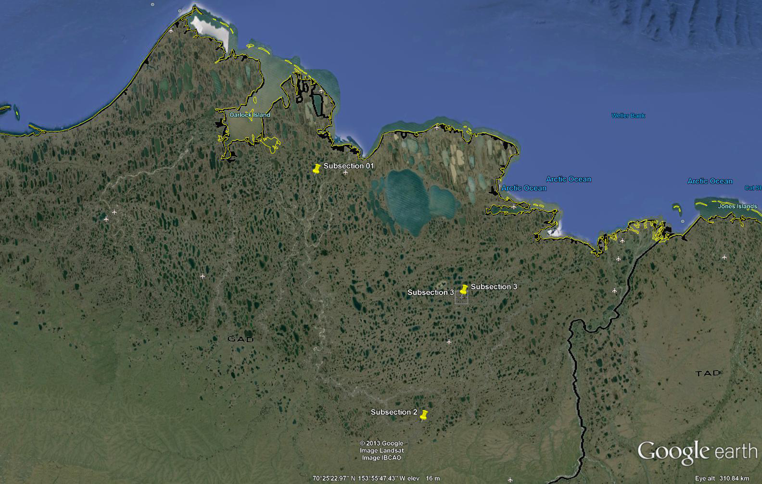

Slide 6
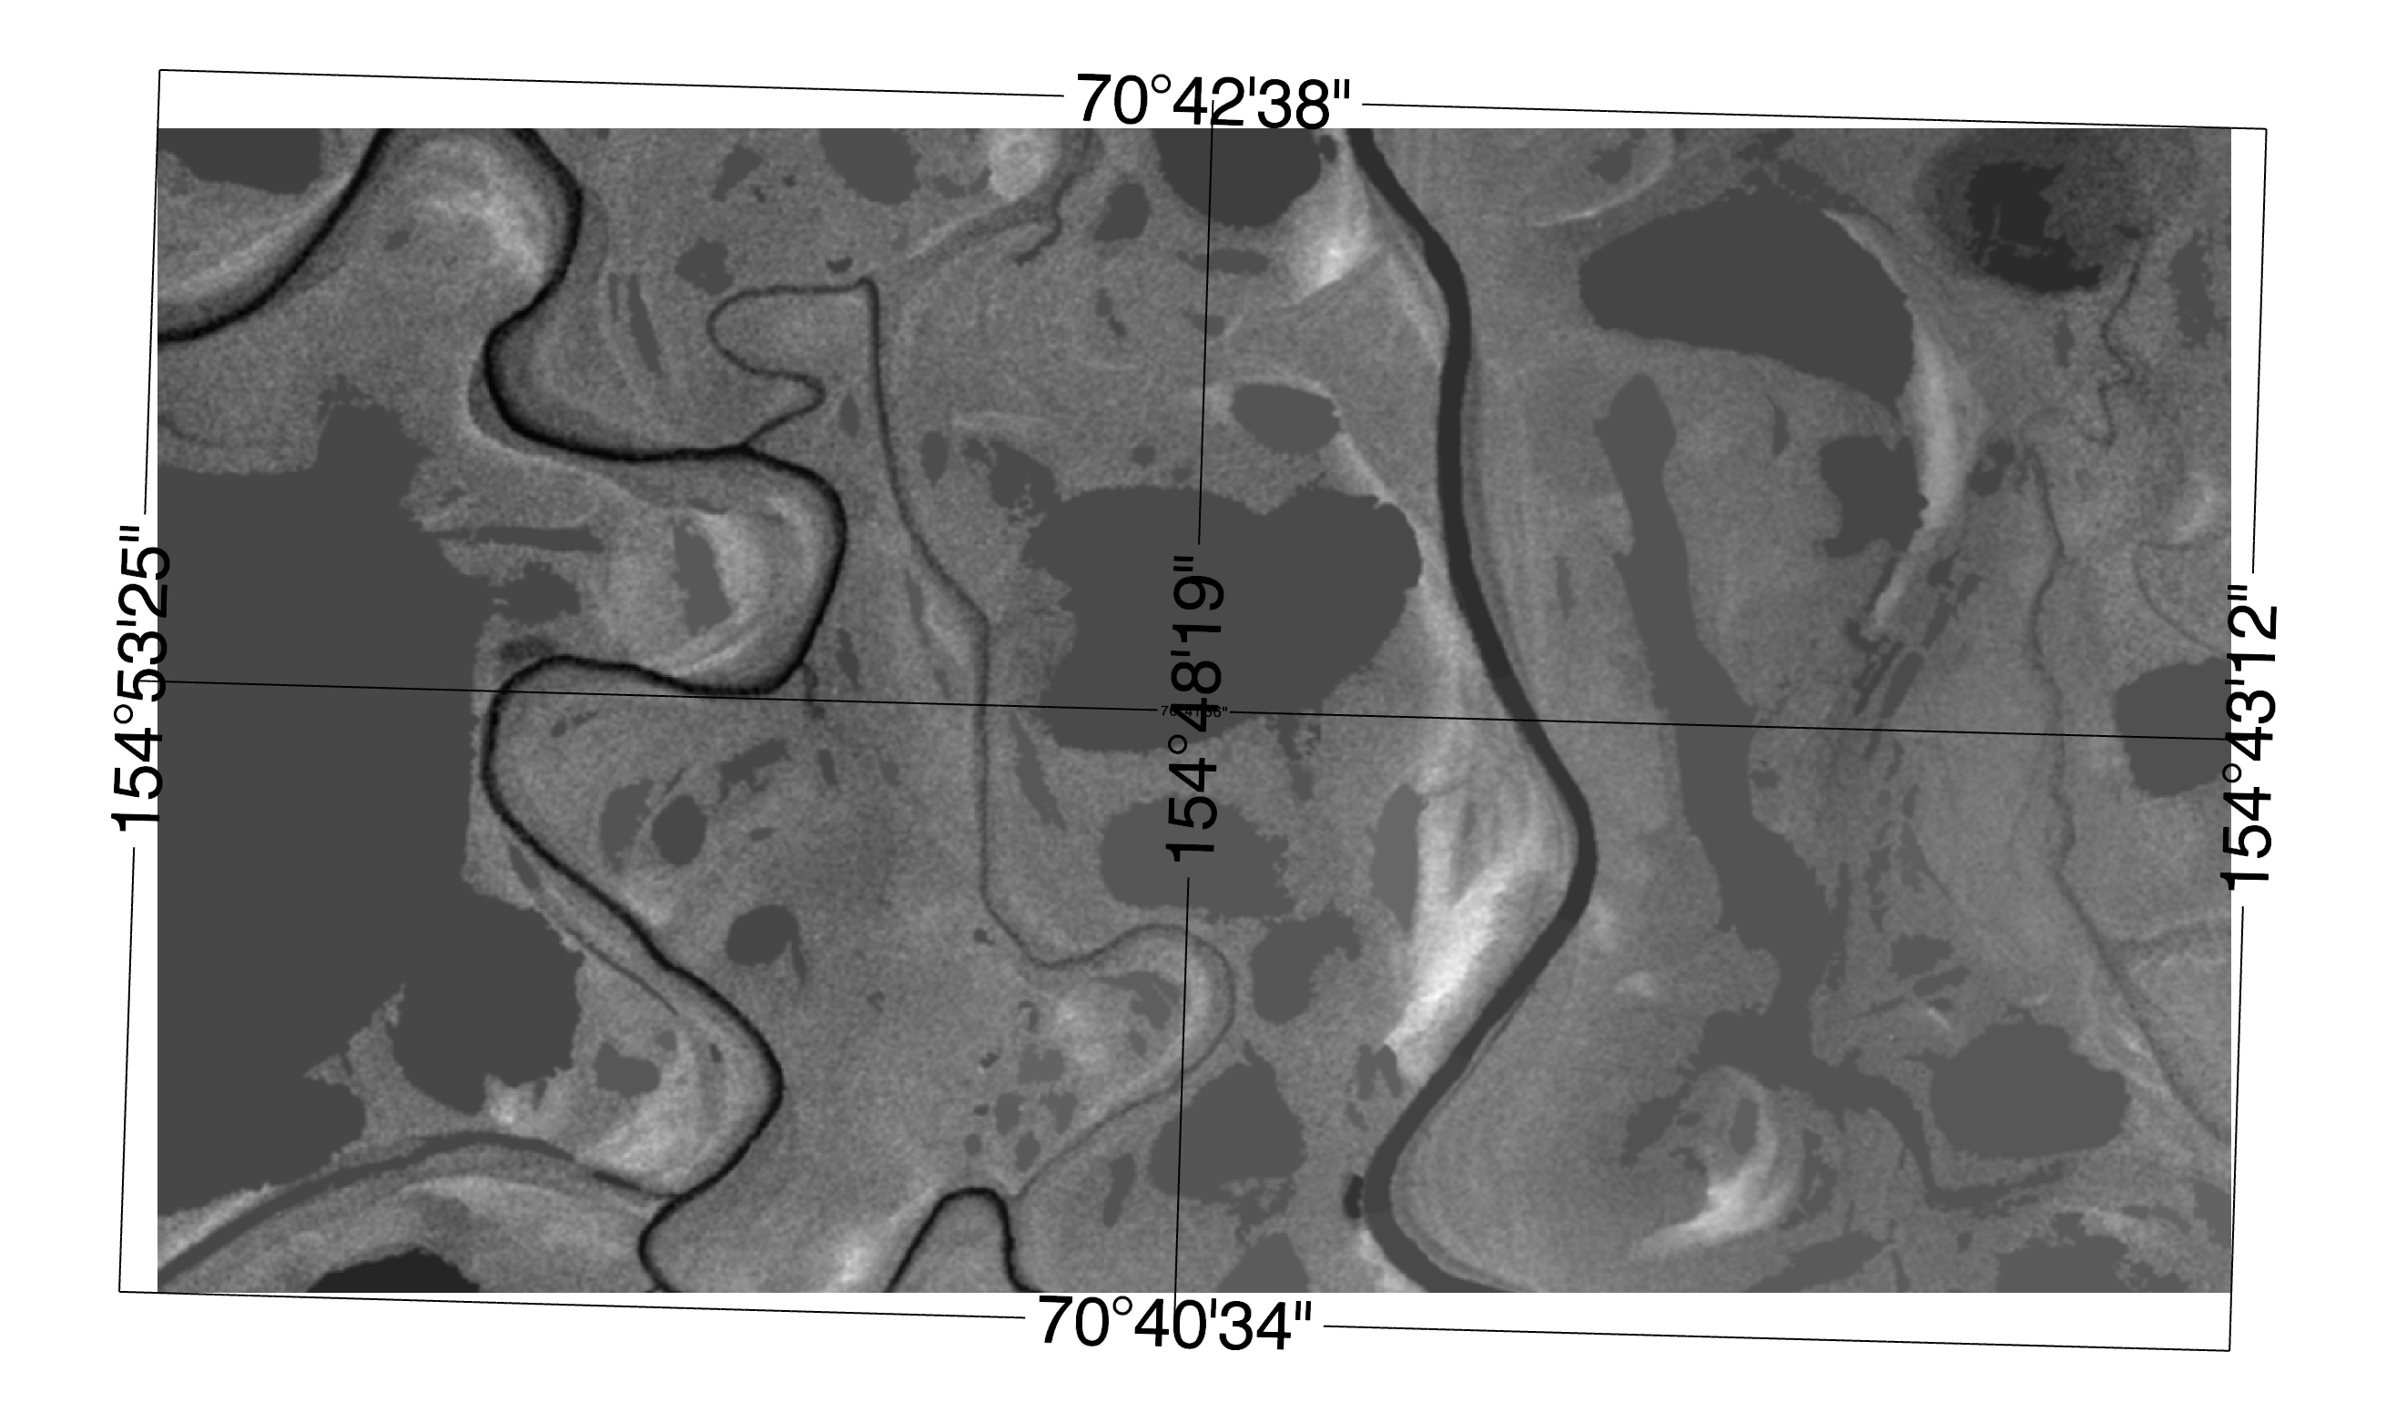

Slide 8
Subsection | Element | Total Above | Total Below | W/O Lakes Above | W/O Lakes Below
1 | 1a | 10.1 | 89.9 | 11.5 | 88.5
1 | 2a | 3.2 | 96.8 | 22 | 78
1 | 3a | 3.2 | 96.8 | 48.6 | 51.4
1 | 4a | 12.8 | 87.2 | 13.5 | 86.5
1 | 5a | 19.2 | 80.8 | 21.3 | 78.7
1 | 6a | 12 | 88 | 15.5 | 84.5
1 | 7a | 9.9 | 90.1 | 10.8 | 89.2
1 | 8a | 14.7 | 85.3 | 21.8 | 78.2
1 | 9a | 7.5 | 92.5 | 8.3 | 91.7
1 | 10a | 8.5 | 91.5 | 10.4 | 89.6
1 | 11a | 9.5 | 90.5 | 18.4 | 81.6
1 | 12a | 9.3 | 90.7 | 12.5 | 87.5
1 | 13a | 3.6 | 96.4 | 6.1 | 93.9
1 | 14a | 6.4 | 96.4 | 8 | 92
1 | 15a | 6.7 | 93.3 | 9.1 | 90.9
1 | 16a | 7.9 | 92.1 | 9.8 | 90.2
1 | 17a | 6.5 | 93.5 | 7.7 | 92.3
1 | 18a | 6.8 | 93.2 | 7.8 | 92.2

Slide 10
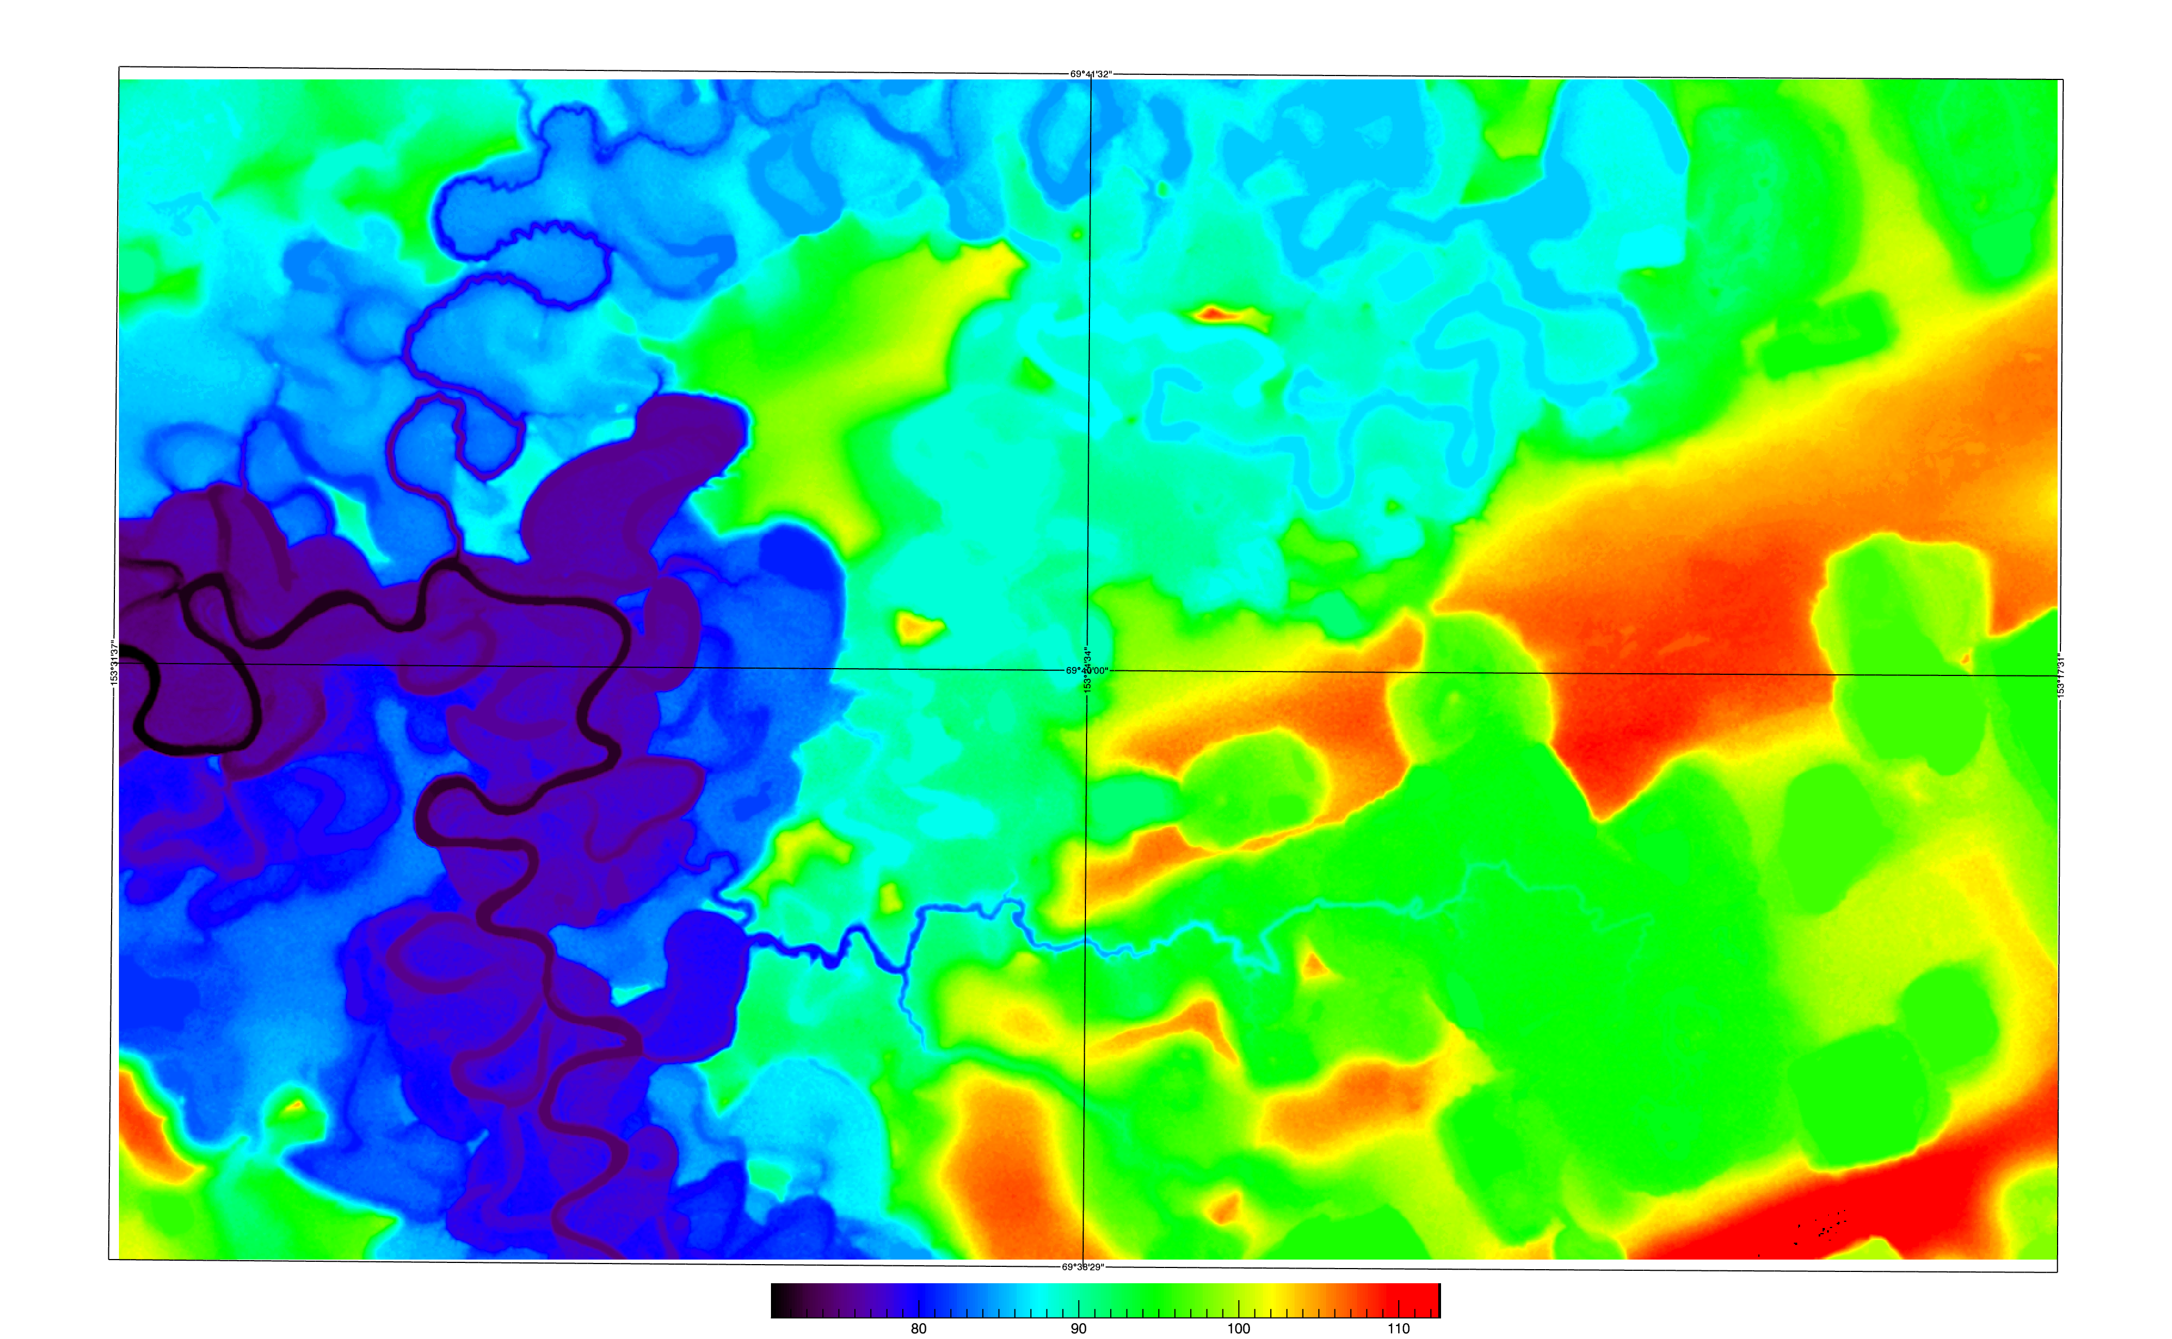

Slide 12
Subsection | Element | Total Above | Total Below | W/O Lakes Above | W/O Lakes Below
2 | 6 | 41.9 | 58.1 | 43.1 | 56.9
2 | 9 | 38.8 | 61.2 | 42.1 | 57.9
2 | 17 | 42.1 | 57.9 | 49.4 | 50.6
2 | 24 | 39.2 | 60.8 | 43.1 | 56.9
2 | 25 | 44.8 | 55.2 | 44.8 | 55.2
2 | 28 | 34.6 | 65.4 | 38.3 | 61.7
2 | 29 | 39.4 | 60.6 | 40.3 | 59.7
2 | 33 | 56.6 | 43.4 | 57.8 | 42.2
2 | 37 | 41.1 | 58.9 | 44.1 | 56.9
2 | 38 | 68.9 | 31.1 | 68.9 | 31.1
2 | 42 | 67.4 | 32.6 | 70.7 | 29.3
2 | 43 | 34 | 66 | 48.8 | 51.2

Slide 16
Subsection | Element | Total Above | Total Below | W/O Lakes Above | W/O Lakes Below
3 | 1 | 47.9 | 52.1 | 52.7 | 47.3
3 | 12 | 46.1 | 53.9 | 49.9 | 50.1
3 | 17 | 34.4 | 65.6 | 40.4 | 59.6
3 | 20 | 50 | 50 | 50.7 | 49.3
3 | 24 | 47.8 | 52.2 | 47.8 | 52.2
3 | 28 | 48.8 | 51.2 | 48.8 | 51.2
3 | 32 | 45.1 | 54.9 | 50.2 | 49.8

Slide 18
Next Steps
Look at the NGEE study site and do similar analysis
  Compare output to mapped vegetation
  Compare output to cumulated flow index (?)
Compare cumulated flow index to sites already analyzed
Consider dividing the region into sub-regions (coastal area, mid-slope, upland, etc etc)

