Slide 1
Drainage Threshold
Horton Strahler : 4
Local slope : 0.1
  (0.5 – 0.7 m elevation change over 5-7 meter horizontal distance)
If max elevation difference > 4m, the drainage threshold was exceeded at all locations (>0.75 * maximum elevation).
Areas designated as lakes : automatically below DT

Slide 2
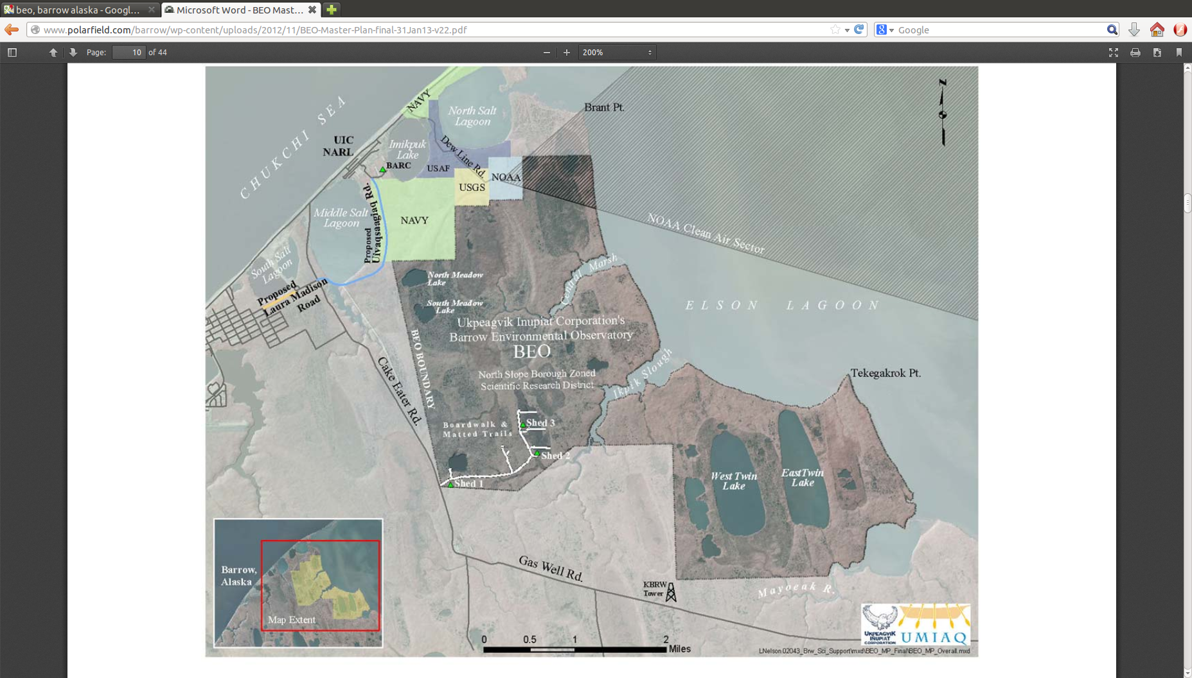
NGEE Area
Barrow Experimental Observatory Master Plan, January 2013

Slide 3
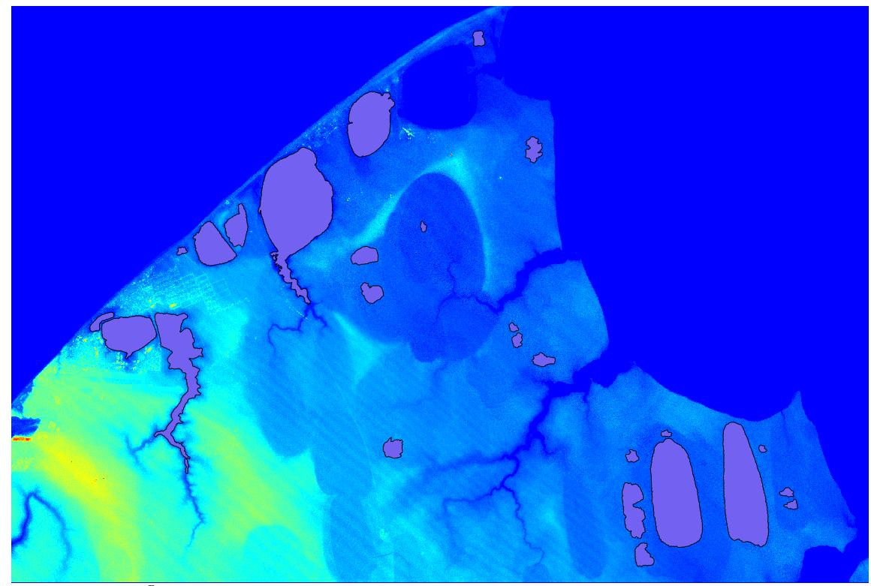
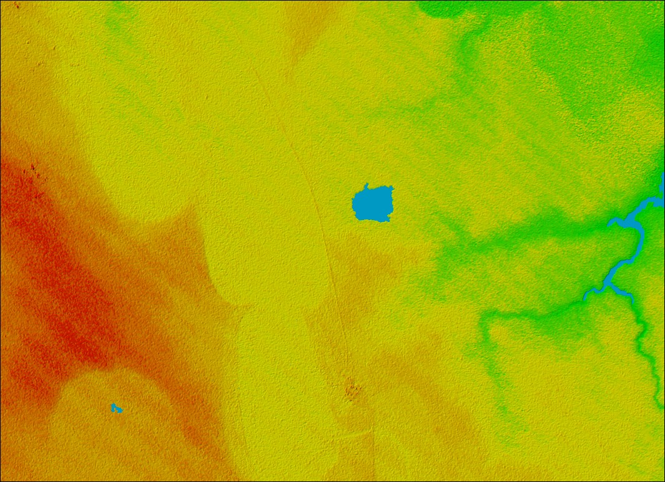

Slide 5
Drainage Threshold Exceeded: 16.7%
(5.325 km x 3.865 km)

Slide 6
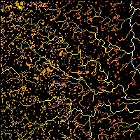
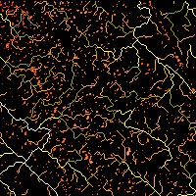
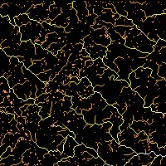
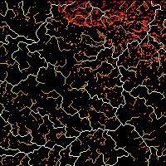
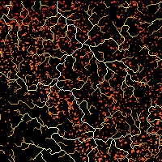
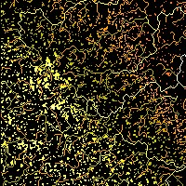
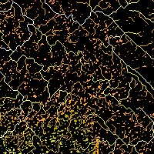
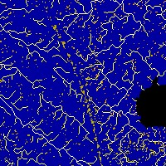
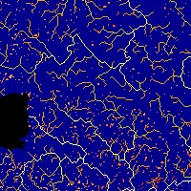
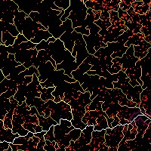
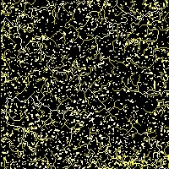
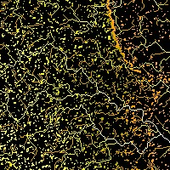
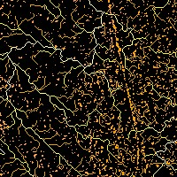
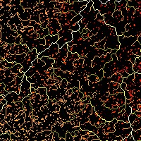
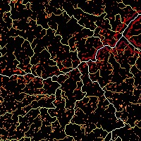

Slide 7
16.7%
12.3%
10.6%
13.8%
16.7%
22.0%
15.7%
11.1%
11.0%
12.2%
22.8%
20.6%
15.1%
16.4%
13.9%

