Slide 1
CAPTIONING
IMAGE
Tejaswini Muthuluru and Sai Sumana Narva

Slide 2
OVERVIEW
Image Captioning is the process of generating textual description of an image. It uses both Natural Language Processing and Deep Learning to generate the captions. Few applications where Image Captioning can be used are:
Self driving cars - If we can properly caption the scene around the car, it can give a boost to the self driving system.
Aid to the blind - This can be achieved by first converting the scene into text and then the text to voice.
CCTV cameras - While monitoring the scene, we can raise alarms as soon as there is some malicious activity going on somewhere

Slide 3
ABSTRACT
We designed a deep learning model which accepts images features along with its possible captions as input.
The model predicts the image caption of test images.
We used pre trained inception V3 model to generate image features.
We mapped caption words using pre trained Glove embedding model.
We used data generator to efficiently train the model.
We tested the trained model on new images.

Slide 4
DATA PREPROCESSING
Image Preprocessing:
Images are input to our model, as input needs to be in form of vector we generated the image feature vector using pre trained INCEPTION V3 model.
The output of the Inception V3 model is a 2048 length vector for each image.
Caption Preprocessing:
As we want to predict captions and we can’t predict entire caption at a time, model predicts word by word.
Since the data model does not recognize words we embedded the words with 200 dimension Glove embedding.
Image Preprocessing:
Images are input to our model, as input needs to be in form of vector we generated the image feature vector using pre trained INCEPTION V3 model.
The output of the Inception V3 model is a 2048 length vector for each image.
Caption Preprocessing:
As we want to predict captions and we can’t predict entire caption at a time, model predicts word by word.
Since the data model does not recognize words we embedded the words with 200 dimension Glove embedding.

Slide 5
MODEL ARCHITECTURE
Train images
INCEPTION V3
RNN trained with Glove Embedding
Preprocessed captions
Image
Feature
Vectors
Partial
Captions
Neural Network Model
Predicted word
next in the
sequence of caption

Slide 6
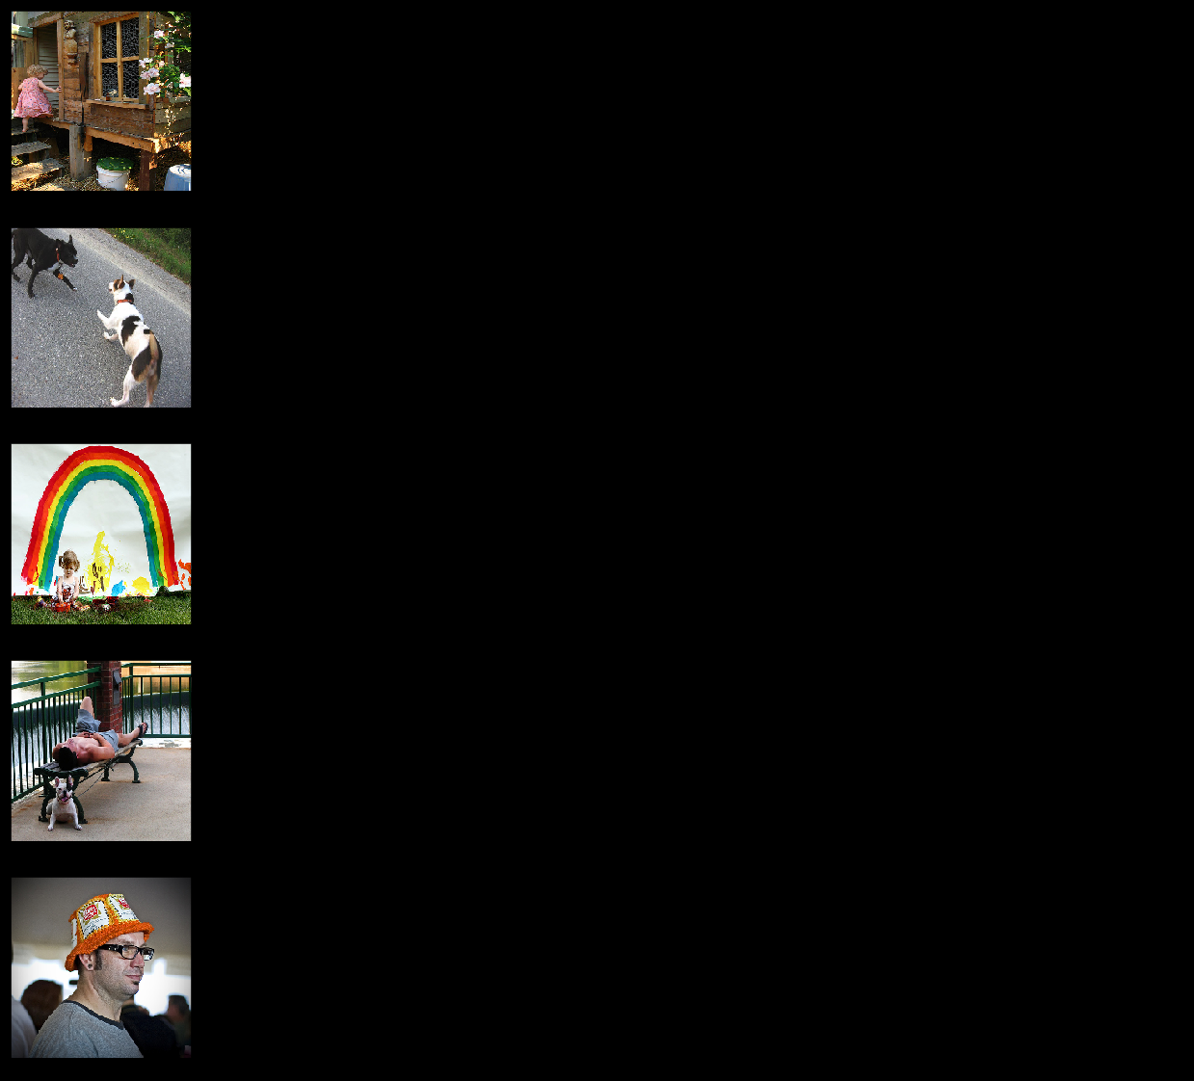
DATASET
We used Flickr 8K dataset, it contains 8000 images along with 5 possible captions for each image.
A little girl in a pink dress going into a wooden cabin
A little girl climbing the stairs to her playhouse
A little girl climbing into a wooden playhouse
A girl going into a wooden building
A child in a pink dress climbing up a set of stairs in an entry way

Slide 7
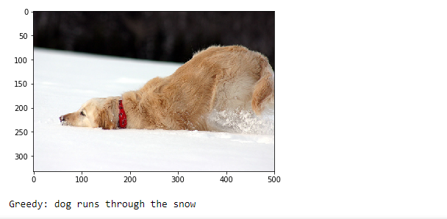
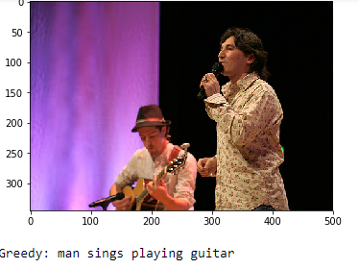
RESULTS
Model was able to caption these images perfectly

Slide 8
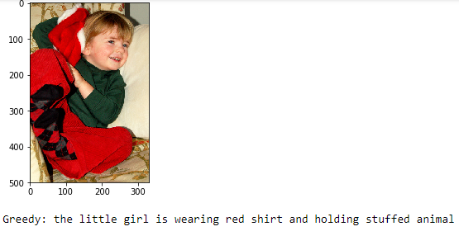
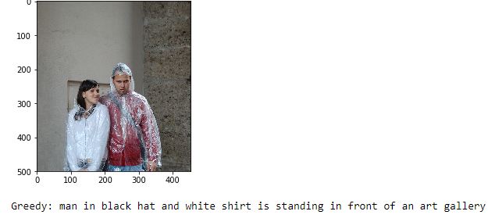
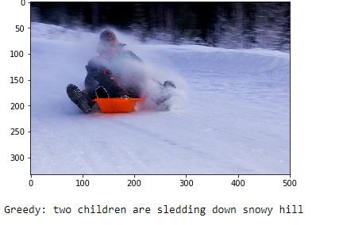
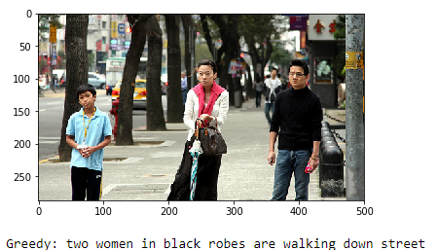
Model identifies colors perfectly
but not the relevant objects
The scenario of the image was
captured but the count of things
was not upto the mark

Slide 9
EVALUATION
The model was able to caption the images promptly but with few errors.
We trained the model in two ways one without cross validation and the other with cross validation, the second one performed better.
We could have improved the model by using word embeddings that capture context like BERT, Flair, etc.
We can improve the model performance by training it on images related to specific category instead of generic set of images.

Slide 10
REFERENCES
https://cs.stanford.edu/people/karpathy/sfmltalk.pdf
https://medium.com/mlreview/multi-modal-methods-image-captioning-from-translation-to-attention-895b6444256e
https://towardsdatascience.com/image-captioning-in-deep-learning-9cd23fb4d8d2
https://www.tensorflow.org/tutorials/text/image_captioning
https://medium.com/@sh.tsang/review-inception-v3-1st-runner-up-image-classification-in-ilsvrc-2015-17915421f77c

