Slide 1
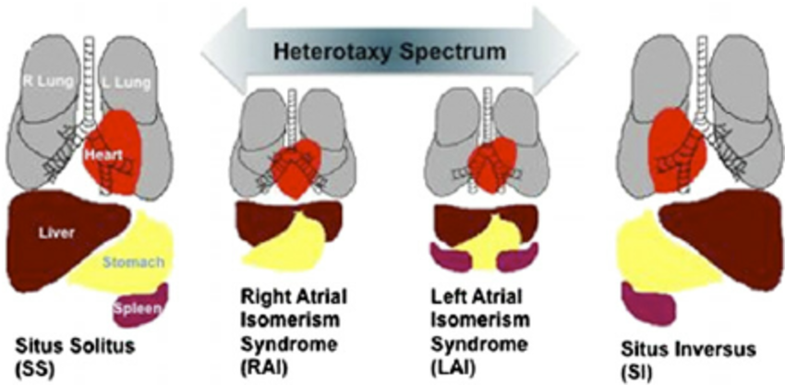
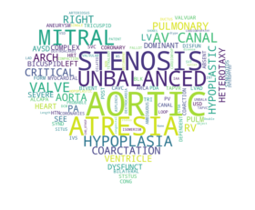
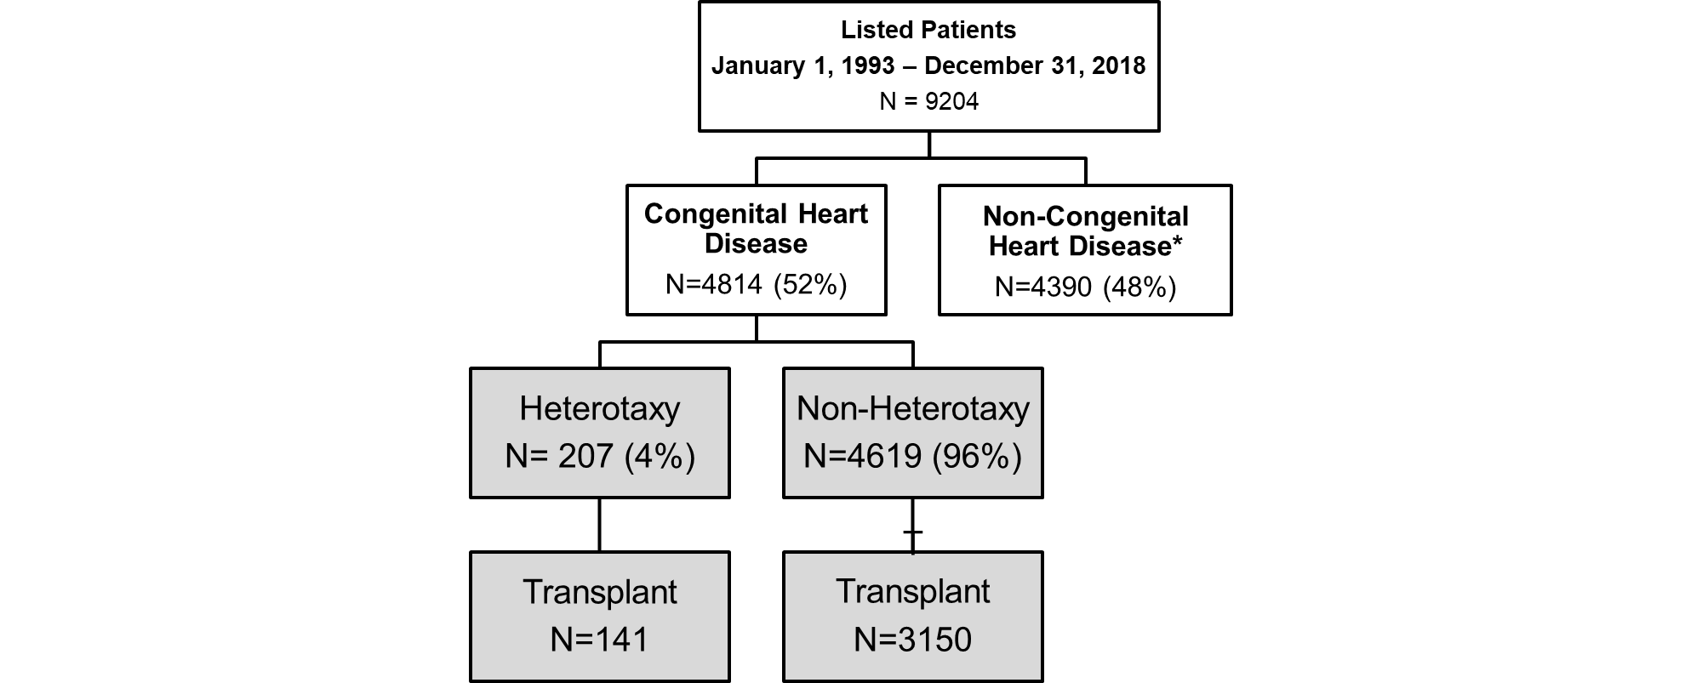
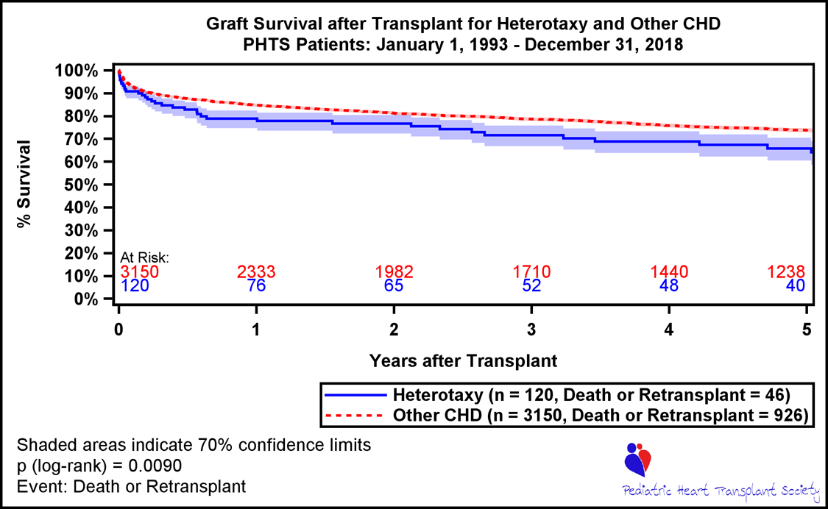
Identification of Heterotaxy from Free Text and Prediction of Graft Loss from the Pediatric Heart Transplant Society Tobias O’Leary, Devin Koehl The University of Alabama at Birmingham
Pediatric Heart Transplant Society
Heterotaxy
Identification of Heterotaxy
Results
The Pediatric Heart Transplant Society was established in 1993 by a group of physicians who wanted to improve the lives of children who needed a heart transplant.
The PHTS registry is a national longitudinal observational study enrolling children when they are listed for a heart transplant.
Patients are followed in the registry while on the waitlist and after transplantation
PHTS has 56 participating centers and over 9000 listed patients
Natural Language Processing was used to identify patients that were Heterotaxy from free text fields.
Before using NLP methods, standard statistical methods alone identified 122 patients. After utilizing these methods, this number increased to 207. These 85 patients are critical to the field of Pediatric Transplant, as this could be the difference in physician inference and standard of care
Levenshtein distance was used with regular expressions to find variations and misspellings of the following keywords: ASPLENIA, POLYSPLENIA, ISOMERISM, DEXTROCARDIA, HETEROTAXY
Blah blah blah some results here about how utilizing free text makes the project better blah
Perhaps a table comparing
Heterotaxy is a condition characterized by internal organs that are not arranged as would be expected in the chest and abdomen. Organs are expected to be in a particular orientation inside of the body, known as situs solitus. Heterotaxy occurs when the organs are not in this typical orientation, but are instead in different positions in the body.
This most commonly causes complications with the heart, lungs, liver, spleen, and intestines.
Conclusions
Materials & Methods
Free text fields provide valuable data that is often overlooked in the field of medicine
These free text fields helped identify 85 additional patients.
Utilizing Free Text fields when predicting Graft Loss increases accuracy
Pediatric Heart Transplant Study Database (PHTS) was used to identify Heterotaxy patients by 2 key fields: Congenital Heart Disease: Heterotaxy and Medical History at Listing: Heterotaxy/Isomerism
Two free text fields (Congenital Heart Disease: Specify and Medical History at Listing: Specify) were used to identify patients that were not currently flagged as having Heterotaxy
PHTS database was queried for donor, transplant and recipient information for these patients
A p-value of <0.05 is considered statistically significant and Survival was compared using SAS 9.4. Machine Learning was complete using Python 3.5.2
Machine Learning for Graft Loss
Utilizing the cohort defined above, graft loss was predicted in this population. The goal was to see how introducing various text fields increased the prediction of graft loss.
Data was split into 80% training and 20% testing
Naive Bayes, Logistic Regression, Support Vector Machines, and X were all trained on the training data. Accuracies were compared on the testing data. Each had accuracy around 60-70%
15 features that are of high clinical importance were entered into the model. These features included Age, Race, Gender, Donor Sex, Donor BSA, and ECMO status at Listing.
Something about USING TF-IDF here and WORD2VEC ON TEXT
Introducing the first free field increased this accuracy to around 84%.
Finally, the last text field was introduced into the model. Accuracy increased to over 90%
The highest factors associated with Graft Loss were INSERT FACTORS HERE
INSERT A PRETTY ML GRAPHIC HERE
Graft Loss
Utilizing Patients flagged from our free text fields, Graft Loss (death or retransplant) was predicted in our transplanted patient population (n=141)
Graft Loss is a known factor for mortality in Heterotaxy patients, as seen below in the Kaplan-Meier Survival Curve. As compared to patients without Heterotaxy, patients with Heterotaxy have a ~70% survival at 5 years post-transplant as compared to ~80% for Non-Heterotaxy, p=0.009.
WordCloud representing all keywords in the Other Specify Fields
Limitations
Heterotaxy only occurred in 4% of the PHTS population causing class imbalance
Missing data in text fields made it difficult to assess the full impact that these fields could have on the data
More patients with Heterotaxy should be studied to see the full affect of Graft Loss
*Cardiac Tumor (n=32)
Cardiomyopathy (n=4023)
Myocarditis (n=313)
Other, Specify (n=9)
UPDATE
Natural Language Processing: CS 662

