Slide 1
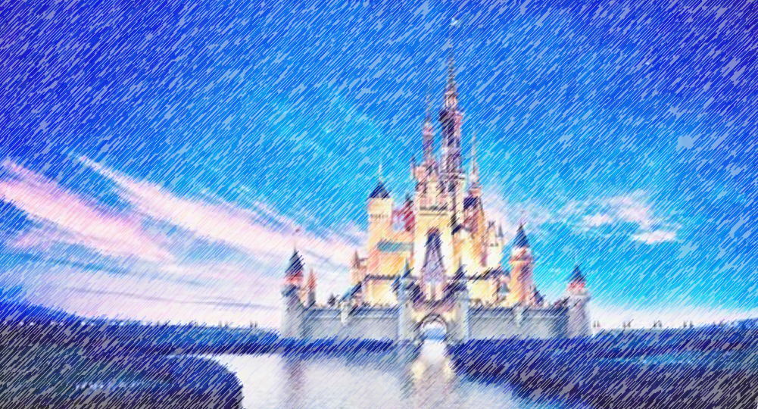

Disney Q and A
Deeptha Srirangam
Leigh Allison
CS 662 NLP
Fall 2020
Dr. John Osborne

Slide 2
Problem
Create a program that can answer questions about Walt Disney World
Information Retrieval System

Slide 3



Method
Question Processing
Question
Document Processing
Question Type
Key Words
Focus
Relations
Answer Type
Document Retrieval
Document Segmentation
Passage Retrieval
Passage Ranking
Answer Processing
Answer
Candidate Answers
Candidate Ranking
NER Tagger

Slide 4
Question Processing
Question
What is the height requirement for Star Wars: Rise of the Resistance?
Tokenize
['What', 'is', 'the', 'height', 'requirement', 'for', 'Star', 'Wars', ':', 'Rise', 'of', 'the', 'Resistance', '?']
Remove stopwords
['height', 'requirement', 'star', 'wars', ':', 'rise', 'resistance', '?']
POS tags
[('height', 'ADJ'), ('requirement', 'NOUN'), ('star', 'NOUN'), ('wars', 'NOUN'), (':', '.’),
('rise', 'NOUN'), ('resistance', 'NOUN'), ('?', '.')]
Look for Disney named entities

Slide 5
Question Processing
Dependency parsing
[('Is', 'AUX', 'Is', 'ROOT’),
('there', 'PRON', 'Is', 'expl’),
('a', 'DET', 'requirement', 'det’),
('height', 'NOUN', 'requirement', 'compound’),
('requirement', 'NOUN', 'Is', 'attr’),
('for', 'ADP', 'requirement', 'prep’),
('Star', 'PROPN', 'Wars', 'compound’),
('Wars', 'PROPN', 'for', 'pobj’),
(':', 'PUNCT', 'requirement', 'punct’),
('Rise', 'NOUN', 'requirement', 'appos'), ('of', 'ADP', 'Rise', 'prep'), ('the', 'DET', 'Resistance', 'det'), ('Resistance', 'PROPN', 'of', 'pobj'), ('?', 'PUNCT', 'Is', 'punct')]

Slide 6
Question Processing
Head words
', 'Is', 'punct')]
Key words
', 'Is', 'punct')]
Answer type
', 'Is', 'punct')]

Slide 7
Question Processing
Answer Types
Cost
Theme
Park
Cost
Speed
Ride
Hotel
Amenities
Height Requirement
Location
Park
Restaurant
Location
Park
Character
Section
Hotel
Quick or Table Service

Slide 8
Disney Q and A
Thank you!
Any Questions?

